Slide 1
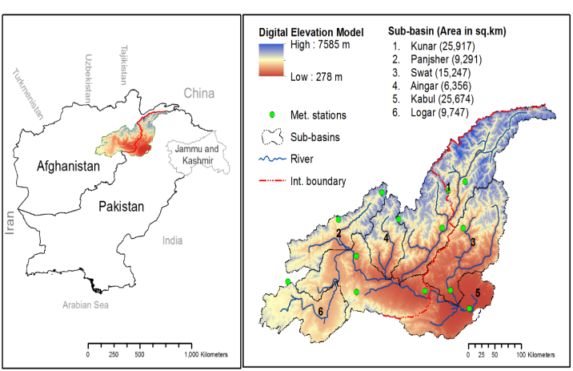
Space and Time Characteristics of Droughts in Kabul River Basin.
Nadeem Tariq1 , Akif Rahim2 , Farhan Aziz3 , and Muhammad Yousaf4
1Dubai Municipality, Environment Department, Dubai, United Arab Emirates (hydrologist.1985@gmail.com)
2 Faculty of Environmental Sciences, Czech University of Life Sciences Prague, Kamýcká 129, Praha –Suchdol, 16500, Czech Republic. (rahim@fzp.cz)u.cz)
3 Jacobs Engineering Group, Legend Tower, King Fahad Road, Al Olaya, Riyadh 12313 Kingdom of Saudi Arabia. (farhanhydro19@gmail.com)
4University of International Business and Economics, Beijing , China. (youeco@hotmail.com)
Introduction:
The climate change have prominent impacts on the hydrological cycle of the high latitude regions, particularly the cryosphere-rich Hindukush-Karakoram-Himalaya (HKH) mountains (Hasson et al. 2013).
The Kabul River Basin has a drainage area of about 54,000 km2, which is only about 12 % of the land area of Afghanistan but about 26% of the annual flow of the country. The Kabul River has its main upper tributaries being the Logar River, and the Panshir River that has the major Ghorband tributary.

Slide 2
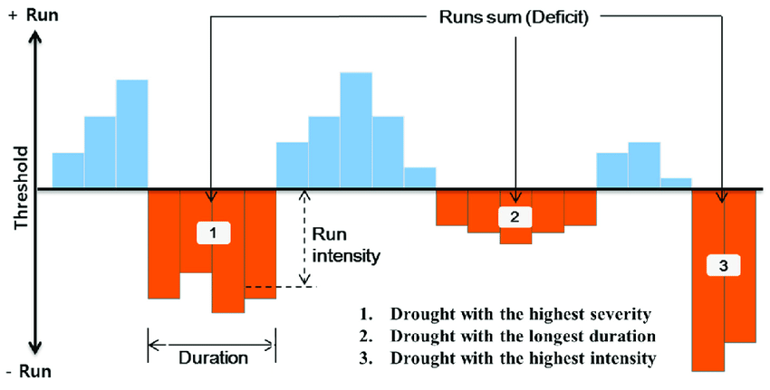
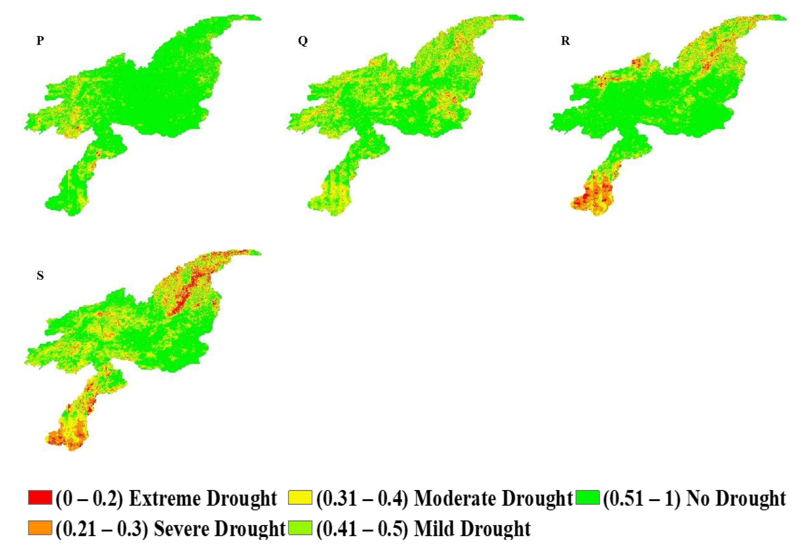
Methods:
Analysis
Space and Time Characteristics
CRU Generated SPEI Monthly Data
Run Theory

Slide 3
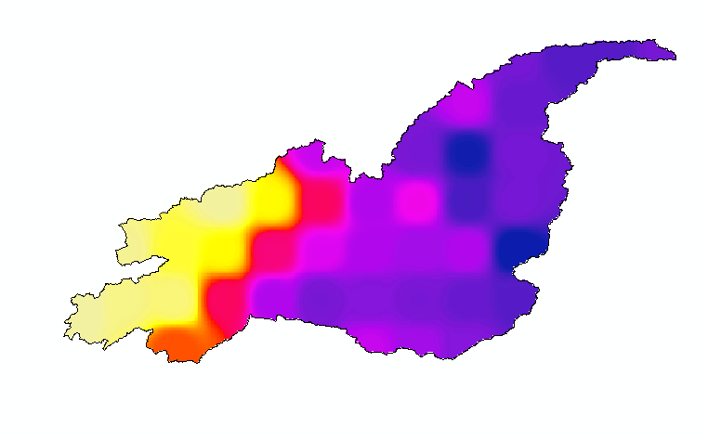
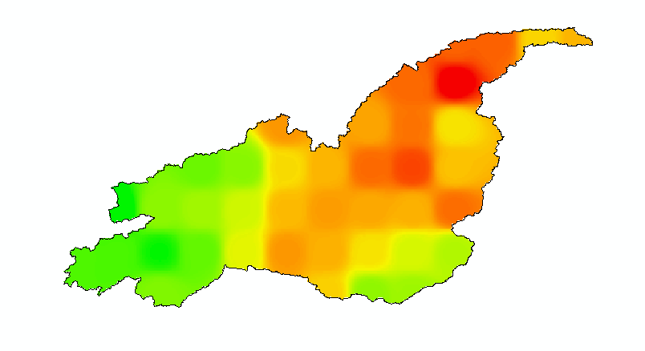
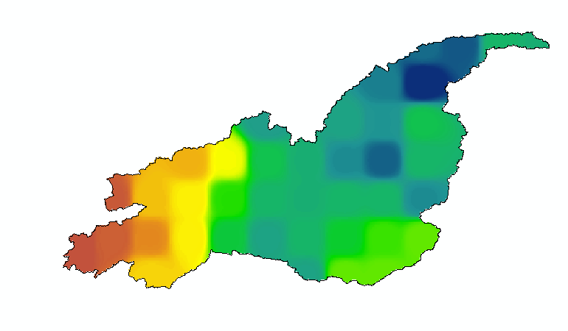
Results:
Temporal Characteristics of Drought Frequency
Spatial Characteristics of Drought
Frequency
Total Duration(months)
Severity

Slide 4
Conclusion:
The Kabul Basin has experienced an increasing extent of severe drought between 1940 and 1960, which increased further after the year 2000. The frequency of drought events in the northern part of the basin is much higher than in the southern part of the basin. Whereas the duration of the drought shows a declining trend in the northern part of the basin. The southern and western parts of the basin experienced a growing trend in the severity drought. At the same time, the incidence of consecutive droughts in the Kabul River basin has also increased. This study suggests that dry conditions in Kabul river basin have been enhanced in recent years.

Slide 5
Thank you!

