Slide 1




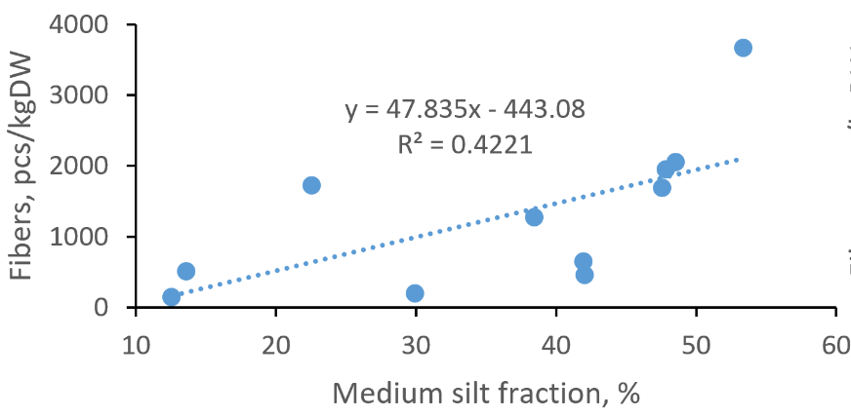

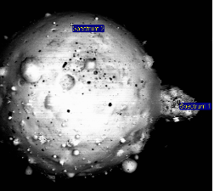
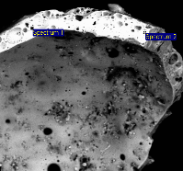
Microplastics in Lake Onego sediments: occurrence and accumulation patterns.
M. Zobkov¹, N. Belkina¹, V. Kovalevski^{1,2}, M. Zobkova¹, T. Efremova¹, N. Galakhina¹
¹Northern Water Problems Institute and ²Institute of Geology of Karelian Research Centre of the Russian Academy of Sciences,
11 Pushkinskaya Street, Petrozavodsk, Karelia, Russia, 185910
Lake Onego is the second largest lake in Europe. Sediment samples (29) were collected in different regions of the lake. Microplastics (MPs) were extracted from sediments with potassium formate, oxidized and MPs abundance was determined using a microscope (Zobkov et al, 2020a).
The anthropogenic origin of randomly selected MPs items was confirmed by Raman spectroscopy and SEM-EDS.
Maximum MPs abundances were observed:
In the mouths of the large tributaries of the lake – rivers Shuya and Suna, inflowing large bays
Petrozavodsk Bay (2244 ± 1901 pcs/kg DW; n= 6) (See Zobkov et al, 2020b)
Kondopoga Bay, receiving discharge of Pulp&Paper mill (18770 ± 6830 pcs/kg DW, n = 6)
The open part of the lake (2356 ± 1689 pcs/kg DW; n = 5), up to 5000 pcs/kg DW
In Kizhi National Park (3413 ± 2005; n = 4), up to 6300 pcs/kg DW
In mean MPs abundance in Lake Onego was 5995±3965; n=29.
Fibers dominated in most of the samples (65±8%; n=29).
Fibers accumulate in sediments together with medium silt fraction (0.01-0.05 mm).
In mean, MPs abundance in Lake Onego sediments was from two to several times higher, than was previously established in Baltic Sea with similar methodology (Esiukova et al, 2020).
MPs abundance was extremely high near Pulp&Paper mill (up to 52 ths. pcs/kg DW).
Gray hollow micro capsules (coke) were observed near Pulp&Paper mill in concentrations more than 250 ths. pcs/kg DW
^{Conclusions}
Extremely high MPs contamination is detected near Pulp&Paper mill. The P&P also contaminates the lake with gray microcapsules.
Fibers dominate among others MPs types.
Fibers accumulates in fine grain sediments, their abundance correlate with medium silt fractions and organic matter content in sediment.
High MPs content near major tourist’s peer of Kizhi Museum indicates tourists activity as one of the possible MPs sources in lake.
Fragments and films accumulate near their sources (WWTP discharge, river mouths).
Fibers can be transported over long distances and accumulates in zones of weak hydrodynamics.
More research required in order to determine the role of Pulp&Paper industry in MPs contamination.
River Shuya
River Suna
Gray hollow microcapsules (coke) 200 μm in size (abundance in gray font)
^{References}
Zobkov, M., Zobkova, M., Galakhina, N., & Efremova, T. (2020). Method for microplastics extraction from Lake sediments. MethodsX, 7, 101140. https://doi.org/10.1016/j.mex.2020.101140
Zobkov, M., Belkina, N., Kovalevski, V., Zobkova, M., Efremova, T., & Galakhina, N. (2020). Microplastic abundance and accumulation behavior in Lake Onego sediments: a journey from the river mouth to pelagic waters of the large boreal lake. Journal of Environmental Chemical Engineering, 8(5), 104367. https://doi.org/10.1016/j.jece.2020.104367
Esiukova E., Zobkov M., Chubarenko I. Data on microplastic contamination of the Baltic Sea bottom sediment samples in 2015-2016 // Data in brief. 2020. Vol. 28. 104887. https://doi.org/10.1016/j.dib.2019.104887
The study was supported by the Russian Science Foundation grant number 19-17-00035.

