Slide 1
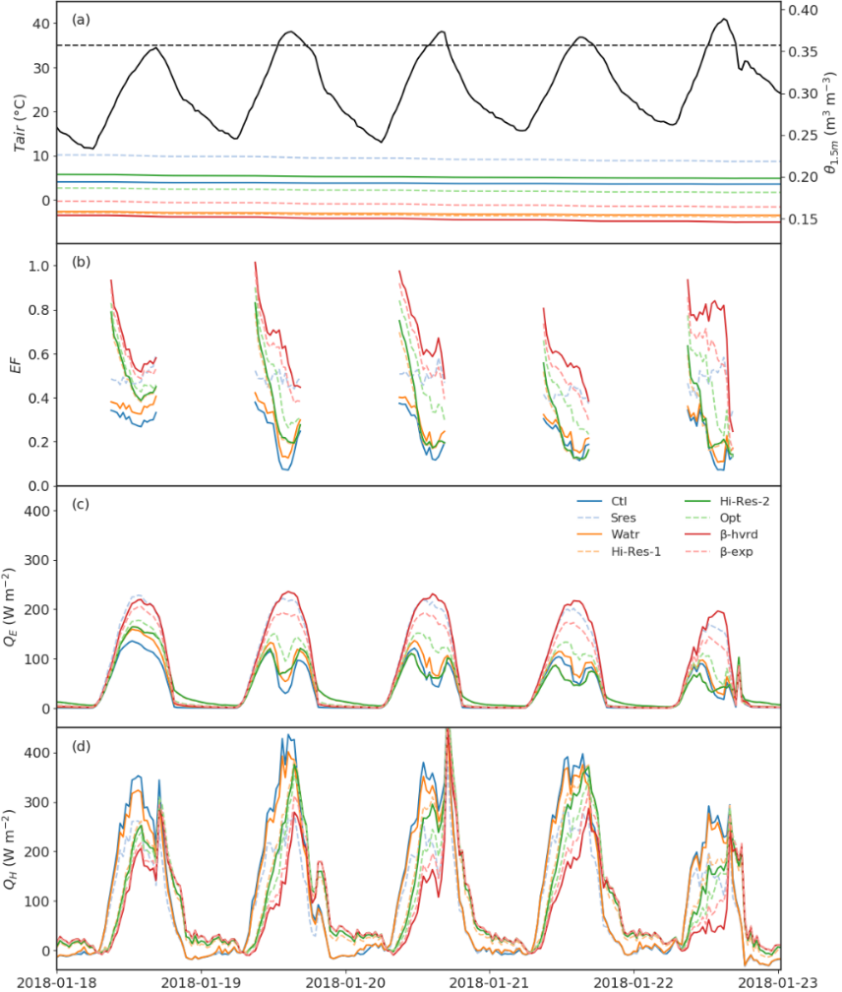
Evaluating a land surface model at a water-limited site: implications for land surface contributions to droughts and heatwaves
Mengyuan Mu, Martin De Kauwe, Anna Ukkola, Andy Pitman, Teresa Gimeno, Belinda Medlyn, Dani Or, Jinyan Yang, David Ellsworth
Introduction Land surface models (LSMs) underpin coupled climate model projections of droughts and heatwaves. However, the lack of sufficient observations has prevented previous model evaluations from explaining the simulated divergences of these extremes in LSMs.
Implications for drought and heatwave
Drought in Oct 2017 – Sep 2018
Heatwave in 19th-22nd Jan 2019
Soil Moisture
Air Temperature
Method We use a comprehensive set of observations from a water-limited site in southeastern Australia including both evapotranspiration components and soil moisture up to 4.5m depth to evaluate the Community Atmosphere-Biosphere Land Exchange (CABLE) land surface model.
Results
Transpiration
Evaporative Fraction
Experiment | Outcome
Out-of-box | Good E_{tr} but large positive biases in E_{s} and Θ
Increase E_{s} resistance | Reduce E_{s} bias but overstate E_{tr} and Θ
Reduce WTD | Improve E_{s} E_{tr} and Θ but deep soil is too dry
Increase soil layers | Better soil dry-down but deep soil is still dry
Add soil texture heterogeneity | Better deep soil but drainage is slow
Optimize soil parameters | Better drainage but Θ isn’t prefect
Soil moisture stress functions | Lead to 50 mm yr⁻¹ ΔE_{tr}
~ 40 mm mon⁻¹
Soil Evaporation
Latent heat
~ 20 mm mon⁻¹
Sensible heat
~30 W m⁻²
Sensible Heat
Notes: E_{tr} : transpiration; E_{s} : soil evaporation; Θ: soil moisture; ΔE_{tr} : E_{tr} difference
Conclusion our results highlight the opportunity to advance the capability of land surface models to capture water cycle processes, particularly during meteorological extremes, when sufficient observations of both evapotranspiration fluxes and soil moisture profiles are available. Whilst our analysis is model specific, since the similarity in parameterizations, the issues indicated here may also deserve the attentions from other LSM communities.

