Slide 1






A novel toolkit to streamline Land Use Land Cover change assessment in the SWAT+ model to enhance flood management and infrastructure decisions
Alex Rigby
(lxr20nkj@bangor.ac.uk)
Sopan Patil
Panagiotis Ritsos
Prysor Williams
Peter Butcher
HS5.1.3 - 'Impacts of land use and land cover changes on hydrological processes and water management’ EGU21-4139

Slide 2
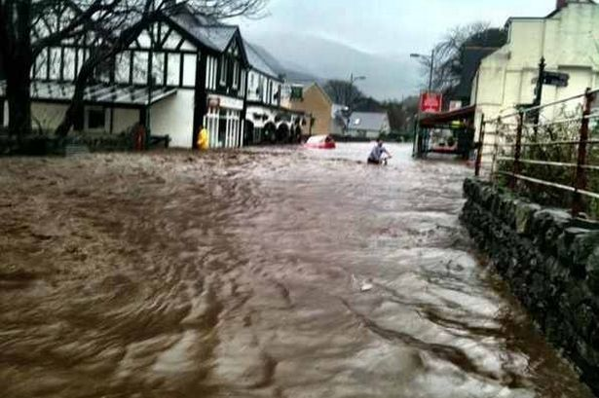
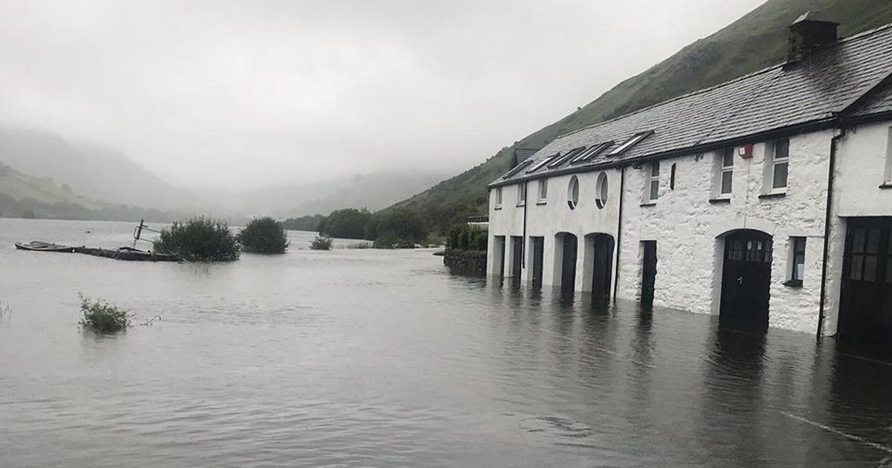
Flood management in Wales
Since the Flood & Water Management Act (2010), the responsibility of flood alleviation in England and Wales falls to regional flood risk management authorities, usually local councils. However, the effectiveness of the current approaches they use for flood alleviation are unclear.
An improved understanding of the impacts of Land Use Land Cover (LULC) change on local hydrology is key to strengthening the flood alleviation schemes and maximising the effectiveness of spending at a local government level.
Llanberis, North Wales 2012
In this project, we have partnered with Gwynedd County Council, a local authority in North Wales, UK, who are looking to improve on their current approach to the development of flood alleviation schemes.
We propose a SWAT+ based web toolkit as a decision support system.
Near Dolgellau, North Wales 2020

Slide 3
Aim of the study
Improve the capability of Gwynedd County Council (and other local authorities in Wales) to make more informed flood alleviation schemes, maximising scheme efficiency as well as spending and resource allocation.
Objectives
Develop a user-friendly toolkit that allows the end user to specify, through a Graphical User Interface (GUI), various types of LULC changes at multiple locations within their study catchment.
Through the toolkit, run the SWAT+ model with the newly defined land use scenarios and enable interactive visualization of the results to aid in assessing the hydrological impacts.
Work with GCC(Gwynedd County Council) to evaluate the effectiveness of the toolkit as a support tool

Slide 4
SWAT+
SWAT+ is a revised version of the Soil and Water Assessment Tool, a public domain hydrological model.
The DEM, Land Use and Soil Maps are inputted through the QSWAT+ plugin in QGIS generating the catchment and its subunits.
Climate data is incorporated via the SWAT+ editor interface.
Individual calculations take place at the smallest spatial unit, Hydrologic Response Unit(HRU: areas with assumed homogeneous hydrologic properties, based on their LULC, soil type and slope), and are aggregated up to sub-catchment and catchment level.
The outputs, including streamflow, are printed as a .txt or .csv file and can be interrogated at a whole catchment to individual tributary scale.
Digital Elevation Model (DEM)
Land Use & Soil Maps
Climate Data
(Wind, Precipitation, Temperature, Solar Radiation, Relative humidity)
Defines topographic characteristics/delineates catchment
Multiple open sources e.g.
DLG, ASTER GDEM, SRTM, Ordinance Survey
Along with user-defined thresholds define HRUs
Multiple open sources e.g. USGS GLCC, FAO/UNESCO, ESDAC, CORINE
Defines ‘weather stations’ and replicates climatic conditions across the catchment
Multiple open sources e.g. NCEP CFSR
INPUTS
SWAT+ OUTPUTS
e.g. Streamflow, Water Quality
Figure 1: SWAT+ simplified input schematic

Slide 5

LULC In SWAT+
SWAT+ runs by reading the .txt files created when the catchment is generated (figure 1, previous slide). These files include codes for the land use, soil, plant type, run off, Manning's n etc. for each HRU.
For use as a support tool for flood alleviation GCC (as well as most local councils) are primarily concerned with the impact of changes to LULC (Land Use Land Cover) i.e. land use and plant type, on the hydrological characteristics of the study area.
For a given HRU; land uses are stated in the hru-data.hru file which connects to the landuse.lum file. Plant communities are stated in the landuse.lum file which in turn connects to the plant.ini file (figure 2).
Figure 2: SWAT+ file connectivity structure for land use and plant type

Slide 6
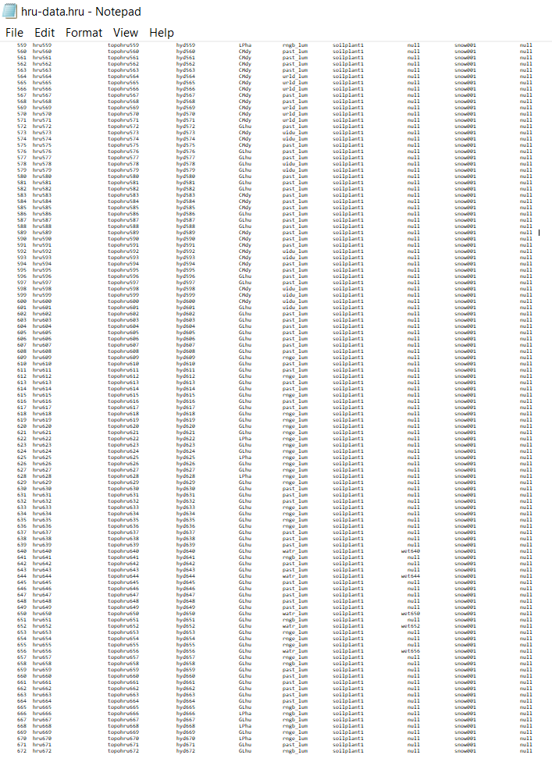
The Issue
1. Identify HRUs to alter
(in QGIS)
2. Manually update land uses
(lu_mgt value in hru-data.hru)
3. Manually add new land use and plant types
(to landuse.lum and plant.ini)
4. Manually interrogate/compare output datasets to assess LULC change impact
The example catchment (figure 4) has a total area of only 46.4km².
This catchment has a total of 672 HRUs.
Correctly Identifying and manually updating hundreds of HRUs is cumbersome, geographically nonintuitive and leaves room for human error.
To make LULC change assessments manually also requires a certain level of understanding of the SWAT+ model and hours in processing time and resources that many local councils do not have access to.
To make the model a viable management tool, we need to simplify and streamline the process of making, and assessing the impact of, LULC changes.
Figure 3:Current SWAT+ LULC change process
HRU672
Figure 4: SWAT+ hru-data.hru sample (Llyfni)

Slide 7
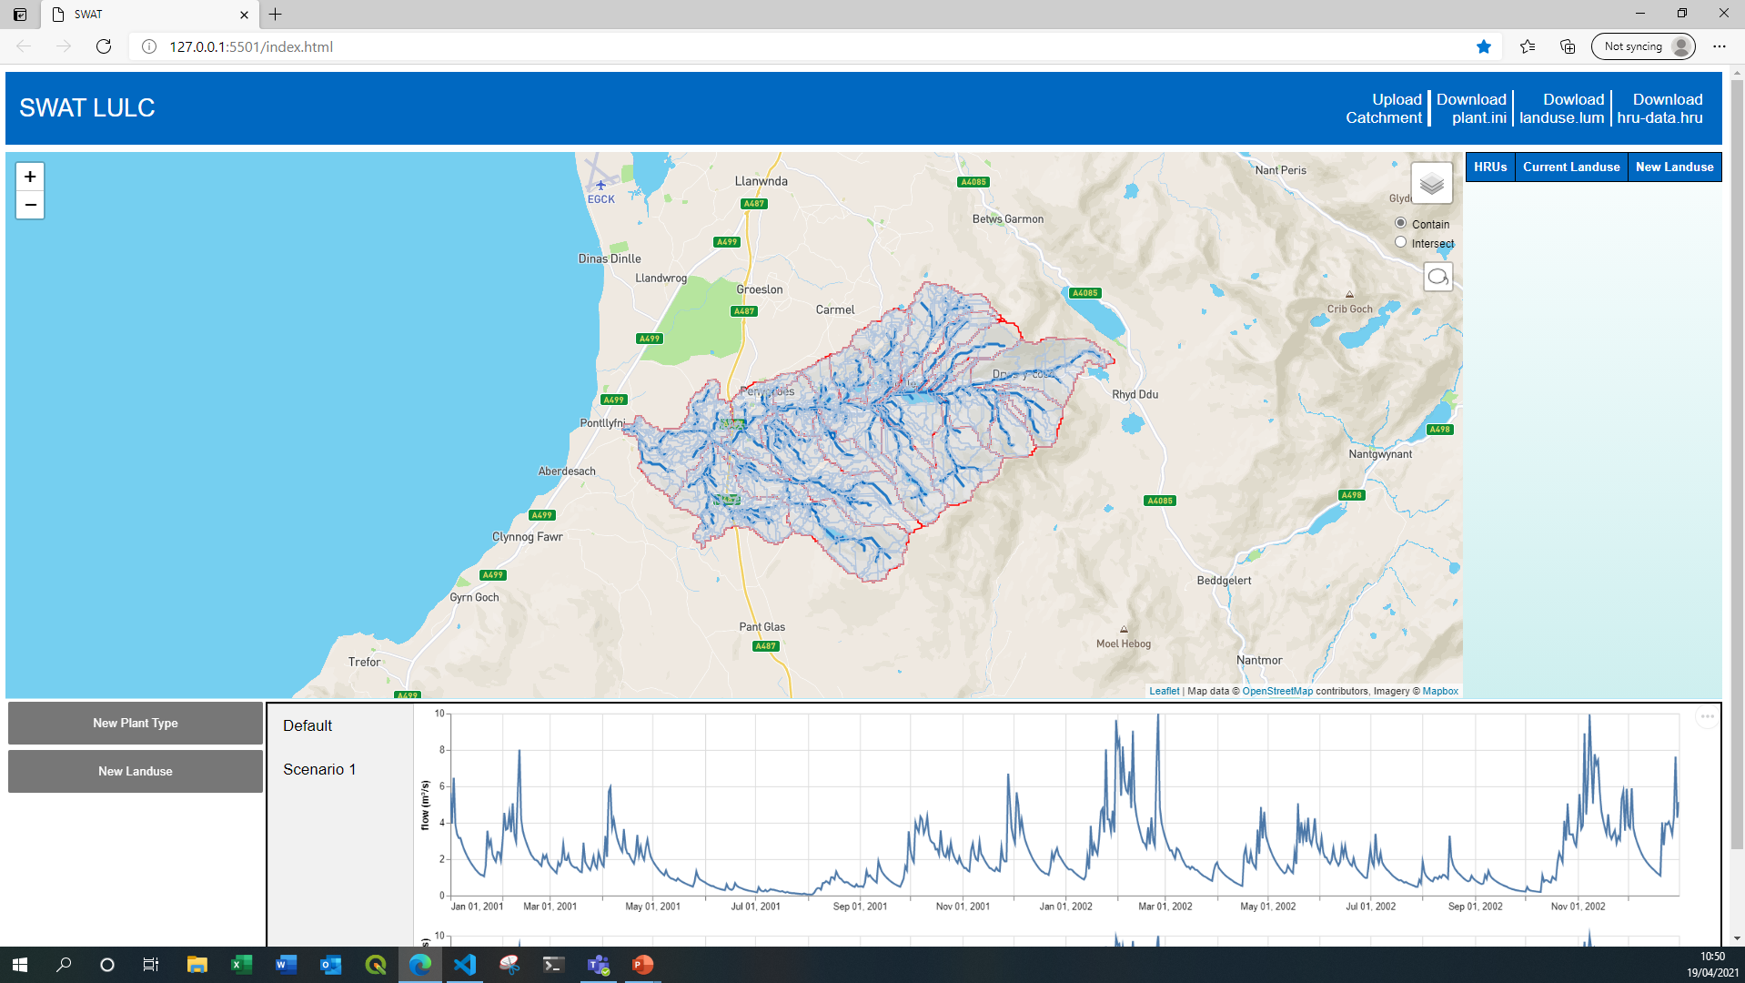
The Toolkit
The web-based toolkit is currently under development and is being updated regularly; so far these are the main components.
2. Dynamic table for editing land use in selected HRUs
1. GUI map with catchment subunits
4. Output visualization and scenario comparison
3. Functions for adding new land use and plant type

Slide 8
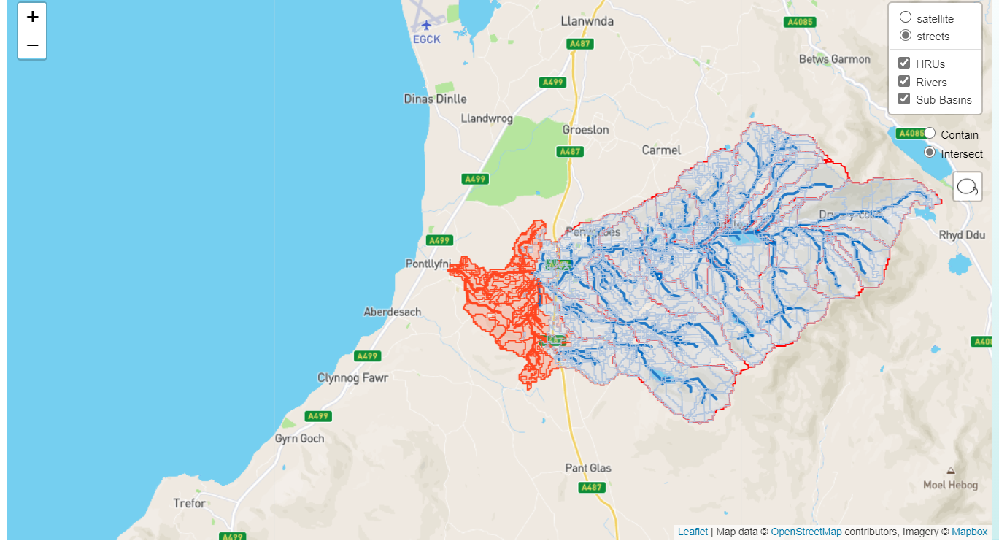
The Toolkit – 1. GUI Map
The shapefiles generated in QSWAT+(HRUs, channels, Sub-Basins) are loaded as layers on the GUI map.
A selection of HRUs can be made using the ‘lasso’ tool.
Interchangeable background map
Interactive catchment layers
Selected area highlighted
‘Lasso’ selection method, contain or intersect option

Slide 9
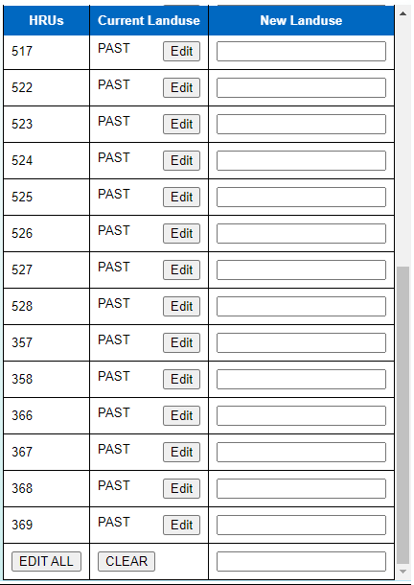
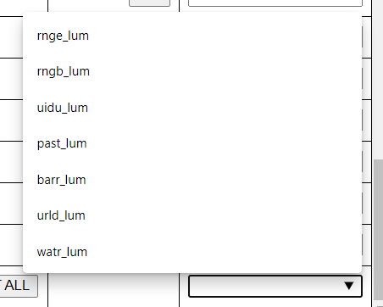
The Toolkit – 2. HRU Land Use Edit Table
The table automatically populates with HRUs selected via the GUI map.
Land use changes can be made to individual HRUs or the entire selection.
IDs of the selected HRUs
User defined new land use
Current land use in selected HRU
Automatically updated selection of available land uses
Edit individual HRU land use
Edit land use of entire selection

Slide 10
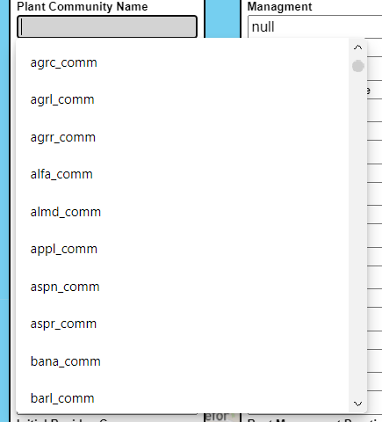
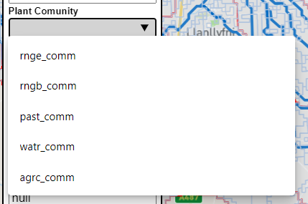
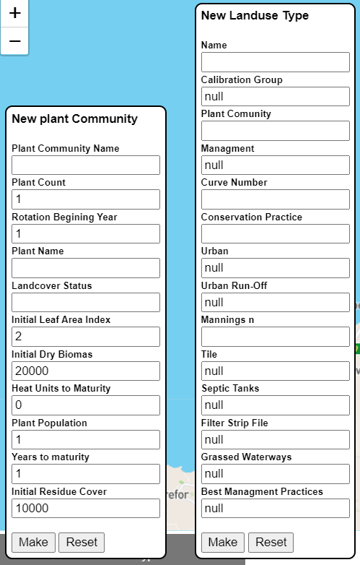
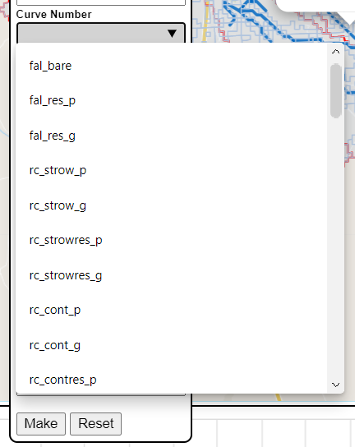
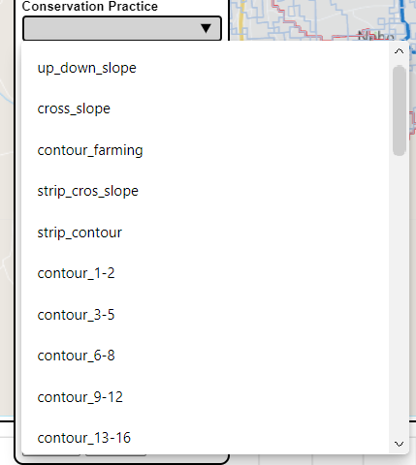
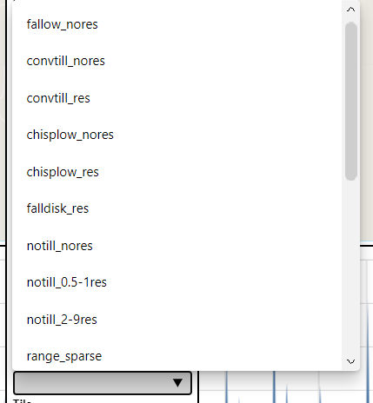
The Toolkit – 3. New Land Use and Plant Type
Automatically updated options with new plant type
Options populated from SWAT+ input files
The forms write new plant.ini and landuse.lum files containing the new user defined plant community and land use
Options populated from SWAT+ input files

Slide 11
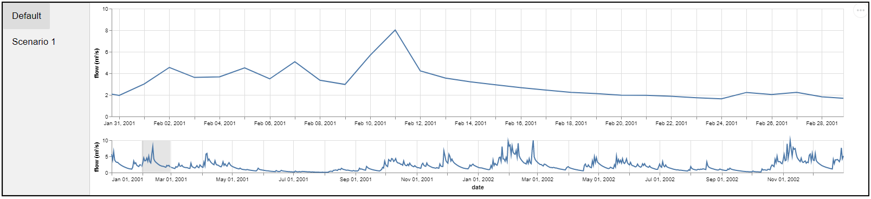
The Toolkit – 4. Output Visualization
Download plots
Tabs to swap between scenario outputs
Resizable ‘brush’ for choosing a period to inspect more closely
Currently output .csv files need to be manually uploaded to the toolkit

Slide 12
The Toolkit – Development
The toolkit is still in early days of development. A prototype is needed before trialling it with the local flood risk management authority across numerous small-medium catchments in Gwynedd county, Wales.
Currently, the toolkit prints modified files which need to be moved manually to the SWAT+ catchment directory, the model run, and the outputs uploaded manually for visualization/comparison.
We have already seen drastic reduction in the time taken to identify and make land use changes to HRUs, making new land uses and plant types. Progress in visualization/comparison of outputs promises good potential.
The next step is to develop the capability of running the SWAT+ model within the toolkit itself, thereby further simplifying the process of LULC change assessment.
Desired Functions | Achieved?
Make visual selection of catchment HRUs | ✓
Make land use changes to selected HRUs | ✓
Make new plant type | ✓
Make new land use type | ✓
Visualize and compare model outputs | ✗
Run the SWAT+ model in the application | ✗

Slide 13
Toolkit Demonstration

