Slide 1


EGU21-4161
Water and nitrogen balance assessment for Krško polje aquifer case study in Slovenia
M. CURK, M. GLAVAN, M. PINTAR, V. ZUPANC
University of Ljubljana, Biotechnical Faculty, Agronomy Department, Ljubljana, Slovenia

Slide 2
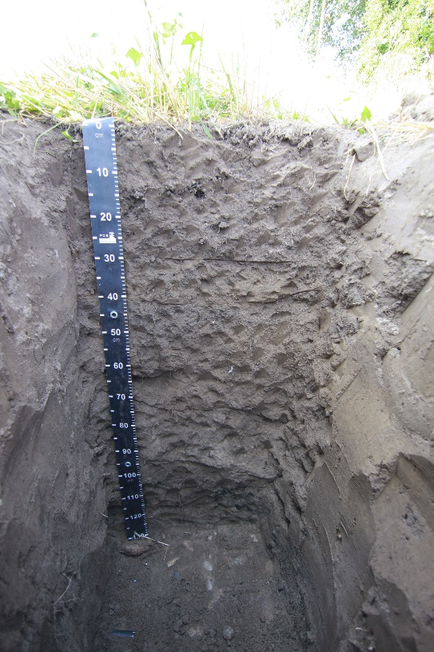

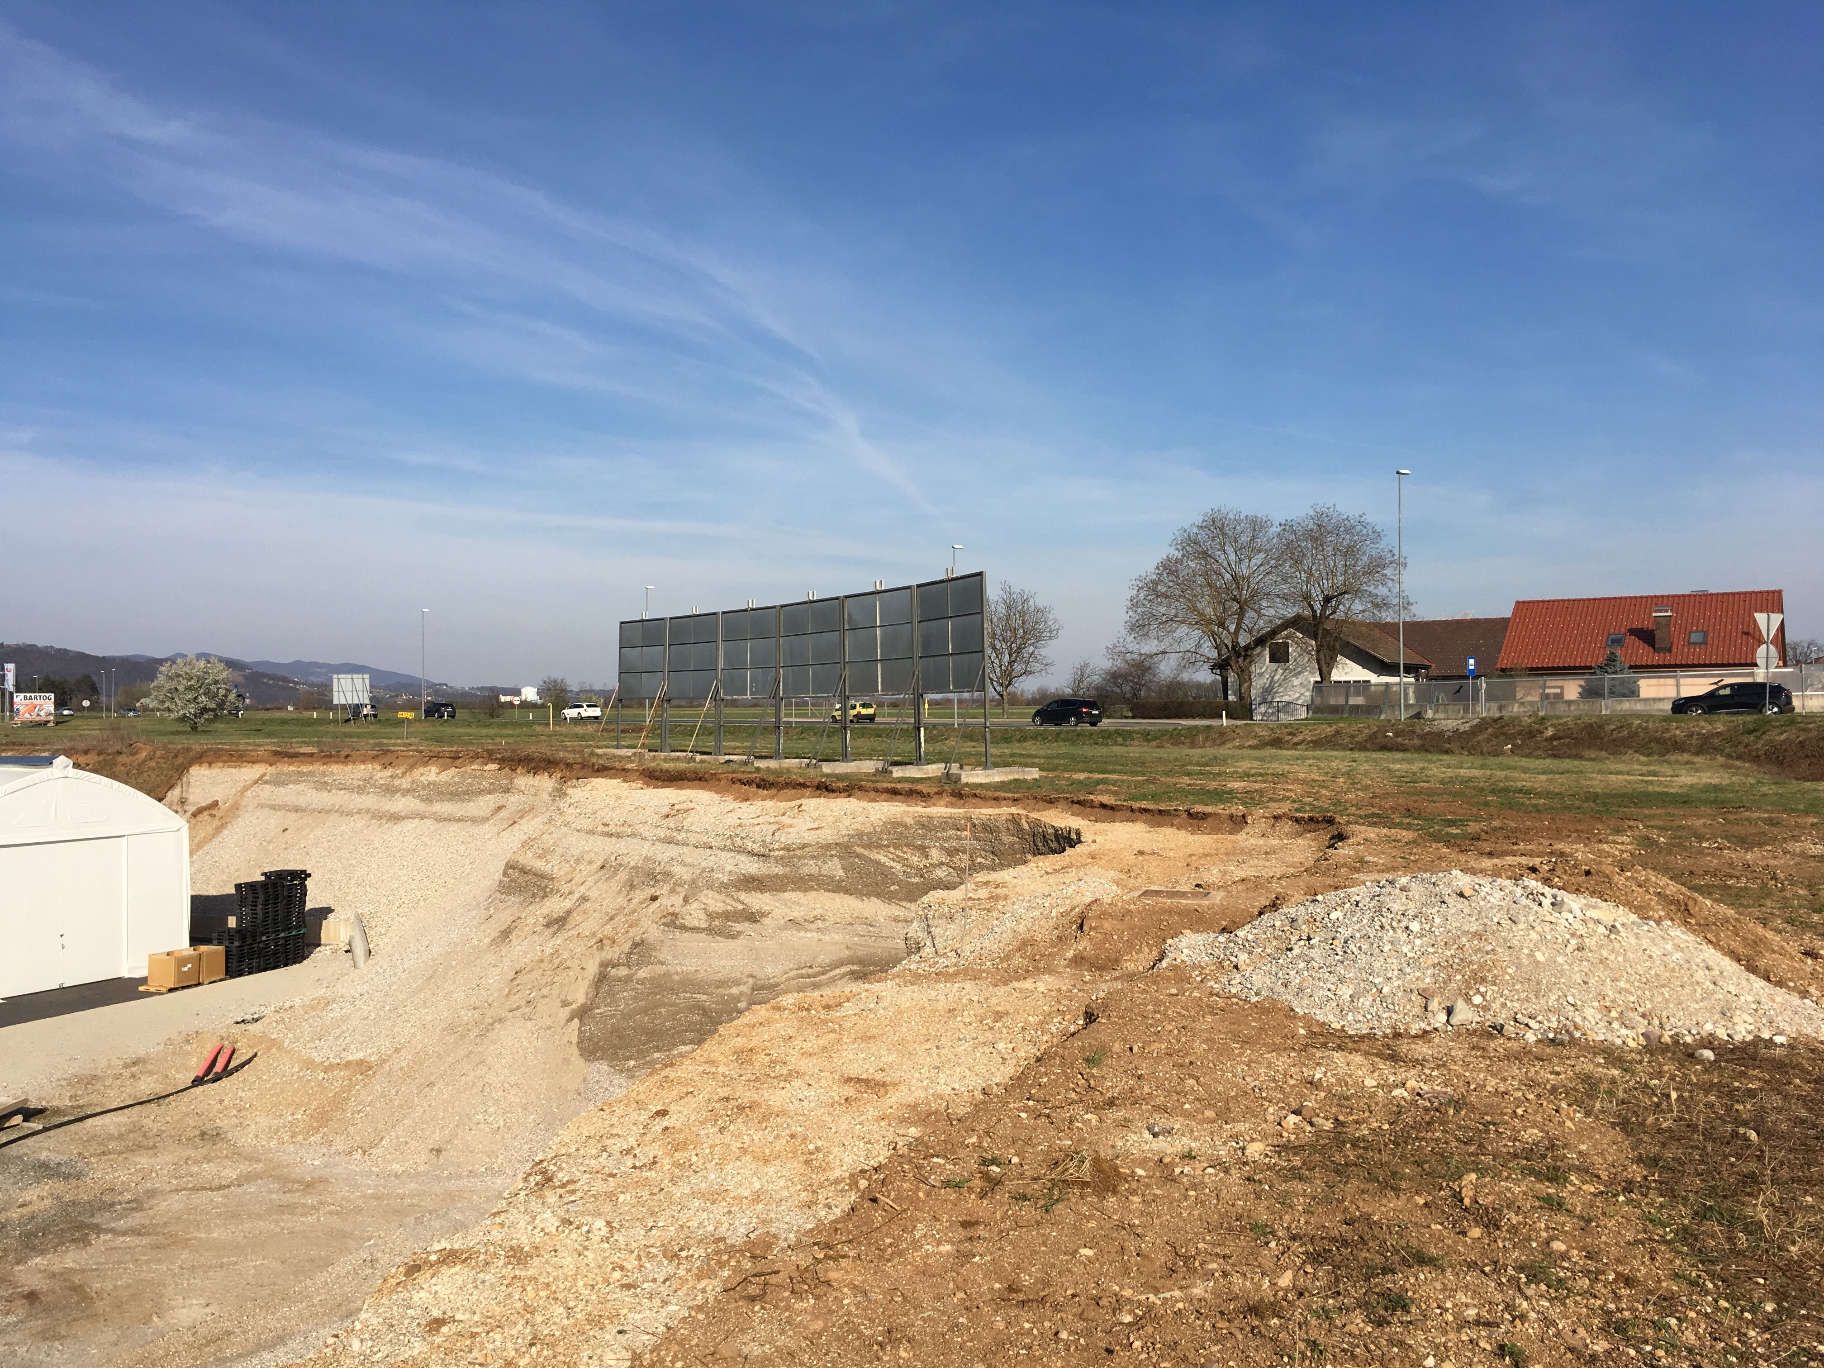
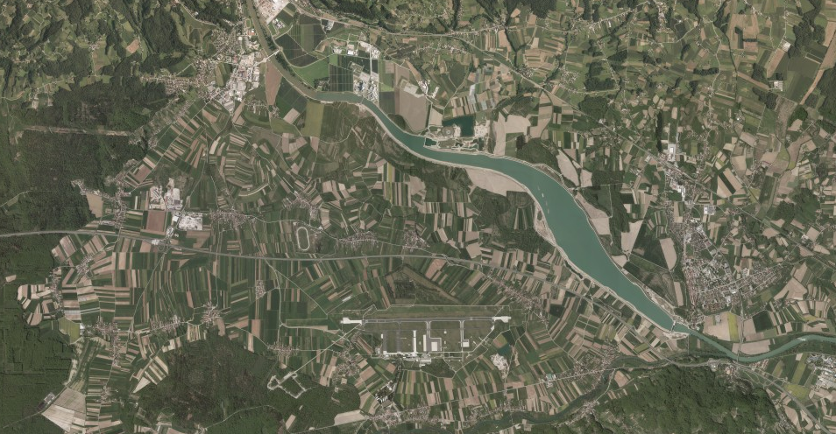
Case study area
Alluvial plain (6,000 ha)
Shallow gravel aquifer (unconfined, 10 m below surface)
Vulnerable soils, high hydr. conductivity, no N reduction
Intensive agriculture (<70 %)
GW is the main (only) DW source
11% area – water protection zones
2 field trial sites - soil water (TDR) and nitrate (suction cups)
nitrate above
WFD limit in 2/14 monitoring wells
orchard
vegetable field

Slide 3
Results – vegetable field
Soil water at 30 cm (2018)
Soil water at 30 cm (2019)
Soil water content at 60 cm is considerably more stable than at 30 cm
Drought in summer of 2018 is very noticeable, with irrigation peak near the end of august
TDR probes seem to be more reliable (less difference) in wet periods
Soil water at 60 cm (2019)

Slide 4
Results – vegetable field
Nitrate at 30 cm (2018)
Nitrate at 30 cm (2019)
Nitrate at 60 cm (2018)
Nitrate at 60 cm (2019)

Slide 5
Results – vegetable field
Nitrate at 30 cm (2018)
Nitrate at 30 cm (2019)
Periods are not the same for 2 years, nitrate concentrations in soil water only near 0 mg/l late in the year (oct, nov)
Only one fertilizer application is performed in the field, which can be noted in high initial concentrations, but a decrease over the growing period
Nitrate at 60 cm (2018)
Nitrate at 60 cm (2019)

Slide 6
Results – orchard
Soil water at 30 cm (2018)
Soil water at 30 cm (2019)
Nitrate at 30 cm (2018)
Drought in summer of 2018 is visible again, but irrigation peaks are present
Nitrate concentrations in soil water are lower than in the vegetable field
Concentrations are more stable, a result of several N applications over the growing period

Slide 7
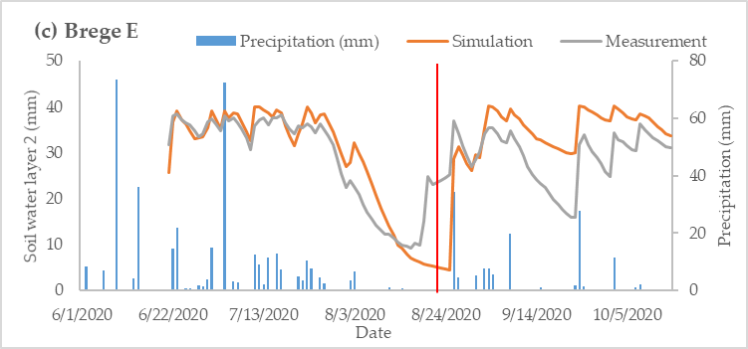
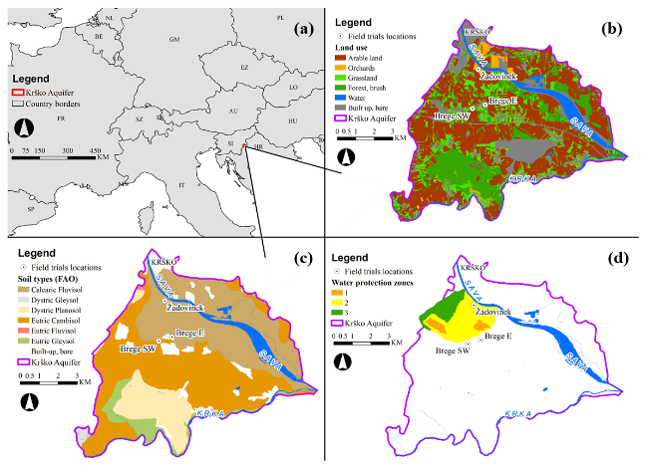
Results – whole area model
Model performance (soil water, year 2018)
Site | Calibration |  | Validation
 | PBIAS | R² | PBIAS | R²
veg. field | 17.6 | 0.78 | 8.7 | 0.40
orchard | 2.1 | 0.41 | -1.5 | 0.71
Model outputs (2018)
Site | ET | Soil water | N_APP | NO3 leached |  | Biomass |  | Yield
 | (mm) | (mm) | (kg/ha) | (kg/ha) |  | (t DM/ha) |  | (t DM/ha)
veg. field | 623.2 | 96.2 | 124.5 | 92.8 | ±24.7 | 3.3 | ±3.1 | 3.2 | ±3.2
orchard | 643.3 | 187.4 | 166.1 | 83.3 | ±28.0 | 28.6 | ±1.3 | 2.1 | ±0.1
Acceptable model performance (soil water)
Soil profile in the orchard is deeper than in the field, thus a larger water storage capacity
Despite larger application of fertilizer per year, leaching from orchard tends to be lesser than from the vegetable field, but smaller difference than with measurements

Slide 8
EGU21-4161
Thank you for listening!
Contact: miha.curk@bf.uni-lj.si

