Slide 1
Importance of satellite observations
for high-resolution mapping of near-surface NO₂
by machine learning
Minsu Kim✉ , Gerrit Kuhlmann, Lukas Emmenegger, and Dominik Brunner
Laboratory for Air Pollution/Environmental Technology
Empa – Swiss Federal Laboratories for Materials Science and Technology
(✉ minsu.kim@empa.ch )

Slide 2
Nitrogen dioxide (NO₂)
is an air pollutant
is toxic to humans (e.g. respiratory symptoms)
is mainly produced by combustion of fossil fuels
(e.g., vehicles, industrial emissions, heating systems, power plants etc.)
shows high spatial and temporal variability
Important to have high resolution maps of NO₂ !!!

Slide 3
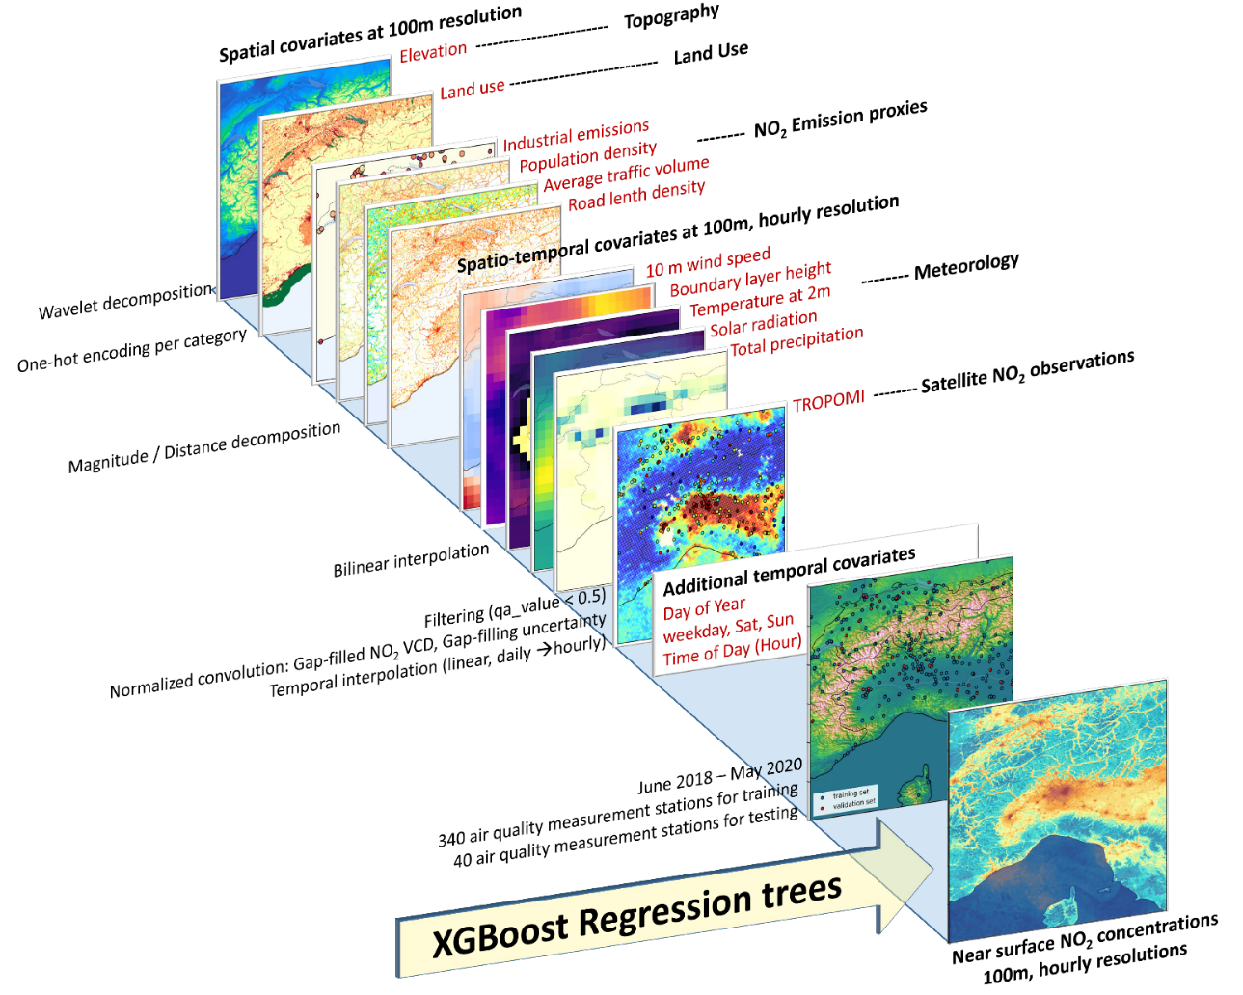
Model and covariates for high-resolution

Slide 4
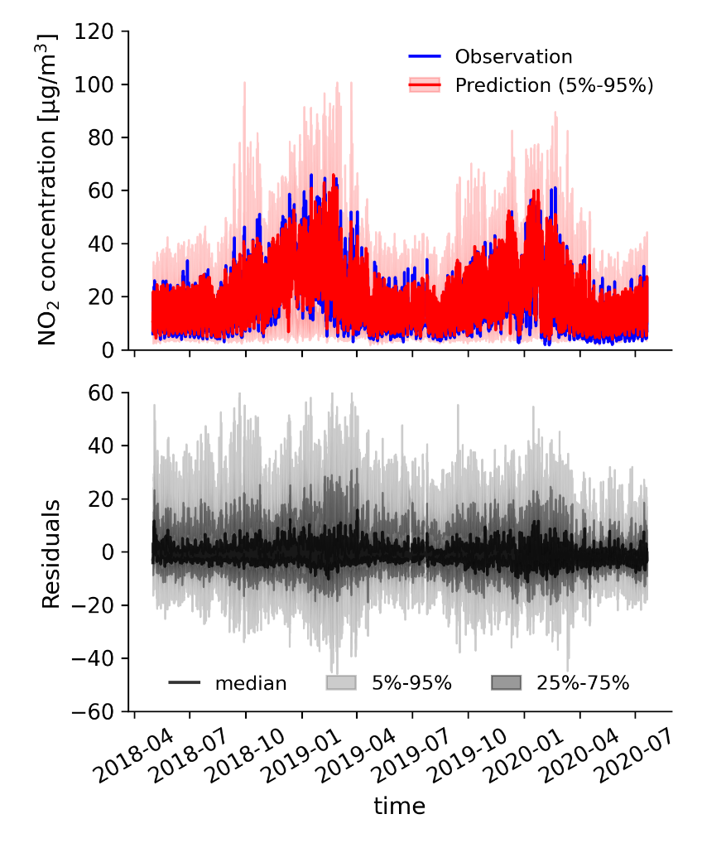
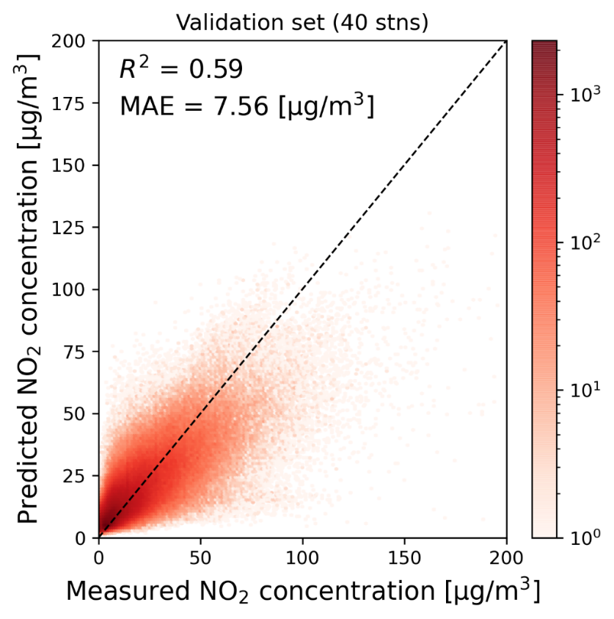
Model predictions vs. observations (hourly)

Slide 5
Animation of predicted near surface NO₂
March 2019

Slide 6
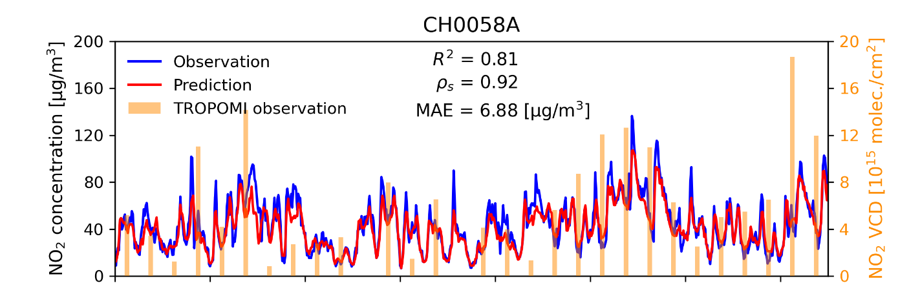
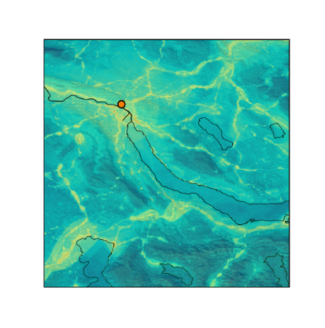
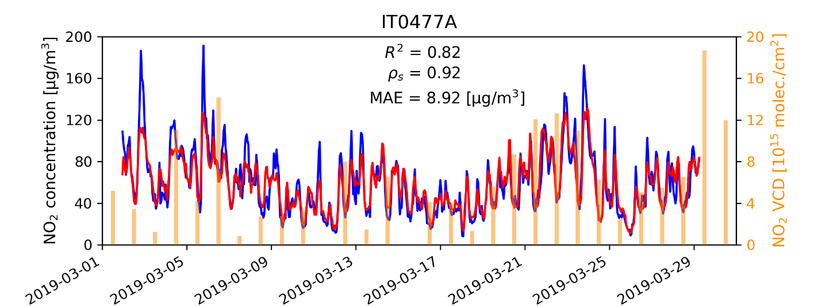
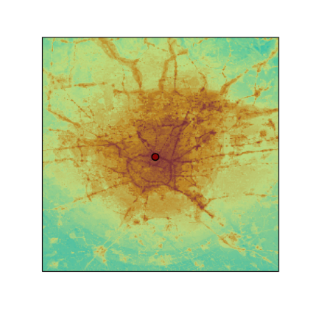
Predicted near surface NO₂ concentrations
Time series comparisons during March 2019
Average NO₂ map
(March 2019)
Test station at Zürich (CH0058A)
Zürich
(CH0058A)
Test station at Milan (IT0477A)
Milan
(IT0477A)

Slide 7
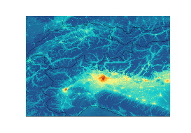
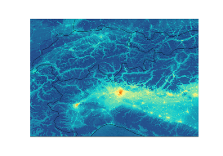
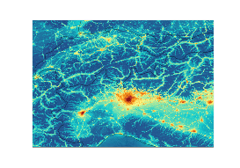
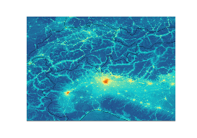
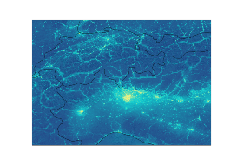
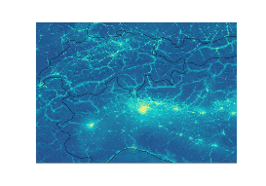
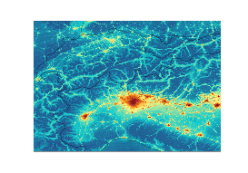
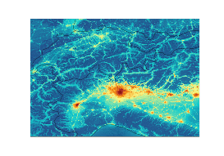
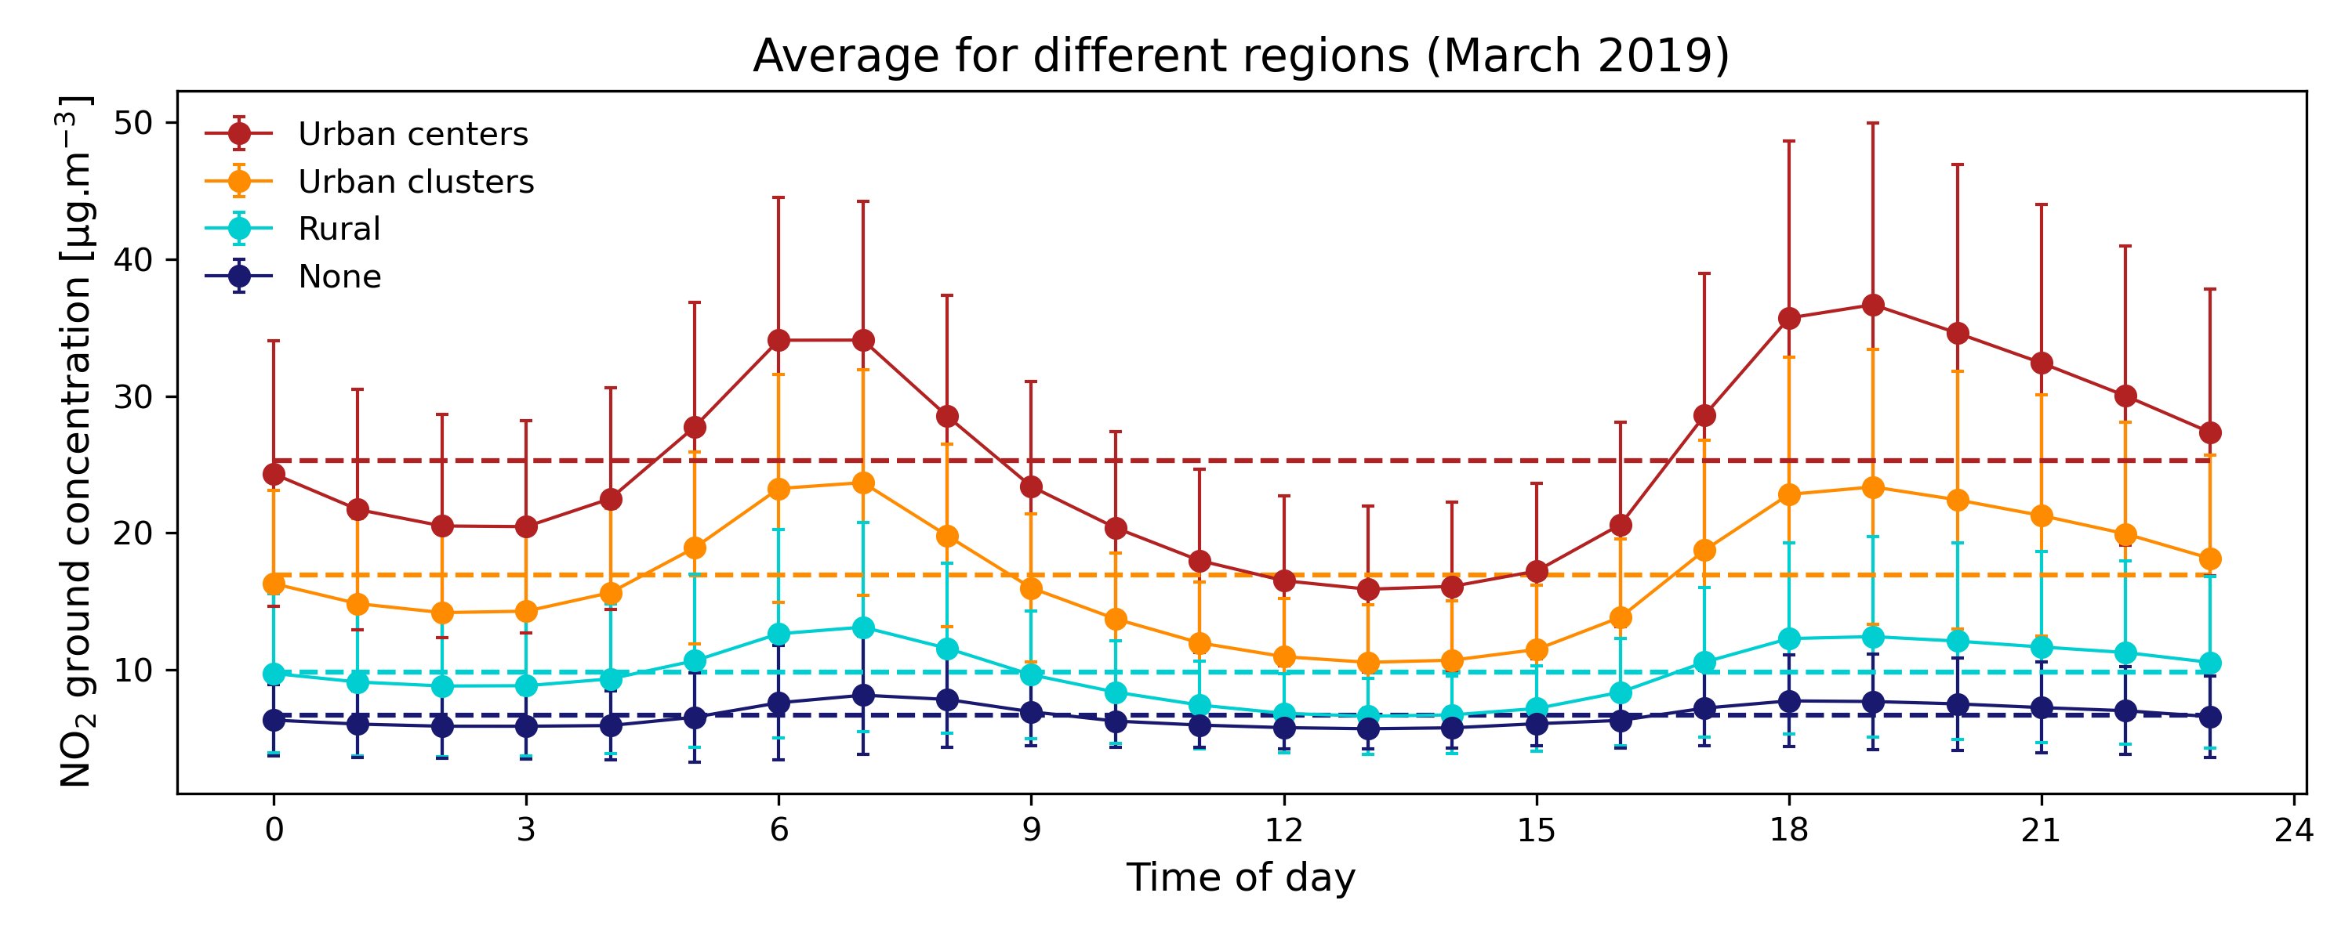
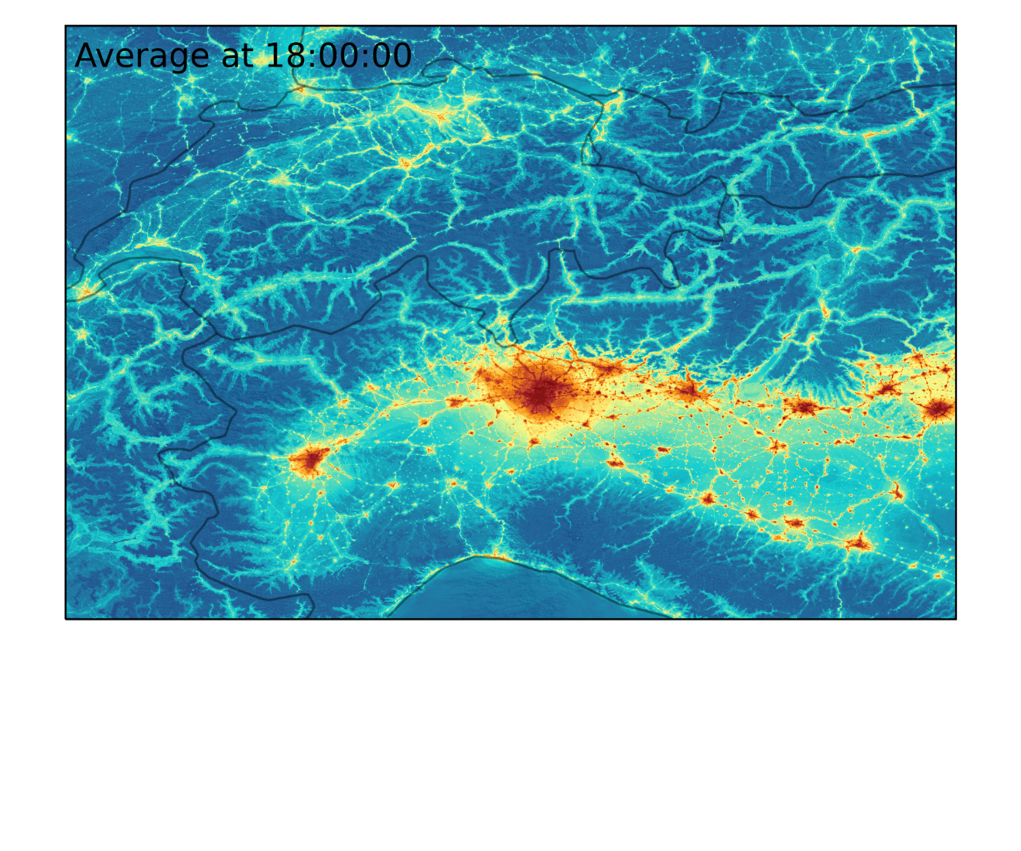
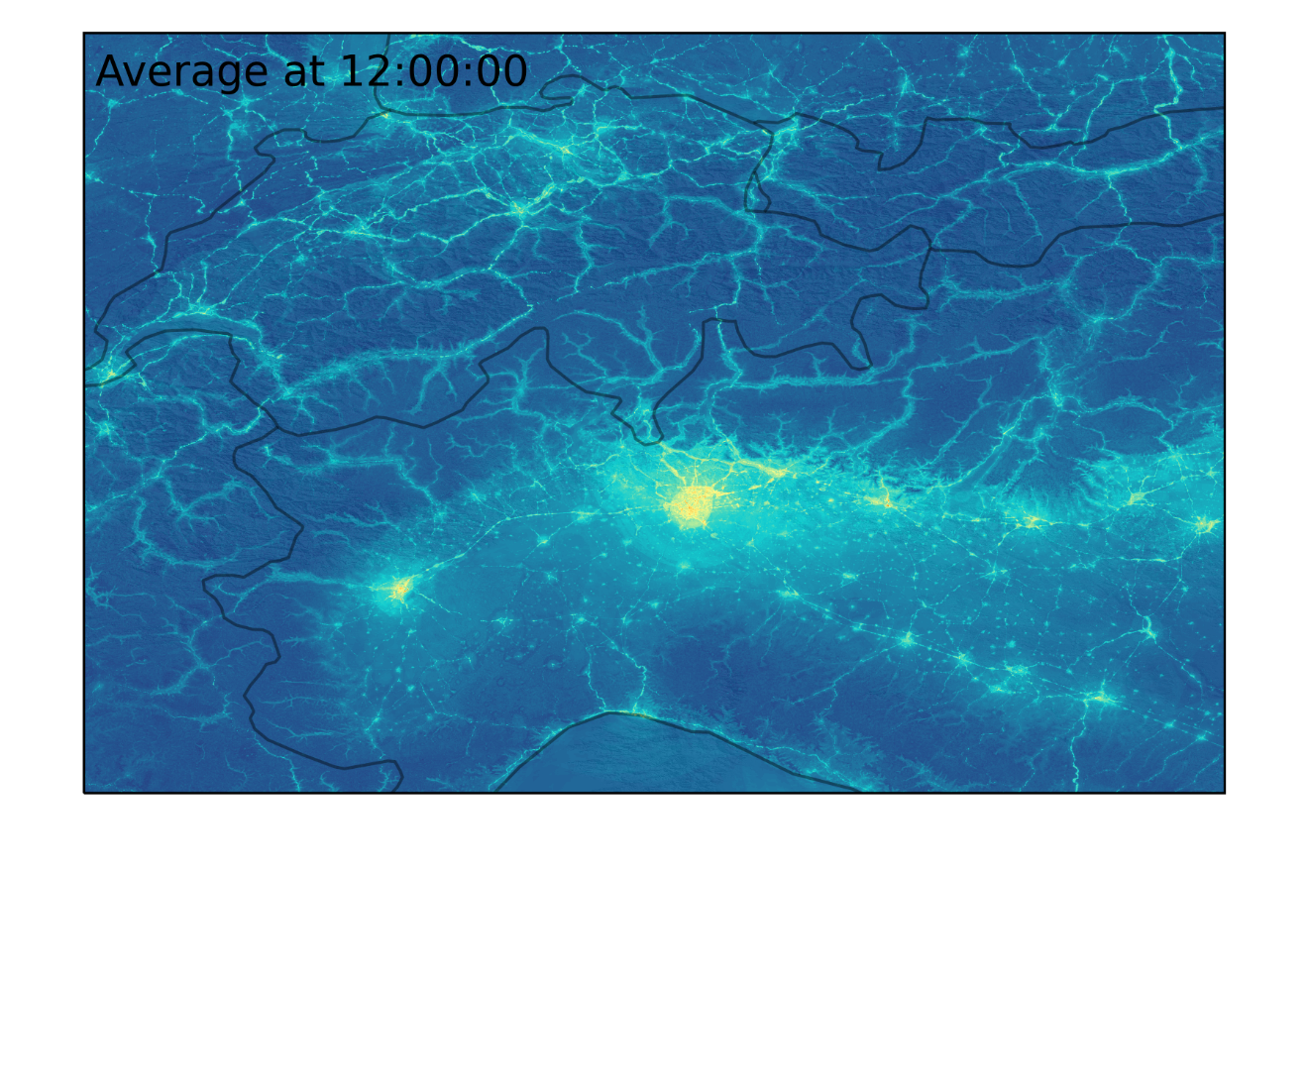
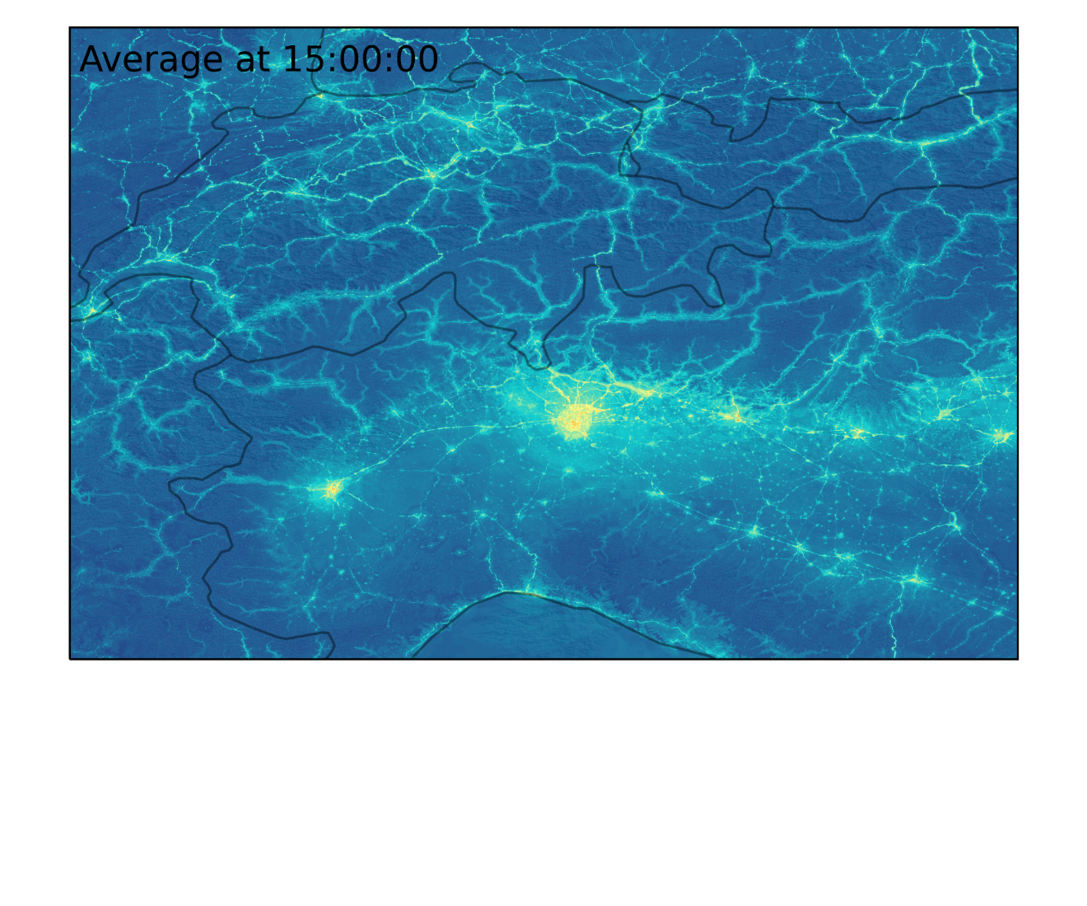
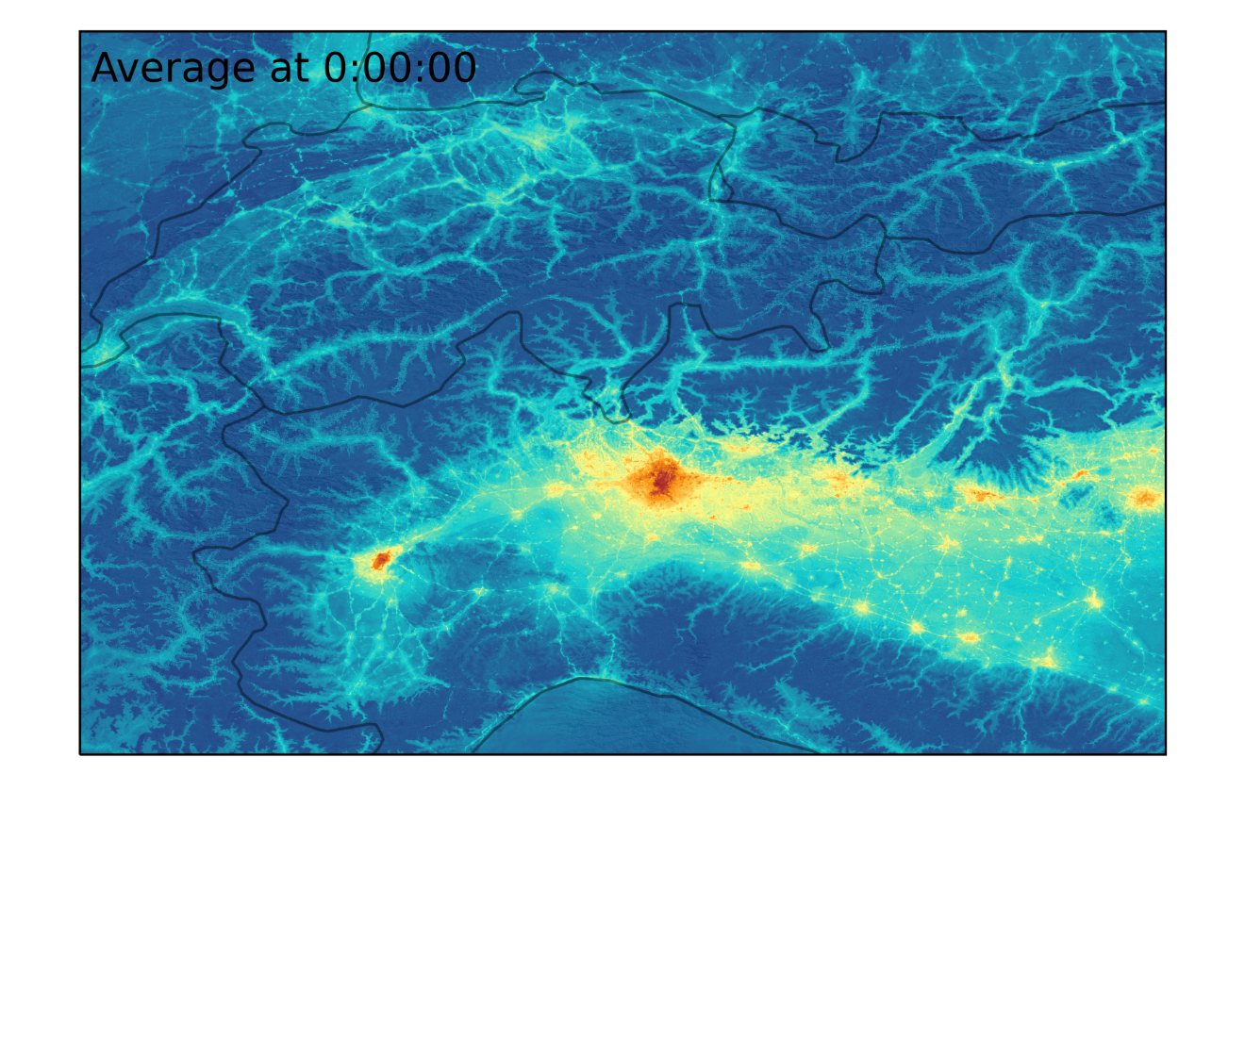
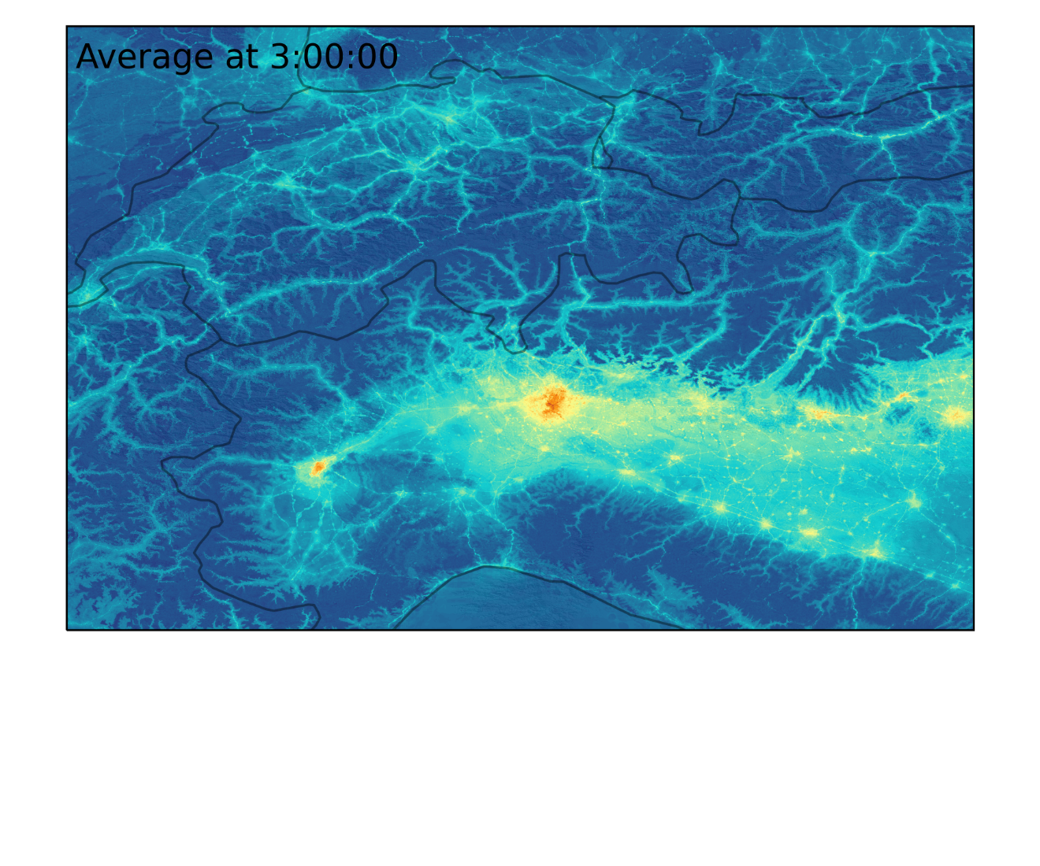
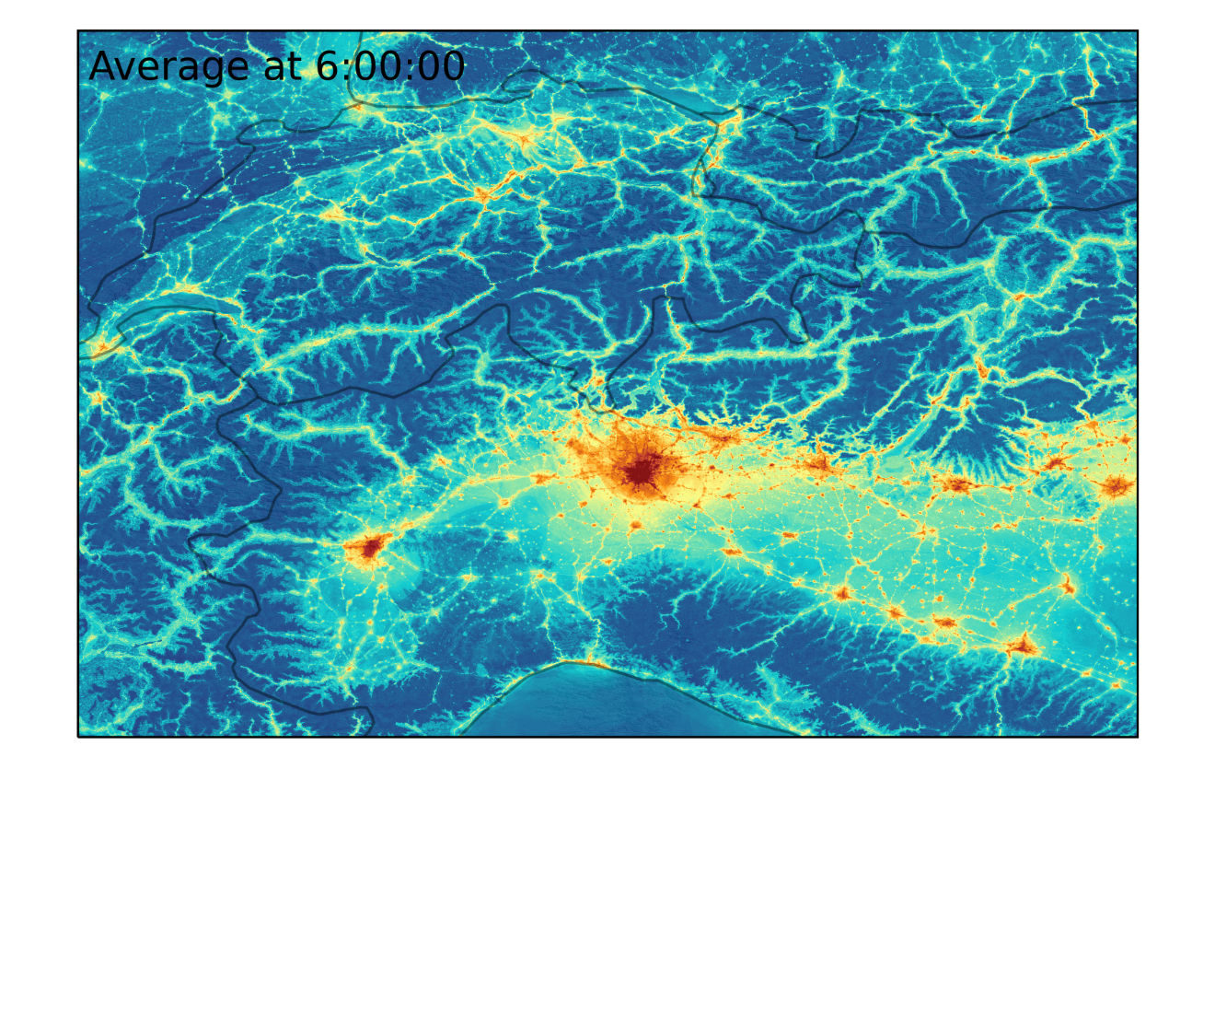
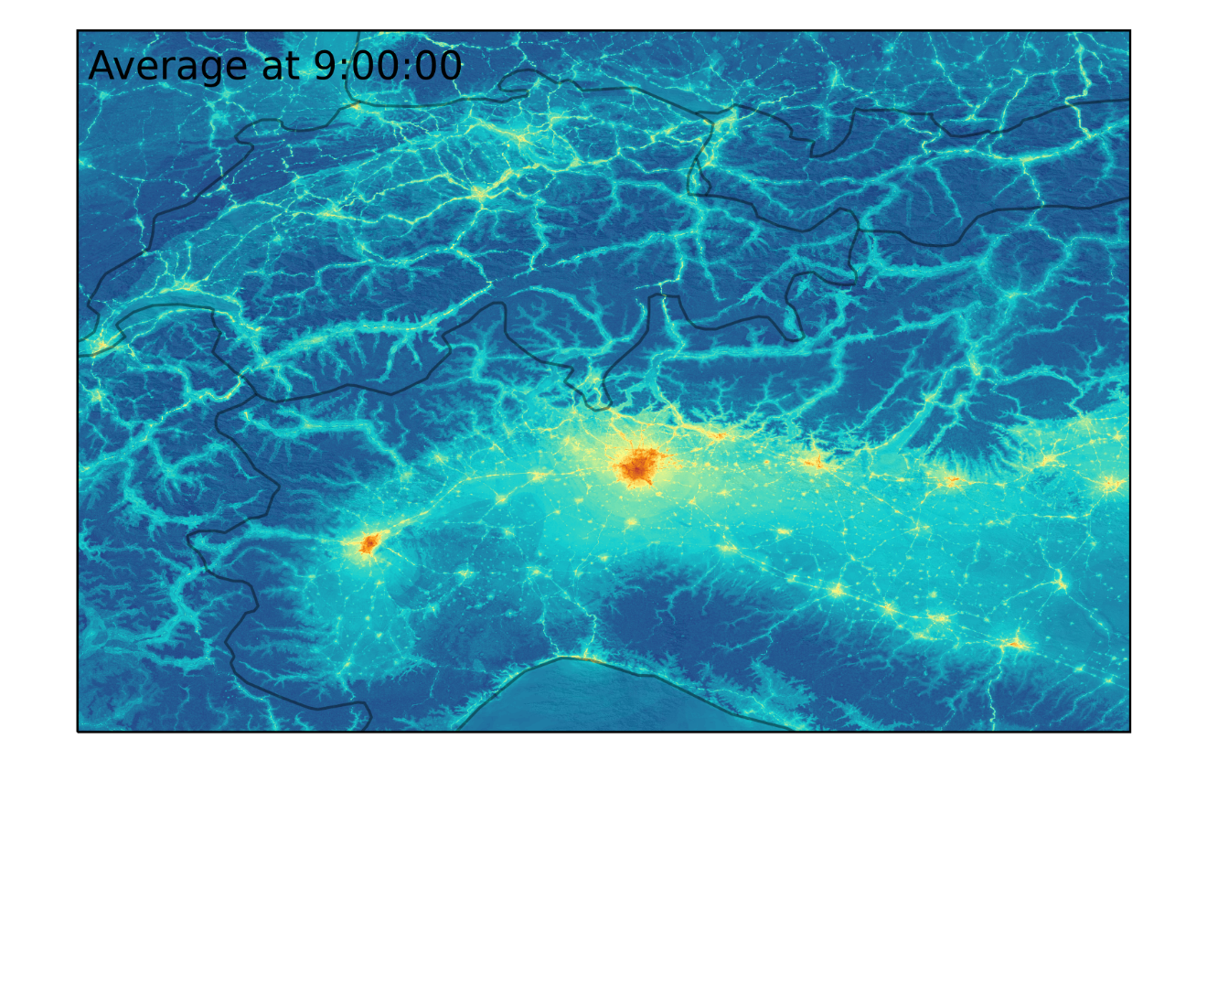
Diurnal pattern of near surface NO₂ (March, 2019)
12AM
3AM
6AM
9AM
12PM
3PM
6PM
9PM

Slide 8
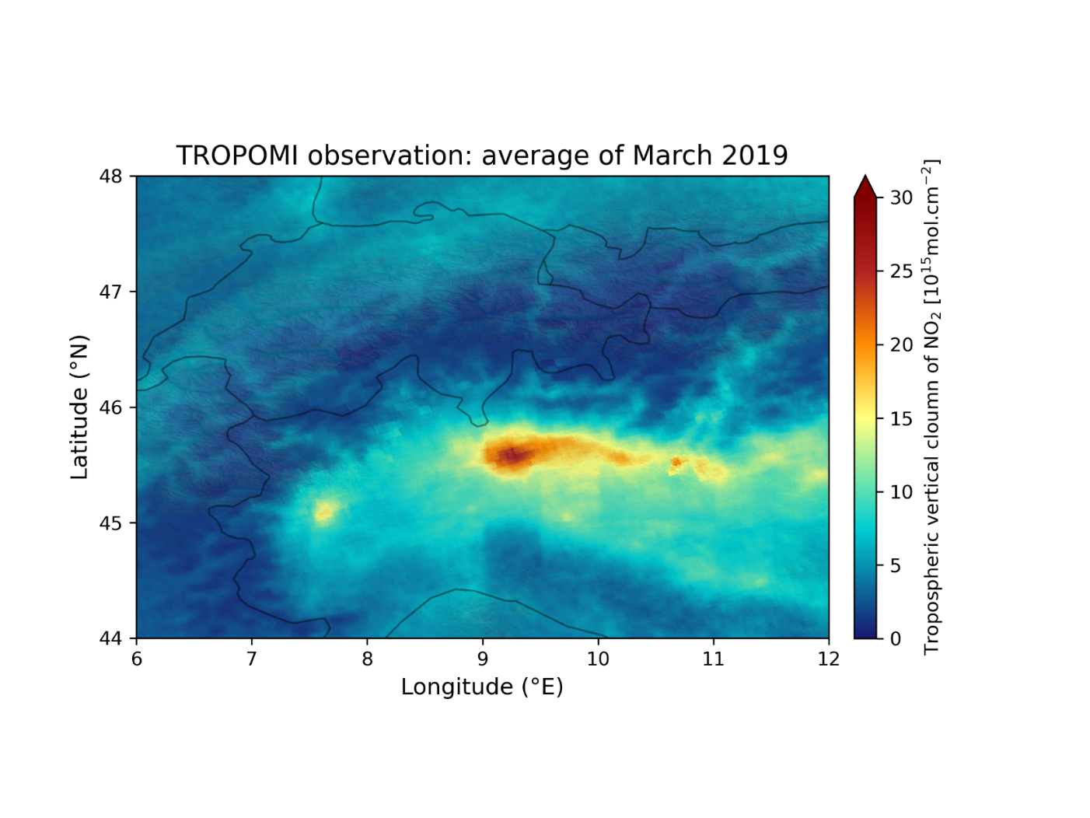
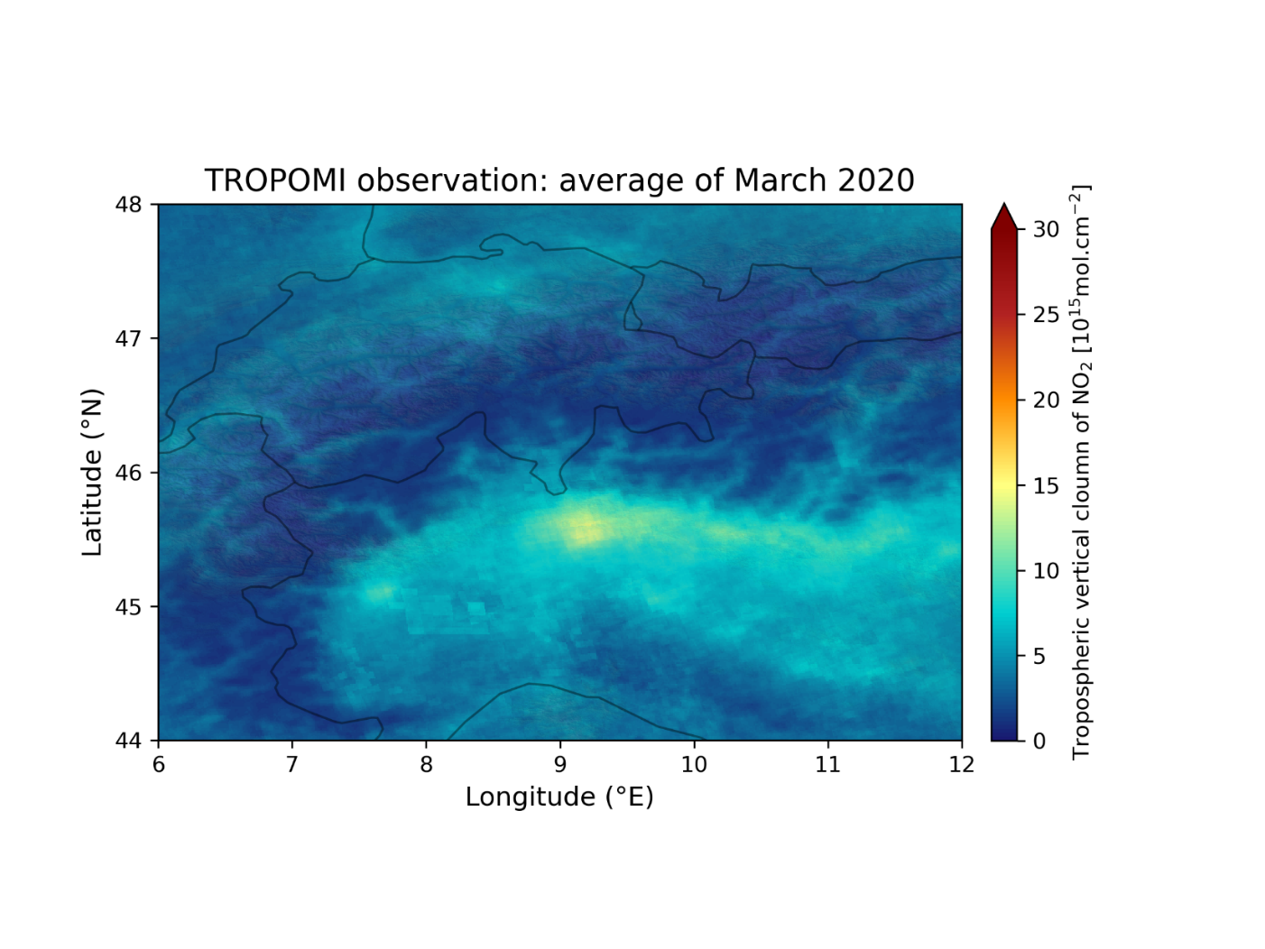
A case study : Covid-19 lockdowns
Monthly average of TROPOMI VCD NO₂ observations (overpass at 13:30)
March 2019 (pre-lockdowns)
March 2020 (during lockdowns)

Slide 9
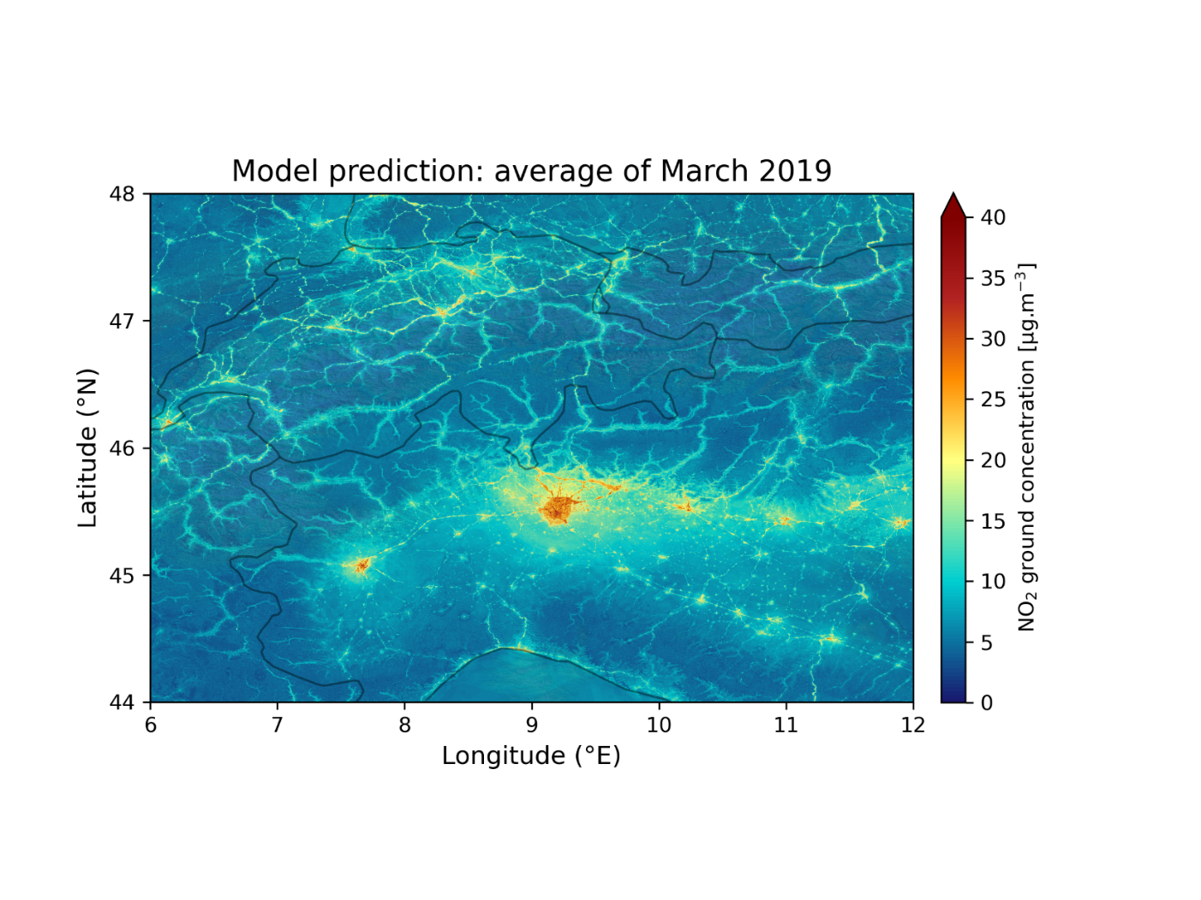
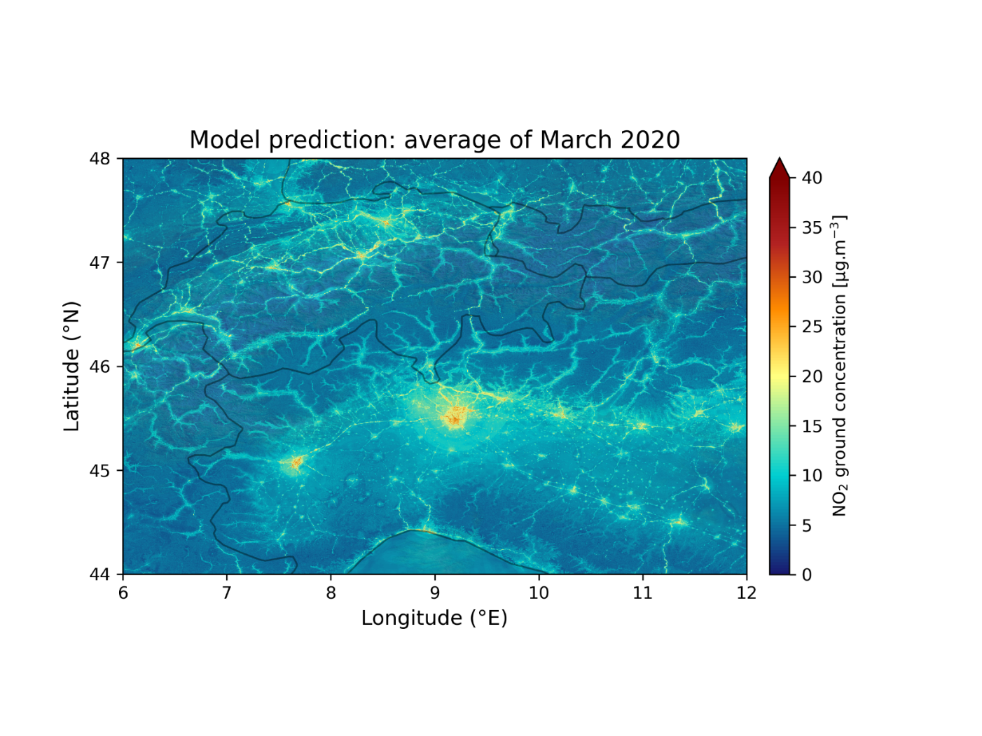
A case study : Covid-19 lockdowns
Average of near-surface NO₂ predictions at 13:00
March 2019 (pre-lockdowns)
March 2020 (during lockdowns)

Slide 10
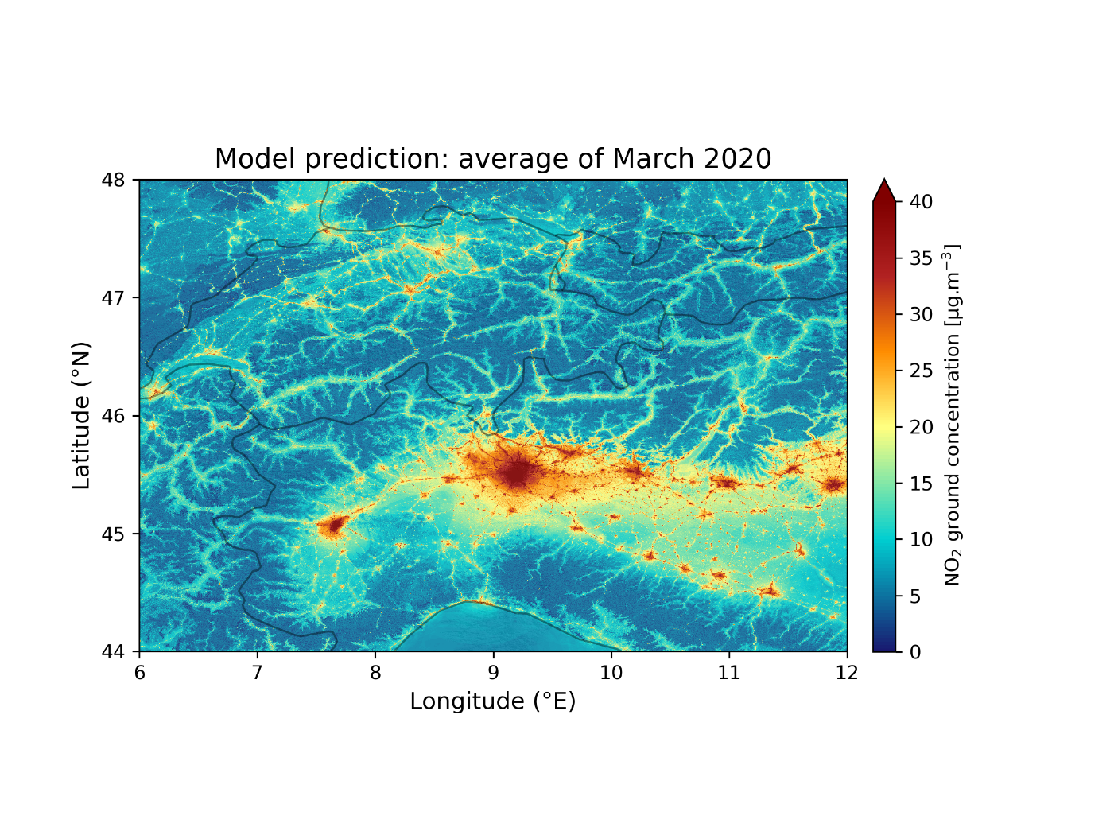
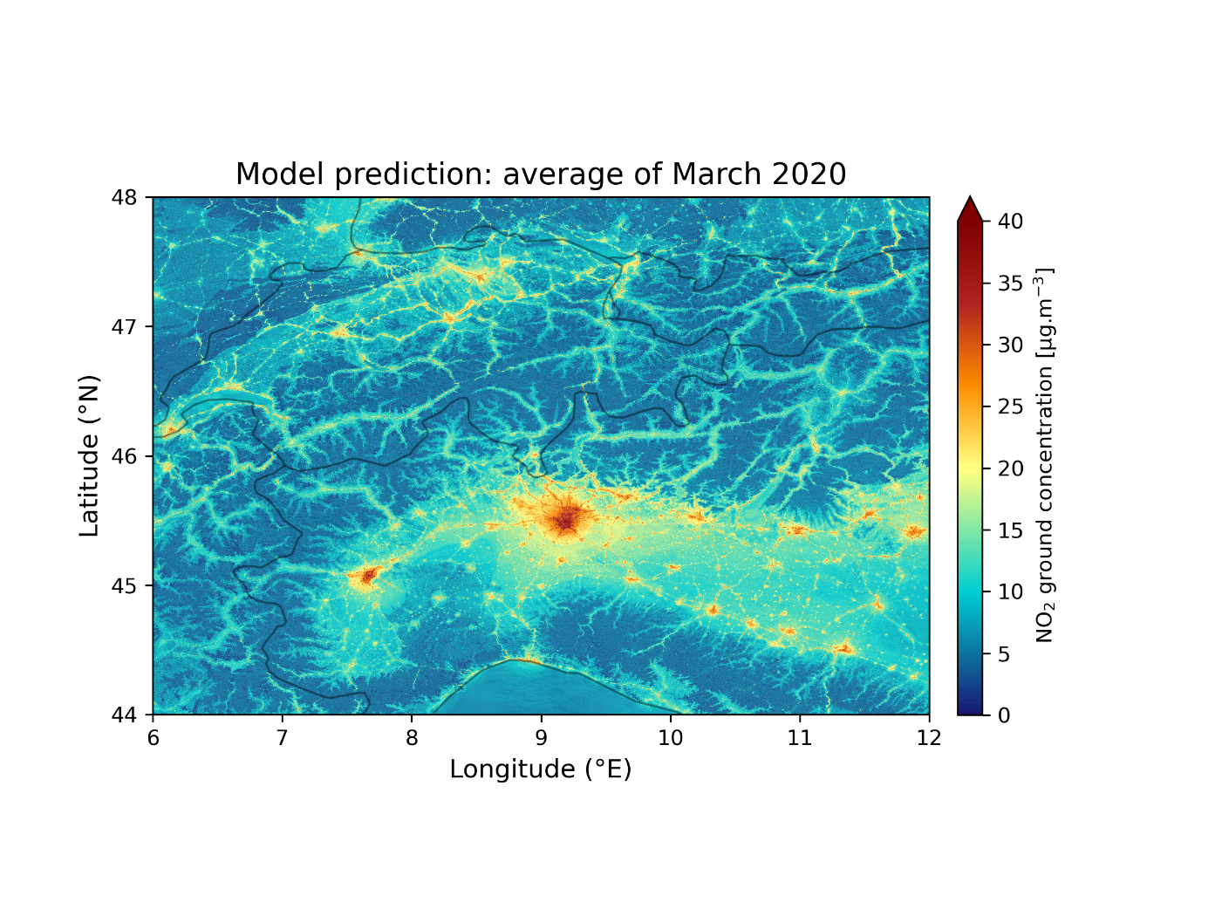
A case study : Covid-19 lockdowns
Average of near-surface NO₂ predictions over all hours of the day
March 2019 (pre-lockdowns)
March 2020 (during lockdowns)

Slide 11
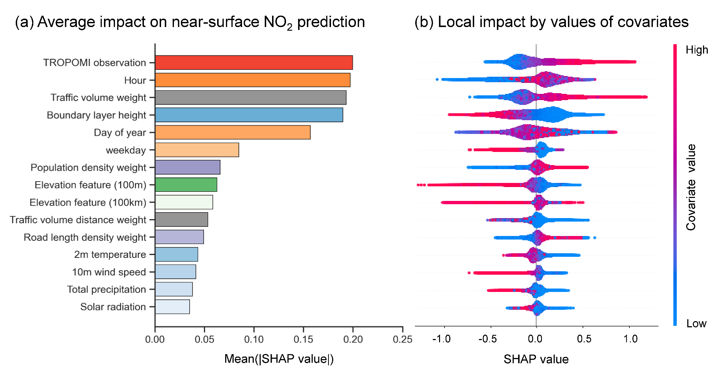
Average of local contribution for prediction

Slide 12
Contribution by TROPOMI in the model?

Slide 13
Conclusions and outlook
High resolution maps of near surface NO₂ concentrations are attained
Satellite observations by TROPOMI (~5km resolution, vertical column density) show the highest contribution for high-resolution (100m) mapping
This study can be extended to any regions in Europe thanks to publicly available data at high quality
A case study of Covid-19 pandemic lockdowns indicates that the model has potential to investigate the role of political intervention for air pollution

Slide 14
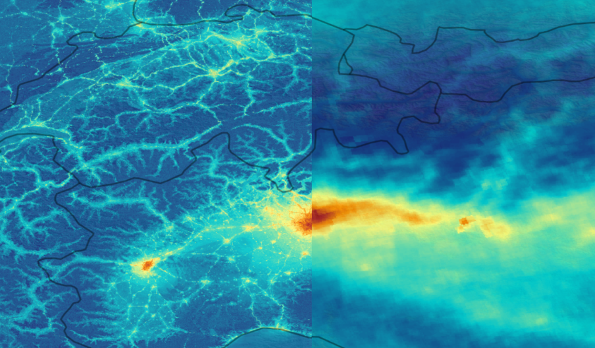
Thank you!

