Slide 1




Using short-term ensemble weather forecast to evaluate irrigation outcomes
Australian Research Council (ARC) Linkage Project
University of Melbourne:
Danlu Guo, Andrew Western, QJ Wang, Dongryeol Ryu
Rubicon Water:
Peter Moller, David Aughton
Contact: danlu.guo@unimelb.edu.au

Slide 2
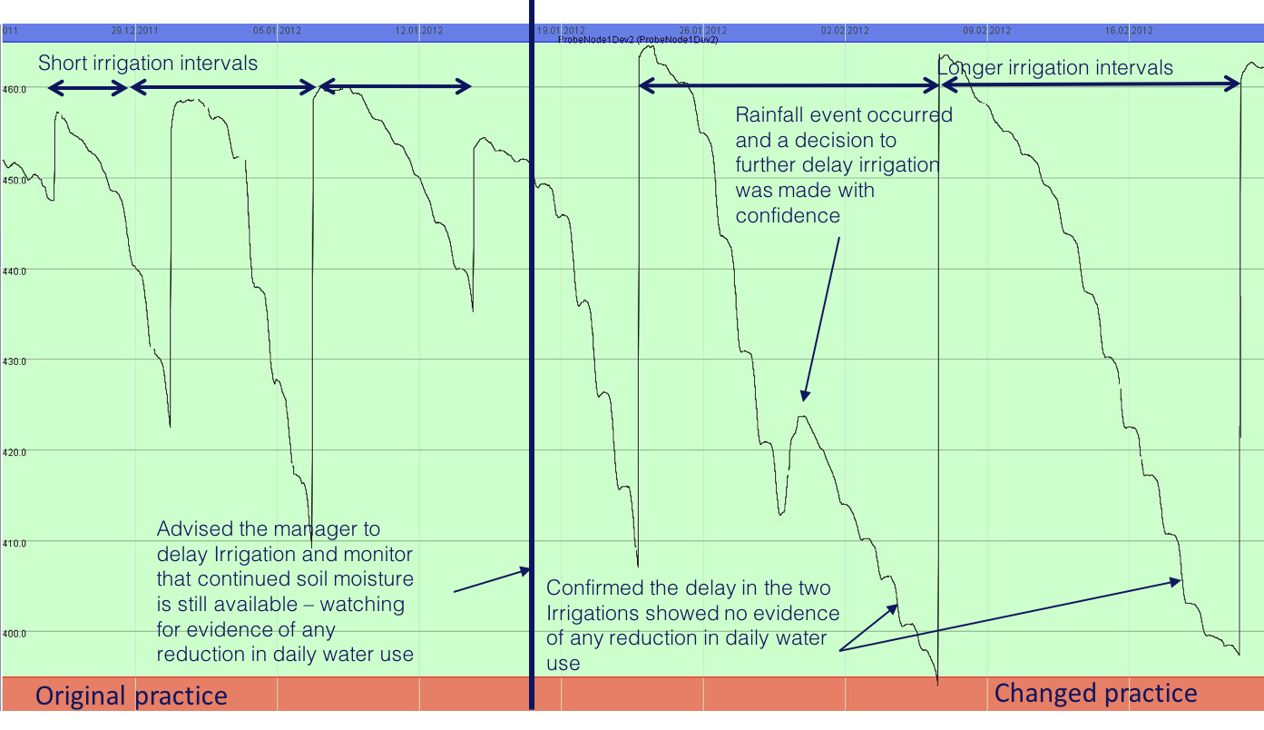
Overarching ARC project objective
Melbourne University and Rubicon Water are working together to develop an integrated irrigation scheduling, benchmarking and forecasting capability, to be delivered through Rubicon’s water ordering portal used by most Australian irrigation farmers and many internationally.
As part of the project, this study specifically focuses on irrigation scheduling i.e. when and how much irrigation water to apply – this is important to maximize crop health/production while minimize water waste.

Slide 3
This study aims to developed a probabilistic framework for evaluating irrigation decisions with incorporating weather forecast uncertainty
Key research question: How does the uncertainty in rain forecast translate to risk management outcomes?
Approach: A model-based (APSIM) study to simulate crop root-zone soil water content for a maize field in SE Australia, combining: 1) ensemble short-term rainfall forecast; 2) alternative decisions of irrigation timing. This modelling produced an ensemble simulation of soil water content to determine risk of over- and under-irrigation.
Driving APSIM soil water simulation with 100 ensemble numeric weather forecasts of a 9-day window.
With the ensemble forecasts, run APSIM with scenarios to irrigate on individual days within the 9-day window.
Gather simulated APSIM soil water for each irrigation scenario and summarize: 1) water wasting risk (Drainage + Runoff > 0); 2) stress risk (SW < critical stress level), across all ensemble forecasts.
9-day forecasting window
Drained Upper Limit
Critical deficit – assuming -40kpa
Day 0
(start of window)
Day 9
(end of window)
Notes:
A simple framework for incorporating forecast uncertainty into irrigation scheduling decisions
Deficit + day e.g. 1mm for 1 day = 0.5mm for 2 days;
What to compare with (existing practice? Showing improvements?) – can we improve decision making? Or we can assume no rain because events are rare.
this study does not intend to find the best decision rules (i.e. optimization) – which will be focus for the next study.

Slide 4
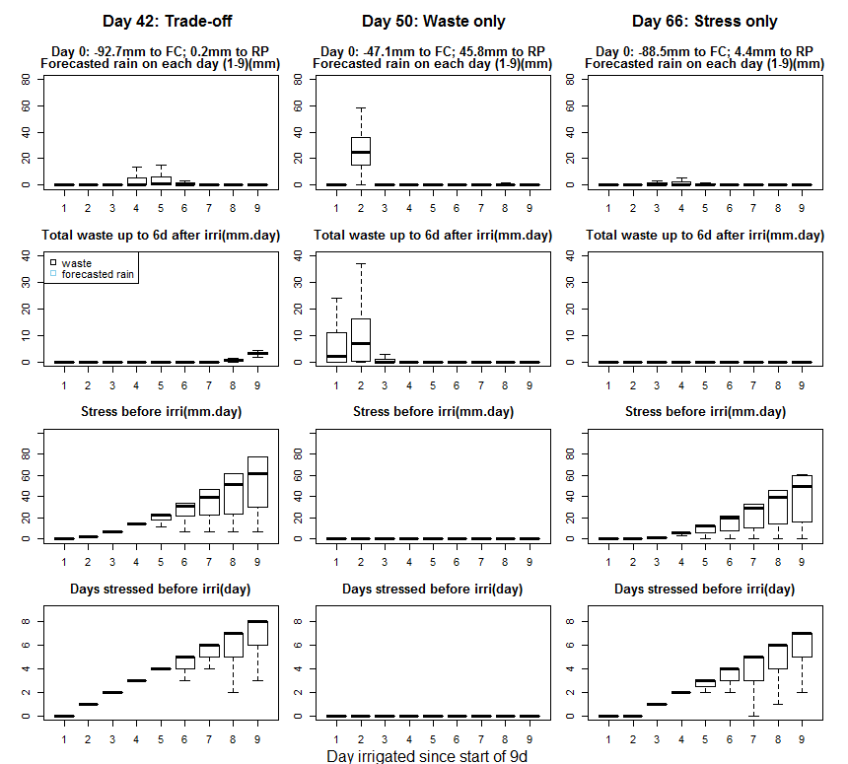
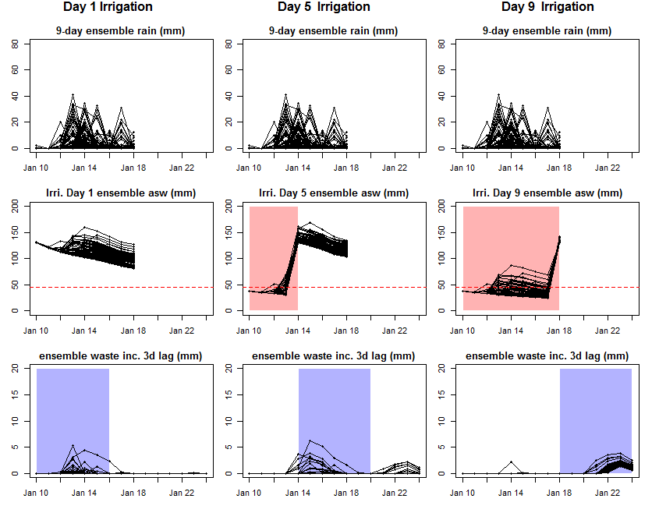
An example of estimating risks of stressing crop and wasting water with ensemble rain forecast
Using ensemble rain forecast (top row, mm) simulate:
Available soil water (ASW, middle row, mm)
Waste (drainage + runoff, bottom row, mm)
Example below is shown for a single 9-day window with three irrigation scenarios: on Day 1, Day 5 and Day 9 within the 9-day window.
The ensemble simulations enabled us to estimate:
% risk of stressing crop (ASW <critical stress level)
% risk for wasting water (waste >0mm).
All boxplots are shown with no outliers (whiskers to 1.5 * IQR only)

Slide 5
Results (short-term): 3 typical patterns of stress-waste risk tradeoff
Day in season | 42 | 46 | 59
Waste risk | Only if irrigated on Days 8-9 | Only if irrigated on Days 1-4 | No risk of waste at all
Stress risk | Keep rising since Day 1 if not irrigated | No risk of stress at all | Keep rising since Day 3 if not irrigated
Optimal decision | Irrigate on Day 1 to minimize stress risk while avoiding waste | No irrigation for entire 9d period to avoid waste | Irrigate on Days 1 or 2 to avoid stress
Any tradeoff | Tradeoff – having both stress and waste risks | No – waste risk dominated, no stress | No – stress risk dominated, no waste
Management implication:
This short-term summary can help farmer to identify the dominant risk/risk trade-off to inform the best short-term irrigation decision
All boxplots are shown with no outliers (whiskers to 1.5 * IQR only)

Slide 6
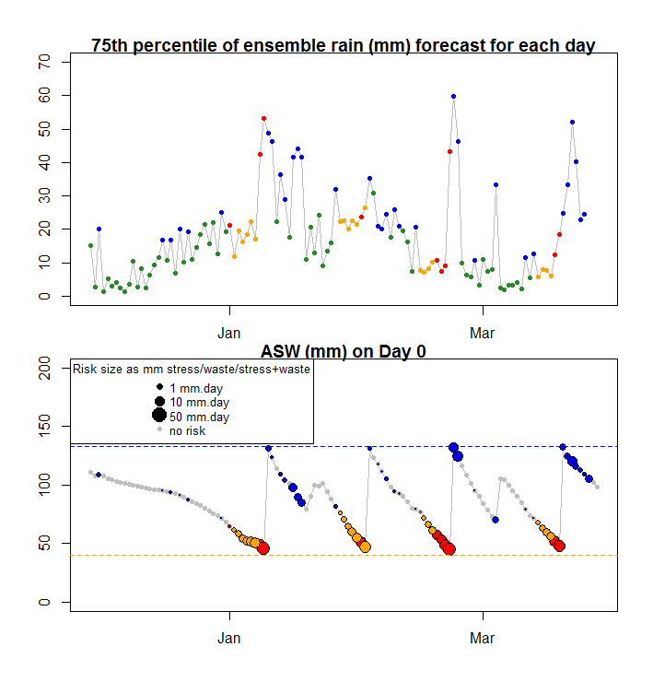
Results (full-season): The dominant risk changes over a full cropping season, with forecasted rain and initial soil water status
Risk feature | % of all 9-day periods
No risk | 46.2
Tradeoff (both risks) | 8.4
Stress risk only | 16.8
Waste risk only | 28.6
Management implication:
This full-season summary can inform farmers on the critical period(s) that risks need to be carefully investigated

Slide 7
Limitations and future works
Assumptions in this study:
Initial state of plant is not stressed before the 9-day window (implemented with APSIM deficit-based auto-irrigation)
Irrigation amount is known accurately (implemented with ‘irrigate to DUL’ function in APSIM)
Only uncertainties in rain forecasts are of interest (i.e. ET is assumed to be perfectly forecasted)
Stress (waste) only occurs before (after) irrigation. An extra 6-day window is included to include the lagged responses of drainage in APSIM.
Future works:
Incorporate other sources of uncertainty to develop a full uncertainty framework, to enable optimization of irrigation decision rules. These include:
Uncertainty in weather observations;
Uncertainty in soil water levels – from both modelling and observations.
Uncertainties in ET forecasts (temp, RH, wind, solar) – important as it affects soil water depletion rates;
Uncertainty in irrigation depth (assuming knowing the perfect depth and filling to FC every time)
Acknowledgement:
University of Melbourne: Qichun Yang, Yating Tang (ensemble weather forecast) Zitian Gao, Arash Parehkar (data acquisition and processing), Shirui Hao (APSIM model assistance);
Rubicon Water: Kevin Saillard, Kevin Clurey, Brett Williamson, Jackson Wilson (farmer outreach and data supply)

