Slide 1
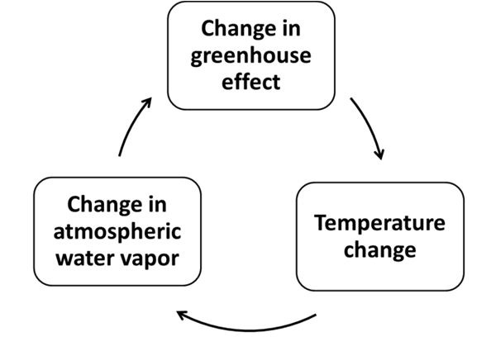
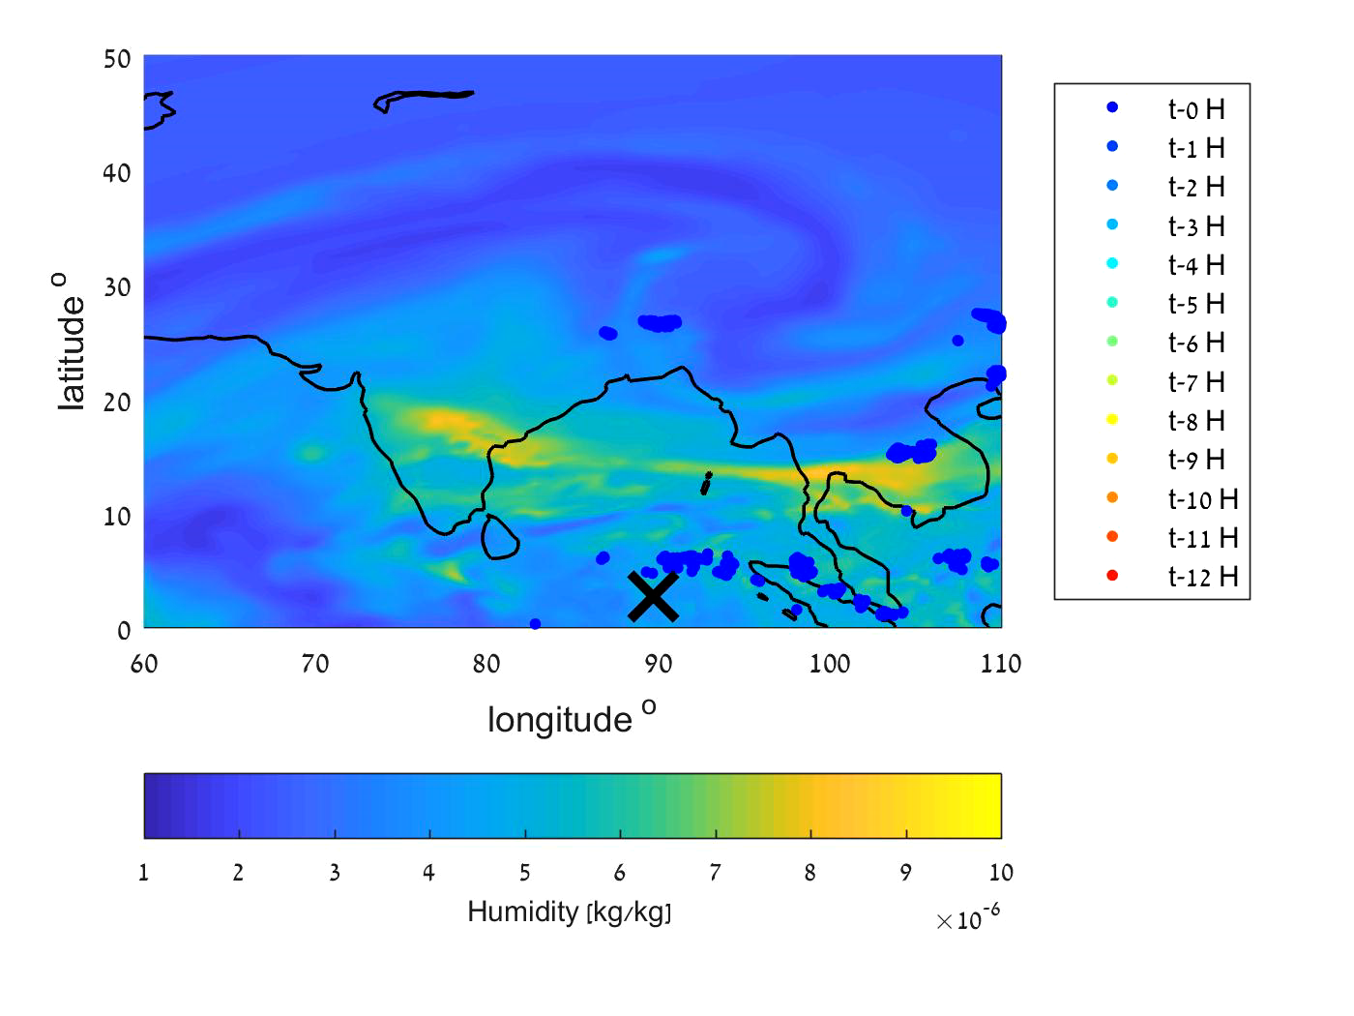
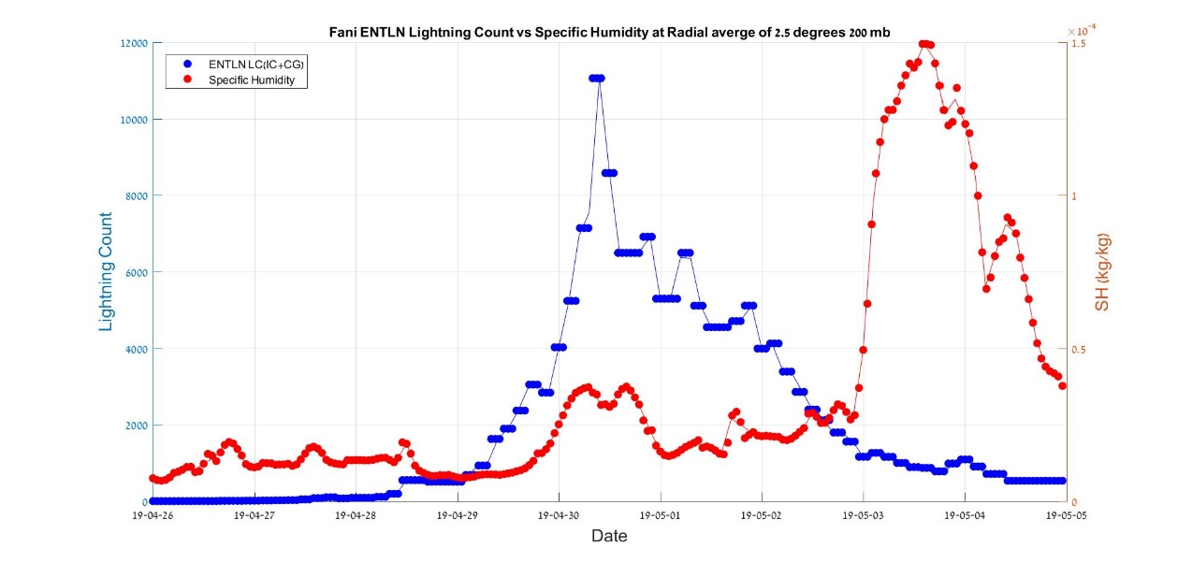
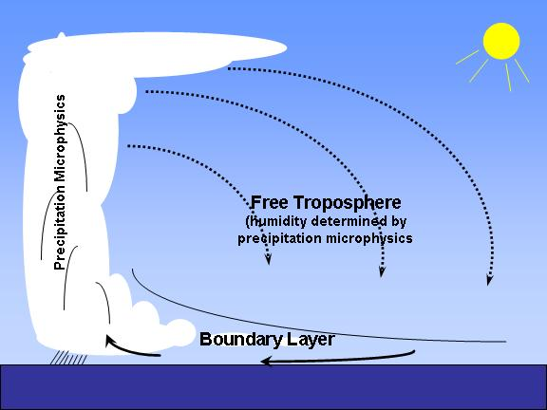
Tropical cyclone eyewall thunderstorms as a driver of upper tropospheric water vapor increases
Colin Price¹, Tair Plotnik¹, Anirban Guha² and Joydeb Saha²
¹Tel Aviv University, Geophysics and Planetary Science, Tel Aviv, Israel (cprice@flash.tau.ac.il)
²Tripura University, Physics Department, India
Tropical Cyclone Fani
April 2019

