Slide 1
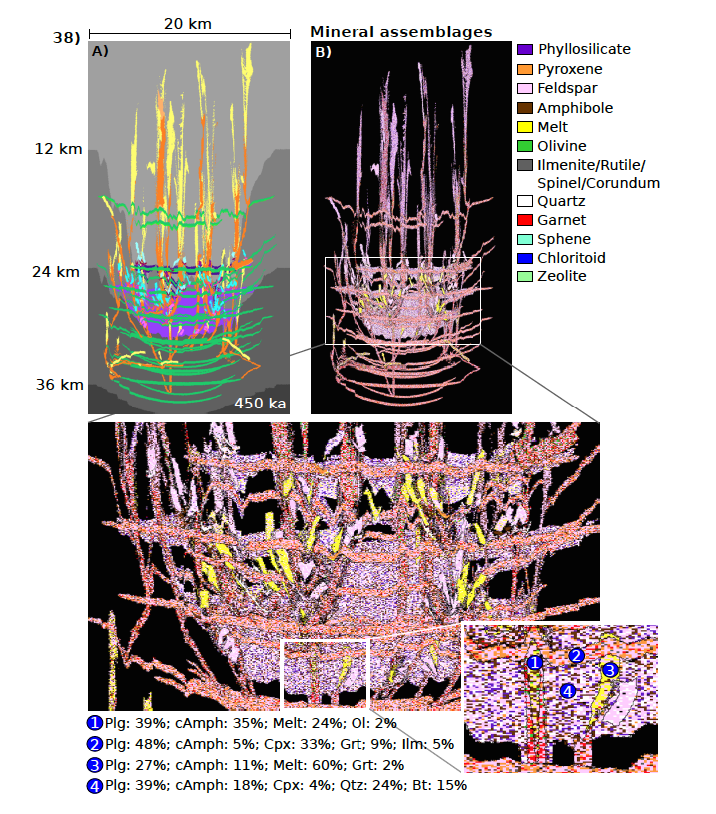
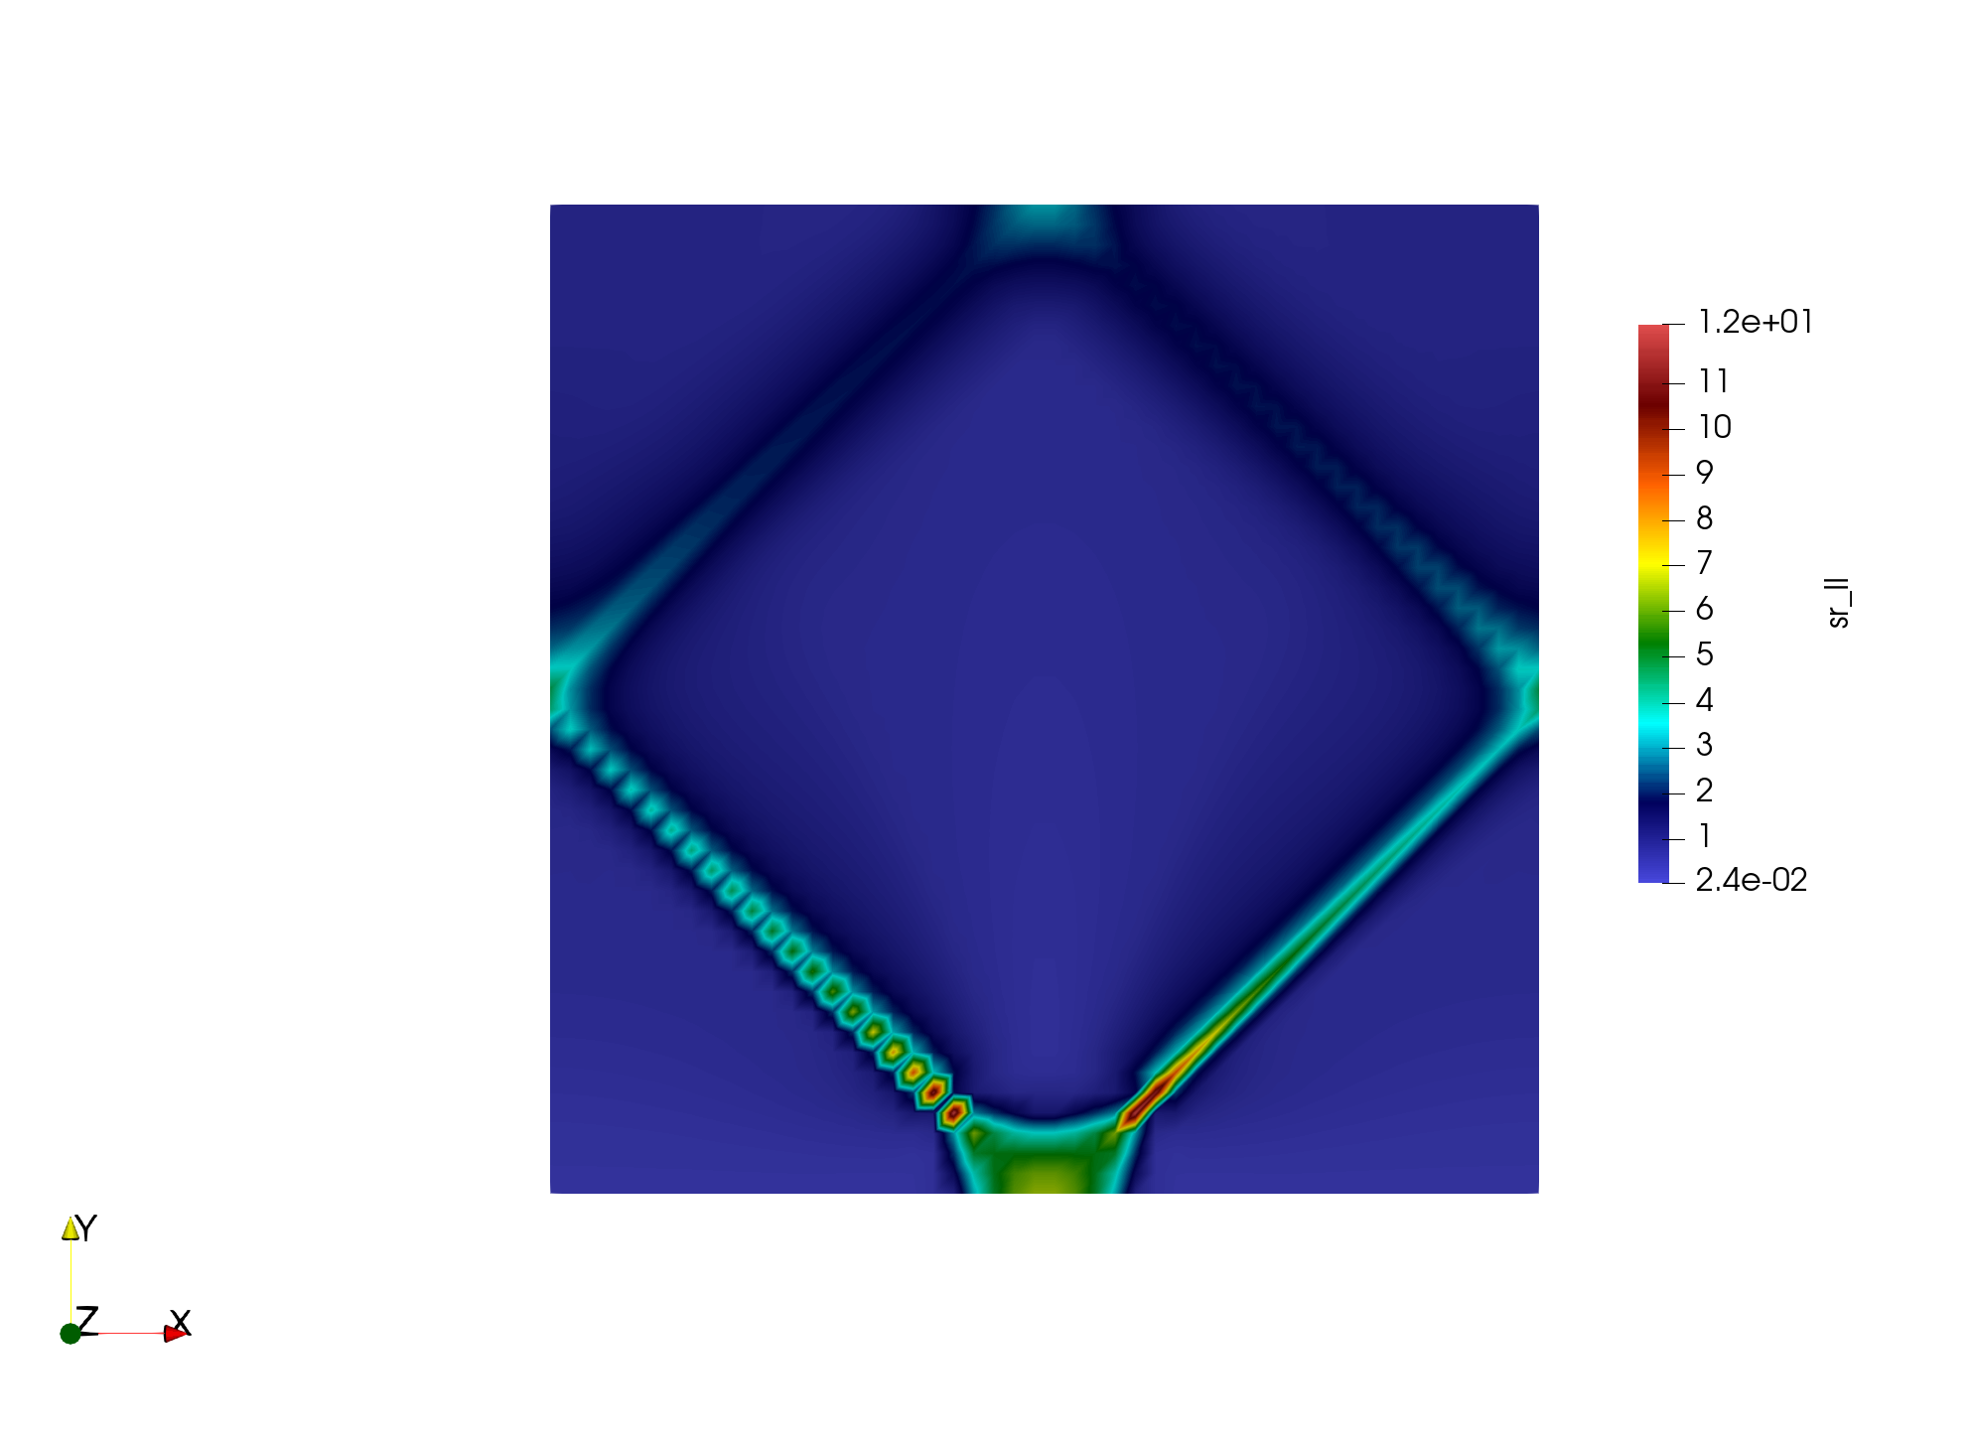

Towards modelling magmatic systems using a staggered grid finite difference method
Nicolas Berlie, Boris Kaus, Anton Popov, Mara Arts, Nicolas Riel, Daniel Kiss
Stable and efficient code to model magmatic system
Viscous, elastic and plastic rheologies
Mode 1 and mode 2 plasticity
PETSc solvers and analytical stiffness matrices (Picard and Jacobian)
Ongoing developments: 2-phase flow and direct coupling with thermodynamic code MAGEMin
Rummel et al. (2020), J. Petrology
Rummel et al. (in press). Geophysical Journal International
Strain rate
nberlie@uni-mainz.de

Slide 2

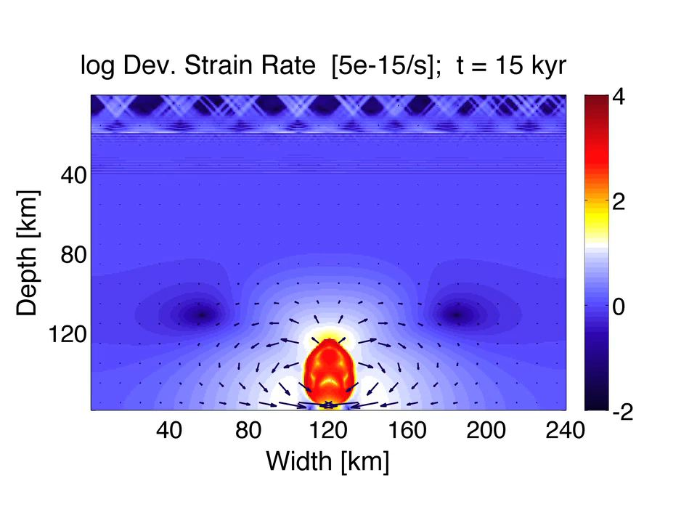
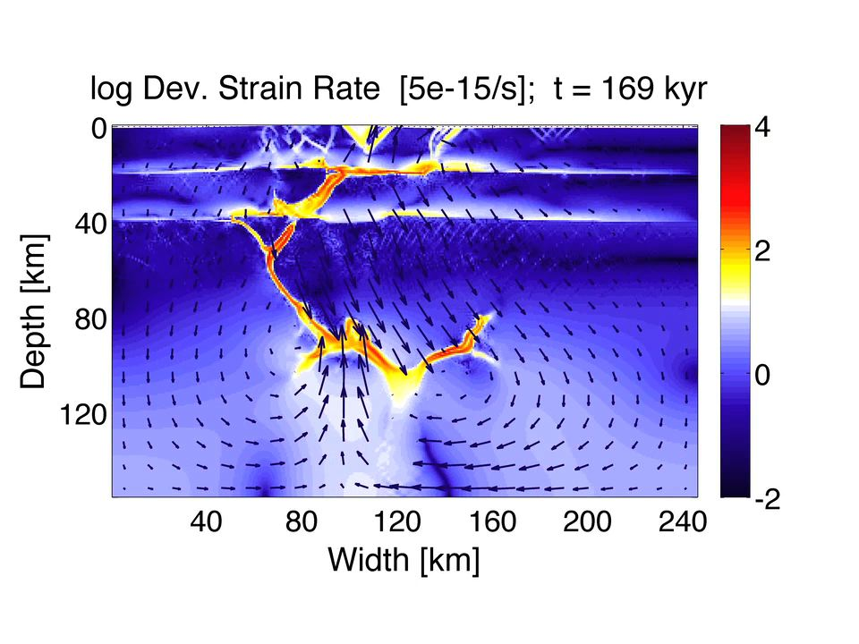
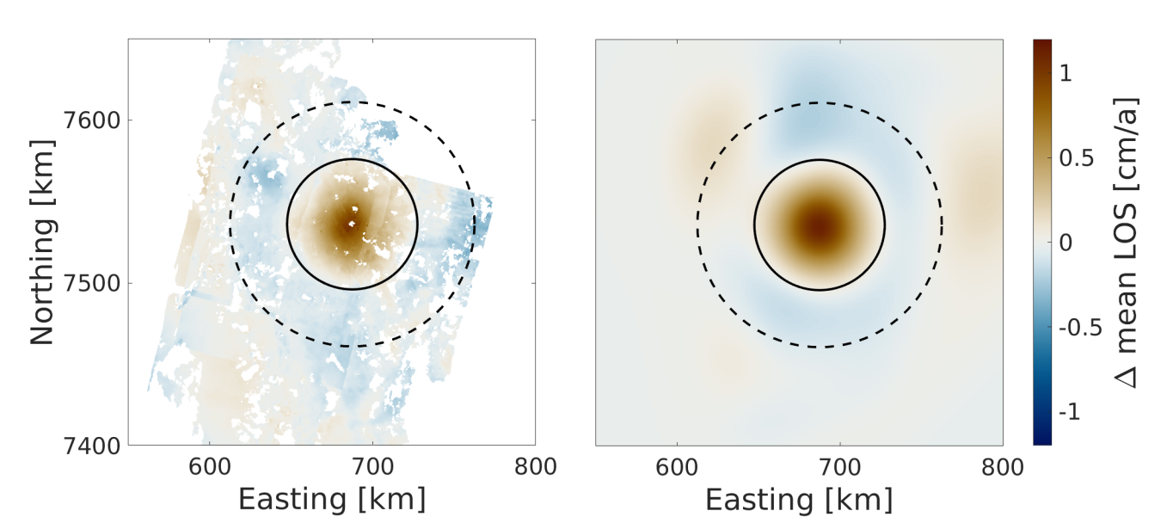
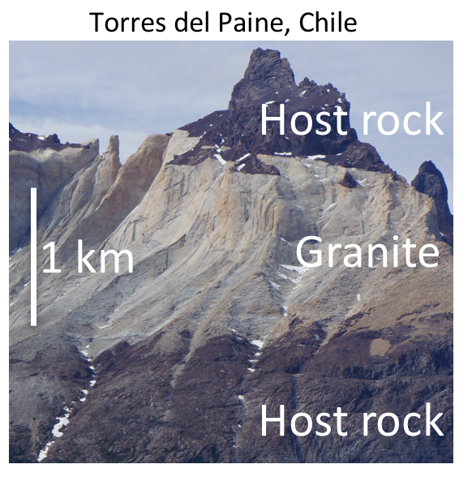
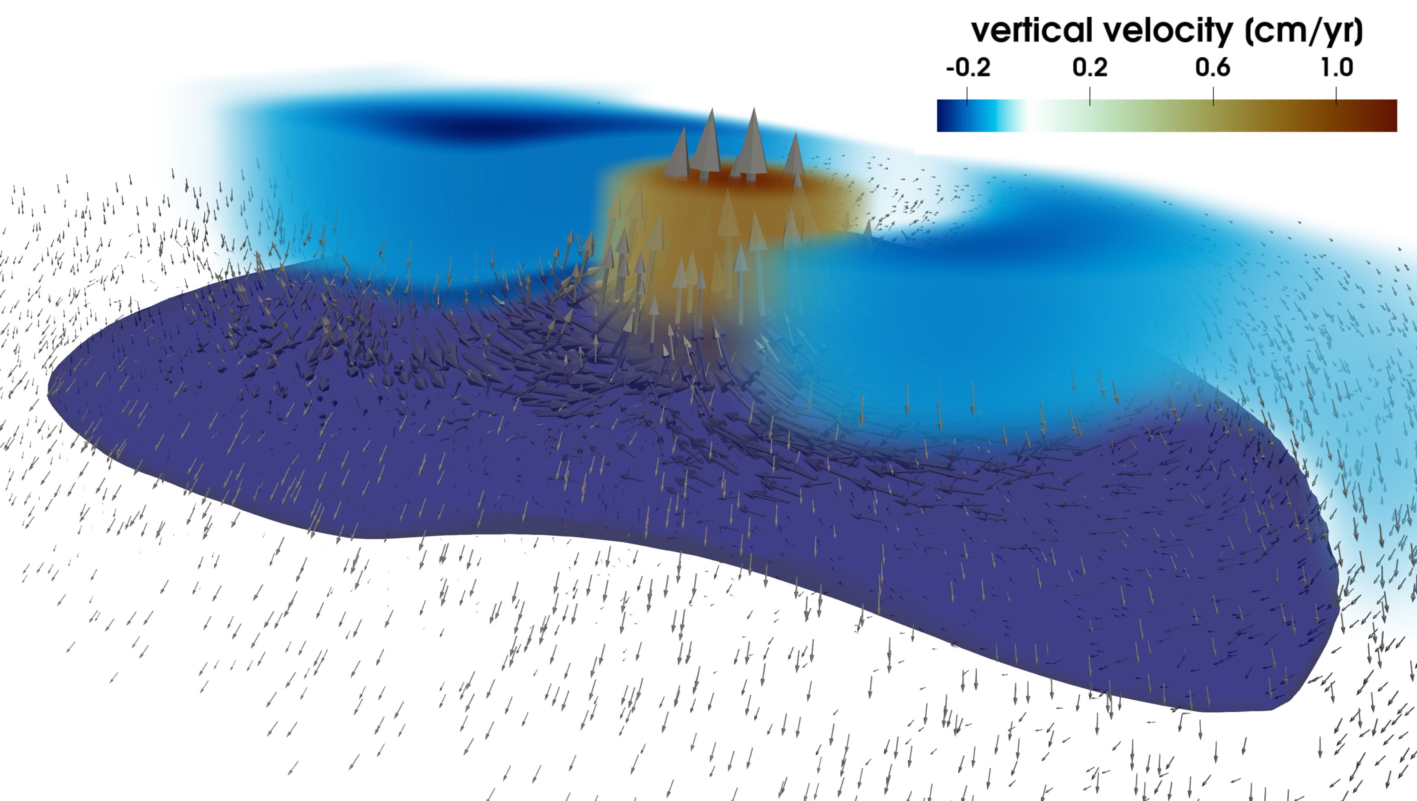
The MAGMA project
Computational framework to simulate magma ascent & evolving chemistry
INSAR data
Reference Model
Keller, May & Kaus, GJI (2013)
MAGMA
3D Velocity Field
Spang et al. (in prep.)
https://bitbucket.org/bkaus/lamem/
3D Mechanically-consistent interpretations
of active magmatic systems
Dynamics of magmatic systems
on geological timescales

Slide 3
Computational challenges
Thermo-Mechanics:
  2-phase flow
  Visco-elasto-plastic bulk and shear rheologies
  Mode 1 and mode 2 plasticity
  Efficient non-linear convergence (requires Newton solvers)
  Stable pressure fields
  Advection schemes for melt and solid rocks
Thermodynamics:
  Fractional crystallization from hydrous mafic melt to granites
  Major differences in chemistry
  Ideally, coupled on the fly with the thermo-mechanical code
  Currently available codes too slow (e.g., Perple_X)
  Utilize the good initial guesses available when performing geodynamic simulations

Slide 4
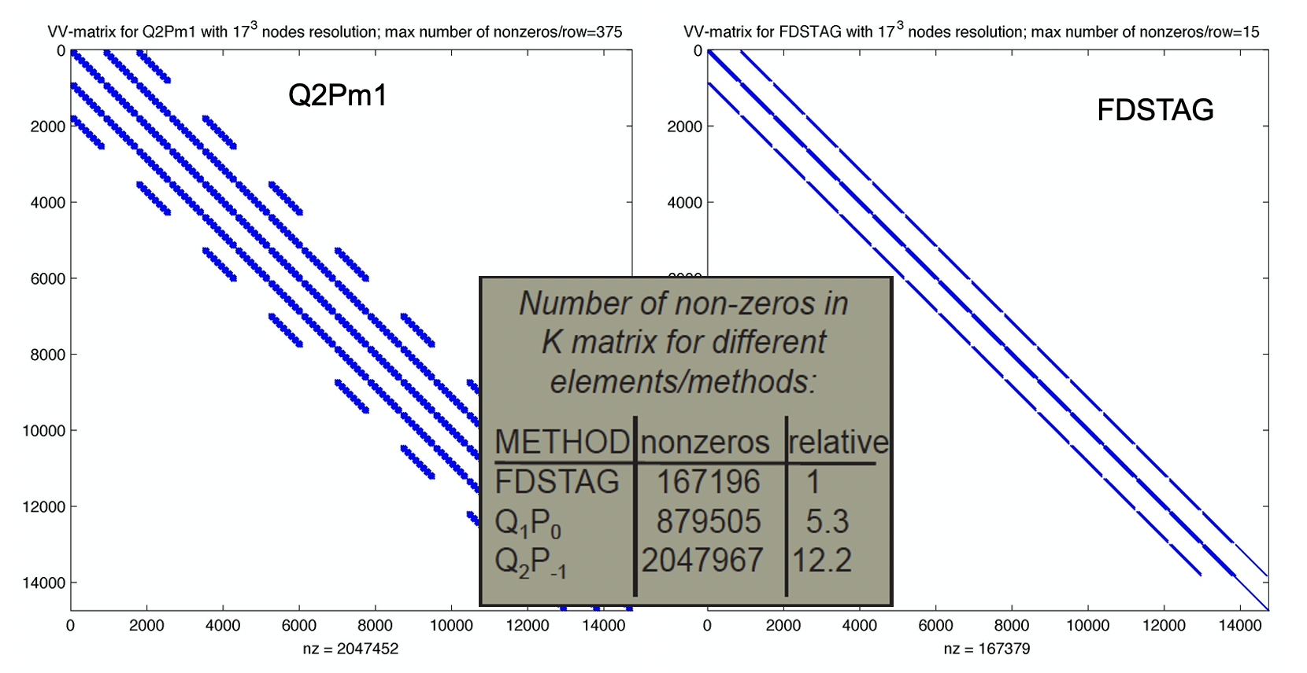
Why Staggered Finite Differences?
Stable pressure fields (no checker board pressures)
Low order discretization (very sparse matrix)
Works well for large jumps viscosities (melt and magma mush vs. solid host rock)
Efficient multigrid solver already exists for the pure visco-elasto-plastic Stokes equations
29/04/2021

Slide 5
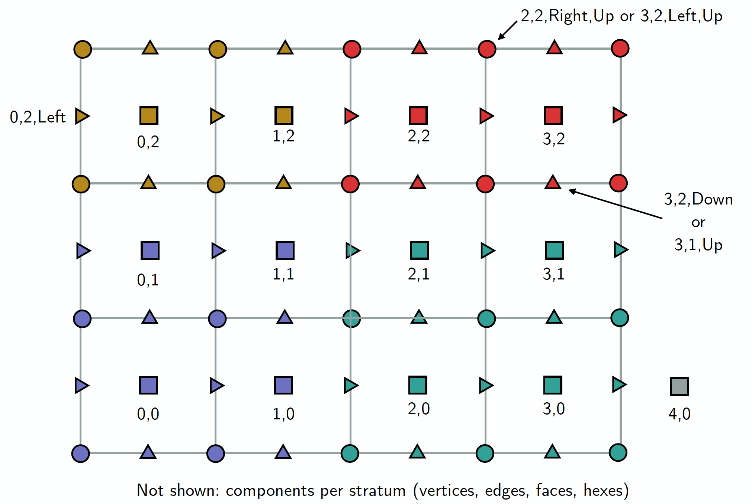
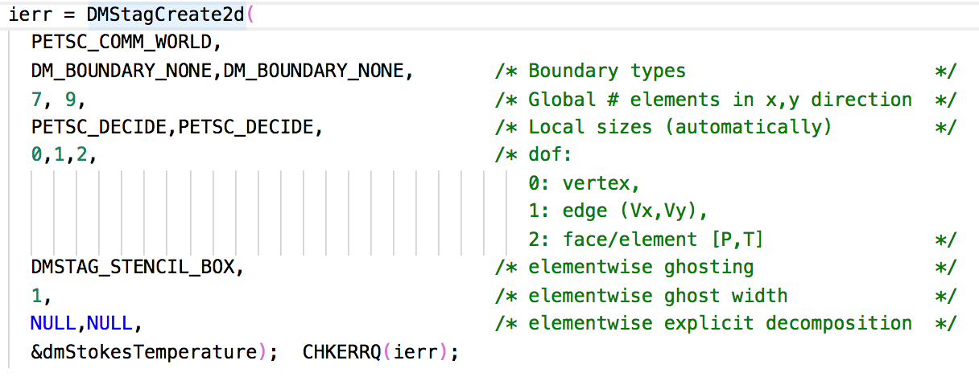
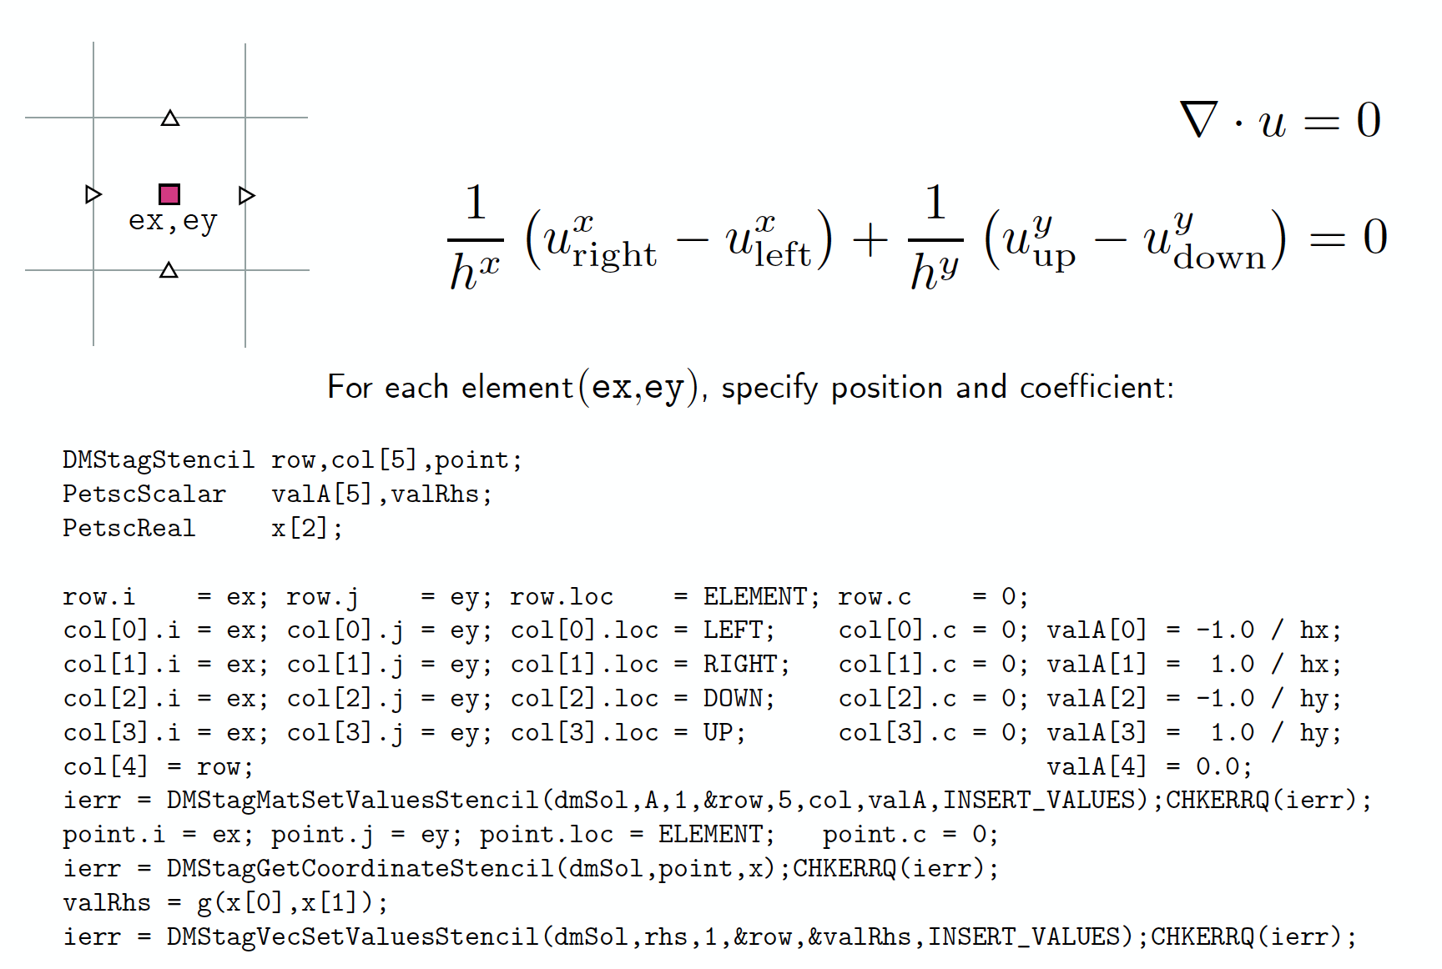
PETSc & DMSTAG
DMSTAG is a new feature in PETSc, that simplifies writing staggered finite difference codes.
Allow easy ways for user to add new fields and create new systems
  Go from 1-phase to a 2-phase code
Runs fully in parallel in PETSc
Access to a wide range of parallel direct and iterative solvers
Coupled with Marker-and-Cell method (DMSWARM)
Multigrid solvers compatible with DMSTAG being implemented
Create parallel grid:
element
edge
edge
vertex
Example for the continuity equation:

Slide 6
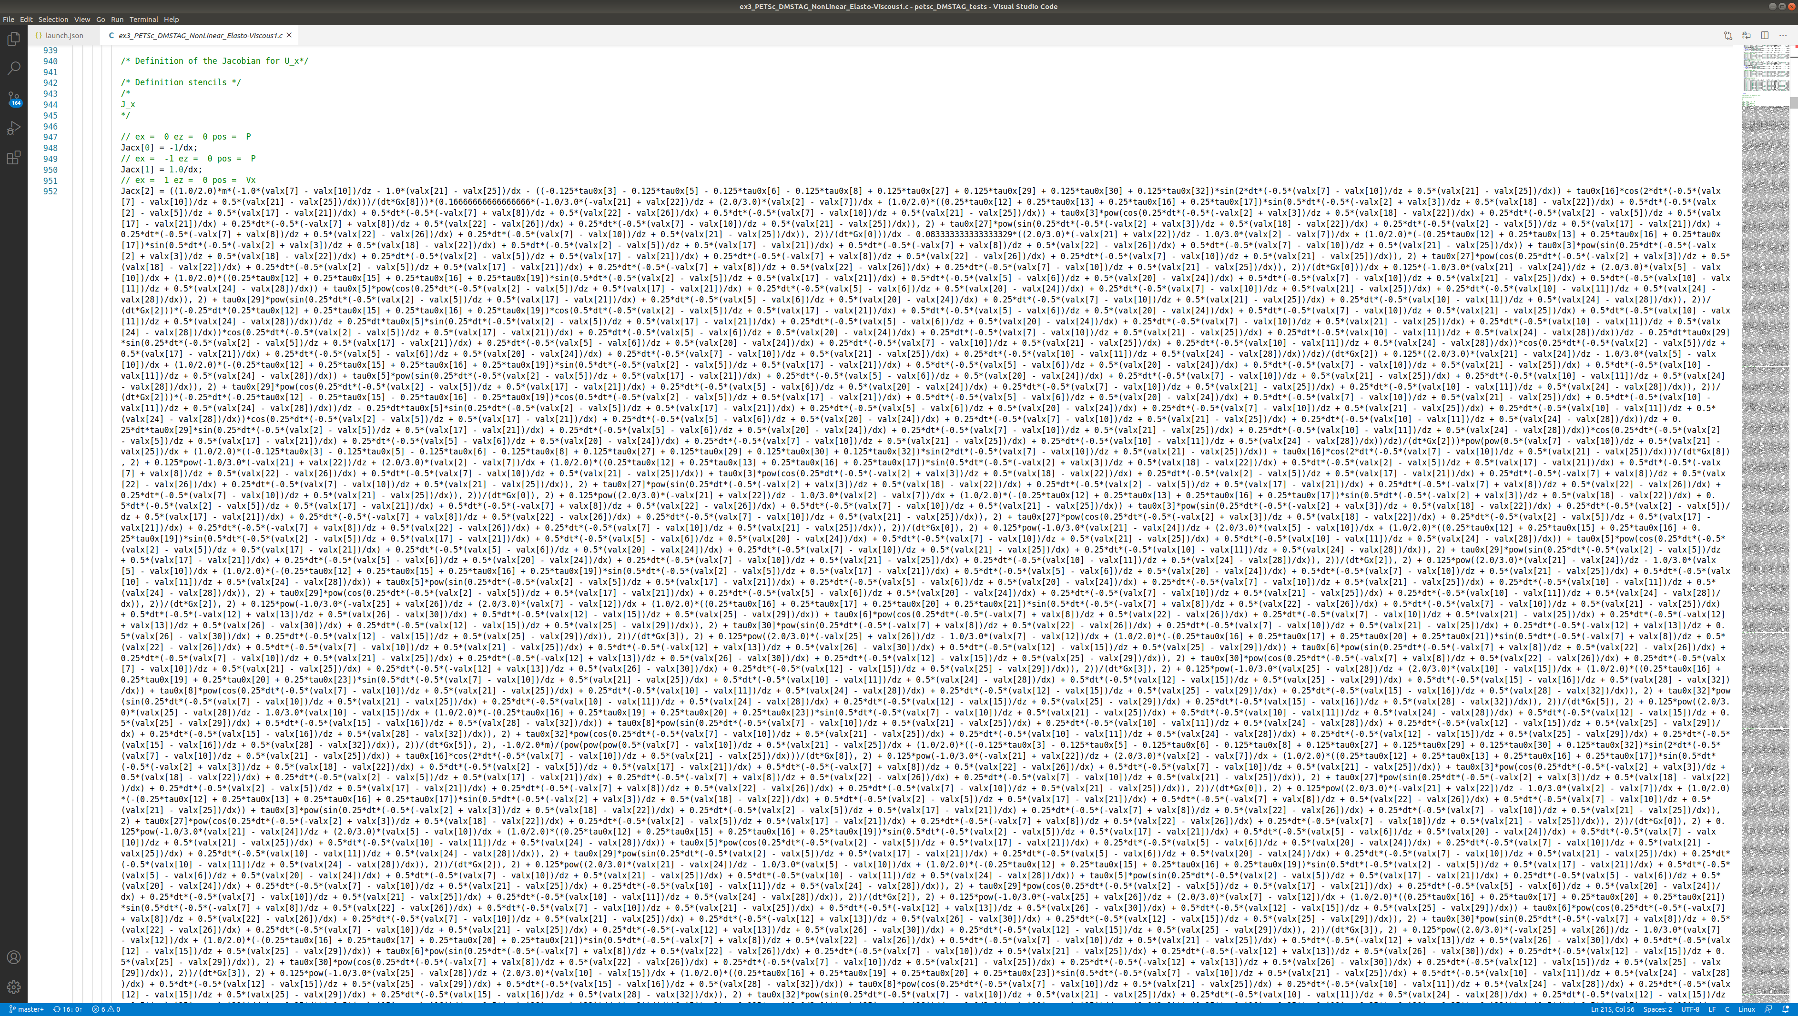
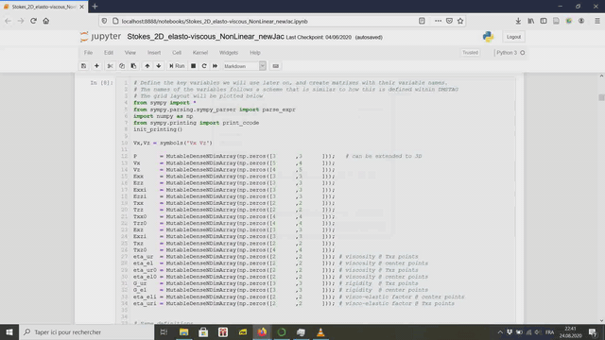
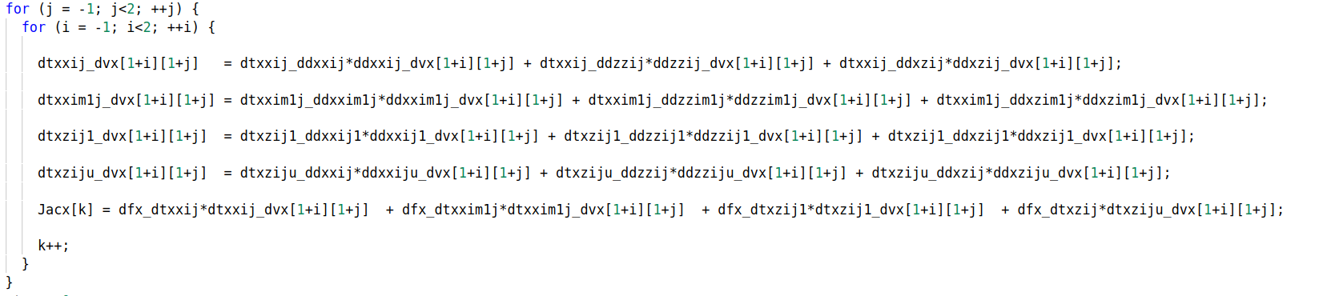

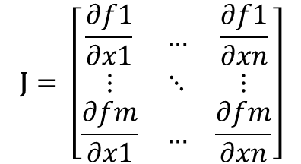
Nonlinearities require Newton solvers
- But how do we easily derive the Jacobian?
Use of symbolic programming software (sympy & jupyter notebooks)
Fraction the Jacobian using the chain rule in recurrent pieces
Solve any non-linearity issue
Ongoing trials on using automatic differenctiation tools (AD) on Julia
$$\frac{∂f(τ(\dot{ε}(x)))}{∂x}= \frac{∂f(τ(\dot{ε}(x)))}{∂τ(\dot{ε}(x))} \frac{∂τ(\dot{ε}(x))}{∂\dot{ε}(x)} \frac{∂\dot{ε}(x)}{∂x}$$
Way shorter expressions
No need to modify the whole code when changing the rheology
Easy to check with finite difference and isolate bugs
$$\text{J}= \left[\begin{matrix}\frac{∂f1}{∂x1} & … & \frac{∂f1}{∂xn} \\ ⋮ & ⋱ & ⋮ \\ \frac{∂fm}{∂x1} & … & \frac{∂fm}{∂xn}\end{matrix}\right]$$
Huge expressions
Difficult to handle
Slows down the software
Slows down the computation
Difficult/impossible to check

Slide 7
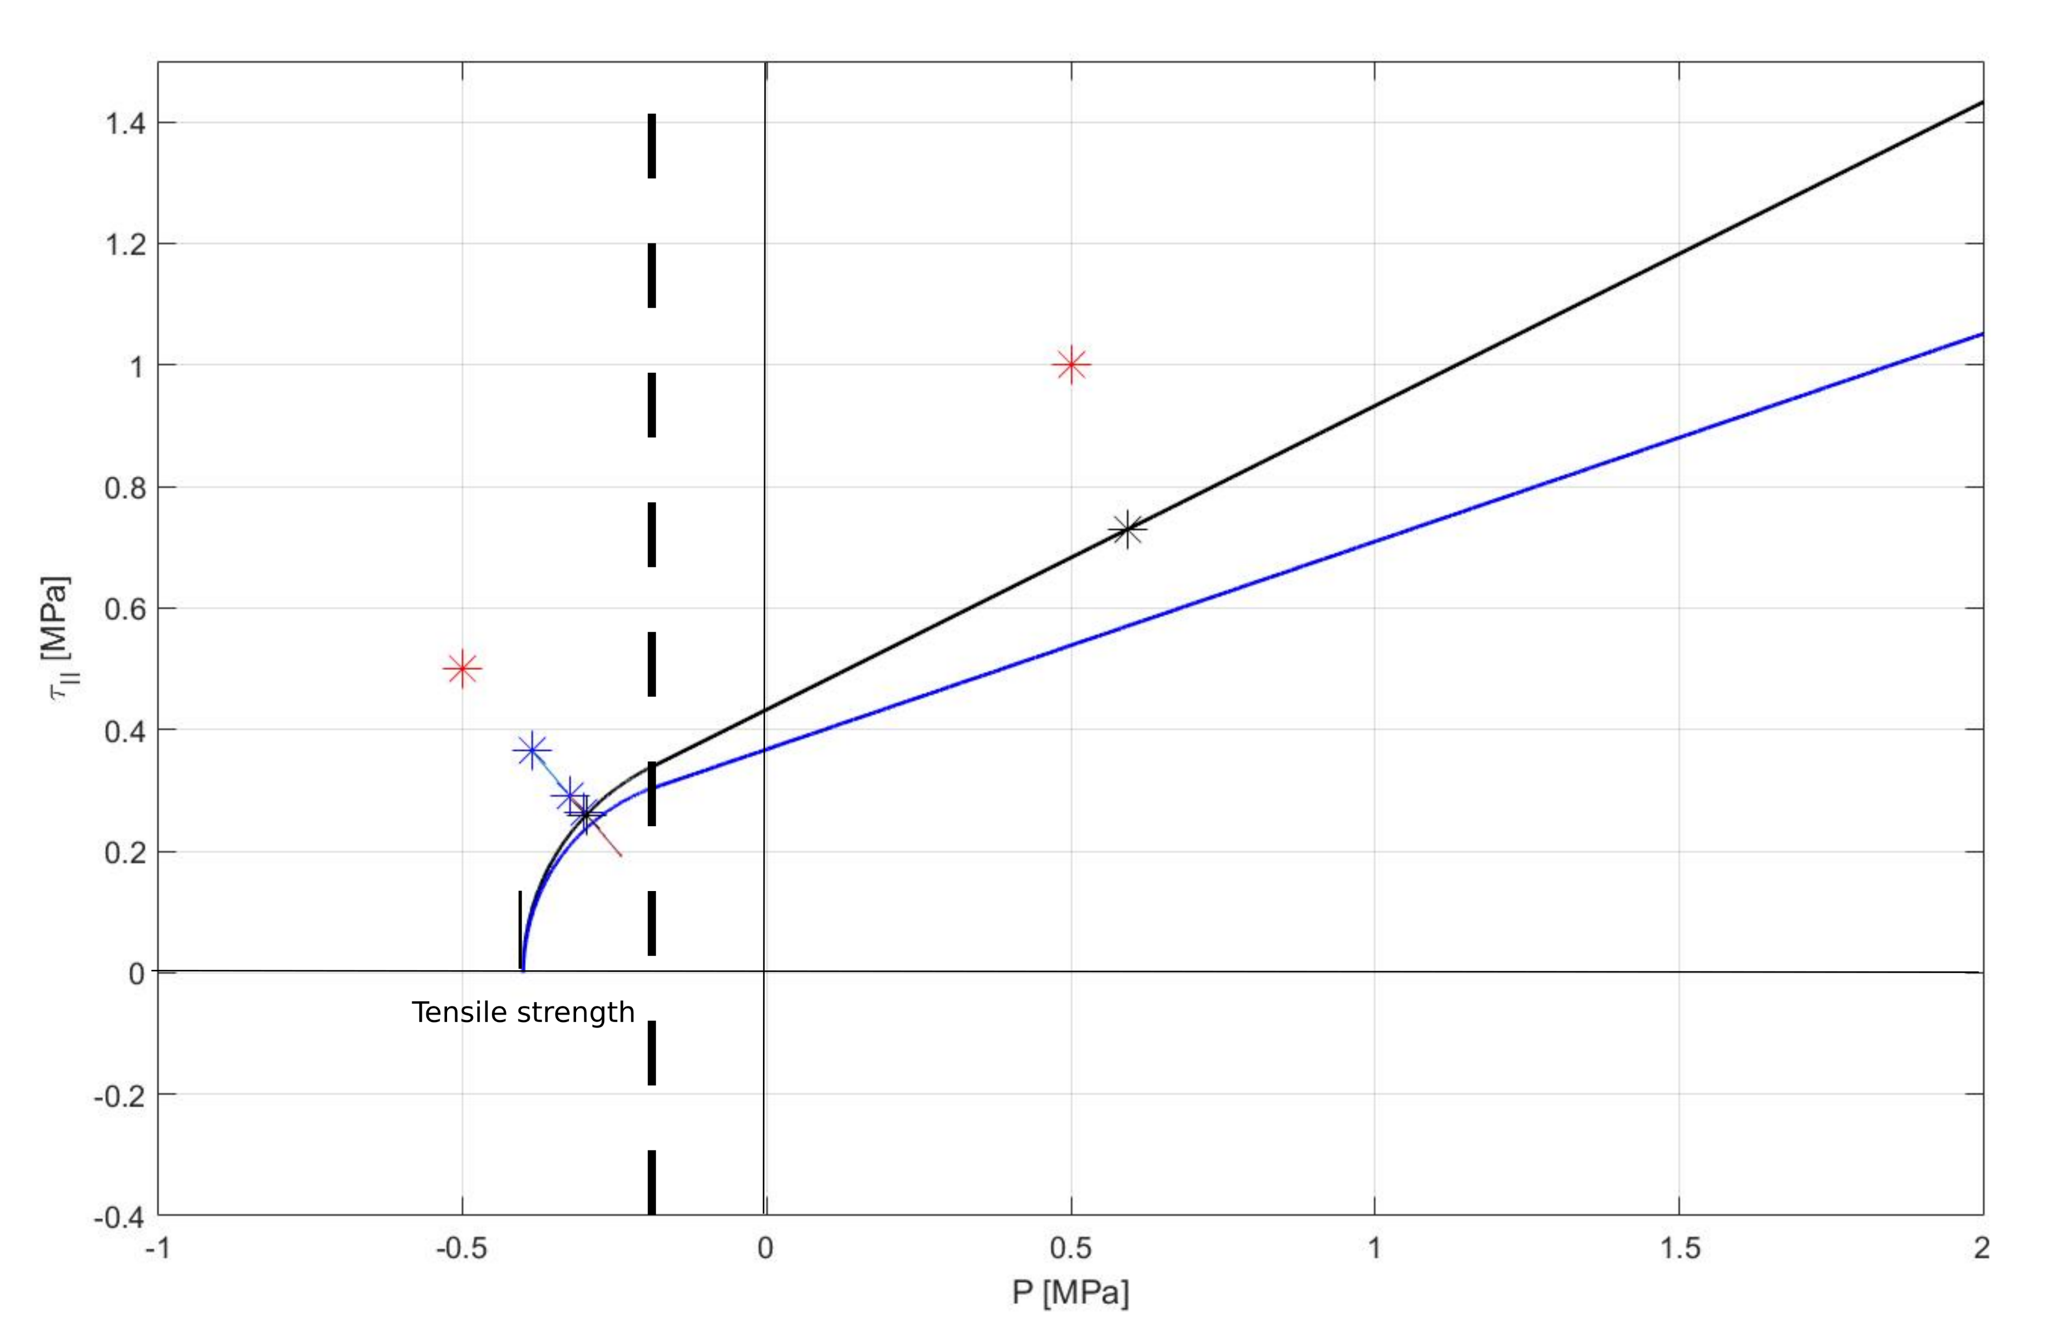
2 plasticity modes
2 plasticity modes for compressive and tensile constrains
Essential for dyke formations
Tension cap resolved iteratively
Shear and bulk plasticity components
Griffith Criterion
Drucker Prager

Slide 8
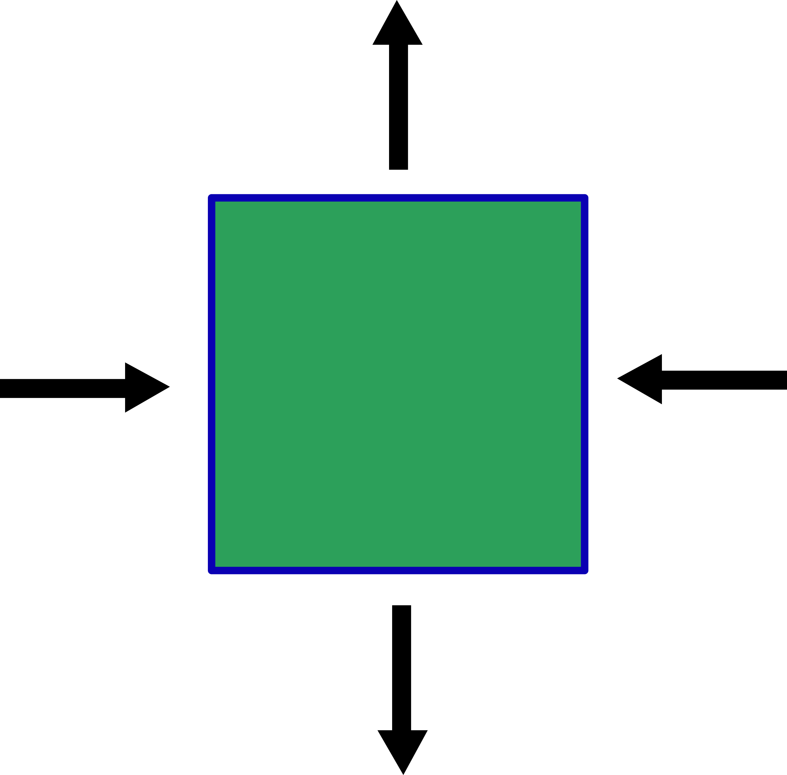
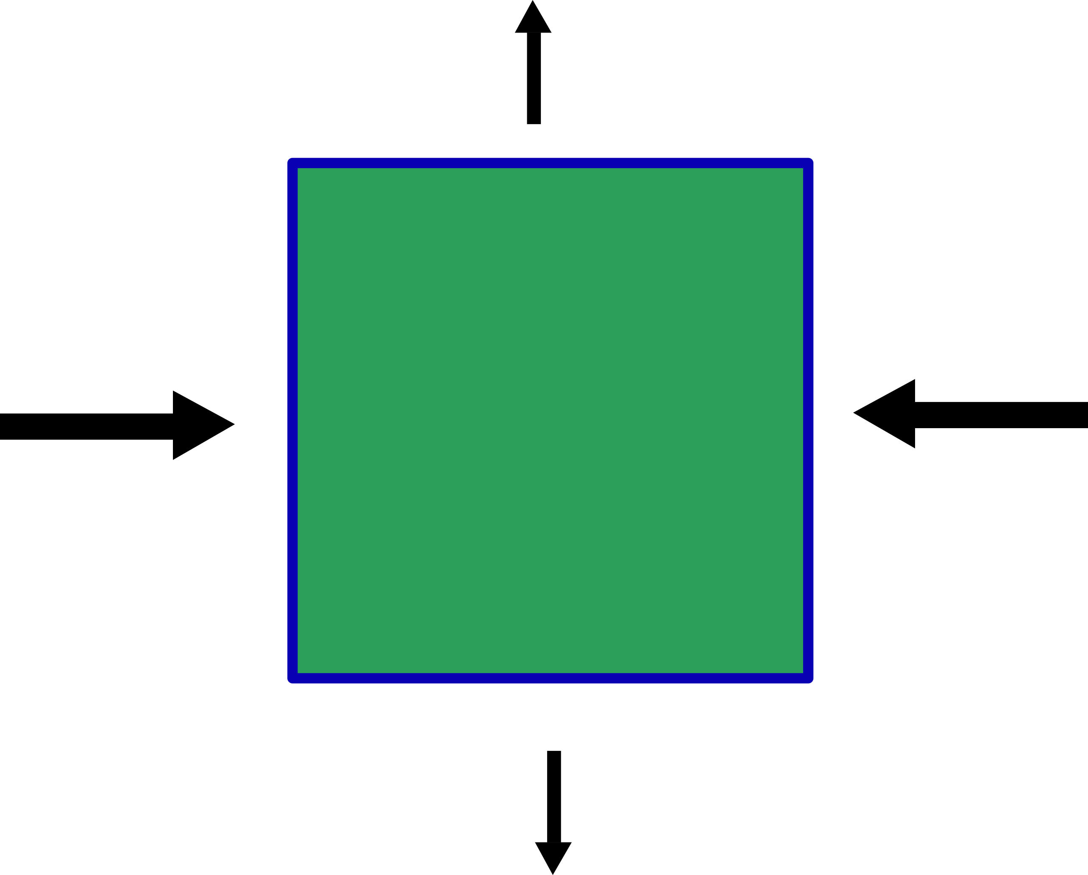
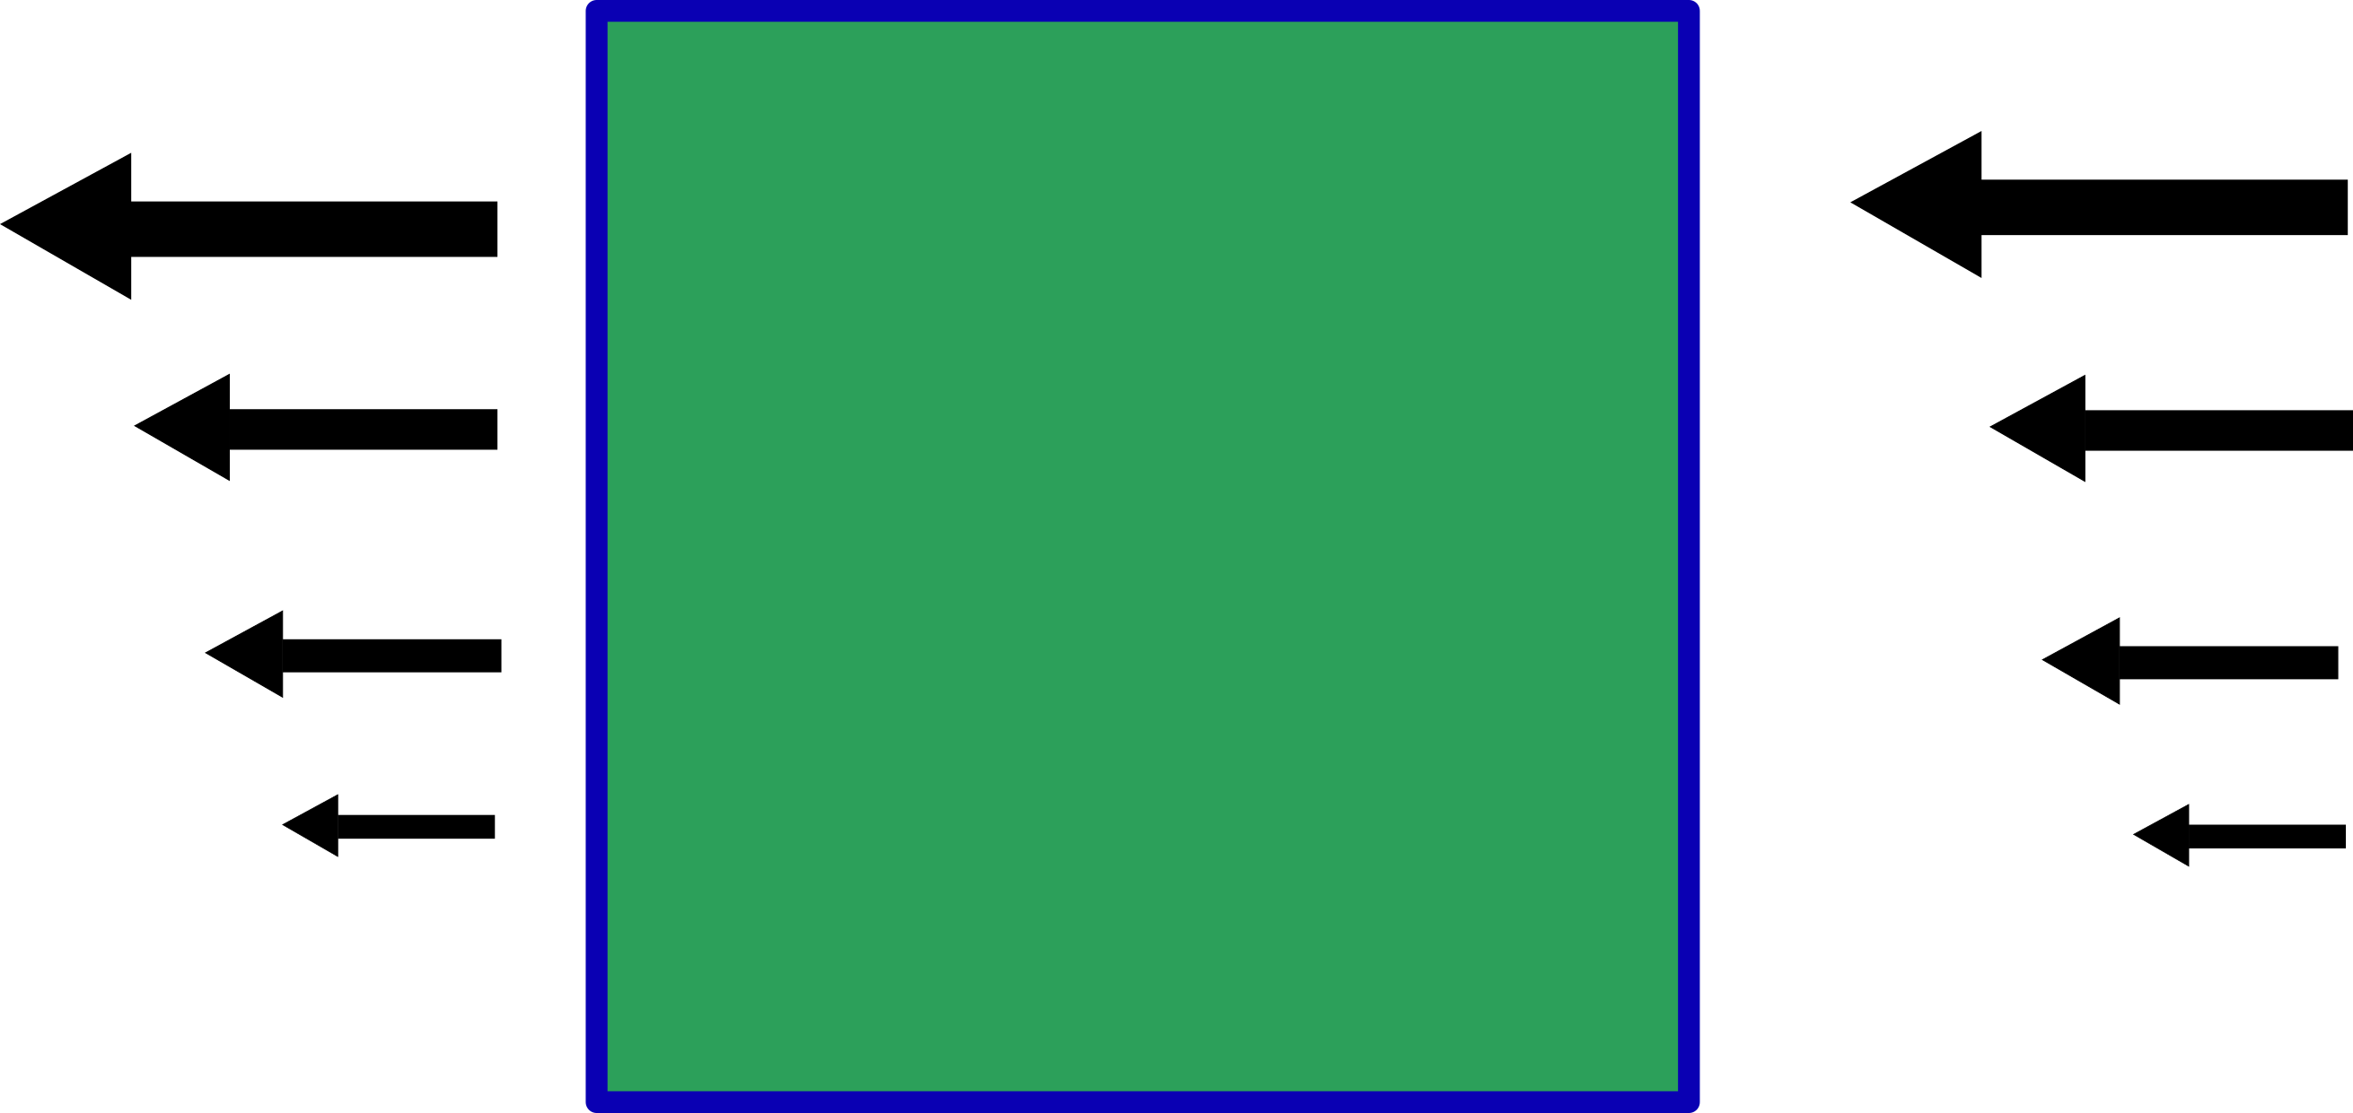
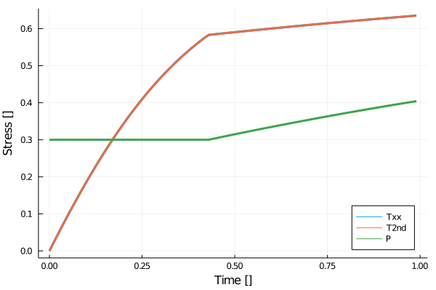
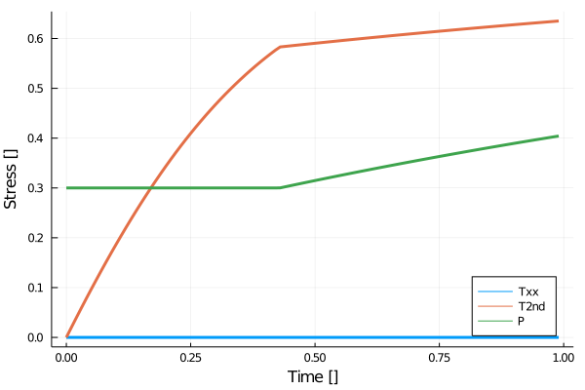
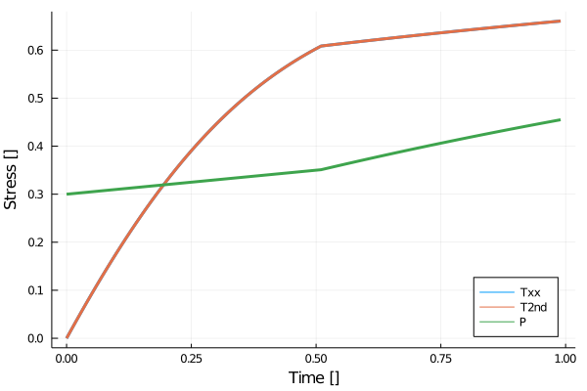
Compressible plasticity
0-D tests of the compressible rheology, prior to the 2-phase flow implementation
Pure shear case, constant pressure until breaking point
Simple shear case, similar behaviour
Compressible Pure shear case, visco-elastic increase of pressure before breaking point already
30/04/2021
8

Slide 9
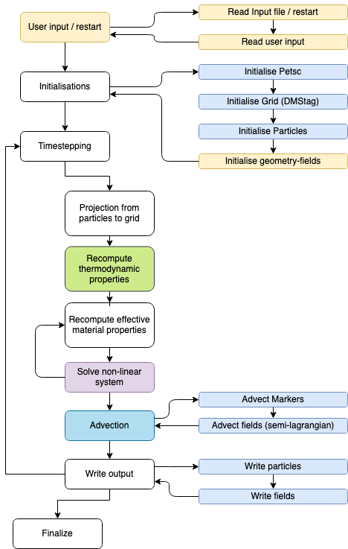
Going from a working solver to a fully functional production code
Having a working solver is only one part of a production code!
  Crucial as well: I/O, creating input geometries, nondimensionalisation, writing output, advection of properties, benchmarking, etc. etc.
  Developing this often takes (at least) the same amount of time than the solver
Some team members are working in this
Utilize the parsing structure and geometry definitions of LaMEM
  Well tested, very powerful
Create a good testing infrastructure
Code advection schemes adapted to a 2-phase code
Create good tutorial examples

Slide 10
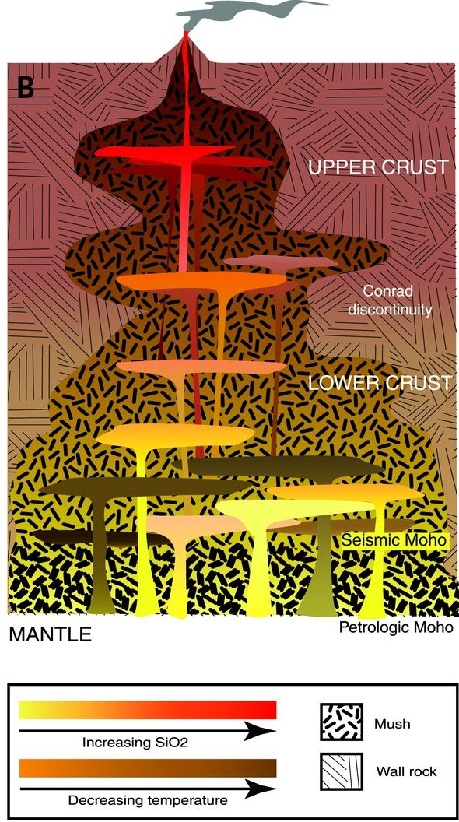
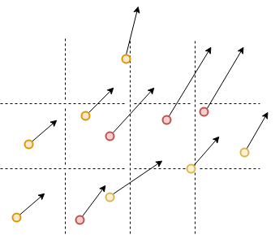
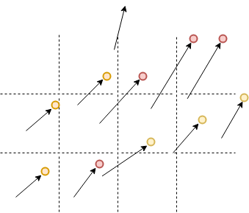
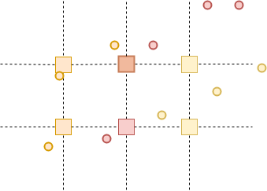

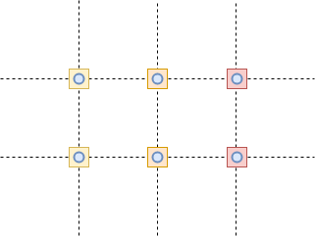
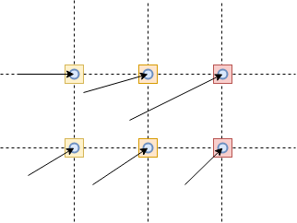
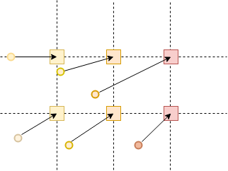
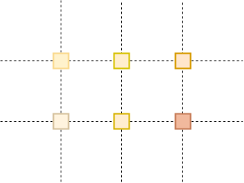
Need for two advection schemes
Using 2 methods allow to deal with huge differences in velocities (melt vs. solid rocks)
Semi-Lagrangian allows large timesteps; no need to inject new markers
Initial State
Particle displacement
Data interpolation
Marker-and-Cell
Semi-Lagrangian
Initial State
Backwards particle tracing
Data acquisition
Data interpolation
Cashman et al. (2017), Science

Slide 11
How to efficiently couple thermo-mechanics and thermodynamics
Overall approaches:
  Parametrize melting models
    Easy to implement and fast to compute
    More difficult for magmatic petrologists to directly link model data with their field observations
  Pre-compute phase diagrams to use as lookup tables
    Used in most geodynamical codes
    Requires a large amount of precomputed diagrams if chemistry changes (melting/crystal)
  Compute the thermodynamics on the fly
    Allows the system to evolve in previously unexplored thermodynamic regions without needing any planning
    Existing approaches such as Perple_X, pMELTS too slow and/or numerically unstable (‘hangs’ at some points)
Not suitable for this project
Rummel et al. (2020), J. Petrology
Rummel et al. (in press). Geophysical Journal International

Slide 12
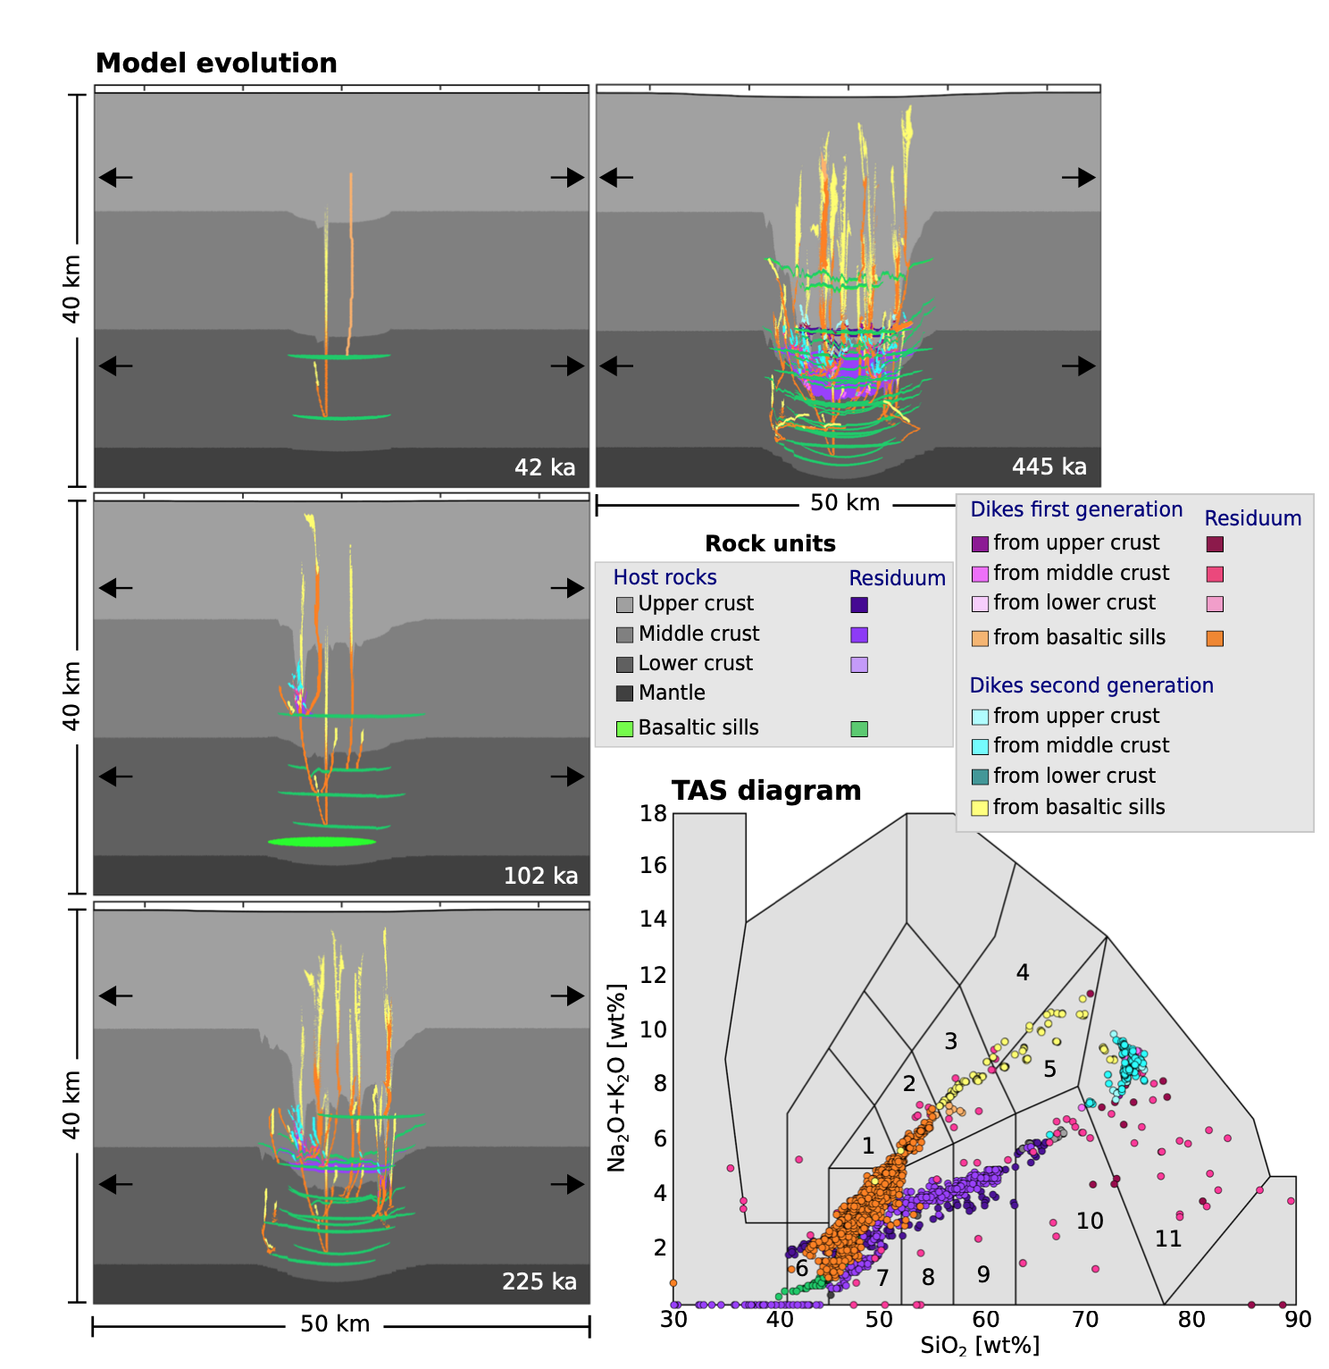
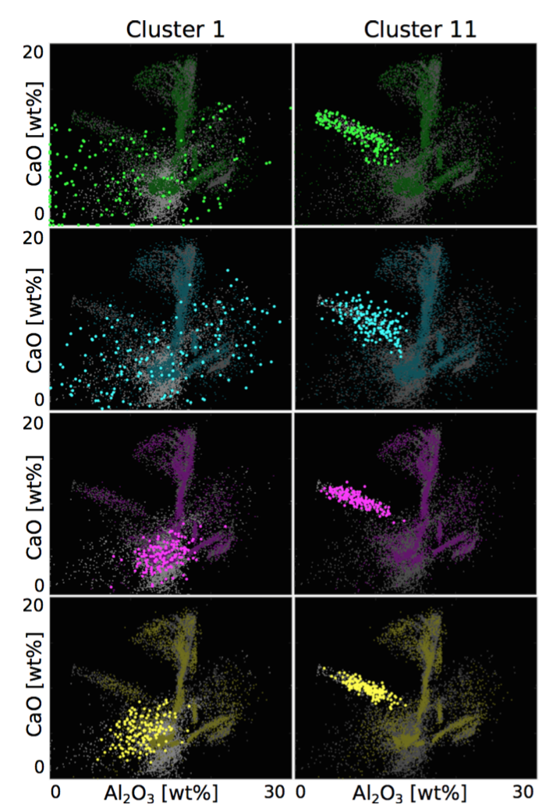
#2: Pre-compute diagrams as a lookup tables
  Precomputed >50’000 phase diagrams in parallel
    by running Perple_X on MPI-parallel machines
  Record which chemical compositions are “required” during an ongoing simulation
    Build up a database with thermodynamic lookup tables by repeating the simulation many times
  Combine this with cluster-analysis to ”best-guess” which diagrams will be required during later simulations
    Significantly reduces the # of times we need to repeat the geodynamic simulation to build up the database.
    Can be better parallelized
Typical model evolution
Phase diagrams with new bulk compositions added to the system, based on clustering algorithms
Rummel et al. (in press). Geophysical Journal International

Slide 13
#3: New thermodynamic computational core
Problem equivalent to any constrained optimization problem
Methods currently used and developed 30 years ago all present some limitations
  Particularly when solution models are employed that have many compositional variables
We are working on a new Gibbs minimization code (C-based, but can be called in Python/MATLAB/Julia)
Explanations on MAGEMin in Nicolas Riel’s Pico in this same sessions:
A new and efficient computational thermodynamics approach for magmatic systems

Slide 14
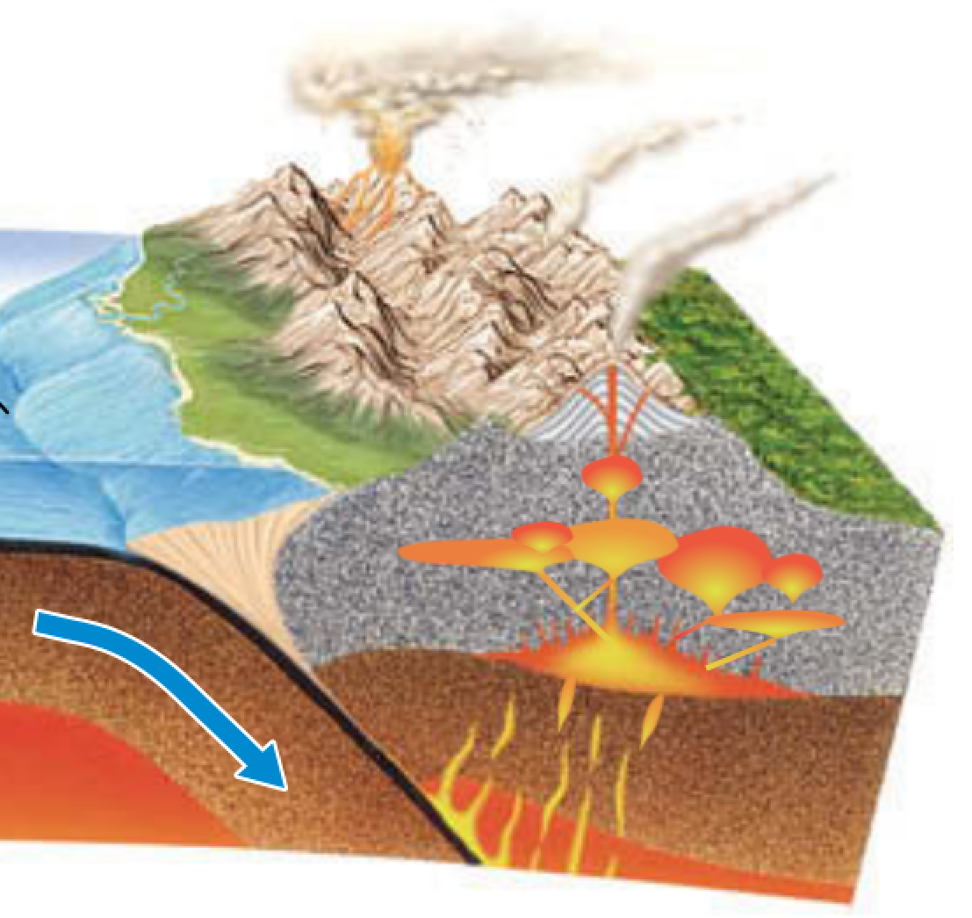
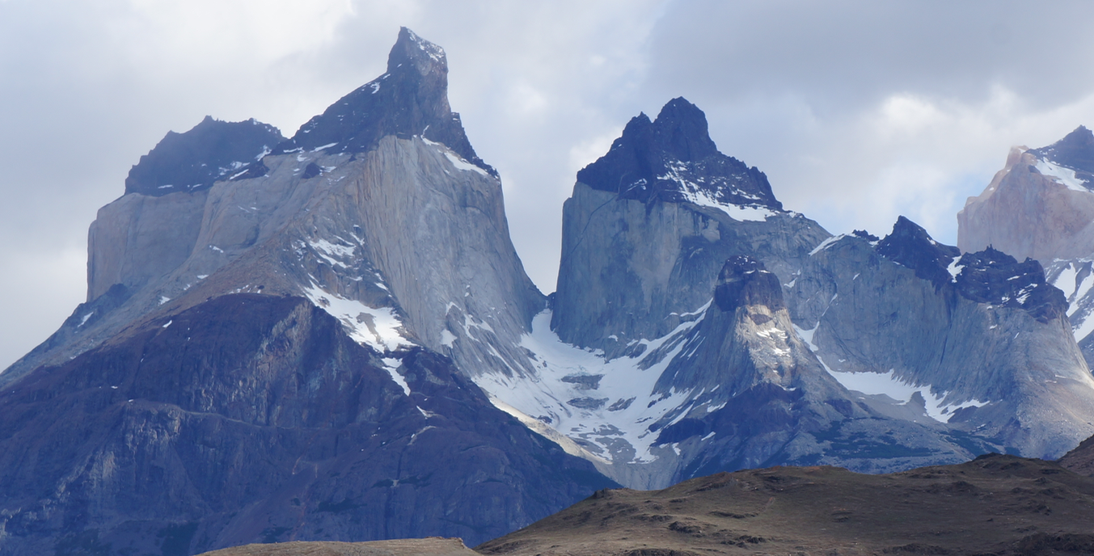
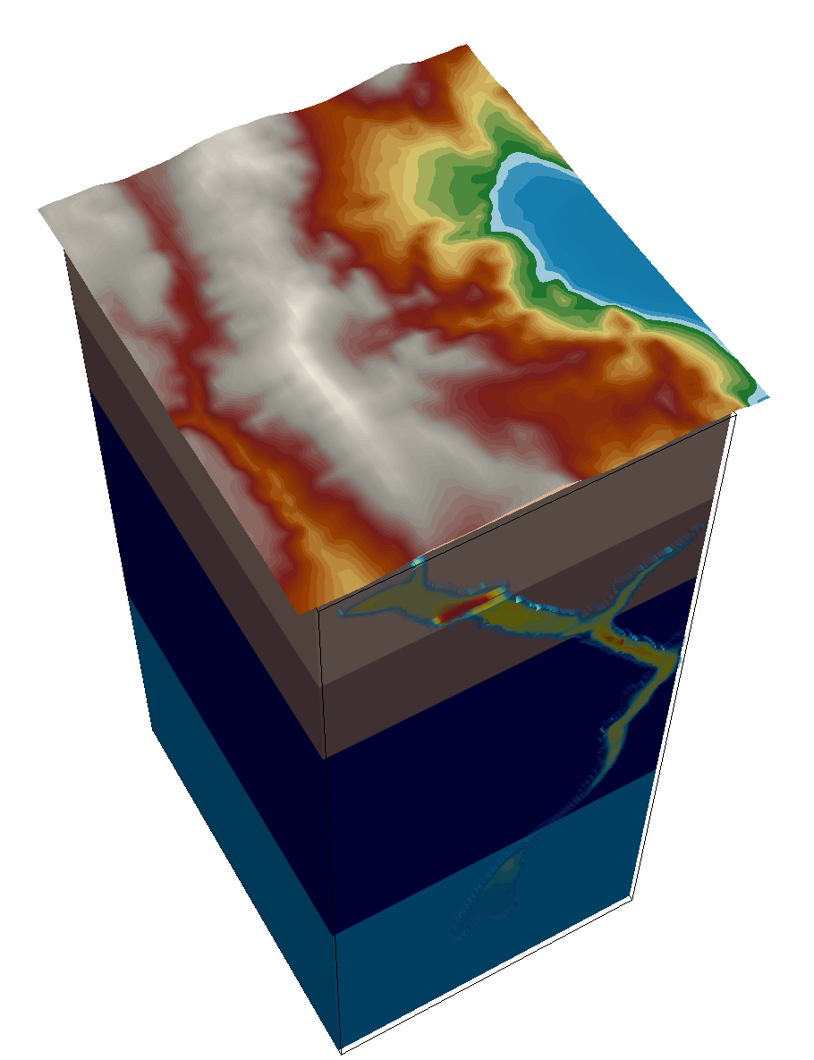
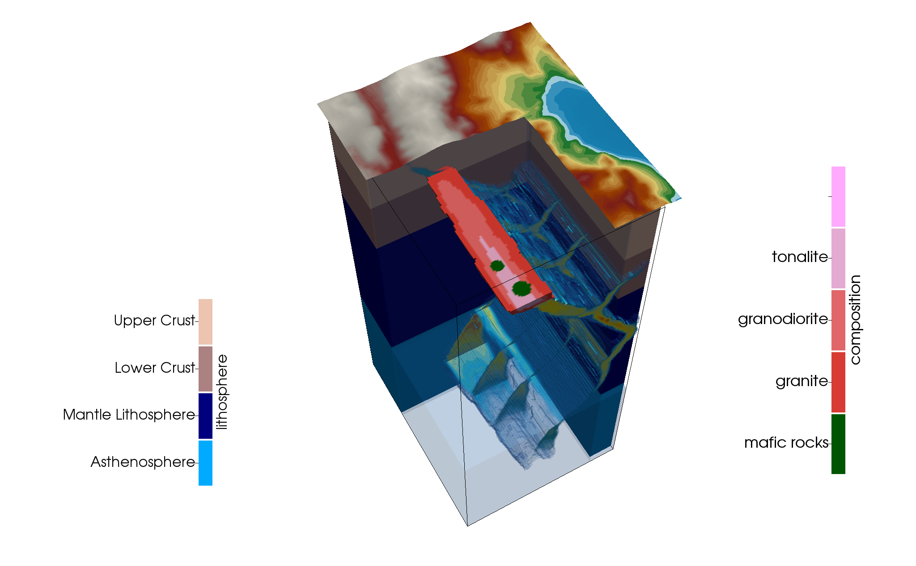
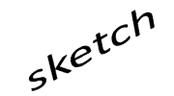
MAGMA – goals
Understanding the dynamics of magmatic systems requires new software:
  link 2-phase flow (magma mush chambers) with the evolving chemistry of the system
  Take diking & fault formation into account
Thermo-mechanics:
  Work in progress on a new 2-phase code
  PETSc & DMSTAG
  Staggered finite differences, nonlinear solvers
  Visco-elasto-plasticy with mode 1 & mode 2 plasticity
Thermo-dynamics:
  Developed a first approach to couple evolving melts to geodynamic simulations by using precomputed phase diagrams
  In addition, working on a new computational core to (hopefully) do the computations on the fly
Stay tuned!
!
upper
crust
tonalite
lower
crust
granite
mantle
lithosphere
mafic melt
asthenosphere
MAGMA

