Slide 1
Spatially coherent postprocessing of cloud cover forecasts using generative adversarial networks
Yinghao Dai and Stephan Hemri; vEGU, 28 April 2021

Slide 2
Overview
Introduction
Traditional postprocessing
  Ensemble model output statistics (EMOS)
  Ensemble copula coupling (ECC)
Machine learning based postprocessing
  Dense neural nets (DNN)
  Generative adversarial networks (GAN)
Summary

Slide 3
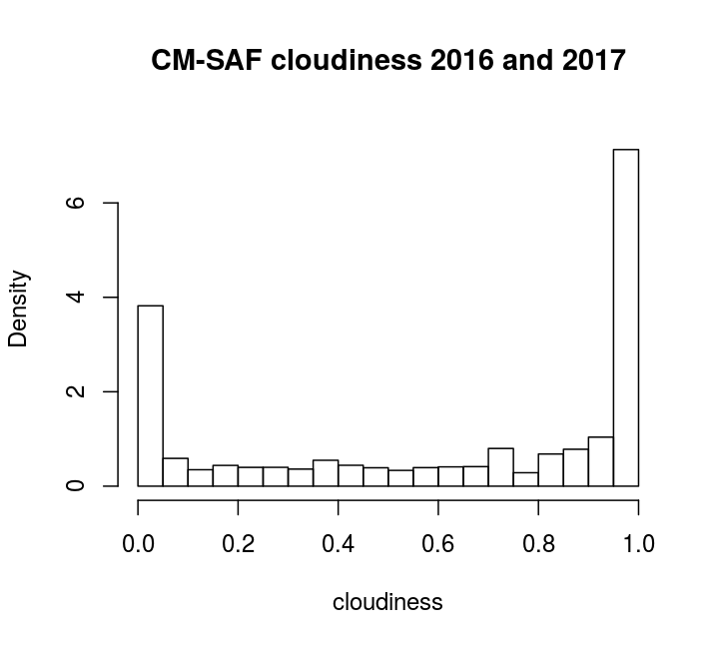
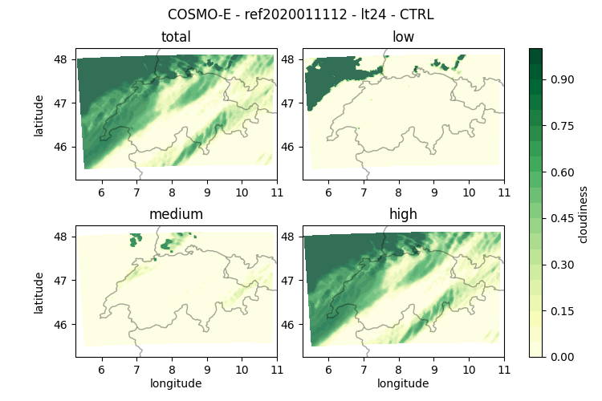
Cloud cover basics
Climatology
Example forecast
Considerable point masses at 0 and 1

Slide 4
Dataset
Predictors (subsampled)
  Numerical forecasts (COSMO-E and IFS [+12h])
    Training set: 05.2016 - 04.2018
    Validation set: 05.2018 - 04.2019
    Test set: 05.2019 - 04.2020
Observations
  EUMETSAT CM-SAF satellite data, 2 × 2 km resolution

Slide 5
gEMOS as univariate postprocessing approach
Postprocess hourly COSMO-E and ECMWF-IFS cloud cover ensemble forecasts
Use an ensemble model output statistics approach (EMOS, Gneiting et al. 2005)
global EMOS (gEMOS) models fitted seasonally (same season other years) for each lead time separately
Estimation of coefficients by minimization of the continuous ranked probabilitiy score (CRPS)
Reference:
Gneiting, Tilmann, et al. "Calibrated probabilistic forecasting using ensemble model output statistics and minimum CRPS estimation." Monthly Weather Review 133.5 (2005): 1098-1118.

Slide 6
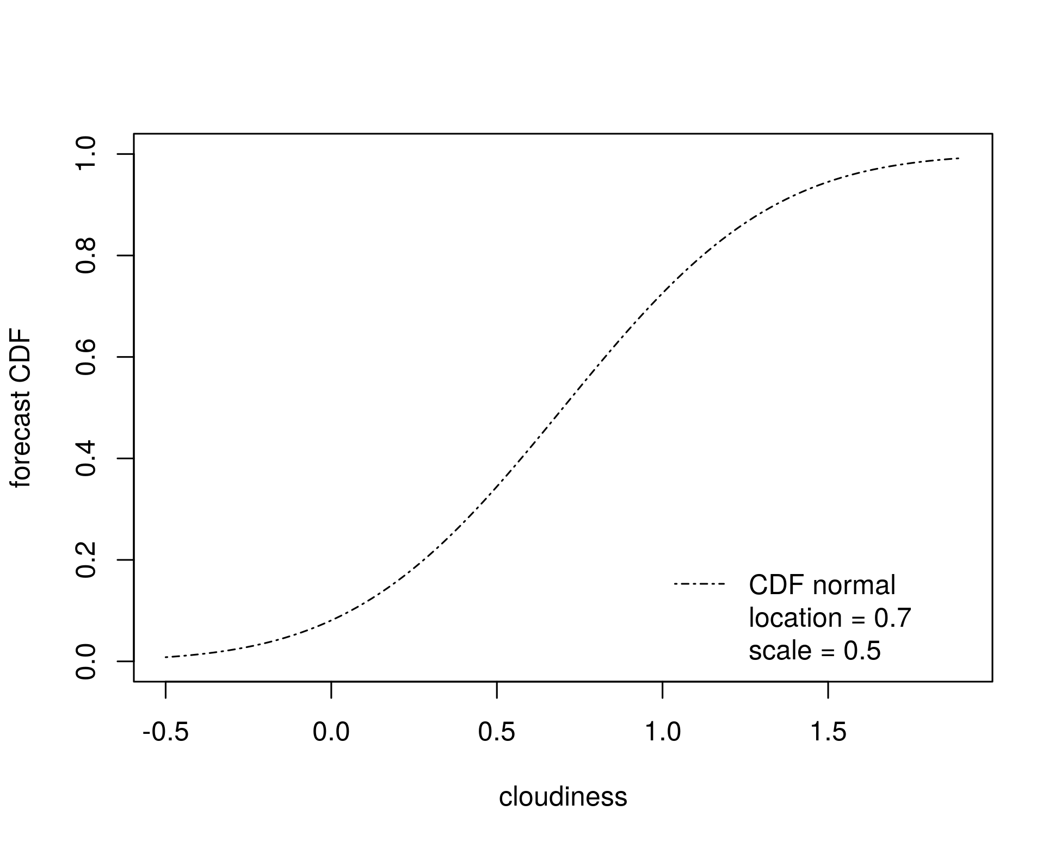
Doubly-censored normal ensemble model output statistic

Slide 7
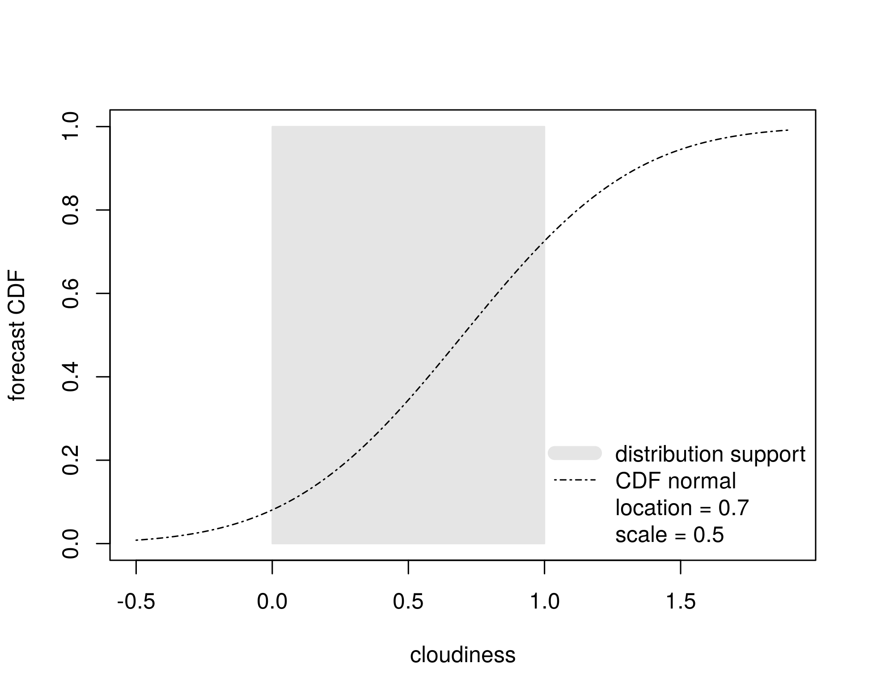
Doubly-censored normal ensemble model output statistic

Slide 8
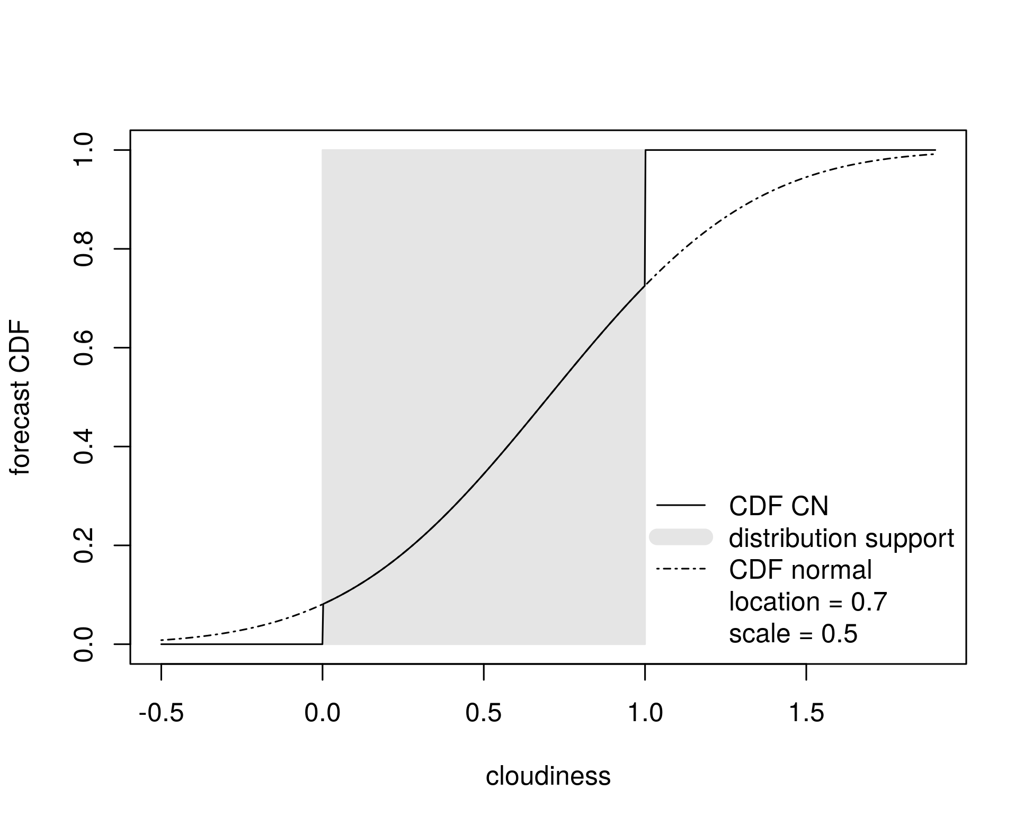
Doubly-censored normal ensemble model output statistic

Slide 9
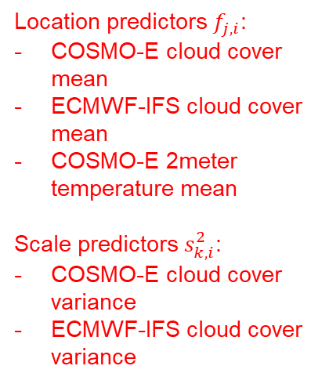
Doubly-censored normal ensemble model output statistic
Location predictors $f_{j,i}$:
COSMO-E cloud cover mean
ECMWF-IFS cloud cover mean
COSMO-E 2meter temperature mean
Scale predictors $s_{k,i}^{2}$:
COSMO-E cloud cover variance
ECMWF-IFS cloud cover variance

Slide 10
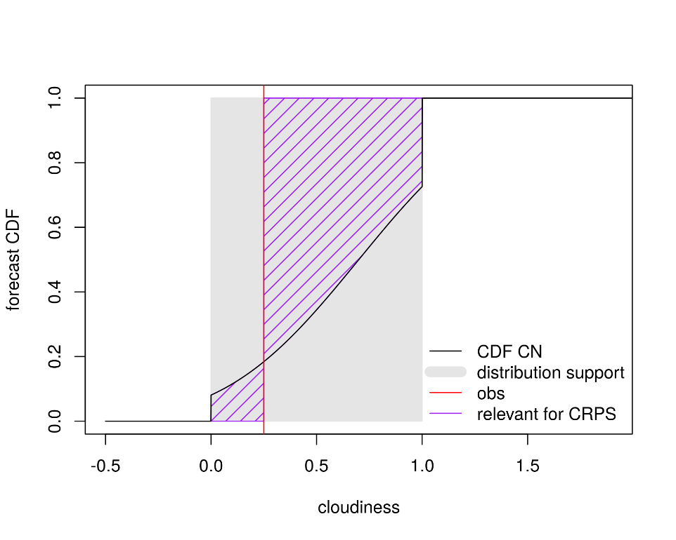
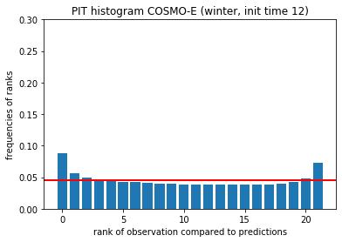
Univariate verification
Continuous ranked probability score (CRPS)
Calibration: PIT histogram
Notes:
We do not show

Slide 11
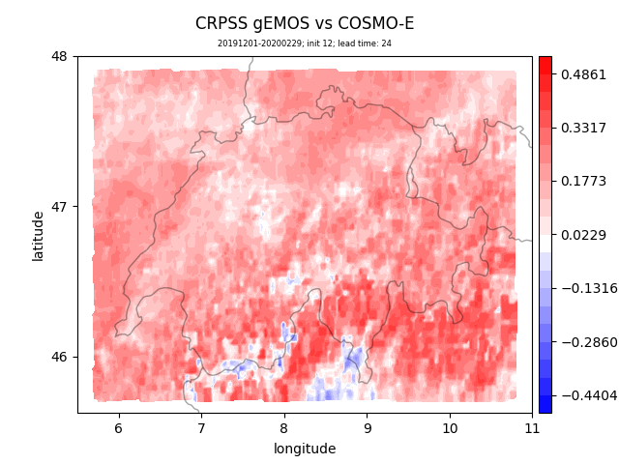
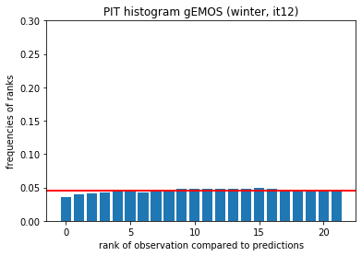
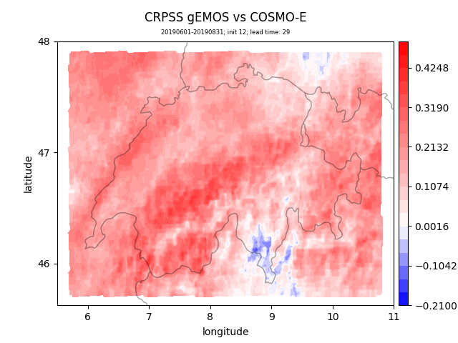
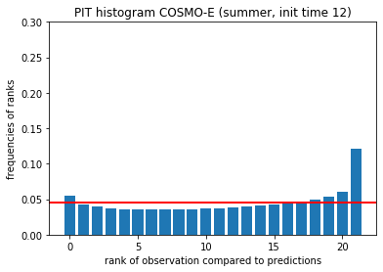
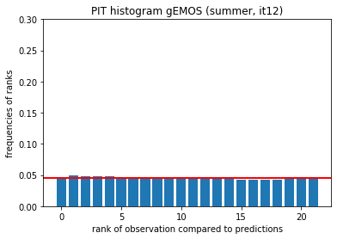
Univariate verification: test set
gEMOS better
COSMO-E
better
gEMOS
better
COSMO-E
better

Slide 12
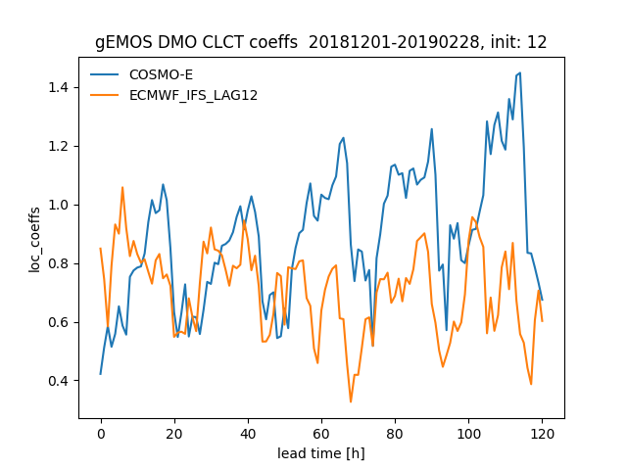
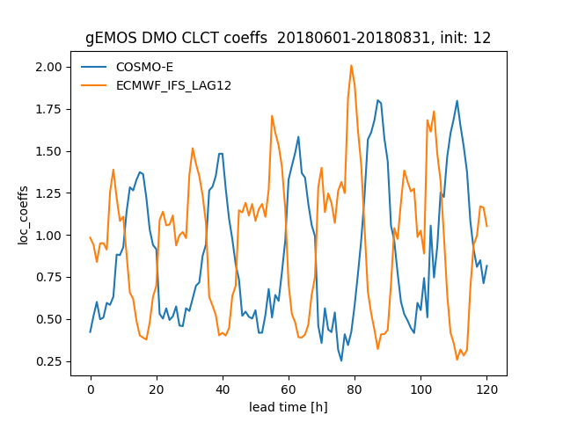
EMOS «weights»
DJF
JJA
Notes:
We do not show

Slide 13
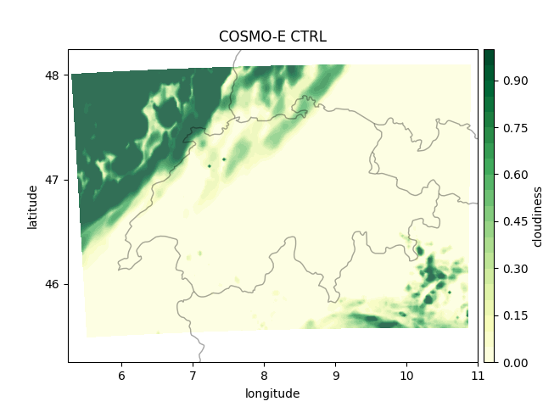
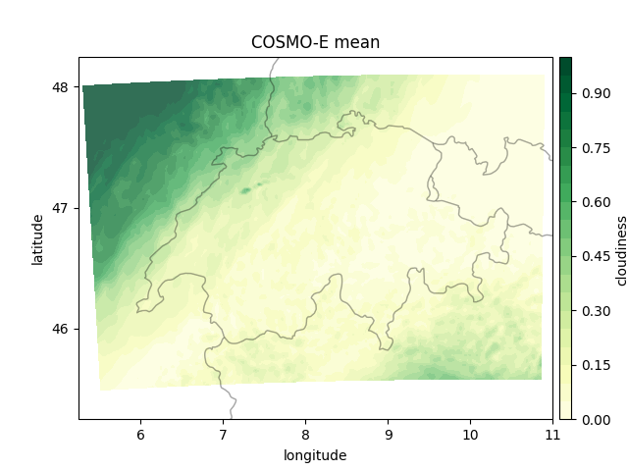
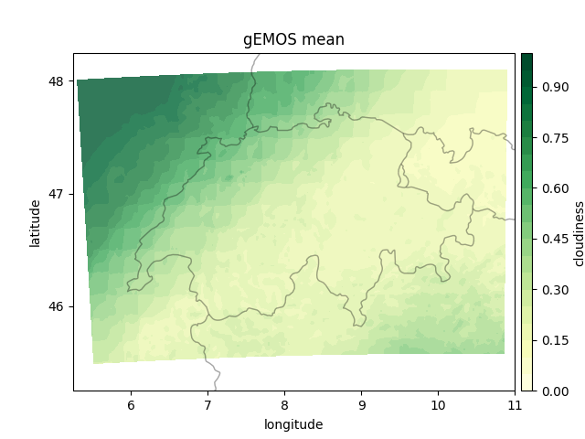
What does gEMOS do in practice?
Smoothing (corrects for DMO being ‘too’ certain)
Destroy the physics

Slide 14
Ensemble copula coupling
Ensemble copula coupling (ECC; Schefzik et al. 2013) reintroduces spatio-temporal dependence structure
Reordering of gEMOS forecast quantiles
For cloud cover a modified ECC variant (Scheuerer et al., 2018) originally developed for precipitation seems appropriate
References:
Schefzik, Roman, Thordis L. Thorarinsdottir, and Tilmann Gneiting. "Uncertainty quantification in complex simulation models using ensemble copula coupling." Statistical science 28.4 (2013): 616-640.
Scheuerer, Michael, and Thomas M. Hamill. "Generating calibrated ensembles of physically realistic, high-resolution precipitation forecast fields based on GEFS model output." Journal of Hydrometeorology 19.10 (2018): 1651-1670.

Slide 15
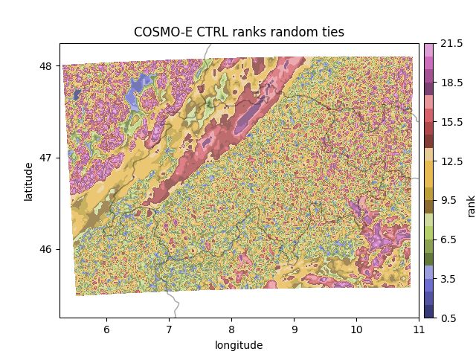
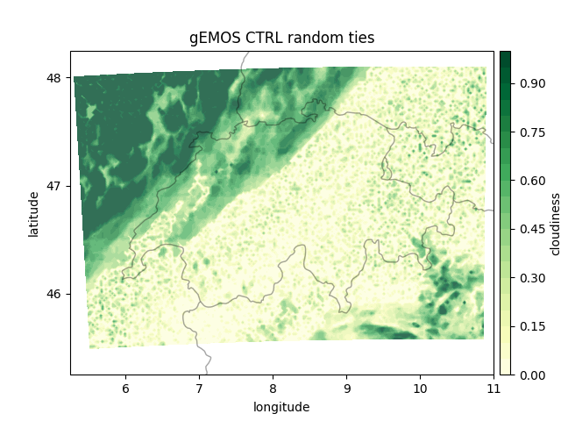
ECC in practice: standard approach
ties resolved at random

Slide 16
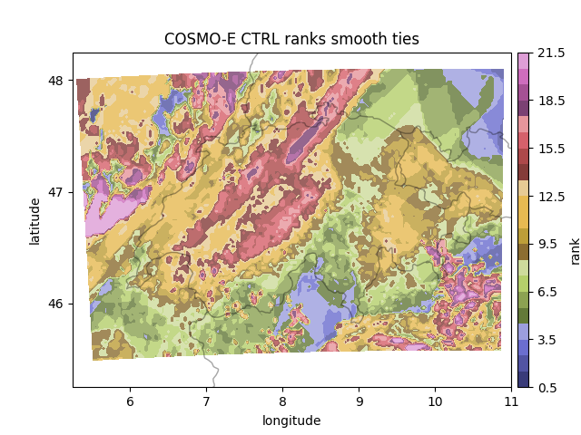
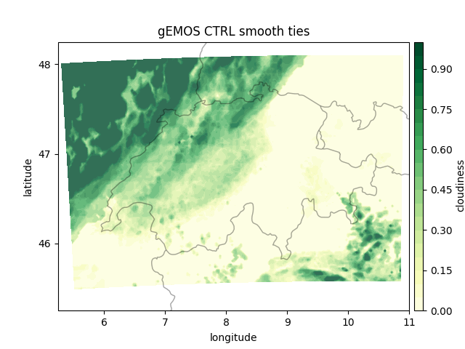
ECC in practice: modified approach
ties resolved using artificial cloudiness below 0 and above 1 and tricubic kernel smoothing

Slide 17
Dense neural network
CLCX: COSMO-E
XCC: IFS (+12)
Input
Output
CLCT_mean
CLCT_var
CLCH_mean
CLCL_mean
TCC_mean
TCC_var
HCC_mean
HCC_var
MCC_mean
MCC_var
HPBL_mean
T_2M_mean
T_2M_var
init_time
lead_time
lat_lon_pair
hour_of_day
month
pred_ensemble0
pred_ensemble1
⋮
pred_ensemble20
embeddings
Dense neural network
Nonparametric
15 830 121 parameters

Slide 18
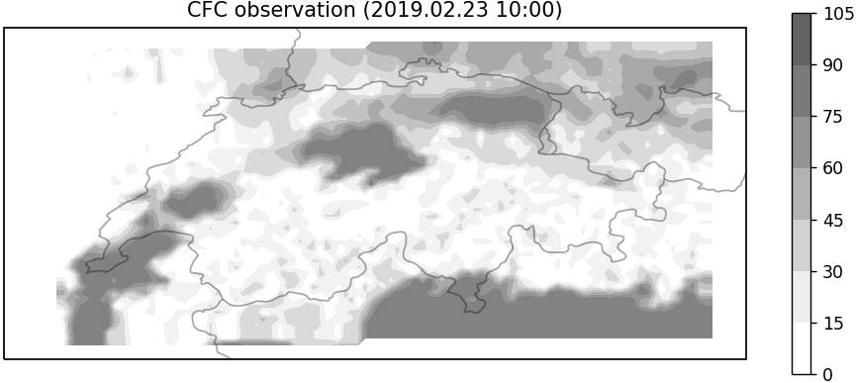
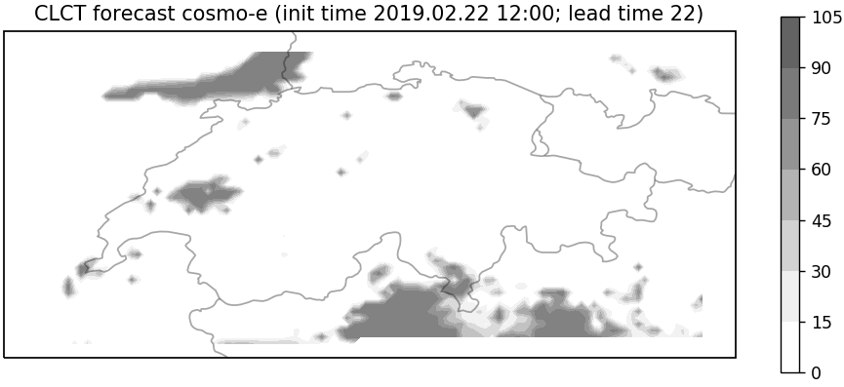
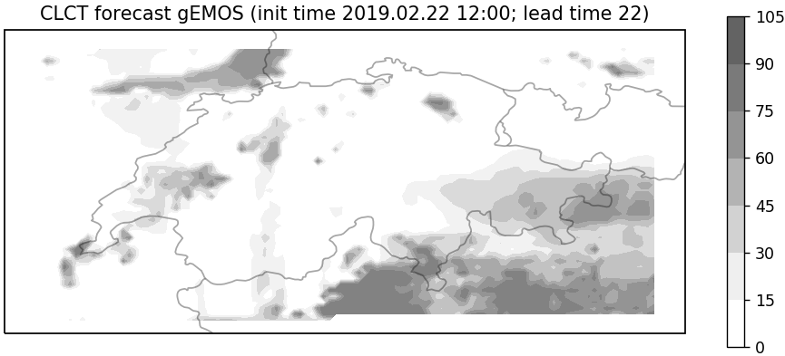
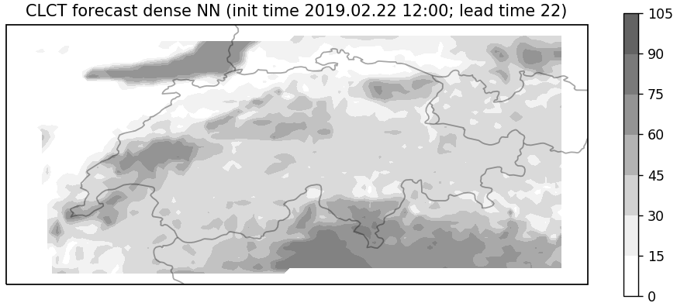
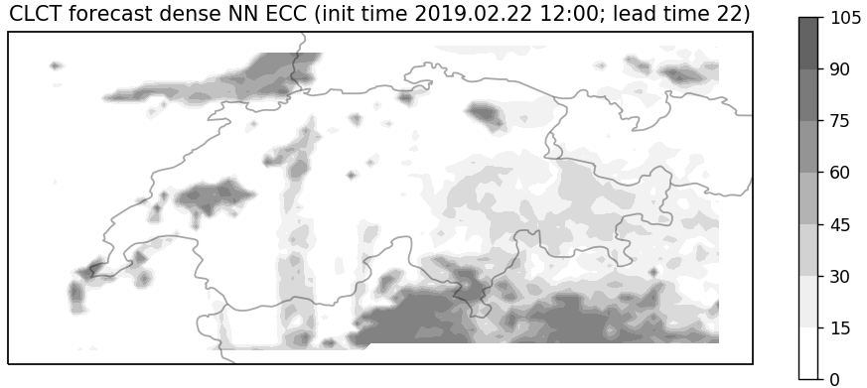
Example forecasts (init time 2019.02.22 12:00, lead time 22)
observation
COSMO-E
gEMOS (+ECC)
ob
dense NN (no ECC)
dense NN (+ECC)

Slide 19
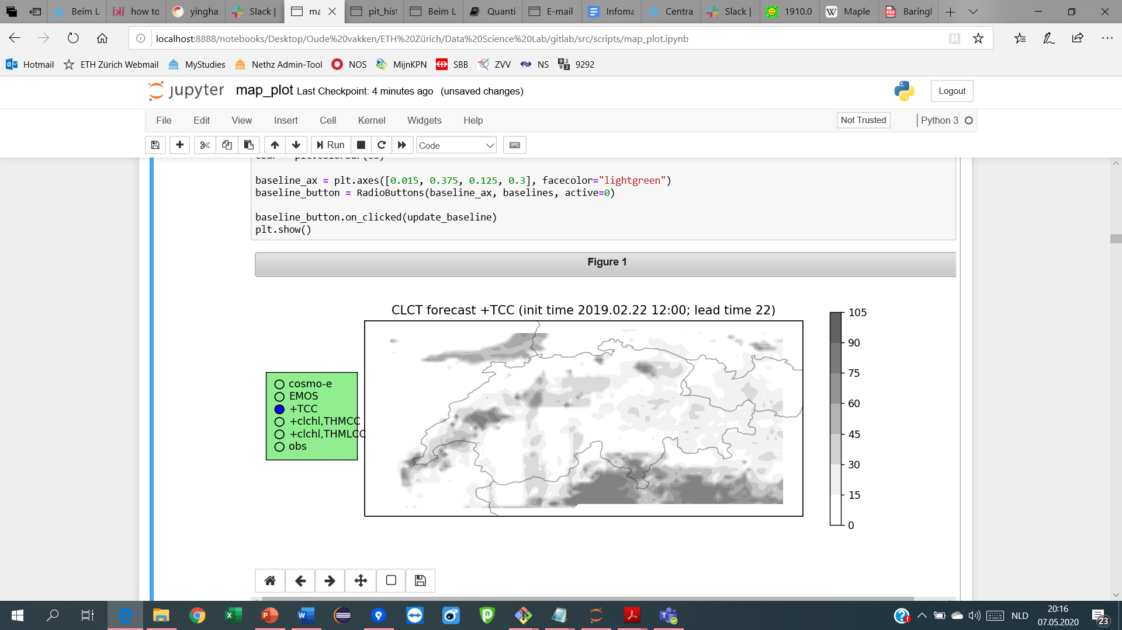



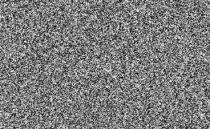
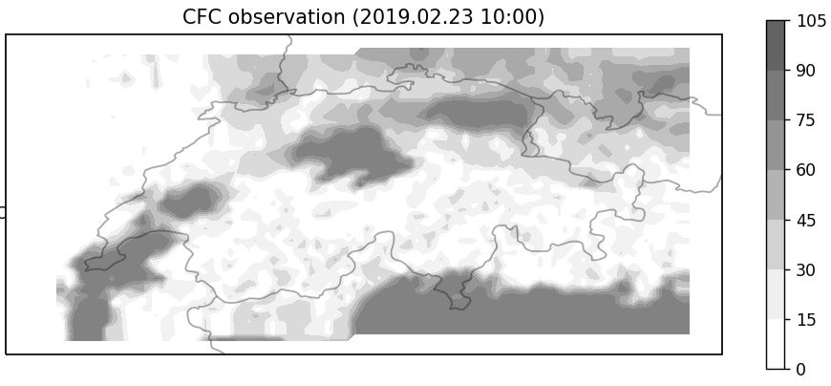

Generative adversarial networks (GANs)
Thanks to Daniele Nerini
G
D

Slide 20
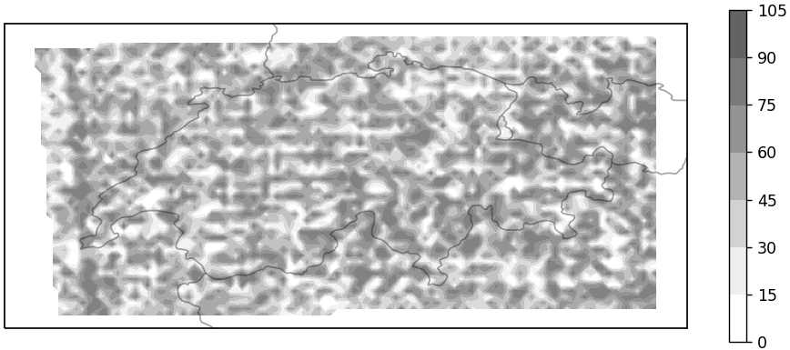
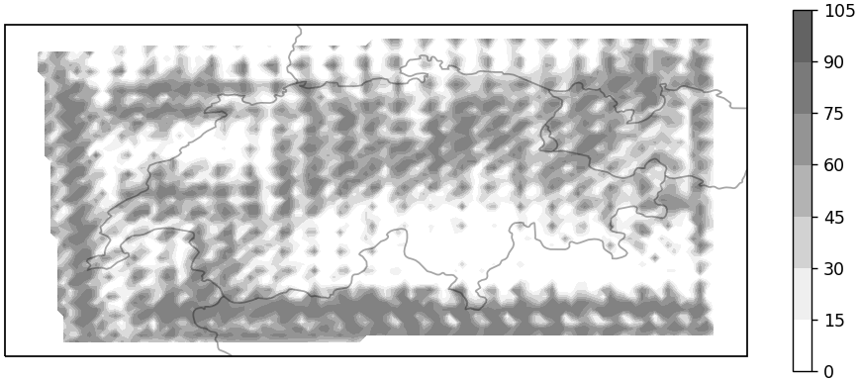
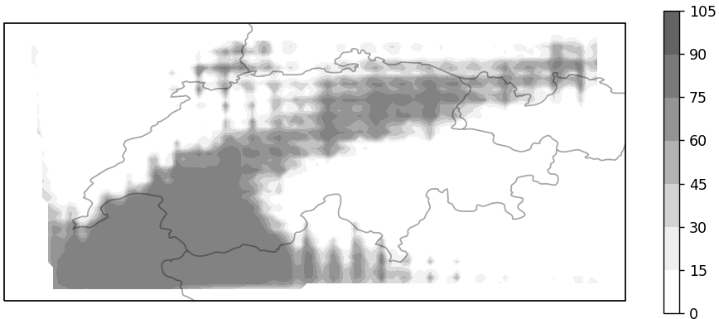
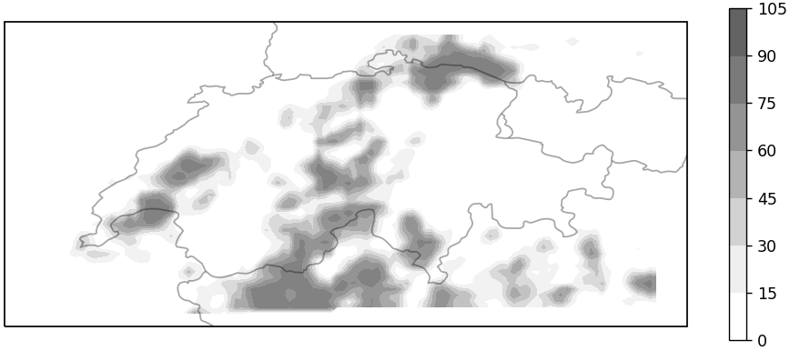
Generative adversarial networks (GANs)

Slide 21
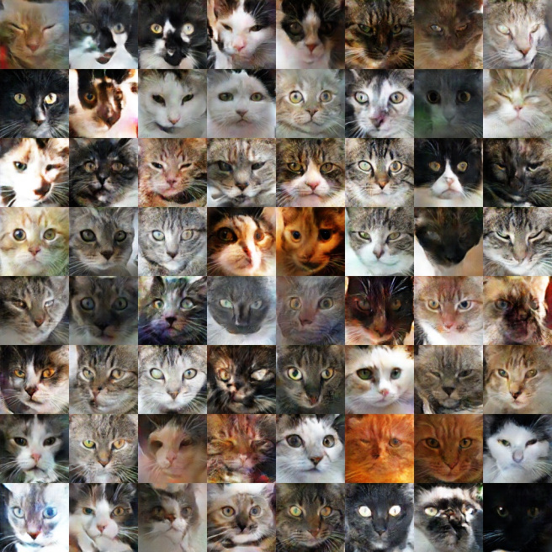
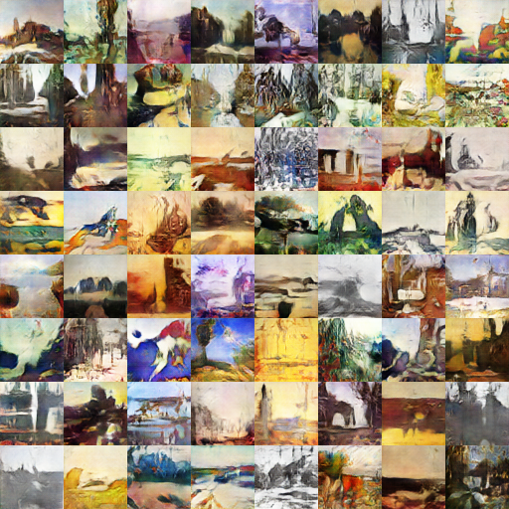
GANs: applications
https://ajolicoeur.wordpress.com/cats/
https://towardsdatascience.com/gangogh-creating-art-with-gans-8d087d8f74a1

Slide 22
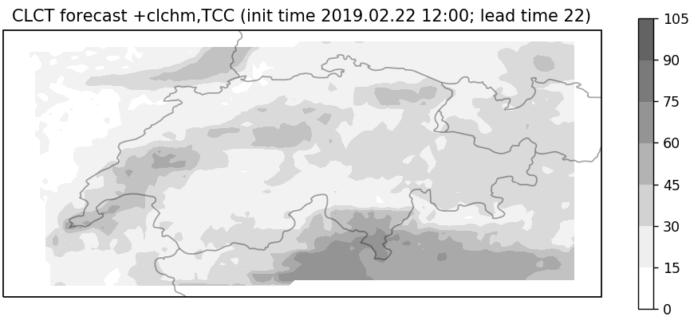
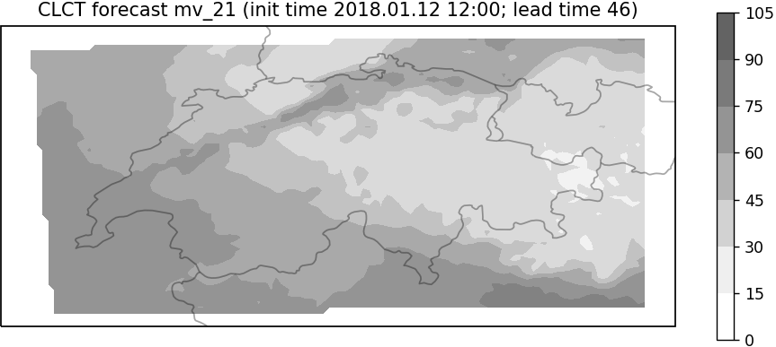
Conditional GAN (cGAN)
G
D
61 206 094 parameters
1 316 951 parameters
CLCT_mean
CLCT_var
CLCH_mean
CLCL_mean
TCC_mean
TCC_var
HCC_mean
MCC_mean
LCC_mean
LCC_var
HPBL_mean
T_2M_mean
COSMO-E
embeddings
IFS
init_time
lead_time
hour_of_day
month

Slide 23
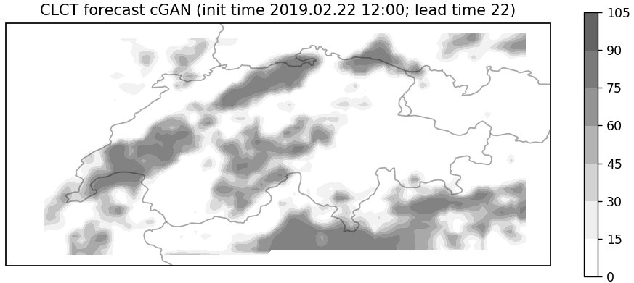
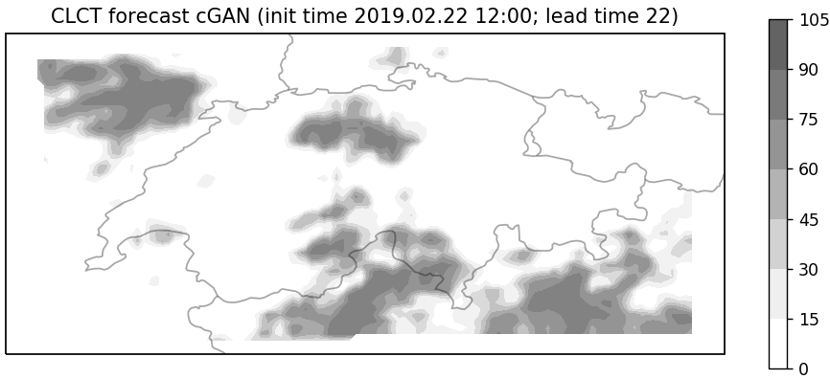
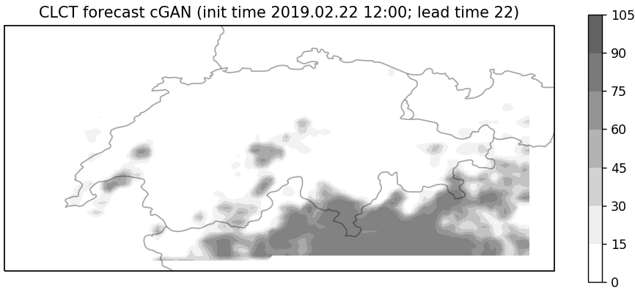
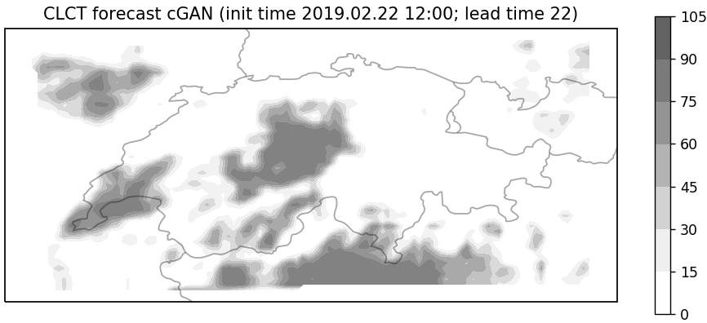
Example forecasts (init time 2019.02.22 12:00, lead time 22)
observation
COSMO-E
gEMOS (+ECC)
ob
dense NN (no ECC)
dense NN (+ECC)
cGAN
cGAN
cGAN
cGAN

Slide 24
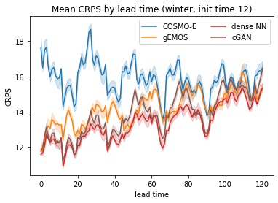
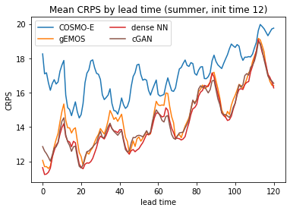
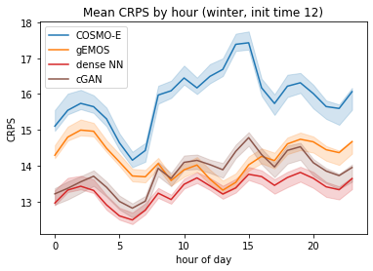
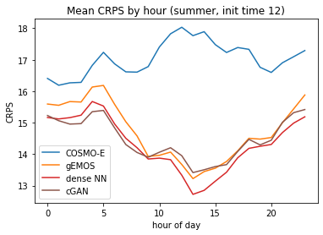
Performance by lead time
better

Slide 25
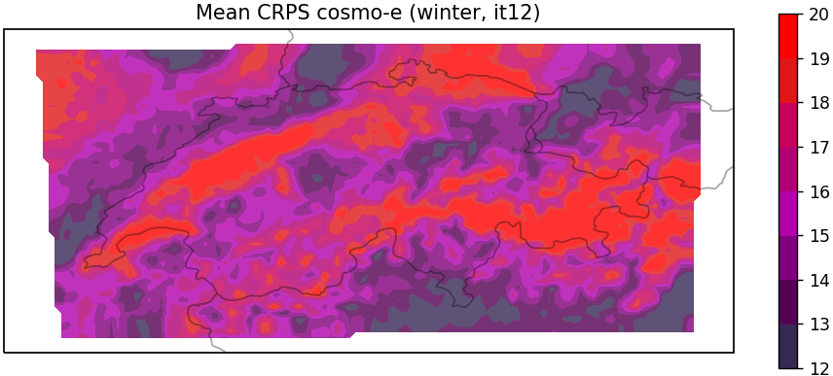
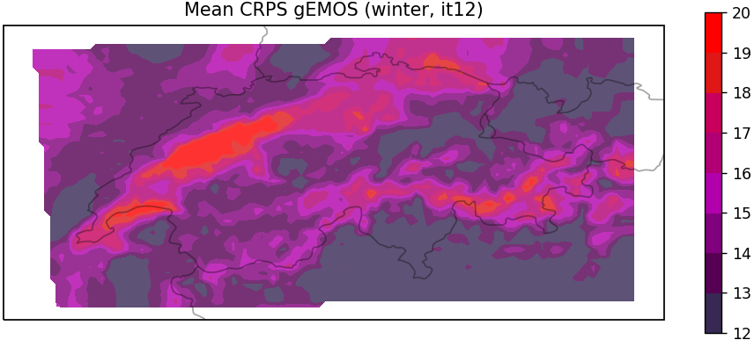
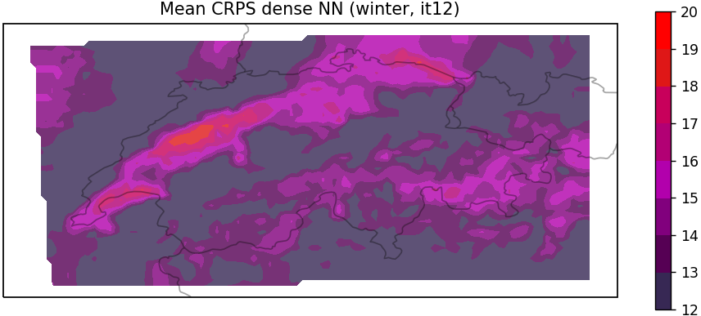
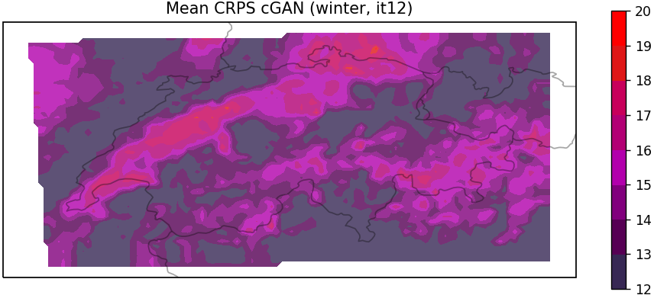
Performance by location
better

Slide 26




Performance compared to gEMOS
ML
better
gEMOS
better

Slide 27








PIT histograms

Slide 28


Energy, p-variogram score
better
skill or correlation structure

Slide 29




Data efficiency
more data needed

Slide 30
Summary
Three approaches for post-processing cloud cover
  Classical statistics: gEMOS
    easy to interpret
  Dense neural networks
    good performance
  Generative adversarial networks
    realistic-looking forecasts
 | gEMOS | Dense NN | cGAN
Interpretability | ★★★☆ | ★☆☆☆ | ★☆☆☆
Forecast skill | ★★☆☆ | ★★★★ | ★★★☆
Calibration | ★★★★ | ★★★☆ | ★★★★
Realistic images | ★★★☆ | ★★★☆ | ★★★★
Realistic videos | ★★★☆ | ★★★☆ | ★★★☆
Data efficiency | ★★★☆ | ★★★☆ | ★★☆☆
★ raw model output
★★ model output with ECC

Slide 32
Disaggregation into cloud levels
Problem: no observations available for separate cloud levels
Ad-hoc approach:
  Generate an archive of cloud level observations by augmenting satellite data with COSMO-1 short-range forecasts (thanks to Francesco Zanetta)
  Fit a seasonal gEMOS model for each level
  Iterate over EMOS ECC forecast scenarios and extract the corresponding cloud level gEMOS quantiles
  Ensure consistency between the different cloud level forecasts by ad-hoc correction of the cloud level forecasts
Notes:
This problem

Slide 33

Disaggregation into cloud levels
Notes:
This problem

Slide 34

Disaggregation into cloud levels
Notes:
This problem

Slide 35


Performance by lead time
better

Slide 36


Performance compared to gEMOS

Slide 37



Multivariate metrics
$X^{(1)},⋯, X^{(M)}∈{[0,100]}^{d}$ ensemble forecast, $y∈{[0,100]}^{d}$ observation
Energy score: $\frac{1}{M}\sum_{k=1}^{M}{{\left\|X^{(k)}−y\right\|}_{2}}−\frac{1}{2M^{2}}\sum_{k=1}^{M}{\sum_{l=1}^{M}{{\left\|X^{(k)}−X^{(l)}\right\|}_{2}}}$
  Generalizes CRPS (case $d=1$)
p-variogram score: $\sum_{i=1}^{d}{\sum_{j=1}^{d}{w_{ij}{\left({\left|y_{i}−y_{j}\right|}^{p}−\frac{1}{M}\sum_{k=1}^{M}{{\left|X_{i}^{(k)}−X_{j}^{(k)}\right|}^{p}}\right)}^{2}}}$
  Correlation structure
weights
coordinate of $y$
coordinate of $X^{(k)}$
References:
Gneiting, Tilmann, and Adrian E. Raftery. "Strictly proper scoring rules, prediction, and estimation." Journal of the American Statistical Association (2007) 102(477): 359–378.
Scheuerer, Michael, and Thomas M. Hamill. “Variogram-based proper scoring rules for probabilistic forecasts of multivariate quantities." Monthly Weather Review (2018) 143(4): 1321–1334.

Slide 38




Energy, p-variogram score
better
skill or correlation structure

Slide 39




PIT histograms

Slide 40


Data efficiency

