Slide 1
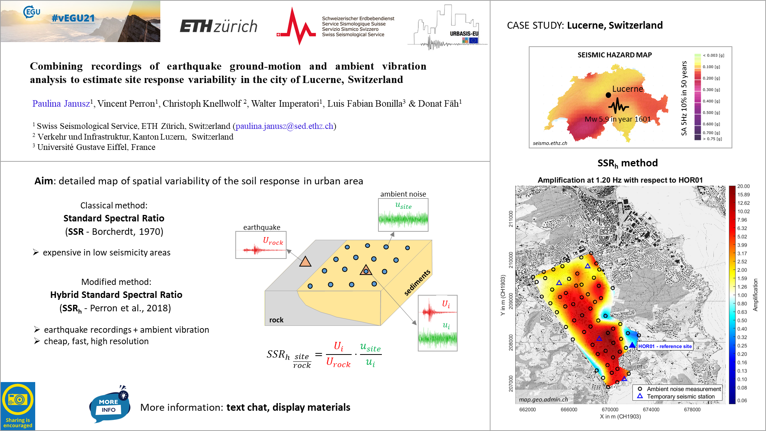
Live presentation slide – 26.04.2021 13:53

Slide 2
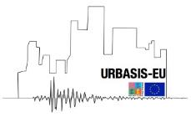

Combining recordings of earthquake ground-motion and ambient vibration analysis to estimate site response variability in the city of Lucerne, Switzerland
Paulina Janusz¹, Vincent Perron¹, Christoph Knellwolf³,
Walter Imperatori¹, Luis Fabian Bonilla², Donat Fäh¹
¹ SED - ETH Zürich, ² Université Gustave Eiffel, ³ Verkehr und Infrastruktur, Abteilung Naturgefahren, Kanton Luzern
Contact: paulina.janusz@sed.ethz.ch

Slide 3

Introduction

Slide 4
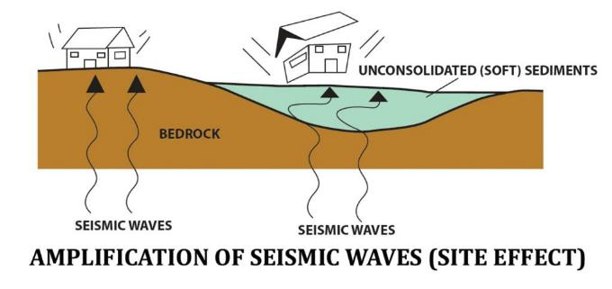
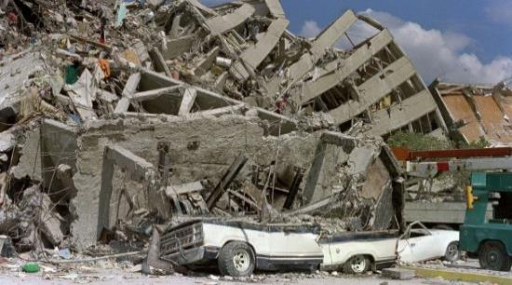

Seismic site effects
Site effects
Increase of amplitude and/or duration of the ground motion
+
Urban vulnerability
Recent urbanization
Exposed elements
High population
Ciaccio and Cultrera (2014)
=
Importance of site effects
Mexico 1985
Elevated seismic risk
theguardian.com

Slide 5
The goal of the study
Evaluation of complex soil response and its variability in the urban environment
using
Empirical methods
Reference site methods (earthquakes-,
noise-based)
Linear site response analysis

Slide 6
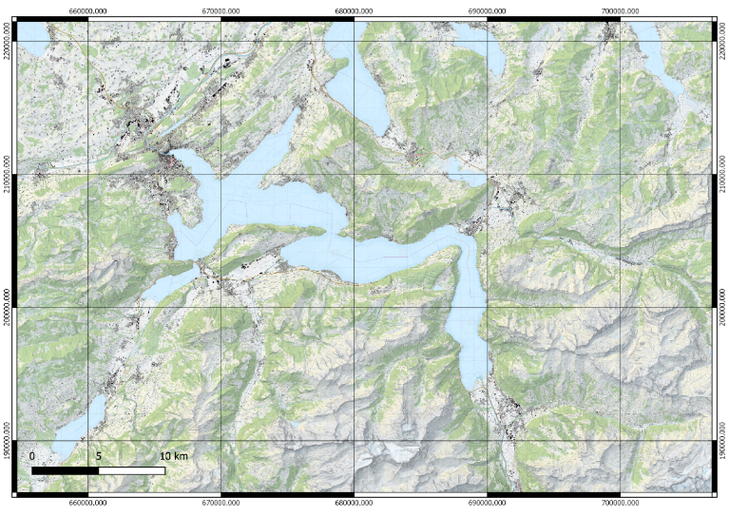
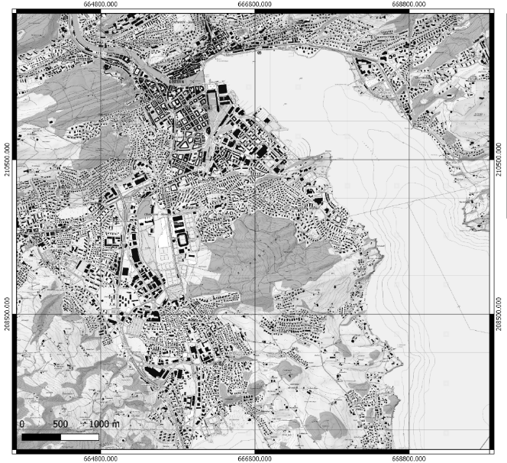
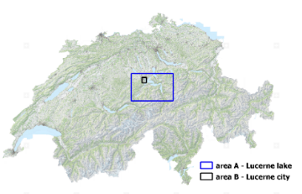
Case study – Lucerne area
Lucerne area
map.geo.admin.ch
Central Switzerland
map.geo.admin.ch

Slide 7
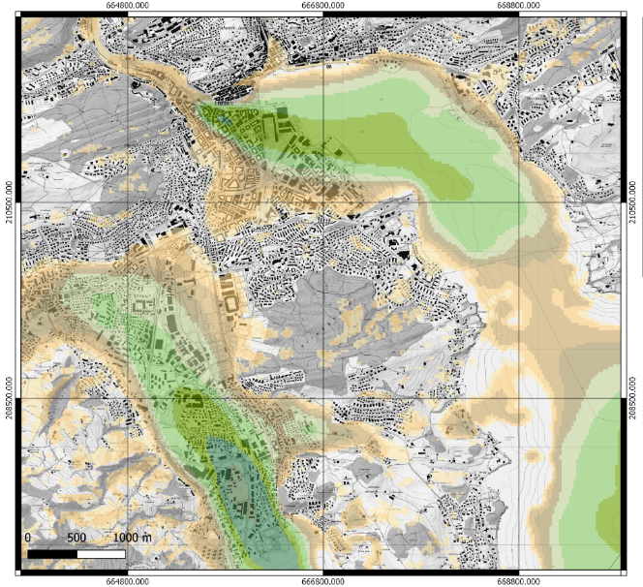
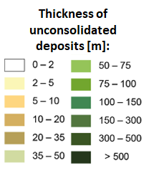
Case study – Lucerne area
Narrow sedimentary basin
Lucerne area
map.geo.admin.ch
Possibility of strong site effects
and amplification of seismic waves
map.geo.admin.ch

Slide 8
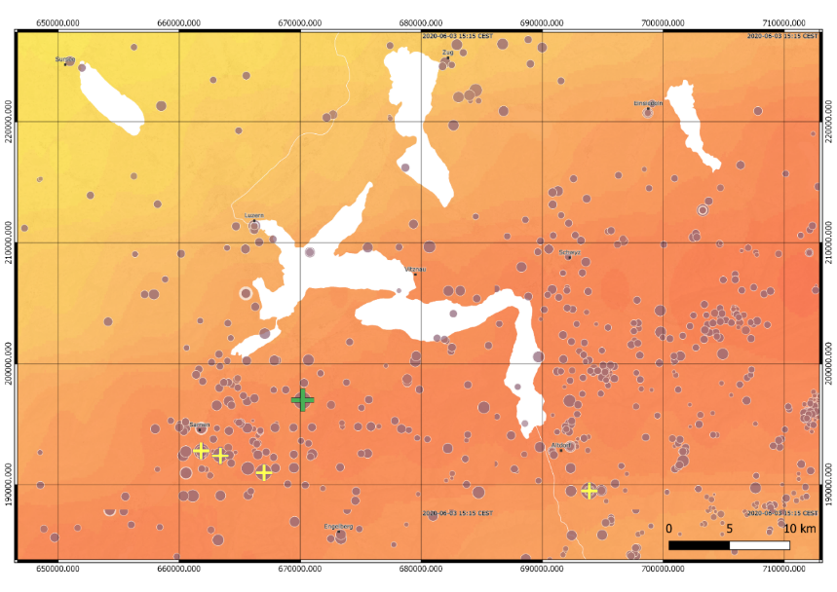
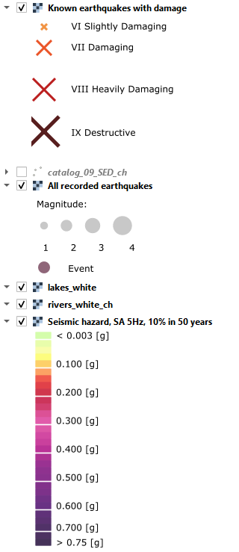
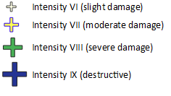
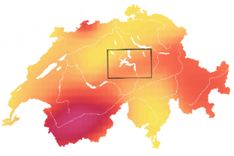
Lucerne area - seismicity
Low-to-moderate seismicity area
with some strong historical earthquakes
All recorded earthquakes
Known earthquakes with damage
Lucerne
Seismic hazard
SA 5Hz
10% in 50 years
Year 1601, Mw 5.9
seismo.ethz.ch
seismo.ethz.ch

Slide 9
Methods and results
Reference-site methods

Slide 10
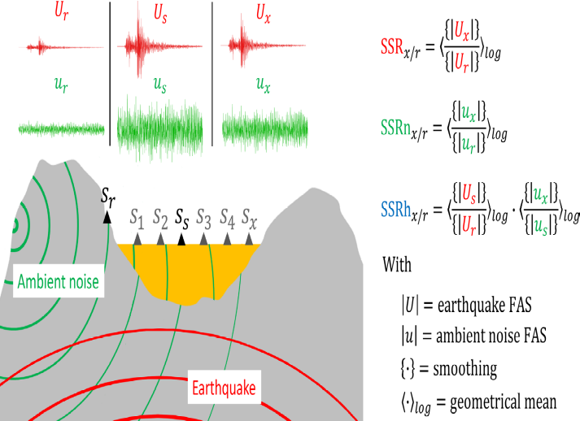
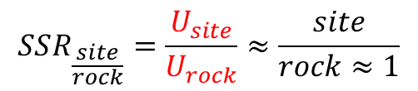
Evaluation of variability of soil response
Estimation of relative amplification factors with reference-site methods:
using earthquakes recordings
Standard Spectral Ratios (Borcherdt, 1970)
$$SSR_{\frac{site}{rock}}=\frac{U_{site}}{U_{rock}}≈\frac{site}{rock≈1}$$
Perron et. al. (2018)

Slide 11
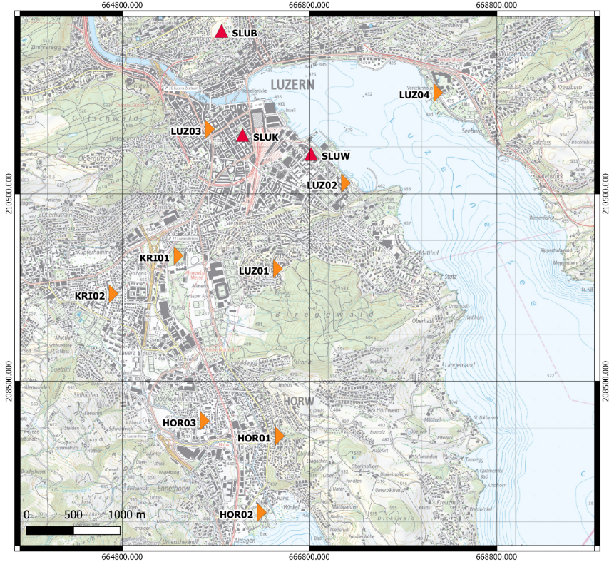
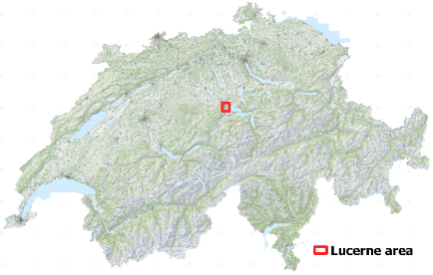
Temporary local seismic monitoring network
Installation: November 2019
9 new station installed
permanent SSMNet stations
Removal: May/June 2020
Recording time: about 6 months
map.geo.admin.ch

Slide 12
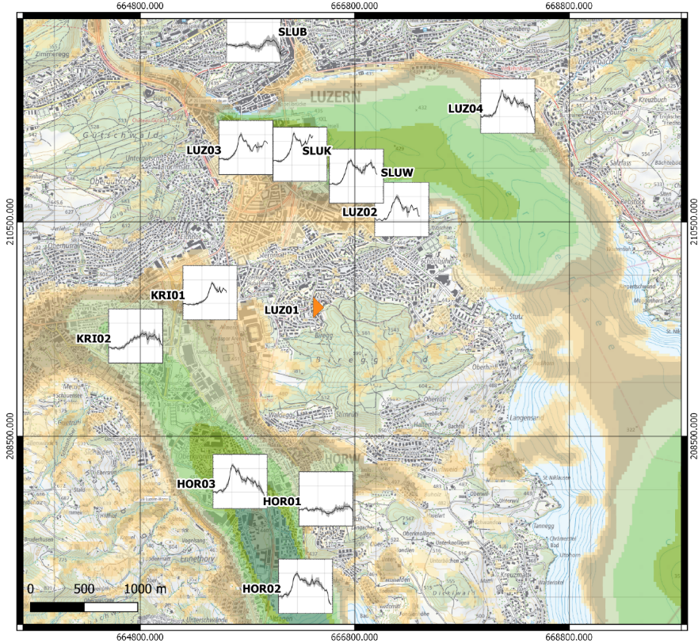
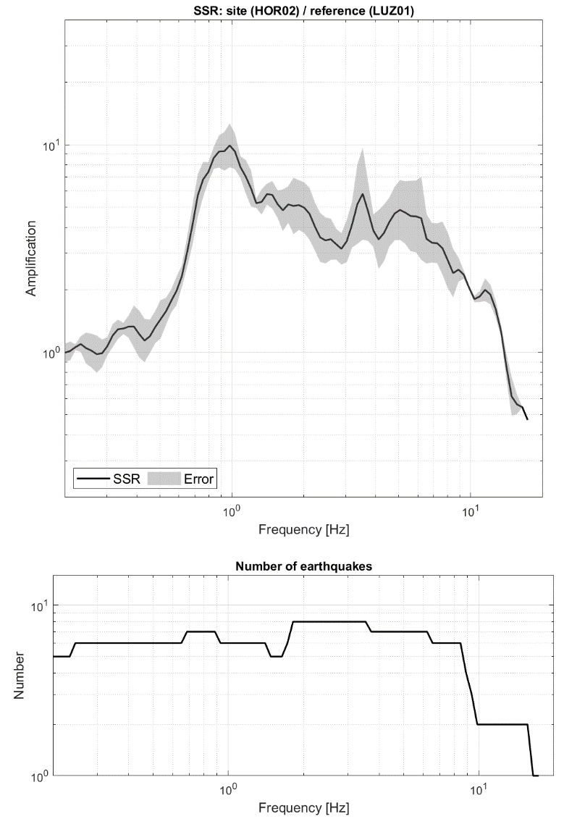
Standard spectral ratios (SSR)
Reference: rock station LUZ01
Amplification factors up to 10
Zoom in
(the plots on the map are
scaled version of the above plot)
map.geo.admin.ch

Slide 13
Evaluation of variability of soil response
Estimation of relative amplification factors with reference-site methods:
using earthquakes recordings | using ambient noise
Standard Spectral Ratios (Borcherdt, 1970) | Standard Spectral Ratios using ambient noise (Kagami, 1982)
Problems
High background noise level in the city
Low seismicity in Lucerne area
Low number of high-quality earthquake recordings
Perron et. al. (2018)

Slide 14
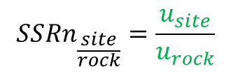
Evaluation of variability of soil response
Estimation of relative amplification factors with reference-site methods:
using earthquakes recordings | using ambient noise
Standard Spectral Ratios (Borcherdt, 1970) | Standard Spectral Ratios using ambient noise (Kagami, 1982)
$$SS{Rn}_{\frac{site}{rock}}=\frac{u_{site}}{u_{rock}}$$
Perron et. al. (2018)

Slide 15
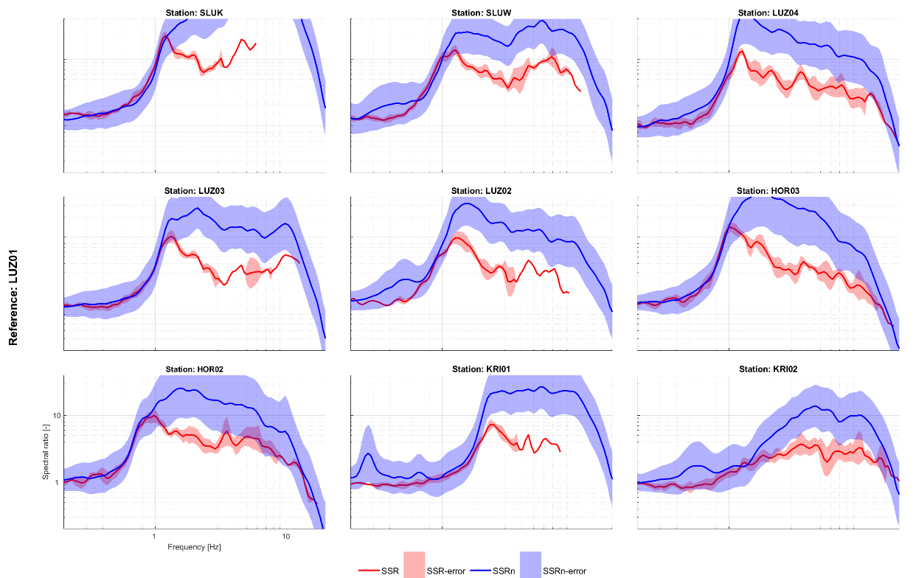
Standard spectral ratios using ambient noise (SSRn)
Above f0 - SSRn >> SSR

Slide 16
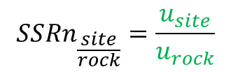
Evaluation of variability of soil response
Estimation of relative amplification factors with reference-site methods:
using earthquakes recordings | using ambient noise
Standard Spectral Ratios (Borcherdt, 1970) | Standard Spectral Ratios using ambient noise (Kagami, 1982)
Standard spectral ratios – hybrid method by Perron et al. (2018)
$$SS{Rn}_{\frac{site}{rock}}=\frac{u_{site}}{u_{rock}}$$
Some problems
Overestimation of amplification factors
Influence of local sources
Possible variability due to human activities
Etc.
Perron et. al. (2018)

Slide 17
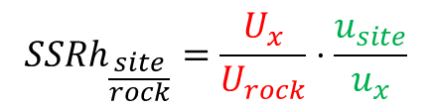
Evaluation of variability of soil response
Estimation of relative amplification factors with reference-site methods:
using earthquakes recordings | using ambient noise
Standard Spectral Ratios (Borcherdt, 1970) | Standard Spectral Ratios using ambient noise (Kagami, 1982)
Standard spectral ratios – hybrid method by Perron et al. (2018)
$$SS{Rh}_{\frac{site}{rock}}=\frac{U_{x}}{U_{rock}}⋅\frac{u_{site}}{u_{x}}$$
Hybrid method:
earthquakes + ambient vibration
Perron et. al. (2018)

Slide 18
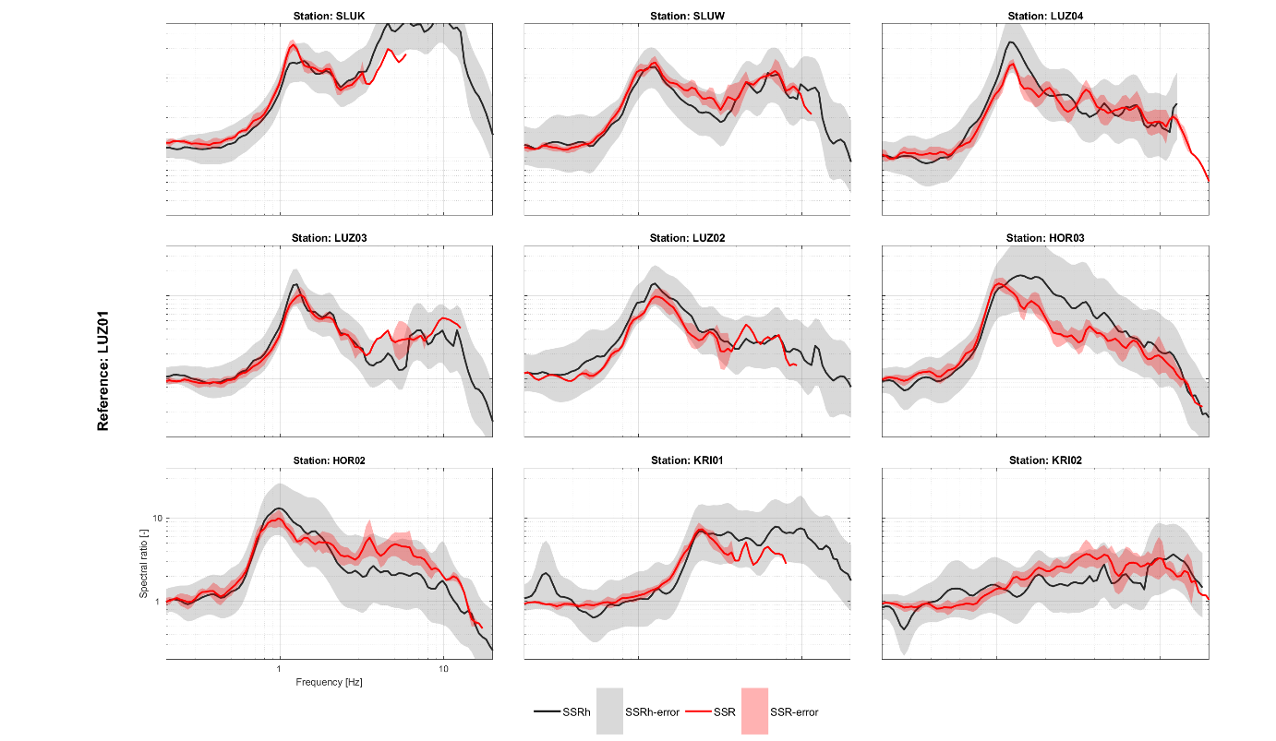

Hybrid standard spectral ratios (SSRh) by Perron et al. (2018)
SSRh $≅$ SSR

Slide 19
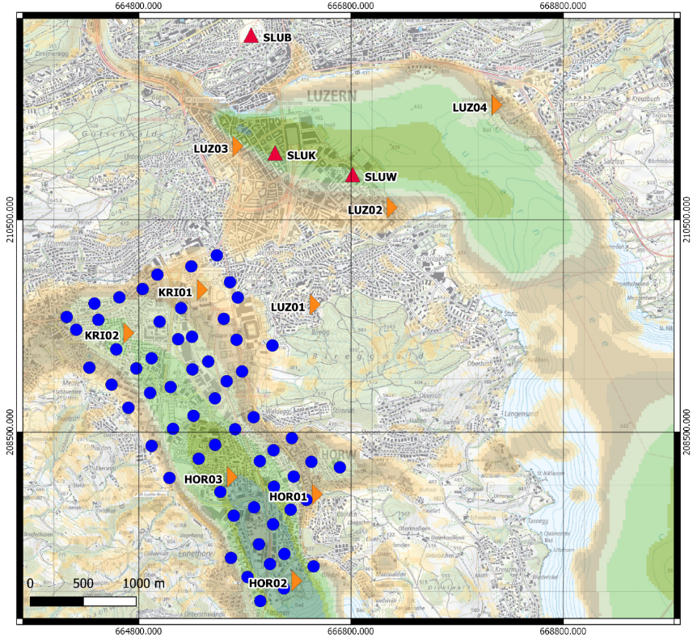
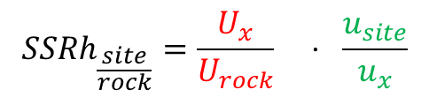
Ambient noise measurement campaign
Performed: 23-25.06.2020
9 new station installed
SSMNet stations
60 single-station measurements
$$SS{Rh}_{\frac{site}{rock}}=\frac{U_{x}}{U_{rock}} ⋅ \frac{u_{site}}{u_{x}}$$
map.geo.admin.ch

Slide 20
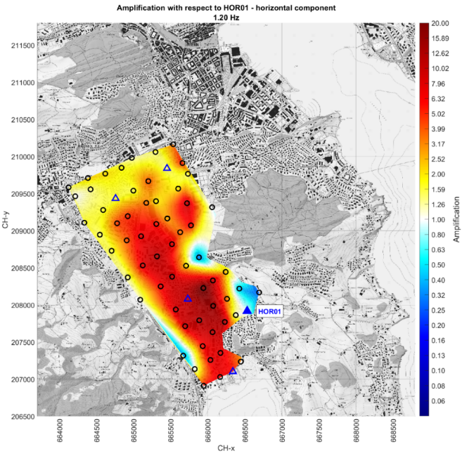
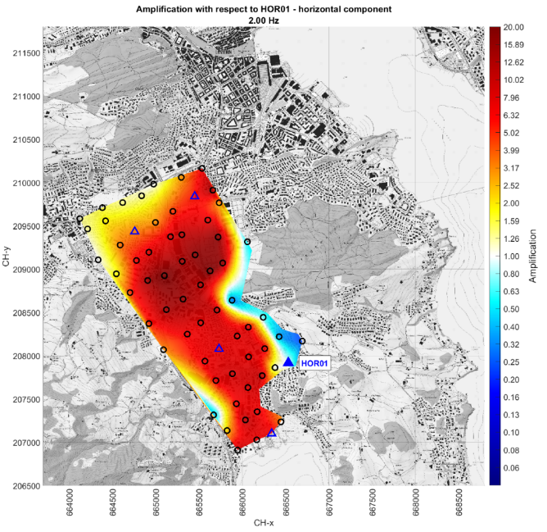
Relative amplification map (using SSRh)
Relative amplification factors (1.2 Hz)
Relative amplification factors (2.0 Hz)
Ambient noise measurements
Points with earthquake recordings
Reference: rock station HOR01

Slide 21
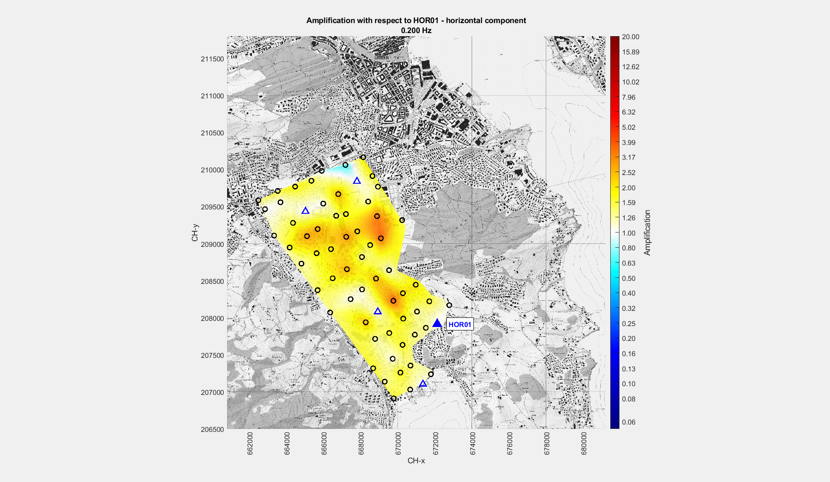
Relative amplification map (using SSRh)
Movie

Slide 22
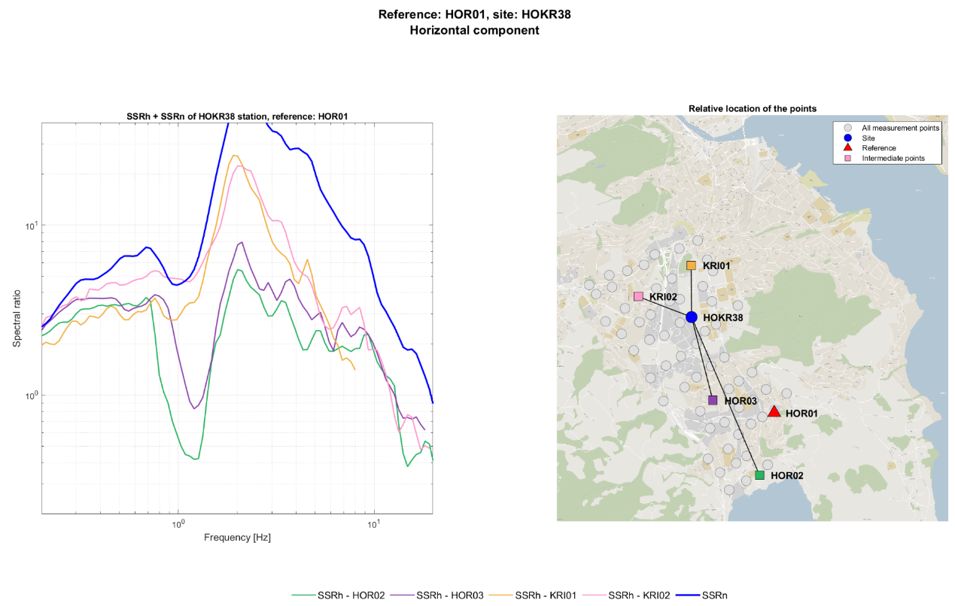
SSRh – importance of intermediate stations deployment
SSRh function may depend on intermediate station

Slide 23
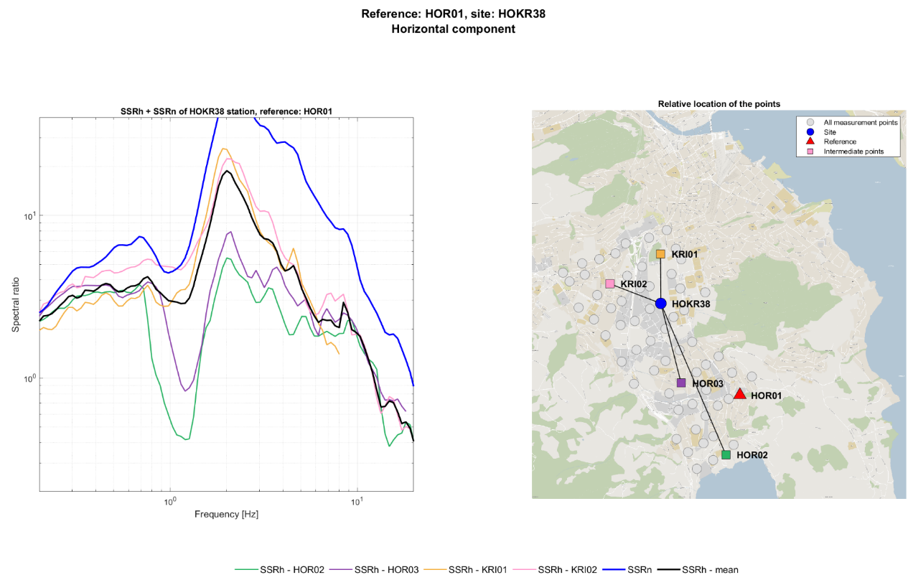
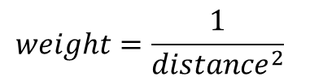
SSRh – importance of intermediate stations deployment
My solution: weighted mean of all intermediate stations
Weighted mean
$$weight=\frac{1}{{distance}^{2}}$$

Slide 24
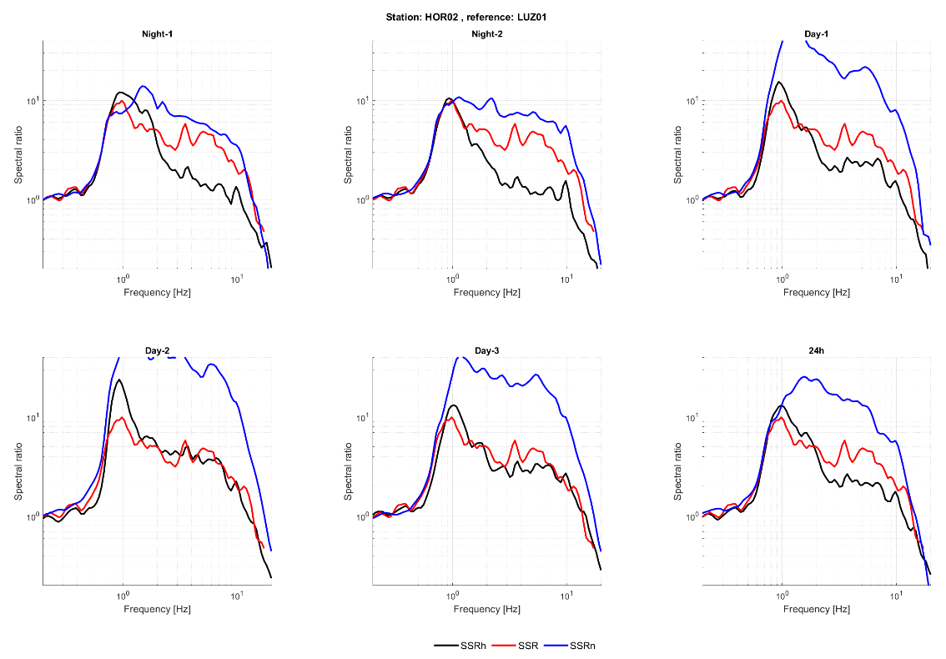
SSRh – influence of human activities
Differences due to the time when recorded
SSR:
earthquakes recordings ->
no differences
SSRn:
significant differences
SSRh:
moderate differences
Day recordings and 24h recording – similar SSRh
Assumption:
We can use day recordings

Slide 25
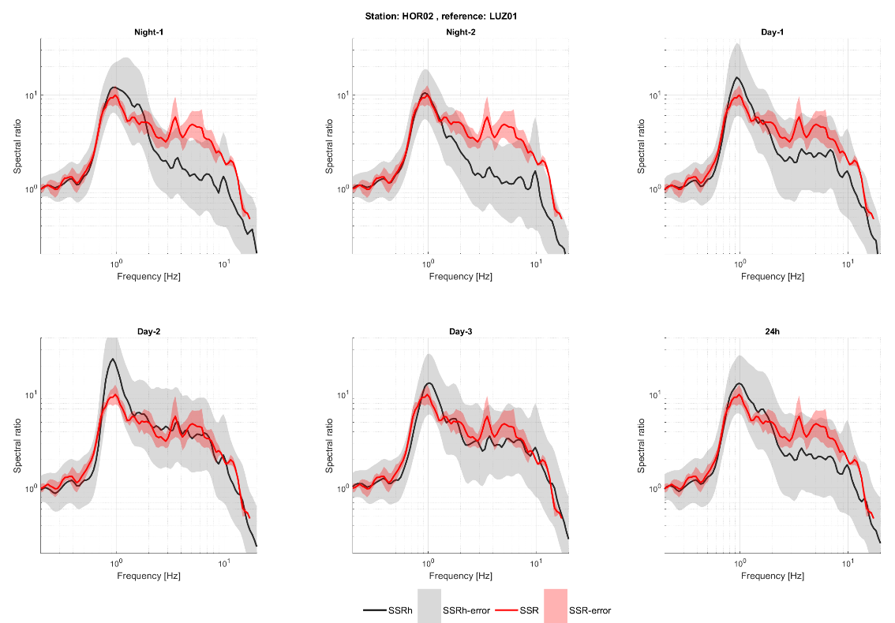
SSRh – influence of human activities
However,
differences due to human activities usually
within error bars

Slide 26
SSRh – influence of human activities and deployment
Solutions:
Preliminary analysis using stations for which SSR function is known:
Check the fit between SSR and SSRh amplification functions
Check the influence of the time when you record
Check if there is a difference due to the choice of intermediate station
(not always applicable based on another case study)
+
The more and the more evenly distributed intermediate stations, the better
The longer ambient noise recording (to some extent), the better
Removal of transient part from ambient noise recordings (not checked)

Slide 27
Conclusions

Slide 28
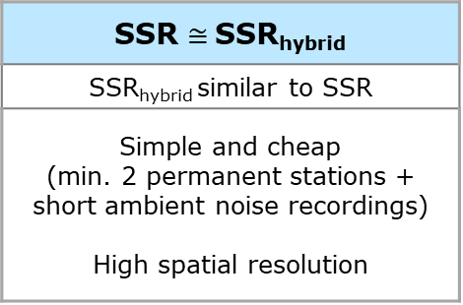
Conclusions
SSR $≅$SSR_{hybrid}
SSR_{hybrid} similar to SSR
Simple and cheap (min. 2 permanent stations + short ambient noise recordings) High spatial resolution
Preliminary estimation of relative amplification factors in Lucerne area:
Strong spatial variability
of the soil response
High amplification factors
in broad frequency range
What to remember before using:
Deployment of
intermediate stations
Influence of human activities

Slide 29
References
Bard, P.-Y., 1999. Microtremor measurements: A tool for site effect estimation? Eff. Surf. Geol. Seism. Motion 3, 1251–1279.
Bonnefoy-Claudet, S., Cotton, F., Bard, P.-Y., 2006. The nature of noise wavefield and its applications for site effects studies: A literature review. Earth-Sci. Rev. 79, 205–227. https://doi.org/10.1016/j.earscirev.2006.07.004
Borcherdt, R.D., 1970. Effects of local geology on ground motion near San Francisco Bay. Bull. Seismol. Soc. Am. 60, 29–61.
Ciaccio, M. G. and Cultrera, G.: Terremoto e rischio sismico, Ediesse, Italy, 2014.
Clinton, J., Cauzzi, C., Fäh, D., Michel, C., Zweifel, P., Olivieri, M., Cua, G., Haslinger, F., Giardini, D., 2011. The Current State of Strong Motion Monitoring in Switzerland, in: Earthquake Data in Engineering Seismology. Predictive Models, Data Management and Networks. Springer, pp. 219–233. https://doi.org/10.1007/978-94-007-0152-6_15
Fäh, D., Giardini, D., Kästli, P., Deichmann, N., Gisler, M., Schwarz-Zanetti, G., Álvarez Rubio, S., Sellami, S., Edwards, B., Goertz-Allmann, B., Bethmann, F., Woessner, J., Gassner-Stamm, G., Fritsche, S., Eberhard, D., 2011. ECOS-09 Earthquake Catalogue of Switzerland Release 2011. Swiss Seismol. Serv. ETH Zür.
Field, E.H., Hough, S., Jacob, K.H., 1990. Using microtremors to assess potential earthquake site response: a case study in Flushing Meadows, New York City. Bull. - Seismol. Soc. Am. 80, 1456–1480.
Kagami, H., Duke, C. M., Liang, G. C., Ohta, Y., 1982. Observation of 1- to 5-second microtremors and their application to earthquake engineering. Part II. Evaluation of site effect upon seismic wave amplification due to extremely deep soil deposits. Bull. Seismol. Soc. Am. 72(3), 987–998.
Perron, V., Gélis, C., Froment, B., Hollender, F., Bard, P.-Y., Cultrera, G., Cushing, E.M., 2018a. Can broad-band earthquake site responses be predicted by the ambient noise spectral ratio? Insight from observations at two sedimentary basins. Geophys. J. Int. 215, 1442–1454. https://doi.org/10.1093/gji/ggy355
Poggi, V., Fäh, D., 2016. Guidelines and strategies for seismic microzonation in Switzerland (Report). SED/ ETH Zurich. https://doi.org/10.3929/ethz-a-010735479
Poggi, V., Fäh, D., Burjanek, J., Giardini, D., 2012b. The use of Rayleigh-wave ellipticity for site-specific hazard assessment and microzonation: application to the city of Lucerne, Switzerland. Geophys. J. Int. 188, 1154–1172. https://doi.org/10.1111/j.1365-246X.2011.05305.x

