Slide 1
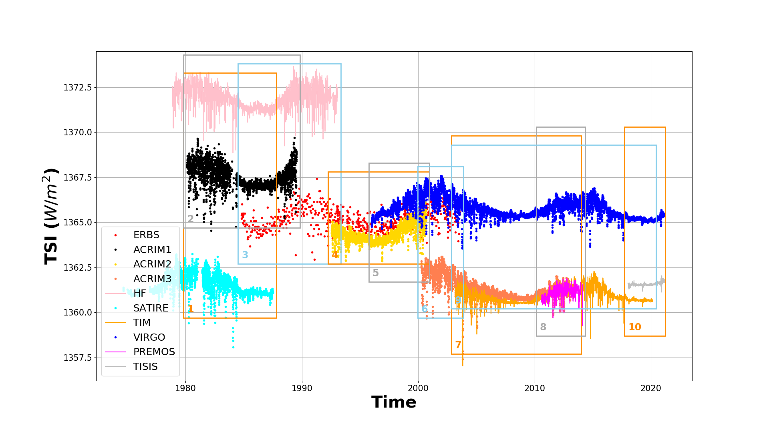
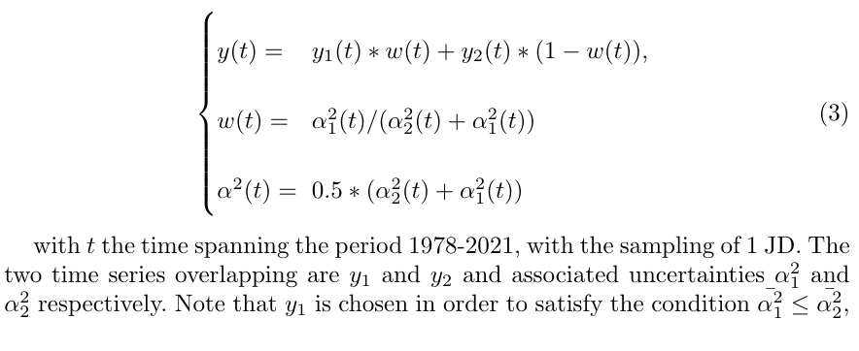

Data Fusion of Total Solar Irradiance Composite Time Series Using 40 years of Satellite Measurements: First Results
Jean-Philippe Montillet¹, Wolfgang Finsterle¹, Werner Schmutz¹, Margit Haberreiter¹, Rok Sikonja²
[1,PMOD/WRC, Davos, Switzerland; 2, ETH Zürich Switzerland]
Technical challenges
Modifying previous software (Montillet et al., AGU 2020, Finsterle et al., 2021) to do fusion of N-time series (degradation corrected), using Gaussian processes with white + Matern kernel (temporal correlations).
Ref: Finsterle W, Montillet JP, Schmutz W, et al. The total solar irradiance during the recent solar minimum period measured by SOHO/VIRGO. Scientific Reports. 2021 Apr;11(1):7835. DOI: 10.1038/s41598-021-87108-y.
Producing composite (1980-2021) a 2-step process
a/ Partioned time series into sub-timeseries and fused overlapping time series
b/ Stiching overlaping sub-TS to produce a 40-year long time series with daisy chain algorithm

Slide 2
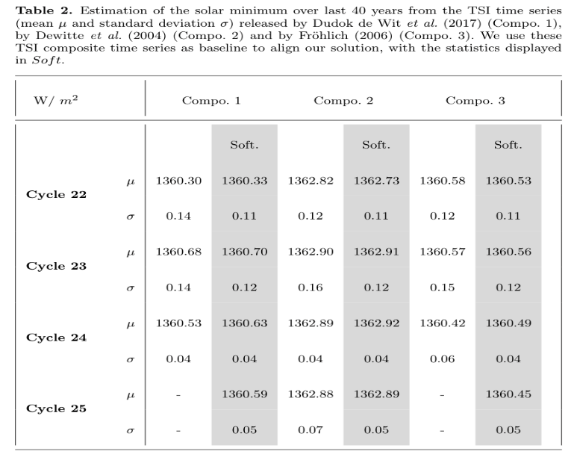
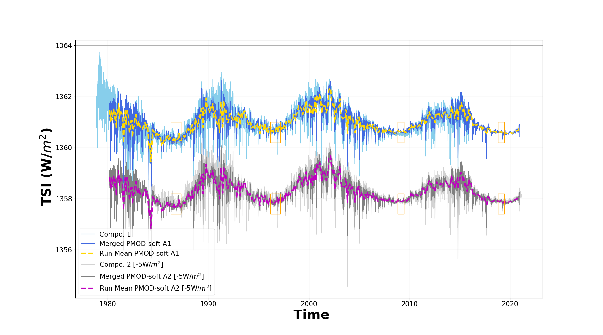
Data Fusion of Total Solar Irradiance Composite Time Series Using 40 years of Satellite Measurements: First Results
Jean-Philippe Montillet¹, Wolfgang Finsterle¹, Werner Schmutz¹, Margit Haberreiter¹, Rok Sikonja²
[1,PMOD/WRC, Davos, Switzerland; 2, ETH Zürich Switzerland]
Cycle 22
Cycle 23
Cycle 24
Cycle 25
Advantages
Fusion process based on not many assumptions on input observations (stochastic process assumed to be mixed white (Gaussian) noise and coloured noise). Proper kernel training (inducing points) capture short-term correlations and solar cycle.
Stiching process requires baseline, thus easy to compare with previous composites (e.g., PMOD -2016, Dudok de Wit et al. -2017)

Slide 3
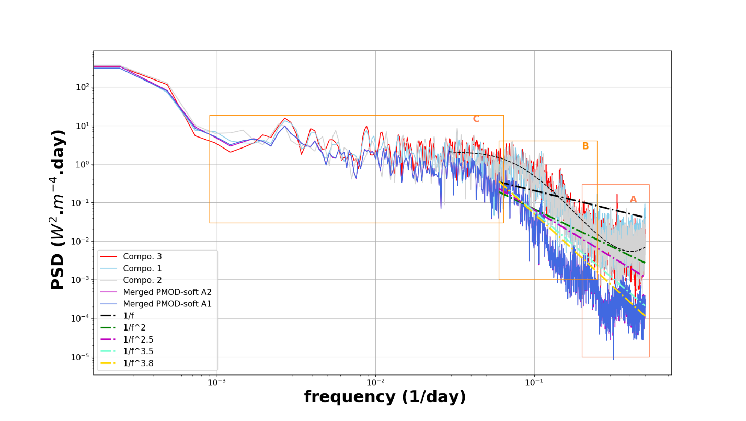
Data Fusion of Total Solar Irradiance Composite Time Series Using 40 years of Satellite Measurements: First Results
Jean-Philippe Montillet¹, Wolfgang Finsterle¹, Werner Schmutz¹, Margit Haberreiter¹, Rok Sikonja²
[1,PMOD/WRC, Davos, Switzerland; 2, ETH Zürich Switzerland]
Drawbacks
- Data fusion introduces correlation between observations in fused TS, requiring
large number of inducing points ( > 5000 pts), hence heavily time consuming. Process not done in real time.
- More correlation between estimates , thus steeper PSD ramp > See Box B in the Figure
Data fusion smoothes observations, thus less power in PSD

