Slide 1

Assembling a geoscience information portal from pieces of the open-source software jigsaw puzzle
Authors: Vincent Fazio*, Rini Angreani, Carsten Friedrich Pavel Golodoniuc, John Hille, Alex Hunt, Lingbo Jiang, Jens Klump, Geoffrey Squire, Peter Warren, Stuart Woodman, Ulrich Engelke, Sam Bradley**
* Presenting author
** All authors work at CSIRO Australia

Slide 2
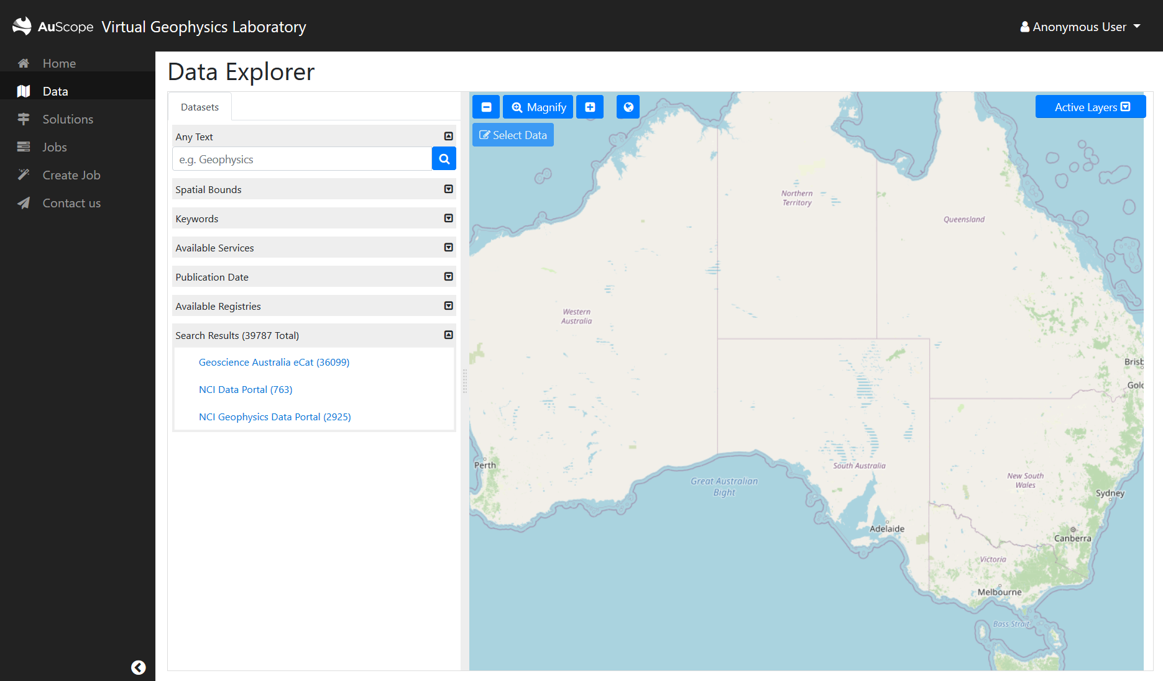
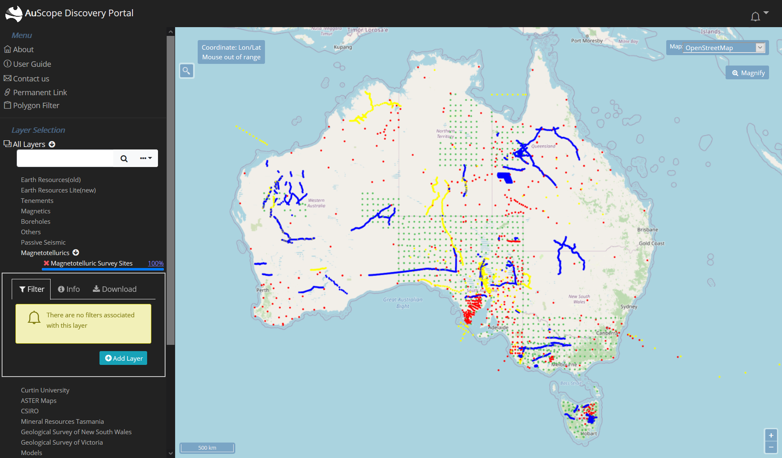
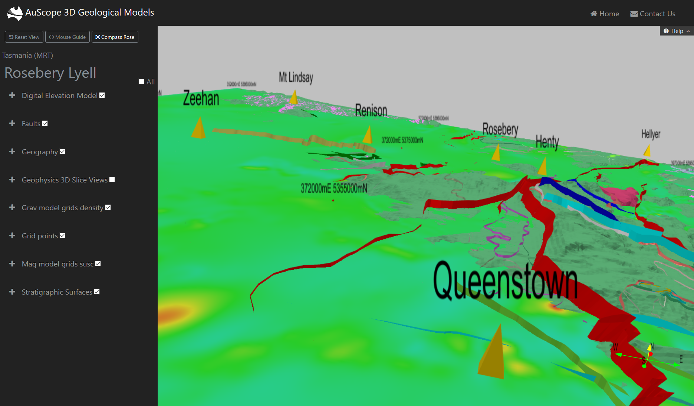
Background
We have three geospatial portals:
AuScope Portal
Virtual Geophysics Lab
3D Geological Models
They are built using the Angular framework
They use OpenLayers and iTowns/ThreeJS
We would like to upgrade and merge them
Notes:
AuScope Portal (http://portal.auscope.org.au/)
Virtual Geophysics Lab (https://vgl.auscope.org/dashboard)
3D Geological Models (http://geomodels.auscope.org.au/)
Angular framework (https://angular.io/)
OpenLayers https://openlayers.org/
iTowns http://www.itowns-project.org/

Slide 3
Strategy, Aims
Required features:
Move to having a 3D capability, time-based data
Move to supporting time-based data
Support viewing underground geology
Support OGC protocols
FAIR principles
Must use fully “Open Source” libraries
Other considerations:
Ease of adding custom display and scientific workflow widgets
Cost and benefits of integration with existing components
Minimise future maintenance burden
Notes:
Support OGC protocols (https://www.ogc.org/)
FAIR principles (https://en.wikipedia.org/wiki/FAIR_data)

Slide 4
Main Contenders
OpenLayers
TerriaJS
KeplerGL
Mapbox GL JS
DeckGL
NASA WorldWind Web
OpenSphere
iTowns
CesiumJS
Notes:
OpenLayers (https://openlayers.org)
TerriaJS (https://terria.io/)
KeplerGL (https://kepler.gl/)
Mapbox GL JS (https://docs.mapbox.com/mapbox-gl-js/api/)
DeckGL (https://deck.gl/)
NASA WorldWind Web (https://worldwind.arc.nasa.gov/web/)
OpenSphere (https://github.com/ngageoint/opensphere)
iTowns (http://www.itowns-project.org/)
CesiumJS (https://cesium.com/cesiumjs/)

Slide 5
Stage 1: Evaluation via Criteria
We evaluated each library with four different kinds of criteria:
Tests of basic mapping functions
Support of industry standard protocols and other desirable features
Community support
Compatibility with current toolset
Notes:
We wrote, adapted and tested code for “Test basic mapping functions”

Slide 6
First Criteria Type: Support basic map functions
Map zoom/zoom to extent
Change map base layers
Can change layer transparency
Supports in map popup info boxes
Register callback for map events
Can style KML layers?
Draw shapes on map with mouse
Mouse coordinate display widget
Map text search widget (geocoders)
Add custom widgets to map
This API just does maps? Or contains a complete website
Fully customizable sidebar map controls?

Slide 7
Second Criteria Type: Support of protocols and desirables
Supports OGC protocols
Supports vector layers
Supports 2D mapbox vector tiles
Split Screen
Supports underground 3D and switching from 2D to 3D
Mobile phone friendly features
Can draw point data as clusters e.g., GeoJSON, KML
Notes:
Only Cesium, Mapbox or ThreeJS are known to support viewing underground structures

Slide 8
Third Criteria Type: Community Support
Free?
Mature
Open source
Large community of users and technology backers
Aggressive API deprecation policy?

Slide 9
Fourth Criteria Type: Compatibility with current toolset
Typescript bindings
Can adapt to Angular framework?
Dependent on any JS frameworks?

Slide 10
Results of criteria survey
1st CesiumJS: 23 criteria satisfied
2nd Mapbox GL, KeplerGL, DeckGL: 21 satisfied, 5 half-sat
3rd OpenSphere, OpenLayers, TerriaJS: 21 satisfied, 2 half-sat
4th iTowns: 20 satisfied
5th NASA WorldWind Web: 17 satisfied
Notes:
NB: KeplerGL and DeckGL only satisfy 18 and 19 criteria by themselves but in practice they are used in combination with MapboxGL JS

Slide 11
Stage 2: Estimation of effort required
Some of these libraries supply just map functions, and others are complete geospatial website solutions, so we evaluate them as combinations
Type of Effort | Max. lines of code affected | Status Quo: OpenLayers Angular | TerriaJS ReactJS | MapBoxGL KeplerGL DeckGL ReactJS | MapBoxGL DeckGL Angular | OpenSphere AngularJS | iTowns Angular | CesiumJS Angular
Rewriting of UI menus | 2129 | Yes | No | No | Yes | No | Yes | Yes
Rewriting specialised Typescript | 5390 | No | Yes | Yes | No | Yes*** | No | No
Replace Angular Framework | 12402 | No | Yes | Yes | No | Yes*** | No | No
Rewrite map & layer functions | 4883 | No | No | No | Yes* | No | Yes | Yes*
Est. total lines rewrite |  | 2129 | 12402 | 12402 | 3000 | 12402 | 5000 | 3000
Effort required in long term | 7012 | HIGH | LOW | LOW | MID ** | LOW | HIGH | MID **
Notes:
* - Cesium and Mapbox each have a library of Angular components which will reduce the effort required
** - Less maintenance than OpenLayers, e.g. there is no ‘ol-cesium’ adaptation layer
*** - OpenSphere uses older ‘AngularJS’ library and plans to upgrade to Svelte or React in future

Slide 12
Evaluation so far
Evaluation so far
All the complete geospatial website solutions use non-Angular frameworks
iTowns and OpenLayers provide a larger maintenance burden
Mapbox and Cesium provide an easier upgrade path and lower maintenance costs

Slide 13
Stage 3: Final Elimination Round!
Desired features for future | CesiumJS | MapboxGL + DeckGL + Three JS
Styling 2D mapbox vector tiles | Limited support and styling control | Well supported
Time based display | Well supported | Limited support
Viewing underground geology | Well supported | Requires source code modification
Point clouds | Well supported | Well supported (via deck.gl)
Supports OGC standards | WMS, TMS, WMTS | WMS & WMTS (mapbox vector tiles only)
Loading 3D GLTF models | Well supported | Well supported (via ThreeJS layer)
3D Tiles | Well supported | Prototype/Experimental
Notes:
Mapbox support for 3D Tiles:
1) Prototype https://github.com/Geodan/mapbox-3dtiles Not clickable, cannot add textures, one CRS
2) Via deck.gl but labelled as "Experimental".

Slide 14
Conclusion
For our purposes, where we have a lot of specialised code written in Angular, Cesium seems to be the best choice.

