Slide 1





Macroplastic debris transfer in rivers: A Travel Distance Approach
Robert Newbould, Mark Powell, Mick Whelan
School of Geography, Geology and the Environment, University of Leicester
ran14@le.ac.uk
@robert_newbould
robertnewbould138

Slide 2
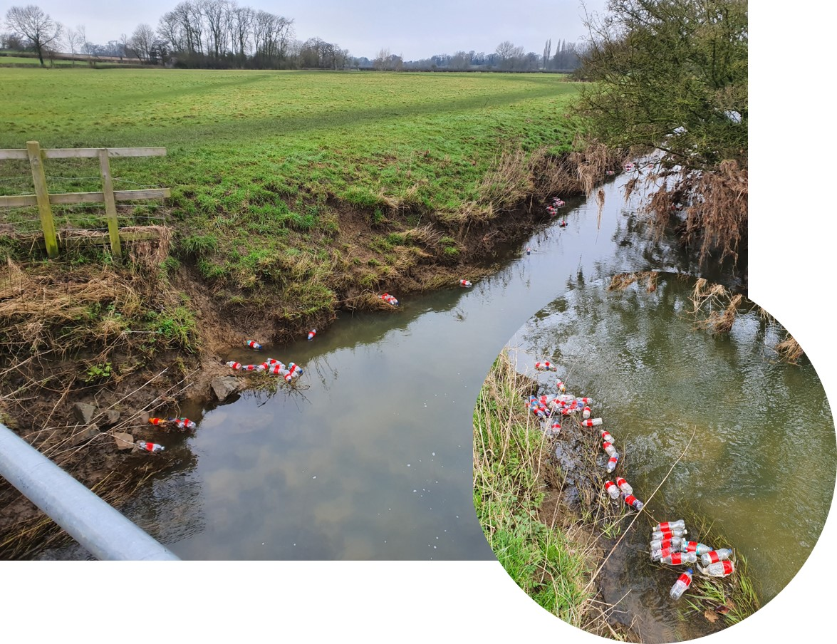
Introduction
Existing methods to investigate plastic transport in rivers do no explicitly consider plastic displacement and storage processes
Here we describe empirical data on the transport of macroplastic tracers in a small river reach and a numerical model framework which attempts to describe processes controlling displacement and storage to predict travel distance distributions
Fig. 1 – Tracers trapped along channel banks

Slide 3
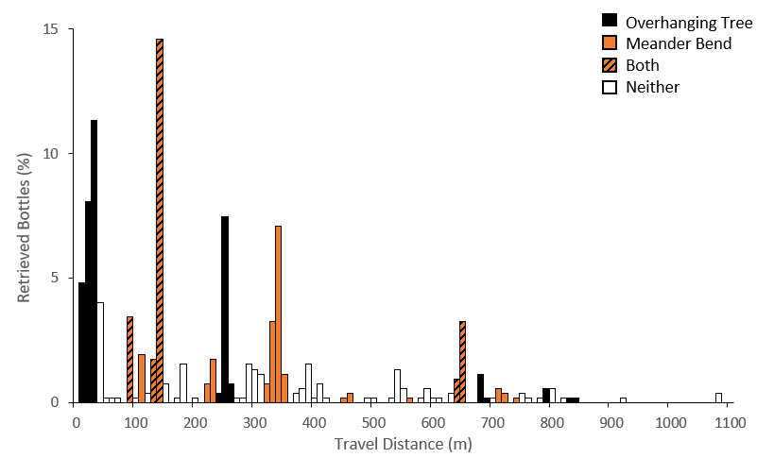

Tracer Experiments
Plastic bottle tracers were injected at the upstream boundary and the location of each bottle was recorded after 24 hours to produce a travel distance distribution
The location and nature of ‘trapping points’ were recorded
The experiment was repeated six times under similar and steady discharge conditions
Fig. 2 shows the combined travel distance distribution from all replicates, colour coded according to the presence/absence of trapping points
Travel distances were…
Low $(x̅$ = 231 m)
Highly variable between replicates (SEM = 106 m)
Mediated by the location of discrete ‘trapping points’ (particularly overhanging trees and meander bends)
Fig. 2 - Combined travel distance distribution from six replicate experiments

Slide 4
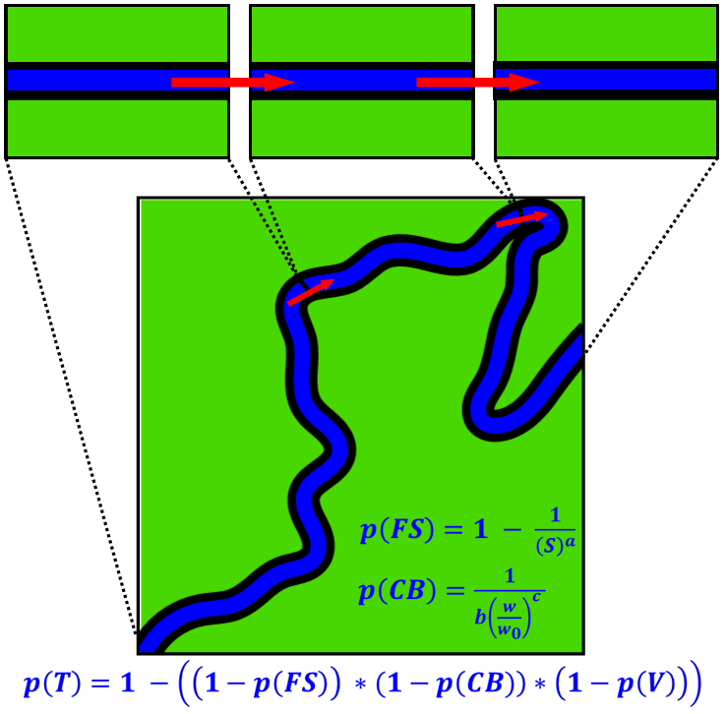
Modelling
Methods:
A stochastic model was constructed to simulate the transfer, trapping and release of plastic debris
The probability of trapping, p(T), in discrete reaches (cells) is described by hypothetical relationships between p(T) and channel and vegetation characteristics (see Fig. 3)
A series of Bernoulli trials are performed for each tracer item, using uniform random numbers which are compared to p(T), to predict the location of particles in each model iteration
The model was calibrated using the empirical observations of tracer locations after 24 hours
Fig. 3 - Schematic illustration of the transfer of macroplastic debris from cell to cell and probability of trapping equations
* p(FS) is the probability of trapping in flow separation zones, p(CB) is the probability of trapping along channel banks, p(V) is the probability of trapping in overhanging vegetation, S is the sinuosity index, w is channel width, w₀ is minimum channel width and a, b and c are calibration parameters

Slide 5
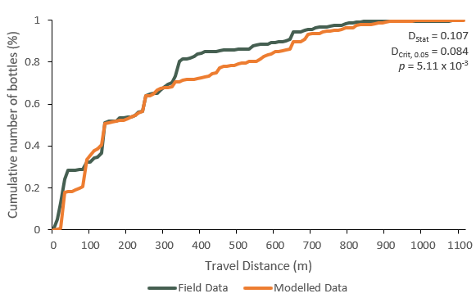
Modelling
Key Results:
The modelled travel distance distribution was in general agreement with the observed data (Fig. 4)
Trapping by overhanging trees was simulated well; trapping along meander bends, less so
The model can be used to evaluate the effect of plastic retention on flux, identify plastic accumulation zones and predict travel distance and residence time distributions
Fig. 4 - CDF of predicted and observed 24 h travel distances

Slide 6
Discussion and Conclusions
Summary:
We present a new approach to investigate macroplastic transport, which considers the processes controlling retention and displacement and predicts the travel distances of macroplastic debris
Limitations and Future Work:
Model performance is limited by an imperfect understanding of displacement and trapping processes
Additional experiments in reaches with similar and different characteristics and at different spatial and temporal scales should improve this understanding and improve model performance
Accurate estimates of the location, frequency and volume of plastic emission to rivers are also needed for real-world estimates of plastic retention and flux

