Slide 1


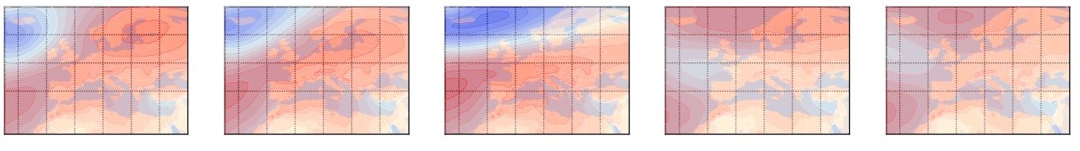
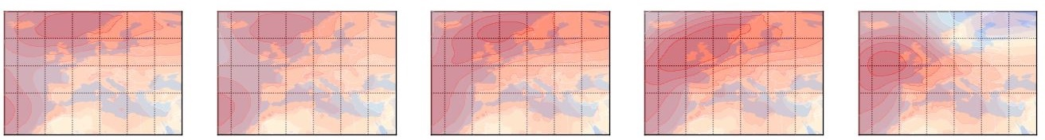


Health-relevant, concurrent ground-level ozone and temperature events in recent and future European climate
Live Presentation Slide with oral presentation information and links (bold and underlined) added
        Sally Jahn¹, Elke Hertig²
        ¹PhD Student, Regional Climate Change and Health, Faculty of Medicine and Institute of Geography, University of Augsburg
        ²Professor, PhD Supervisor, Regional Climate Change and Health, Faculty of Medicine, University of Augsburg
Click me!
Modeling of combined tropospheric ozone and temperature events relevant for human health in Europe
The project focuses on statistical modeling and projecting health-relevant, compound ozone and temperature (o-t-) events in present and future European climate.
In Central Europe, five meteorological factors and ozone persistence were identified as main drivers of o-t-events. A sharp increase of these events was projected under RCP4.5 and RCP8.5 scenario assumptions, especially with more frequent occurrences in south- to mid-eastern parts of Central Europe.
The results in Central Europe already point to the fact that the relationship between both variables as well as between both variables and underlying drivers varied with the location of sites and seasons.
The current work focuses on the spatial-temporal characterization of recent occurrences and future frequency shifts of elevated ozone and temperature levels in the whole European domain. The study domain is objectively divided into six identified European regions showing deviant o-t-characteristics. Meteorological drivers but also synoptic weather types were evaluated with regard to the European ozone and temperature characteristics in order to identify factors associated with high ozone and temperature levels.
Recent Publication
Jahn, S., Hertig, E. Modeling and projecting health-relevant combined ozone and temperature events in present and future Central European climate. Air Qual Atmos Health 14, 563–580 (2021). https://doi.org/10.1007/s11869-020-00961-0

Slide 2
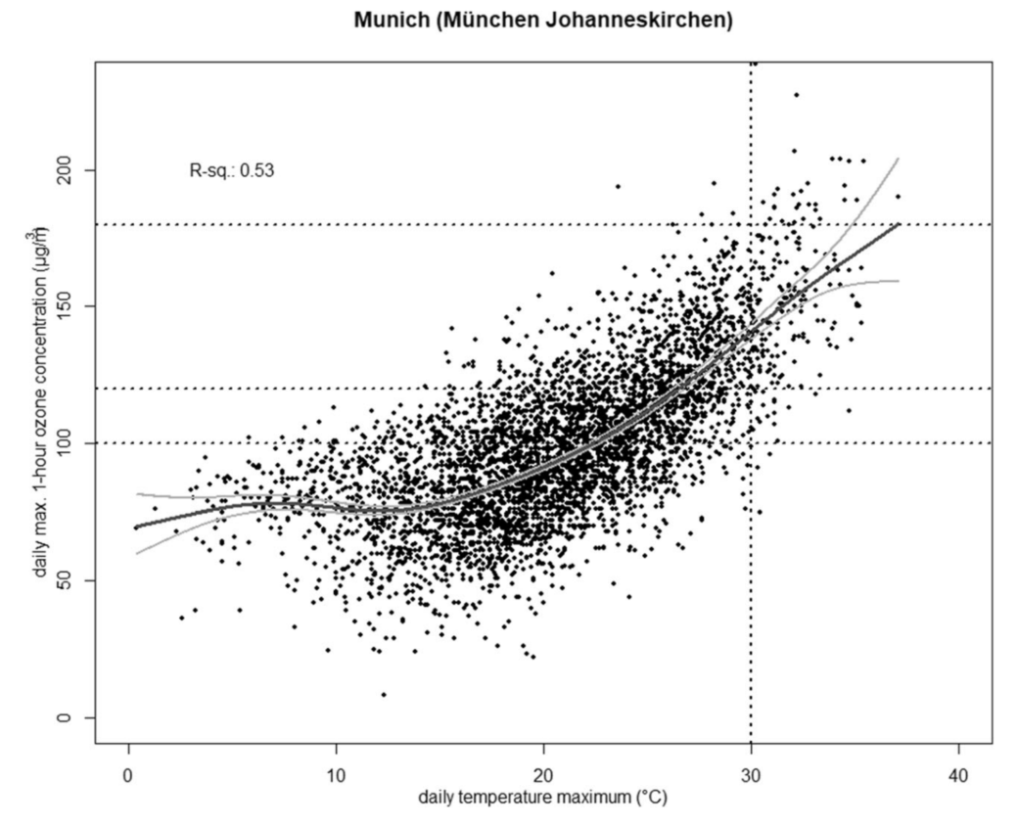
Health-relevant compound events
Temperature and Health
Single day occurrences or prolonged episodes of elevated air temperature levels, e.g. heat waves, are recurrently associated with an exceptionally high mortality rate, only representing the extreme end of a wide range of possible health effects.
Ozone and its Air Quality Standards
Exposure to ground-level ozone provokes negative impacts on human health primarily affecting the cardio-pulmonary system, mainly causing respiratory or cardiovascular diseases.
For protecting humans from ozone exposure, the Ambient Air Quality Directive of the European Union suggests 120 μg/m³ (daily maximum 8-h mean) as a target value (EEA 2019). The WHO even recommended not more than 100 μg/m³ in their Air Quality Guidelines (WHO 2006).
Compound health effects
Due to the specific characteristics of ozone formation, ozone and air temperature are correlated and high levels of both variables often coincide (here the o-t-relationship is shown exemplarily for Munich, Fig 1). The most severe health-relevant events are generally associated with the co-occurrence of elevated levels of both variables. These co-occurrences represent an even intensified human health risk as synergistic effects lead to a risk beyond the sum of their individual effects (e.g., WHO 2008, Hertig et al. 2020). So, compound o-t-events present a severe major health risk, especially for vulnerable groups such as children, the elderly, and people with pre‐existing conditions.
Fig 1: Observation-based relationship between daily maximum ozone and air temperature from April to September (Station: München Johanneskirchen, 1993–2017)
Source: Hertig 2020

Slide 3
Combined o-t-events in recent Central European climate
Station-based ozone and temperature data is extracted for the observation period from 1993 to 2012. A high frequency of co-occurring threshold exceedances of ozone and temperature become evident by considering the spatial distribution (Fig 2) of the number of days with observed combined exceedances of ozone and temperature (a) and the proportion of these event days to the total number of days with thermal load (b). Exceedances and thermal load days are defined by a daily 75th percentile-threshold.
On average, 66% of days with elevated thermal load also ozone concentrations surpassing the 75th threshold. Thus, thermal load occurrences were associated with coinciding O₃ pollution on average on 592 days (approx. 16% of all days in the o-t-season in Central Europe).
For modeling, days with thermal load were observed when temperature values rose above the 75th percentile-based thresholds, while ozone exceedances were defined for days with ozone pollution levels beyond the respective 75th percentile-based or 100 μg/m³ thresholds.
On combined event days, mean and median daily ozone and air temperature levels in the o-t-season amounted to 121.6 μg/m³ and 119.2 μg/m³ as well as 27.5 °C and 27.9 °C, respectively.
Fig 2: Absolute number of and proportion of o-t-event days to the total number of days with thermal load in the o-t-season from 1993-2012. Ozone and temperature exceedances are defined based on the 75th thresholds. Shape of points indicate the class of each station.
Source: Jahn and Hertig 2020

Slide 4
Combined o-t-events in future Central European climate
Projected changes (%) (Fig 3) of the number of o-t-events between 2031-2050 and 2081-2100 in comparison to the observation period from 1993-2012 point to a sharp projected increase, especially under RCP8.5 scenario assumptions. Numbers in Fig 3 refer to the ensemble mean across all seven used Earth System Models (ESMs) of the Coupled Model Intercomparison Project Phase 5 (CMIP5). Strongest increases (>60%) were projected for south- to mid-eastern Central Europe under RCP8.5 scenario assumptions. High levels of ozone and air temperature will increasingly coincide in these hotspot regions and hence more frequent occurrences of these combined events in the o-t-season will be observable. As a result, an even intensified threat to human life due to the associated individual and combined health effects of these health stressors can be anticipated in future scenarios.
Fig 3: Projected changes (%) with respect to the number of days with o-t-events between the periods 2031–2050 (left) and 2081–2100 (right) compared with 1993–2012. Numbers in the figure refer to the ensemble mean across all seven ESMs. Changes are shown under RCP4.5 (a, b) and RCP8.5 (c, d) scenario assumptions.
Source: Jahn and Hertig 2020

Slide 5
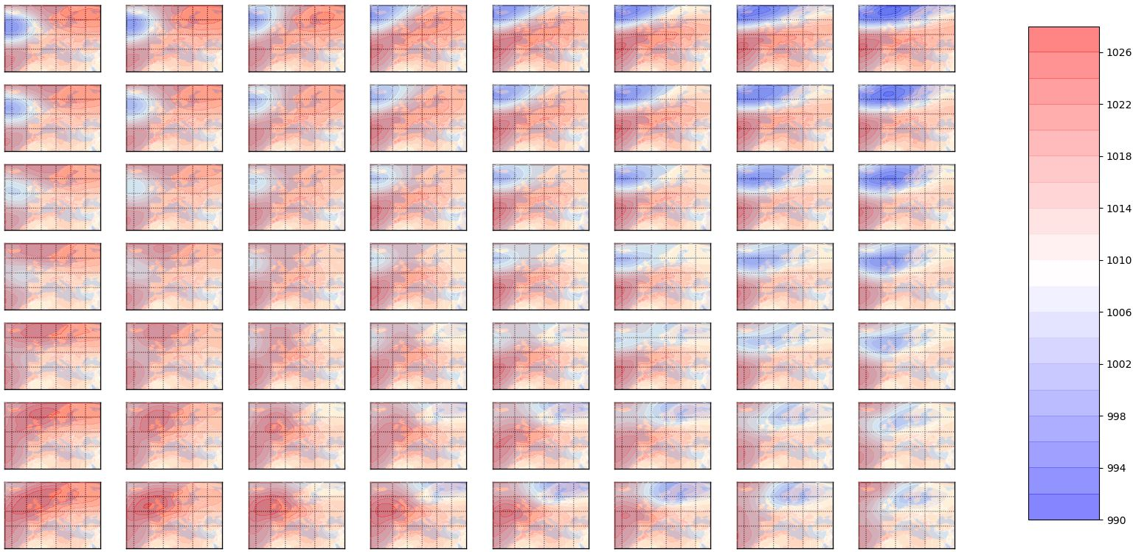
Insights current research work: Self Organizing Maps (SOM)
In order to describe the spatial-temporal characterization of recent occurrences and future frequency shifts of elevated ozone and temperature levels in the whole European domain, the impacts of large-scale weather patterns (aka weather types WT) on present-day o-t-events are evaluated. Therefore, Self-Organizing Maps (SOM) as a type of artificial neural network (ANN) based on unsupervised learning are used to classify synoptic weather types. Advantages of this algorithm in comparison to other clustering methods are e.g., that clusters are arranged in a meaningful manner with neighboring nodes being similar to each other. Daily mean sea level pressure data (MSLP, ERA5 reanalysis, resolution: 1° x 1°) is used to generate a SOM based weather classification for the European domain.
An overview map of the final 56 weather types (i.e., weights) is created and shown in Fig 4. Each pattern shows the MSLP-“weight” of one node. It becomes apparent that the array of nodes self-organize into a pattern with more similar nodes being into closer proximity and more dissimilar nodes further away. New samples can be classified by evaluating the Euclidean distance between the new sample and the weights of all nodes. Weather types that are highly associated with ozone- , temperature- and compound o-t-events are identified the most influencing WTs in Europe across all regions are extracted. For example, WT49 (black arrow) is identified to lead substantially to o-t-events favoring conditions in northern parts of Europe.
Click here to ZoomIn
Fig 4: 56 synoptic weather types (WTs) in Europe. Every single WT is based on one SOM node. The respective pattern shown is the MSLP-“weight” of each node. Consequently, weather type WT1 (upper left corner) to WT56 (bottom right corner) is presented. Atmospheric pressure levels are shown in hPa.
Source: Jahn and Hertig 2021
WT49

Slide 6
Overview: Results
The most important and striking results
Ground-level ozone and air temperature are highly correlated and high levels of both variables often coincide. These co-occurrences result in an intensified human health risk as synergistic effects lead to a risk beyond the sum of the individual effects of each variable.
In Central Europe, five meteorological factors and ozone persistence were identified as main drivers of ozone-temperature(o-t)-events.
O-t-events were projected to substantially increase in Central Europe under RCP 4.5 and RCP 8.5 scenario assumptions. Hotspot regions showing a strong frequency shift towards a sharply growing number of combined high levels of ozone and temperature under future scenarios can be identified.
In general, in most regions of Central Europe, an even intensified threat to human life due to the associated individual and combined health effects of these health stressors can be anticipated under future scenarios.

Slide 7
Recent Publications
Hertig E. (2020) Health-relevant ground-level ozone and temperature events under future climate change using the example of Bavaria, Southern Germany. Air Qual. Atmos. Health. doi: 10.1007/s11869-020-00811-z
Hertig E., Russo A., Trigo R. (2020) Heat and ozone pollution waves in Central and South Europe- characteristics, weather types, and association with mortality. Atmosphere. doi: 10.3390/atmos11121271
Jahn S., Hertig E. (2020): Modeling and projecting health-relevant combined ozone and temperature events in present and future Central European climate. Air Qual Atmos Health 14, 563–580 (2021). https://doi.org/10.1007/s11869-020-00961-0
Jahn S., Hertig E. (2021) Current and future occurrences of health-relevant, compound heat and ozone pollution events in six European ozone-temperature regions. In preparation

Slide 8
Sources and further information
EEA (European Environment Agency) (2019) Air quality in Europe - 2019 report. European Environment Agency, Luxembourg
EEA (European Environment Agency) (2014) AirBase - the European air quality database. Data and metadata available at: https://www.eea. europa.eu/dataandmaps/data/airbase- the-european-air-qualitydatabase-8. Accessed 26 Mar 2020
Hersbach H., Dee D. (2016) ERA5 reanalysis is in production. ECMWF Newsletter 147:7. Available at: https://www.ecmwf.int/en/ newsletter/147/news/era5-reanalysis-production. Accessed 27 Apr 2020
Klein Tank A.M.G., Wijngaard J.B., Können G.P., Böhm R., Demarée G., Gocheva A., Mileta M., Pashiardis S., Hejkrlik L., Kern-Hansen C. (2002) Daily dataset of 20th-century surface air temperature and precipitation series for the European Climate Assessment. Int J Clim 22:1441–1453. https://doi.org/10.1002/joc.773
Otero N., Sillmann J., Schnell J.L., Rust H.W., Butler T. (2016) Synoptic and meteorological drivers of extreme ozone concentrations over Europe. Environ Res Lett. doi: 10.1088/ 1748-9326/11/2/024005
Taylor K.E., Stouffer R.J., Meehl G.A. (2012) An overview ofCMIP5 and the experiment design. Bull Am Meteorol Soc 93:485–498. https:// doi.org/10.1175/BAMS-D-11-00094.1
WHO (World Health Organization) (2006) WHO Air quality guidelines for particulate matter, ozone, nitrogen dioxide and sulfur dioxide. World Health Organization, Geneva
WHO (World Health Organization) (2008) Improving public health responses to extreme weather. World Health Organization, Copenhagen

Slide 9
Additional Background Information: Health effects and correlation
Health effects of ozone and temperature
Single-day and prolonged episodes of elevated air temperature levels can negatively affect human health. A higher cardiovascular, cerebrovascular, or respiratory mortality rate just represents the final extreme end of a variety of adverse human health impacts determined by the level of exposure with respect to e.g., duration, severity, and frequency. Increasing thermal load due to high air temperature levels can lead to or worsen health effects, such as severe dehydration, cramps, heat exhaustion, syncope, oedema, thrombogenesis, heat rush or life-threatening heatstrokes.
Elevated levels of ozone cause a variety of human health effects with the severity and extent of symptoms being highly determined via duration and intensity of the exposure to the reactive and oxidative gas. Ground-level ozone mainly affects the cardio-pulmonary system mainly resulting in respiratory or cardiovascular diseases. Elevated concentrations have irritating effects on eyes, mucous membranes, and airways leading e.g., to lung inflammation and tissue damage, asthma, a reduction of the self-cleaning mechanism of the bronchi, cardiac arrhythmia, heart attacks, and heart failure.
Correlation of ground-level ozone and surface air temperature
S1: Spearman rank correlation coefficients between observed MDA8O3 concentrations and TX values for each station in Central Europe during the 1993–2012 period. 85 stations pairs (number depicted on the x-axis) are considered.

Slide 10
Additional Background Information: Database
Observation-based station ozone and temperature data
Data | Data Source / Institution | Spatial Resolution | Temporal Resolution | Information
Ground-level ozone | European Environment Agency (EEA): AirBase version 8 Air Quality eReporting (current work) | Station-based (S2) | Daily maximum based on running 8-h means Period 1993-2012 Period 2004-2018 (current work) | e.g. EEA 2014
Surface air temperature | European Climate Assessment & Dataset project (ECA&D) | Station-based (S2) | daily maximum Period 1993-2012 Period 2004-2018 (current work) | e.g. Klein Tank et al. 2002
ERA5 reanalysis and CMIP5 ESM data
Data | Level | Data Source / Institution | Spatial Resolution | Temporal Resolution | Information
Mean air temperatures Thermal radiation Geopotential heights Meridional winds Relative humidity | 850 hPa Surface 850 hPa 500 hPa 500 hPa | European Centre for Medium-Range Weather Forecasts (ECMWF) | 0.75° x 0.75 (downloaded resolution) | 1993-2012 | e.g. Hersbach and Dee 2016
same variables as above |  | Seven ESMs (only first run) of the Coupled Model Intercomparison Project Phase 5 (CMIP5) | Original ESM data was regridded to match ERA5 resolution (nearest neighbor remapping) | historical period 1993–2012 mid-century 2031–2050 late-century 2081–2100 (CMIP5 labels: historical, rcp45, rcp85) | e.g. Taylor et al. 2012
S2: Location of all 85 selected o-t-station pairs in Central Europe. All spatial station information is representative for the respective ozone station. Color and shape of points indicate the class of each station. Classes are specified as follows:
rb = rural background, ri = rural industrial, sb = suburban background, ub = urban background, ut = urban traffic

Slide 11
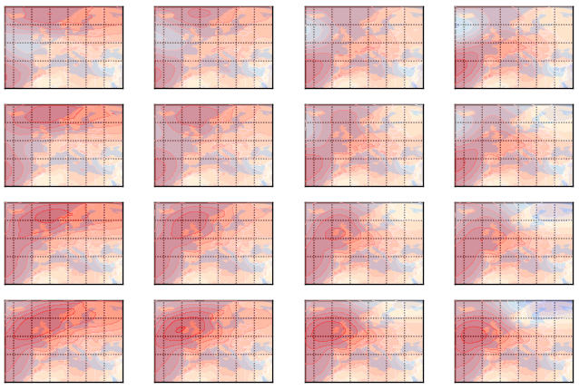
Additional Background Information: ZoomIn WTs
WT49

