Slide 1
Deploying vertical wires with drones to study wind turbine electrification under fair weather
Pol Fontanes Molina, Marcelo Arcanjo, Joan Montanyà – Universitat Politècnica de Catalunya (UPC)
Carmen Guerra-Garcia – Massachusetts Institute of Technology (MIT)
29th April 2021
Notes:
Good morning,
I am Pol Fontanes and I will be presenting my PhD thesis research plan: Electrostatic charge influence on lightning attachment process to aircraft and wind turbines.
Joan Montanyà from the UPC Lightning Research Group is the director of this thesis and Carmen Guerra from the Aerospace Plasma Group at the MIT the co-director.

Slide 2
AIM
Study wind turbine electrification under fair weather
Current induction
Point/corona discharge
Blade rotation effects into electrification

Slide 3
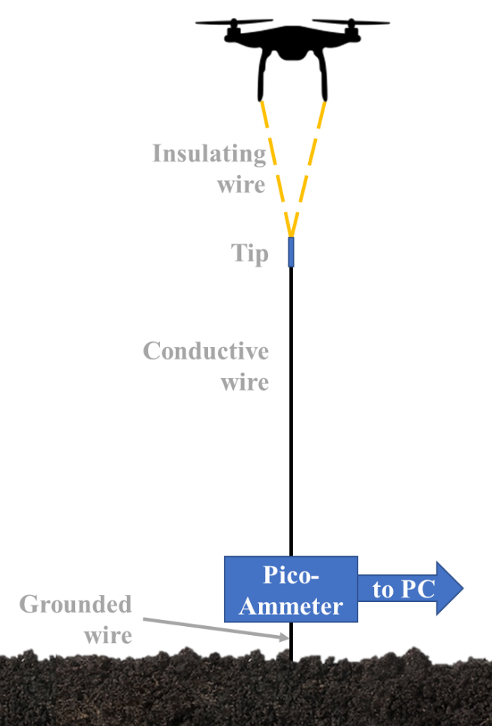
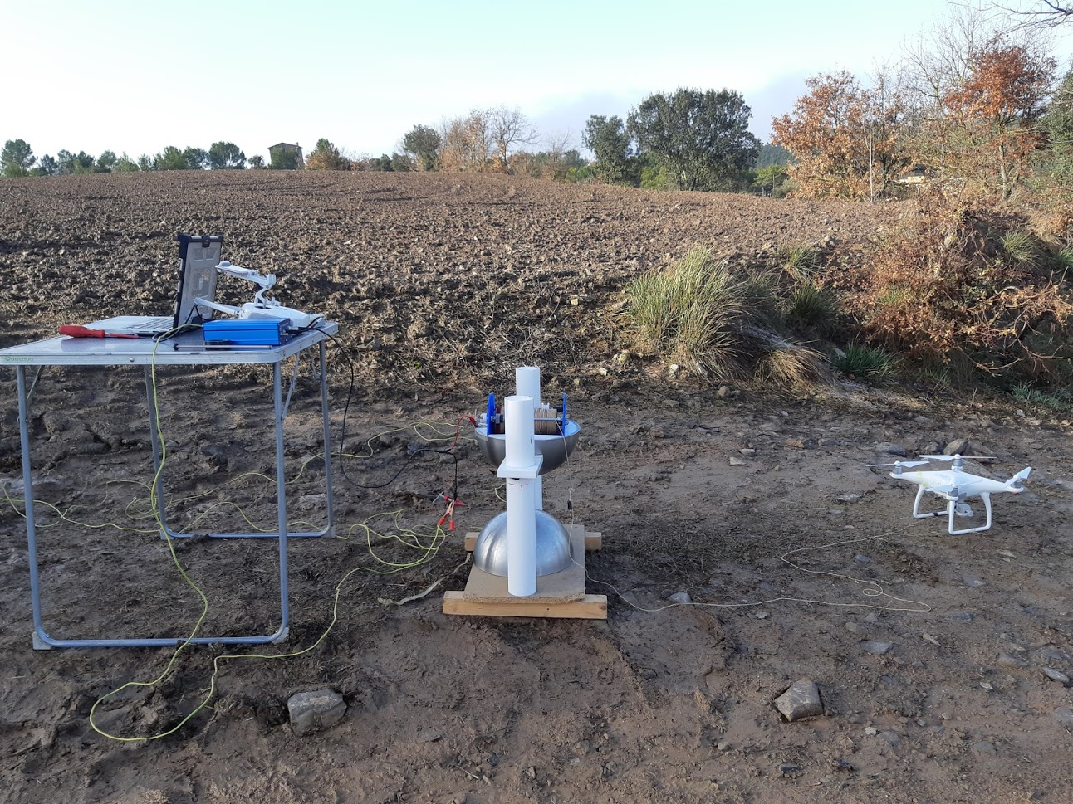
Experimental setup

Slide 4
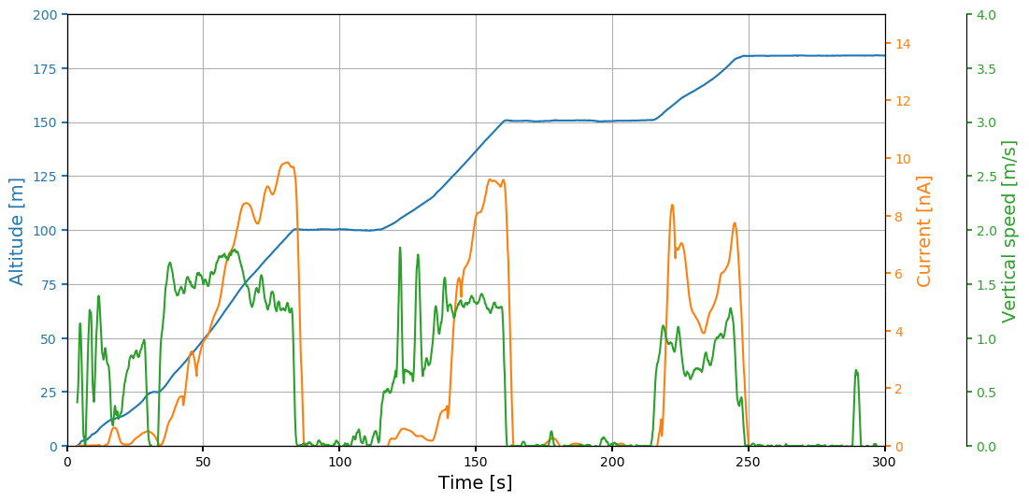
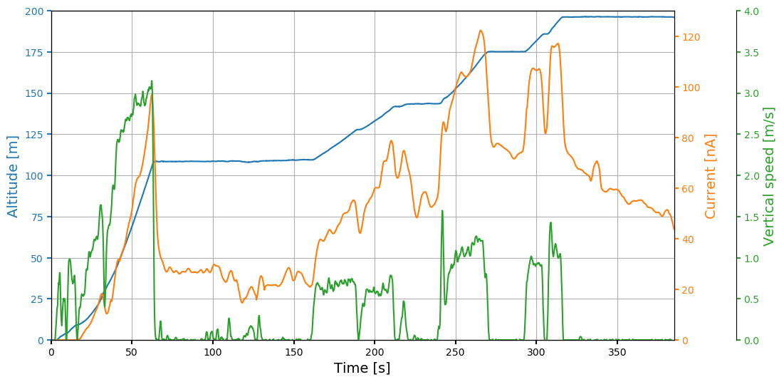
Results – Rounded tip
Vertical speed
Steady height

Slide 5
Results – Needle tip
Vertical speed
Steady height
Mixed
Decay

Slide 6
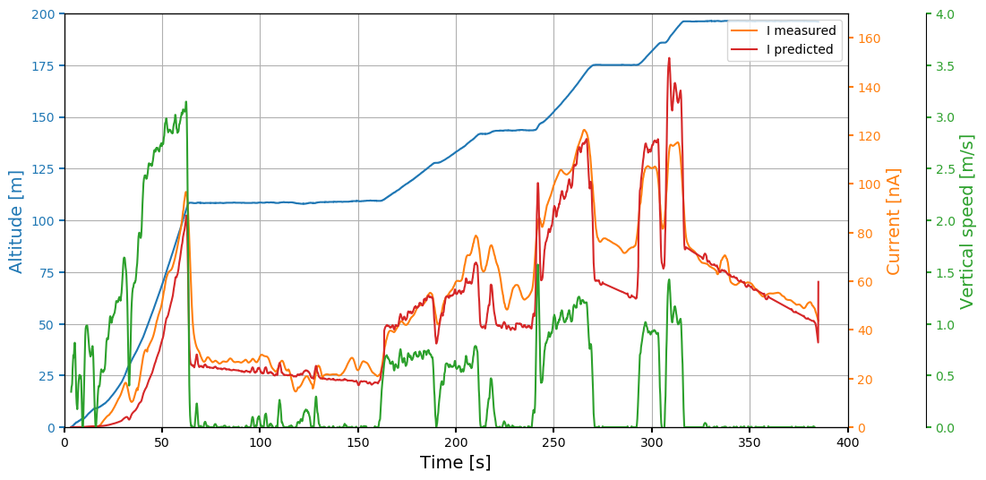
Model
Point discharge: $i_{PD}=Aε_{0}kE_{0}V_{p}$
Vertical speed: $i_{vel}=K\left(z\right)E\left(z\right)v_{z}$
Induced current: $i=i_{PD}+i_{vel}$

Slide 7
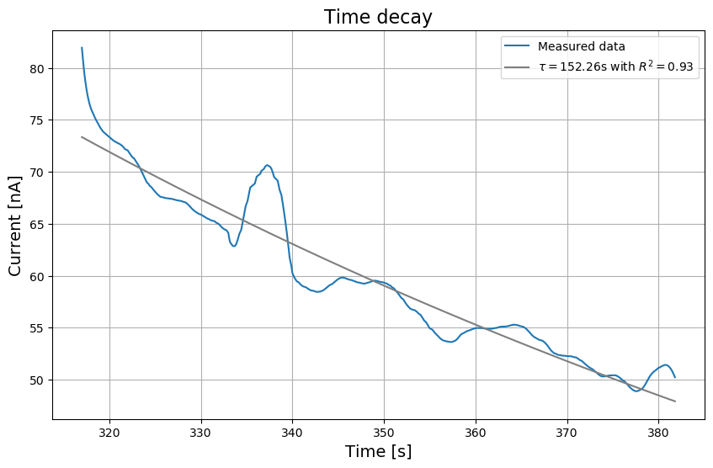
Current Decay – space charge formation
+
+
+
+
+
+
+
+
+
+
+
+
+
+
+
+
+
+
+
-
+
+
+
+
+
+
-
+
+
-
+
+
+
+
+
-
+
+
+
-
+
+
-

Slide 8
Conclusions
Wind turbines induce much higher currents than tall structures because of their blade’s rotation
Point discharge currents appear under fair weather conditions
Experiment setup useful for:
Atmospheric current measurements
Test platform for simulating grounded blades

Slide 9
Deploying vertical wires with drones to study wind turbine electrification under fair weather
Pol Fontanes Molina, Marcelo Arcanjo, Joan Montanyà – Universitat Politècnica de Catalunya (UPC)
Carmen Guerra-Garcia – Massachusetts Institute of Technology (MIT)
29th April 2021
Notes:
Good morning,
I am Pol Fontanes and I will be presenting my PhD thesis research plan: Electrostatic charge influence on lightning attachment process to aircraft and wind turbines.
Joan Montanyà from the UPC Lightning Research Group is the director of this thesis and Carmen Guerra from the Aerospace Plasma Group at the MIT the co-director.

