Slide 1





Session NH3.6:
Integration of ambient noise and ERT data to investigate the structure of the Yang Jia Gou rock avalanche deposits (Sichuan-China)
P. Caponeª , V. Del Gaudioª, J. Wasowski^{b} , W. Hu^{c}, N. Venistiª, Y. Li^{b}
ª Dipartimento di Scienze della Terra e Geoambientali, Università degli Studi di Bari “Aldo Moro”– Bari, Italy
^{b} Consiglio Nazionale delle Ricerche – Istituto di Ricerca per la Protezione Idrogeologica - Bari, Italy
^{c}State Key Laboratory of Geo-Hazard Prevention and Geo-Environment Protection, Chengdu University of Technology, P.R. China

Slide 2
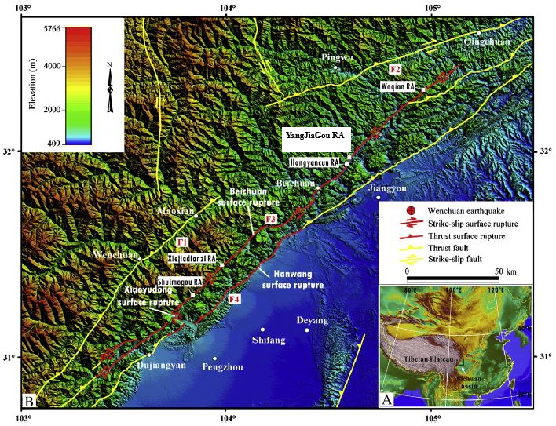
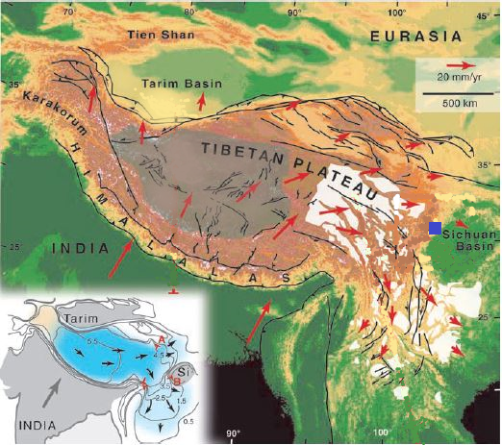
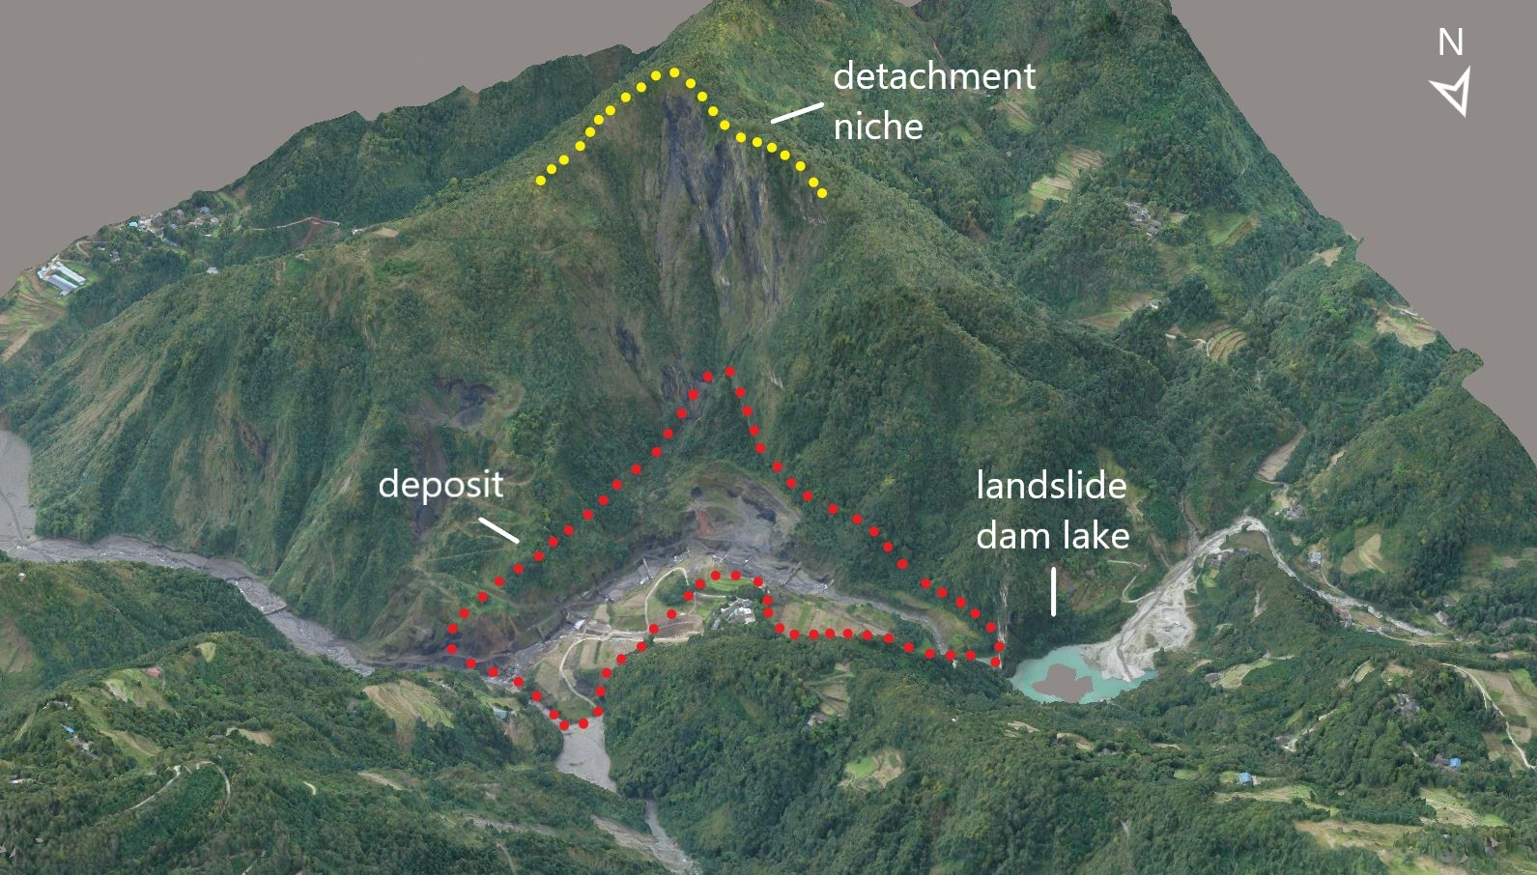
Session NH3.6:
Study of structure and mechanical properties of rock avalanche dam deposit triggered by the 2008 Wenchuan earthquake (Mw=7.9) in a gully named Yang Jia Gou
AIM
Yang Jia Gou
Beichuan
rupture surface
200.000 landslide
9.000 deaths
Del Gaudio V. et al, 2020. Ambient noise and ERT data provide insight into the structure of co-seismic rock avalanche deposits in Sichuan (China). Under review. Bull. Eng. Geol. Environ.

Slide 3
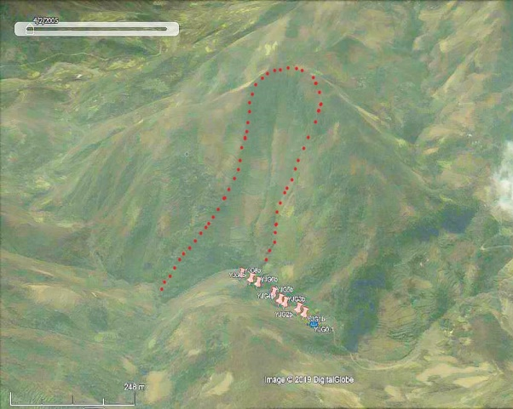
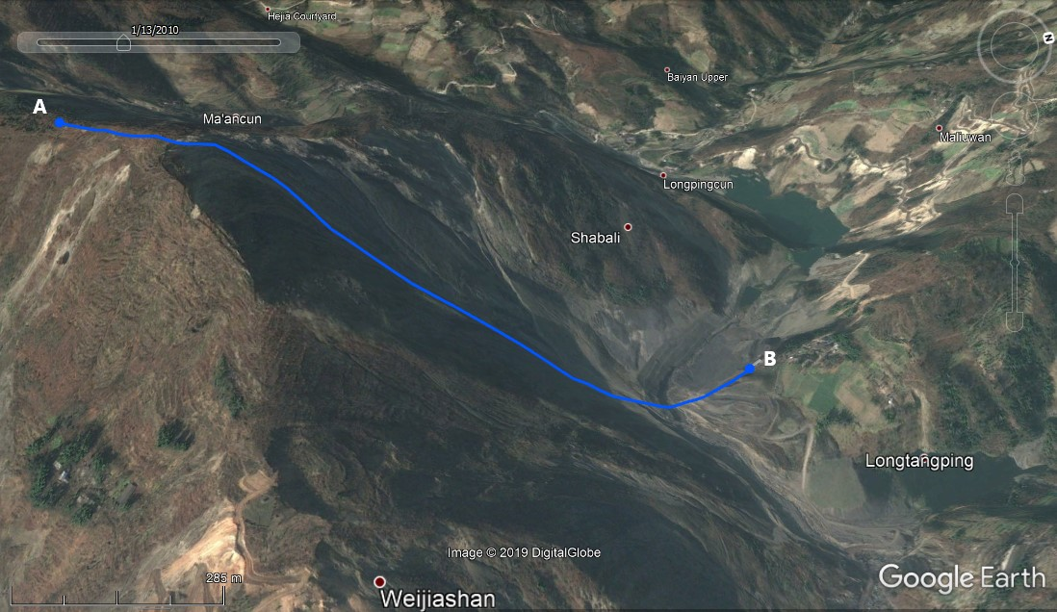
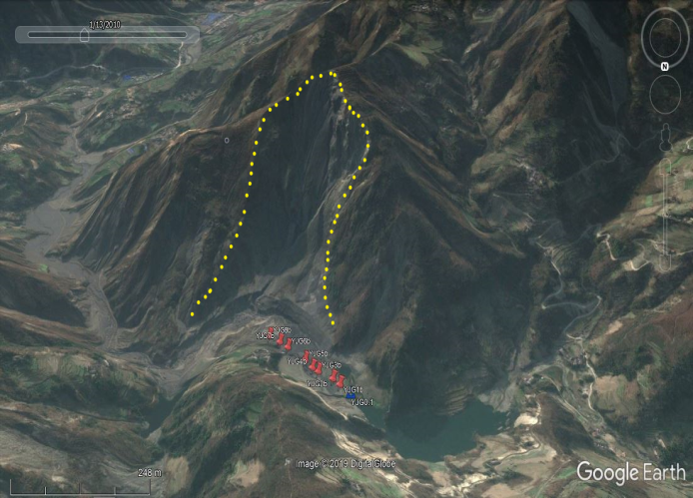
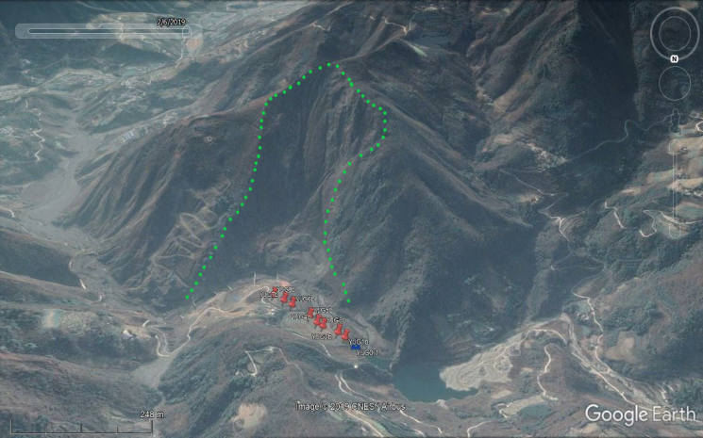
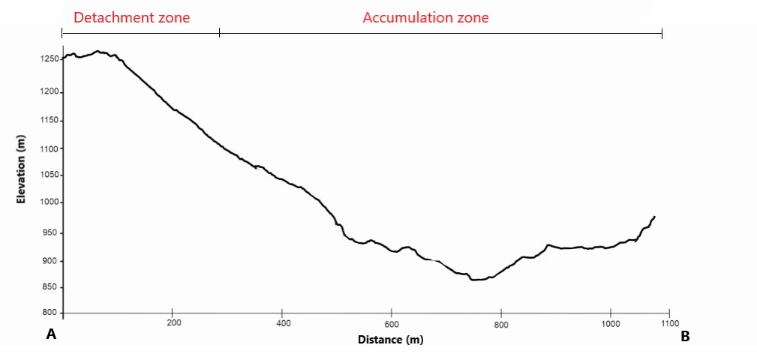
Session NH3.6:
2005
SLOPE EVOLUTION
Niche detachment has changed during the time..
2010
..probably due to the triggering of several landslides..
2018
..overlapped at the base of the slope

Slide 4
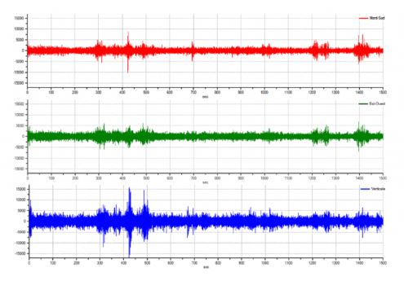
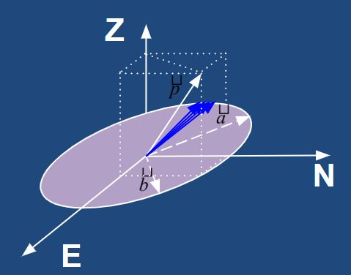
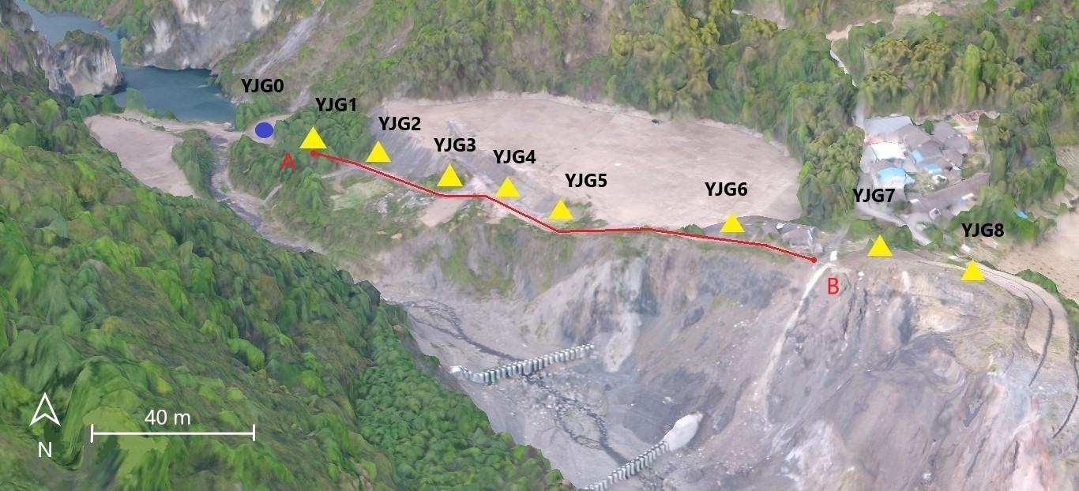
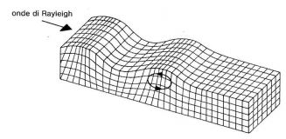
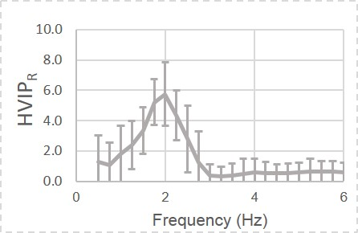

Session NH3.6:
HVIP
1) Identification
METHODOLOGY
Instantaneous polarization analysis allow to identificate and extract Rayleigh wave to better characterize site response
HVNR
(Nakamura, 1989)
HVIP
(Del Gaudio, 2017)
Passive seismic techniques
Representation of the signal as a vector (Morozov and Smithson, 1996)
Analytic transformation
Rover
$$u_{c}\left(t\right)=u\left(t\right)+i\hat{u}\left(t\right)=A(t)e^{iφ(t)}$$
Reference
2) Instantaneous H/V
Amplification
Geophysical surveys
ERT
Resonance Frequency
Requirements:
axis a and b respectively horizontal and vertical
Planarity vector must be horizontal

Slide 5
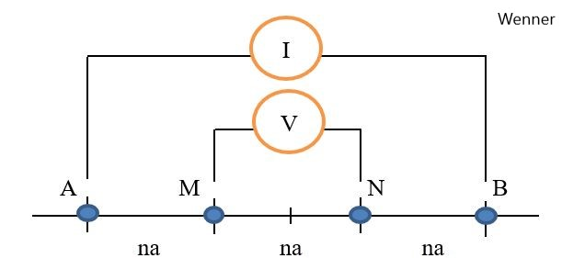
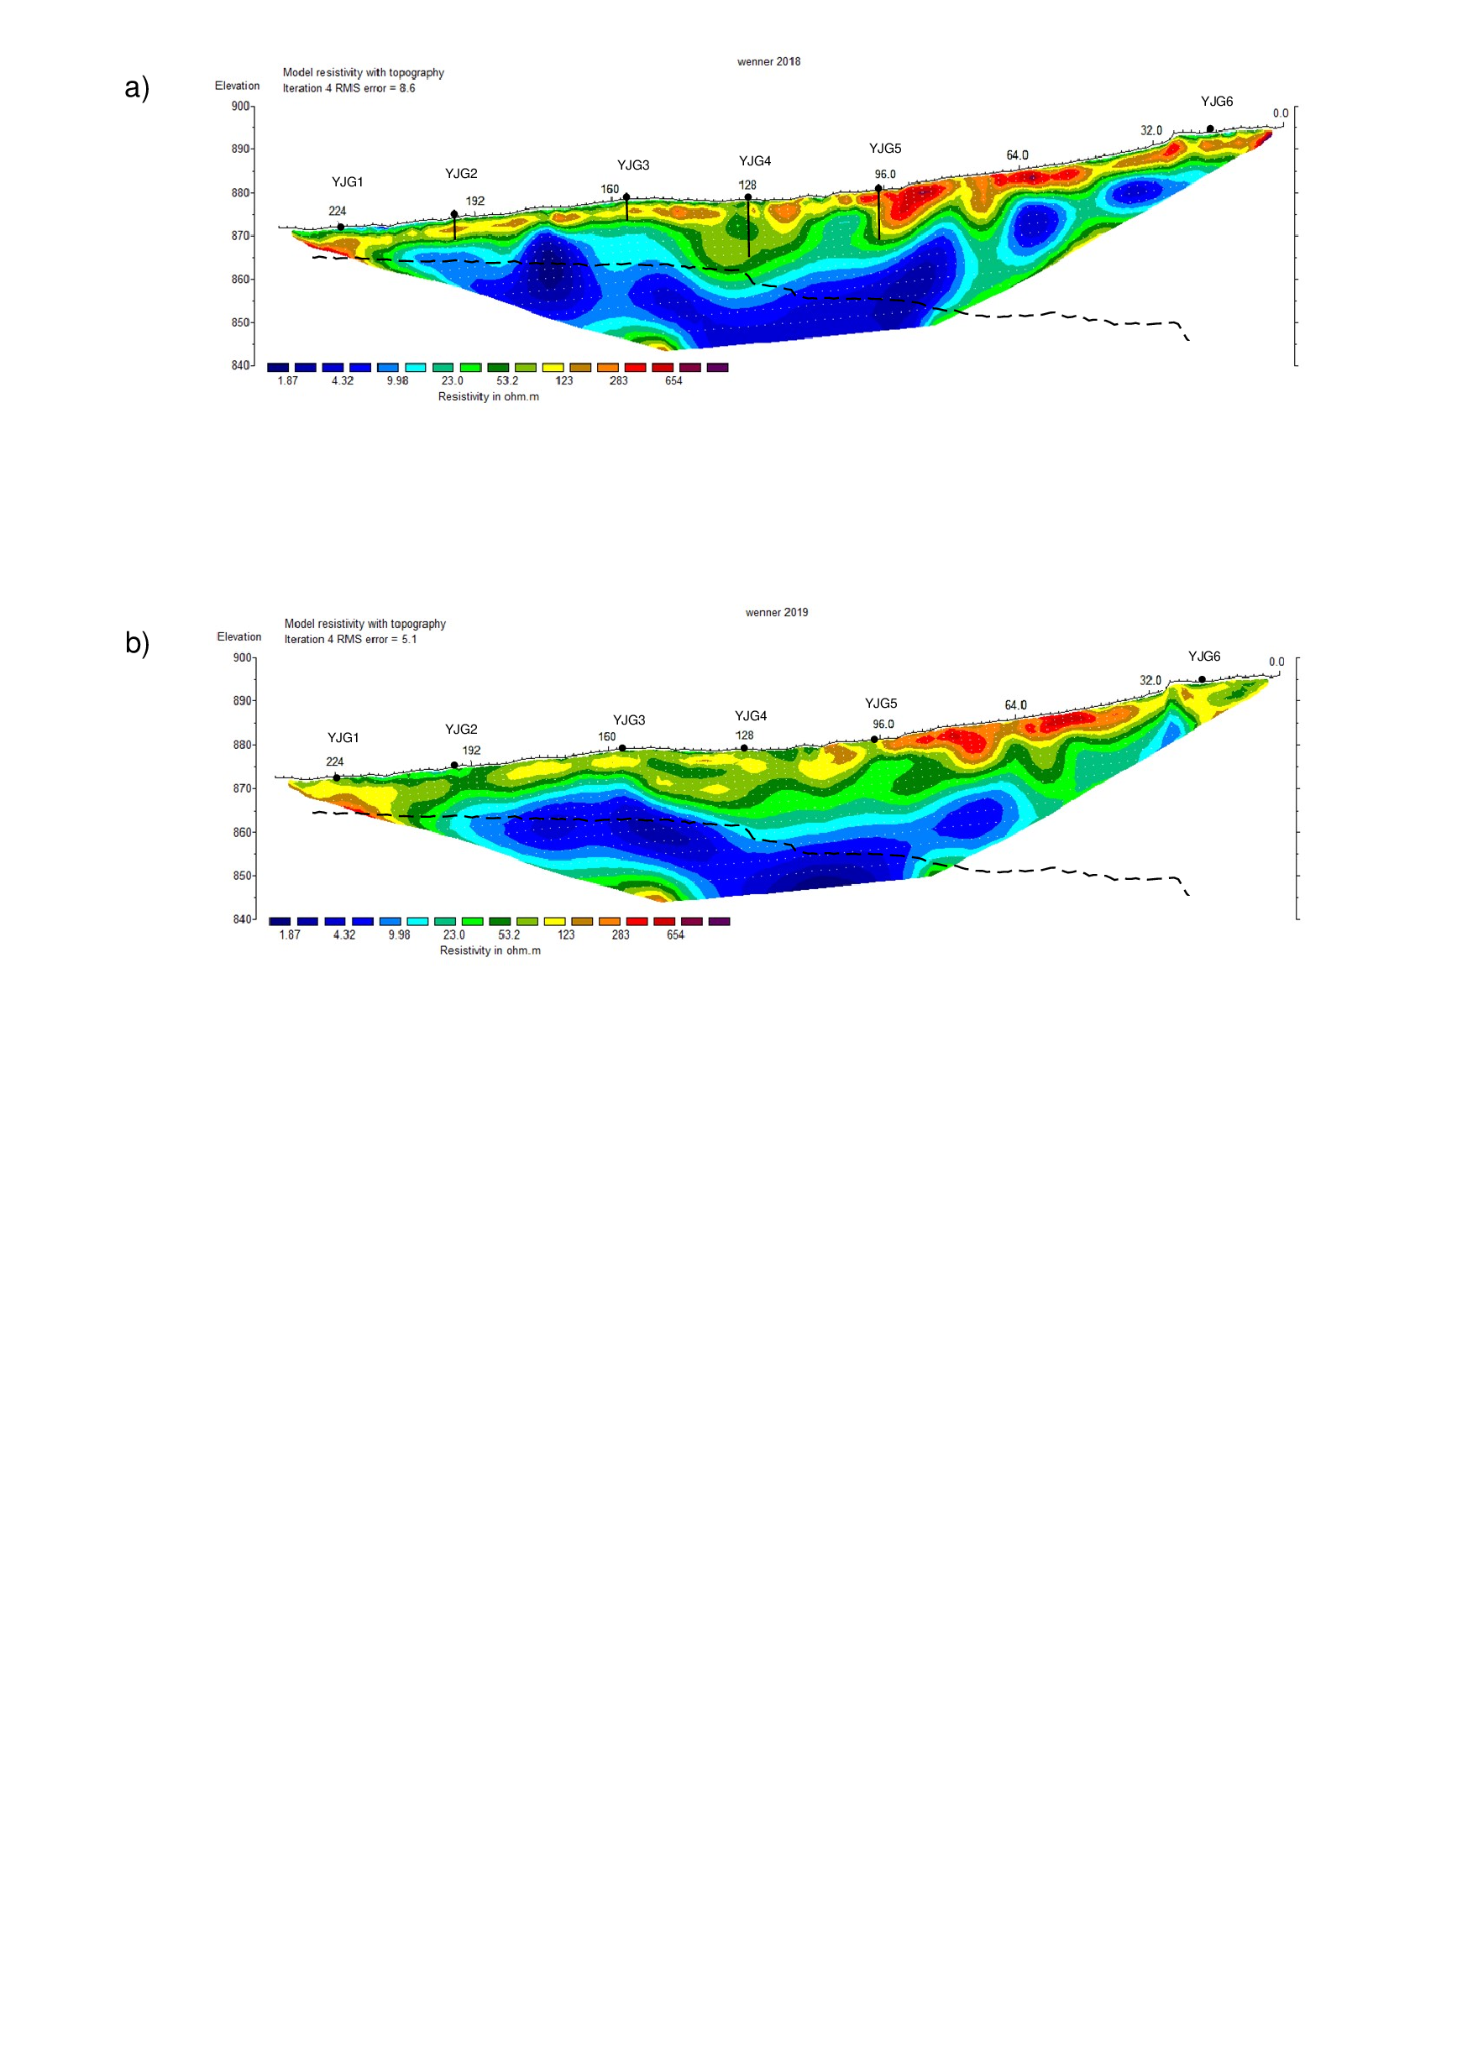
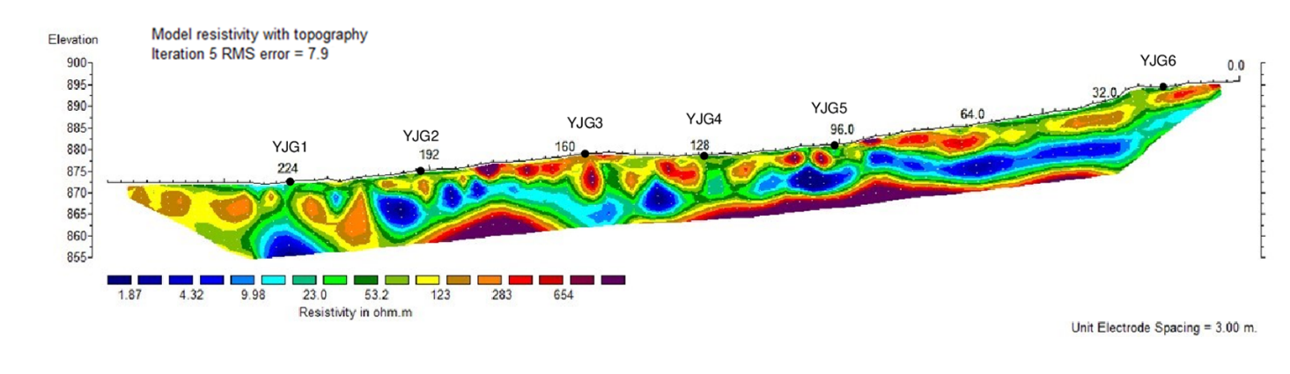
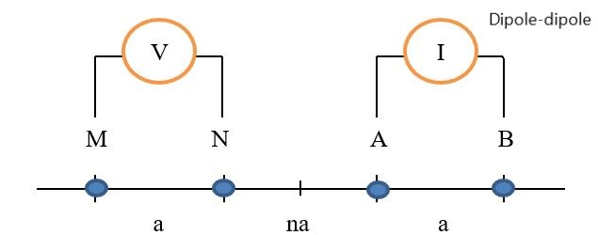
Session NH3.6:
ERT
METHODOLOGY
Introduce constraints for the parameterization of the medium
Solve interpretative ambiguities of passive seismic techniques
HVNR
(Nakamura, 1989)
HVIP
(Del Gaudio, 2017)
Passive seismic techniques
Wenner
Rover
Reference
Dipole-Dipole
Geophysical surveys
ERT

Slide 6
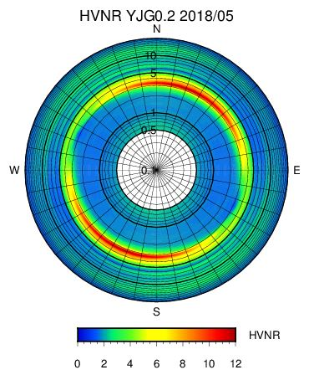
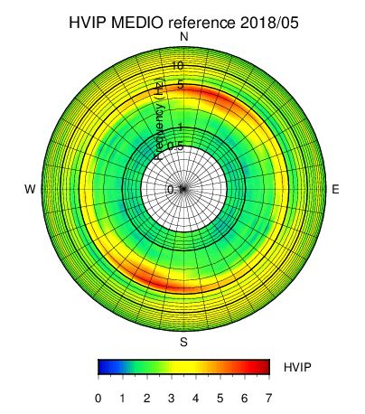
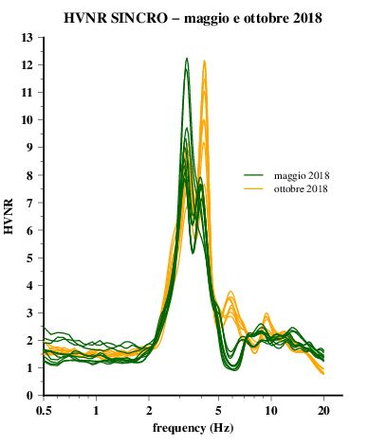
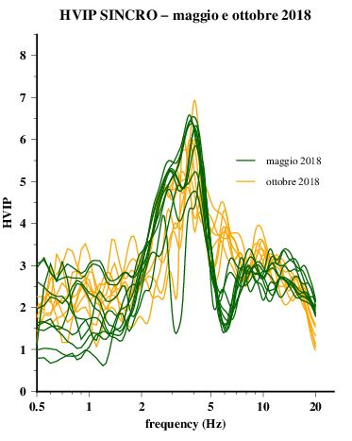
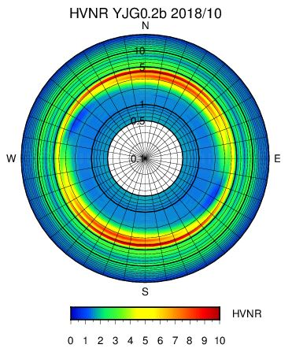
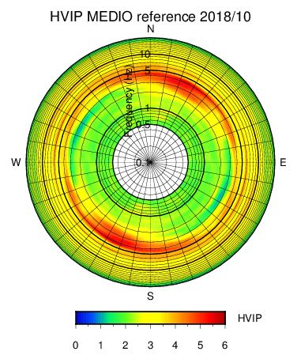
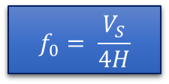
Session NH3.6:
Reference
RESULTS
More stable in amplitude
Resonance Frequencies
3-4 Hz
$$f_{0}= \frac{V_{S}}{4H}$$
8-10 Hz
Amplitude
Directivity
30°

Slide 7
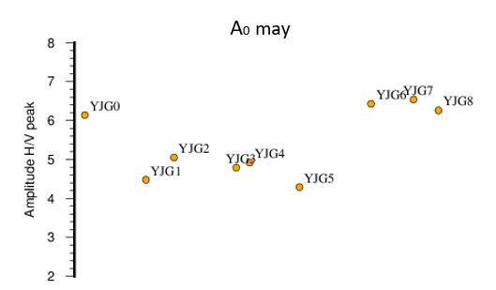
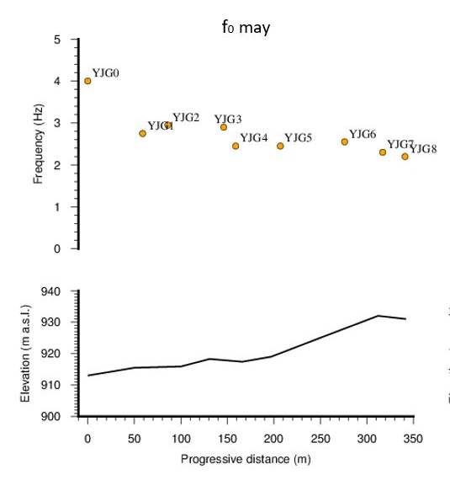
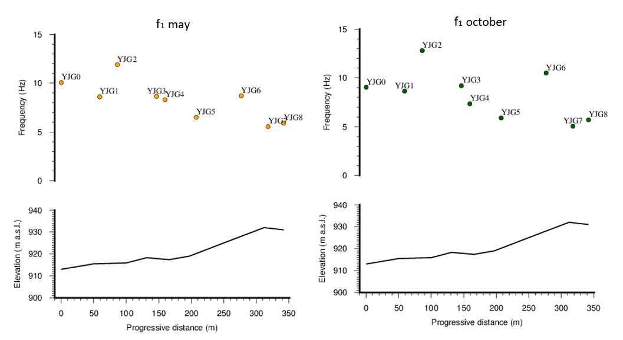
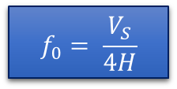
Session NH3.6:
Rover
Dipole-Dipole
RESULTS
A0
$$f_{0}= \frac{V_{S}}{4H}$$
A0
f0
Lower values in amplitude are probably due to a larger portion of rock boulders and block within the deposit
A0
Wenner
f1
Downward trend in according with the increasing thickness of the entire deposit
High frequencies trend is confirmed by the thickness measured on Wenner’s profile
Station | Thickness (m) | Frequency (Hz)
YJG2 | 7.50 | 12.05
YJG3 | 8.75 | 8.35
YJG4 | 11.25 | 6.90
YJG5 | 11.25 | 6.95

Slide 8
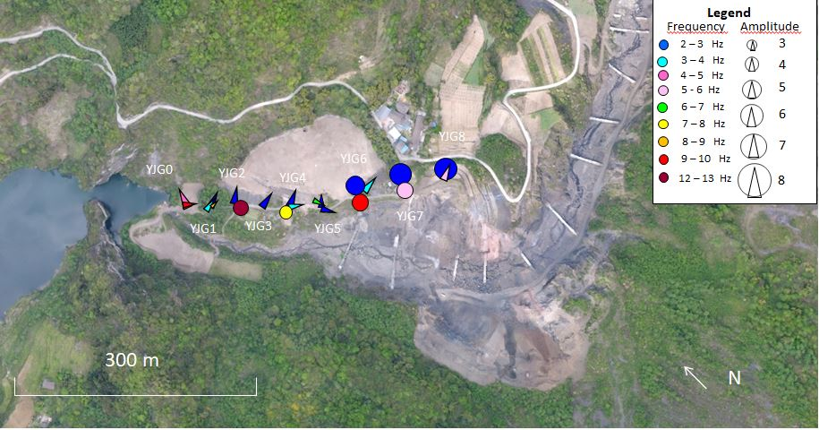
Session NH3.6:
Rover
RESULTS
Directivity

Slide 9
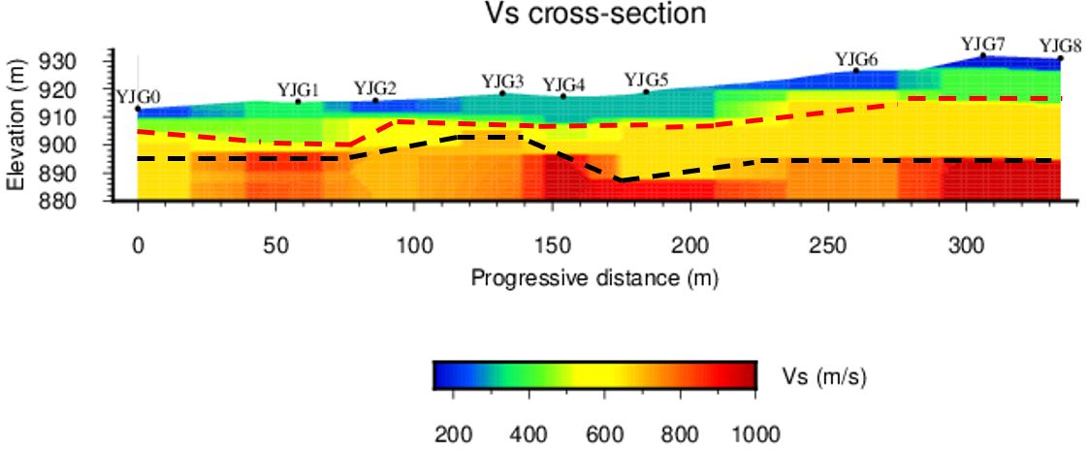
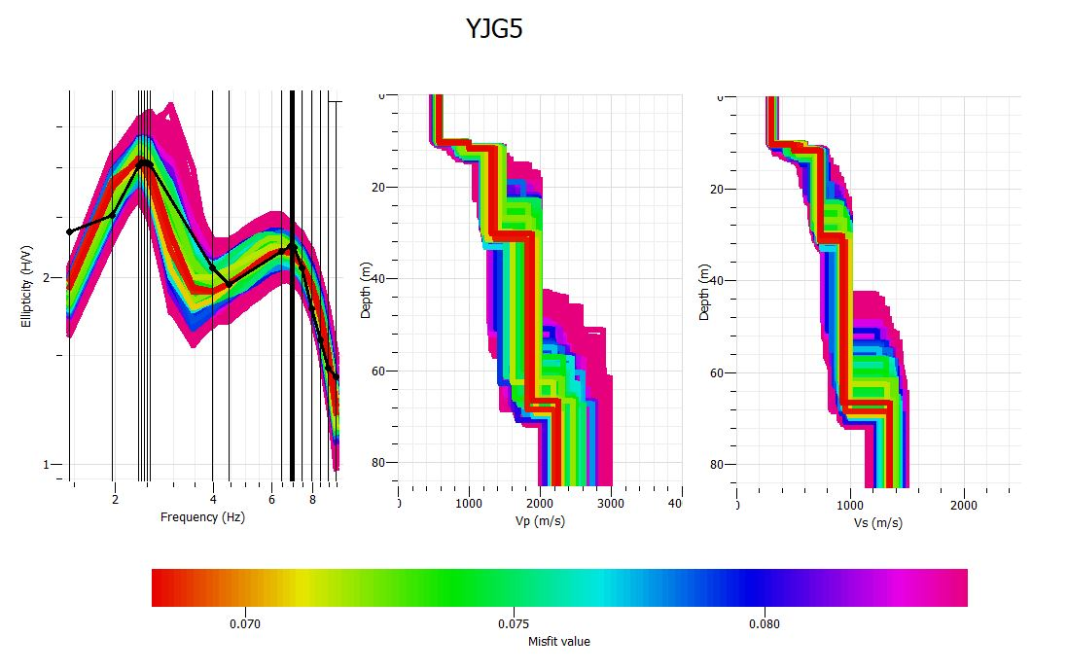
Session NH3.6:
INVERSION AND DISCUSSION
Synthesis
Vs = 200-500 m/s
Velocity profiles obtained by the inversion of the ellipticity curves
Vs = 600-700 m/s
Conclusion:
The presence of an overlap of layers having different proportions of solid (rock blocks) and fragmented material;
2) Lateral changes in thickness and mechanical properties of the most surficial layer;
3) Lateral variation of the overall thickness of the dam deposit

Slide 10
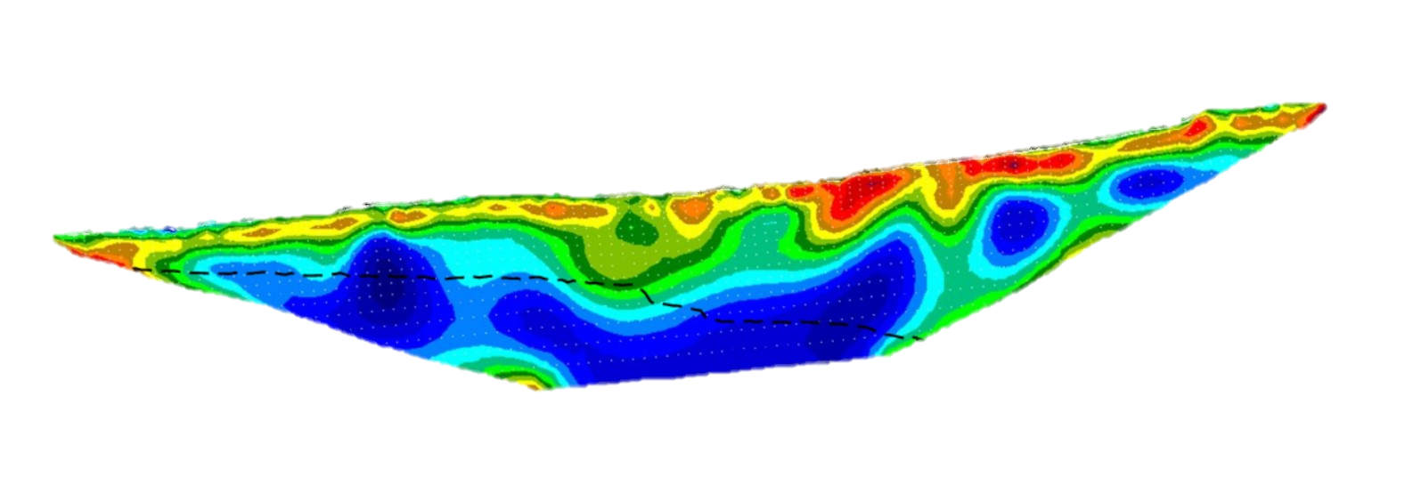
Session NH3.6:
INVERSION AND DISCUSSION
Synthesis
Vs = 200-500 m/s
Velocity profiles obtained by the inversion of the ellipticity curves
Vs = 600-700 m/s
The nature of the first discontinuity remain uncertain, it may be the surface which separate the deposit of the 2008 rock avalanche characterized by different permeability

Slide 11
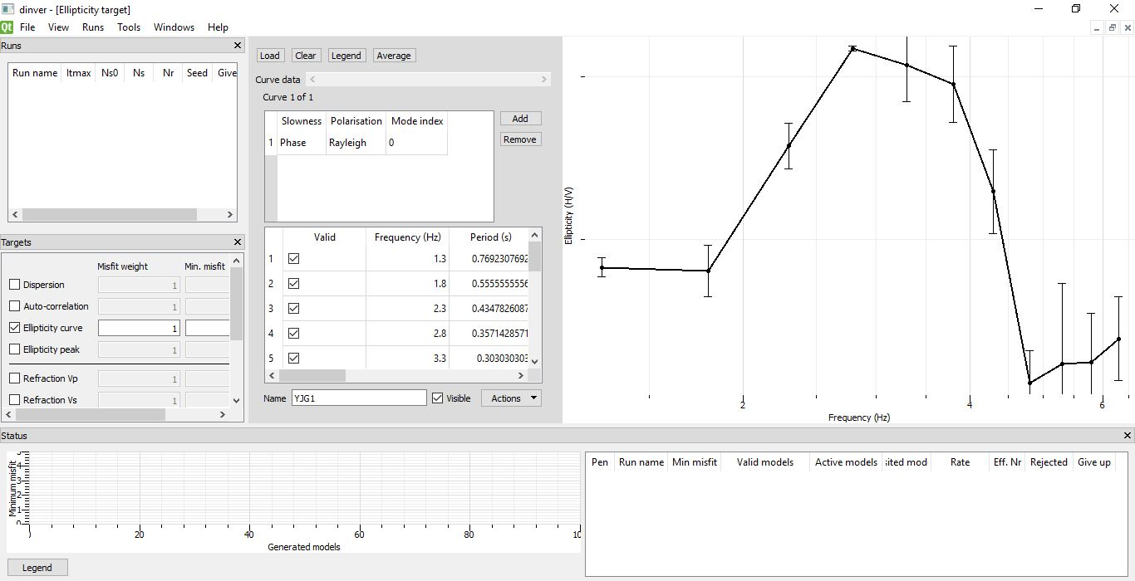
Session NH3.6:
FUTURE PROJECTS
The studies will continue by combining other passive seismic technique to understand the origin of the stratification and the origin of the contrast in resistivity
PASSIVE SEISMIC TECHNIQUES
Simultaneous acquisition (CROSS-CORRELATION, SSRn)
Geophone array (SPAC, ESAC, ReMi)
Single station (HVNR, HVIP)
IN COMBINATION WITH
Geological surveys
ERT surveys

