Slide 1
Research theme and significance
Title: Interactions between hydrological changes and geomorphological responses in the Yellow River basin from the perspective of basin system integrity
Significance
Strong anthropogenic activities and climate change have led to distinct hydrological changes and sediment budget in river systems worldwide.
Presenter | Shihua Yin
Institution | RCEES, CAS
Time | 2021/4/19
Notes:
Hello, everybody! My title is “Interactions between hydrological changes and geomorphological responses in the Yellow River basin from the perspective of basin system integrity”. We know, strong anthropogenic activities and climate change have led to distinct hydrological changes and sediment budget in river systems worldwide. The understanding of the interactions between hydrological changes and geomorphological responses from the perspective of basin system integrity remains limited.

Slide 2
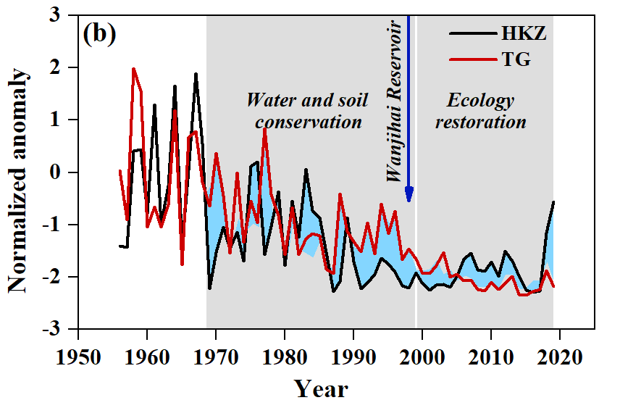
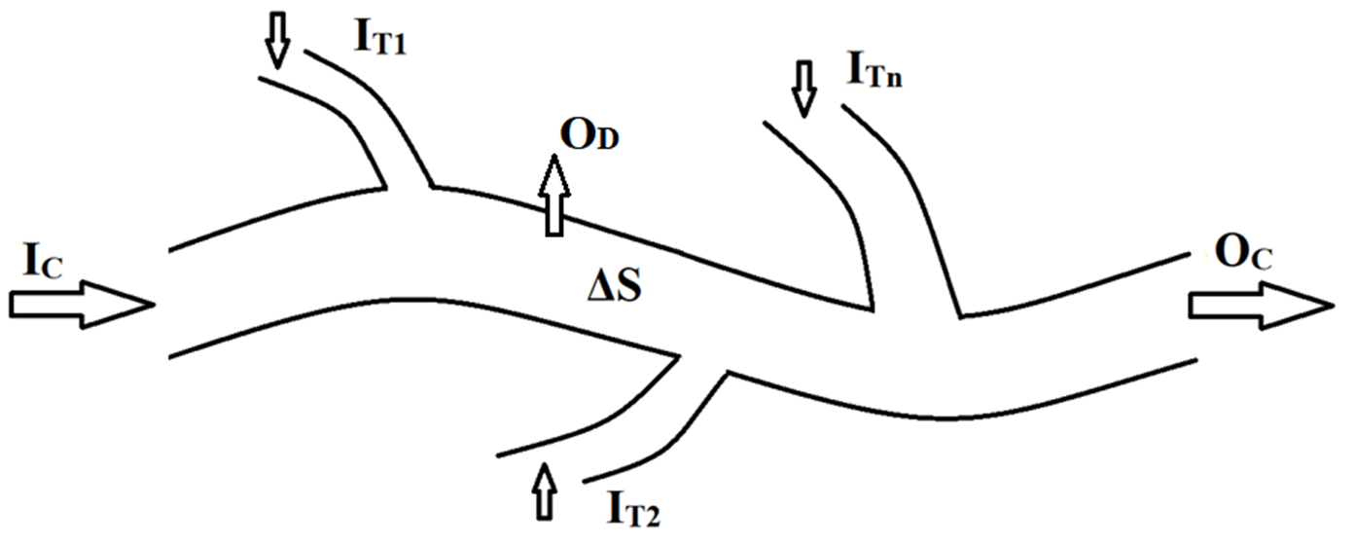
Objectives and methods
Methods
Examine
Trend and difference analysis
the basin-wide streamflow and sediment load changes stretching from the headwater to the delta in the Yellow River basin (YRB) during 1956-2019
Explore
Sediment budget analysis
the coupling relationships of water-sediment variations with channel erosion and delta evolution across the basin.
Notes:
Therefore, we examined the basin-wide streamflow and sediment load changes stretching from the headwater to the delta in the Yellow River basin (YRB) during 1956-2019, and explored the coupling relationships of water-sediment variations with channel erosion and delta evolution across the basin using the methods of Trend and difference analysis and sediment budget analysis.

Slide 3
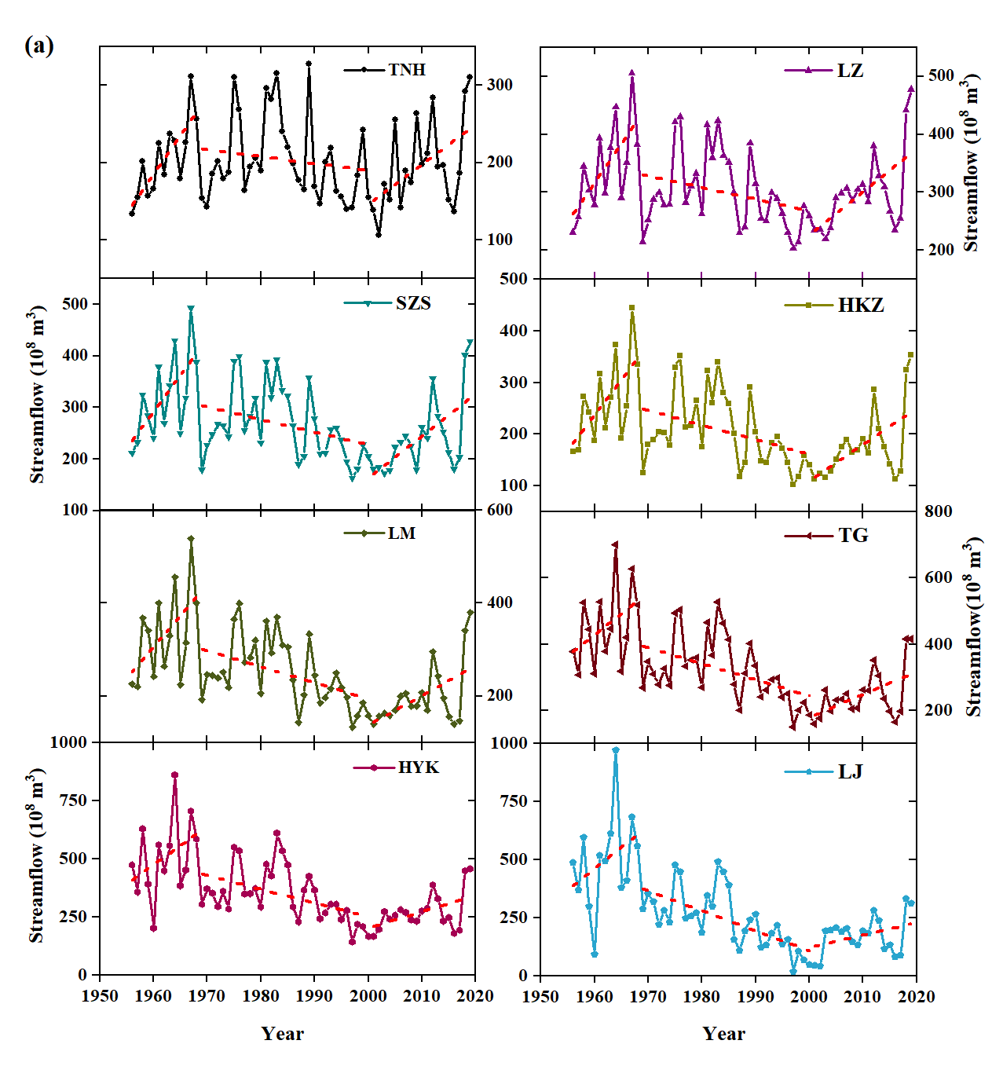
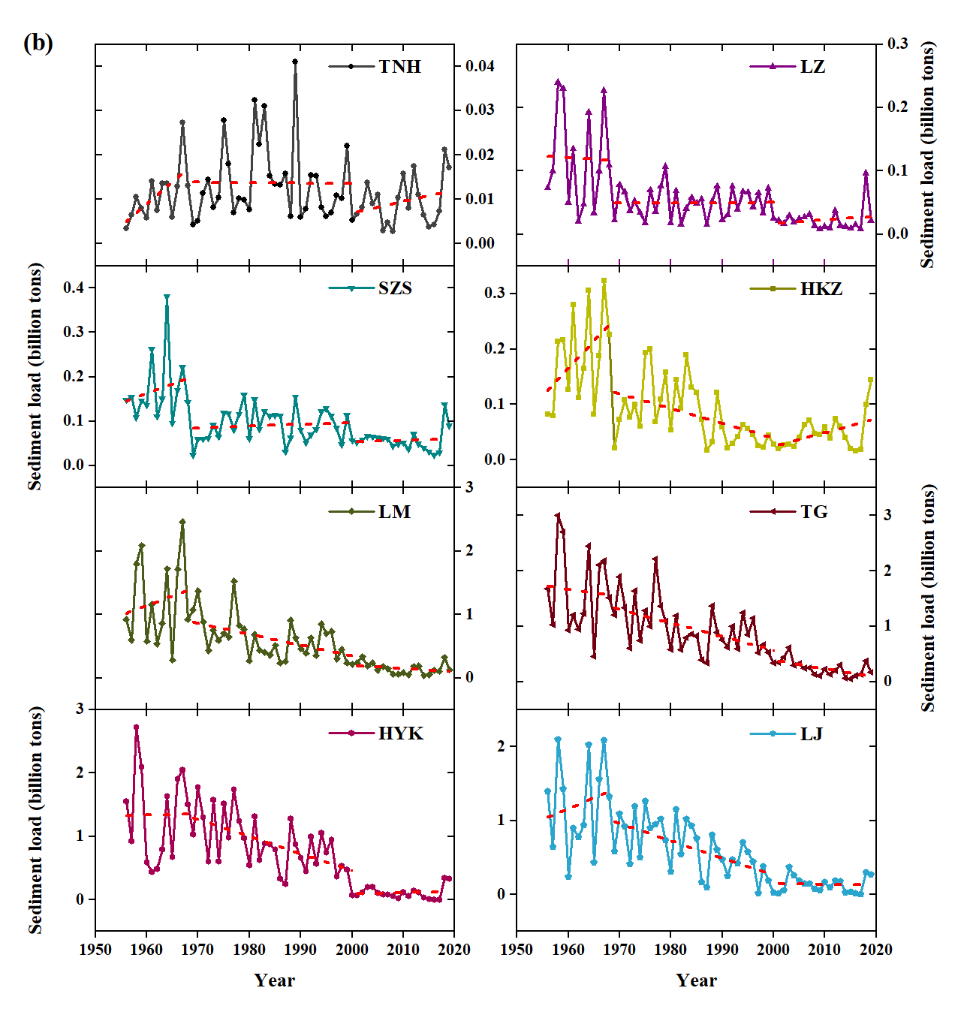
Results 1 Streamflow and sediment load changes
1
The streamflow increased significantly and the sediment load tended to be gradually stabilizing since 2000 because of significantly increased precipitation.
Notes:
First, look at the picture. Regardless of the significant sediment reduction trend in the early stage, the streamflow increased significantly and the sediment load tended to be gradually stabilizing since 2000 because of significantly increased precipitation.

Slide 4
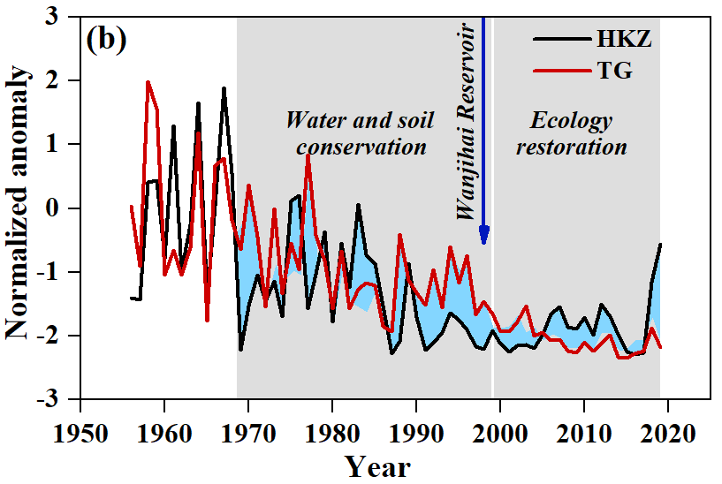
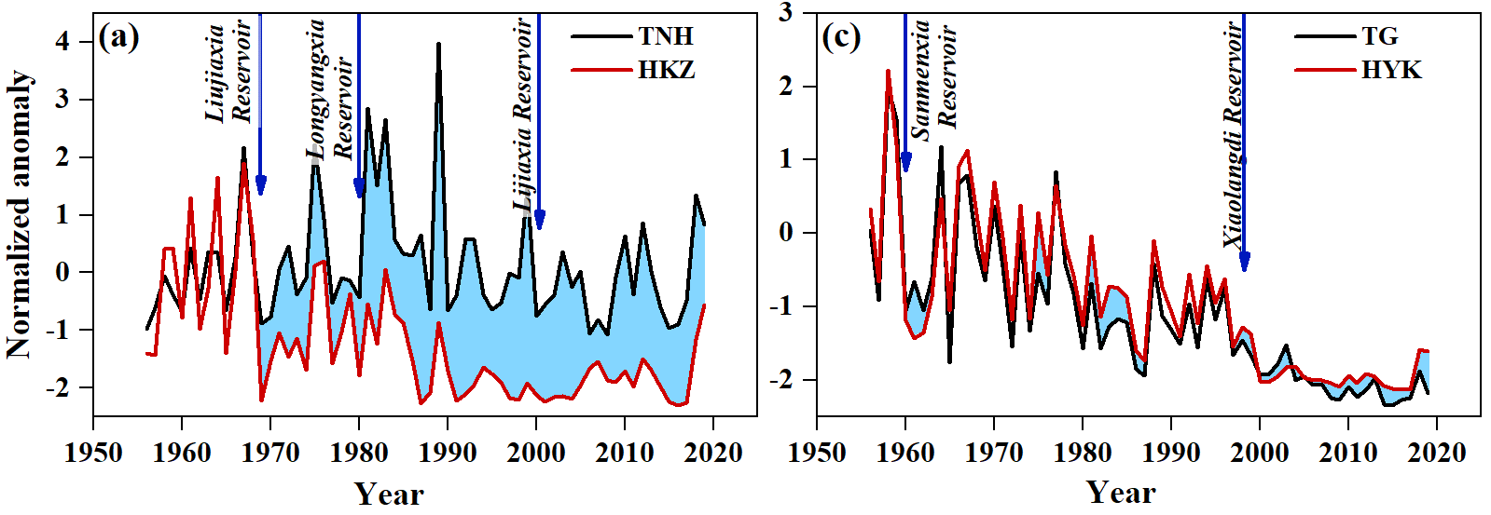
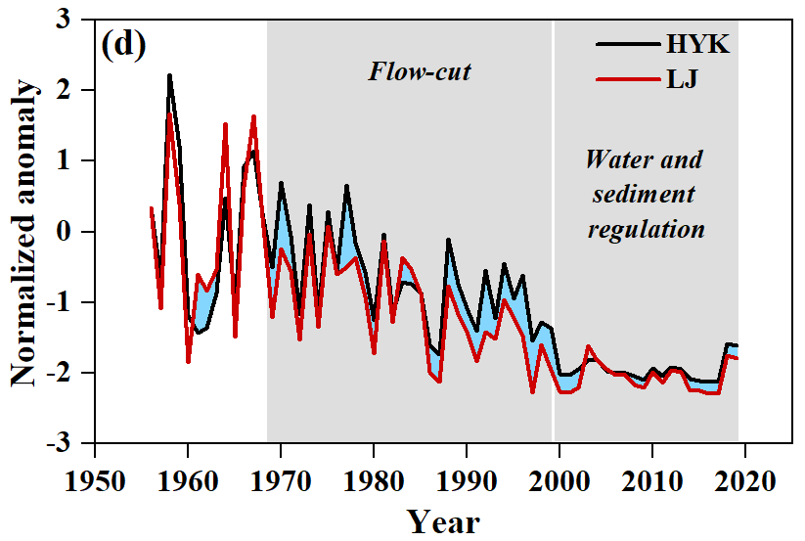
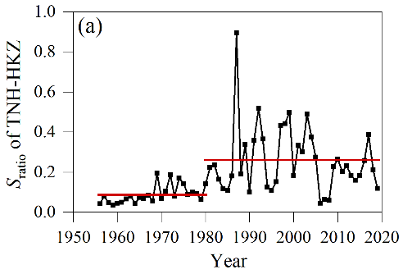
Results 2 Trend differences of sediment load
There are distinct trend differences of sediment load between near stations.
2
Soil and water conservation, ecological restoration and other engineering
Construction of dams in the river channel
Diversion or consumption of streamflow
Water and sediment regulation by dam operation
Four main causes
Notes:
There are distinct trend differences of sediment load between near stations.
By discussion, we concluded that there were four main reasons, Soil and water conservation, ecological restoration and other engineering, Construction of dams in the river channel; Water and sediment regulation by dam operation, and Diversion or consumption of streamflow.

Slide 5
Results 3 In-reach sediment budget dynamics and delta changes
3
Along the YR course, the scour and deposition changes had complex spatiotemporal variations from 1956 to 2019. Some reaches were eroded in general, yet some reach was generally silted up.
The delta area increased considerably from 1973 to 1980, but the expansion rate slowed down during 1981-1998. After 1999, the delta shrunk.
9.31 km² yr⁻¹
59.42 km² yr⁻¹
-3.45 km² yr⁻¹
1999
Notes:
Along the YR course, the scour and deposition changes had complex spatiotemporal variations from 1956 to 2019. Some reaches were eroded in general, yet some reach was generally silted up.
The delta area increased considerably from 1973 to 1980, then the expansion rate slowed down from 1981. After 1999, the delta shrunk.

Slide 6
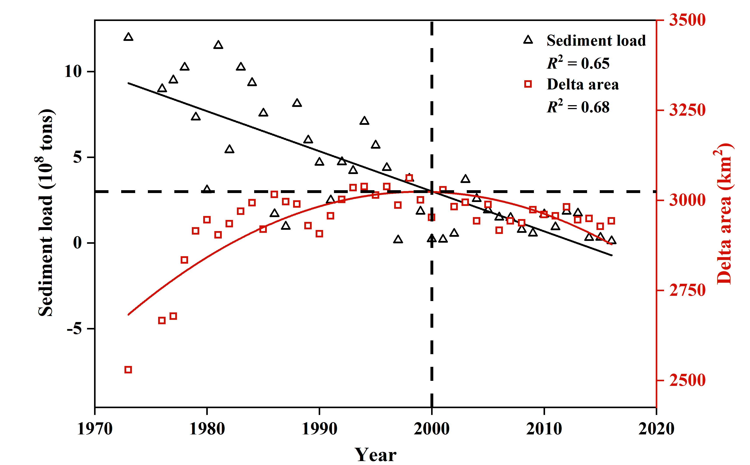
Result 4 Causes of in-reach sediment budget dynamics and delta changes
The construction of dams and reservoirs in river channels was the dominant factor of sediment deposition change in the channel of the upstream and midstream (R² = 0.82/0.48; R² = 0.84).
The sediment deposition in the lower reach depended on the sediment concentration exporting from the middle reach (R² = 0.81);
The decreasing sediment supply resulted in the gradual erosion of delta land since 2000 with combination of tidal waves.
Notes:
You can see from these pictures that the construction of dams and reservoirs in river channels was the dominant factor of sediment deposition change in the channel of the upstream and midstream, whereas the sediment deposition in the lower reach depended on the sediment concentration exporting from the middle reach; The decreasing sediment supply resulted in the gradual erosion of delta land since 2000 but with combination of tidal waves.

