Slide 1
Oil spill risk assessment for a Single Point Buoy Mooring terminal at the Port of Taranto (Southern Italy)
Svitlana Liubartseva, Ivan Federico, Giovanni Coppini, and Rita Lecci
Centro Euro-Mediterraneo sui Cambiamenti Climatici, Ocean Predictions and Applications Division Bologna – Lecce, Italy

Slide 2
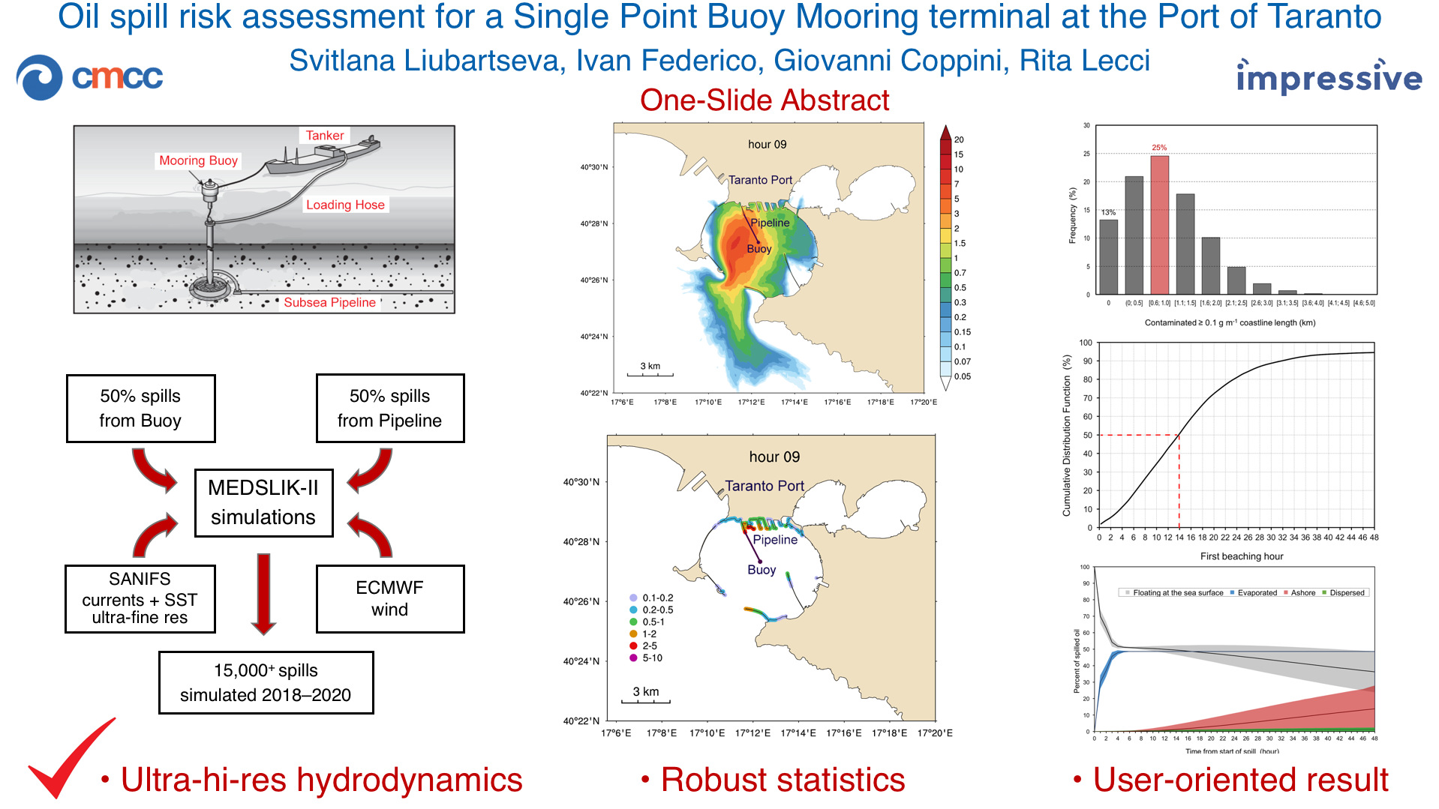

Slide 3
Outline
            Study area
            Stochastic oil spill modeling
      (a) Oil spill model: MEDSLIK-II
      (b) Hydrodynamics: SANIFS
      (c) MEDSLIK-II – SANIFS coupling
      (d) Spill scenario
      (e) Stochastic simulations
      3. Results
      (a) Oil concentration and pollution index maps
      (b) Timing
      (c) Oil mass balance
      (d) Polluted coastline length
      (e) Sub-regional integral analysis
            Problems
            Conclusion

Slide 4
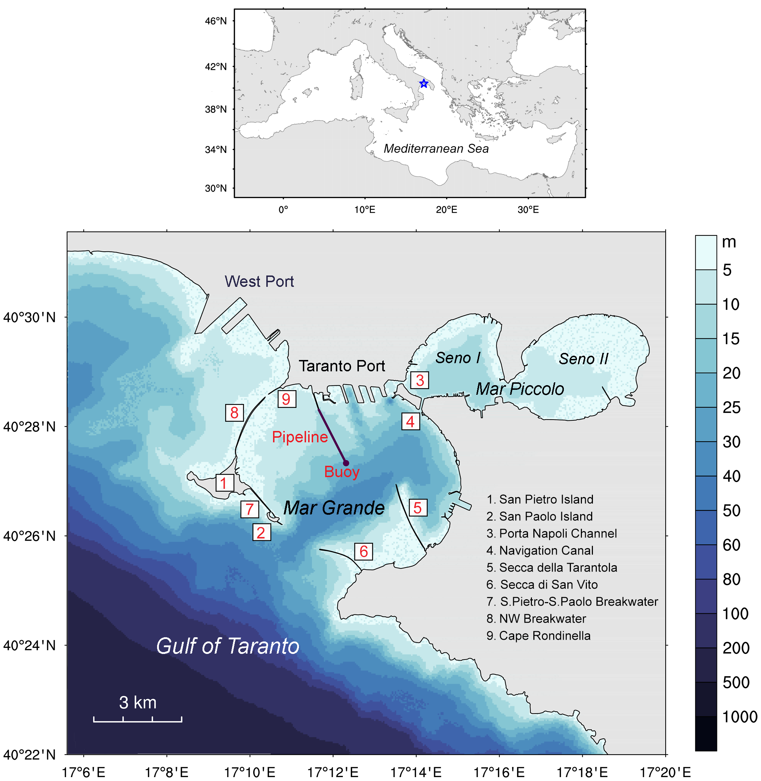
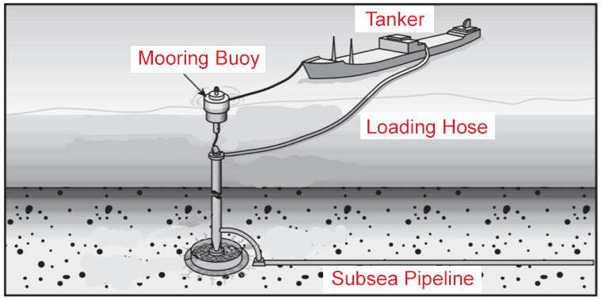
Study area
https://new.abb.com/news/detail/12860/
abb-wins-40-million-order-to-upgrade-oil-transportation-infrastructure-in-italy
Single Point Buoy Mooring and subsea pipeline
as the possible sources of oil pollution

Slide 5
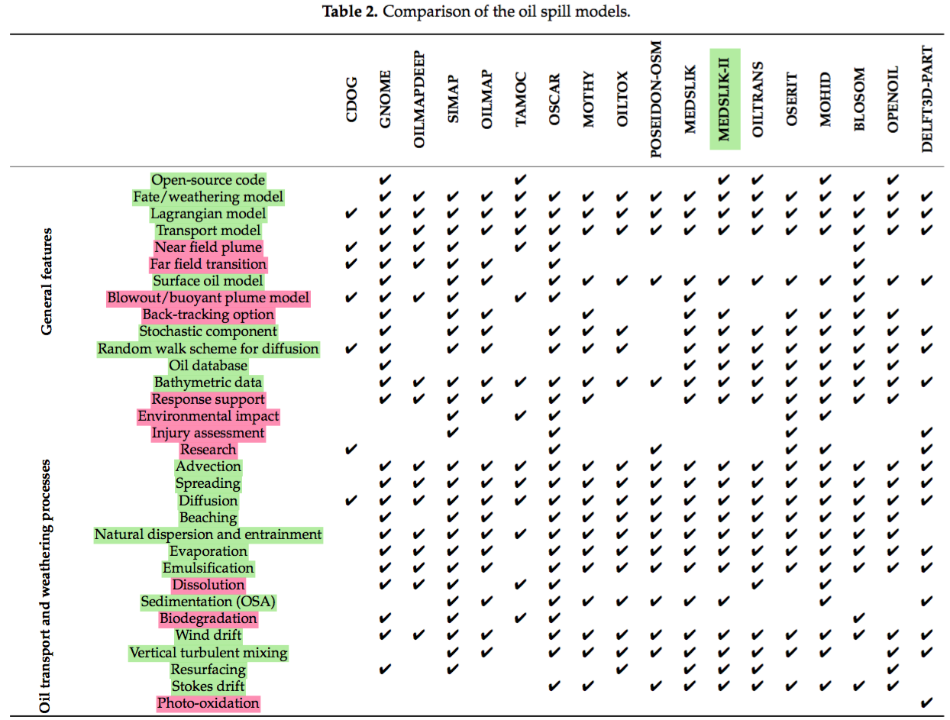
MEDSLIK-II oil spill model
^{(Keramea et al., 2021)}

Slide 6
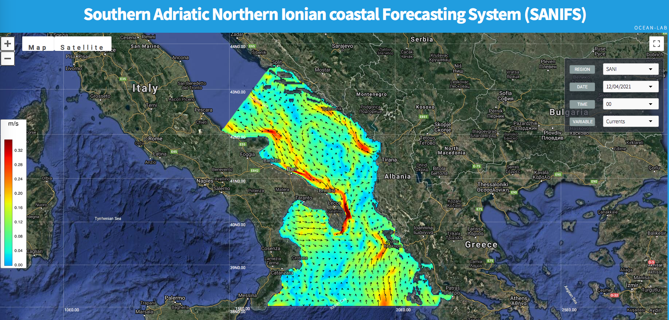
Southern Adriatic Northern Ionian Coastal Forecasting System SANIFS
SANIFS uses the unstructured-grid finite element method, addressing various open-sea and coastal scales
at the same time:
3 km – in the open sea, 100 m – in the coastal waters, 20 m – at the Port of Taranto
http://sanifs.cmcc.it (Federico et al., 2017)
Daily forecast cycle (a) and operational chain (b)

Slide 7
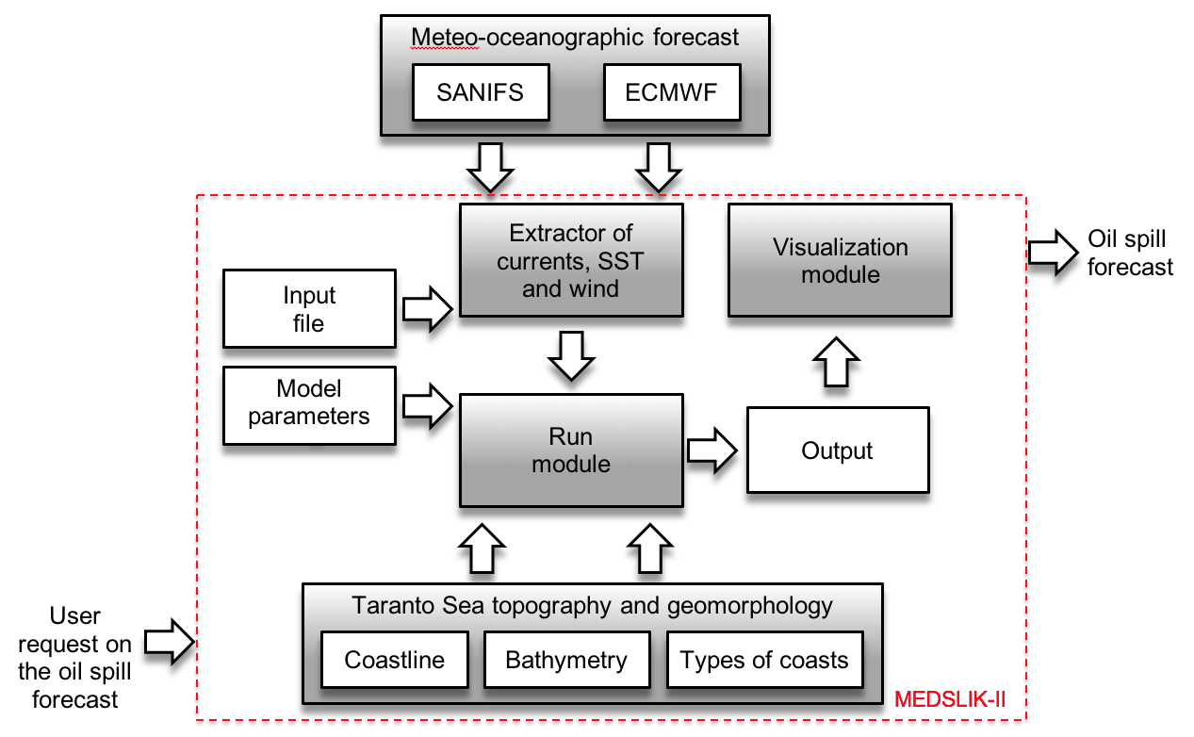

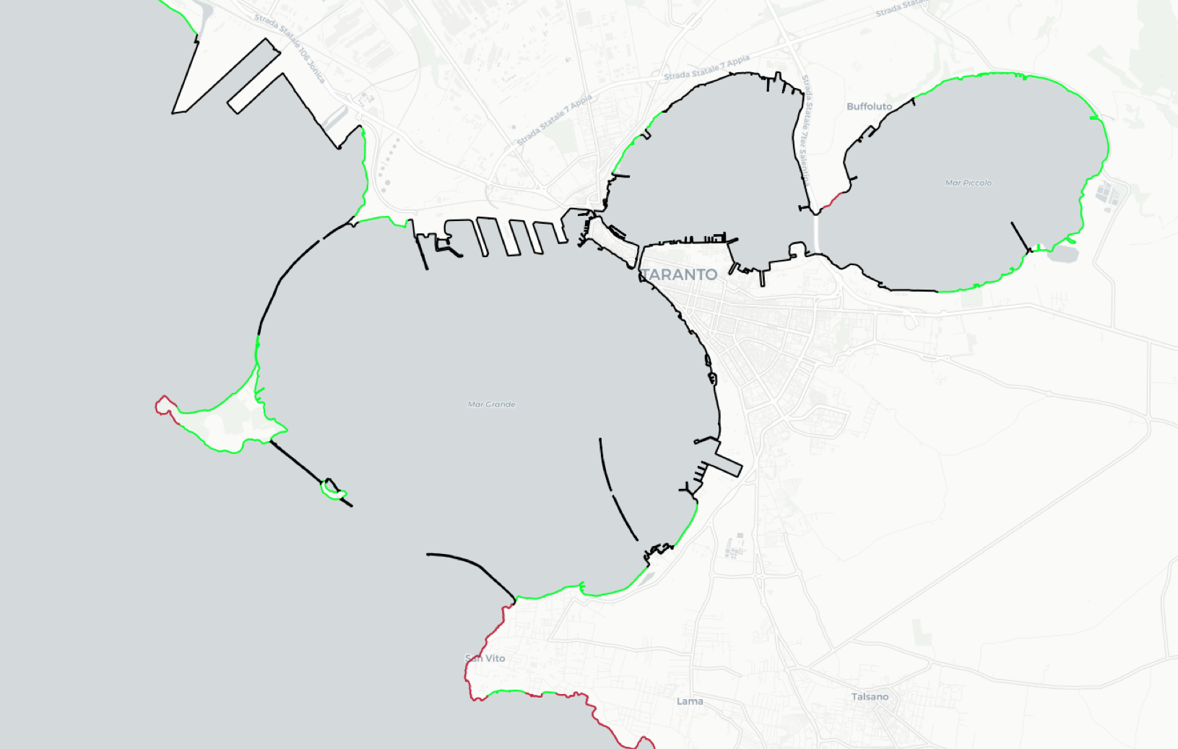

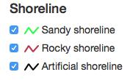

MEDSLIK-II – SANIFS coupling
Update of coastline types using MEDGIS-MAR by REMPEC
Horizontal diffusivity coefficient of 0.2 m² s⁻¹
Integration time step of 5 min
1% windage instead of JONESWAP
Simplified scheme of the MEDSLIK-II coupled to SANIFS

Slide 8
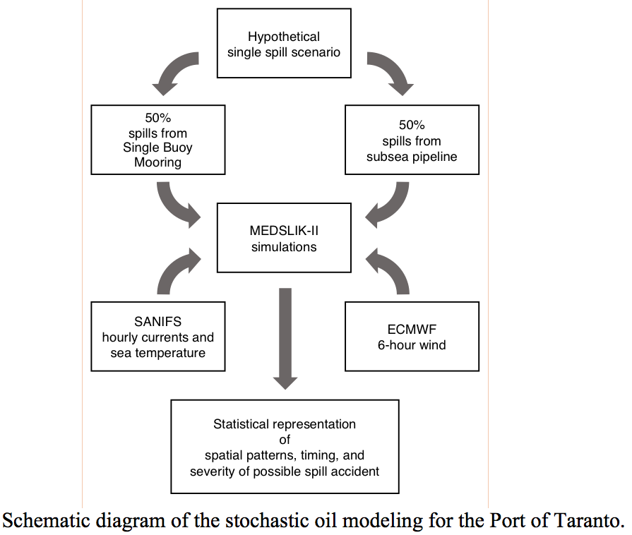
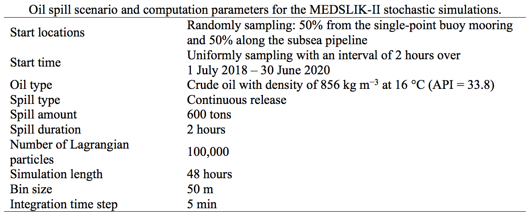
Spill scenario and stochastic simulations for the Port of Taranto
Spill scenario is based on a real accident
caused by a catastrophic pipeline failure near the Genoa Port
in April 2016 (Vairo et al., 2017)
15,000⁺ spills are simulated

Slide 9
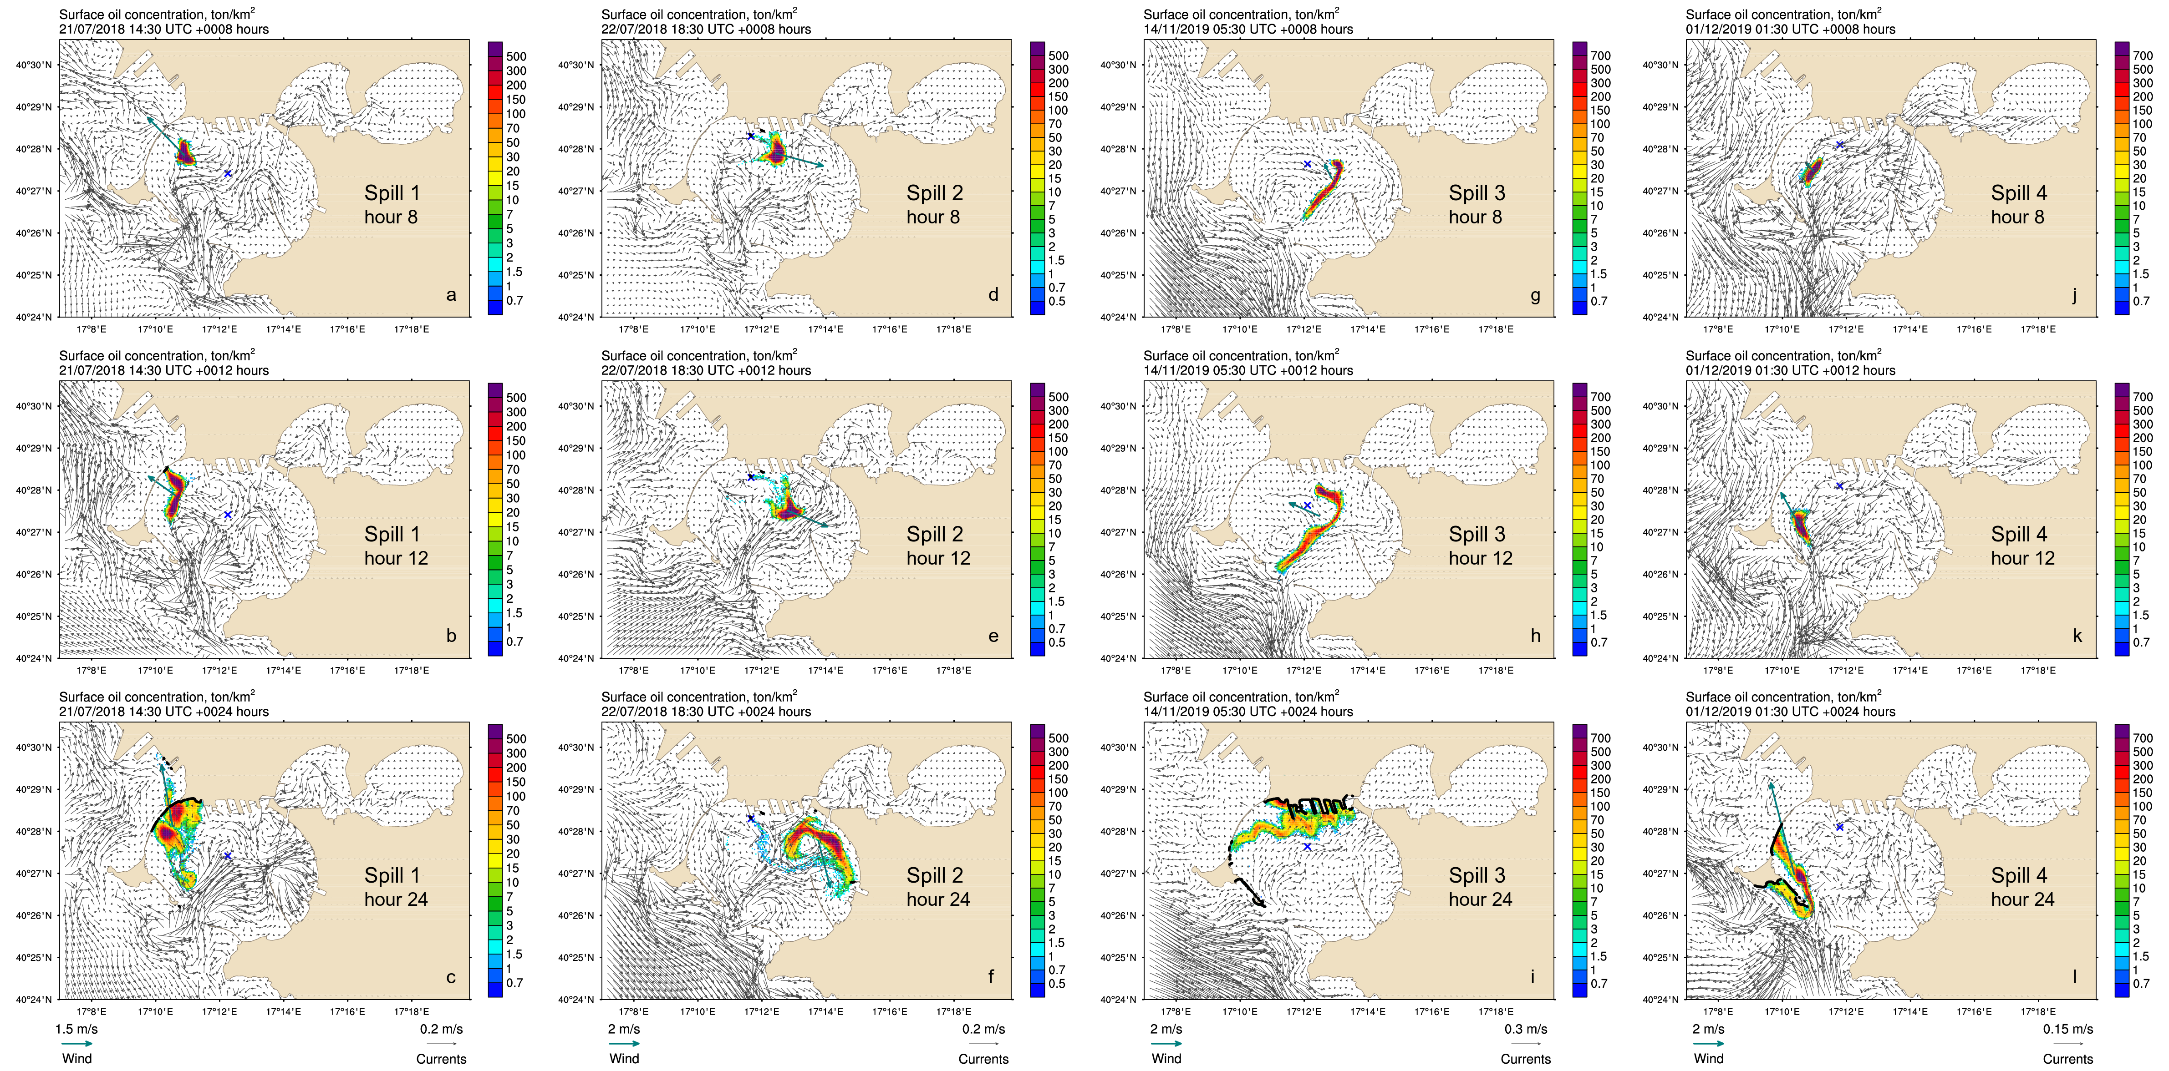
Results: some spill snapshots
The finer resolution of underlying hydrodynamics, the more stretched and deviated are oil patterns
in comparison with the Gaussian or Bessel-type distributions typical of constant currents

Slide 10
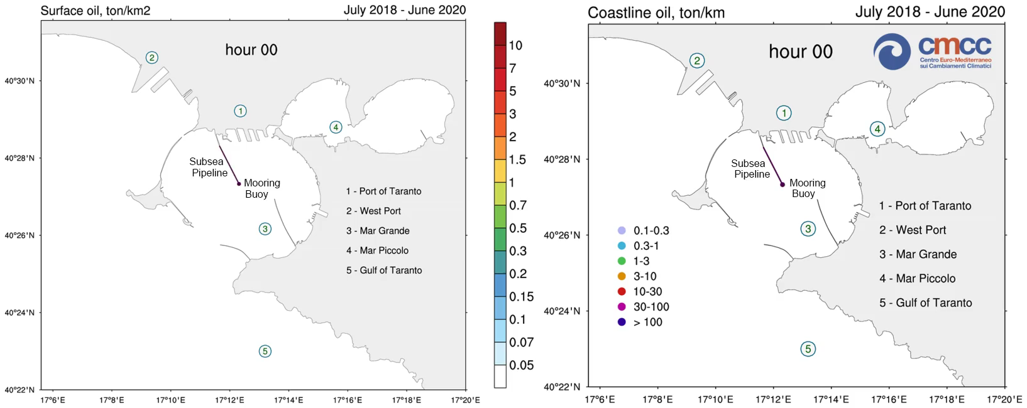
Ensemble mean oil concentration
! please kick off mp4 below !

Slide 11
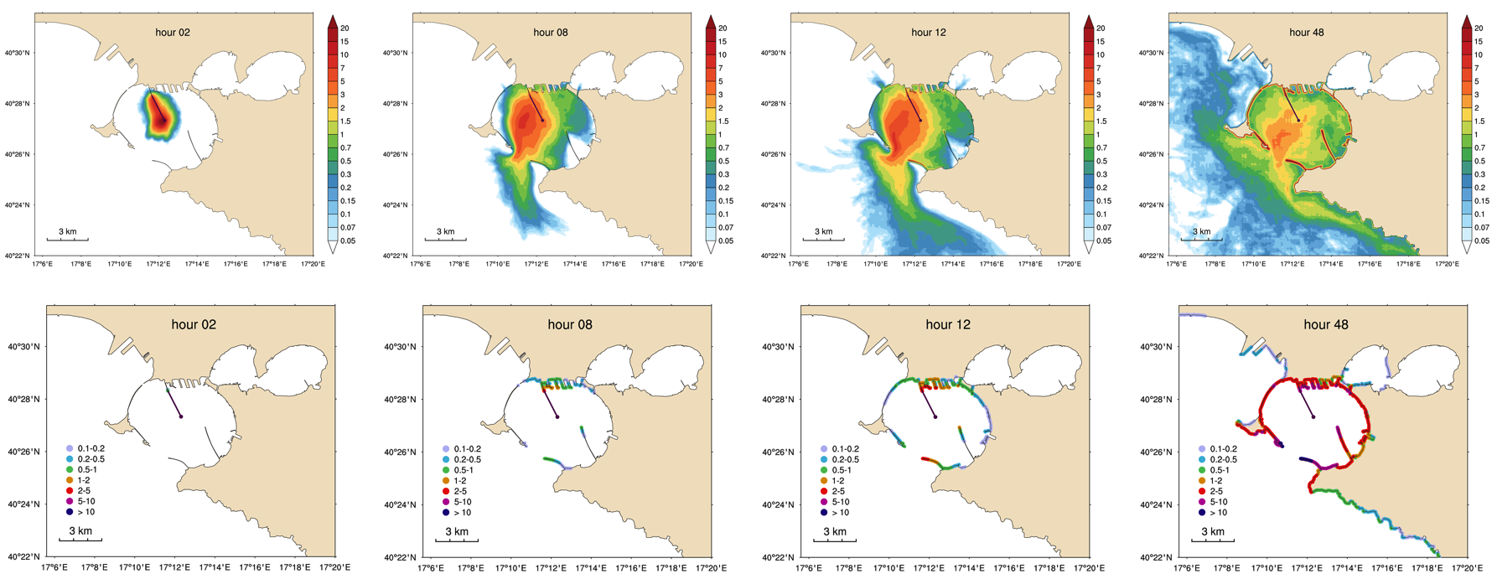
Pollution indices
Pollution index maps showing the probability (%) to exceed the pre-defined sea surface threshold concentration of 0.01 g m⁻² and the coastline threshold concentration of 0.1 g m⁻¹
within 2, 8, 12, and 48 hrs after the start of the release

Slide 12
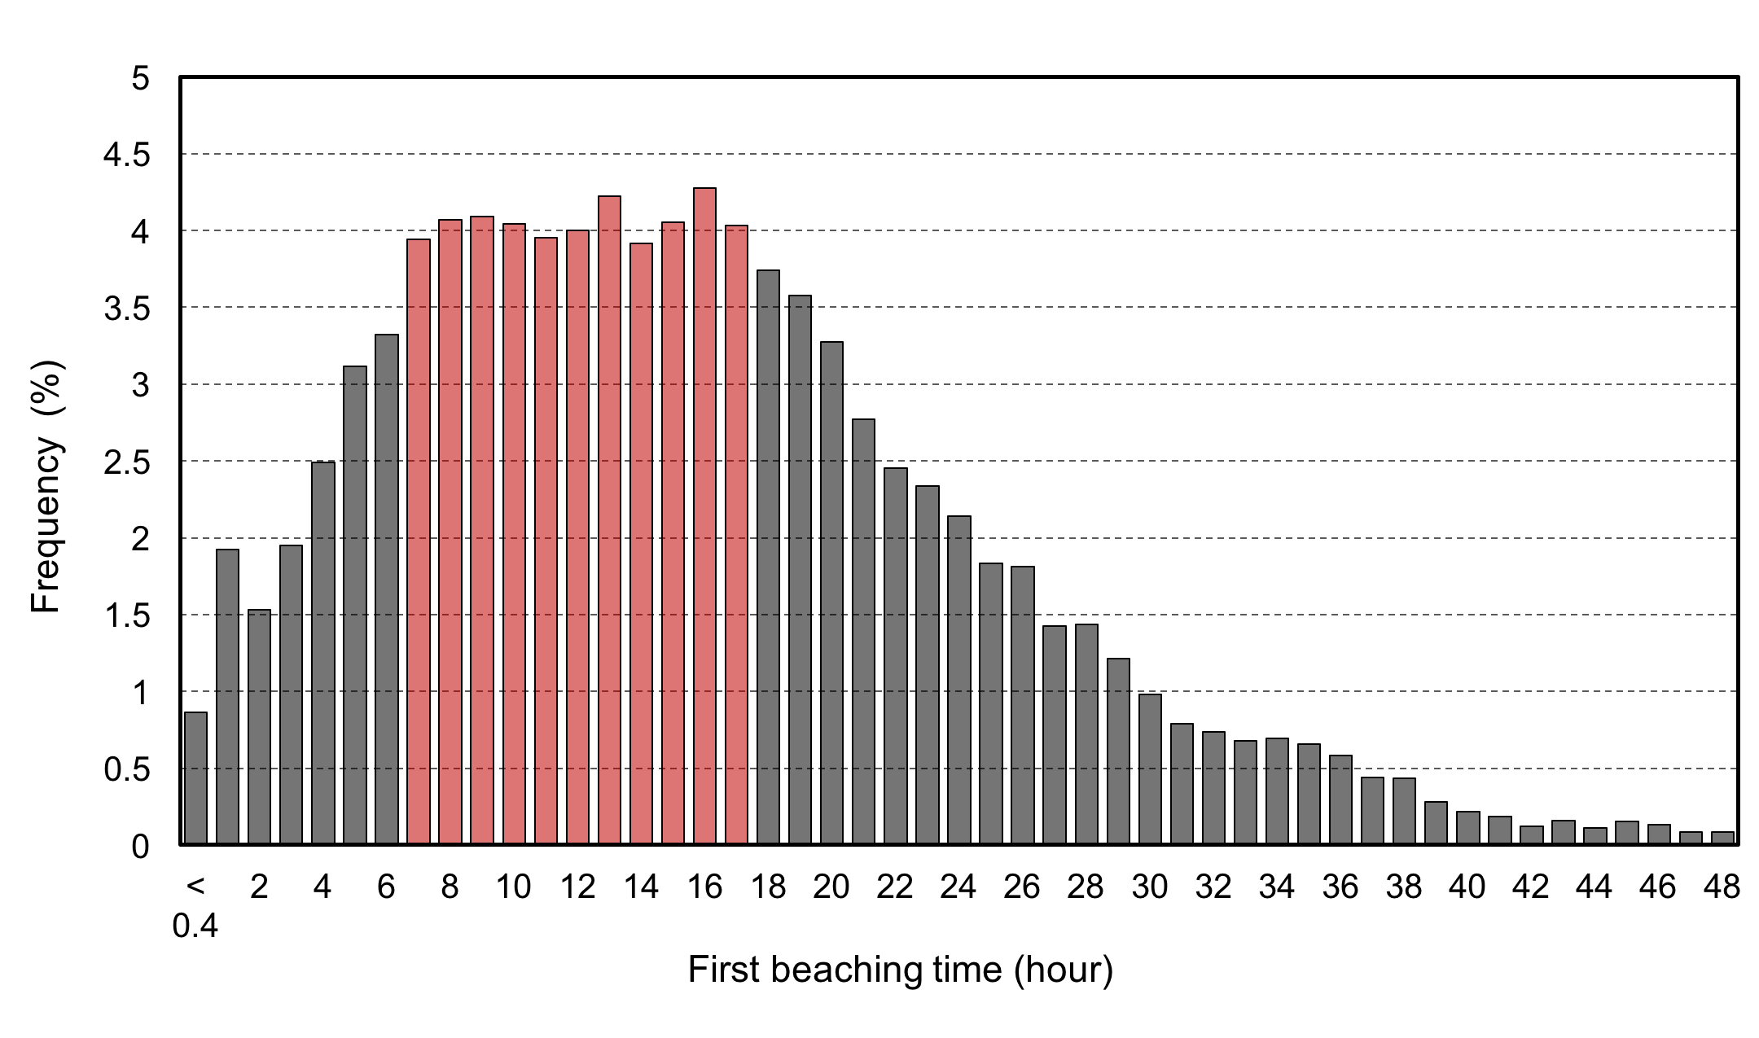
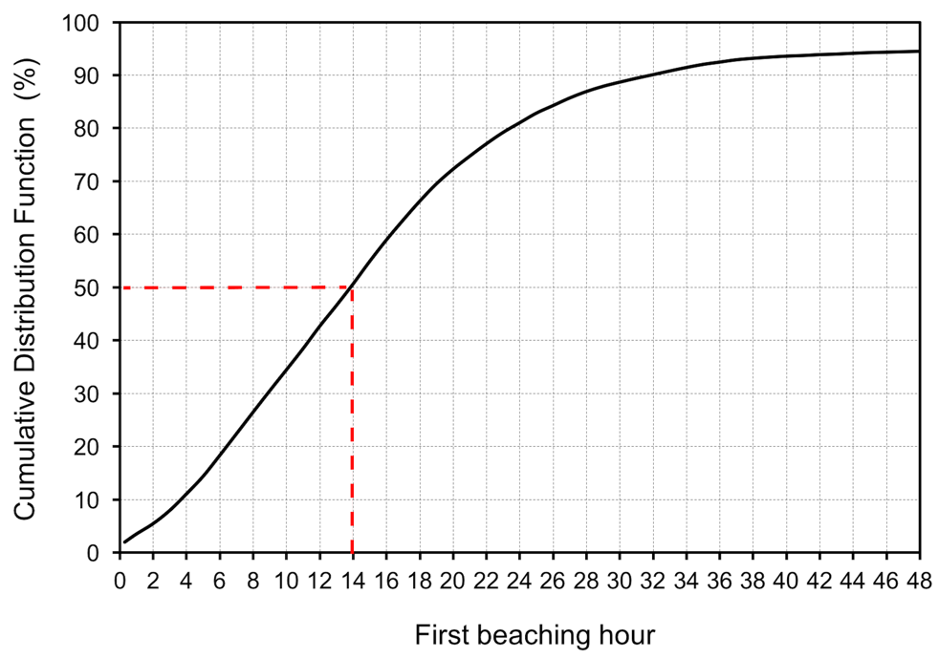
First beaching time
Histogram showing the probability distribution of the first beaching hour. Time interval of 7–17 hours after the start of the release indicates the highest probabilities of 3.9%–4.3% (highlighted in red)
Cumulative Distribution Function (CDF) of the first beaching time. The red lines show that 50% of oil spills reach the coast within 14 hours

Slide 13
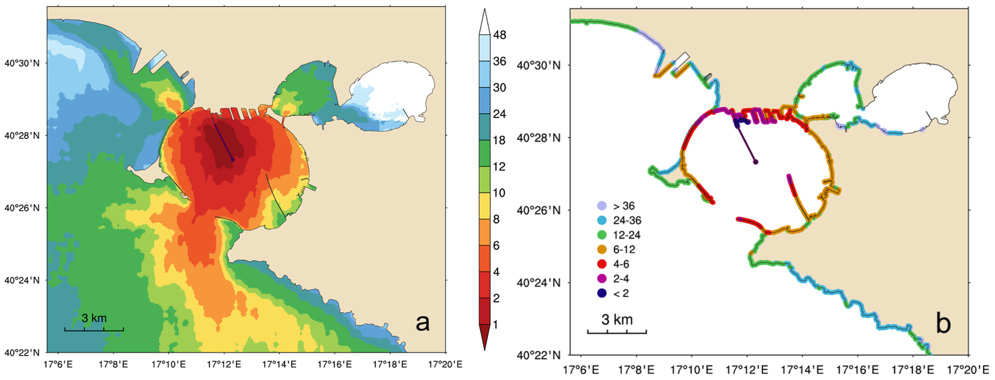
Arrival time
Arrival time plots showing the minimum time (hrs) for the oil to exceed the pre-defined (a) sea surface threshold concentration of 0.01 g m⁻², and (b) coastline threshold concentration of 0.1 g m⁻¹

Slide 14
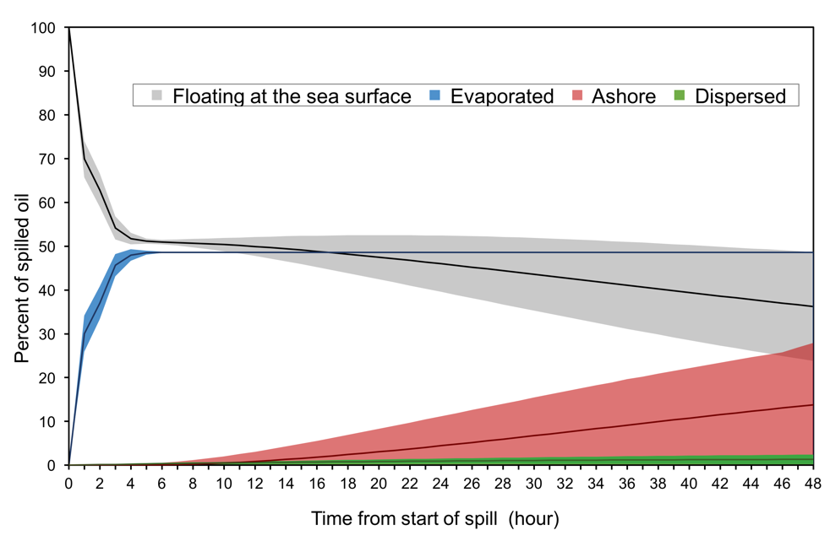
Oil mass balance
Oil mass balance diagram showing the distribution of oil (%) over the four components: at the sea surface, evaporated, washed ashore, and dispersed in the water column.
Shaded areas depict the spread (mean value ± standard deviation)

Slide 15
Polluted coastline length
The most probable (25%) polluted coastline length varies from 0.6 to 1 km.
~13% of spills pollute the coastline insignificantly

Slide 16
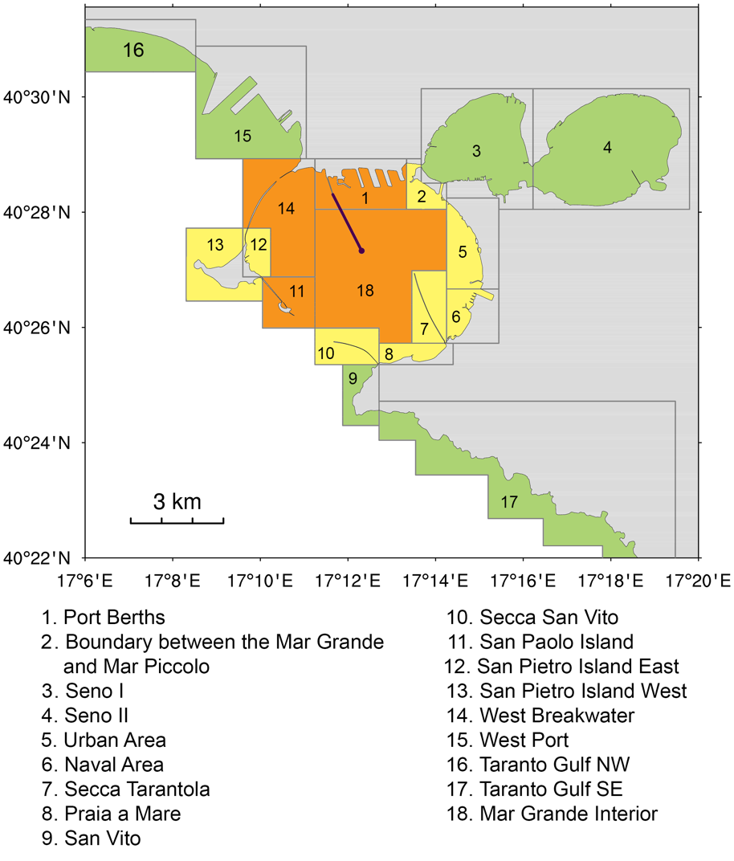
Integral pollution of the sub-regions
Sub-regions can be conditionally divided into
3 groups with respect to the required response urgency:
Sub-regions that call for imperative countermeasures: the Port Berths, Mar Grande Interior, West Breakwater, and San Paolo Island
(2) Sub-regions where some reasonable response delay is possible: Secca San Vito, Praia a Mare, the Urban Area, Boundary between the Mar Grande and Mar Piccolo, Secca Tarantola,
San Pietro Island East and West, and the Naval Area
(3) Sub-regions that are naturally sheltered:
San Vito, West Port, the Taranto Gulf NW and SE,
Seno I, and Seno II.

Slide 17
Problems
mainly methodological
        Uncertainty in definition of oil spill scenario
        Lack of agreement on:
        (a) Pollution/hazard/risk index definition
        (b) Threshold values
        (c) Terminology
        To overcome these problems we need feedback from stakeholders

Slide 18
Conclusion
Stochastic model simulations are conducted to predict the statistical footprint of oil pollution associated with the potential spills from the single-point buoy mooring and subsea pipeline at the Port of Taranto
The MEDSLIK-II oil spill model is coupled to SANIFS run on an unstructured grid at an ultra-fine resolution
Hypothetical oil spill scenario is based on the real case occurred at the Port of Genoa in 2016
15,000⁺ spill simulations are carried out randomly sampling over the environmental conditions 2018–2020
The main oil drift is directed southwesterly towards the outlet to the open sea, which is consistent with the mean 2018–2020 surface flow direction
Under the combined transport by highly variable currents, waves, and turbulent mixing, oil is exposed to
multiply strandings and washing offs from concrete constructions at the Port
Oil tends to be dispersed almost isotropically over the Mar Grande, indicating a rather moderate or small levels of concentration over the pre-defined minimum threshold values
The first oil beaching is predicted within 7–17 hours after the start of the release
Arrival time vary 1–16 hours in the interior of the Mar Grande
The most probable contaminated coastline length is estimated to be 0.6–1 km
After the rapid evaporation of ~48%, oil tends to be re-distributed between the sea surface and coastline
with gradually growing the latter component
This work was performed in the framework of the IMPRESSIVE project (#821922) co-funded by the European Commission under the H2020 Programme

