Slide 1
A comparison of topsoil organic carbon concentration maps of Great Britain
Chris Feeney (chrfee@ceh.ac.uk)
Jack Cosby
David Robinson
Amy Thomas
Bridget Emmett
SSS10.3: Digital Soil Mapping and Assessment
Thursday, 29 April 2021, 11:45-12:30 (CEST)

Slide 2
Assess risks of carbon losses & opportunities for gains
Why should we map soil organic carbon (SOC)?
Majority constituent of soil organic matter, which is important for…±
Impractical to try & sample every 1 km² area of land
SOC = largest OC store of the terrestrial biosphere (Lal, 2004)
Dynamic; sensitive to biophysical drivers*; can learn more…
Soil chemistry e.g. pH
Nutrient store & energy source
Position in the landscape
Stable aggregate formation
Climate
Soil aeration
Land cover / use
Infiltration & water storage
±see Blanco-Canqui et al. (2013) for a more complete list.
Geology & parent material
*This is not a complete list.
Porosity & bulk density
Organ-isms
Rapid pH change buffer
However, 1/3 of the world’s soils are degraded – losing SOC
Many regions don’t conduct large, repeat surveys; global map prediction = alternative

Slide 3
Digital mapping of SOC
Soil texture
pH
Relief / elevation
Climate
Land cover
SOC
Digital mapping of SOC relies on a mix of observations & environmental co-variates (biophysical drivers of SOC accumulation).
SOC observations from large field surveys calibrate the model & should cover all variation in the covariates to extrapolate model predictions across the entire area.
These are fed into a model that predicts SOC at the soil surface (0-30 cm typically).
Could be a model based on pedo-transfer rules, uses machine learning techniques, or geo-statistics to interpolate a map.
Survey data
Organisms
Parent material
For a detailed overview of digital soil mapping, see Minansy et al. (2013).

Slide 4
Aim & objectives of the study
Evaluate how closely 8 maps of topsoil (up to 30 cm) organic carbon concentration of Great Britain compare with one another & with survey data, with an exploration of why (dis)agreements arise
Harmonise each map to common units, spatial extent & resolution;
Compare spatial distributions of predicted SOC concentration;
Evaluate (dis)agreements between SOC maps & with survey data;
Explore why (dis)agreements arise by leveraging auxiliary datasets & proxies including for land cover, soil types & climate conditions.

Slide 5
Map | Description (see notes on abbreviations) | Source
CSGB-AIC | 1km vector; CS2007; CU, using AIC to select best predicting parent material variable | Henrys et al. (2012)
CSGB-GAMM | 1km raster; CS2007; spatial GAMM | Thomas et al. (2020)
CSGB-KRGS | 1km raster; CS2007; GS (OK) | Emmett et al. (2010)
CSGB-MLRF | 1km raster; CS2007; ML (RF); uses climate to predict land use to then predict SOC | Griffiths (unpublished)
ISRIC-2017 | 250m raster; WoSiS; ML | Hengl et al. (2017)
ISRIC-2020 | Same as ISRIC-2017, but with improvements listed on webpage | ISRIC World Soil Information (2020)
LUCAS | 500m raster; LUCAS 2009; spatial GAMM | de Brogniez et al. (2015)
OCTOP | 1km raster; ESDB; combining a pedo-trasfer rule with temperature & land cover | Jones et al. (2005)
Green = GB- wide maps generated from Countryside Survey 2007 data; Red = maps with global coverage; Blue = EU-wide maps.
Notes:
Note on abbreviations:
CU = Conventional Upscaling
ML = Machine Learning
AIC = Akaike’s Information Criterion
GS = Geo-statistics
SOC = Soil Organic Carbon
GB = Great Britain
WoSiS = World Soil Information System
GAMM = Generalized Additive Mixed Models
OK = Ordinary Kriging
RF = Random Forest
ESDB = European Soils Database

Slide 6
How do we know which map is “best”?
First,
Next,
Lastly,
Fractionate the analysis by land units to explore the role of bio-physical drivers
Compare maps with each other
Compare maps with survey observations
Do any of them stand out from the ensemble?
GB Countryside Survey 2007
“Best” refers to the most coincident map predictions with the mean of the map ensemble & with survey data.

Slide 7
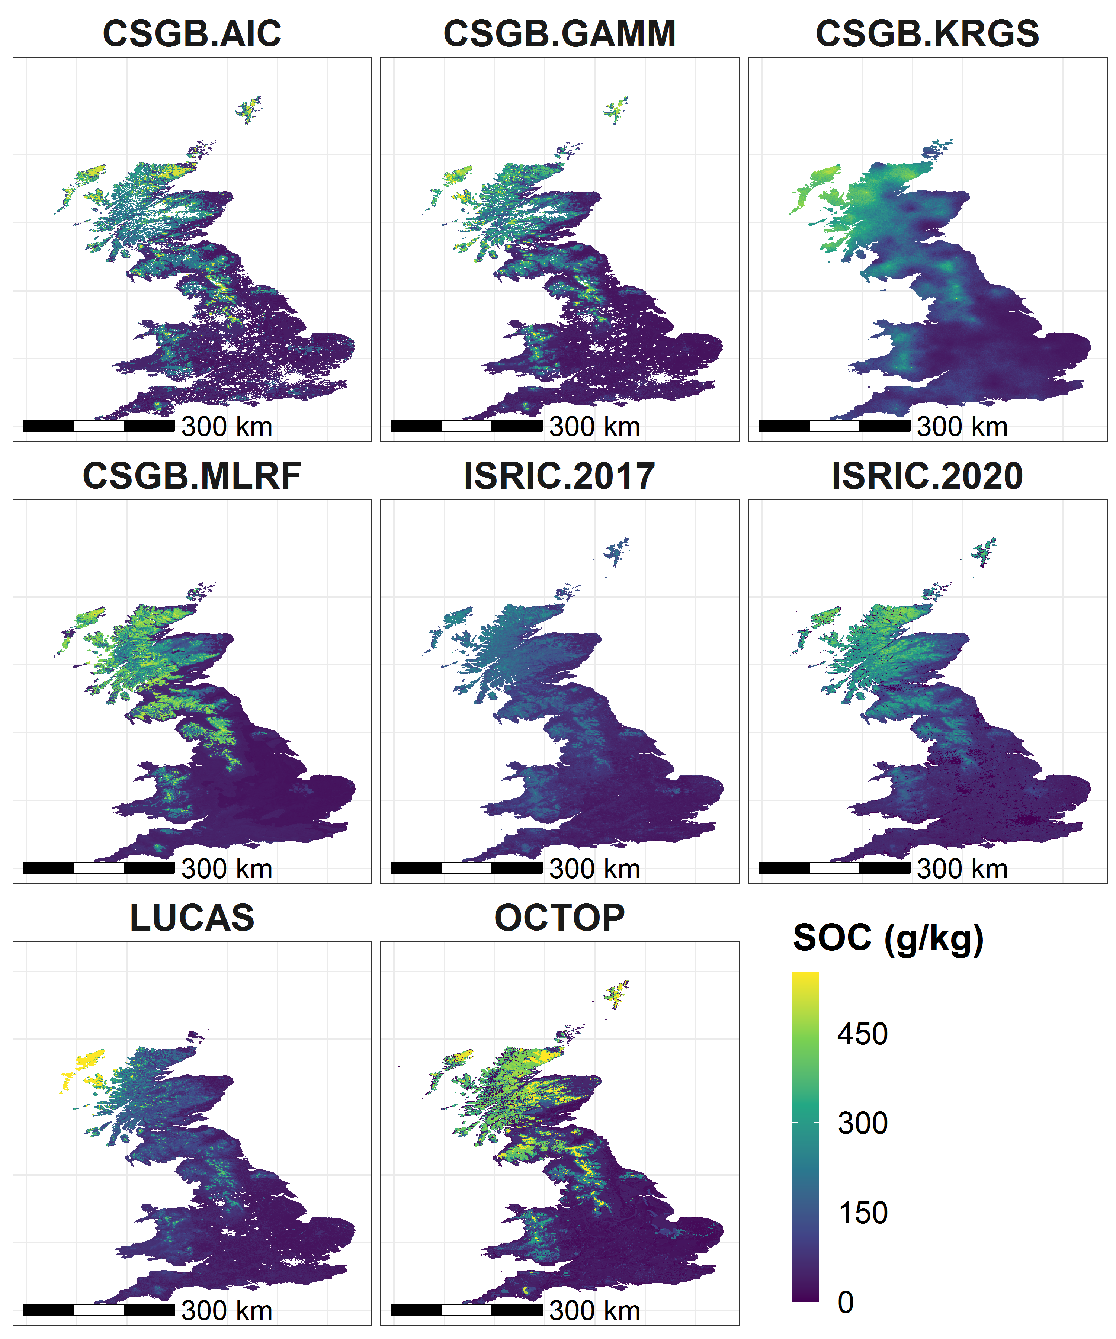
SOC distributions compared
Map | Mean | Median | Minimum | Maximum | Standard Deviation
CSGB-AIC | 117.96 | 62.80 | 18.94 | 513.03 | 119.09
CSGB-GAMM | 104.92 | 47.75 | 17.89 | 550 | 113.77
CSGB-KRGS | 133.63 | 97.32 | 13.97 | 527.58 | 101.27
CSGB-MLRF | 121.93 | 48.10 | 14.60 | 544.74 | 137.26
ISRIC-2017 | 91.73 | 71.83 | 10.83 | 332 | 58.56
ISRIC-2020 | 120.21 | 71.43 | 0 | 503.90 | 105.80
LUCAS | 89.09 | 60.81 | 9.02 | 550 | 89.01
OCTOP | 121.56 | 42.98 | 0 | 550 | 154.40

Slide 8
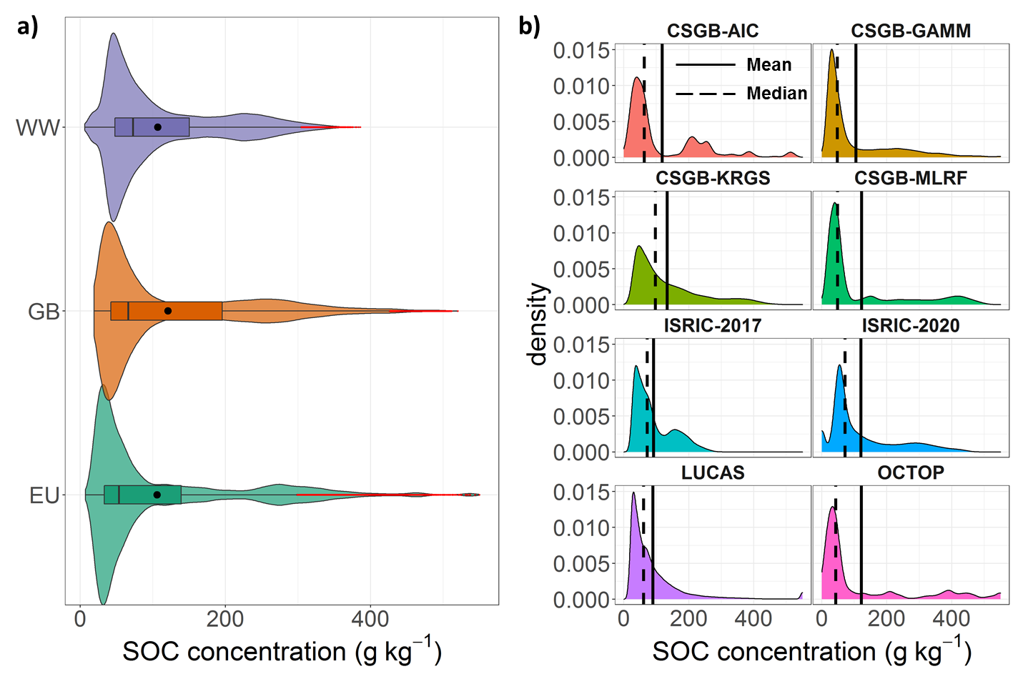
SOC distributions compared
Distributions of modelled SOC concentrations: a) for the 3 groups of models: worldwide, (WW), Great Britain only (GB), and European Union-wide (EU); b) for each individual map.
Notes:
For the 3 grouped distributions in part (a), the mean at each cell is taken and the distributions of these mean values are plotted. So, for the GB maps distribution, where a grid cell contains data from at least 1 CSGB map, the mean value is taken and then the distribution of all these mean values are plotted; for the WW maps, this focusses on the 2 ISRIC maps; for the EU-wide maps, this includes LUCAS & OCTOP.
Note: Whiskers extend to ±1.5 x IQR.

Slide 9
SOC concentrations: Average of the 8 maps
Focussing on just the grid cells where there are data for all 8 maps:
Clear gradients in SOC means & standard deviations, increasing in size from SE to NW.
Largest values in the highest elevations & latitudes as well as low-lying peatlands.

Slide 10
Coefficient of variation & signal to noise ratio
High coefficient of variation occurs where maps fail to capture high OC in lowland peat; & where maps predict higher OC in mineral soils than most of the maps do.
High Signal : Noise = greater conformity of SOC predictions across all 8 maps.

Slide 11
Maps that differ most from the 8-map ensemble
Stripes = positive deviation
Dots = negative deviation
Notes:
There are a small handful of 1km grid cells (total of 68) where 2 maps tie for deviating the most from the mean of the 8-map ensemble.

Slide 12
Where maps disagree the most & by how much
Notes:
You may not be able to see the grey cells that indicate where 2 maps are “Tied” for disagreeing most with the 8-map ensemble mean. That’s because there are only 68 such instances of “Ties”, out of a possible ~200,000 grid cells!
As in the previous slide, negative values for disagreements here refer to where an individual map under-predicts SOC relative to the mean of the 8-map ensemble; positive disagreements refer to over-predictions.
The “No. of SDs” map illustrates the scale of the disagreement between the 8-map mean and the individual map that disagrees most with this mean. Some maps disagree by more than 1 standard deviation; others disagree by more than 2. No maps disagree by less than 1 standard deviation or by more than 3 – hence the choice of binomial scale here.

Slide 13
Comparison with Countryside Survey 2007
Why use CS 2007?
Stratified random sampling; 45 land types based on climate, land cover & elevation. Within each 1km² grid, 5 random samples are taken (591 grids). Range of SOC environments are well represented.
We have multiple maps that are based on the CS 2007 survey. While we expect these maps to be the most accurate when compared with observations, it is still useful to try to investigate differences between these 4 maps & the reasons why.
LUCAS 2009 does not cover areas >600 m asl: good coverage of mineral soils; organic soils, especially in Scotland, are not well represented, however.
National Soils Inventory (NSI) uses systematic/grid sampling (5km² grid) & covers a large no. of samples (>5500 in England & Wales alone). This may be advantageous for evaluating the accuracy of e.g. digital soil maps created by spatial interpolation. However, we’re interested in figuring out why these 8 maps predict SOC concentrations differently. We fractionate our comparisons between map predictions & observations by various land type attributes (e.g. latitude, major soil type & land cover) to explore potential effects of environmental controls. For this reason, a stratified random survey is most appropriate here.
Notes:
More info on NSI from Jones et al. (2005: p.669):
“The systematic sampling scheme for ground data in England and Wales has by design a tendency to underestimate the presence of soils with little representation in the area covered.”

Slide 14
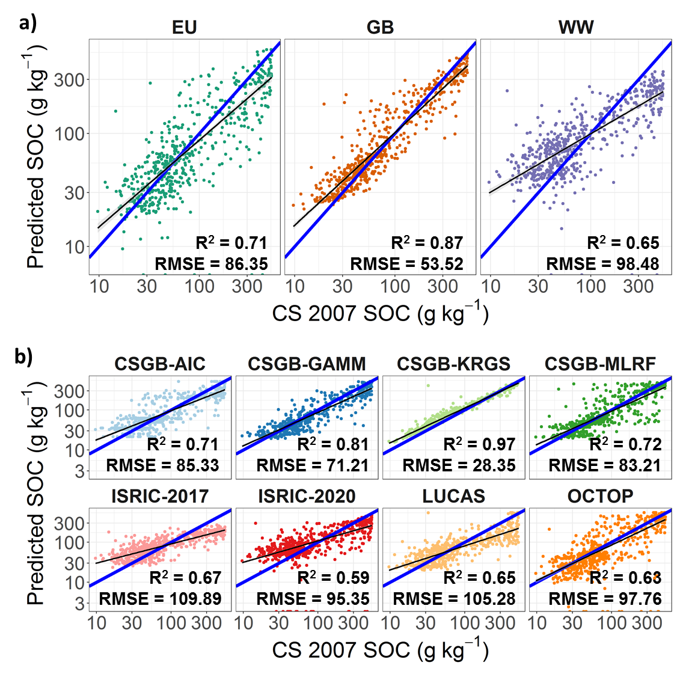
Countryside Survey 2007 vs Map’s SOC
Predicted SOC concentrations vs data from the Countryside Survey (CS 2007): a) for the 3 groups of models – worldwide, (WW), Great Britain only (GB), and European Union-wide (EU); b) for each map individually. 1:1 line in blue; best-fit linear model in black (grey shading = ±1 standard error of the mean.
R² & RMSE refer to the best-fit linear relationship between the maps & CS2007; not the 1:1 line!
Notes:
Unsurprisingly, the 4 maps based on Countryside Survey data had the highest adj. R-squared & lowest RMSE when compared with CS2007 data.
At individual CS points, the CSGB maps – CSGB-KRGS in particular – show a high level of agreement (high adjusted R² & low RMSE). However, as we will see in the later analysis, models that appear to perform best at the aggregate national scale do not necessarily produce SOC distributions by various smaller-scale land units (e.g. latitude bands, land cover types or soil types) that match with distributions of CS2007 data at these levels…

Slide 15
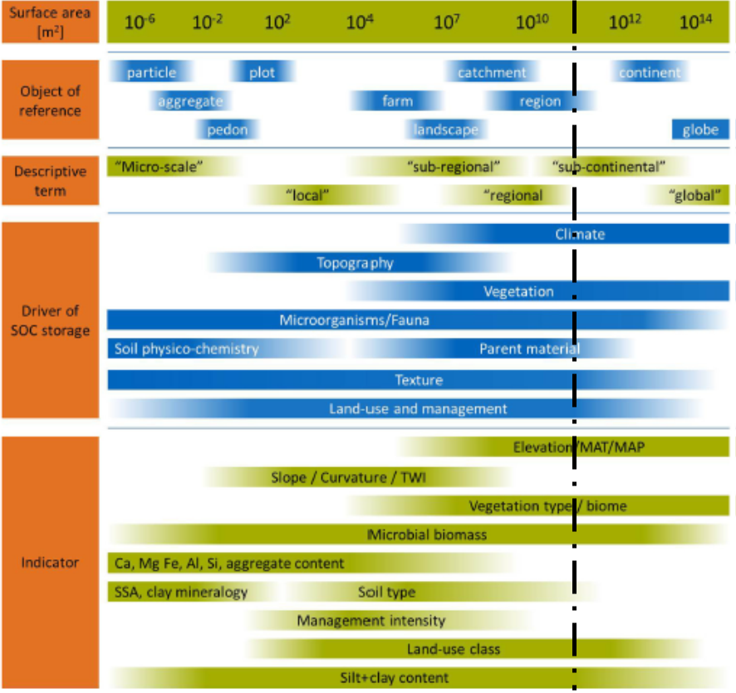
SOC distributions by environmental indicators
Great Britain can be fractionated into various geographical units that represent environmental characteristics which may be the main drivers of SOC at GB-scale.
Here, we divided GB into different:
Latitudes to incorporate elevation, climate & position in the landscape;
Land cover aggregate classes to include organisms, vegetation & land-use/management;
Major soil types to incorporate a mix of the above as well as other factors e.g. parent material, texture & time.
GB land area
Adapted from Wiesmeier et al. (2019).
Notes:
Different environmental factors drive SOC storage at different spatial scales.
At GB-scale (indicated above), climate, vegetation, organisms/fauna, parent material, soil texture & land-use/management drive SOC storage.
These can mostly be captured by the 3 indicators listed here: latitudes, land cover aggregate classes, & major soil types.

Slide 16
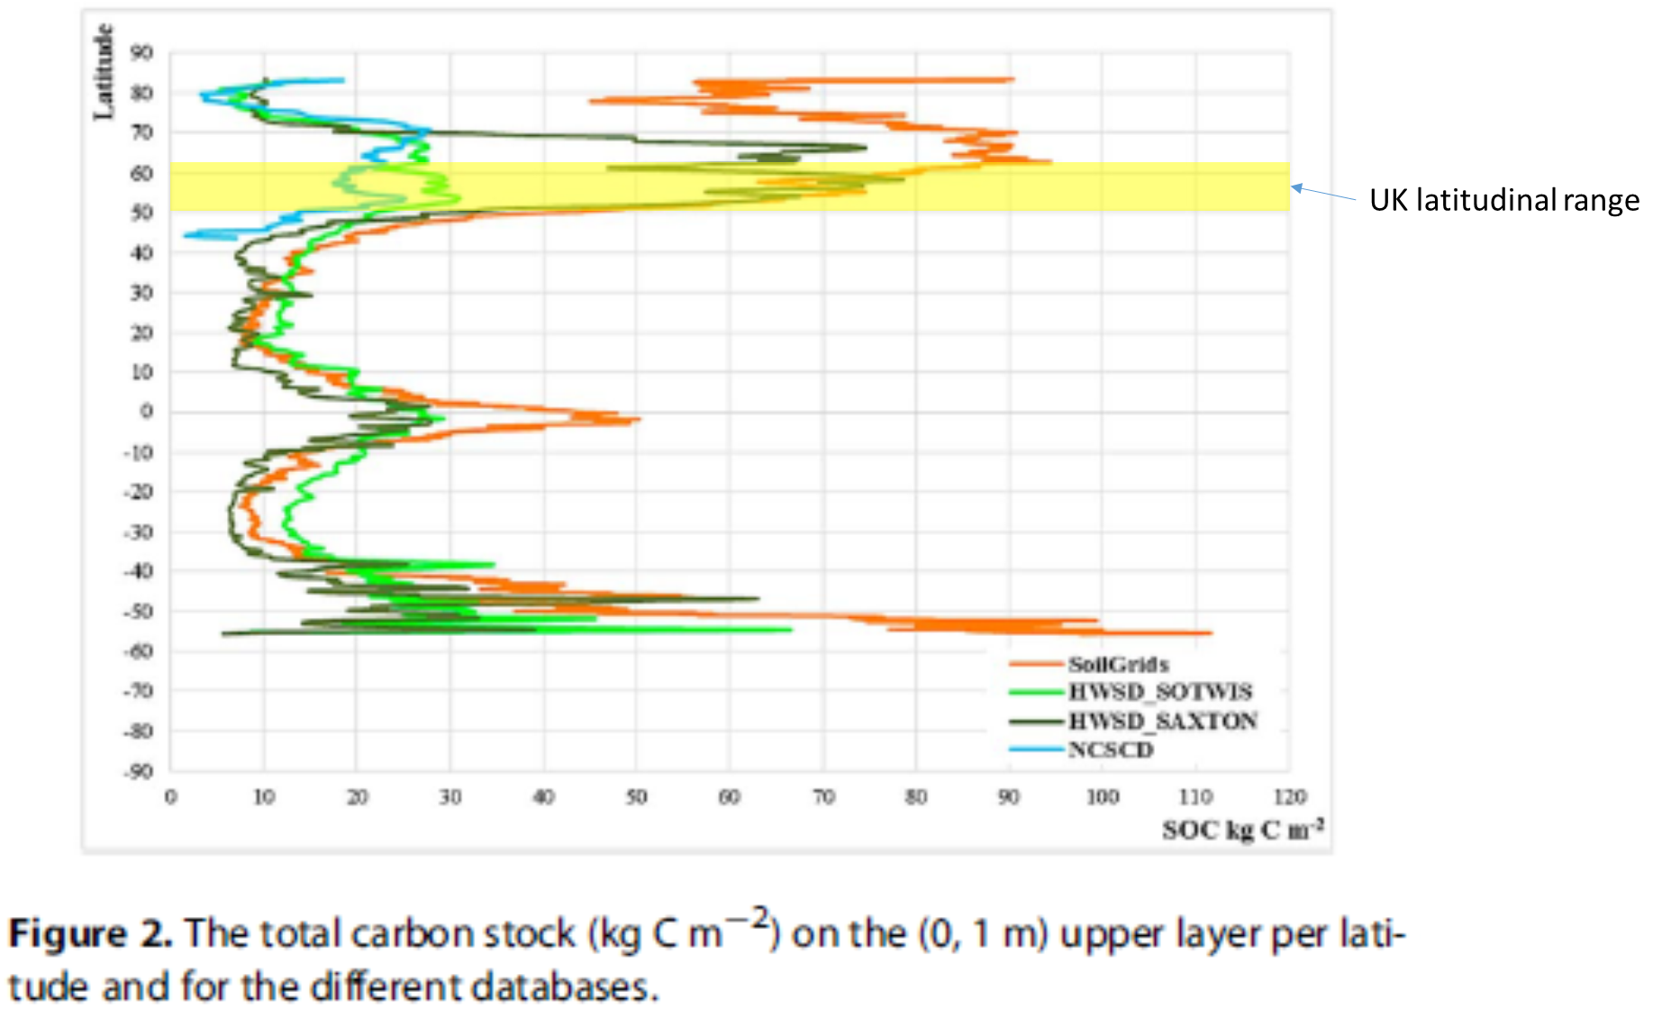
SOC distributions by environmental indicators
Adapted from: Tifafi et al. (2018).
Notes:
GB also straddles a critical latitude range (~50 to 60ºN) where SOC stocks increase by approximately an order of magnitude (from tens to hundreds of kg C m⁻²) from south to north. This is another reason why GB is an interesting case study to focus on and another reason why we compare distributions within each 1-degree latitude band.

Slide 17
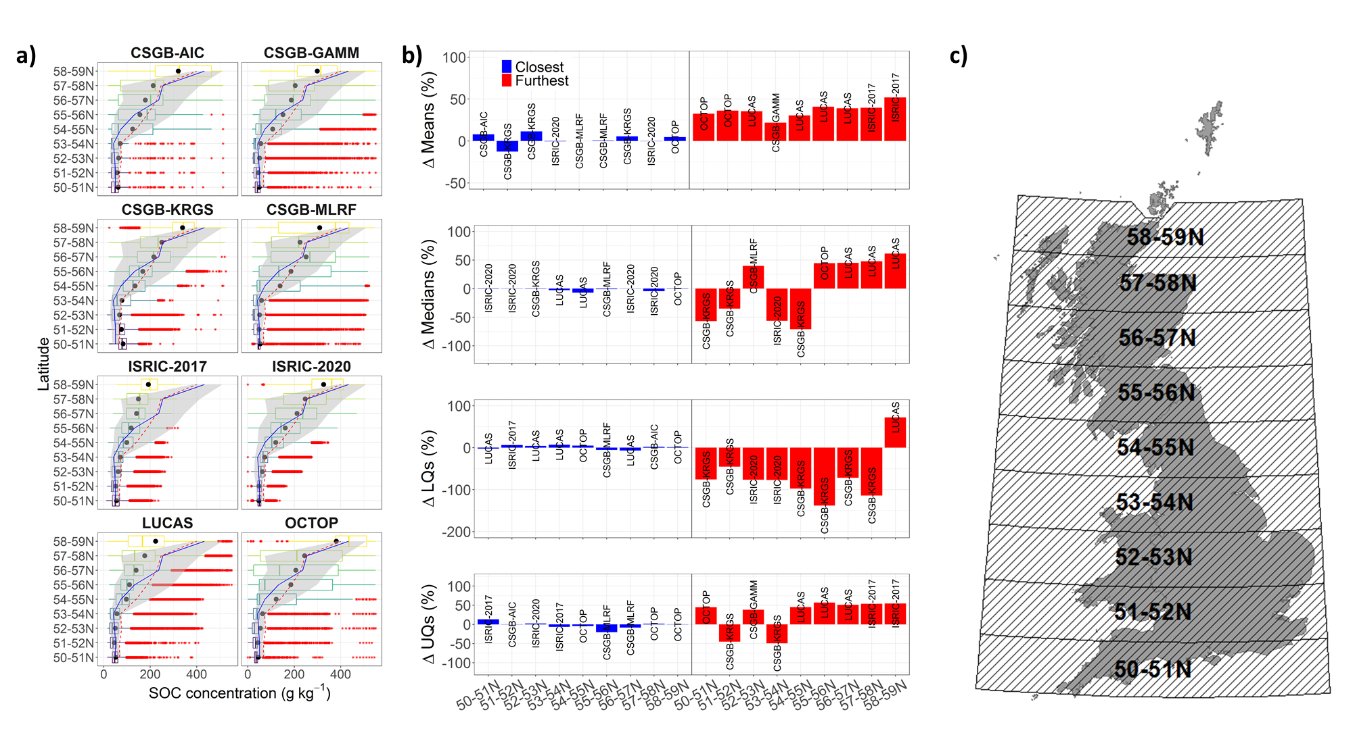
Climate: SOC distributions by latitude
*The Shetland & Orkney Islands are excluded here due to their small area.
Grey area = CS2007 Inter-Quartile Range; Solid blue line = CS2007 Median; Dashed red line = CS2007 Mean
Notes:
SOC concentrations modelled at each 1-degree latitude interval: a) Boxplots of the SOC distribution modelled at each latitude interval for each of the 8 maps (black circles are the means). The grey area is the IQR of the CS 2007 SOC distribution, and the solid blue and dashed red lines denote the median and mean CS 2007 SOC values, respectively. b) Differences between the maps and CS 2007 SOC values at each latitude interval for each statistic (mean, median, lower-quartile and upper-quartile). Percentages refer to how much the map over- (negative) or under-estimates (positive) compared to the CS 2007 data. c) Illustration of Great Britain in relation to each latitude interval (note: the Shetland and Orkney Islands are excluded due to the limited spatial coverage at these higher latitude intervals).

Slide 18
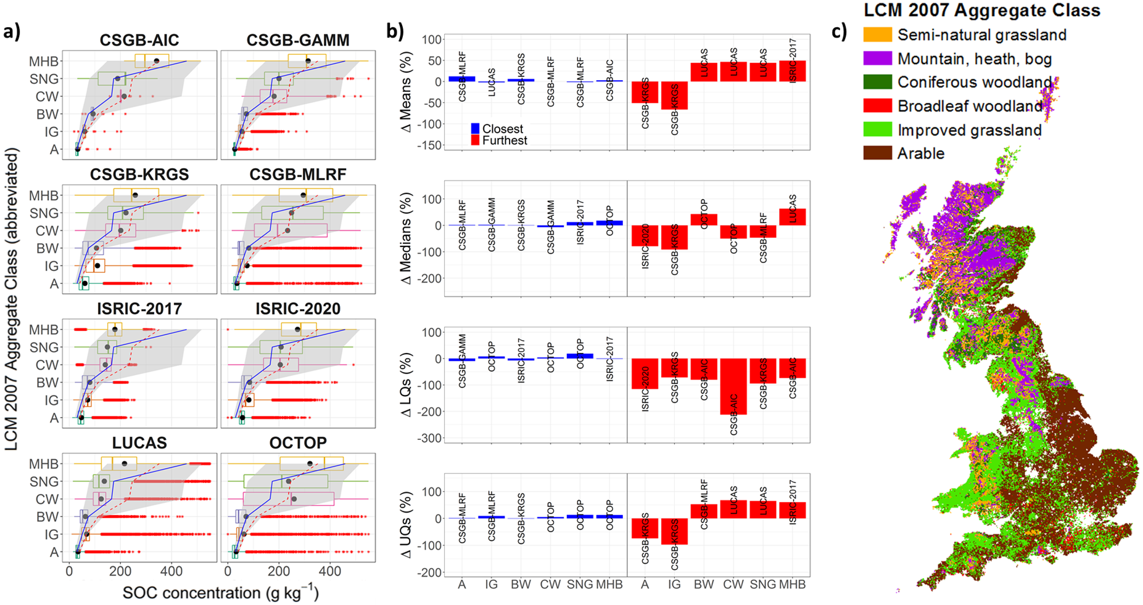
Land Cover: SOC distributions by land cover
Grey area = CS2007 Inter-Quartile Range; Solid blue line = CS2007 Median; Dashed red line = CS2007 Mean
Notes:
SOC concentrations modelled for each Land Cover Map (LCM) 2007 aggregate class: a) Boxplots of the SOC distribution modelled for each aggregate class for each of the 8 maps (black circles are the means). The grey area is the IQR of the CS 2007 SOC distribution, and the solid blue and dashed red lines denote the median and mean CS 2007 SOC values, respectively. b) Differences between the maps and CS 2007 SOC values for each aggregate class for each statistic (mean, median, lower-quartile and upper-quartile). Percentages refer to how much the map over- (negative) or under-estimates (positive) compared to the CS 2007 data. c) Map of the land cover aggregate classes in Great Britain (“Saltwater”, “Freshwater”, “Coastal” and “Built-up areas and gardens” areas excluded as these should not contain soil).
NOTE: I chose to use the 2007 LCM as most of the maps seem to use survey measurements taken around the year 2007.

Slide 19
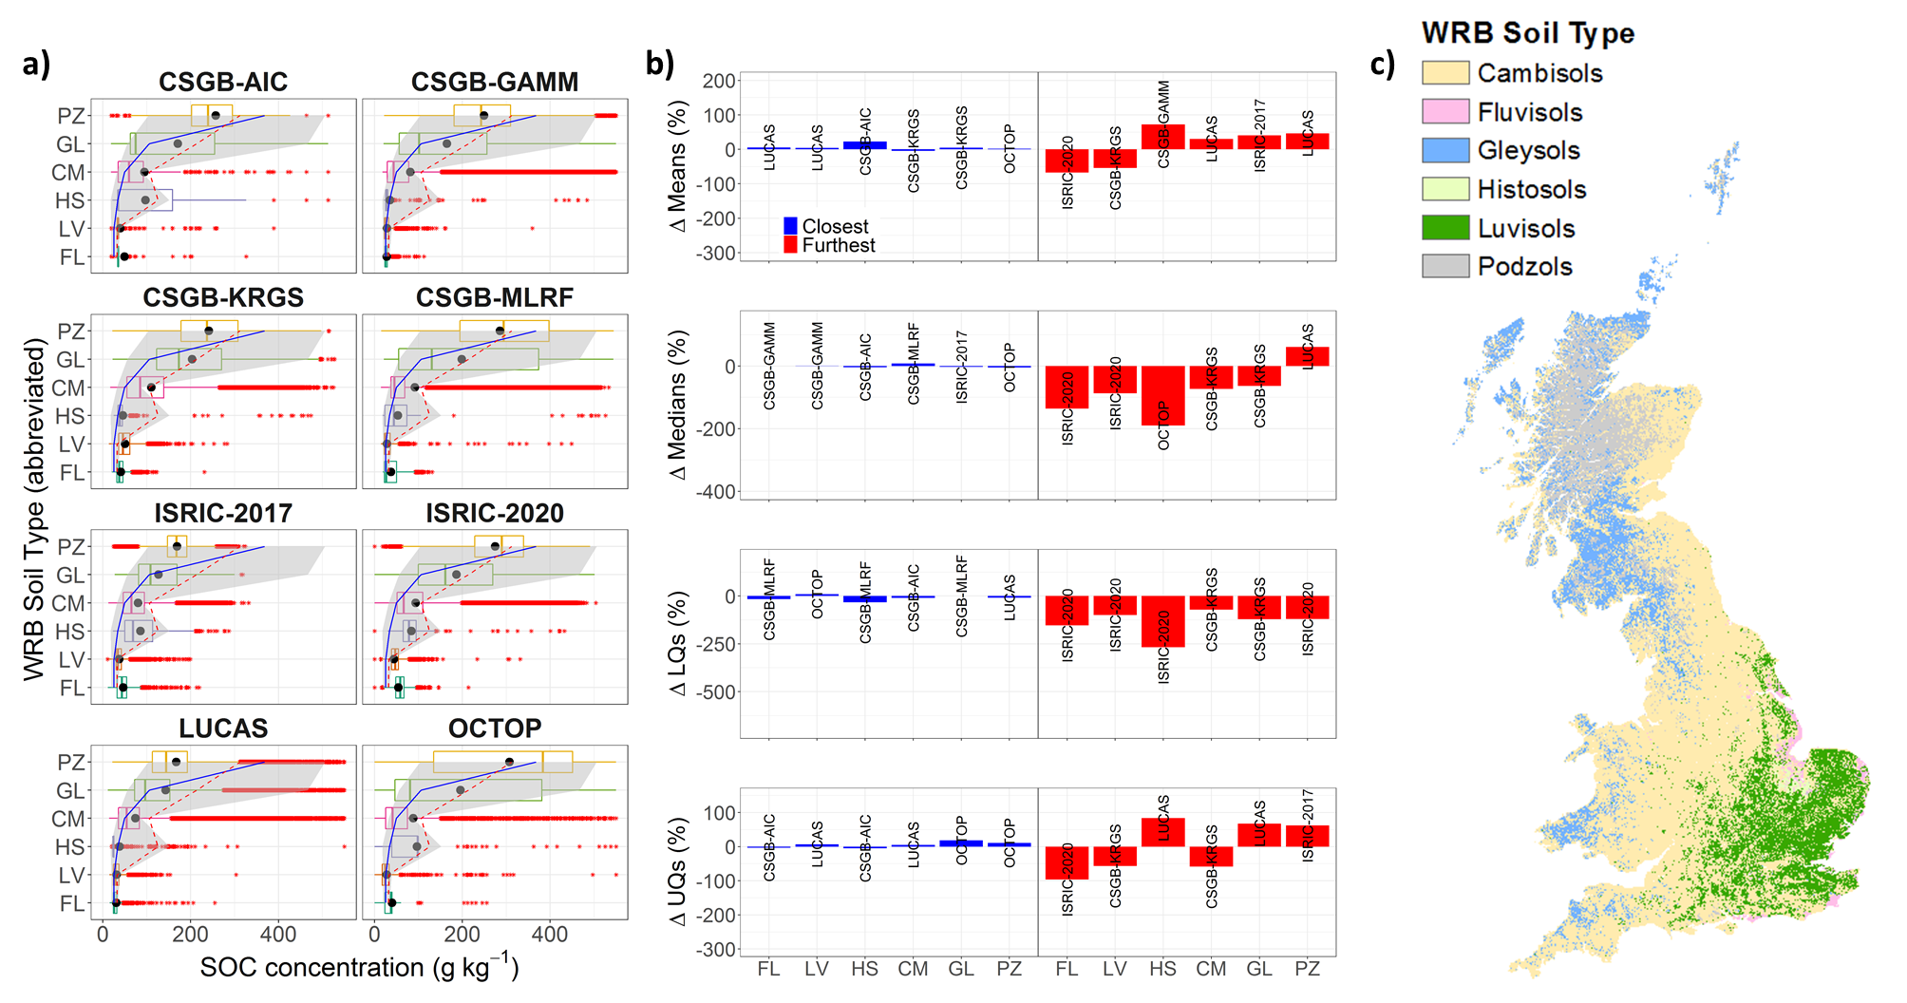
Soil Type: SOC distributions by major soil types
Grey area = CS2007 Inter-Quartile Range; Solid blue line = CS2007 Median; Dashed red line = CS2007 Mean
Notes:
SOC concentrations modelled for each World Reference Base (WRB) map soil type: a) Boxplots of the SOC distribution modelled for each WRB soil type for each of the 8 maps (black circles are the means). The grey area is the IQR of the CS 2007 SOC distribution, and the solid blue and dashed red lines denote the median and mean CS 2007 SOC values, respectively. b) Differences between the maps and CS 2007 SOC values for each WRB soil type for each statistic (mean, median, lower-quartile and upper-quartile). Percentages refer to how much the map over- (negative) or under-estimates (positive) compared to the CS 2007 data. c) Map of the WRB 2006 soil types that occur in Great Britain (other soil types occur, but make up less than 1% of the land surface, hence are excluded here).

Slide 20
Summary of results
Similarities
Right-skewed, mostly bimodal distributions
Median SOC predictions = 40-100 g kg⁻¹
Disagreements
CSGB-KRGS, OCTOP & ISRIC-2020 differ most from the others
Scale of dis-agreement as high as 400 g kg⁻¹ & >2 std. devs.
OCTOP, ISRIC-2020 & CSGB maps predict high SOC well
Maximum SOC = 500-550 g kg⁻¹; may reflect underlying data
Effects of elevation & climate captured successfully
Notes:
All maps had a median SOC value in the range of 40-100 g kg⁻¹.
OCTOP, ISRIC-2020 & the CSGB maps appeared to capture the higher SOC values one would expect to see in the higher elevation & wetter/colder areas, with maxima in the range of 500-550 g kg⁻¹.
This also likely reflects the underlying distribution of survey data capturing this diversity of SOC levels. Better models with more complete data coverage!
Identified disagreements among the 8 maps in the tested ensemble:
CSGB-KRGS stands out most often as the furthest away from the mean of the ensemble, with OCTOP & ISRIC-2017 the 2nd and 3rd most deviant maps.
Differences between the furthest removed maps & the mean of the ensemble are as high as 400 g kg⁻¹ in some places!
Differences between the furthest removed maps & the mean of the ensemble are often on the order of >2 standard deviations of the mean.

Slide 21
Summary of results
CSGB maps vs. CS 2007 data
Lowest RMSE & highest R² of all 8 maps.
CSGB-KRGS best fits CS 2007; CSGB-AIC worst of these 4 maps
Global & EU-wide maps vs. CS 2007 data
Highest RMSE & lowest R² of all 8 maps
ISRIC-2017 has highest R²; ISRIC-2020 has lowest RMSE
Similar best-fit maps by land types
OCTOP & CSGB-MLRF capture the breadth of SOC levels best
ISRIC-2017 & LUCAS don’t predict high SOC very well
Notes:
Clear patterns emerged when comparing maps with CS 2007 data:
Unsurprisingly, the CSGB maps showed stronger relationships with smaller RMSEs than the 4 EU-wide & worldwide maps.
OCTOP, ISRIC-2020 & CSGB-MLRF were the “best” maps at predicting SOC distributions by latitude. LUCAS & ISRIC-2017 predictions decreased in accuracy with increasing latitude (i.e. from south to north).
OCTOP & CSGB-MLRF were the “best” at predicting SOC distributions by land cover. LUCAS & ISRIC-2017 distributions were furthest from the CS 2007 survey data.
OCTOP predictions were closest to CS 2007 when comparing distributions by soil type, with LUCAS & all 4 CSGB maps producing good fits overall too. Again, ISRIC-2017 distributions were furthest from the CS 2007 data.
“Best” refers to the most coincident map predictions with CS 2007 observations.

Slide 22
Possible explanations for map differences
OCTOP incorporated thematic layers representing land cover, temperature & soil properties; when plugged into a PTR, yielded 140 topSOC content conditions.
Verified against NSI from England & Wales: R² for NSI observations vs OCTOP results = 0.95.
Unlike LUCAS, OCTOP predictions were not constrained by an imposed unimodal distribution.
Jones et al. (2005) claim their methodology provides more accurate predictions than spatial interpolation or conventional upscaling (may explain how it compares with CSGB-KRGS & CSGB-AIC).
LUCAS under-predicts SOC – likely due to the imposed unimodal distribution with a mean that tilts towards the prevalent mineral soils (de Brogniez et al., 2015).
Our results confirm this (see e.g. podzols, latitudes > 55ºN & MHB areas).
ISRIC-2020 benefited from more sample points for calibration of the model, as well as more accurate error quantification than ISRIC-2017. Similar to LUCAS, the ISRIC-2017 map performs poorly in high SOC areas; ISRIC-2020 performs better.

Slide 23
Possible explanations for map differences
CSGB-AIC predicted SOC using conventional upscaling to generate weighted averages of SOC by land cover & BGS parent material characteristics.
Compared to the other 3 CSGB maps, this map exhibits the narrowest range of SOC values. This may be the result of some smoothing out of extreme values by spatial averaging.
CSGB-KRGS predicted a lower proportion of mineral soil SOC concentrations (0-44 g kg⁻¹) than any other map, but predicted a higher proportion of humus-mineral (44-165 g kg⁻¹) & organo-mineral (165-330 g kg⁻¹) SOC concentrations than most other maps.
This over-prediction of intermediate humus-mineral & organo-mineral SOC concentrations is expected given the spatial interpolation between C-poor mineral soils & C-rich organic soils.
CSGB-MLRF appeared to be most accurate relative to CS 2007 out of the 4 CSGB maps, matching the median, mean & IQR of the CS2007 observations more frequently than the other 3 maps.
Its reliance on a few core parameters (climatic, topographic & parent material attributes) to predict aggregate vegetation classes to then predict SOC, better captured the high spatial variability of SOC than CSGB-GAMM.
CSGB-GAMM uses many more mechanistic links to better understand how these drive SOC.

Slide 24
Map sources & other references
Blanco-Canqui, H., Shapiro, C.A., Wortmann, C.S., Drijber, R.A., Mamo, M., Shaver, T.M. and Ferguson, R.B. (2013). Soil organic carbon: The value to soil properties. Journal of Soil and Water Conservation, 68(5), pp.129A-134A.
de Brogniez, D., Ballabio, C., Stevens, A., Jones, R.J.A., Montanarella, L. and van Wesemael, B. (2015). A map of the topsoil organic carbon content of Europe generated by a generalized additive model. European Journal of Soil Science, 66(1), p.121-134.
Emmett, B.A., et al. (2010). Countryside Survey: Soils Report from 2007. Technical Report No. 9/07 NERC/Centre for Ecology & Hydrology. 192pp. (CEH Project Number: C03259).
Griffiths, R. (unpublished). Mapping GB soil carbon. October 13, 2020. 19pp.
Hengl, T., et al. (2017). SoilGrids250m: global gridded soil information based on Machine Learning. PLoS ONE, 12(2): e0169748. doi:10.1371/journal.pone.0169748.
Henrys, P.A., Keith, A.M., Robinson, D.A. and Emmett, B.A. (2012). Model estimates of topsoil carbon [Countryside Survey]. NERC Environmental Information Data Centre. https://doi.org/10.5285/9e4451f8-23d3-40dc-9302-73e30ad3dd76. [last accessed 11/12/2020].
ISRIC World Soil Information. (2020). SoilGrids – global gridded soil information. https://www.isric.org/explore/soilgrids. [last accessed 01/02/2021].
Jones, R.J.A, Hiederer, R., Rusco, E., Loveland, P.J. and Montanarella, L. (2005). Estimating organic carbon in the soils of Europe for policy support. European Journal of Soil Science, 56, p.655-671.
Lal, R. (2004). Soil carbon sequestration impacts on global climate change and food security. science, 304(5677), pp.1623-1627.
Minasny, B., McBratney, A.B., Malone, B.P. and Wheeler, I. (2013). Digital mapping of soil carbon. Advances in Agronomy, 118, pp.1-47.
Thomas, A., Cosby, B.J., Henrys, P. and Emmett, B. (2020). Patterns and trends of topsoil carbon in the UK: Complex interactions of land use change, climate and pollution. Science of the Total Environment, 729, p.138330.
Tifafi, M., Guenet, B. and Hatté, C, (2018). Large differences in global and regional total soil carbon stock estimates based on SoilGrids, HWSD, and NCSCD: Intercomparison and evaluation based on field data from USA, England, Wales, and France. Global Biogeochemical Cycles, 32(1), pp.42-56.
Wiesmeier, M., et al. (2019). Soil organic carbon storage as a key function of soils-A review of drivers and indicators at various scales. Geoderma, 333, pp.149-162.

