Slide 1



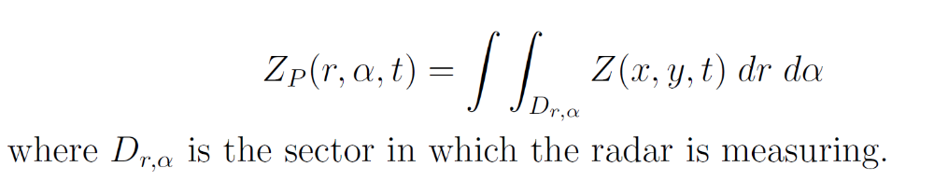
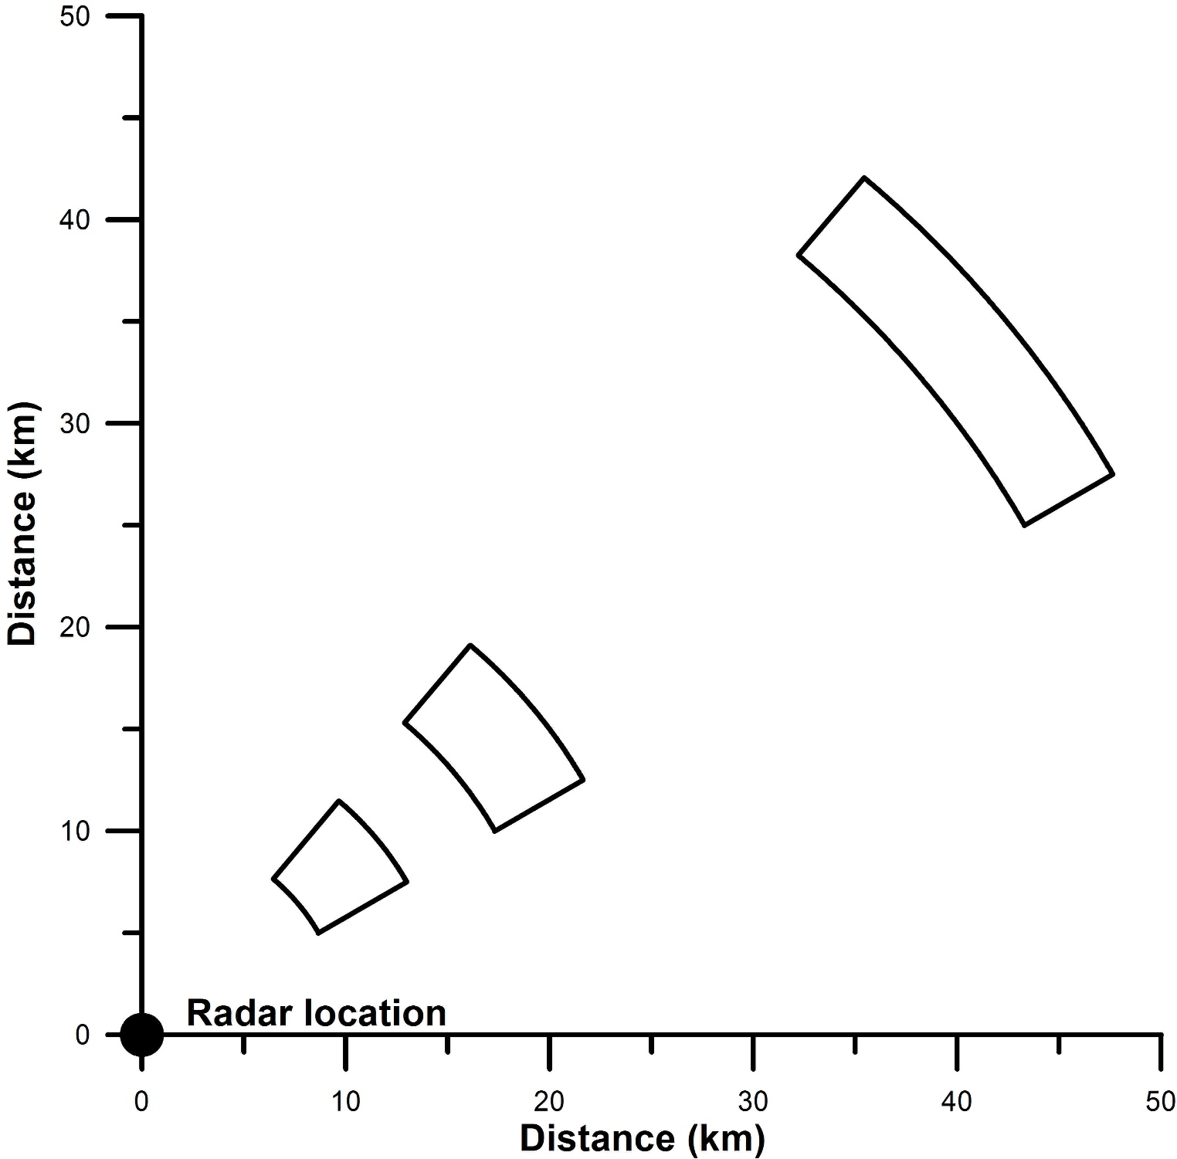
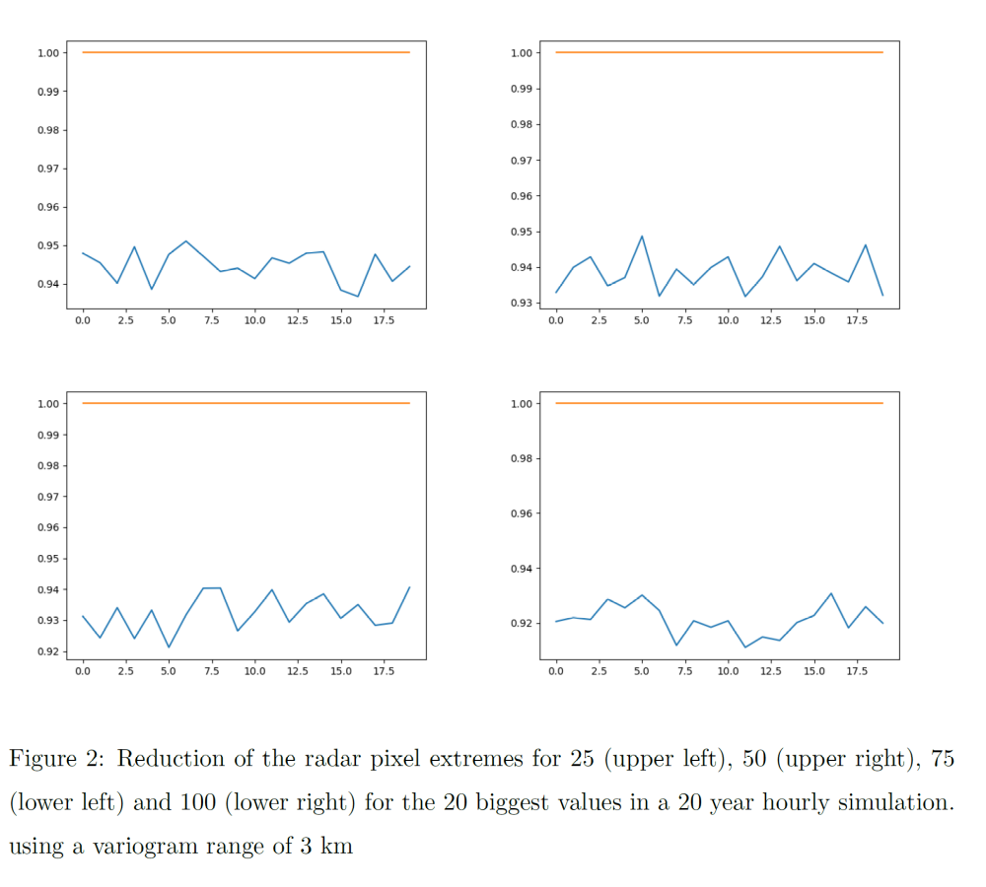
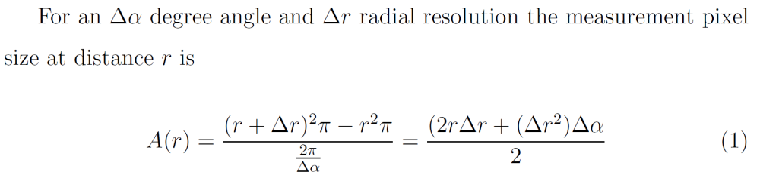
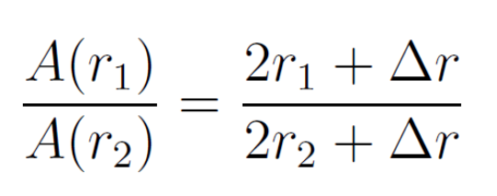
Extreme precipitations measured by radar
EGU21-4726
The problem
Radars measure reflectivity at different elevations corresponding to different distances and angles. The volumes measured differ considerably with increasing distance. The natural coordinate system of the radar is polar, however radar products are delivered on a Cartesian system, which does not reflect the changes of the volumes.
The purpose of this investigation is to quantify the effect of scanned volume differences on the distribution of measured precipitation specifically on extremes of different durations.
measurements.
András Bárdossy and Geoffrey Pegram
^{bardossy@iws.uni-stuttgart.de}
Radar measured precipitation
Results
The distributions of radar measured precipitation differ depending on the distance from the radar due to the different corresponding areas. This difference affects the extremes the most. Extremes are reduced depending on the spatial dependence which is a function of the aggregation time. The reduction can exceed 10 % for hourly aggregations.
Data Used:
As a first step simulated precipitation data were used:
☑ Precipitation simulated using the String of beads model
☑ Precipitation simulated using a normal and a v- copula using marginal distributions of precipitation in SW Germany
Fig 1 Radar measurement pixels as a function of distance
Methodology
Simulate sub radar resolution scale precipitation using
  Local point scale precipitation distributions
  Aggregation dependent spatial dependence
  Gaussian and non Gaussian copulas
Aggregate to the polar coordinate scale
Disaggregate to Cartesian coordinates
Evaluate distributions and extremes
The areas of the measurement “pixels” may differ by a factor of 10

