Slide 1




Correcting Net Ocean-Atmosphere CO₂ Fluxes for Near-surface Temperature Deviations.
Andrew J. Watson¹, Jamie D. Shutler¹, Peter Landschützer², David K. Woolf³, Thomas Holding¹, Lonneke Goddijn-Murphy⁴, Ute Schuster¹, and Ian G. C. Ashton¹
College of Life and Environmental Sciences, University of Exeter, UK
Max Planck Institute for Meteorology, Hamburg, Germany
Herriot-Watt University, UK
University of the Highlands and Islands, UK
We gratefully acknowledge all those who have contributed data to SOCAT!

Slide 2

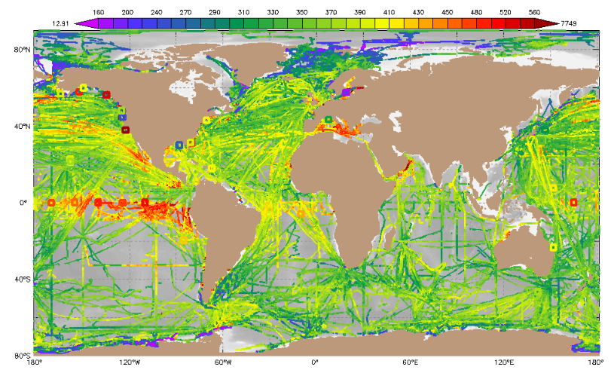
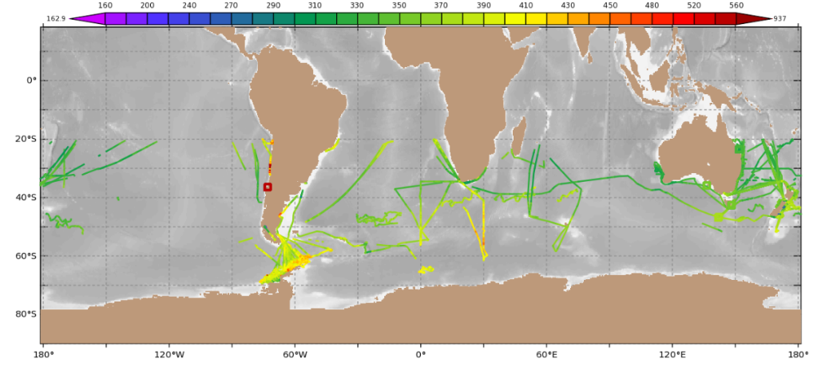
SOCAT: www.socat.info
A voluntary effort that has assembled more than 20 million observations of surface CO₂.
The Northern Hemisphere oceans are well covered in SOCAT, from the early 90s on.
The Southern Hemisphere is much less well covered.
pCO₂ (µatm)
200 300 400 500
(a)
Bakker, D. C. E. et al, Earth System Science Data, 2016, 8, pp. 383–413
(b)
www.socat.info
Surface ocean pCO₂ data in SOCAT:
  All good data
  Southern hemisphere winter (JJA) data, 2000-2018

Slide 3
Estimates of ocean-atmosphere fluxes from SOCAT data
In recent years there have been several estimates of global fluxes from SOCAT surface data.
However, up to now, none have corrected for small deviations in temperature close to the ocean surface, which have a substantial (~50%) effect on calculated fluxes.
In this work we
  Make those temperature corrections
  Estimate uncertainties due to imperfect coverage by applying nine different techniques of data interpolation.
  Outline implications for the global carbon budget.

Slide 4
Adjustments/corrections to SOCAT data.
We will:
Correct data to take account of mixed layer temperature gradients between sampling depth and “sub-skin” surface, using satellite data for SST (Goddijn-Murphy et al, 2015) .
Then adjust flux calculation for skin temperature deviation (Robertson and Watson 1992, Woolf et al 2016).
L. M. Goddijn-Murphy , D. K. Woolf , P. E. Land , J. D. Shutler , and C. Donlon” . “The OceanFlux Greenhouse Gases methodology for deriving a sea surface climatology of CO2 fugacity in support of air–sea gas flux studies” Ocean Sci. 11, 519-541, doi:10.5194/os-11-519-2015 (2015)
Robertson, J. E. and Watson, A. J. “Thermal skin effect of the surface ocen and its implcations for ocean CO2 uptake”, Nature, 358, 738-740 (1992).
Woolf, D. K., Land, P. E., Shutler, J. D., Goddijn-Murphy, L. M. & Donlon, C. J. On the calculation of air-sea fluxes of CO₂ in the presence of temperature and salinity gradients. J. Geophys, Res. Oceans 121, 1229-1248, doi:10.1002/2015jc011427 (2016).

Slide 5
Two surface temperature effects on CO₂ air-sea flux calculation
1) SOCAT “inlet” T differs from satellite-derived remote sensing product for subskin* temperature (at ~20cm depth).
  The difference ΔT can be positive or negative, but inlet temperatures are higher by ~0.2-0.3ºC on average than co-located satellite temperature estimates of subskin T.
  Why?
    Probably on average a small increase in T with depth this close to the surface.
    Most likely affected by warm bias in “Engine-room Inlet” temperatures, warmed by ship’s infrastructure – a well known effect observed in studies of surface temperature observations.
  Dissolved CO₂ needs to be adjusted to take this into account when calculating air-sea fluxes.
*For discussion and definition see GHRSST group page:
https://www.ghrsst.org/ghrsst-data-services/products/

Slide 6
Histogram of subskin temperature – SOCAT inlet temperature (SOCAT v2019)
14000
mode = -0.32K
mean = -0.127K
12000
10000
8000
6000
4000
2000
0
-2
-1.5
-1
-0.5
0
0.5
1
1.5
2
ΔT (K)
Calculated from From Holding et al product which is constructed using OISST monthly average SSTs co-located with SOCAT data, then “cruise-weighted” average taken
Holding, T., Ashton, I. G. C. & Shutler, J. D. Reanalysed (depth and temperature consistent) surface ocean CO&#8322; atlas (SOCAT) version 2019. PANGAEA, doi:10.1594/PANGAEA.905316 (2019).

Slide 7
Two surface temperature effects on CO₂ air-sea flux calculation continued
2) There is a cool “skin” at the surface.
  Increase in solubility results in higher concentration of dissolved CO₂ in equilibrium with atmospheric CO₂.

Slide 8
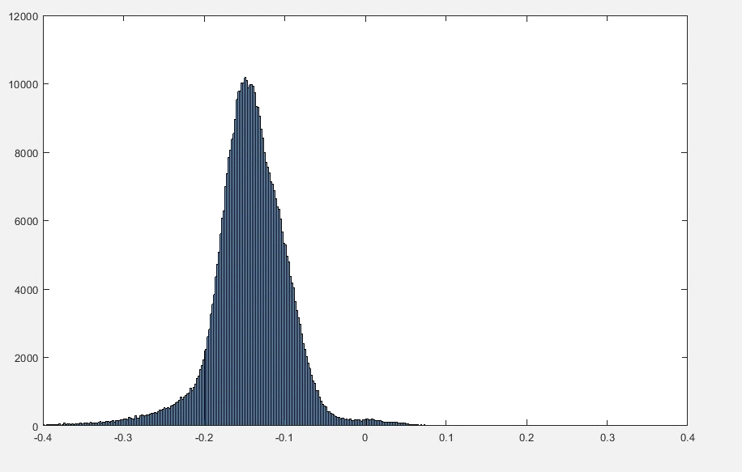
Histogram of climatological surface-subskin temperature, 2003-2011
Constructed from ESA CCI SST product (Merchant, C.J. et al., Nat Sci Data 6, 223, 2019).
  Almost always negative
  Much narrower frequency distribution than the subskin-to-inlet ΔT
Temperature, ºC

Slide 9
Comparison of frequency distributions of near-surface temperature differences
skin-subskin
subskin-SOCAT
ΔT (ºC)

Slide 10
Temperature and dissolved CO₂ in the top layer of the ocean
“Rapid transport” (solid line): assumes dissolved CO₂ remains constant from 10⁻³m to 10⁻⁴m.
Transit time in this layer similar to the hydration time of CO₂ +H₂O.
Alternatively, assume “equilibrium transport” (dashed line): dissolved CO₂ decreases with temperature and the skin temperature effect is bigger.
These two assumptions are limiting cases – reality lies between the two.
Interface concentration set by fCO2 in atmosphere x solubility at interface temperature
This cartoon shows typical temperature (blue) and dissolved CO₂ (red) in the top 10m.
Note the log depth scale!
For detailed discussion see Woolf, D. K. et al,
J. Geophys. Res
Oceans, 121
pp. 1229–1248 (2016)
Air-water interface
10⁻⁴m
base of mass boundary layer ~100µm
base of mass boundary layer~100µm
Interior concentration set by equilibrium of carbonate system at subskin temperature.
10⁻³m
base of thermal boundary “skin” ~1000µm
10⁻²m
Log depth
T_{subskin}
10⁻¹m
dissolved CO₂
1m
Depth at which pCO2 is measured
SOCAT “Inlet” temp ~0.3ºC higher than subskin
10m
Temperature
0.1 0.2 0.3
ΔT ºC

Slide 11
Climatological skin temperature deviation, 2003-2011
January
1 x 1 degree, monthly climatology
These maps are constructed from ESA CCI SST product (Merchant, C.J. et al., Nat Sci Data 6, 223, 2019).
Deviation is largest in the winter hemisphere, and in warm currents (Gulf Stream, Kuroshio).
skin-subskin ΔT, ºC
June

Slide 12
Effect of temperature corrections on global FFN-SOM CO₂ flux
Ocean-atmosphere CO₂ flux (PgC yr⁻¹)
References:
Watson, A. J. et al, Nat Comm 11, art no. 4422 (2020) doi.org/10.1038/s41467-020-18203-3
Woolf, D. K. et al, JGR 121 1229 (2016) doi.org/10.1002/2015JC011427

Slide 13
Quantifying uncertainties in ocean-atmosphere fluxes due to the imperfect coverage of surface data
Start from SOCAT gridded data,
Gap-fill by three methods.
Apply to oceans divided up in each of three ways, so 9 estimates in total.

Slide 14
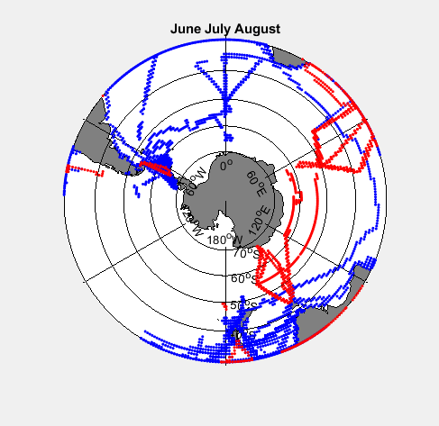
Quantifying uncertainties in ocean-atmosphere fluxes due to the imperfect coverage of surface data
SOCAT Coverage in the Southern Ocean of winter-time data
-- Pacific sector, very little data
-- Indian ocean, most data is before 2000
-- Atlantic ocean – most data is after 2000
Red – data in SOCAT 1992-2000
Blue – data in SOCAT 2000-2018

Slide 15
Gap filling methods
Method 1: Fit seasonal cycle and linear time trend of fCO₂ to all monthly mean of data, apply fitted values over whole region.
Method 2: Multiple linear regressions of fCO₂ on SST, SSS, Mixed layer depth, XCO_{2atm}.
Method 3: Landschützer feed-forward neural net.

Slide 16
Method 1:
deliberately simplistic!
generally poor fits!
Polar N. Atlantic
N. Pacific
Subtropical N. Atlantic

Slide 17
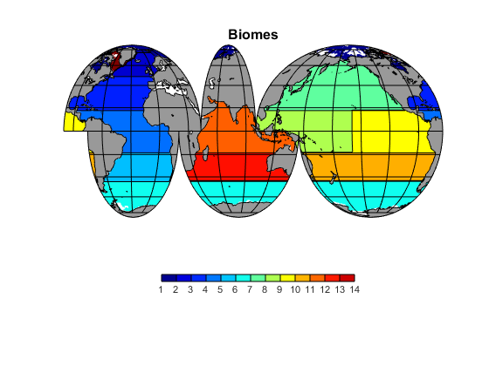
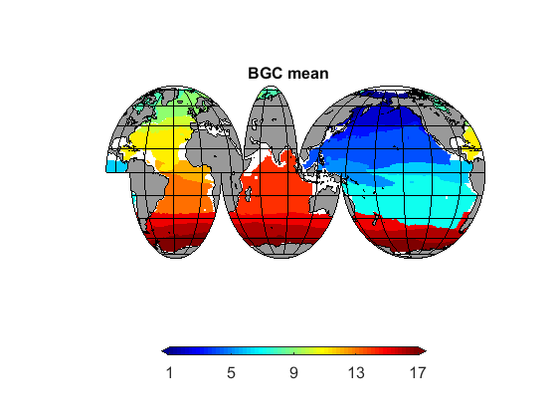
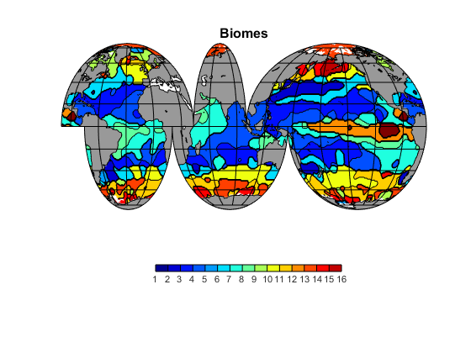
Divide the Ocean up in three different ways
“Transcom” regions
Fay and Mckinley (2012) biomes
SOM-”Takahashi” biomes (December)

Slide 18
0
Results:
All methods give broadly similar results when averaged over large areas
(even method 1!)
-0.5
Global flux
-1
1
)
-
r
y
-1.5
C
g
P
(
-2
x
u
l
f
O
2
C
-2.5
Thick black line is mean of all methods
Cyan line is “Landschutzer SOM-FFN”
Shaded zones are 1-and 2-sigma uncertainties
-3
-3.5
-4
1990
1995
2000
2005
2010
2015
2020
Year

Slide 19
Results:
Northern hemisphere: good agreement all methods
Most uncertainty comes from the Southern Hemisphere
0
0
-0.5
Northern hemisphere
-0.5
-1
-1
1
)
-1.5
-
r
0
y
C
-2
g
-0.5
P
(
Southern hemisphere
x
u
-1
l
-1
f
O
2
C
-1.5
-1.5
-2
-2
-2.5
-2.5
-3
-3
1990
1995
2000
2005
2010
2015
2020
Year

Slide 20
Global flux corrected for “riverine flux” and Arctic, compared to Gruber et al interior estimate of anthropogenic CO2 uptake, 1994-2007.
Earlier surface flux estimates
Landschützer et al
Rödenbeck et al
Our revised estimate for the flux calculated at the surface is compatible with the recent Gruber et al estimate of “Cant” – net anthropogenic uptake by the ocean calculated from internal hydrography, between 1994 and 2007, without the need to postulate an anomalous natural outgassing of CO₂ during this period .
Gruber, N. et al. The oceanic sink for anthropogenic CO₂ from 1994 to 2007. Science 363, 1193-1199, doi:10.1126/science.aau5153 (2019).
0
-0.5
-1
1
)
-1.5
-
r
y
C
-2
g
P
(
-2.5
x
u
l
f
2
-3
O
C
-3.5
-4
Gruber et al interior estimate
-4.5
-5
1990
1995
2000
2005
2010
2015
2020
Year

Slide 21
Conclusions
Correcting “surface” fCO₂ observations to true interface temperatures increases the calculated fluxes by ~0.8 Pg C yr⁻¹
Globally and at basin level, fluxes can be specified with 90% confidence intervals of around ±0.3 Pg C yr⁻¹ after 2000, (and before that in N. Hemisphere).
Southern ocean and South Pacific contribute much of the uncertainty.
Corrections make surface fluxes consistent with observed increase in anthropogenic CO₂ calculated from ocean interior observations, without the necessity for arbitrary “anomalous natural” carbon fluxes.

