Slide 1
Enabling efficient uncertainty quantification for seismic modeling via projection-based model reduction
Francesco Rizzi (Nga Analytics, contractor)
Collaborators: Eric Parish, Patrick Blonigan, and John Tencer
SAND2021-4876 C

Slide 2
High-fidelity simulations are crucial but too costly
High fidelity Full Order Model (FOM)
  Extreme-scale nonlinear computational simulation
  Example: captive carry aerodynamics hybrid RANS/LES
    Extreme-scale: 100 million cells, 200,000 time steps
    High cost: 6 weeks on 5000 cores
Captive carry aerodynamics
courtesy M. Barone
Antarctic ice sheet modeling
courtesy R. Tuminaro
Magnetohydrodynamics
courtesy J. Shadid
Key use cases are often time-critical and/or many-query
Parameter Estimation | Uncertainty Quantification | Design Optimization
Material property estimation | Qualification of engineering systems in uncertain normal and abnormal environments | Rapid iteration of conceptual designs
Matching field experiments | Quantification of margins and uncertainty | Shape and material optimization
Parameters for digital twins
Surrogates of FOMs reduce computational cost and enable mission use cases
Motivates projection-based reduced-order model (pROM)
Notes:
Do not spend time discussing plots, just bullets…
One example of this that I have been working on at Sandia is modeling the internal captive carriage for the B-61 LEP. The goal of the analysis is to calculate the pressure exerted on the store when it is placed in the cavity on the right over long time intervals.
To model this, our analysts have developed a validated hybrid RANS/LES model that is accurate to within 5% of experiment in our quantity of interest over wide Mach number range; however, this validation result necessitated a highly resolved mesh with 100 million cells, and necessitates 200,000 time steps.
This is common in CFD, as RANS models are not able to accurately predict regions of separated turbulent flows, which can occur in off-design conditions for existing aircraft and will likely occur in designed conditions for future aircraft.
6 runs maxes out Cielo
Barrier between such high-fidelity models and a range of time-critical aerospace applications.
The goal of Our research is to break this computational barrier that prevents high-fidelity models—especially those in fluid and structural dynamics—from being used in a range of time-critical aerospace applications.
The approach I’ve taken to this is to develop new model reduction methods for large-scale nonlinear dynamical systems
OTHER
This is particularly true in CFD, as RANS models are not able to accurately predict regions of separated turbulent flows, which can occur in off-design conditions for existing aircraft and will likely occur in designed conditions for future aircraft.
in terms frequency of spectral peaks

Slide 3
Why using pROMs?
  Directly tied to a “full-order model”
  pROMs are “physics-based” surrogates
    Results are explainable
    Evaluating known dynamics rather than learning unknown dynamics
  A priori and a posteriori error bounds
    Quantifying the uncertainty of the pROM is critical
  Enables full-field predictions
    Useful for engineering design and analysis
Physics/Equations | Exact | pROM | FOM
 | Approximate | Data Driven Surrogates | Reduced Physics
 |  | Approximate | Exact
 |  | Numerics
Notes:
Why and When pROMs vs surrogate models or FOM.
Large investments over decades in high fidelity models. Use these tools for more than just data generation.
Solving the correct problem approximately vs solving the approximate problem correctly
Less data, lower costs
Eric will talk later about the ways that Sandia’s unique requirements have driven ROM research at Sandia
No free lunch (intrusiveness, higher cost than surrogates)

Slide 4
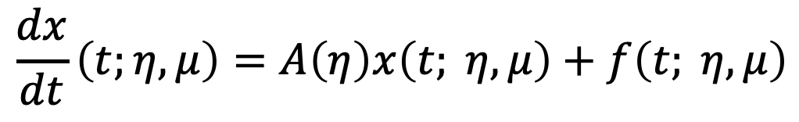
Linear Time-Invariant (LTI) Systems
What is an LTI system?
System matrix
(typically large and sparse)
State
Forcing
$$\frac{dx}{dt}\left(t;η, μ\right)=A\left(η\right)x\left(t; η, μ\right)+f\left(t; η, μ\right)$$
Parametrization
Sample real-world applications:
  Aeroelasticity: aircraft structure modeled as a linear PDE, while the aerodynamic loads are highly nonlinear
  Acoustic waves: modeled by a linear PDE but can have a number of nonlinear sources, most notably turbulent shear layers that arise in the wakes of cars, aircraft, and other moving objects
  Linear circuit models: biquitous in electrical engineering 115 and evolve time according to ODEs of the form (1) while commonly being driven by complex nonlinear forcing functions
  Elastic seismic waves (topic of this work)
Notes:
Linear in the state ($x$)
Discrete system matrix $A$ is sparse (sparsity pattern is problem-dependent) and does not change in time
Can have an arbitrary nonlinear parametric dependence
Purposefully split the parametric dependence into $η$ and $μ$ to highlight their different roles:
$μ$ includes only the parameters that impact the forcing, while $η$ includes the others.
Sample real-world applications:
Aeroelasticity: aircraft structure is modeled with a linear PDE, but aerodynamic loads are highly nonlinear
Acoustic waves: modeled with a linear PDE, but can have a number of nonlinear sources, most notably turbulent shear layers that arise in the wakes of cars, aircraft, and other moving objects
Linear circuit models
One shot UQ
Efficient compute utilization

Slide 5
Rank-2 Galerkin for (LTI) Linear Time-Invariant Systems
Standard Galerkin ROM:
Rank2 Galerkin ROM:
Single forcing realization
State and forcing are rank-1 tensor (Kx1)
Consider M forcing realizations simultaneously
Represent state and forcing as a rank-2 tensors (KxP)
$x= Φ\hat{x}$ with${ Φ}^{T}Φ=I$
$$\frac{d\hat{x}}{dt}=Φ^{T}A\left(η\right)Φ \hat{x} + Φ^{T}f\left(t; η, μ\right)$$
$$\frac{d\hat{X}}{dt}=Φ^{T}A\left(η\right)Φ \hat{X} + Φ^{T}F\left(t; η, μ\right)$$
K
M
K
M
K
=
+
K
=
+
$$Φ^{T}A\left(η\right)Φ$$
$$Φ^{T}A\left(η\right)Φ$$
Leads to compute-bound kernels
Optimal for modern multi- and many-core nodes
The larger K, M the better to saturate throughput
  Natural fit for problems requiring large K
Extensible to rank-3 formulation:
  handle multiple A (batched BLAS)
Leads to memory-bandwidth bound kernels
Not optimal for modern many-core nodes
Desirable to be keep K as SMALL as possible
Notes:
One shot UQ
Efficient compute utilization

Slide 6
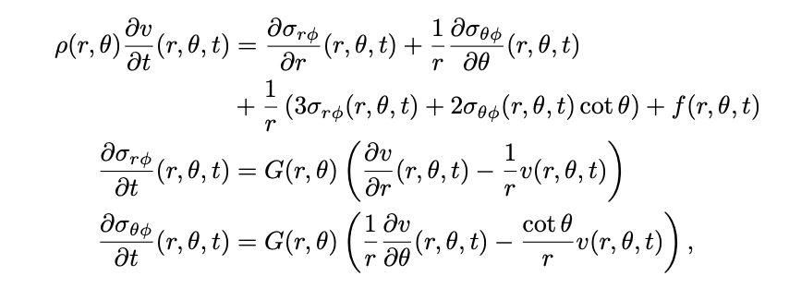
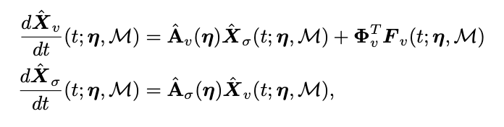
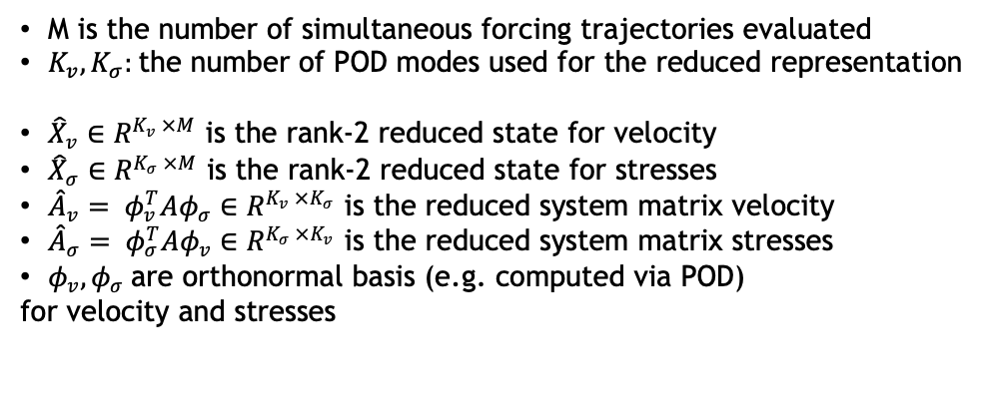
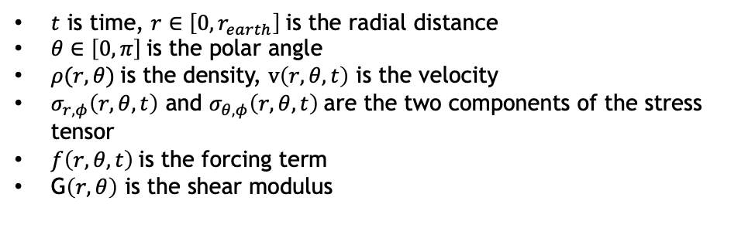
Rank-2 Galerkin: demonstration on elastic shear waves
Axisymmetric elastic seismic shear waves:
The Rank-2 Galerkin formulation can be written as:
$t$ is time, $r∈\left[0, r_{earth}\right]$is the radial distance
$θ∈\left[0, π\right]$is the polar angle
$ρ(r, θ)$is the density, $v\left(r, θ,t\right)$ is the velocity
$σ_{r,φ}\left(r, θ,t\right)$ and $σ_{θ,φ}\left(r, θ,t\right)$are the two components of the stress tensor
$f\left(r, θ,t\right)$is the forcing term
G$\left(r, θ\right)$ is the shear modulus
M is the number of simultaneous forcing trajectories evaluated
$K_{v},K_{σ}:$the number of POD modes used for the reduced representation
${\hat{X}}_{v}∈R^{K_{v} ×M}$ is the rank-2 reduced state for velocity
${\hat{X}}_{σ}∈R^{K_{σ} ×M}$ is the rank-2 reduced state for stresses
${\hat{A}}_{v}= φ_{v}^{T}Aφ_{σ}∈R^{K_{v} ×K_{σ}}$ is the reduced system matrix velocity
${\hat{A}}_{σ}= φ_{σ}^{T}Aφ_{v}∈R^{K_{σ} ×K_{v}}$ is the reduced system matrix stresses
$φ_{v}, φ_{σ}$are orthonormal basis (e.g. computed via POD)
for velocity and stresses

Slide 7
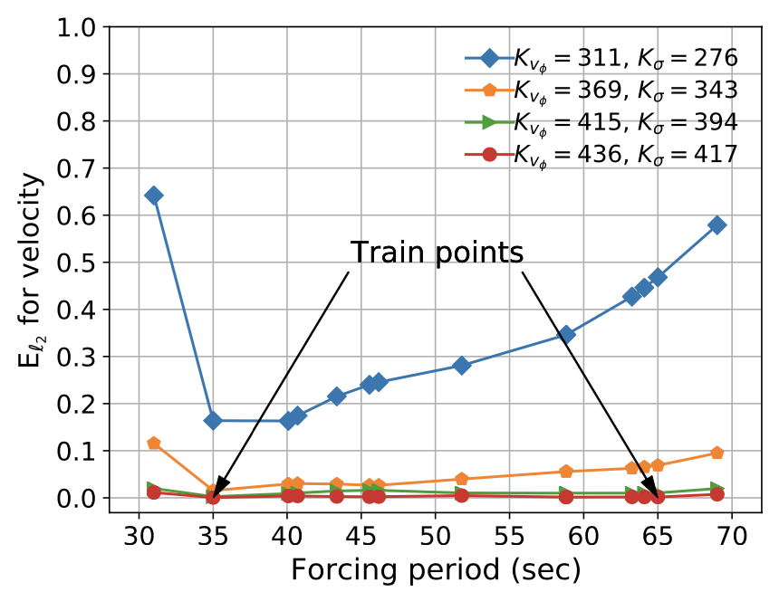
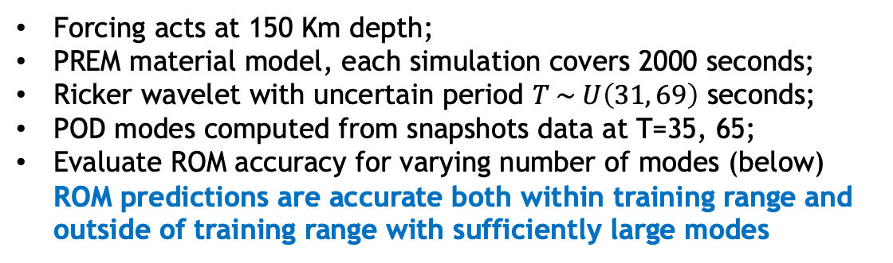
How accurate it the ROM?
Forcing acts at 150 Km depth;
PREM material model, each simulation covers 2000 seconds;
Ricker wavelet with uncertain period $T \sim U\left(31, 69\right)$ seconds;
POD modes computed from snapshots data at T=35, 65;
Evaluate ROM accuracy for varying number of modes (below) ROM predictions are accurate both within training range and outside of training range with sufficiently large modes
Earth Surface
Source location
Core-mantle
Boundary
ROM
High-fidelity
Relative L2-norm of
velocity error at final time
Velocity field at final simulation time obtained for T= 69 seconds. The domain is a slice of the Earth since we use an axisymmetric approximation; the liquid core is excluded because of no shear.

Slide 8
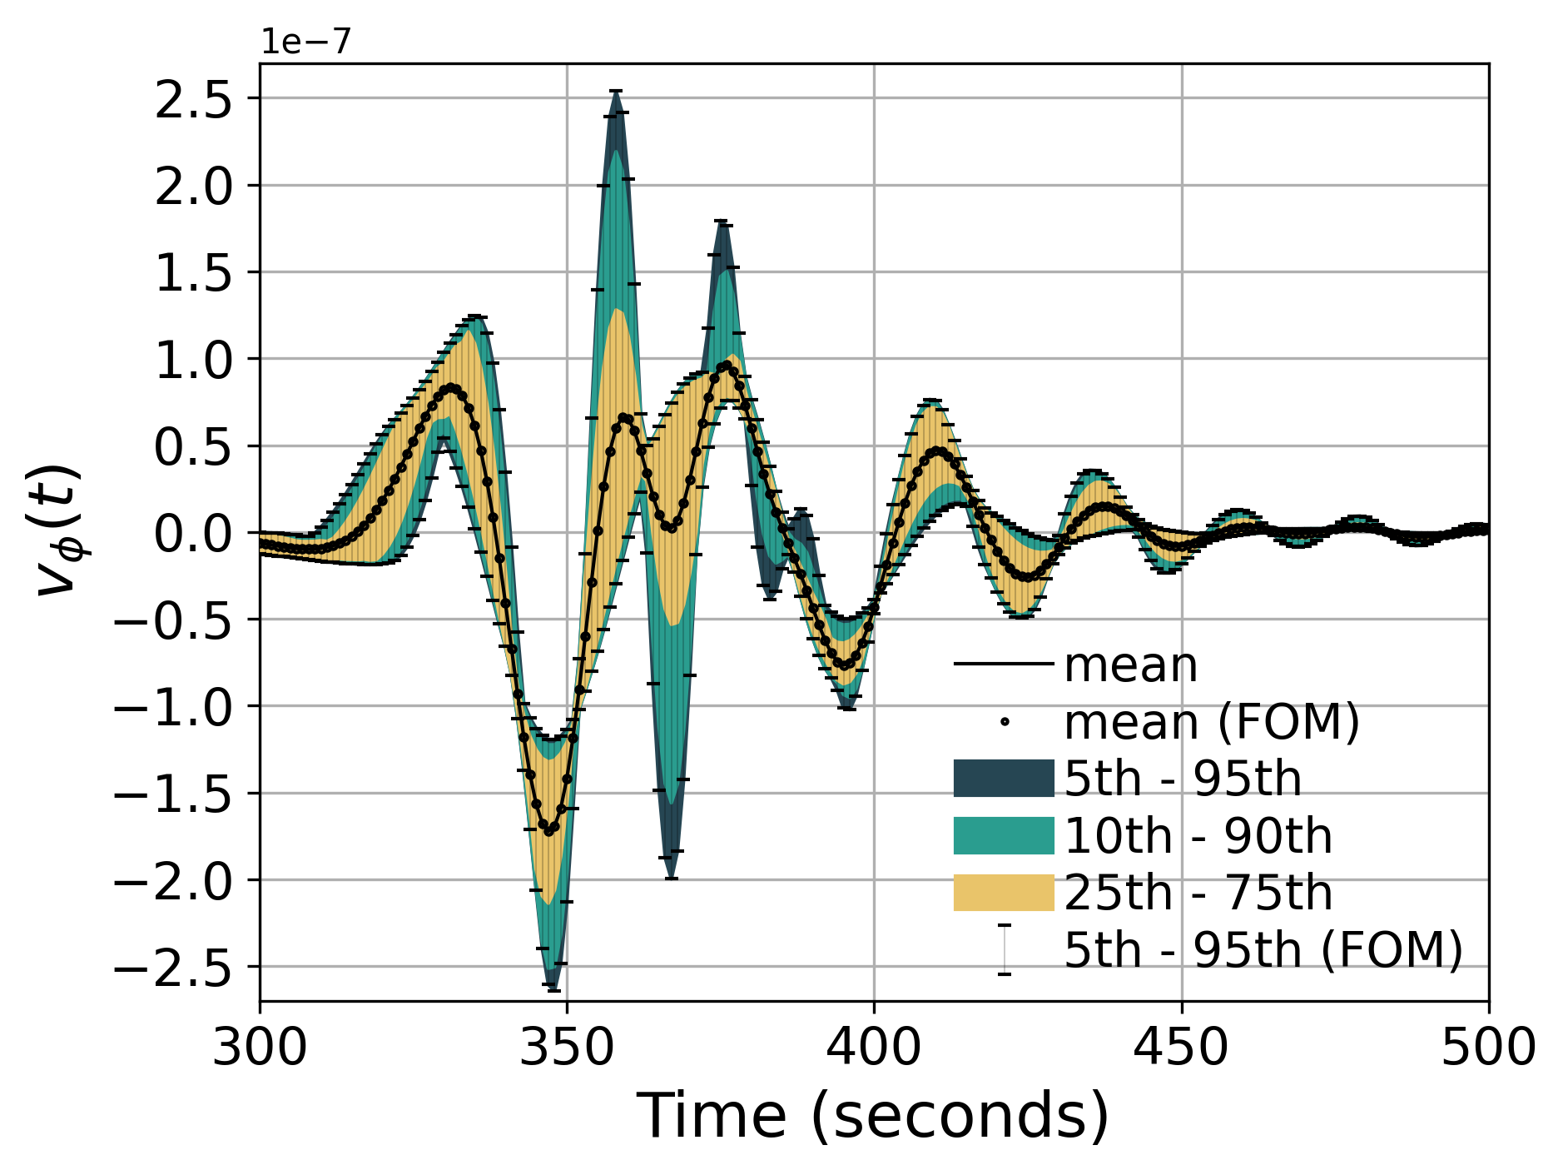
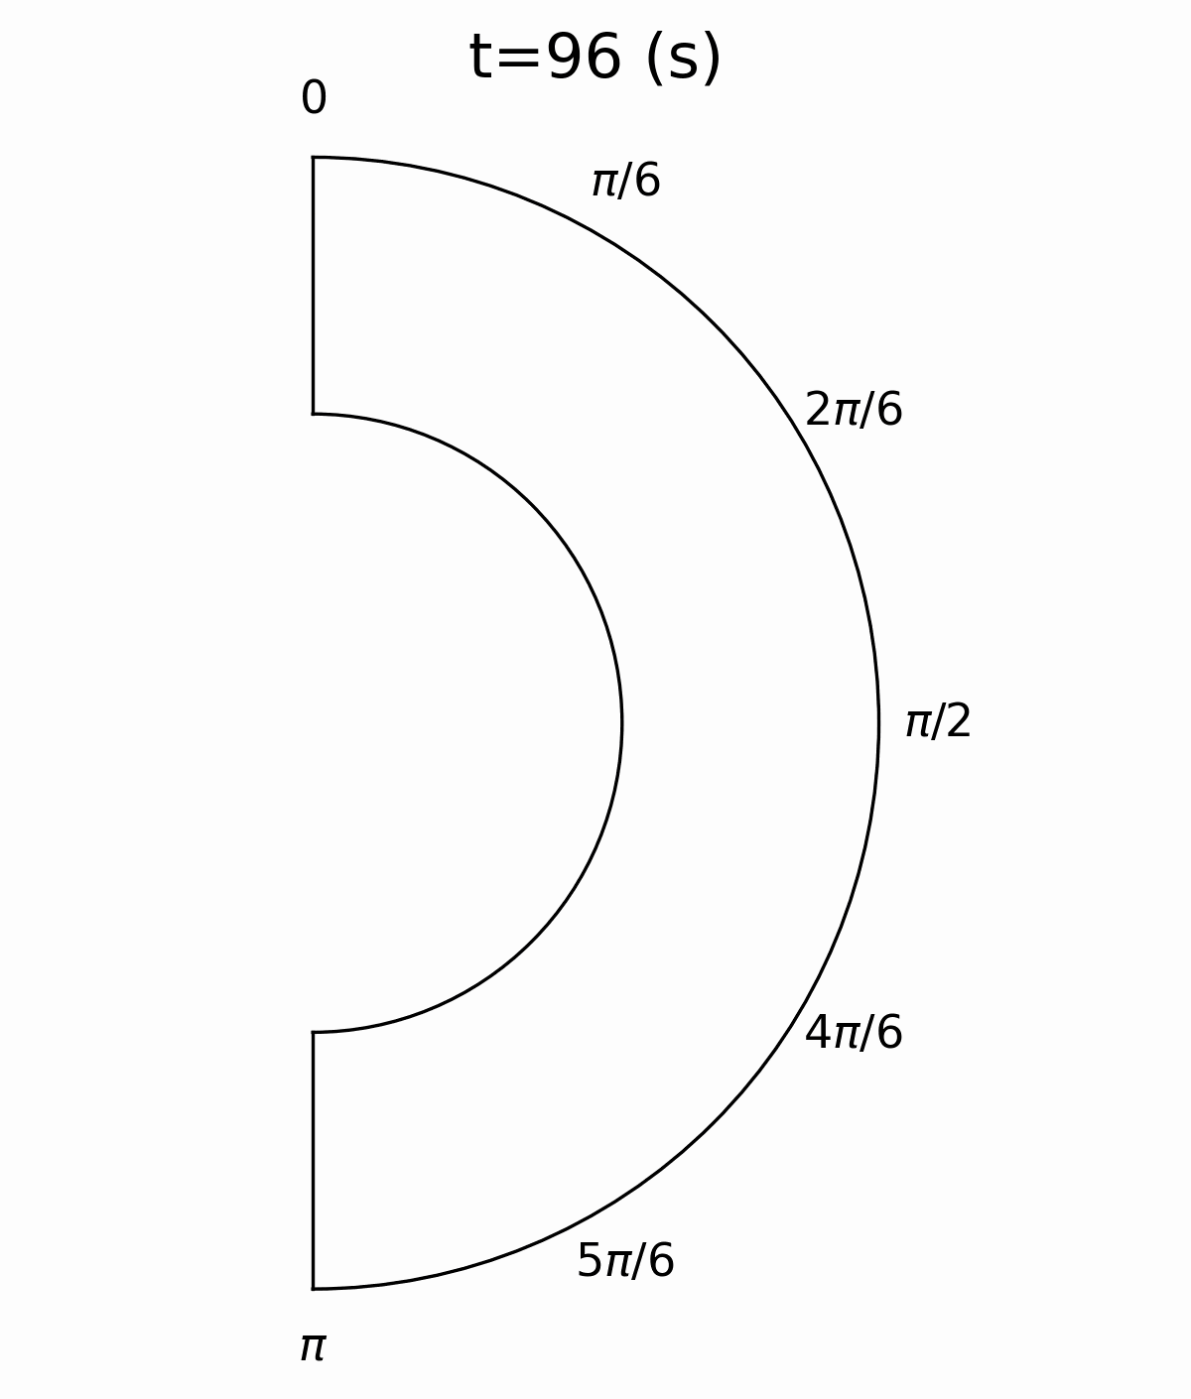


Rank-2 Galerkin: efficient ensemble propagation
Monte Carlo sampling of the forcing period T propagating 512 trajectories
Seismogram at ${10}^{o}$
FOM
ROM
~950x savings in wall time wrt FOM
< 1% error in seismogram prediction
Sample FOM and predictive ROM animation for one forcing term
Notes:
One shot UQ
Efficient compute utilization

Slide 9
References
  Code is open-source and available at: https://github.com/Pressio/SHAW
  Online documentation available at: http://francescorizzi.net/shaw/
  F. Rizzi, E. Parish, P. Blonigan, and J. Tencer, A compute-bound formulation of Galerkin model reduction for linear time-invariant dynamical systems. arXiv e-print, (arXiv:2009.11742), 2020.
  This work is part of a broader ongoing effort (Pressio) on improving portability and reducing intrusiveness of projection-based model reduction for large-scale systems: https://github.com/Pressio

