Slide 1


EGU21 session G6.1 – 'Open Session in Geodesy'
Validation of sea surface heights from satellite altimetry along the Indian coast
Milaa Murshan, Balaji Devaraju, Nagarajan Balasubramanian, and Onkar Dikshit
Indian Institute of Technology Kanpur
Thursday, April 29, 2021

Slide 2
Objectives
Tide gauges measure relative sea level whereas satellite altimetry provides absolute sea level measurements.
Tide gauges observations are restricted to coastal regions whereas satellite altimetry measure global sea changes.
The main goal of this study is to predict the sea level signature that should be observed by the satellite altimetry and to compare the results with tide gauge predictions.

Slide 3
Tide Gauge Data
Satellite Altimetry Data
There are 28 tide stations along the Indian coastlines. four among them are selected since they have the longest high quality records.
The sea-level of tide gauge records used to compare with satellite altimetry were obtained from the Permanent Service of Mean Sea Level (PSMSL).
The observations of time period spanning from September 1992 to December 2016 are only taking into account for temporal matching with altimetry data in these sites.
Monthly sea level data is used here.
Nine satellite altimetry data namely Envisat, ERS-1, ERS-2, GFO, SARAL/AltiKa, Topex/Poseidon, and Jason-1, 2, 3 are used in this study.
The data is downloaded from OpenADB (Technical University of Munich).
The combined altimetry data span about 25 years (1992-2016).

Slide 4
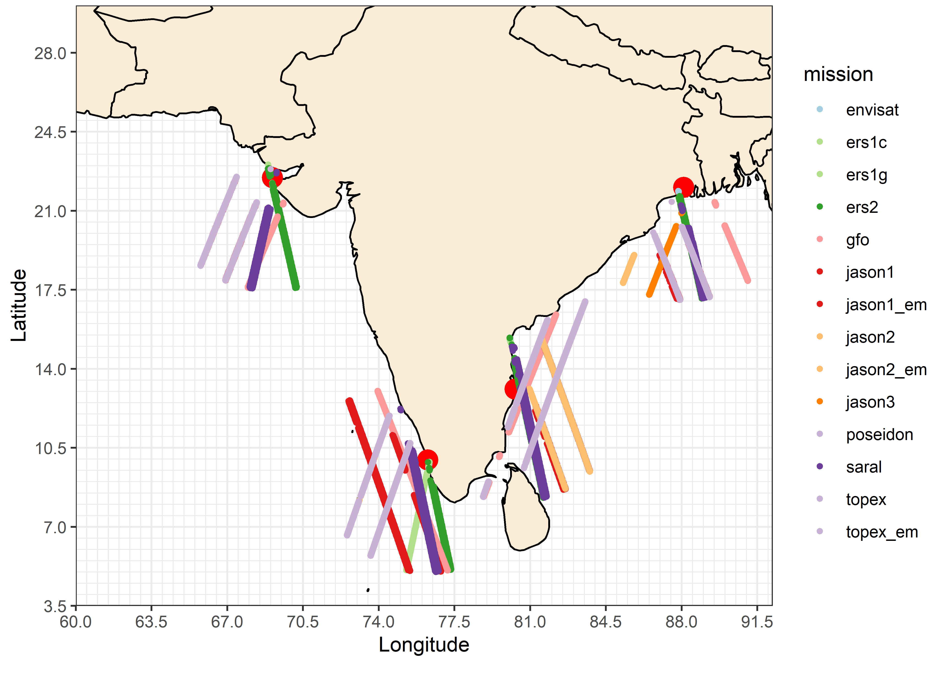
Location of TG stations and Altimetry ground tracks

Slide 5
Methodology
Outliers removal from both data sets (TG, and Altimetry).
Select the data of nearest altimetry pass of individual missions to the TG station within circle of 5 deg radius around the TG station.
Remove altimetry data up to 10 km distance from coastline (10 km buffer).
Group the selected data by cycle number.
Take the average of observation within each cycle to construct along-track time series.
Convert these time series to monthly series.
Take integer no. of year and compute SLA from both data sets.
Apply frequency analysis to both data sets to check the different types of variations.
Compare SLA time series of TG to SLA of satellite altimetry.

Slide 6
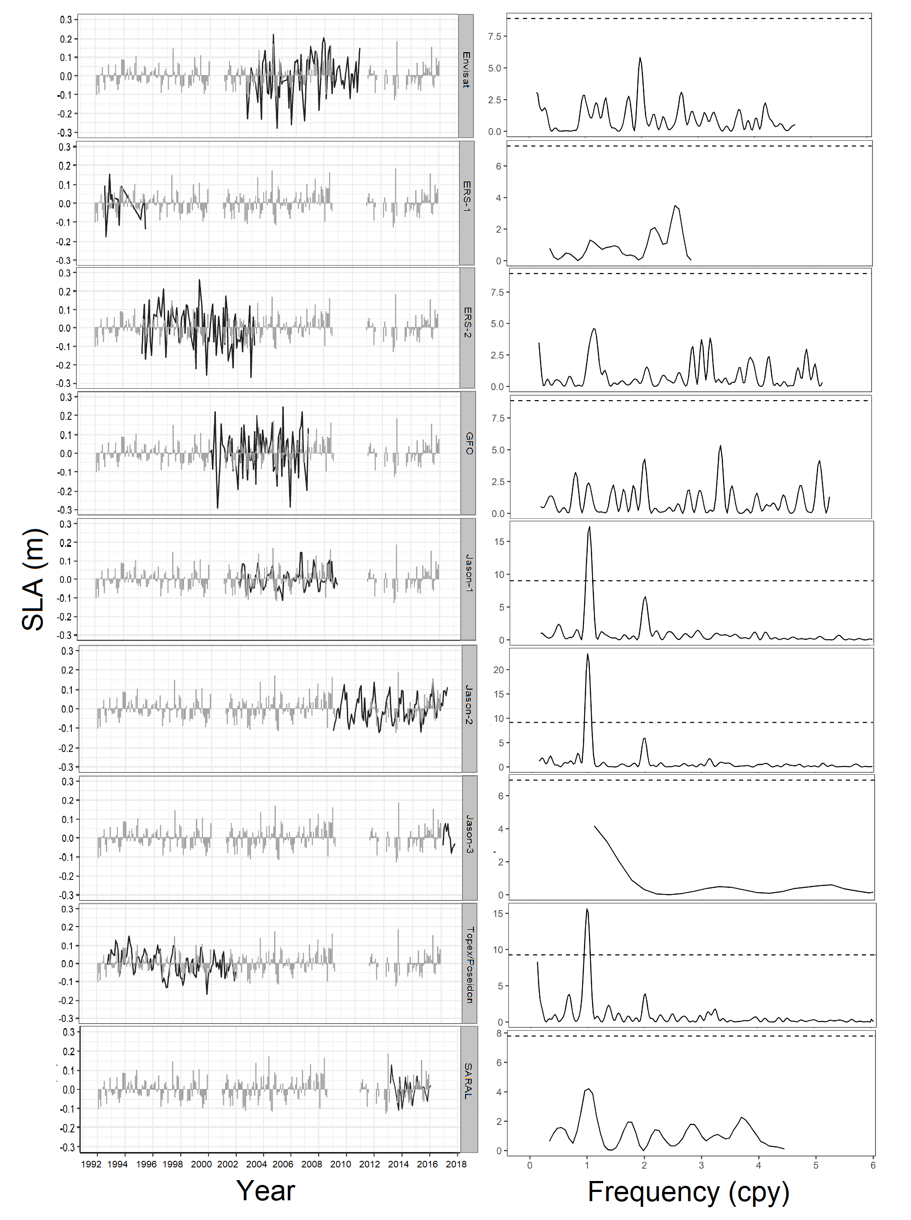
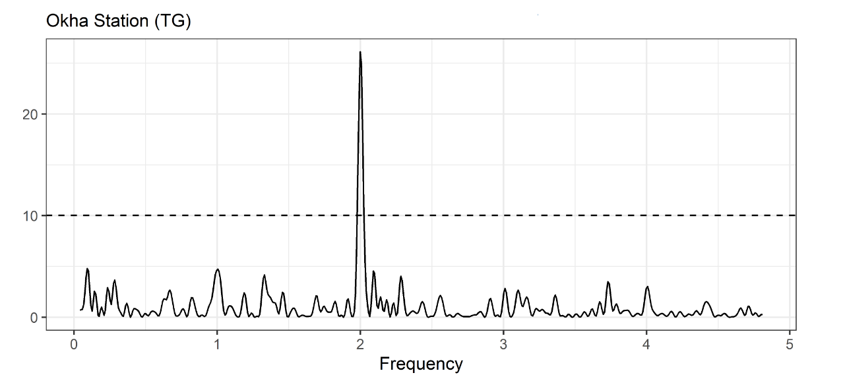
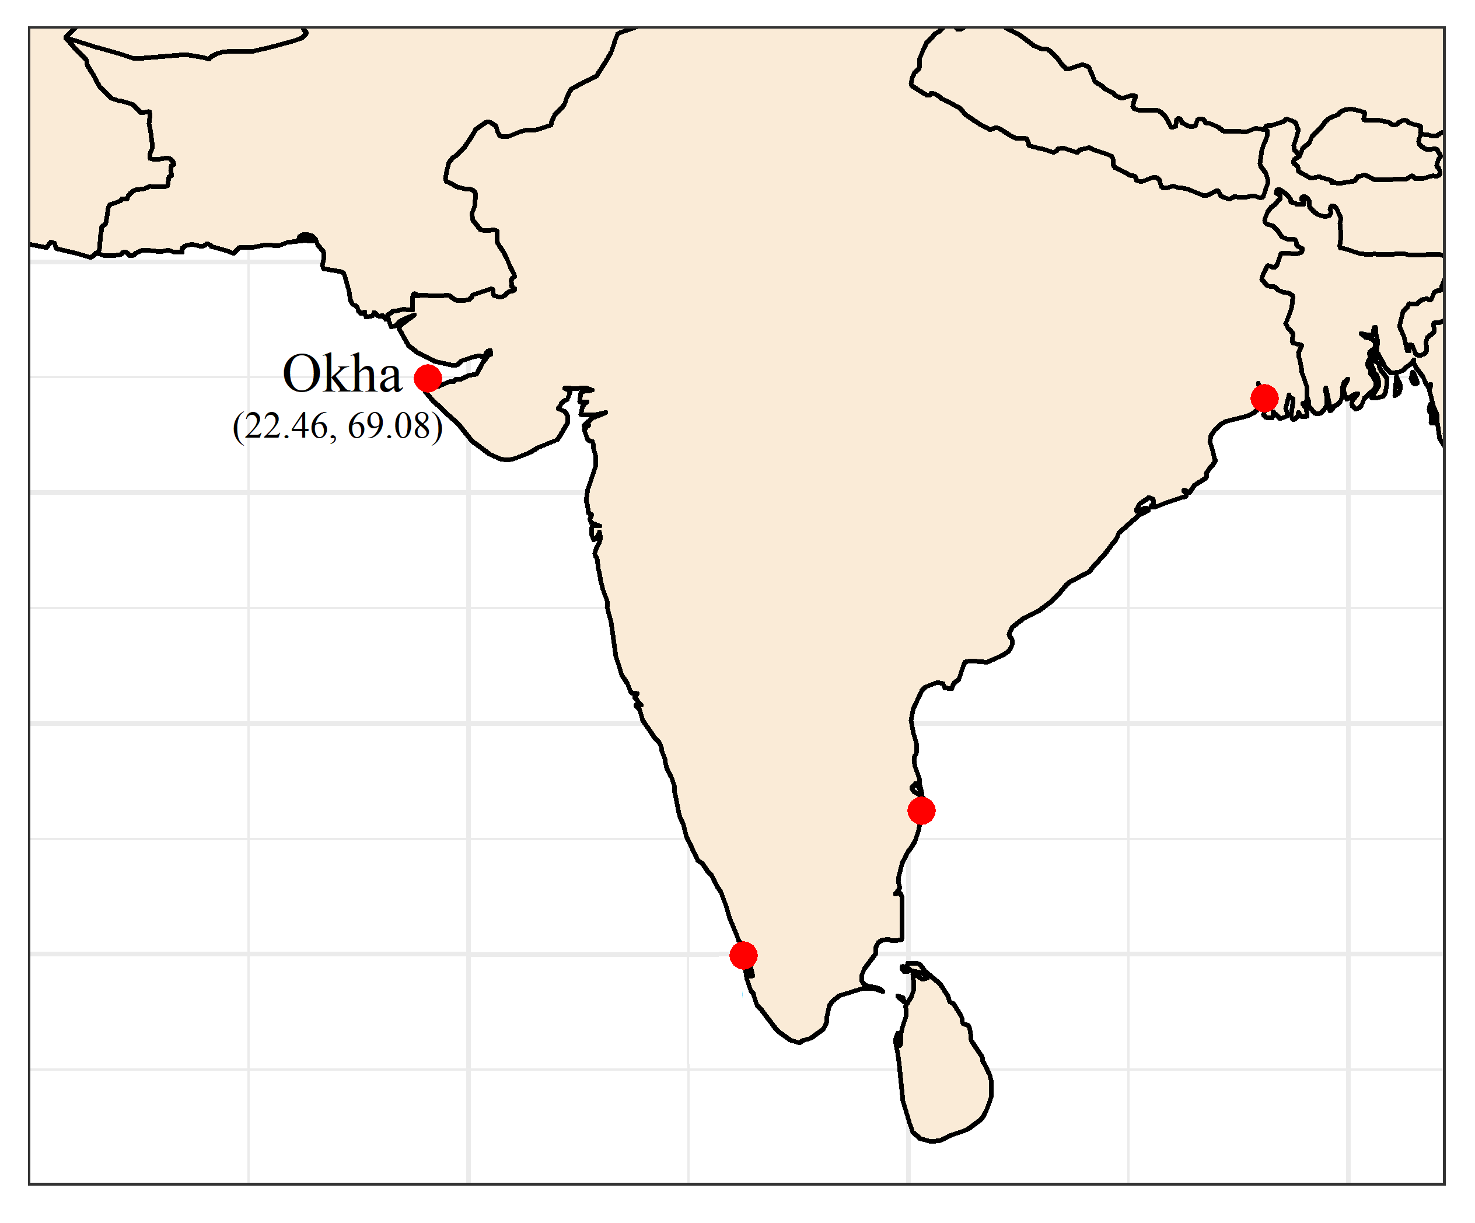
Statistics | Envisat | ERS-1 | ERS-2 | GFO | Jason-1 | Jason-2 | Jason-3 | Topex-Poseidon | SARAL/AltiKa
Min. (cm) | -19.31 | -18.08 | -19.59 | -25.5 | -13.49 | -12.88 | NA | -13.17 | -9.94
Mean (cm) | 0.95 | 0.73 | -0.73 | -0.85 | 0.66 | -0.26 | NA | -0.13 | 1.36
SD (cm) | 10.14 | 8.79 | 11.91 | 11.52 | 6.25 | 7.08 | NA | 6.79 | 5.75
Max. (cm) | 20.23 | 16.25 | 25.83 | 27.46 | 17.14 | 22.33 | NA | 17.68 | 11.33

Slide 7
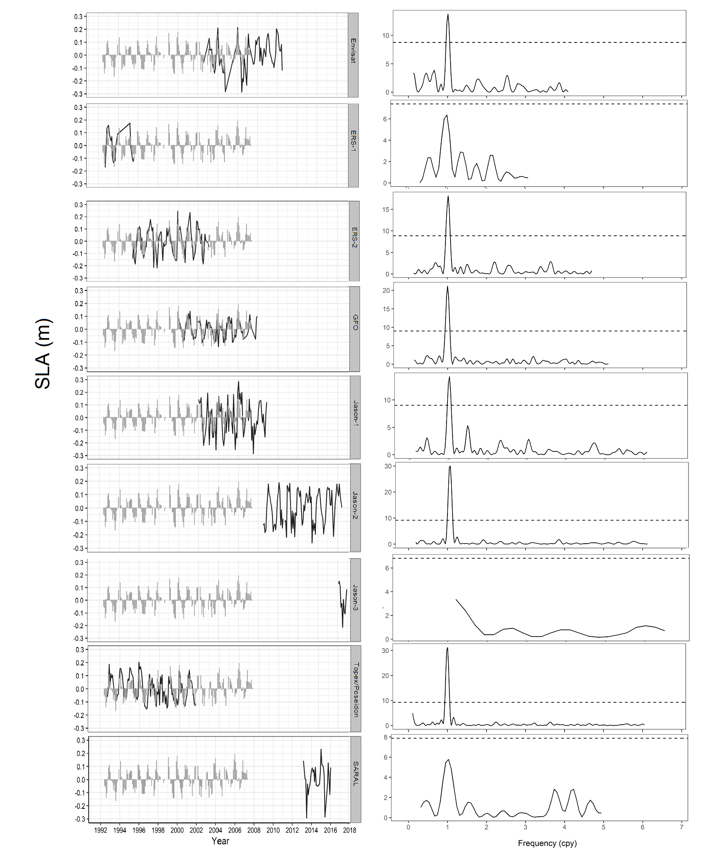
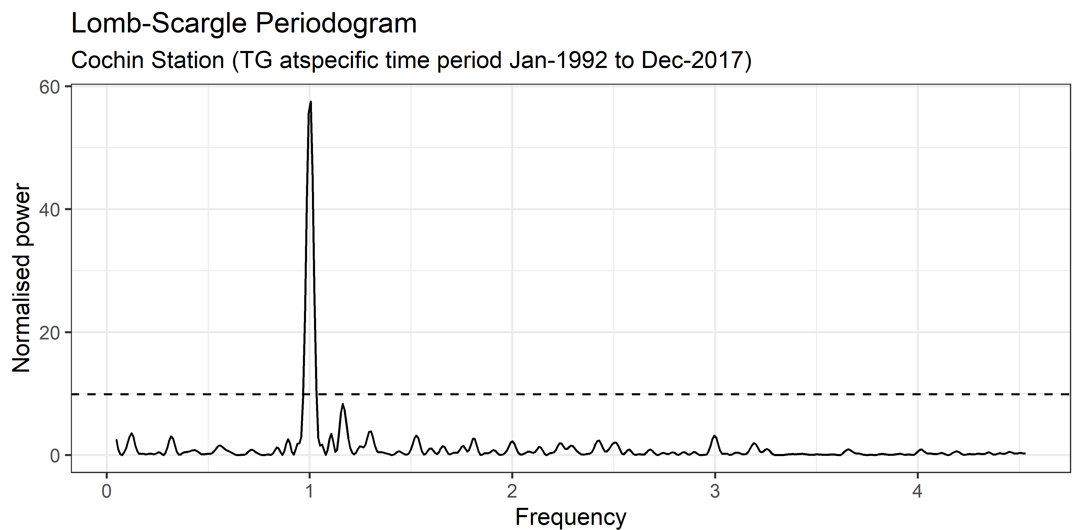
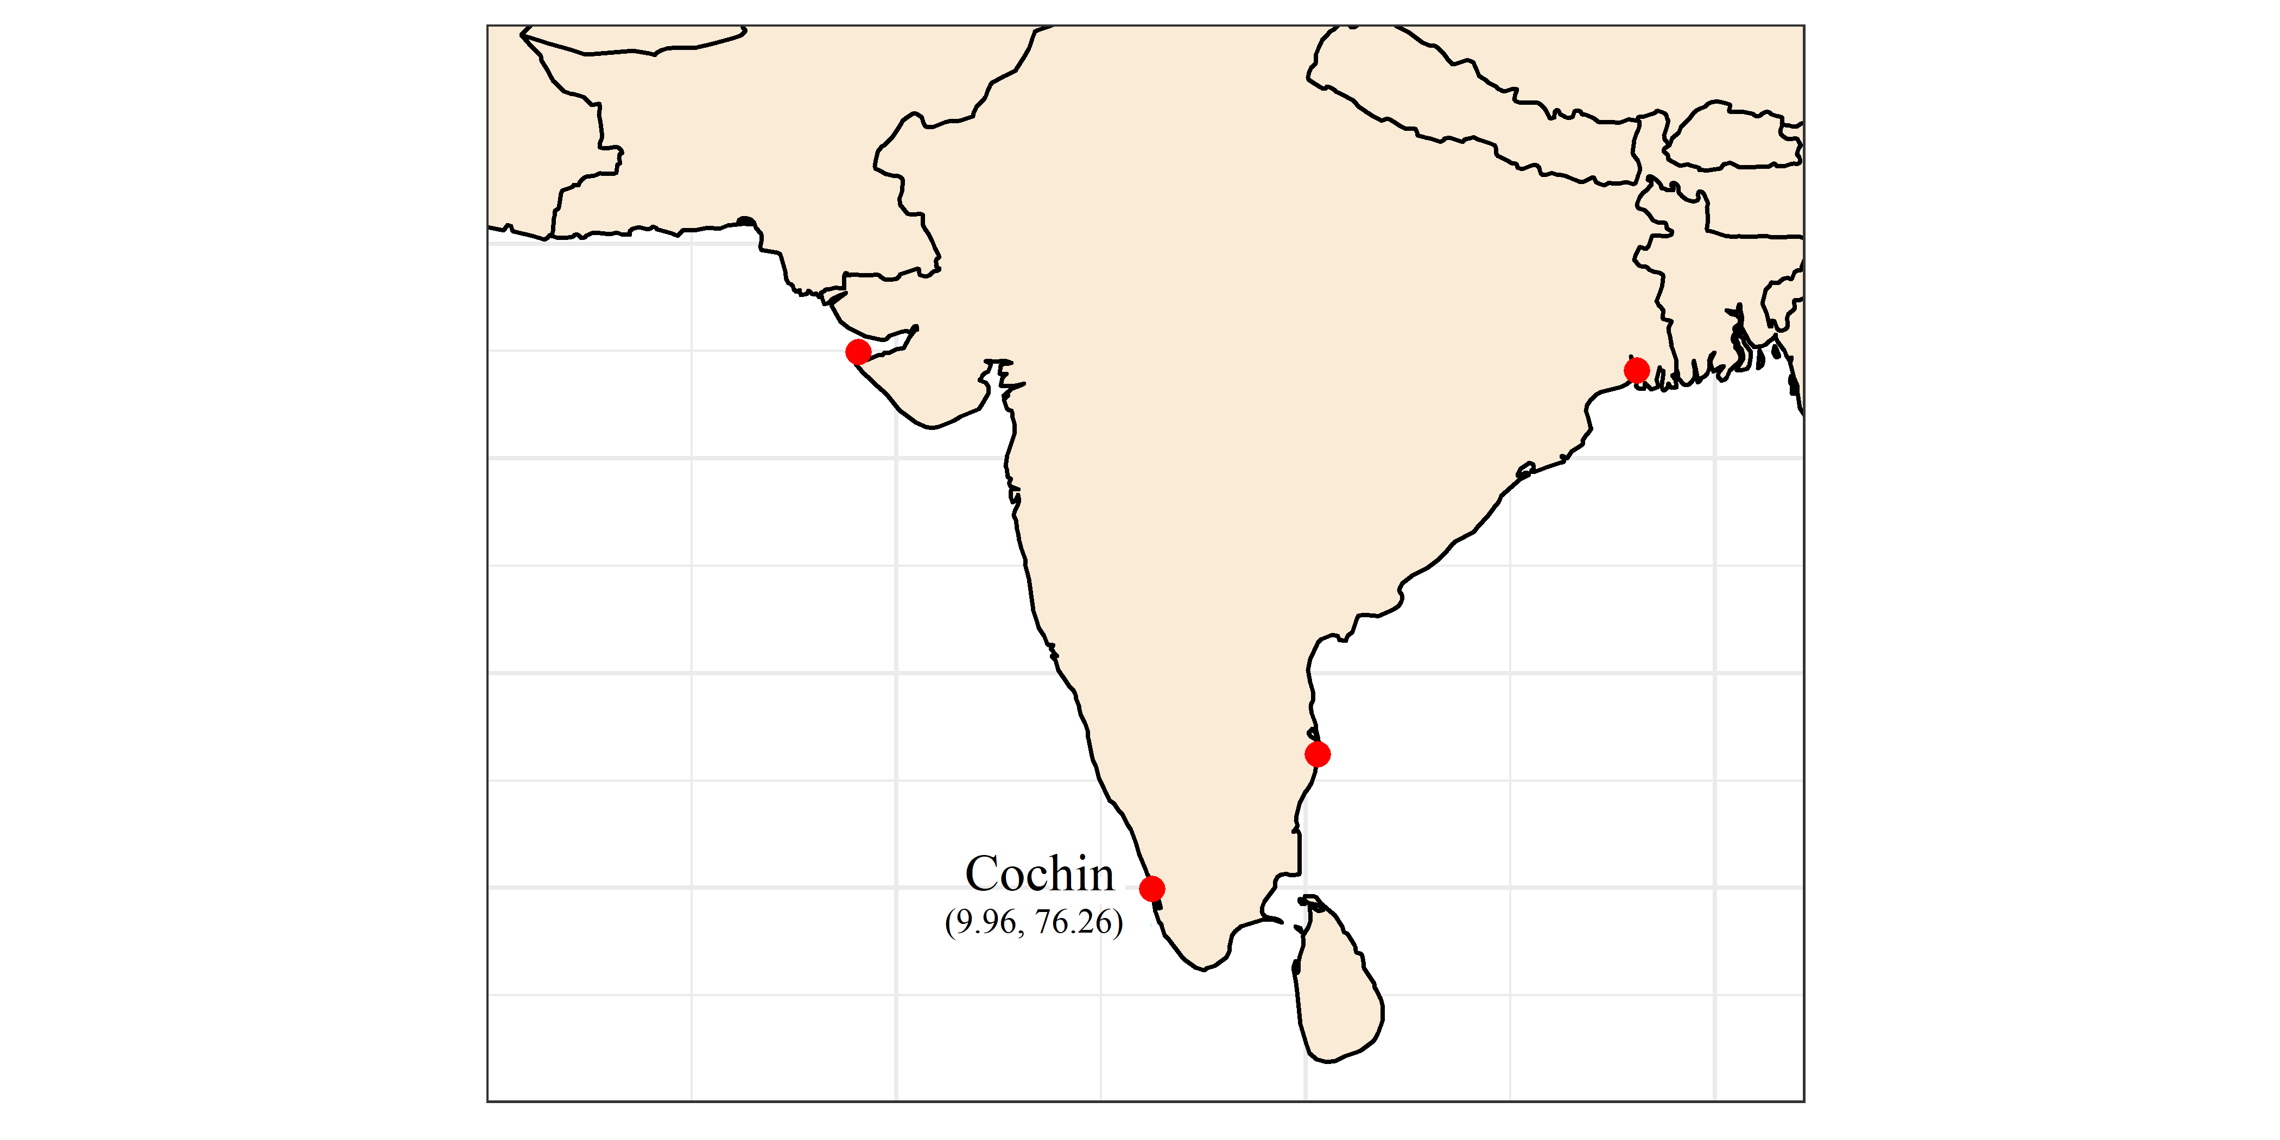
Statistics | Envisat | ERS-1 | ERS-2 | GFO | Jason-1 | Jason-2 | Jason-3 | Topex-Poseidon | SARAL/AltiKa
Min. (cm) | -11.68 | -15.19 | -23.63 | -15.06 | -21.36 | NA | NA | -14.53 | NA
Mean (cm) | 3.59 | -1.35 | -0.77 | 0.92 | 1.5 | NA | NA | -.0.92 | NA
SD (cm) | ±9.68 | ±6.90 | ±9.32 | ±7.23 | ±11.80 | NA | NA | ±7.41 | NA
Max. (cm) | 29.67 | 7.00 | 35.87 | 29.16 | 26.07 | NA | NA | 22.02 | NA

Slide 8
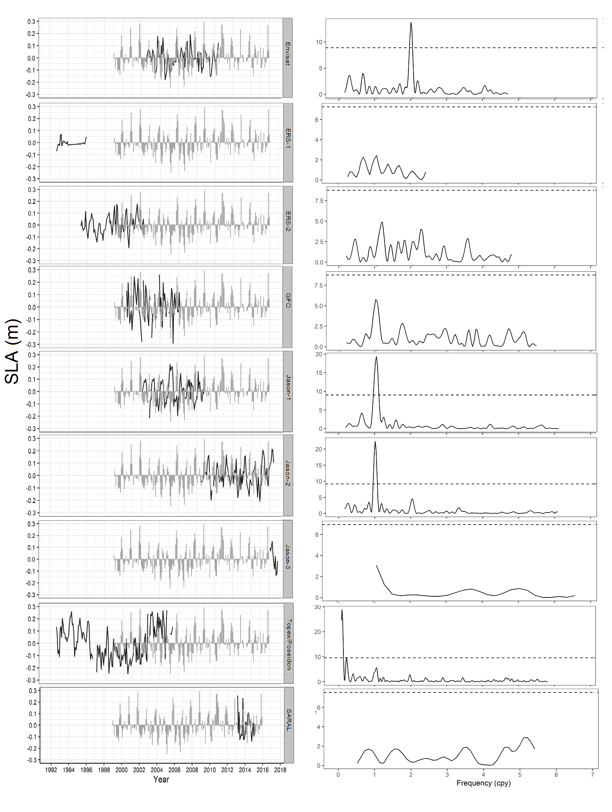
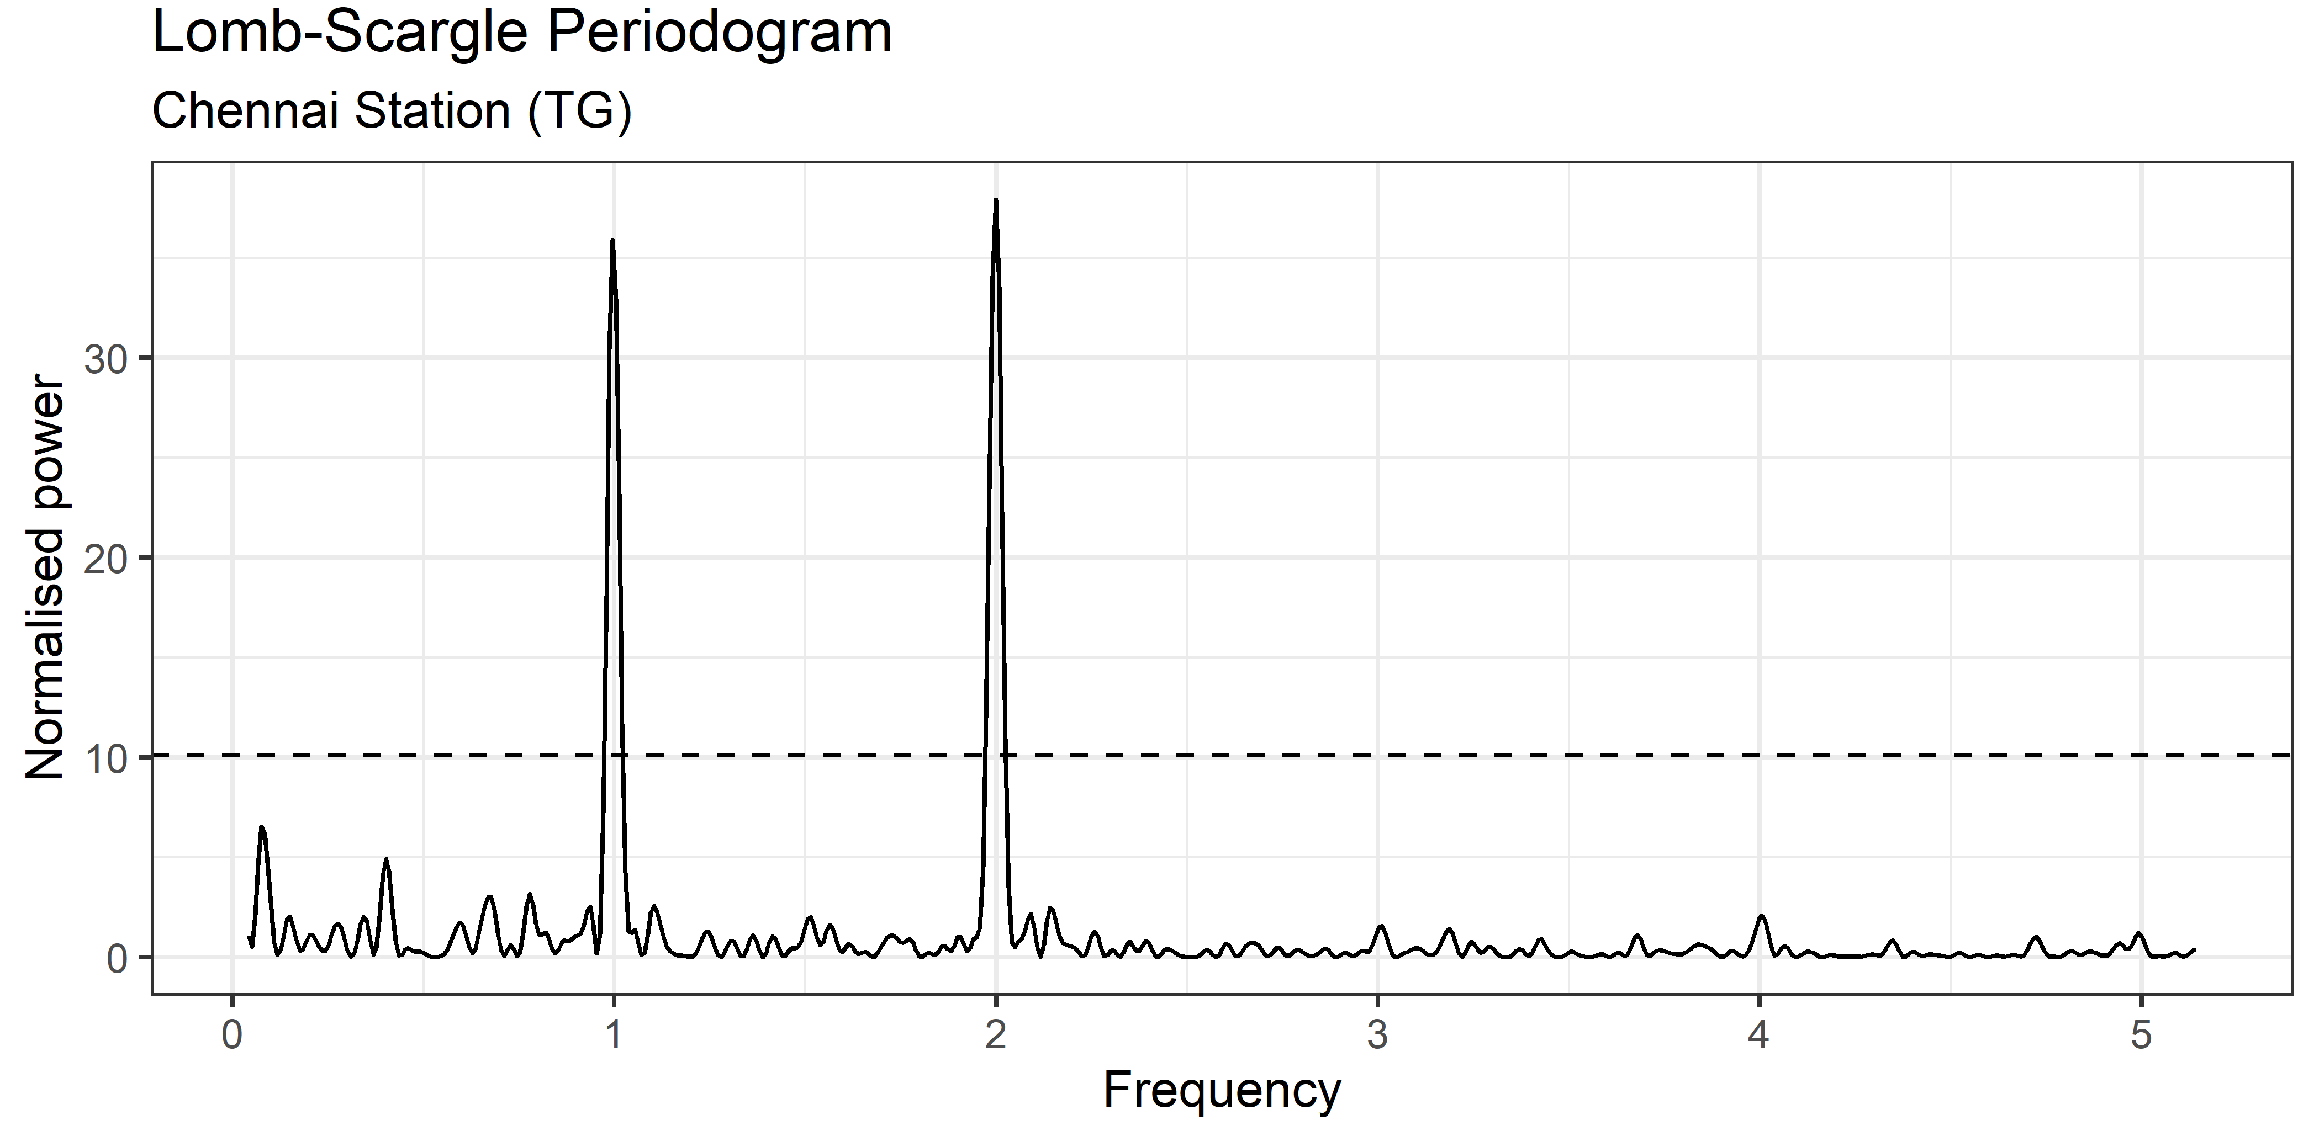
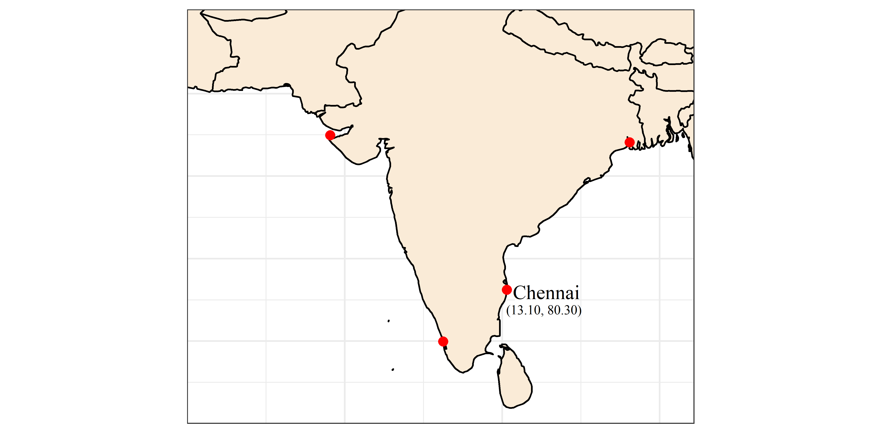
Statistics | Envisat | ERS-1 | ERS-2 | GFO | Jason-1 | Jason-2 | Jason-3 | Topex-Poseidon | SARAL/AltiKa
Min. (cm) | -28.25 | NA | -20.27 | -42.68 | -42.03 | -25.39 | NA | -37.83 | -29.35
Mean (cm) | -2.05 | NA | -2.88 | -0.47 | -2.14 | 3.04 | NA | -1.48 | 0.69
SD (cm) | ±10.27 | NA | ±9.62 | ±20.41 | ±17.22 | ±14.2 | NA | ±18.41 | ±14.89
Max. (cm) | 20.73 | NA | 15.84 | 43.68 | 37.38 | 37.41 | NA | 44.55 | 31.15

Slide 9
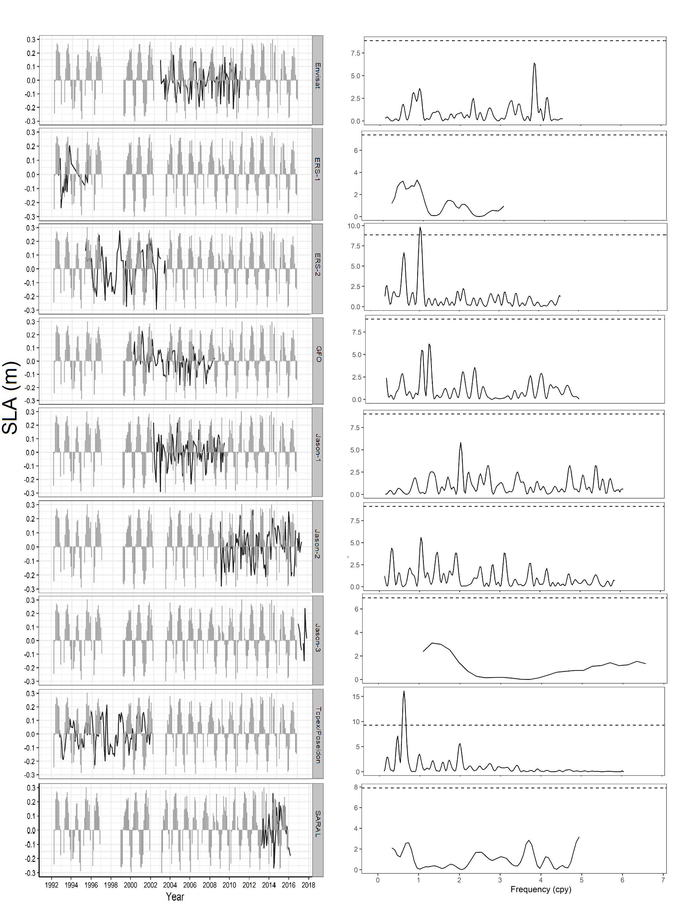
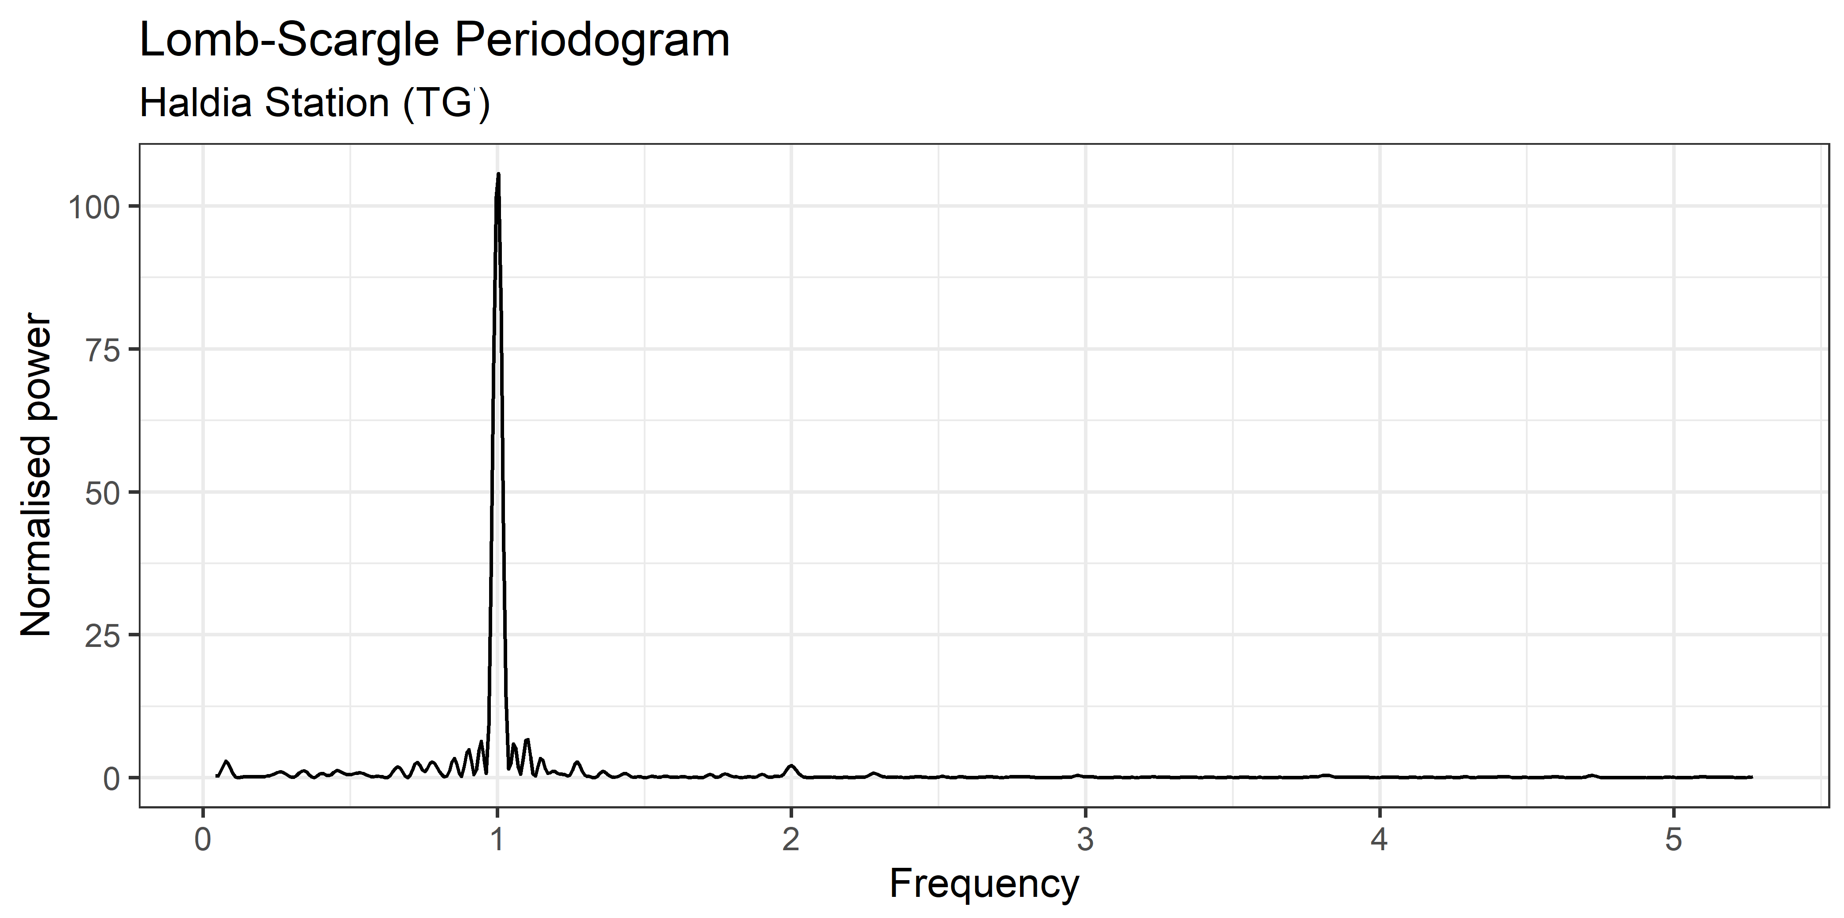
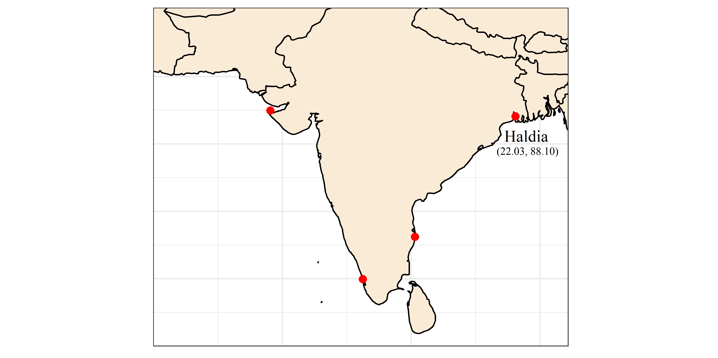
Statistics | Envisat | ERS-1 | ERS-2 | GFO | Jason-1 | Jason-2 | Jason-3 | Topex-Poseidon | SARAL/AltiKa
Min. (cm) | -38.66 | -23.6 | -40.18 | -44.11 | -42.26 | -51.51 | NA | -41.97 | -43.82
Mean (cm) | -1.71 | 3.28 | -1.73 | -2.48 | -2.43 | 2.83 | NA | -0.97 | 2.34
SD (cm) | ±20.69 | ±18.73 | ±18.37 | ±21.44 | ±23.17 | ±25.97 | NA | ±21.05 | ±26.68
Max. (cm) | 44 | 35.8 | 37.33 | 43.34 | 47.31 | 61.57 | NA | 37.56 | 62.51

Slide 10
Limitations and Solutions
Limitations | Solutions
Sea levels recorded by tide gauges are referenced to the local Earth’s solid surface that makes the comparison to SL from altimetry not possible as the later provides ellipsoidal height o sea surface. | Compute the SLA which is the difference between the mean value of SL and the individual SL observations for both data sets and then subtract tide gauge SLA from Altimetry SLA.
Absence of GNSS receiver near to tide gauge site led to absence of ellipsoidal height of their recorded SL measurements, which makes measuring VLM difficult. | Estimation VLM instead of measuring it, by subtracting the altimetry sea-level linear trend from tide gauge trend.

Slide 11
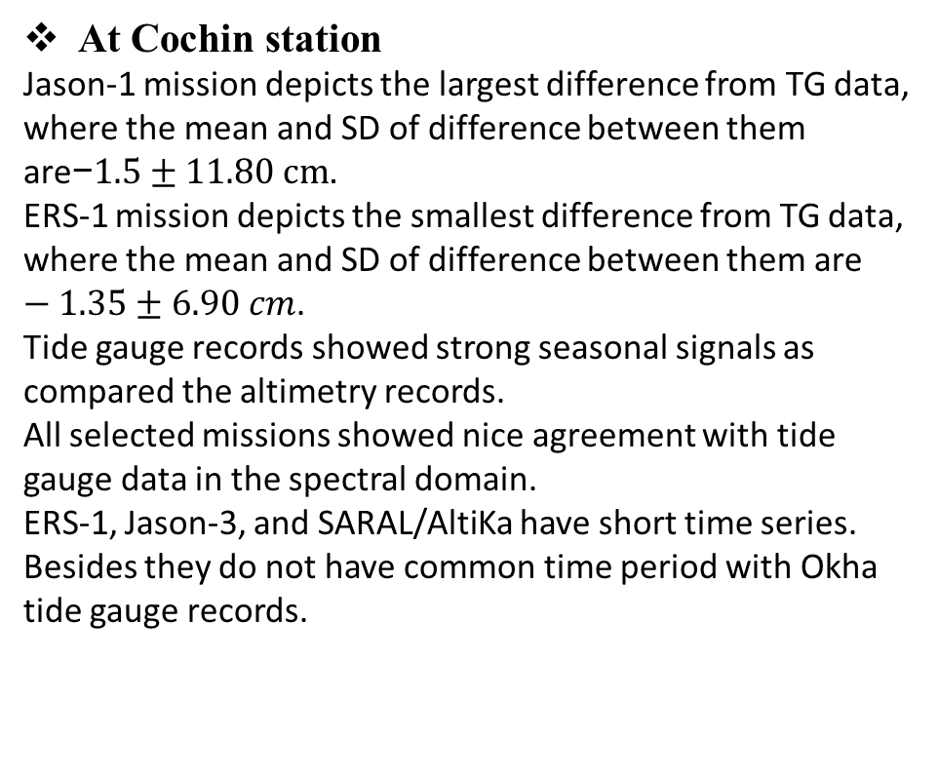
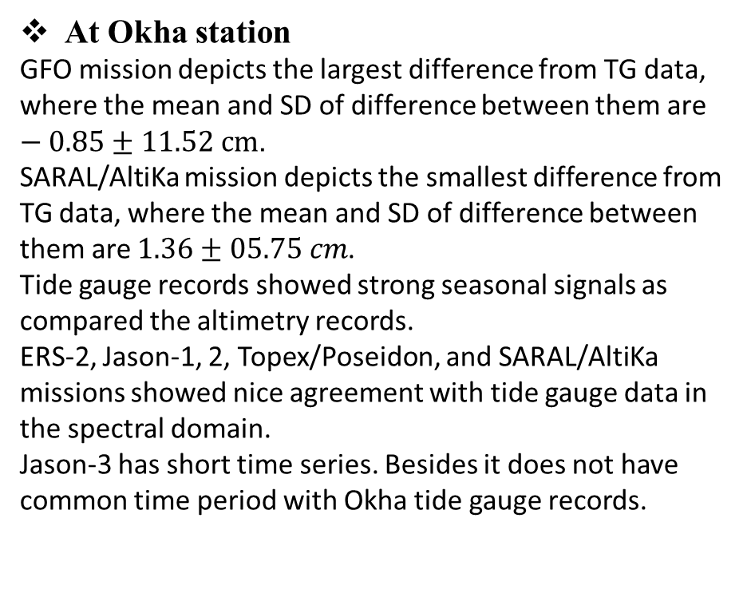
Discussion and Conclusion
At Okha station
GFO mission depicts the largest difference from TG data, where the mean and SD of difference between them are $−0.85±11.52 cm$.
SARAL/AltiKa mission depicts the smallest difference from TG data, where the mean and SD of difference between them are $1.36±05.75 cm$.
Tide gauge records showed strong seasonal signals as compared the altimetry records.
ERS-2, Jason-1, 2, Topex/Poseidon, and SARAL/AltiKa missions showed nice agreement with tide gauge data in the spectral domain.
Jason-3 has short time series. Besides it does not have common time period with Okha tide gauge records.
At Cochin station
Jason-1 mission depicts the largest difference from TG data, where the mean and SD of difference between them are$\text{−}1.5±11.80 cm$.
ERS-1 mission depicts the smallest difference from TG data, where the mean and SD of difference between them are $−1.35±6.90 cm$.
Tide gauge records showed strong seasonal signals as compared the altimetry records.
All selected missions showed nice agreement with tide gauge data in the spectral domain.
ERS-1, Jason-3, and SARAL/AltiKa have short time series. Besides they do not have common time period with Okha tide gauge records.

Slide 12
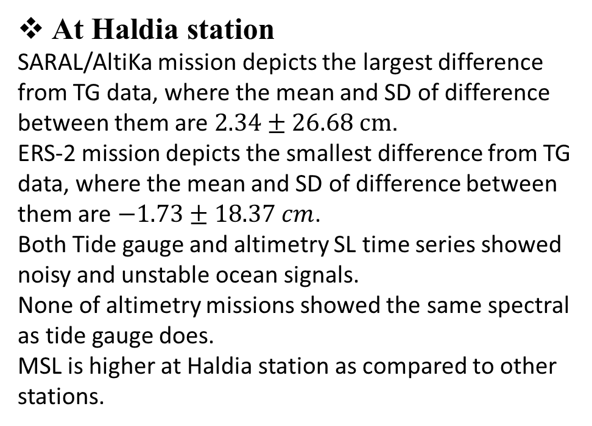
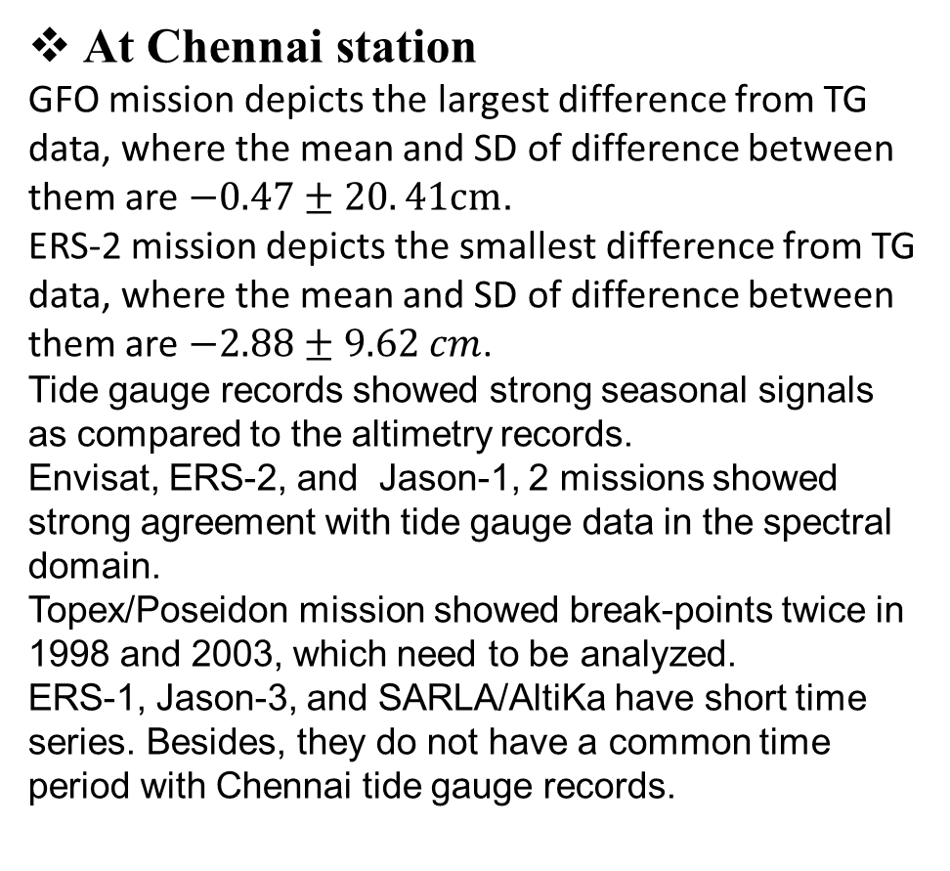
Discussion and Conclusion
At Chennai station
GFO mission depicts the largest difference from TG data, where the mean and SD of difference between them are $−0.47±20. 41cm$.
ERS-2 mission depicts the smallest difference from TG data, where the mean and SD of difference between them are $−2.88±9.62 cm$.
Tide gauge records showed strong seasonal signals as compared to the altimetry records.
Envisat, ERS-2, and Jason-1, 2 missions showed strong agreement with tide gauge data in the spectral domain.
Topex/Poseidon mission showed break-points twice in 1998 and 2003, which need to be analyzed.
ERS-1, Jason-3, and SARLA/AltiKa have short time series. Besides, they do not have a common time period with Chennai tide gauge records.
At Haldia station
SARAL/AltiKa mission depicts the largest difference from TG data, where the mean and SD of difference between them are $2.34±26.68 cm$.
ERS-2 mission depicts the smallest difference from TG data, where the mean and SD of difference between them are $−1.73±18.37 cm$.
Both Tide gauge and altimetry SL time series showed noisy and unstable ocean signals.
None of altimetry missions showed the same spectral as tide gauge does.
MSL is higher at Haldia station as compared to other stations.

Slide 13
THANK YOU

