Slide 1
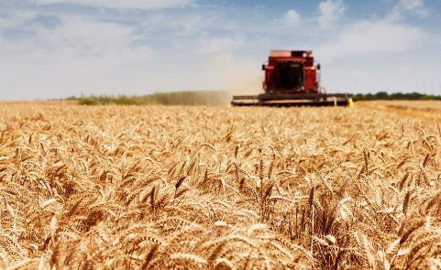
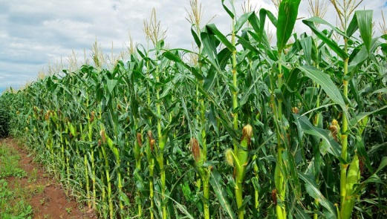
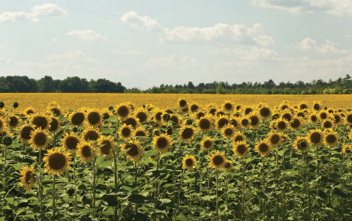
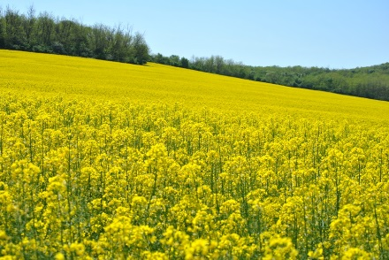


Investigation of the two-decade environmental impact of largescale agricultural cultivation and its impact on climate change in the Lajta-Project
András Polgár⁽¹⁾, Karolina Horváth⁽¹⁾, Imre Mészáros⁽¹⁾, Adrienn Horváth⁽¹⁾, András Bidló⁽¹⁾, Sándor Faragó⁽²⁾ and Veronika Elekné Fodor⁽¹⁾
⁽¹⁾Institute of Environmental and Earth Sciences, Faculty of Forestry, University of Sopron, Sopron, Hungary
⁽²⁾Institute of Wildlife Management and Wildlife Biology, Faculty of Forestry, University of Sopron, Sopron, Sopron, Hungary

Slide 2
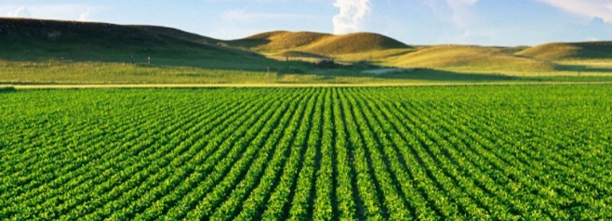
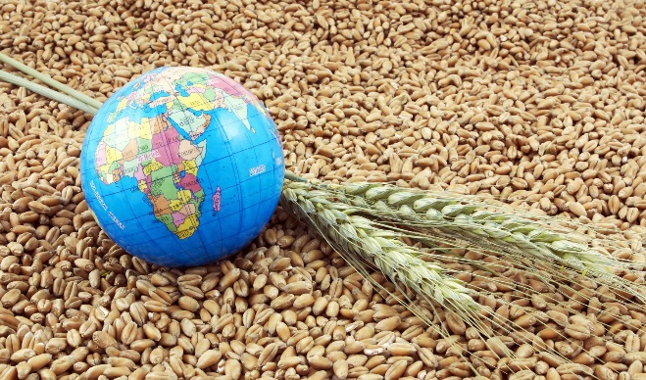
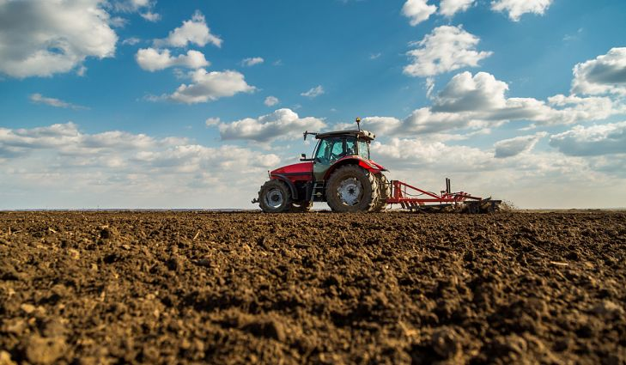
PICO - 2 minutes madness
Crop production is applied on about half of Hungary’s land area, which amounts to approximately 4.5 million hectares.
The agricultural activity has significant environmental impacts.
Our work aims the time series investigation of the impacts of large-scale agricultural cultivation on environment and primarily on climate change in the test area by applying environmental life cycle assessment (LCA) method.
The investigated area of Lajta Project can be found in the north-western corner of Hungary, in Győr-Moson-Sopron county.
The area has intense agri-environment characteristics, almost entirely lacking of grasslands and meadows.

Slide 3
Research question
We were looking for the answer to the question:
„To what extent does agricultural activity on this area impact the environment and how can it contribute to climate change during a given period?”
We analysed the cultivation data of 5 crops:
  canola (15 years),
  winter barley (20 years),
  winter wheat (18 years),
  green maize (20 years) and
  maize (13 years).

Slide 4
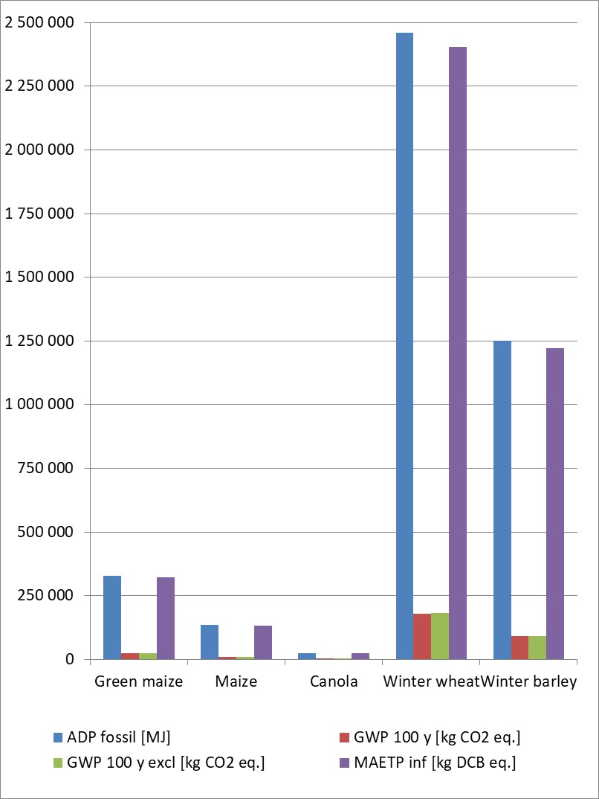
Results – Impact Assessment
Fig. 1. Environmental impact category indicator results cumulated to total cultivation periods and total crop growing areas by impact categories of CML 2001 (Jan 2016)
Figure 1. displays the specific environmental footprints by crops
Increasing environmental ranking of environmental stress resulted from cultivating the observation plot is the following:
(1) canola – (2) maize – (3) green maize – (4) winter barley – (5) winter wheat.

Slide 5
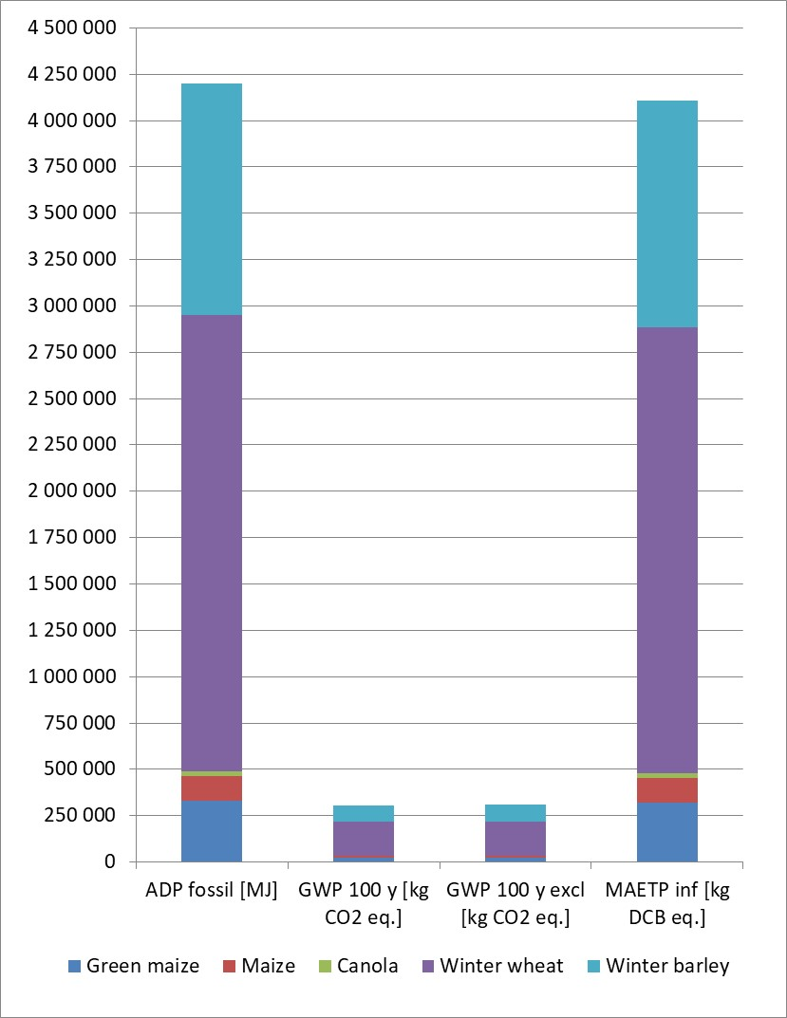
Results – Impact Assessment
Fig. 2. Territorial environmental footprints of crops for the total time period (‟super footprint” values) by impact categories of CML 2001 (Jan 2016)
Figure 2. displays territorial environmental footprints of crops for the total time period, namely the ‟super footprint” values.
The calculated carbon footprint value specific to the area was 307 000 kg CO2-equiv. according to ‟super footprint” approach.
The obtained results help for the selection of appropriate technologies that have been adjusted to environmental sensitivities.
Thank you for your kind attention!

Slide 6

Investigation of the two-decade environmental impact of largescale agricultural cultivation and its impact on climate change in the Lajta-Project
András Polgár⁽¹⁾, Karolina Horváth⁽¹⁾, Imre Mészáros⁽¹⁾, Adrienn Horváth⁽¹⁾, András Bidló⁽¹⁾, Sándor Faragó⁽²⁾ and Veronika Elekné Fodor⁽¹⁾
⁽¹⁾Institute of Environmental and Earth Sciences, Faculty of Forestry, University of Sopron, Sopron, Hungary
⁽²⁾Institute of Wildlife Management and Wildlife Biology, Faculty of Forestry, University of Sopron, Sopron, Sopron, Hungary
MAIN MENU
Introduction
Objectives
Material and method
Results – Interpretation
Conclusions
Acknowledgement

Slide 7

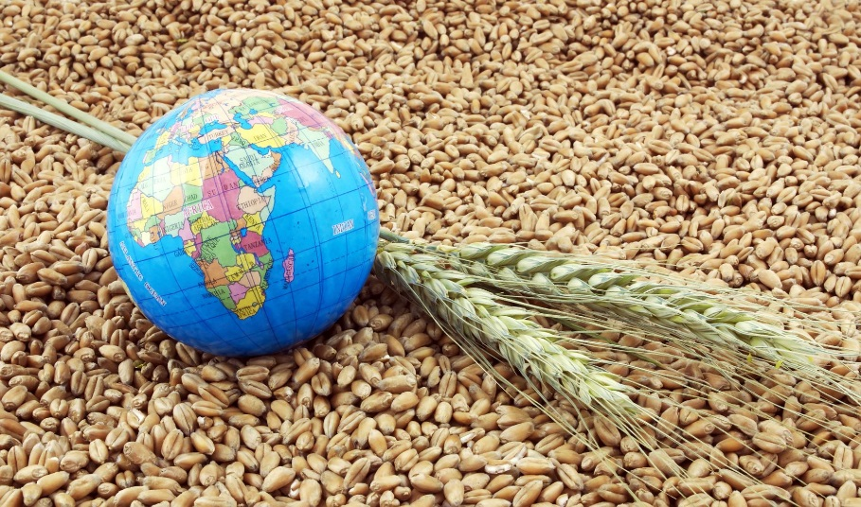
Introduction
MAIN MENU
Crop production is applied on about half of Hungary’s land area, which amounts to approximately 4.5 million hectares.
Maintaining environmental balance and reducing the damages caused by climate change anomalies are the two basic pillars of sustainable agricultural competitiveness.

Slide 8

Objectives
MAIN MENU
Our work aims the time series investigation of the impacts of large-scale agricultural cultivation on environment and primarily on climate change in the test area by applying environmental life cycle assessment (LCA) method.
Applying agricultural sector-LCA to achieve both internal (comparative) and external (efficiency enhancing) benefits is a priority.

Slide 9



Material and method 1/3
MAIN MENU
The investigated area of Lajta Project can be found in the triangle formed by the local places Mosonszolnok, Jánossomorja and Várbalog, in the north-western corner of Hungary, in the Győr-Moson-Sopron county.
This area is located in Kisalföld plain, specifically in the southern part of Mosoni-sík (plain).
The area has intense agri-environment characteristics, almost entirely lacking of pastures and meadows.
The main cultivated plant species in this agricultural land (2678-2768 ha) are cereals, maize, hemp and canola.
There are, on average, 10-15 crops present during a single production cycle.
The area is divided into 56 parcels measuring between 20 and 105 ha.
The investigation covers the two decade period between 1991 and 2011.

Slide 10
Material and method 2/3
MAIN MENU
We sought the answer for the question “To what extend does agricultural activity on this area impact the environment and how can it contribute to climate change?”
Crops were involved in the investigation due to their extensive production areas.
We examined the cultivation data of 5 crops: canola, winter barley, winter wheat, green maize and maize.
Material flows of arable crop production technologies were defined in time series by the agricultural parcel herd-book data.
These covered the size of the area actually cultivated, the operational processes and records on seeds, fertilizer and pesticide use and harvest data by parcels.
The examined environmental inventory database contained also the fuel consumption and lubricating oil usage of machine operations, and the water usage of chemical utilization.

Slide 11
Material and method 3/3
MAIN MENU
In the life cycle modelling of cultivation, we examined 13 years of maize, 20 years of green maize, 20 years of winter barley, 18 years of winter wheat and 15 years of canola data calculated on 1 ha unit using GaBi life cycle analysing software.
In addition, we also calculated by an average cultivation model for all cultivated plants with reference data to 1 ha and 1 year.
We applied the following methods and models in our impact assessment:
  CML2001 (January 2016) method,
  carbon footprint analysis according to the standard ISO 14067,
  GaBi impact assessment model for land use and
  GaBi model for water.
In order to represent the overall environmental impact, we used the method of CML2001, Experts IKP (Central Europe).

Slide 12

Results – Interpretation 1/8
MAIN MENU
Significant impact categories resulted from the average cultivated plant values calculated on 1 ha (territorial approach) were:
  abiotic depletion pot. (ADP fossil),
  global warming (GWP 100 years) and
  marine aquatic ecotoxicity pot. (MAETP inf).

Slide 13
Results – Interpretation 2/8
MAIN MENU
According to the values of the impact categories, we organised the following increasing environmental ranking of plant cultivation:
  (1) canola has minimum environmental impacts followed by (2) green maize and (3) maize with slightly higher values. (4) Winter barley has 6 times higher values preceded by (5) winter wheat with a slight difference.

Slide 14
Results – Interpretation 3/8
MAIN MENU
The previous environmental ranking of the specific cultivated plants’ contribution was also confirmed as regards the total environmental impact:
  canola (1.0%) – green maize (4.9%) – maize (7.1%) – winter barley (43.1%) – winter wheat (44.0%).

Slide 15
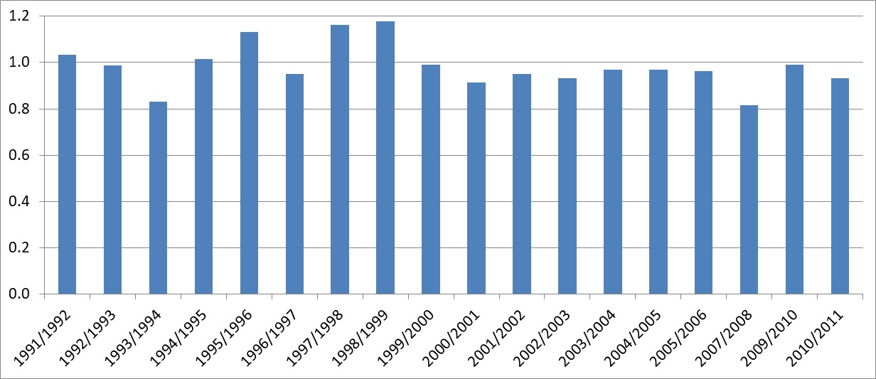
Results – Interpretation 4/8
MAIN MENU
We compared the yearly time series values on 1 ha and the average yearly values of cultivated plants. According to the resulted ratio, we could define the year of above-average level emission and the year of lower level environmental stress.
This provides opportunity to draw further conclusions in the time series assessments of the resulting changes in the local flora and fauna.
Winter wheat - Comparison of the yearly time series values on 1 ha and the average yearly values of cultivated plant

Slide 16
Results – Interpretation 5/8
MAIN MENU
Environmental impact category indicator results cumulated to total cultivation periods and total crop growing areas (territorial approach) display the specific environmental footprints by crops.
The slight difference resulted in the rankings according to territorial and quantitative approach on the investigated area is due to the diversity of cultivation time factor and the crop-growing parameter of the specific crops.

Slide 17
Results – Interpretation 6/8
MAIN MENU
Environmental impact category indicator results cumulated to total cultivation periods and total crop growing areas by impact categories of CML 2001 (Jan 2016)
Figure displays the specific environmental footprints by crops
Increasing environmental ranking of environmental stress resulted from cultivating the observation plot is the following:
(1) canola – (2) maize – (3) green maize – (4) winter barley – (5) winter wheat.

Slide 18
Results – Interpretation 7/8
MAIN MENU
We also summerized the indicator results of impact categories according to CML2001 method in the examined area by crops which resulted in the territorial environmental footprints of crops for the total time period, namely the ‟super footprint” values.
The calculated carbon footprint value specific to the area was 307 000 kg CO₂-equiv. according to ‟super footprint” approach.
The calculated values are clear to interpret by comparison with the similar data or average values of other areas or time periods.

Slide 19
Results – Interpretation 8/8
MAIN MENU
Territorial environmental footprints of crops for the total time period (‟super footprint” values) by impact categories of CML 2001 (Jan 2016)
Figure displays territorial environmental footprints of crops for the total time period, namely the ‟super footprint” values.
The calculated carbon footprint value specific to the area was 307 000 kg CO2-equiv. according to ‟super footprint” approach.
The calculated values are clear to interpret by comparison with the similar data or average values of other areas or time periods.
The obtained results help for the selection of appropriate technologies that have been adjusted to environmental sensitivities.

Slide 20
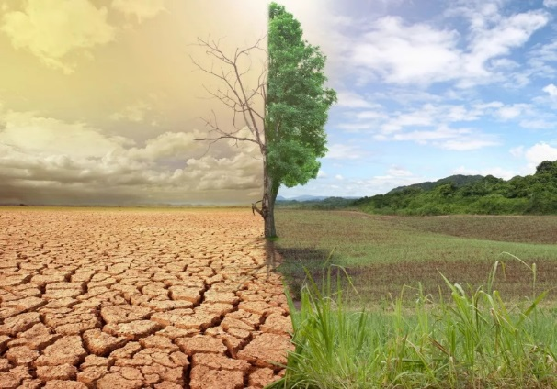

Conclusions
MAIN MENU
The research outcomes are only comparable with other LCA studies involving the same functional unit and system boundaries.
The obtained results help to better assess environmental impacts, climate risks, and climate change as they pertain to arable crop production technologies, which advances the selection of appropriate technologies that have been adjusted to environmental sensitivities.

Slide 21
Acknowledgement
MAIN MENU
Our research was supported by the „Lajta-Project”.

