Slide 1


In-season crop classification using optical remote sensing with random forest over irrigated agricultural fields in Australia
Presenter:
Zitian Gao (zitiang@student.unimelb.edu.au)
Co-authors:
Prof. Andrew Western, A/Prof. Dongryeol Ryu, Dr. Danlu Guo

Slide 2
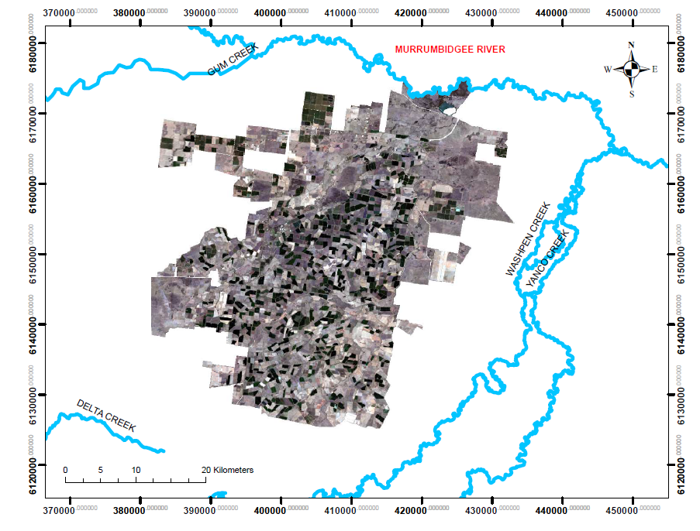
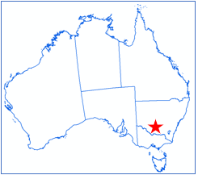
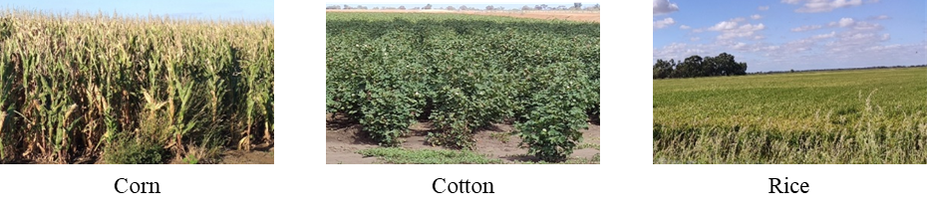
Research Background
Importance
Spatially-precise, timely crop type information is critical for agronomic planning in water use and crop production
Crop type maps before harvest can be used for late-season water management and crop yield prediction
Study area
Study period and crop types
2013-2019; maize/corn, cotton and rice

Slide 3
Research method
Delineate field boundary for field-scale classification
Collect ground-truth samples
Extract pixel-level Landsat data (raw bands, vegetation indices etc.) and aggregate for individual fields
Optimise setting of training sample (sample size, sample class, samples collected from multiple years/single years) to reach better model performance
Develop a Random-Forest classification model to generate in-season maps

Slide 4
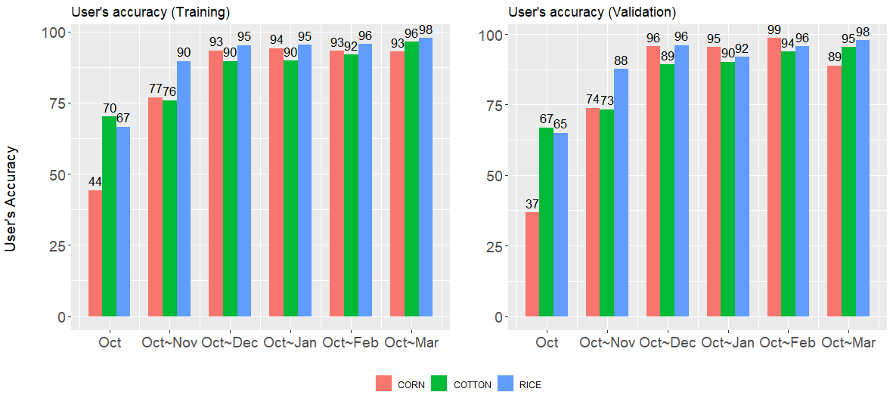
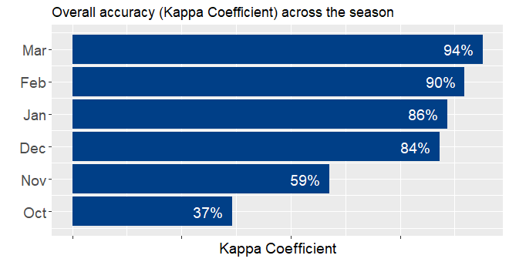
Results
Summary
Model overall accuracy (kappa coefficient) reaches 84% in the 3rd month
Cotton and rice have higher in-season accuracy than corn/maize at the early season

Slide 5
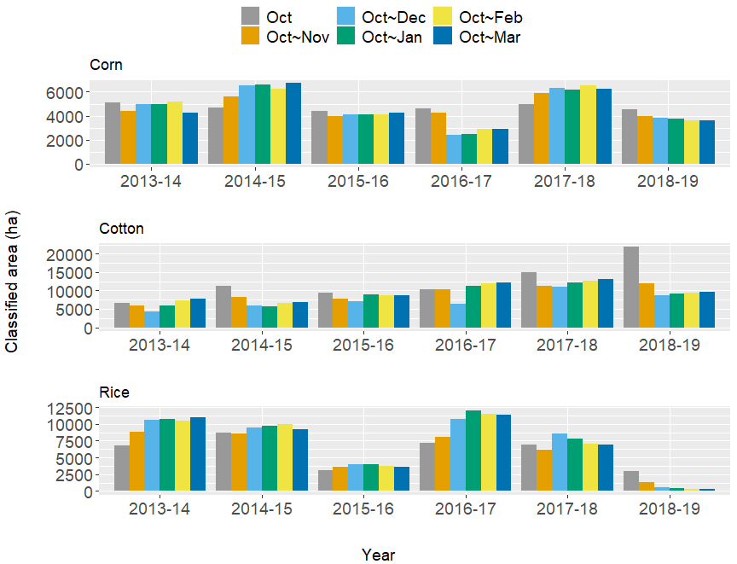
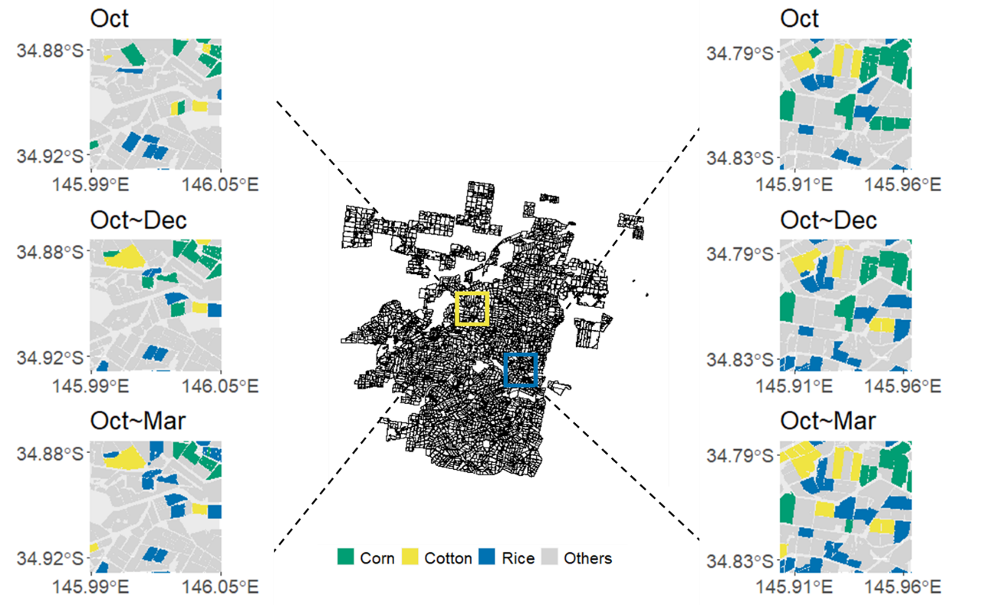
Results
Summary
Large variability of total cropping area across years
Consistent and reliable in-season maps can be obtained 3 months after the start of the season
Significant change
Minor change

Slide 6
Thank you!
Any questions?
Presenter:
Zitian Gao
Co-authors:
Prof. Andrew Western, A/Prof. Dongryeol Ryu, Dr. Danlu Guo

