Slide 1


Tectono-magmatic evolution of the Karoo and Kerguelen plumes and their impact onto magmatism of the East Antarctica
Sushchevskaya N.M.(1), Leitchenkov G.L.(2), Belyatsky B.V.(3),
1 – Vernadsky Institute of Geochemistry, RAS, Moscow, Russia
2 – Gramberg Research Institute of Geology and Mineral Resources of the World Ocean, St. Petersburg, Russia
3 – Karpinsky Geological Institute (VSEGEI), St.Petersburg, Russia

Slide 2

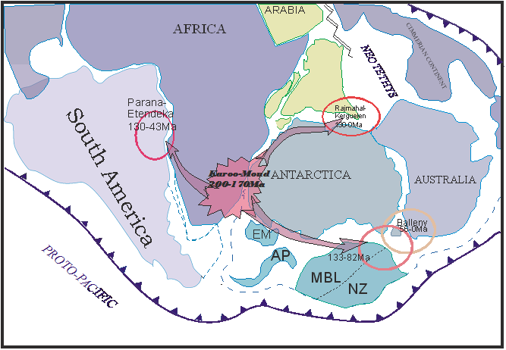
Evolution of Gondwana Plume provinces
(reconstruction modified after Lawver et al., 1992, Segev 2002)
Karoo-Maud superplume is an example of deep plume, born at the border core-mantle. Its penetration into the upper layers of lithosphere caused disintegration of Gondwana and separation of Africa from Antarctica.
Distribution of plume substances along the weakened zones of Gondwana to the south (province Ferrar in the Transantarctic Mountains) and to the east (from the west part of QML towards the Prince Charles Mountains) of the Antarctic reflects the possible deep dislocations of the plume which possibly took place at different levels of lithosphere and underlithospheric mantle. This can be explained by the long history of Karoo-Maud plume which started about 180 m.y. ago and its expansion to the east along collision zones of East Antarctic till the Jetty Oasis and further to the Indian Ocean where it is still alive as Kerguelen plume for about 110 Ma.
The Karoo-Maud-Ferrar initial plume, which caused the breakup between east and west Gondwana along the proto-oceanic rift between the Weddell Sea and Somali basin radial migrated during 40 Ma in a direction of Kerguelen, Paran´a - Etendeka, Marie Byrd Land plumes. First-generation plumes are larger (diameter ca 3000 km) than the late-generation plumes (ca 2000 km) and apparently have a radial dispersion of magmatism and rifting (Segev, 2002). The migration of the plume maybe below the upper mantle convection level.

Slide 3
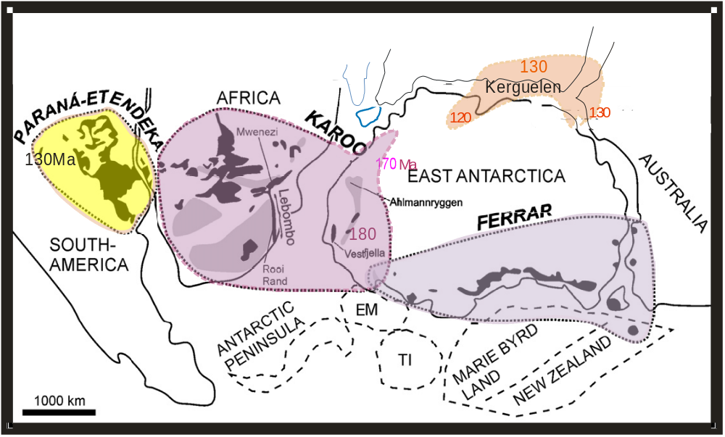
Distribution of Mesozoic CFBs in reconstructed Gondwana supercontinent at the age about
180 Ma ago
In the case of the Karoo province, the known extent of intrusive equivalents (found outside CFBs) is also shown. EM − Ellsworth-Whitmore Mountains, TI − Thurston Island.
Reconstruction modified after Heinonen et al. (2010), Hergt et al. (1991), Kent (1991), Storey et al. (1992), Segev (2002), Leat et al. (2006), and Jourdan et al. (2004).

Slide 4
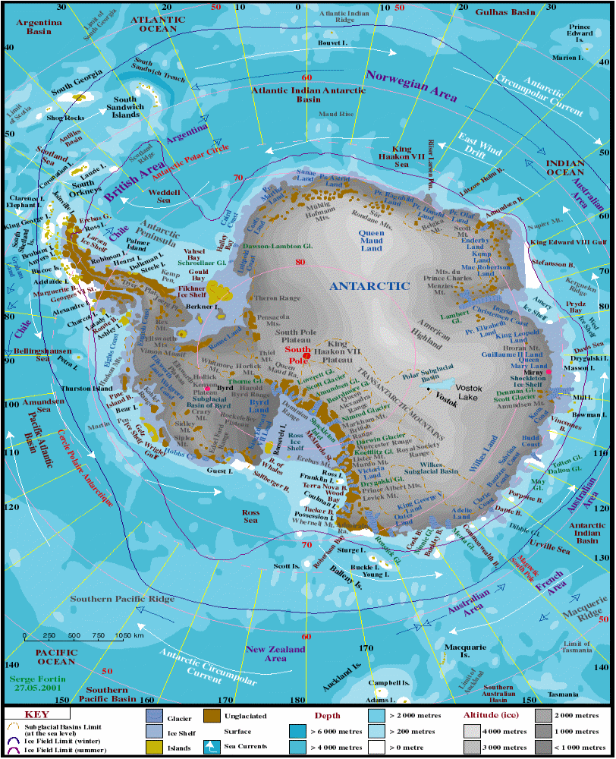
Space distribution of Mesozoic magmatism in the East Antarctica:
Droning Maud Land (180-170 Ma),
Ferrar (180 Ma) and o. Jetty (125-120 Ma)
The main goal of our study to interpret the structure and evolution of the Mz-upper mantle plume beneath Gondwana, and the origin of different geochemical fingerprints for Antarctic basaltic provinces.

Slide 5
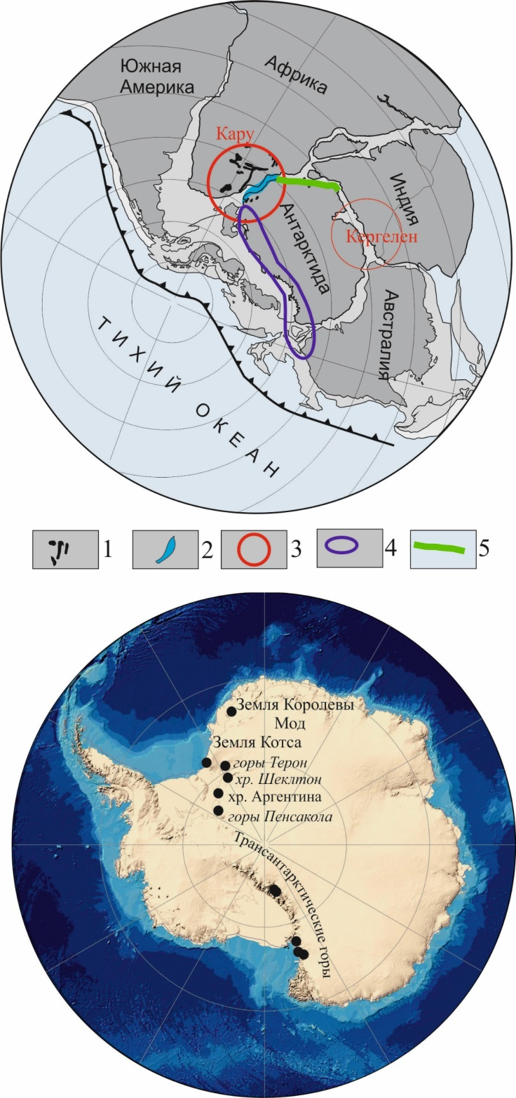
The propagation and heterogeneity of the Karoo-Maud plume in the southeastern Gondwana at the age (180 Ma) of the beginning of the Africa and Antarctica dividing, taking into account the various geochemical types of magmas
These mega-apophyses are represented by the Ferrar Igneous Province (ca. 3000 km long area of intrusive activity along the Transantarctic Mountains)
а) A modified 180 Ma reconstruction of Gondwana (Leichenkov et al., 2000). The contour shows the impact areas of the Karoo plume (190-180 Ma) with its distribution along the western margin of East Antarctica. 1 - mafic intrusive and effusive rocks with an age of 190–180 Ma in Africa and Antarctica, outcropped on the surface; 2 - volcanic complexes of rifted margins; 3 - area of ​​manifestation of the Karoo and Kerguelen mantle plumes; 4 - area of ​​distribution of Early Jurassic Ferrar dolerites with an age of 185-180 Ma; 5 - a complex of mafic intrusive rocks, which is marked by magnetic and gravity anomalies.
b) Sampled outcrops of East Antarctica, within which of Early Jurassic igneous rocks were collected.

Slide 6
The manifestation of two types of magmas is typical for the Karoo province: high- and low-Ti magmas (Jourdan et al., 2007; Hastie et al., 2014; Luttinen 2018; Melankholina, Sushchevskaya, 2019); for the DML the distribution of high-Ti varieties is manifested more locally. The primary melts of the Ferrar magmas are depleted in Ti, which probably reflects the more depleted nature of the source that underwent previous melting.
Variations of major elements in Karoo LIP provinces : Karoo, Dronning Maud Land, Ferrar, and old Ferrar bssalts (GEOROC, Sushchevskaya et al., 2021 in press)

Slide 7
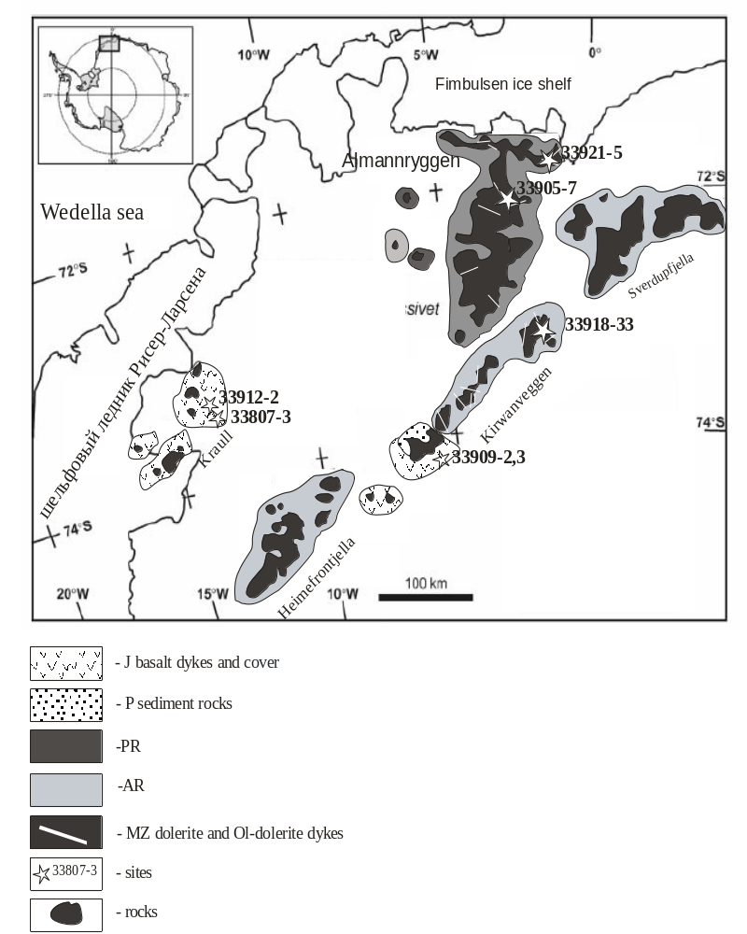
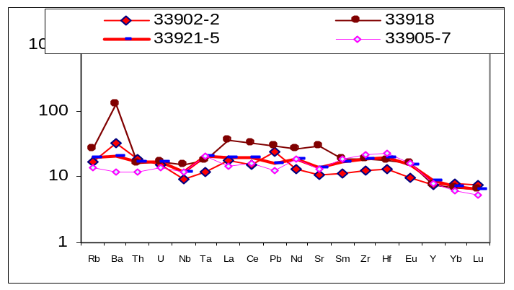
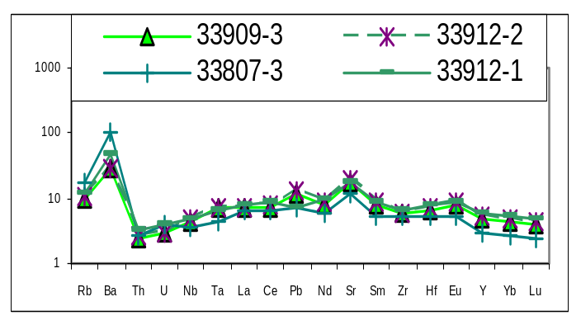
The results of the pyroxenite melting experiments at pressures of 20-25 kbar showed the existence of melts close in composition to the samples we studied (Lambart et al., 2013). Such melts are characterized by a low MgO content of about 10% (in the studied - averaged 11%).
Samples of dolerites (33921-7, 33905-7) consisting of 40-60% of plagioclase, orthopyroxene (about 20%), clinopyroxene (about 10%) and ore minerals, has been analyzed. Olivine (about 1-3%) forms small rounded grains, sometimes, aggregation of grains in the matrix. In some cases, olivine is assumed only based on the morphological form of grains and secondary products of the whole-altered crystals (33905-7). The matrix, often altered, consists of plagioclase, titanomagnetite and olivine microphenocrysts.

Slide 8
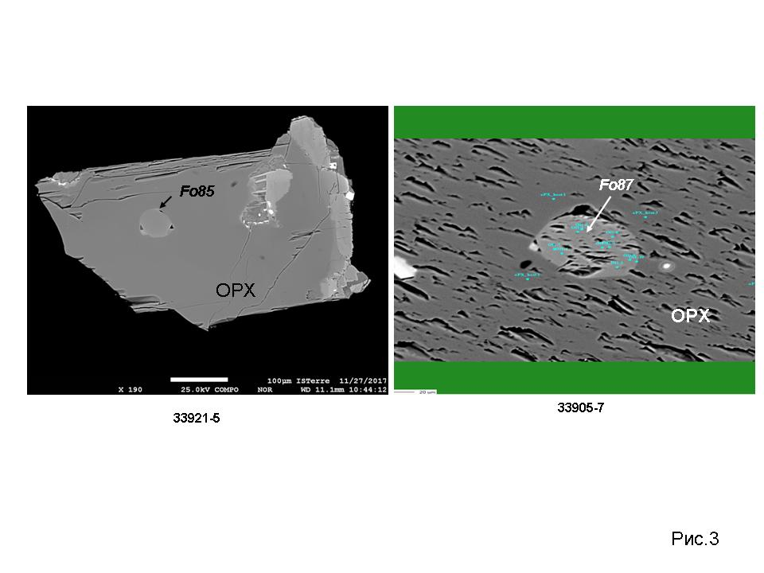
Inclusions of olivines Fo₈₅ and Fo₈₇ in orthopyroxenes from dolerite samples 33921-5 and 33905-7 of the Ahlmannryggen massif ( Sushchevskaya et al., 2021)

Slide 9
Variations of olivine composition in Px-basalts from the Ahlmannryggen (DML). Ni excess over Mg in olivine phenocrysts suggest the presence of Ol-free pyroxenite lithologies in the sources of primary melts (Sobolev et al., 2007). Obtained results suggest the participation of recycled crustal component in the generation of primary melts. That component was involved in rising mantle in the form of Si oversaturated eclogite as previously subducted oceanic crust or as fragments of ancient continental lithosphere. The Si-enriched eclogite melt interacts with peridotite and transforms into Ol-free pyroxenite.
(

Slide 10
Isotope characteristics of melts related to the pyroxenite source
Shown are magma compositions: variations of isotope ratios in magmas related to the Karoo plume (Sushchevskaya et al., 2021). (1–2) South Africa basalts: (1) high-Ti, (2) low-Ti; (3) basalts and dolerites of different geochemical types, Droning Maud Land; (4) picrites of the Ahlmannryggen Mountains; (5) basalts and dolerites of the Vestfjella Mountains, DML, (6) high-Ti ferrobasalts of the Nuanetsi area; (7) enriched model (EM I, EM II, HIMU) and (DM) depleted sources after (Armienti, Longo, 2011).

Slide 11
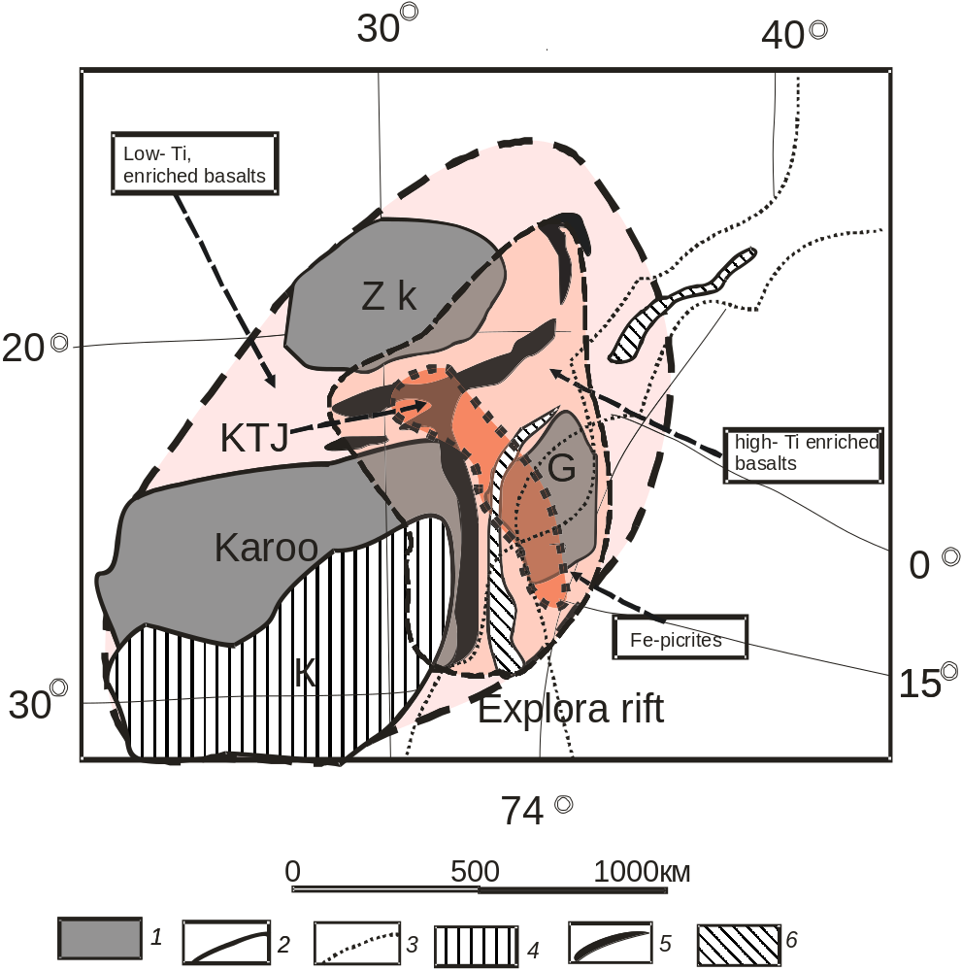
Reconstruction of the surface distribution of the Karoo–Maud plume. Reconstruction is presented for the time of the Gondwana breakup starting (180 Ma), fields show the distribution of different geochemical rock types in the Karoo igneous province, which reflects plume zoning (compiled using Ellam, Cox, 1989; Ferraccioli et al., 2005; Heinonen et al., 2016; 2017; Luttinen, 2018).
The unique finding of pyroxenitic high-Fe magnesian melts
confined to the high-Ti trap region of the Karoo
(central Karoo and northern part of the QML) is due to they
mark the central part of the plume and correspond to the
earliest eruptions. These melts must be a relatively low-SiO2 and high-FeO, as well as have a high CaO/Al2O3 ratio, but is not the case in our case, probably because of the great heterogeneity of the eclogite giving rise to pyroxenite as the mantle diapir ascent. The isotopic composition of the samples studied can reflect the composition of the pyroxenite source of the ancient oceanic lithosphere (EMI), which was subducted along the ancient subduction zone (Luttinen, 2018). With the evolution of the plume, over time, the admixture of pyroxenites in the mantle wedge decreases and the melts acquire the characteristics of the melti g lithospheric mantle, which is reflected in the isotope signatures of the melts by increasing the share of the EMII enriched component.
1- Karoo-Kaapval Craton; ZK - Zimbabwe Craton; G - Grunehogna Cratron; 2 - craton outline; 3-continent outline; 4 - Karoo trough; 5 - dike swarm; 6 - volcanic complex of the Antarctic margin;
Compiled using (Ellam, Cox, 1989; Ferraccioli et al., 2005; Heinonen et al., 2016; Kamenetsky et al., 2017; Luttinen, 2018).

Slide 12
Variations of trace elements in mafic rocks from the Karoo, Droning Maud and Ferrar provinces
Geochemical difference of the basalts of the Ferrar province - increased U content, Rb/Sr, Th/Yb, which indicates the addition of the fluid component
( Sushchevskaya et al., 2021 in press)
indicate the addition of the fluid component

Slide 13
The Ferrar Province reflects the properties of an enriched, fluid-rich, ancient continental mantle, metasomatized at the early stages of the tectonic development of the region and involved in the melting process.

Slide 14
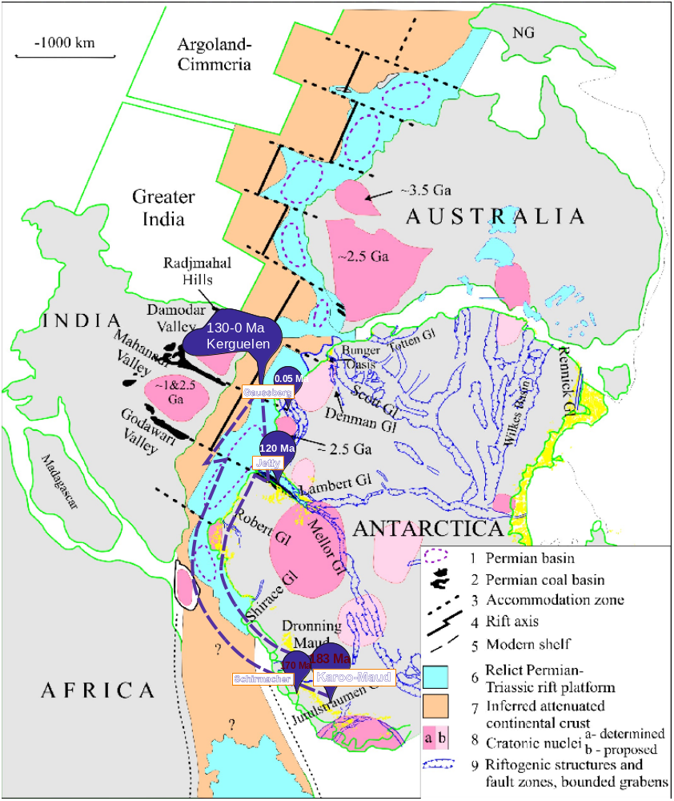
Possible propagation of the Karoo-Maud plume to the Eastward
The alkaline magma generation in the eastern India
and Antarctica occurred within the periphery of the
Kerguelen-plume at 120-110 m.y. ago. This is the
time preceded or corresponded to the beginning of
the plume activity in the Indian Ocean. Alkaline
magmas originated by low degree melting of
substantially heterogeneous lithospheric mantle,
which was formed at the early stages of eastern
Gondwana evolution. The influence of the plume on
the first stages of activity affected this mantle and
metasomatized it by penetrating melts which were
often enriched in volatile components. Subsequent
high temperature plume impact could lead to the
mantle melting and to incipient alkaline and
carbonatite magmas appearance within Lambert
and Rajmahal regions (Sushchevskaya et al., 2017) .

Slide 15
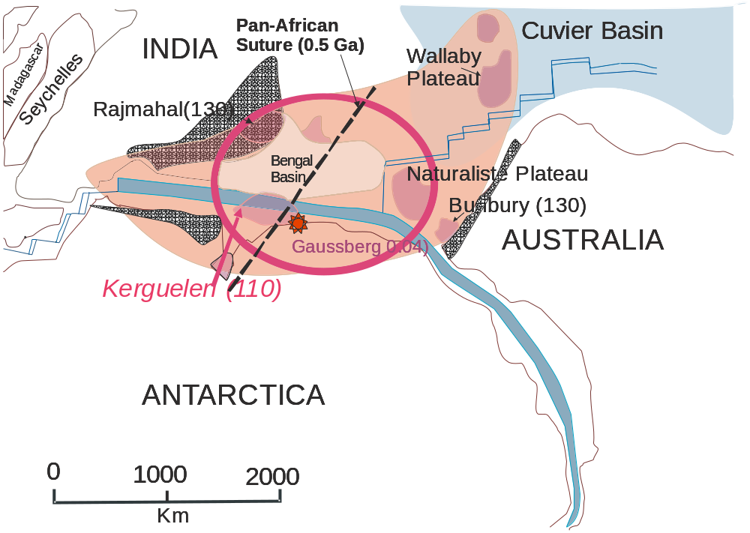
Location of postulated Kerguelen mantle plume head 130-110 Ma
(reconstruction modified after Segev 2002)
Areas influenced by igneous activity
Main rifting and
development of
spreading center
The 0.5 Ga Pan-African suture that created East Gondwana is after Kelsey et al. (2008) and Chatterjee et al. (2011)

Slide 16
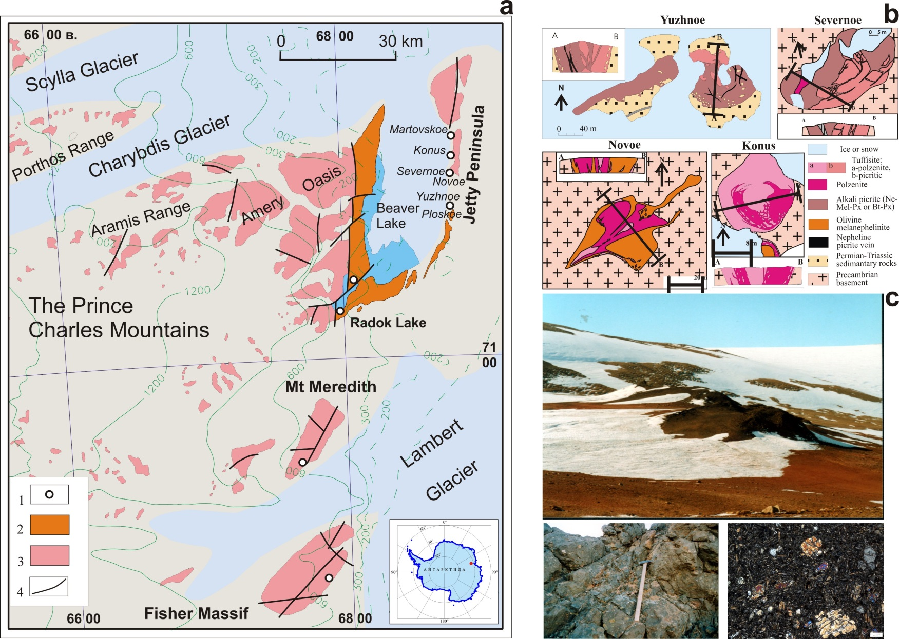
Thet Mesozoic–Cenozoic occurrences of intraplate magmatism (alkaline ultrabasic intrusions, kimberlite sills and dikes, and leucite basalts) are localized at the region of the Prince Charles Mountains, 3000–4000 km east of DML. Their formation is supposedly related to the activation of the sublithospheric mantle of Antarctica under the influence of the Kerguelen plumeat 130–105 Ma.
(a): 1- Jurassic-Cretaceous alkaline picrites, 2 – Permian-Triassic coal-dearing deposits, 3 – Precambrian rocks, 4 – faults; (b) schematic structure of the alkaline-ultramafic stock-like bodies from Jetty Oasis; (c) general view of the Severnoe stock, detail of outcrop and optic microfoto of tuffisite in crossed nicols.
Notes:
Emplacement 130-115 m.y. ago of dikes and sills of alkaline-ultrabasic composition within Jetty oasis is suggested as a later appearance of plume magmatism within the East-Antarctic Shield (Andronikov et al., 1993, 2001; Laiba et al., 1987). This region is located opposite Kerguelen Islands and possibly could be properly connected with activity of the Kerguelen-plume (Foley et al., 2001, 2006). Jurassic-Cretaceous dikes, stocks and sills of alkaline-ultrabasic rocks, relatively close to kimberlite-type, are exposed within Jetty oasis and on the southern shore of the Radock Lake (Mikhalsky et al., 1992). This alkaline-ultrabasic magmatism has appeared to be connected with the main Mesozoic stage of the evolution of the Lambert and Amery glaciers riftogenic structure (Kurinin et al., 1980, 1988). The alkaline-ultrabasic dikes and sills within Jetty oasis cut the rocks of the Beaver complex, Permo-Triassic terrigeneous successions of the Amery complex, and late Paleozoic low-alkaline basic dikes as well. Dashed chain of 6 stock bodies spread out on 15 km along the eastern shore of the Beaver Lake, marked their allocation with submeridianal zone of the deep cracks, boarded of the eastern side of the Beaver Lake trough. Some of the polzenite and biotite-pyroxene alkaline picrite dikes were discovered on Kamenistaya Platform (northern extremity of Jetty oasis). They have north-north-eastern strike, subvertical dip and are 0.5-1.0 m thick. Oasis Jetty alkaline bodies on the present-day erosion surface have oval, rare isometric forms from 10х25 to 80х120 m; dike bodies reach up to 180 m long and thickness is about 2 m (Fig. 6b). All of these dike rocks are abundant in mantle nodules, mainly peridotites, and numerous xenoliths of the host Permo-Triassic sediments and Precambrian metamorphics as well (Fig. 6c). It has been suggested that the alkaline-ultrabasic bodies were intruded into two phases. In the elder bodies (150-140 Ma, Yuzhnoe and Severnoe stocks) biotite-pyroxene alkaline picrites prevail, at the same time the younger (123-110 Ma, Novoe and Ploskoe stocks) is composed by polzenites and/or melanephelinites (Laiba et al., 1987; Mikhalsky et al., 1998) (Fig. 6).

Slide 17
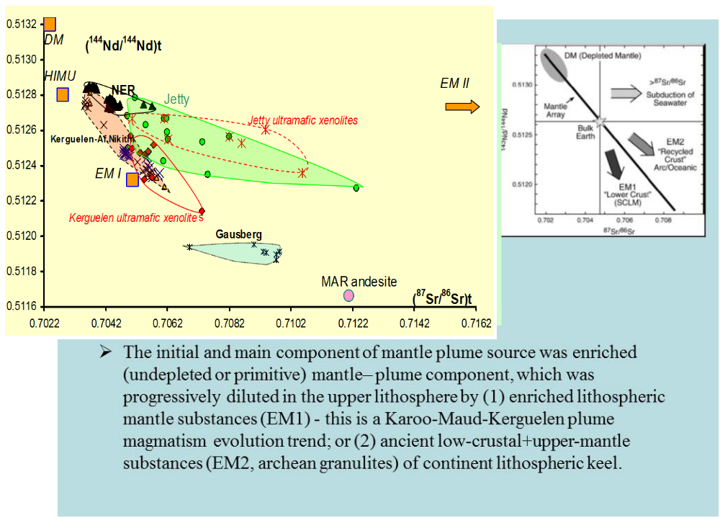

Slide 18
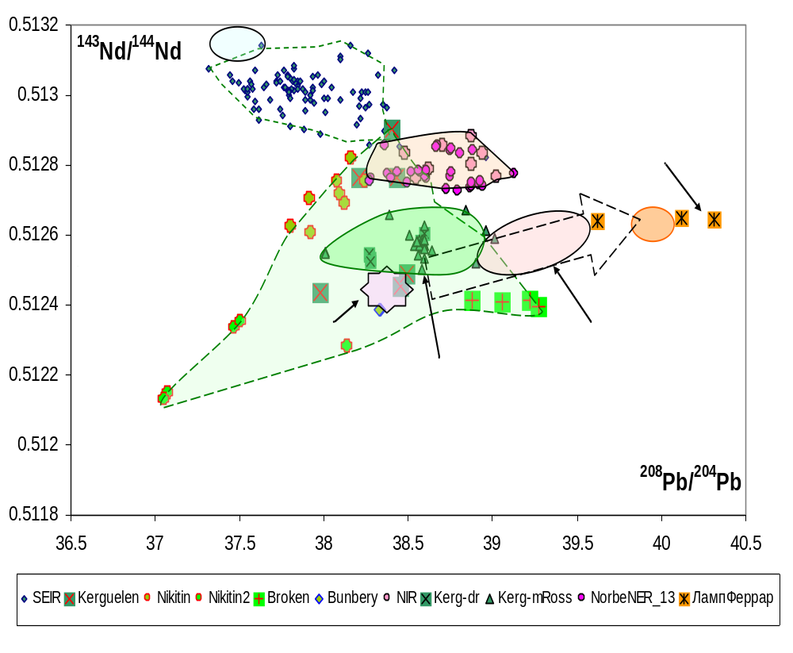
Comparison of Pb isotope composition in the plume magmas of East Antarctica and Kerguelen (Sushchevskaya et al., 2020).

Slide 19

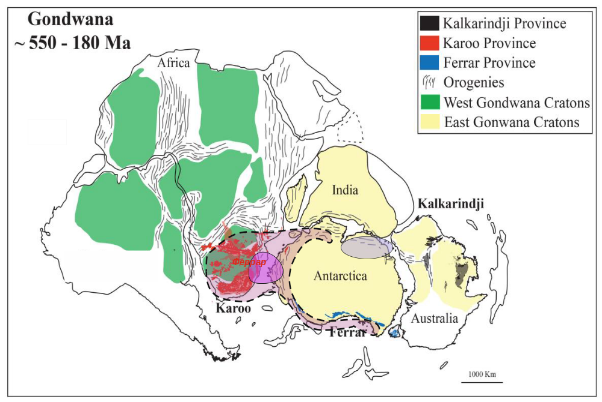
Reconstruction of Gondwana in the period of 500-180 Ma (after Gray et al., 2008 with changes and additions) and the evolution of Mesozoic mantle plumes
Kerguelen-plume
plume center
Karoo– plume

Slide 20
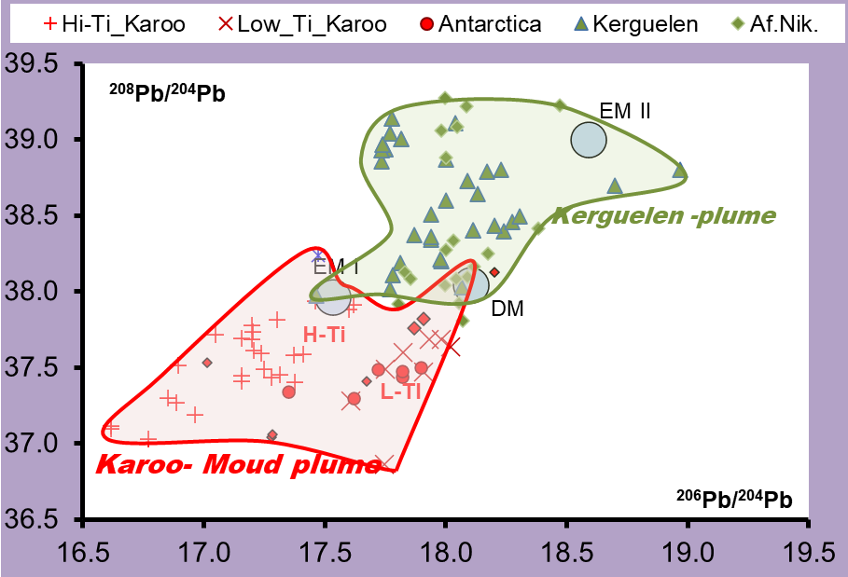
Isotopic characteristics of the magmas of different genesis associated with the Karoo-Maud and Kerguelen plumes (Jetty, Antarctica; Banbury, West Australia) and the oceanic plateaus in the Indian ocean (Af.Nikitin, Naturalist, Kerguelen Islands)
For all magmas associated with Karoo and Kerguelen plumes, the main source of melt enrichment is a mantle source with characteristics of the EM-II component
A rarer admixture of the ancient lithospheric component (EM-I, with ²⁰⁶Pb/²⁰⁴Pb = 16.5 and ¹⁴³Nd/¹⁴⁴Nd = 0.5122) was revealed in both plumes.

Slide 21
CONCLUSIONS:
Karoo-Maud superplume is an example of deep plume, born at the border core-mantle. Its penetration into the upper layers of lithosphere caused disintegration of Gondwana and separation of Africa from Antarctica. Distribution of plume substance along the weakened zones of Gondwana to the south (province Ferrar in the Transantarctic Mountains) and to the east (from the west part of DML towards the Prince Charles Mountains) of the Antarctic reflects the possible deep dislocations of the plume which possibly took place at different levels of lithosphere and underlithospheric mantle. This can be explained by the long history of Karoo-Maud plume which started about 180 million years ago and its expansion to the east along collision zones of East Antarctic till the Jetty Oasis and further to the Indian Ocean where it is still alive as Kerguelen plume for about 110 Ma.
Flood basaltic magmatism related to the Karoo plume gained the wide distribution in the South Africa and eastern Antarctica. It can be considered as marking a unique plume activity in the Mesozoic time, which is reflected in the formation of spatially separated high- and low-Ti magma types, and the confinement of the high-Ti magmas to the central part of the plume.
The geochemical study of ferropicrites of the central part of the plume (the Almannryggen massif) showed that the melts derived from a pyroxenite source of the Karoo plume differ in a relatively smoothed lithophile element pattern and have low ²⁰⁶Pb/²⁰⁴Pb: 17.33–17.37 and moderately radiogenic Nd compositions ¹⁴³Nd/¹⁴⁴Nd: 0.51249–0.51259, which indicate a relative old age of the pyroxenite component. The compositions of all high-Ti basalts point to the admixture of this source, but its proportion could vary significantly.

Slide 22
The geochemical characteristics of magmas from DML, Ferrar, Karoo, connected with Karoo plume activity indicate crustal contamination. The magmatism of the Ferrar Province was formed during the melting of the metasomatically altered Gondwana mantle near the subduction zone surrounding the southern part of Gondwana, which was quite active during the influence of the Karoo – Maud plume. This led to the enrichment of the primary melts in U, Th, Rb, and Pb, elements from a mantle source metasomatically altered under the action of the mantle fluid with the formation of an extended trend in the coordinates of isotopic ratios, which differs from insignificant variations in the isotopic ratios of 143Nd/144Nd, 87Sr/86Sr, 206Pb/204Pb , 207Pb/204Pb, 208Pb/204Pb for primary melts of Mesozoic magmas of the Karoo provinces and Queen Maud Land.
The magmatism that occurred 40 Ma after the main phase of the Karoo volcanism at the margins of the adjoining continents of Australia (Bunbury basalts) and India (Rajmahal traps) could be initiated by the Karoo–Maud plume, which propagated along the developing spreading zone and subsequently moved toward the Kerguelen Plateau, where it occurs currently as an active hotspot.
A peculiar feature of the opening of the Indian Ocean, which was triggered by the influence of the Karoo–Maud plume, is that it occurred in the presence of nonspreading blocks of varying thickness, such as the Elan Bank in the central part of the Kerguelen Plateau, and was accompanied by the formation of intraplate volcanic rises, which were detected in the seafloor relief around Antarctica. The geochemical characteristics of the resulting rises (Afanasy Nikitin, Kerguelen, Naturaliste, and Ninetyeast Ridge) were affected by crustal assimilation processes. The identical geochemical characteristics of the Mesozoic magmas of the lavas of the Af.Nikitin Rise, and the rocks of the central Kerguelen Plateau suggest that the enrichment of all these magmas was related to the old continental rocks of Gondwana.

Slide 23
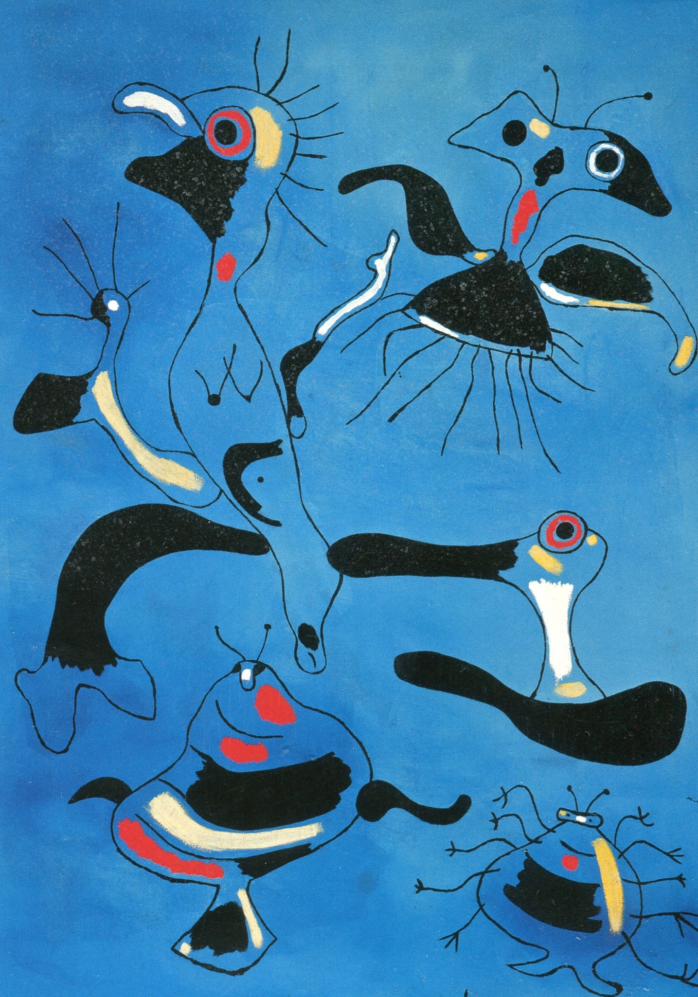
Thanks for attention
Thanks for attention

