Slide 1

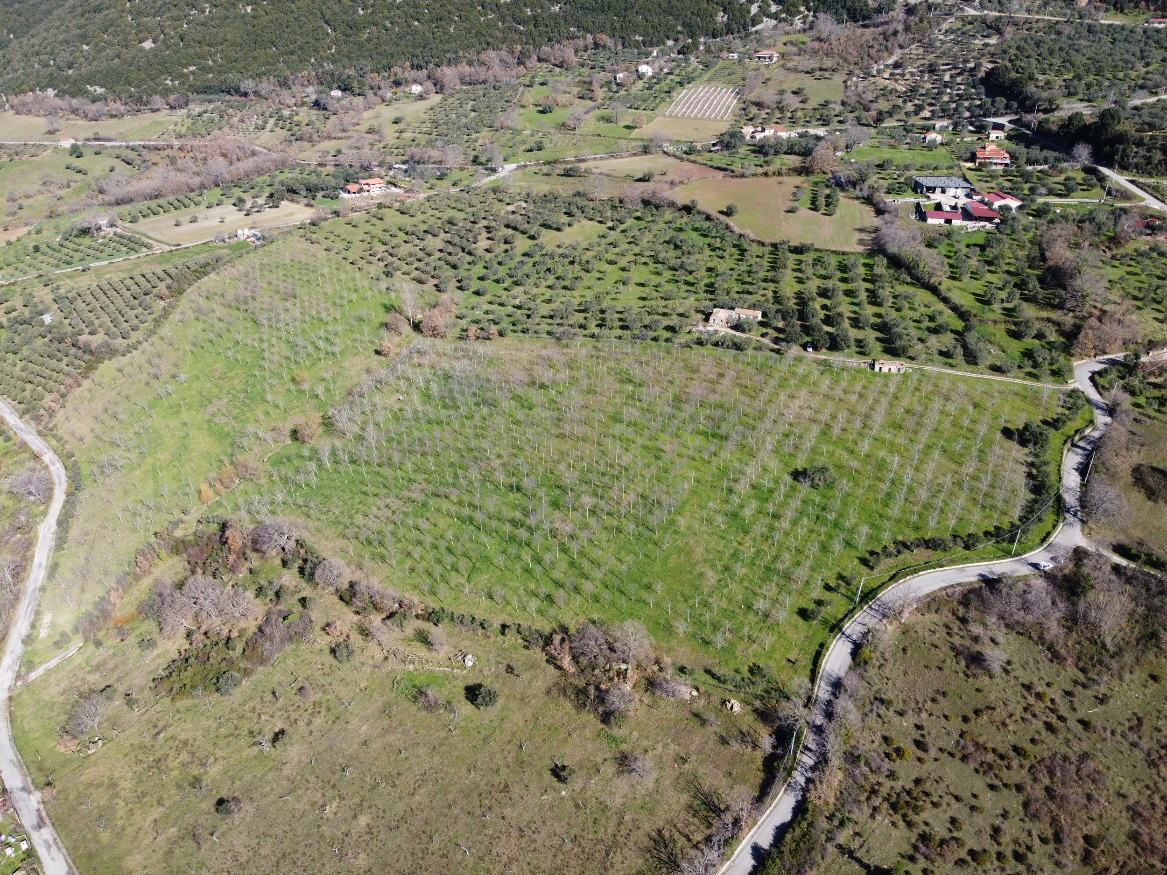
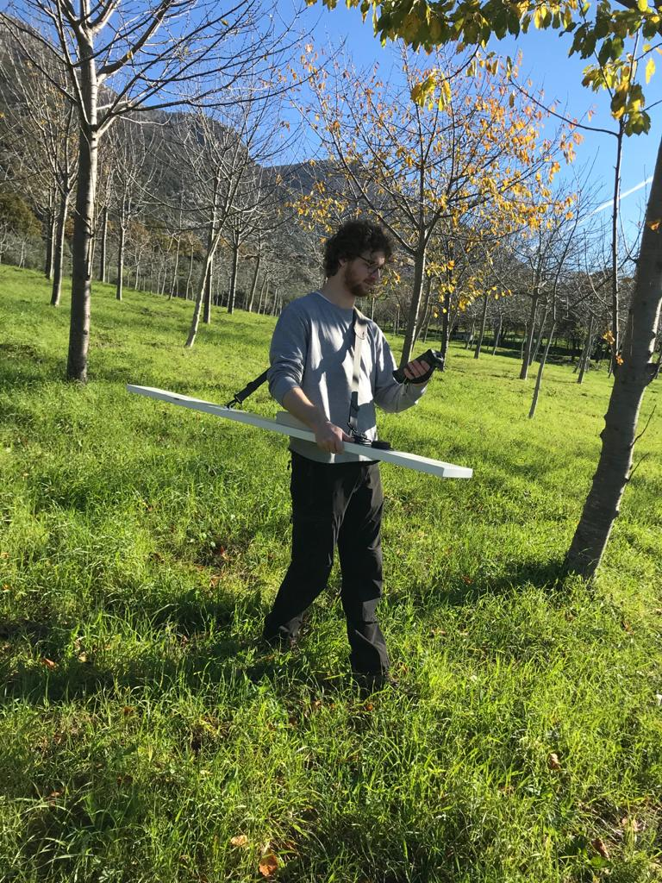
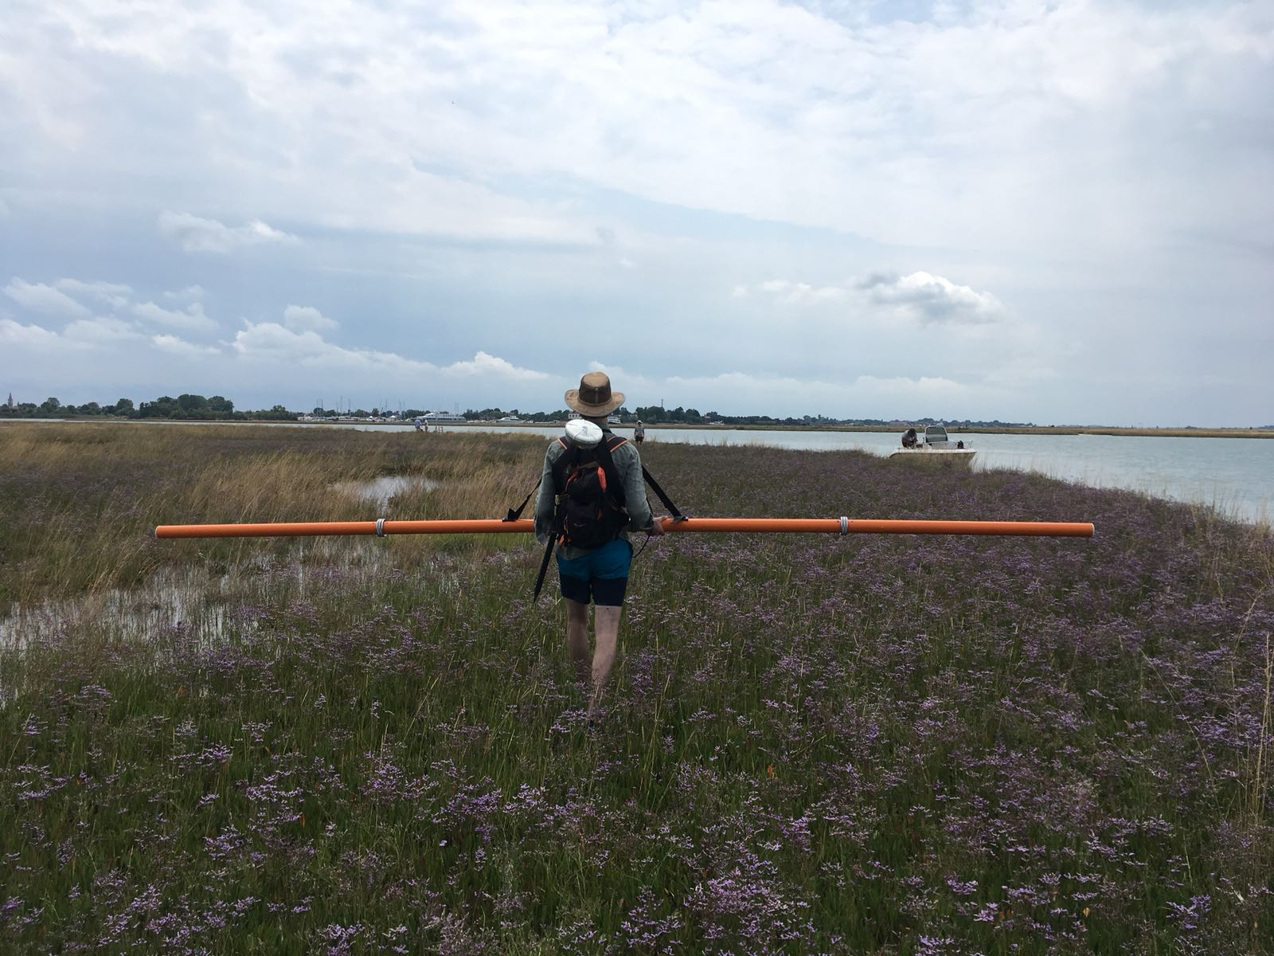
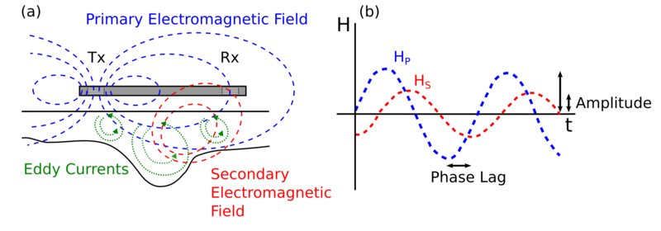






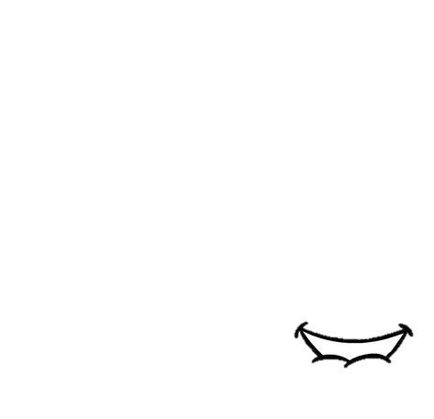

EMI characterization in mountain catchments:
multi-frequency versus multi-coil inversion using EMagPy
Guillaume Blanchy, Paul McLachlan, Matteo Censini, Jacopo Boaga, Andrew Binley and Giorgio Cassiani
(left): the Alento catchment in Southern Italy where we want to understand the hydrological behavior of the subsurface.
(right): the GEM-2 multi-frequency instrument and the CMD Explorer multi-coil instrument.
GEM-2
Explorer
(left): schematic showing the Internal working of EMI instruments. (a) shows the transmitter coil (Tx) emitting a primary electromagnetic field. This field induces eddy currents in the ground which in turn generate a secondary electromagnetic field. Both primary and secondary electromagnetic fields are measured by the receiver coil (Rx). (b) Given the amplitude ratio and the phase shift between the primary and secondary fields, knowledge about the subsurface electrical properties can be determined.
McLachlan et al. (2021)

Slide 2
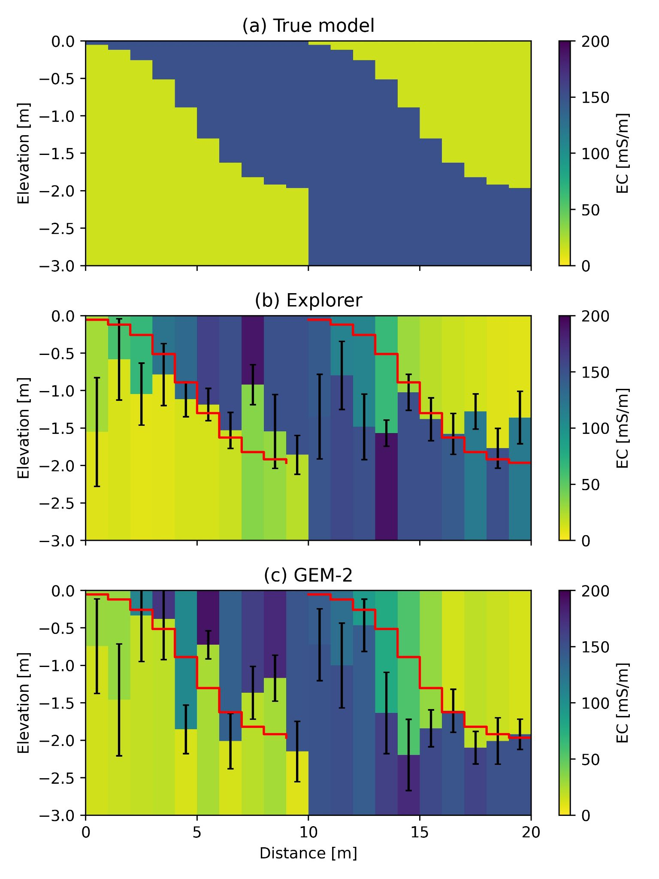
EMI characterization in mountain catchments:
multi-frequency versus multi-coil inversion using EMagPy
Guillaume Blanchy, Paul McLachlan, Matteo Censini, Jacopo Boaga, Andrew Binley and Giorgio Cassiani
How much information can be recovered with both instruments?
To assess this, a synthetic study was conducted.
The table below shows coil specifications of both devices. EMagPy requires this information to predict the response of a given distribution of ground conductivities.
(a) synthetic data were generated for a three-layer model with low EC (15 mS/m) and high EC (150 mS/m) values for both device specifications.
2% Gaussian noise was then added to the synthetic data.
(b) and (c) show recovered structure after inversion (ROPE solver, L2 regularization). The red lines represent the true boundaries between the layers. The error bars represent the standard deviation of the distribution of the 10% best realizations.
Both devices recover the interface to similar accuracies.
Explorer | GEM-2
VCP1.48f10000h1 | HCP1.66f425h1
VCP2.82f10000h1 | HCP1.66f1525h1
VCP4.49f10000h1 | HCP1.66f5325h1
HCP1.48f10000h1 | HCP1.66f18325h1
HCP2.82f10000h1 | HCP1.66f63025h1
HCP4.49f10000h1 | HCP1.66f92775h1

Slide 3
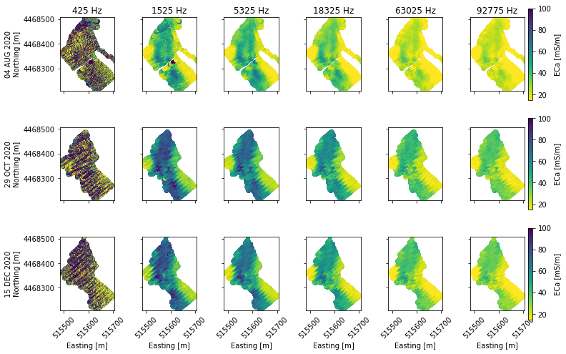
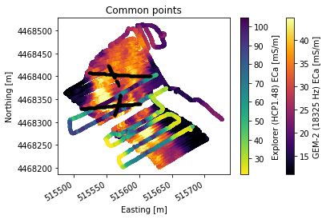
EMI characterization in mountain catchments:
multi-frequency versus multi-coil inversion using EMagPy
Guillaume Blanchy, Paul McLachlan, Matteo Censini, Jacopo Boaga, Andrew Binley and Giorgio Cassiani
What about field data?
(above) surveys with the GEM-2 show spatially consistent patterns, and an increasing conductivity with depth (lower frequencies image to deeper depths).
The lowest frequency, however, is relatively noisy, consequently it was not used for inversion.
(left) Explorer were also collected done in the same catchment. Using co-located transects allows for direct comparison between both instruments.
Four electrical resistivity transects were also collected in this area (black dots).

Slide 4
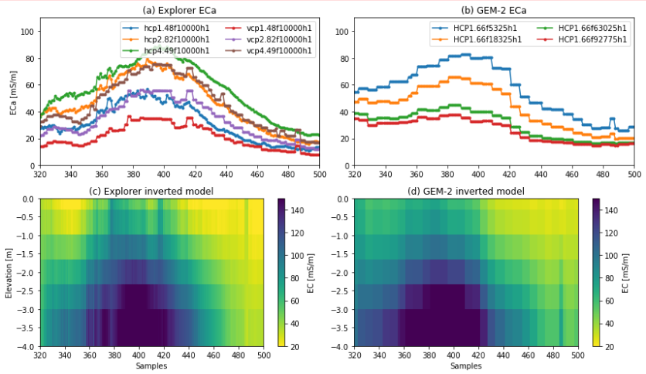
EMI characterization in mountain catchments:
multi-frequency versus multi-coil inversion using EMagPy
Guillaume Blanchy, Paul McLachlan, Matteo Censini, Jacopo Boaga, Andrew Binley and Giorgio Cassiani
How to compare?
ECa values cannot be compared directly as the coil configuration have different sensitivity patterns and hence different ECa values (a and b).
However, when data along the same 50 m transect is inverted on the same grid, the resultant inverted models show agreeable patterns (c and d).
For instance they have similar structure (a resistor on top of conductor).

Slide 5
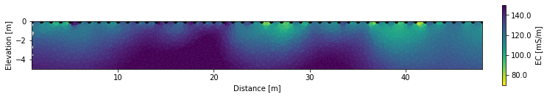

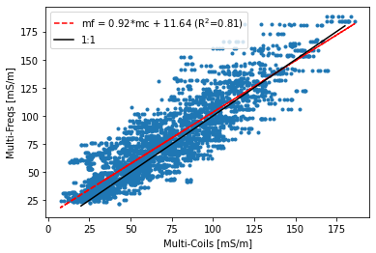
EMI characterization in mountain catchments:
multi-frequency versus multi-coil inversion using EMagPy
Guillaume Blanchy, Paul McLachlan, Matteo Censini, Jacopo Boaga, Andrew Binley and Giorgio Cassiani
(left) In the ERT transect taken not far from the EMI transects common points, we can see that the same structure (resistor on top of conductors) is resolved.
ERT was inverted using EMagPy’s sister code, ResIPy.
Blanchy et al. (2020)
(left) the electrical conductivities from each cell of the inversion results, for both instruments, from both instruments, fall near to te 1:1 line and show a high degree of correlation (R2 = 0.81).

Slide 6
EMI characterization in mountain catchments:
multi-frequency versus multi-coil inversion using EMagPy
Guillaume Blanchy, Paul McLachlan, Matteo Censini, Jacopo Boaga, Andrew Binley and Giorgio Cassiani
Conclusions
This work has demonstrated that more portable multi-frequency devices can offer a similar level of subsurface characterization as multi-coil devices.
These findings are also valuable with relation to miniaturization of devices for UAV based imaging. For instance, the 4 kg weight is manageable by a number of commercially available devices.
GEM-2
Explorer

Slide 7
EMI characterization in mountain catchments:
multi-frequency versus multi-coil inversion using EMagPy
Guillaume Blanchy, Paul McLachlan, Matteo Censini, Jacopo Boaga, Andrew Binley and Giorgio Cassiani
Future work for comparing devices
Additional work will seek to compare the performance of these devices in other environments.
This will included assessing the stability and errors of both instruments.
Further work for the Alento catchment
(left): temporally distributed GEM-2 surveys indicate increasing conductivity from August 2020 through to December 2020. These changes are associated with increasing moisture content.
Time-lapse inversions will be conducted with EMagPy and compared to geological, hydrological and meteorological data from the site.

