Slide 1

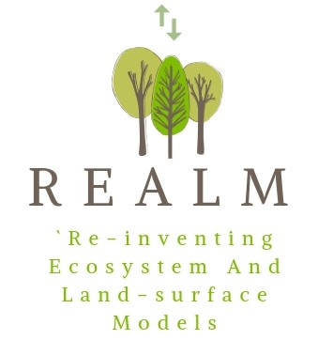

Common environmental dependencies of GPP
EGU21-BG3.7
Inter-model comparisons
Keith J. Bloomfield, Benjamin D. Stocker, Trevor F. Keenan, I. Colin Prentice

Slide 2
Introduction
Environmental dependencies of GPP
We hope to provide an empirical demonstration that gross primary production (GPP) is predictable using a single model structure.
We control for light conditions by adopting light use efficiency (LUE) as our response.
Methods
  Daily GPP estimates provided by FLUXNET
  Normalised for absorbed light (PPFD * MODIS_EVI)
  Soil moisture interpolated using SPLASH_SoilGrids
  Growing season
  15-day periods
Notes:
LUE = GPP / I_{abs}
Absorbed light (I_{abs}) is the photosynthetic photon flux density multiplied by an index of vegetation cover – the index is bound between zero (bare soil) and unity (complete canopy cover).

Slide 3
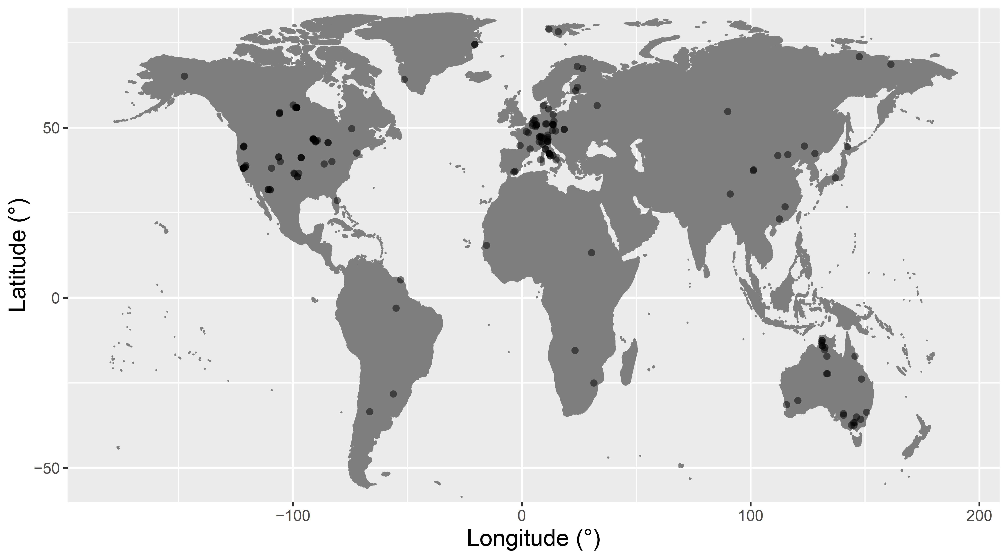
Global scale: 117 FLUXNET sites
Environmental dependencies of GPP
Notes:
The dataset spans 9 vegetation classes (IGBP land cover classification system) and 16 Köppen-Geiger climate zones.
Key exclusions: C4 metabolism, croplands

Slide 4
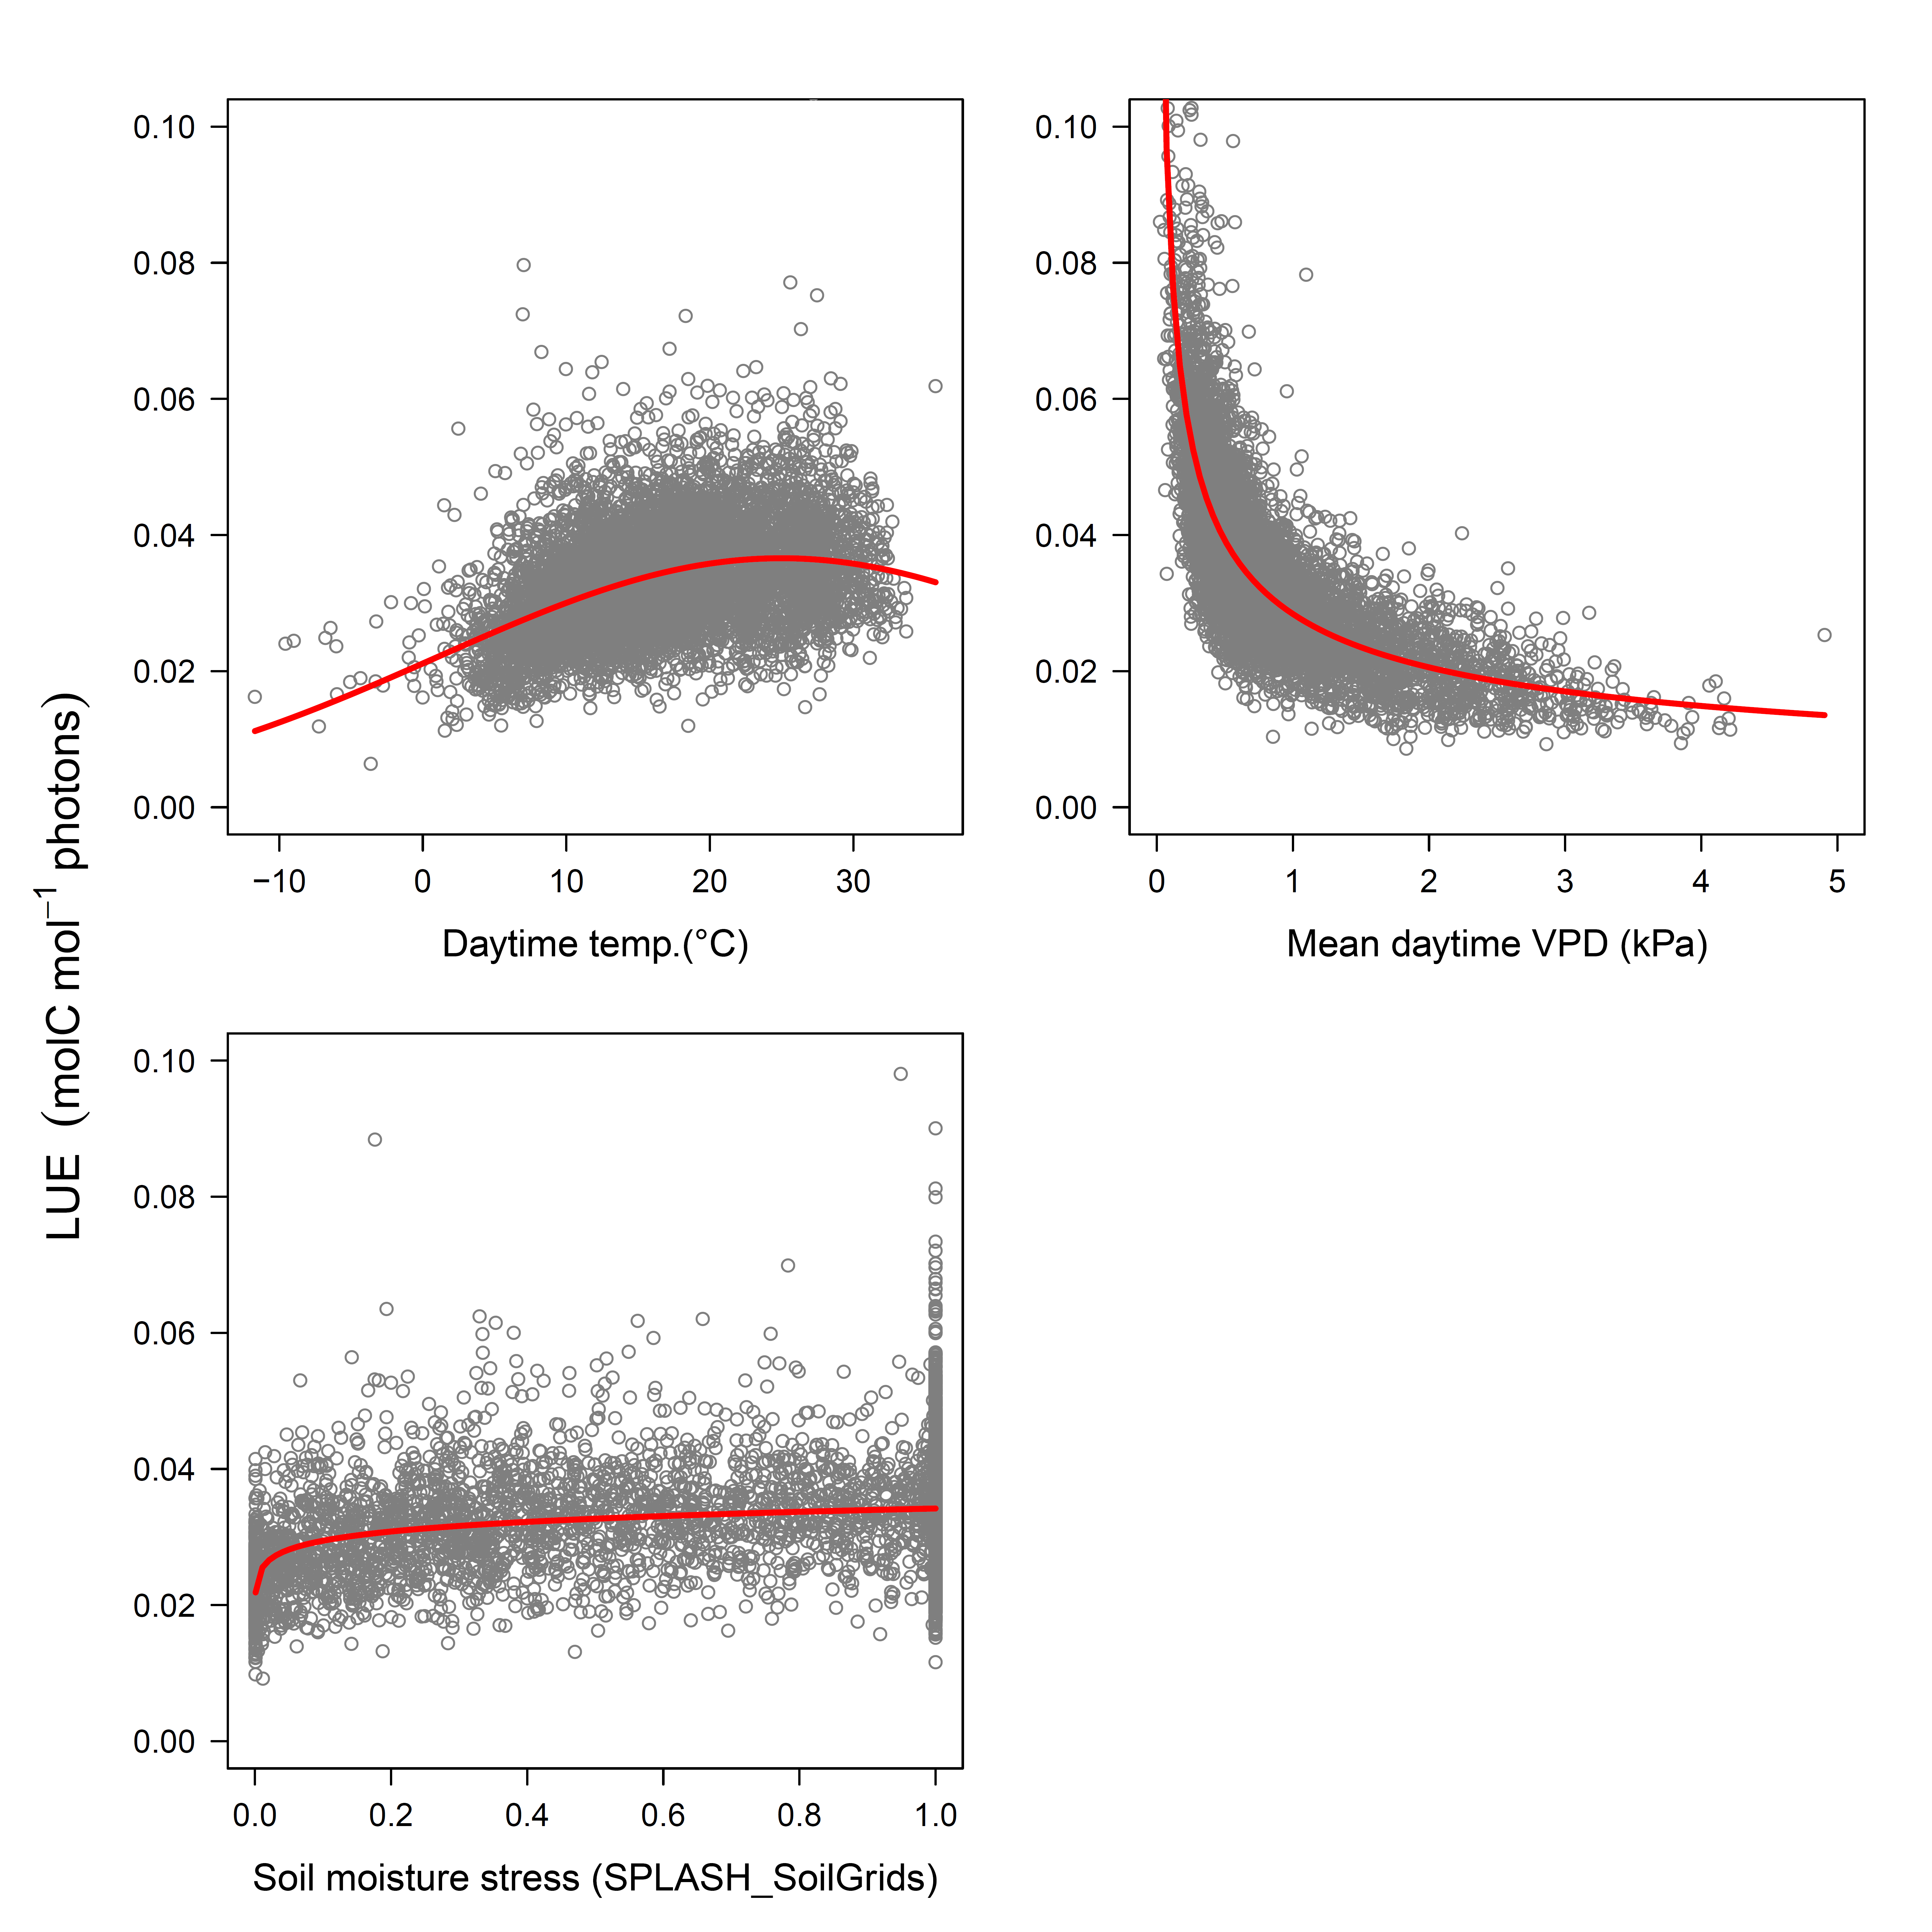
A parsimonious model of LUE
Environmental dependencies of GPP
A generalised linear mixed model: family = Gamma (link = log)
Fixed term:
  Air temperature;
  Vapour pressure deficit;
  Soil moisture.
Random term:
  Year nested in Site
Notes:
The figure shows plots of partial residuals for each of the explanatory terms in the model’s fixed term. The partial residuals visualise the effect of a given variable on LUE, conditional upon holding other model terms at median value.

Slide 5
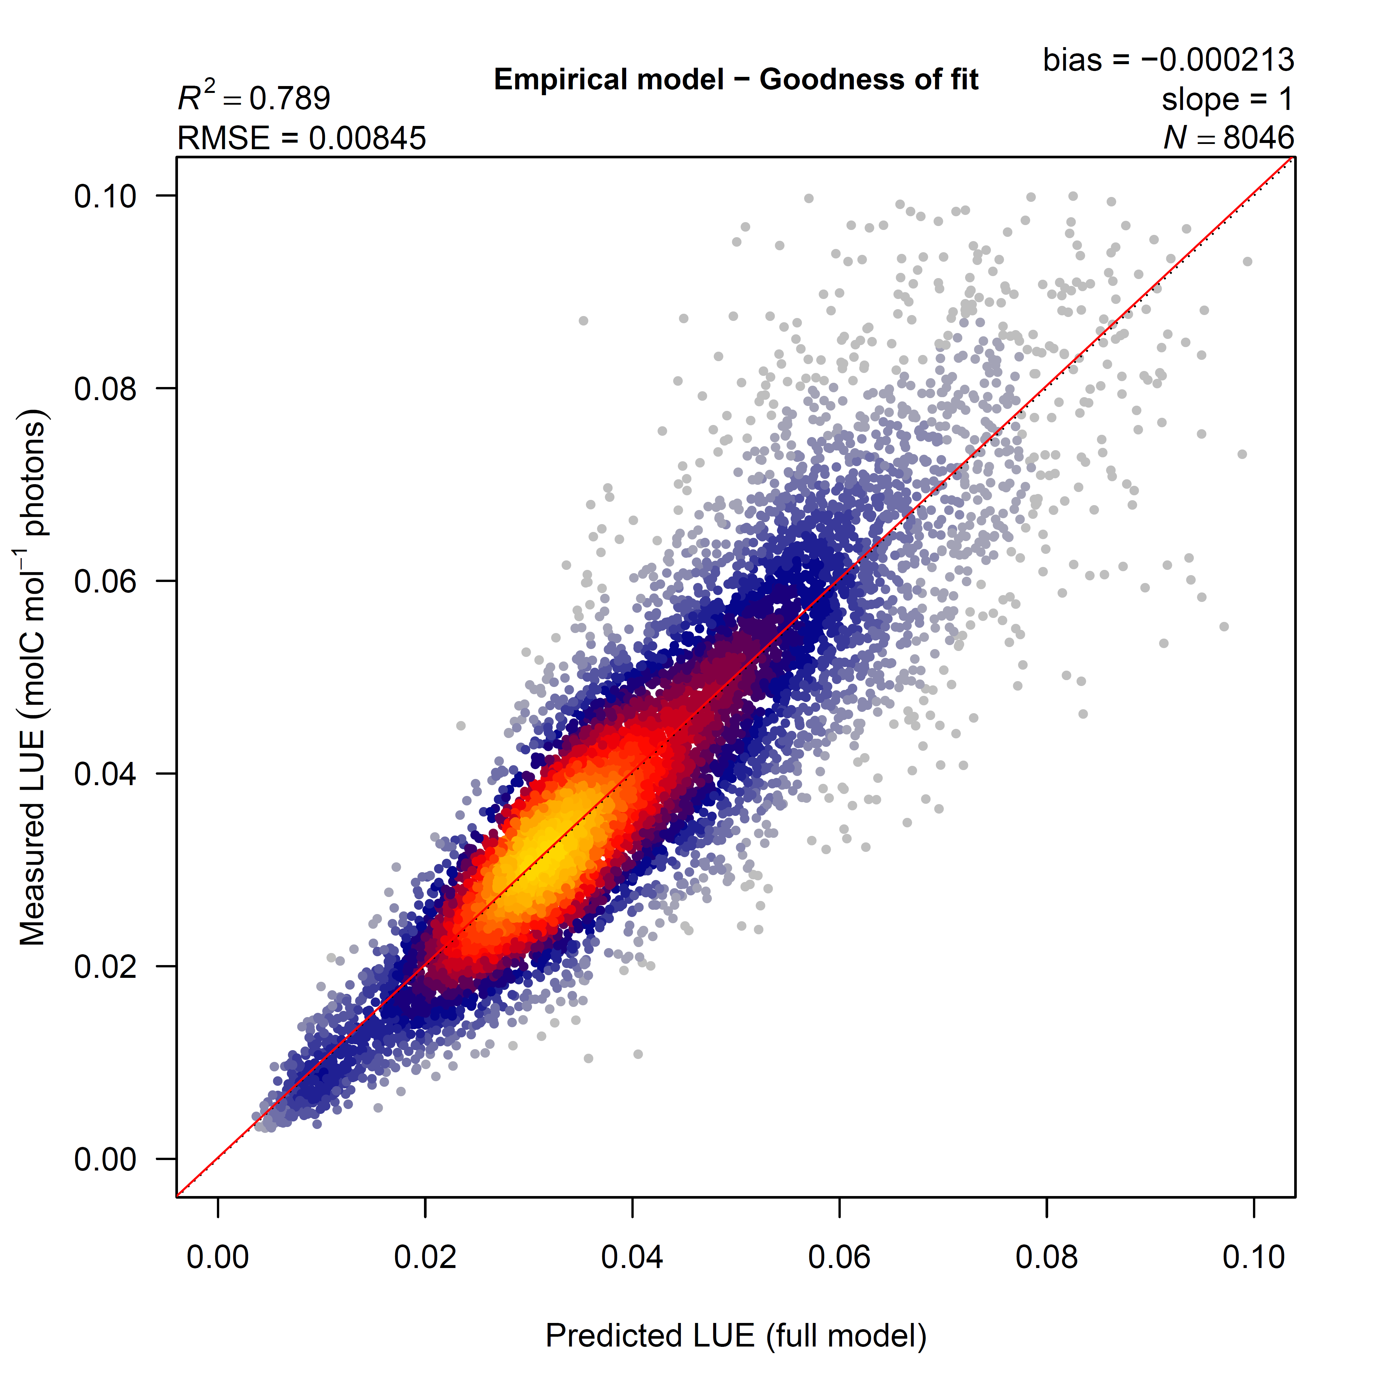
Model evaluation
Environmental dependencies of GPP
Notice the absence of bias
A cross-validation exercise (site-sequential model iterations), that necessarily ignores the random site effect, provides an R² of 0.31
Notes:
Each point represents a 15-day average for a given Site_Year.
Axes have been clipped to exclude a handful of extreme ratios.

Slide 6
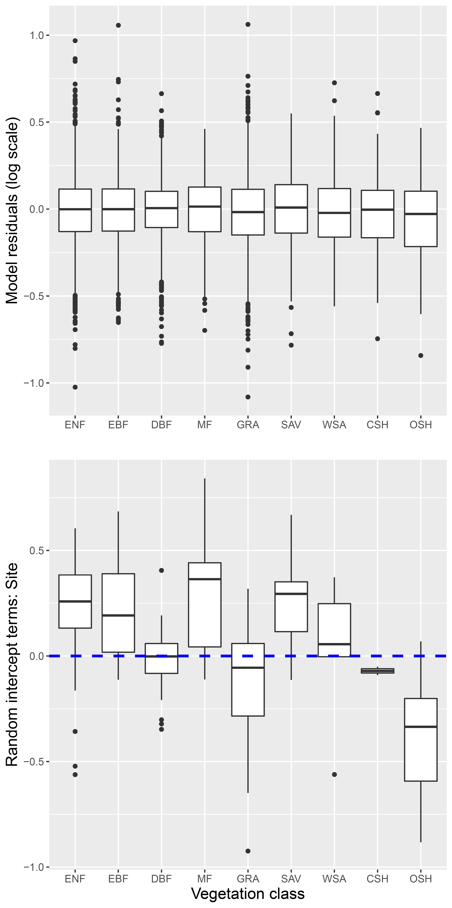
Independent of vegetation class
Environmental dependencies of GPP
Top: model residuals are well-behaved across the different vegetation classes.
Bottom: random site intercept terms from the GLMM
  Do shrub and grasslands sites (CSH, OSH, GRA) share characteristics not described by temperature, vapour pressure deficit and soil moisture?
Notes:
Vegetation classes (IGBP) are arranged by order of descending prevalence within the dataset

Slide 7
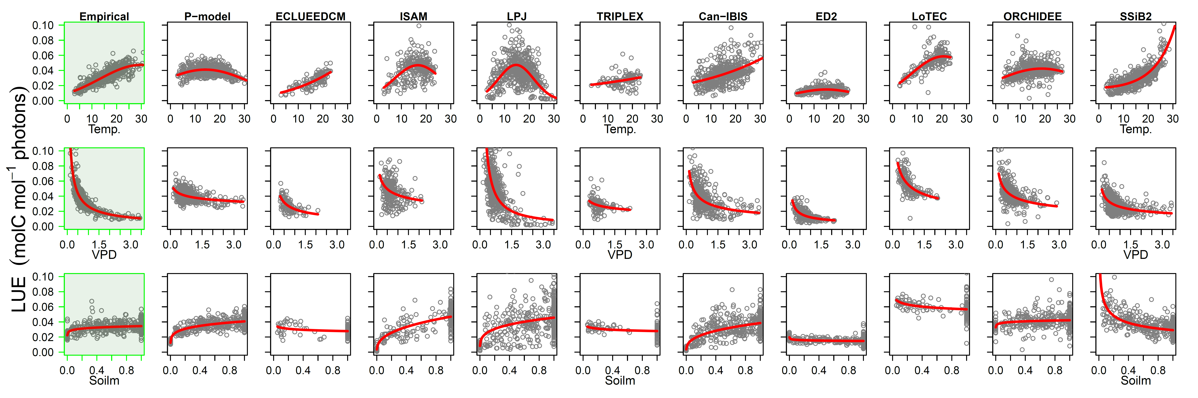
Inter-model comparisons: with site-based estimates of GPP compiled by the North American Carbon Program using common, eddy covariance data
Environmental dependencies of GPP
Notes:
The panel compares the relationships between GPP and our three environmental variables as estimated by our preferred empirical model (left-hand column) the P-model (Stocker et al. 2020) and nine of the Terrestrial Biome Models contributing to the NACP. [A companion plot, not included here, shows these same relationships for a further ten TBMs from the NACP suite.]
Not all TBMs generated estimates of GPP for every site or year.
Apart from the left-most column, the LUE (GPP) values are predictions generated by the participating TBMs using the common flux-site forcing data.
The points shown are partial residuals as in Slide 4 (above).

Slide 8
Key references
Environmental dependencies of GPP
Falge, E. et al. (2016) FLUXNET Research Network Site Characteristics, Investigators, and Bibliography, https://doi.org/10.3334/ornldaac/1530.
Law, B.E., et al. (2002). Environmental controls over carbon dioxide and water vapor exchange of terrestrial vegetation. Agricultural and Forest Meteorology 113(1-4): 97-120.
Reichstein, M., et al. (2005). "On the separation of net ecosystem exchange into assimilation and ecosystem respiration: review and improved algorithm." Global Change Biology 11(9): 1424-1439.
Ricciuto, D. M., et al. (2013). NACP Site: Terrestrial Biosphere Model and aggregated flux data in standard format. ORNL Distributed Active Archive Center.
Stocker, B. D., et al. (2020). "P-model v1.0: an optimality-based light use efficiency model for simulating ecosystem gross primary production." Geoscientific Model Development 13(3): 1545-1581.

