Slide 1
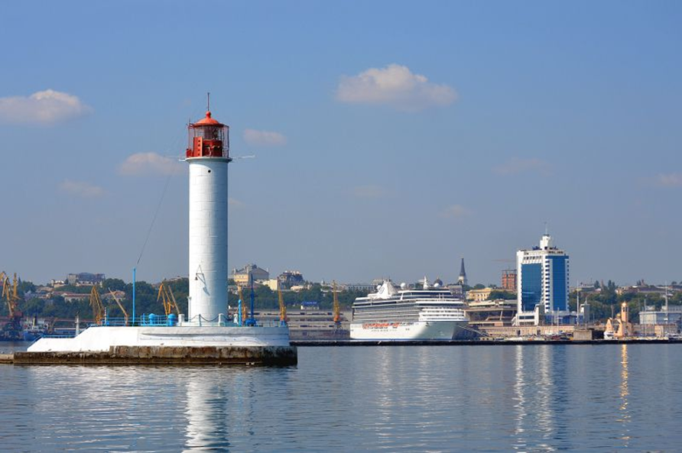
Coastal zone dynamics - as a result of changes at the border of three environments
O.R. Andrianova, A.A. Batyrev,
R.R. Belevich,
M.I. Skipa
The State Institution “Hydroacoustic Branch of Institute of Geophysics
of NAS of Ukraine”, Odesa, Ukraine

Slide 2
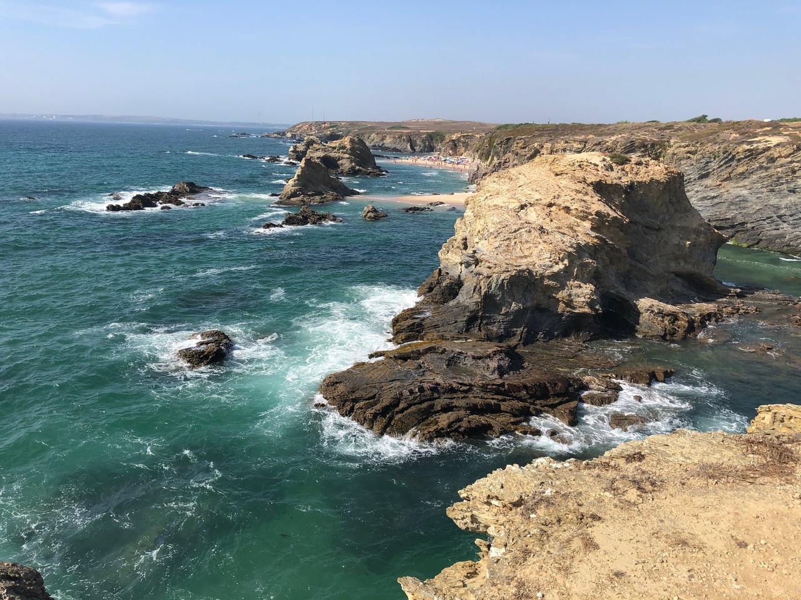
Coastal areas – are natural contact zones of interaction of three environments:
geological – land and the bottom of the seas and oceans
hydrological – the water layer of the seas and oceans
meteorological – the air with atmospheric impact
The aim of this research: to study and estimate the dynamics of land on the coast of the western part of the Black Sea in connection with the impact of climate change, as well as to analyze the contribution of different factors for optimizing wildlife and comfortable people living.

Slide 3
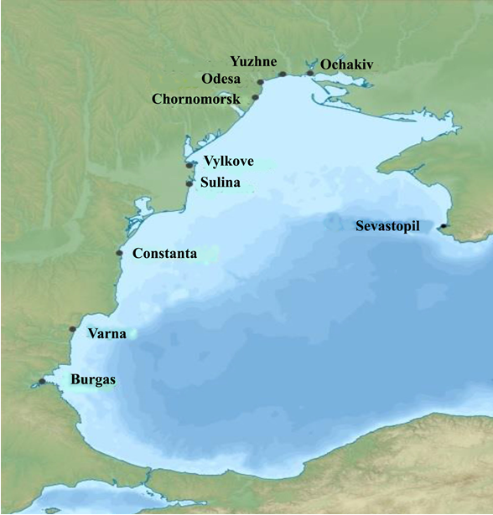
Fig. 1 - Map of the coast of the western part of the Black Sea indicating the stations considered

Slide 4
٭ Note: annual precipitation, annual runoff of the Danube and Dnieper
Table 1 - Information about hydrometeorological characteristics and its annual climatic norms
Point of observation | Characteristics | Unit of measurement | Years | Annual
Odesa | Air temperature | ºС | 1894 – 2017 гг. | 10,29
 | Air temperature | ºС | 1947 – 2017 гг. | 10,56
Odesa | Precipitation | mm / mon | 1900 – 2017 гг. | 415,7٭
 | Precipitation | mm / mon | 1947 – 2017 гг. | 450,0٭
Odesa | Water temperature | ºС | 1950 – 2017 гг. | 11,27
Odesa | Salinity | ‰ | 1948 – 2017 гг. | 14,45
Odesa | Sea level | cm | 1875 – 2017 гг. | 469,0
 | Sea level | cm | 1947 – 2017 гг. | 484,0
Danube (Reni) | Flow rates | km³ / year | 1860 – 2015 гг. | 213,2٭
 |  | km³ / year | 1947 – 2015 гг. | 234,5٭
Dnieper (Nova Kakhovka) | Flow rates | km³ / year | 1851 – 2000 гг. | 50,5٭
 |  | km³ / year | 1947 – 2000 гг. | 50,6٭

Slide 5
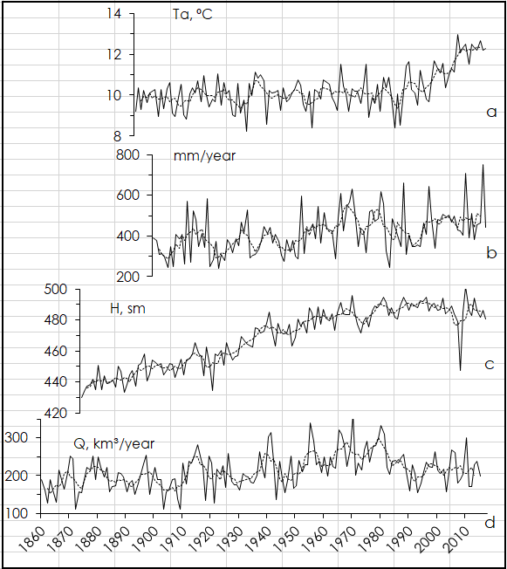
Fig. 2 - Time series of annual mean (solid line) and moving average by 5-year (dashed line) values of air temperature (a), precipitation (b), sea level height in Odesa (c) and flow rates of the Danube river (d).

Slide 6
Fig. 3 - Time series of annual mean (1) and moving average by 5-year data (2)
A - sea level heights; B - calculated values of land subsidence at stations of the Black Sea
a - Sevastopil;
b - Ochakiv;
c - Yuzhne;
d - Odesa;
e - Chornomorsk;
f - Vylkovo;
g - Sulina;
h - Constante;
i - Varna;
j - Burgas
A
B

Slide 7
Table 2 - Information about the stations on the Black Sea coast and averaged over the observation period the values and rates of the land dynamics.
№ | Stations | Observation period, years | Series length, years | Values of land subsidence, cm per whole period | Rates of land subsidence, cm/year | Rates of land subsidence by trends, cm/year
1 | Sevastopil | 1875-2015 | 141 | – | – | –
2 | Ochakiv | 1874-2015 | 142 | –1 | –0,0766 | –0,074
3 | Yuzhne | 1977-2015 | 39 | –14 | –0,36 | –0,32
4 | Odesa | 1875-2015 | 141 | –50 | –0,3546 | –0,3554
5 | Chornomorsk | 1960-2015 | 56 | –7 | –0,127 | –0,076
6 | Vylkove | 1945-2015 | 71 | –32 | –0,44 | –0,18
7 | Sulina | 1900-2015 | 116 | –24 | –0,21 | –0,16
8 | Constanta | 1933-2015 | 83 | –15 | –0,169 | –0,121
9 | Varna | 1928-2015 | 88 | –68 | –0,77 | –0,769
10 | Burgas | 1928-2015 | 88 | –41 | –0,466 | –0,382

Slide 8
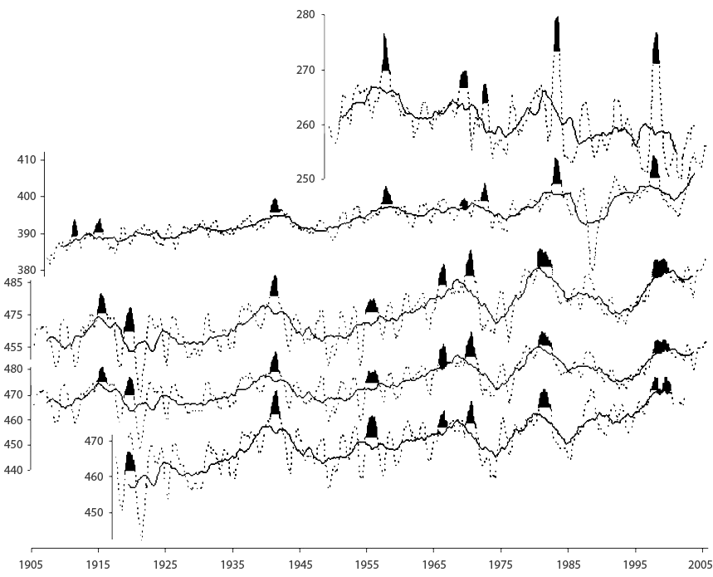
Fig. 4 - Time series of annual mean (solid line) and moving average by 5-year (dashed line) sea level height on stations: a – La Libertad (Pacific), b – Balboa (Pacific), c – Ochakiv (Black Sea), d – Sevastopol (Black Sea), e – Tuapse (Black Sea).
a
b
c
d
e

Slide 9
Conclusions
The growth of all parameters (water and air temperature, precipitation, river flow rates, and sea level) in recent decades is a general trend in fluctuations in hydrometeorological characteristics. At the same time, the salinity of the water decreases accordingly.
Uneven subsidence of coastal land is a consequence of the growth of the sea level - its mirror image. The dynamics of the land motions are the result of the action of level fluctuations and tectonic processes.
The remote displays of El Niño are one of the reasons for the observed surges in changes in the water and air environments.
The fluctuations in the Black Sea level are synchronous on low-frequency scales (their period is more than 5 years) because they are under the influence of global climate processes on our planet.
The short-term changes in the Black Sea level are determined by regional characteristics and are created by local factors.

Slide 10
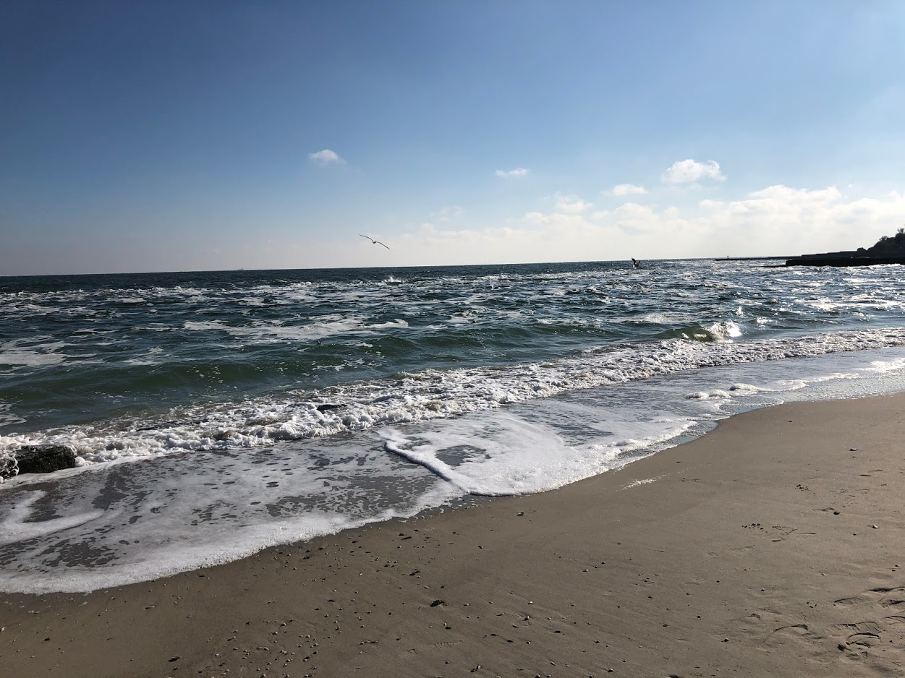
Thanks for attention !

