Slide 1

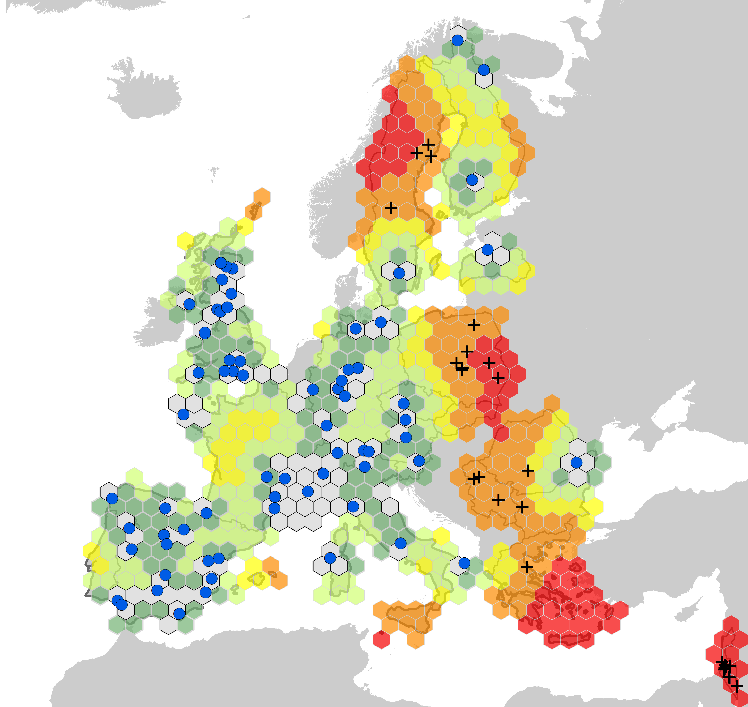
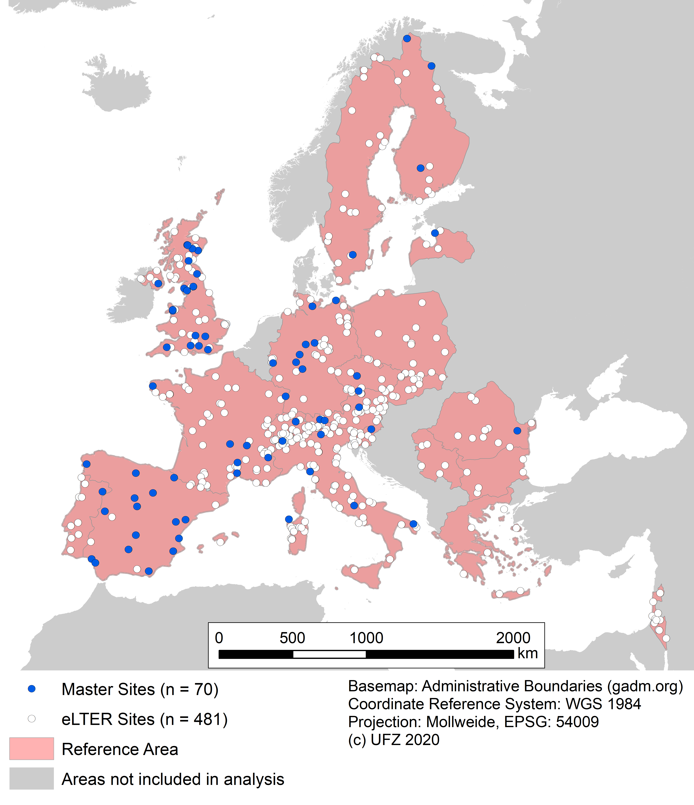
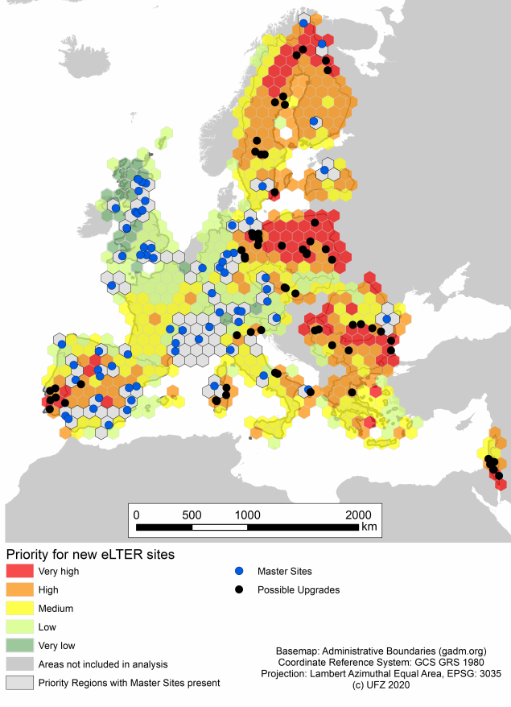
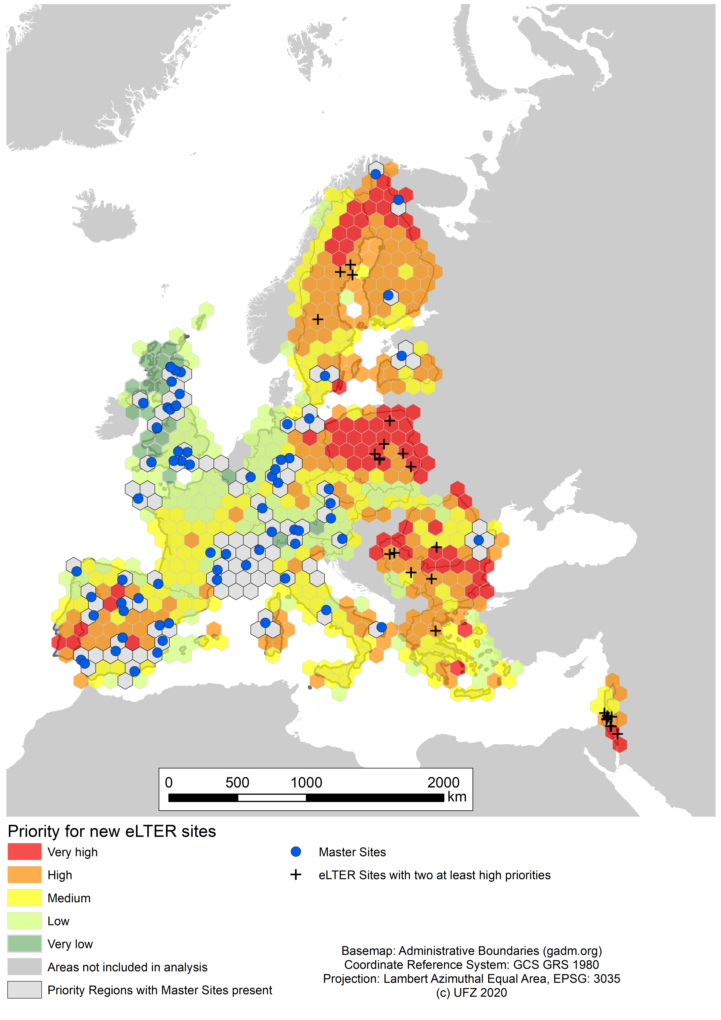


Designing the eLTER* Research Infrastructure
3b
Euclidean Priority
EGU General Assembly, 28.04.2021
1
2
3a
Priority Regions
Following Wohner et al. (In Review)
*eLTER data as of October 2020
Notes:
Building up on the work just presented by Christoph Wohner, we extended this approach. On this account, we looked at the European part of the ILTER network, eLTER. This is one of the most dense regional networks, and most importantly some infrastrucutre data for the individual sites exists. Sites with the necessary infrastrucutre to conduct holistic ecological research are called Master Sites, seen in the figure on the left as blue dots.
The goal was to get an understanding how these Master Sites are distributed and to identify the most suitable infrastructurel upgrades among all other eLTER sites, seen as white dots.
For this purpose we ran two different analyses. First, similar to what Christoph just introduced, we ran the representativity analysis with the same reference parameters, seen in Figure 2. The resulting priority regions are shown in figure 3a. We defined possible upgrades as sites lying in areas of high or very high priority. At this stage however we could identify a total of 72 possible upgrades, which are more sites than could realistically be upgraded.
So to more clearly define recommendations for sites to be upgraded we established a second analysis. This analysis is based on the euclidean distance to established Master Sites, and again the results were categorized into priority regions, as seen in figure 3b. Ultimately we combined the results of both analyses and identified sites that could be upgraded, defined as sites of at least high priority in both analyses. This left us with 26 sites arranged in ~7 clusters that are of highest priority to be upgraded, seen as black crosses in figure 3.
Concluding, the combination of biogeographical, socio-economical and ecological gradients and the spatial distribution of established sites of the network allowed to give clear recommendations for the development of the already fairly dense eLTER network.

Slide 2
Designing the eLTER Research Infrastructure
Representativity, priority regions and recommendations for development
Speaker Thomas Ohnemus
22.03.2021

Slide 3

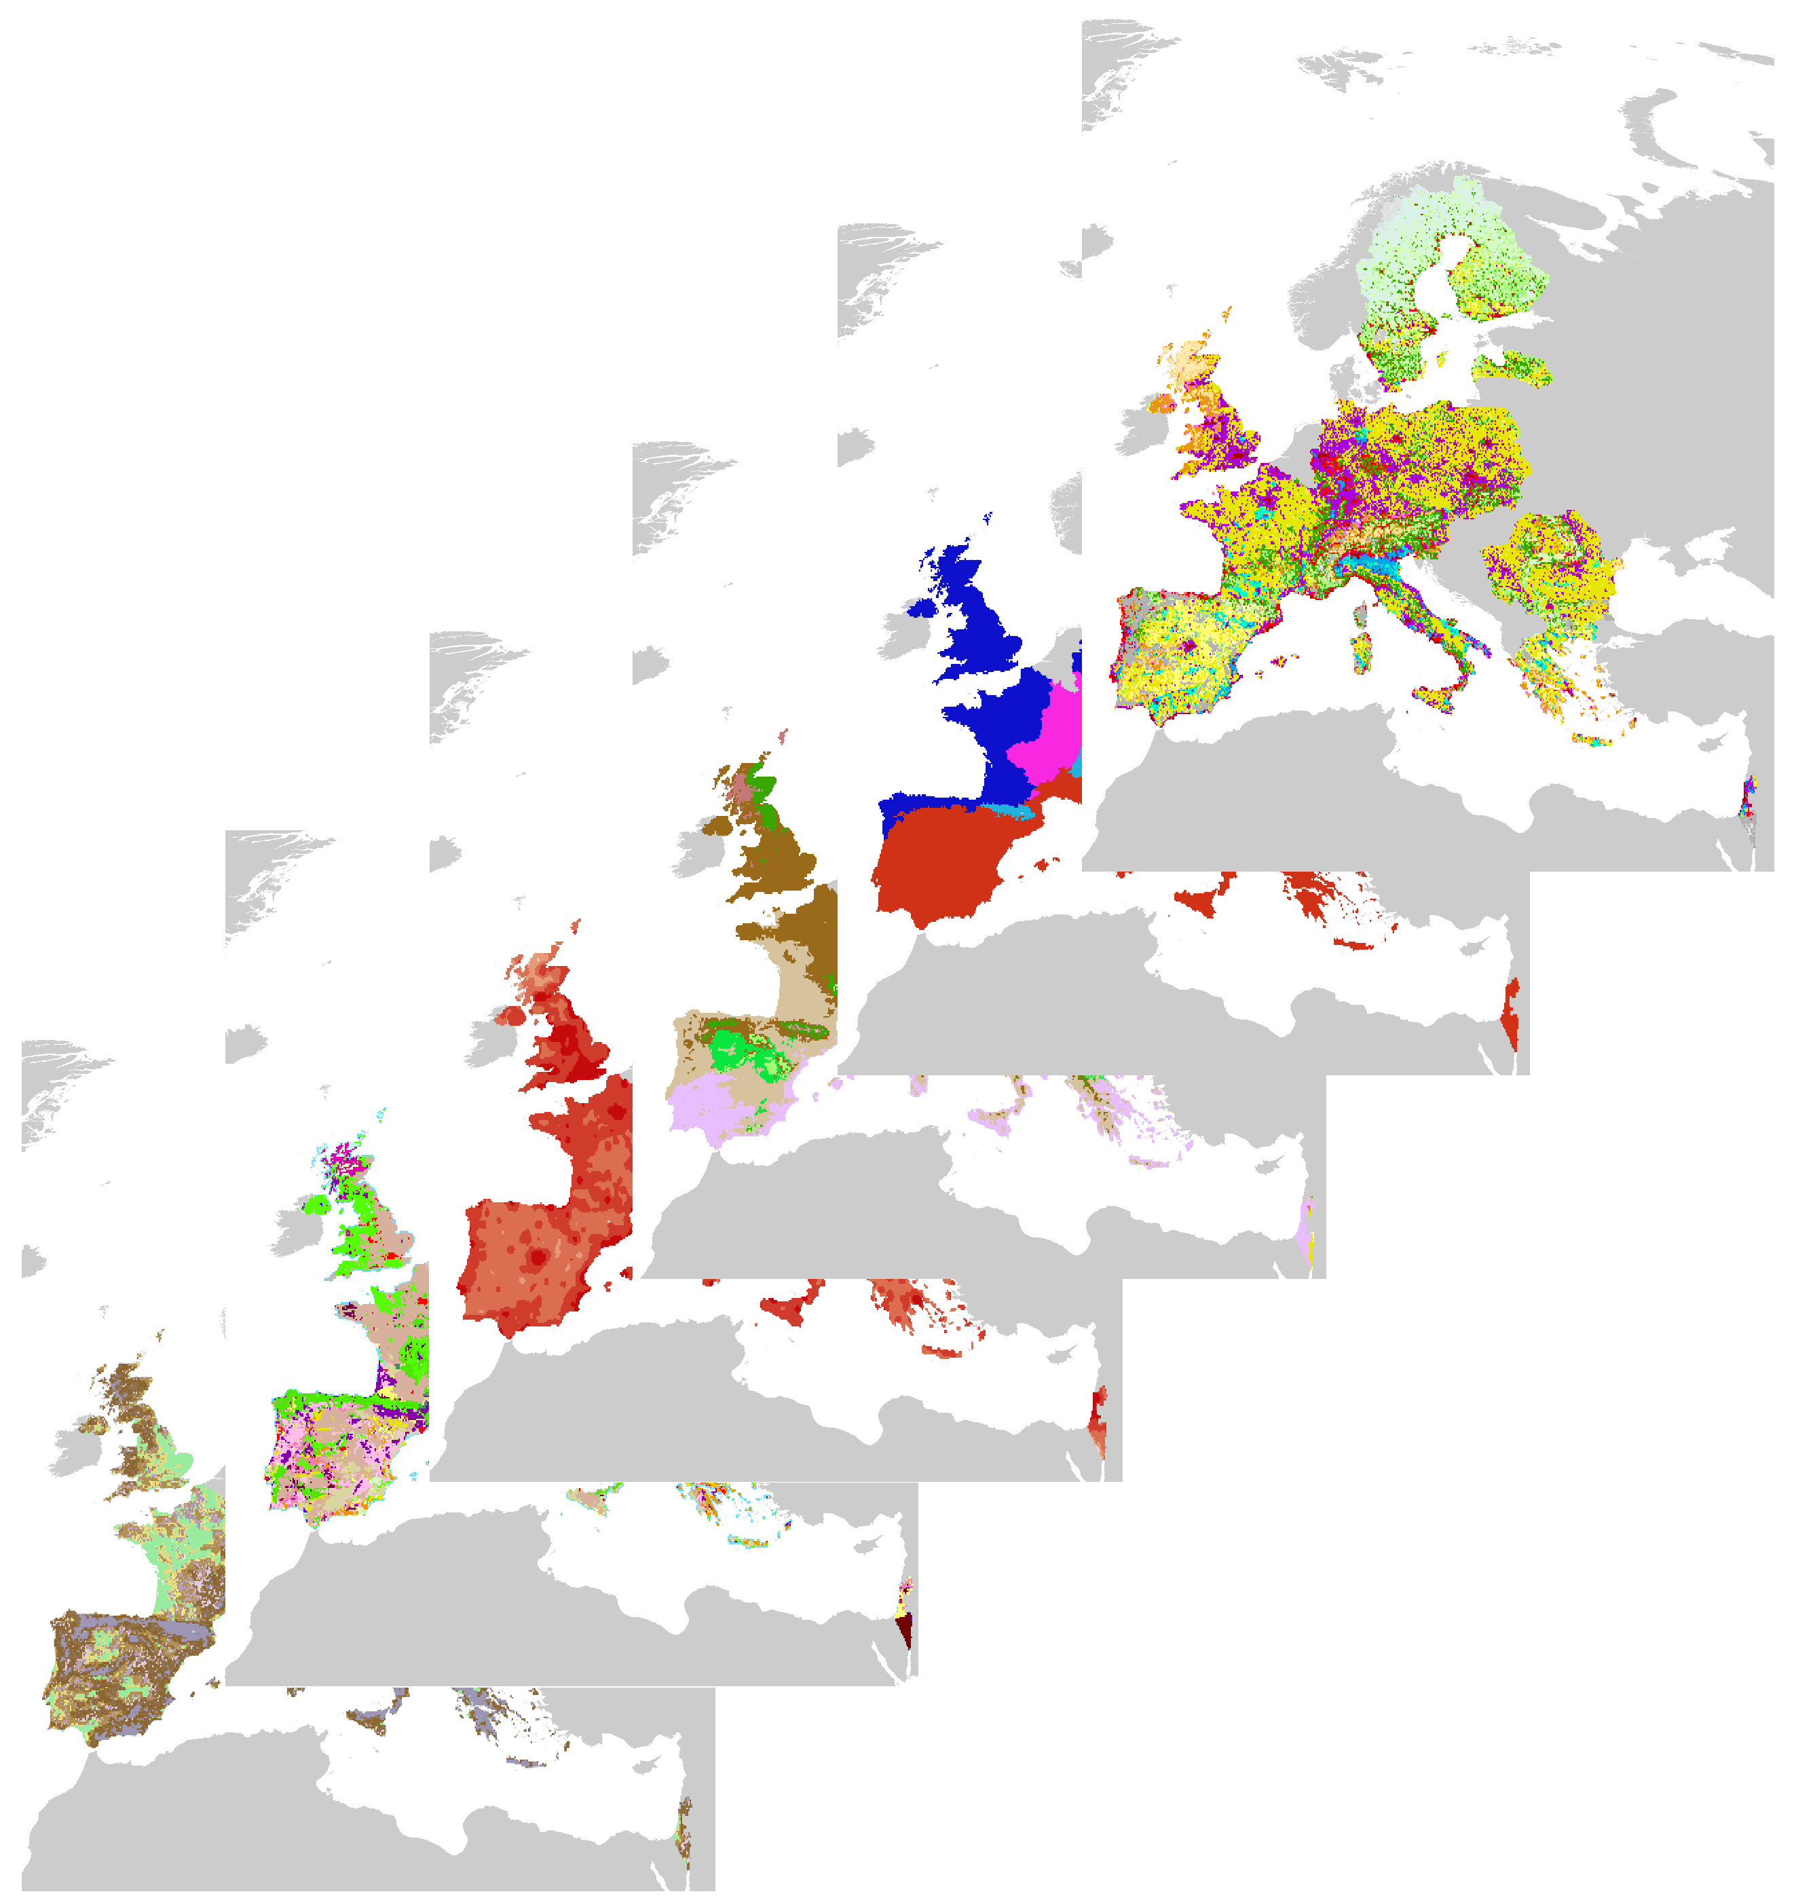
Designing the eLTER
Research Infrastructure
Wohner et al. (In Review)
Notes:
Building up on the work just presented by Christoph Wohner, we extended this approach. On this account, we looked at the European part of the ILTER network, eLTER. This is one of the most dense regional networks, and most importantly some infrastrucutre data for the individual sites exists. Sites with the necessary infrastrucutre to conduct holistic ecological research are called Master Sites, seen in the figure on the left as blue dots.
The goal was to get an understanding how these Master Sites are distributed and to identify the most suitable infrastructurel upgrades among all other eLTER sites, seen as white dots.
For this purpose we ran two different analyses. First, similar to what Christoph just introduced, we ran the representativity analysis with the same reference parameters, seen in Figure 2. The resulting priority regions are shown in figure 3a. We defined possible upgrades as sites lying in areas of high or very high priority. At this stage however we could identify a total of 76 possible upgrades, which are more sites than could realistically be upgraded.
So to more clearly define recommendations for sites to be upgraded we established a second analysis. This analysis is based on the euclidean distance to established Master Sites, and again the results were categorized into priority regions, as seen in figure 3b. Ultimately we combined the results of both analyses and identified sites that could be upgraded, defined as sites of at least high priority in both analyses. This left us with 28 sites arranged in ~7 clusters that are of highest priority to be upgraded, seen as black crosses in figure 3.
Concluding, the combination of biogeographical, socio-economical and ecological gradients and the spatial distribution of established sites of the network allowed to give clear recommendations for the development of the already fairly dense eLTER network.

Slide 4
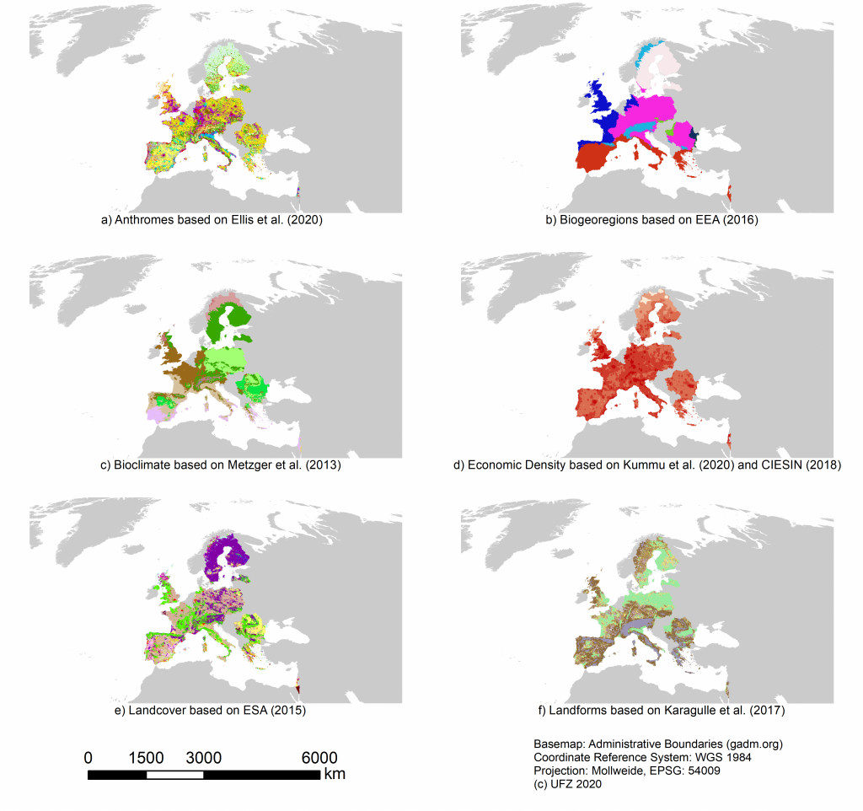
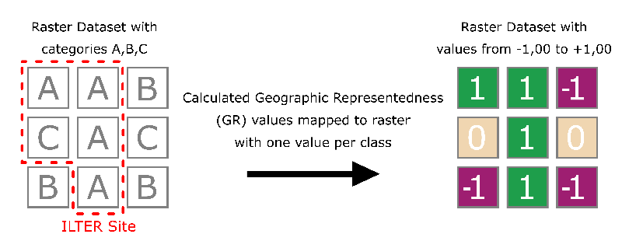
Reference Parameters
Wohner et al. (In Review)

Slide 5
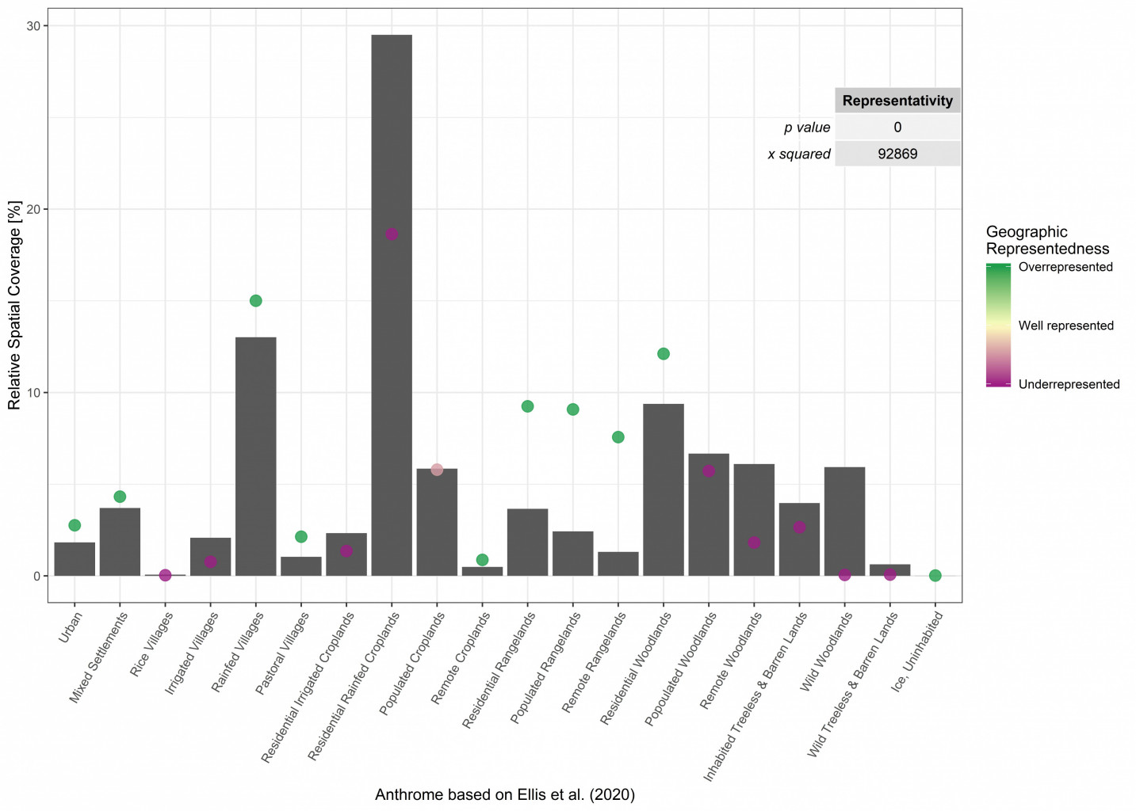
Representativity & Representedness:
Anthromes
Wohner et al. (In Review)

Slide 6
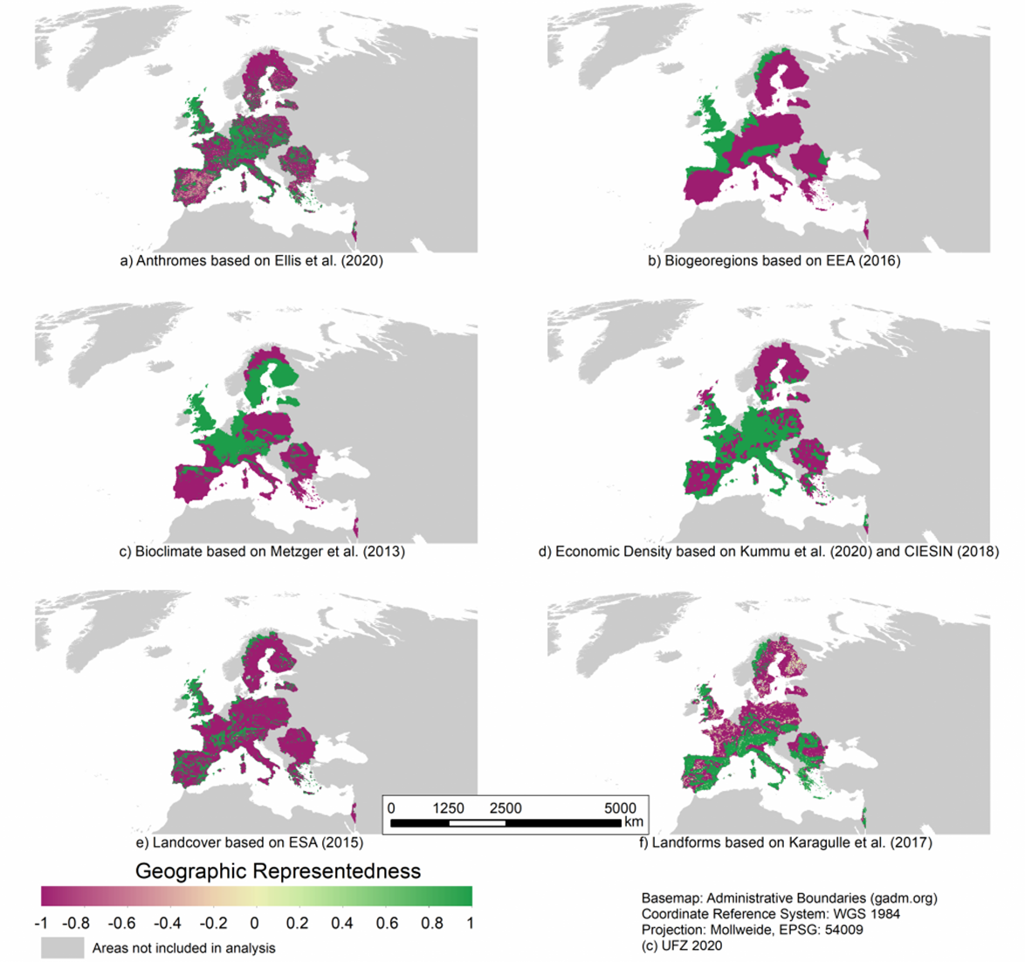
Geographic Representedness
Wohner et al. (In Review)

Slide 7
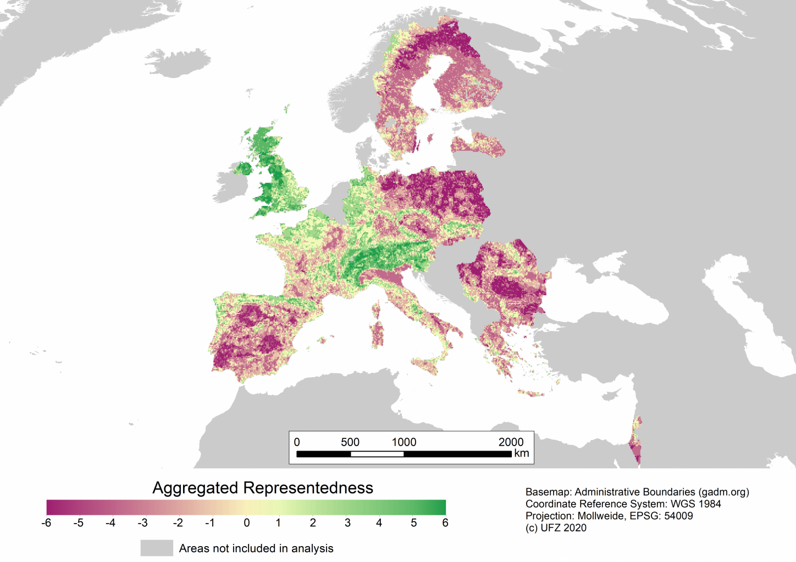
Aggregated Representedness
Priority | Mean Aggregated Representedness
Very low | 3.01 to 6.00
Low | 0 to 3.00
Medium | -1.99 to -0.01
High | -3.99 to -2.00
Very high | -6.00 to -4.00
Wohner et al. (In Review)

Slide 8
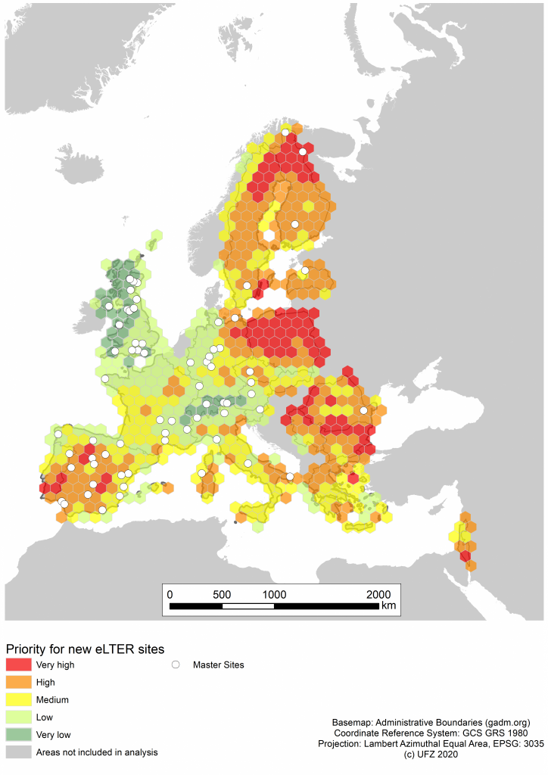
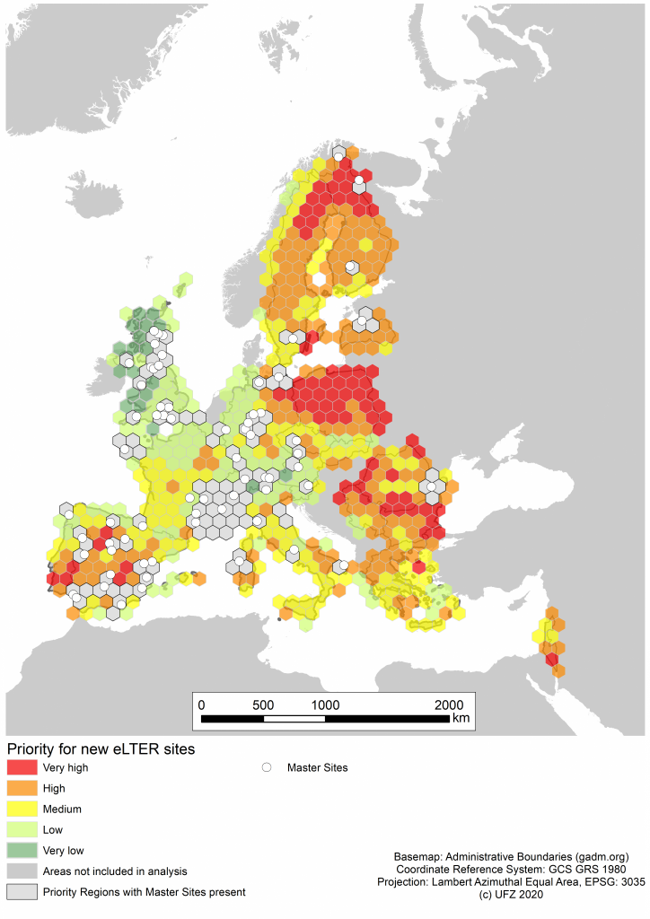
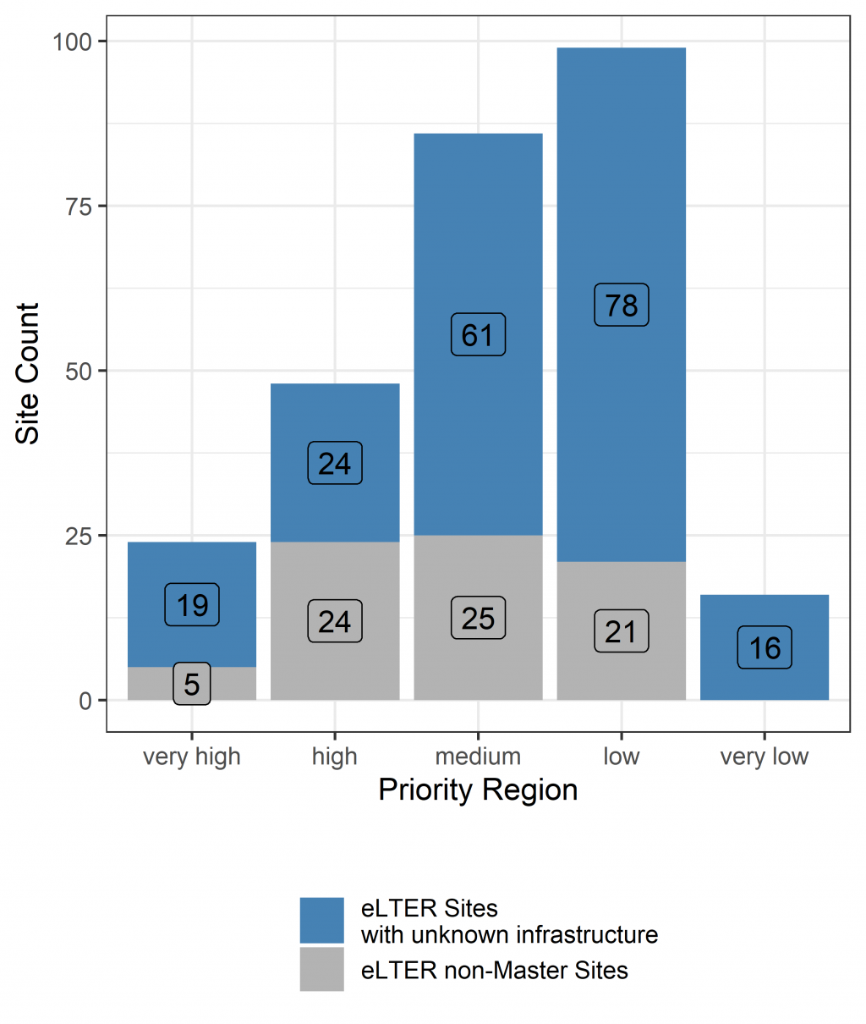
eLTER priority regions
Exclusion of site locations

Slide 9
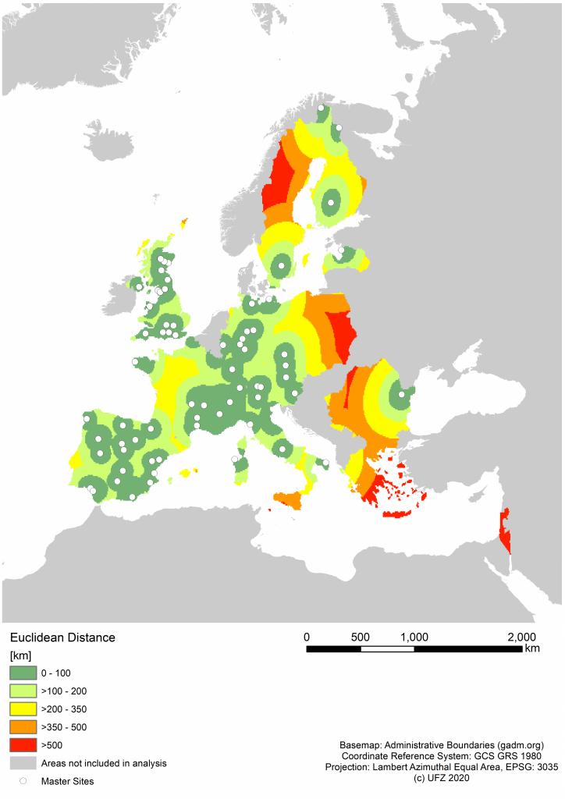
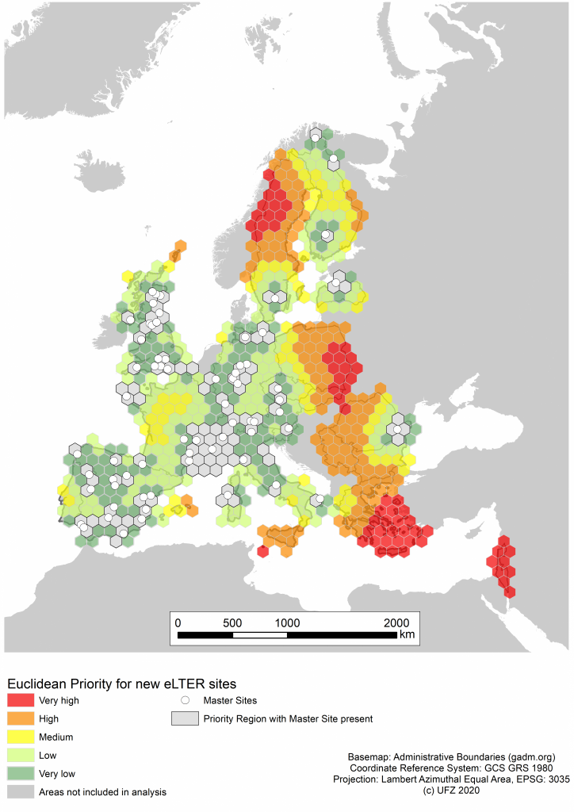
eLTER priority regions
Priority Regions

Slide 10
eLTER Euclidean priority regions
Priority | Scaled value | Minimum distance [km] | Maximum distance [km]
Very low | < -0.5 | 0 | 106
Low | < 0 to -0.5 | 106 | 206
Medium | 0 to < 0.5 | 206 | 306
High | 0.5 to < 1.5 | 306 | 506
Very high | >= 1.5 | 506 | 1949
Scaled value = (x – mean)/sd

Slide 11
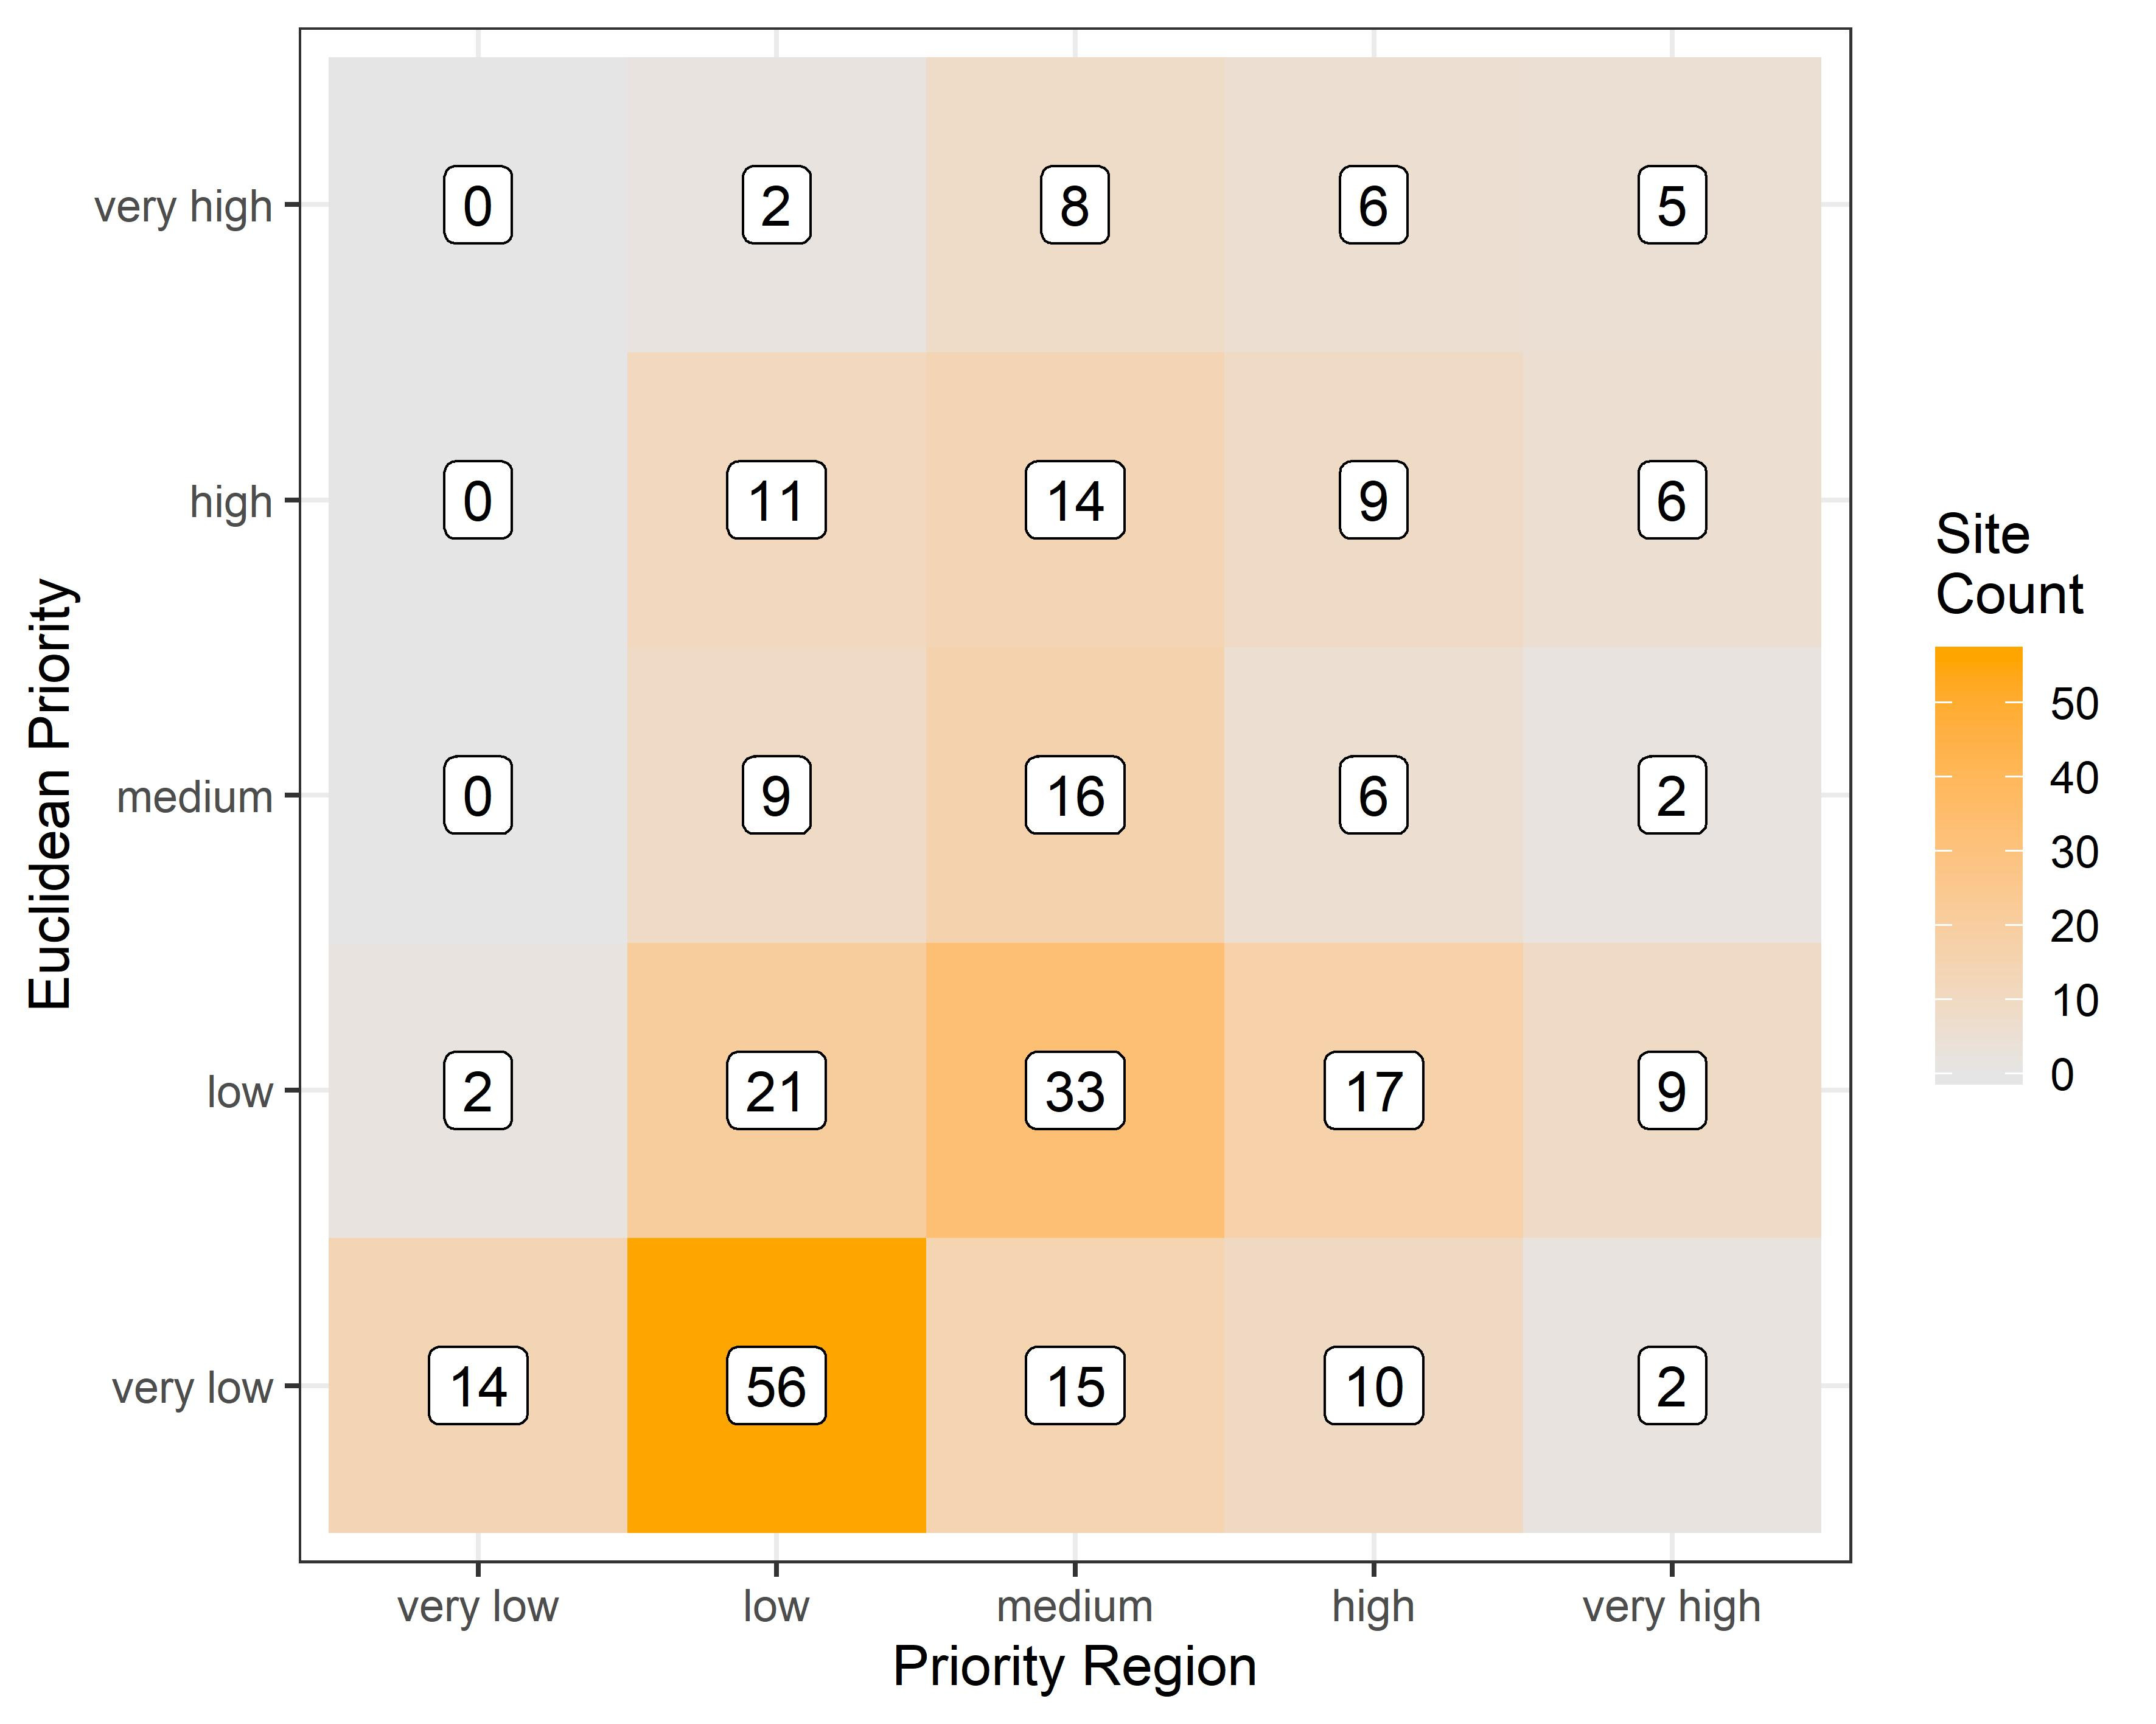
eLTER priority regions

Slide 12
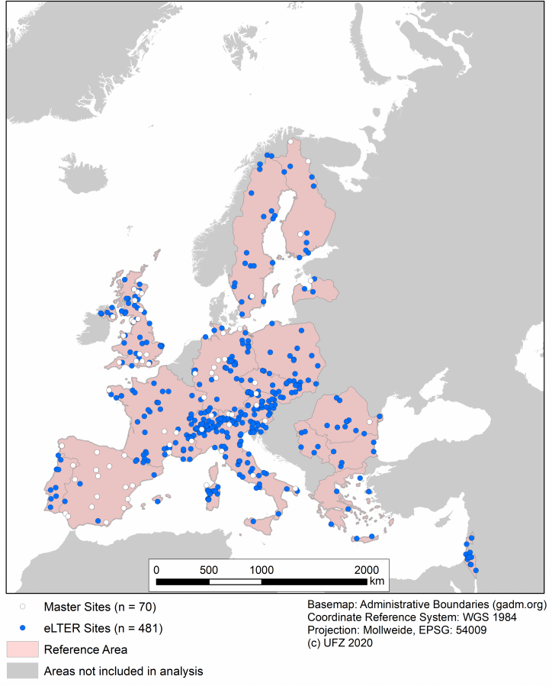
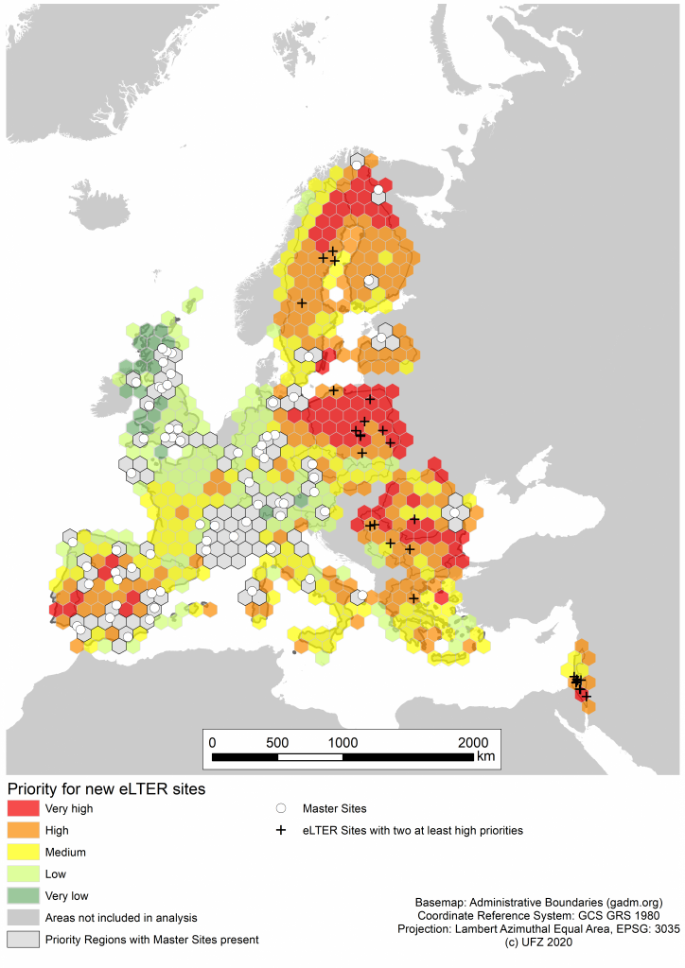
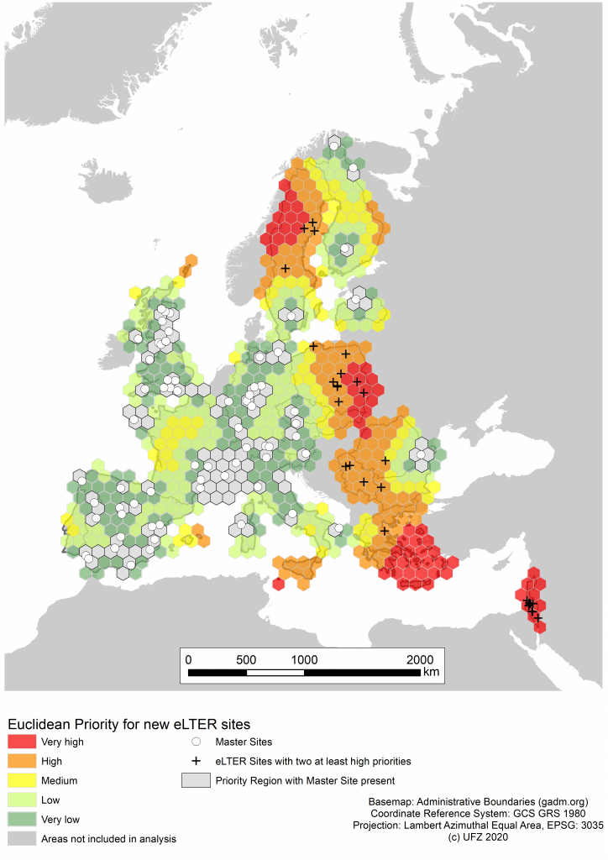
Designing the eLTER
Research Infrastructure
Wohner et al. (In Review)
Notes:
This talk is about the development of the ecological eLTER network. On the left we can see a map with the 20 current member countries seen in the pinkish color, and 70 white dots representing sites with the necessary infrastructure to conduct holistic ecological research, so called Master Sites. Additionally, we see plenty of blue dots, representing 481 other eLTER sites that do not yet have the necessary infrastructure to conduct holistic ecological research.
The research question thusly is, which sites should be upgraded to Master Sites to best develop the eLTER network?
We ran two different analyses to answer this question. First, a representativity analysis was conducted, comparing the distribution of the 70 Master Sites to biogeographical, socio-economic and ecological gradients. On this account we used data depicting anthromes, biogeographical regions, bioclimate, economic density, landcover and landforms. Regarding these gradients we could define priority regions for the establishment of new sites, ranging from very low to very high priority as seen in the central figure. At this stage, we could identify 76 sites in regions of high or very high priority.
So to further narrow down the recommendations for sites to be upgraded we established a second analysis. This analysis is based on the euclidean distance to established Master Sites, and again the results were categorized into priority regions, as seen in the figure on the right. Ultimately we combined the results of both analyses and identified sites that could be upgraded and are of at least high priority for both analyses. This left us with 28 sites arranged in ~7 clusters that are of highest priority to be upgraded.
Thus, combination of biogeographical, socio-economical and ecological gradients and the spatial distribution of established sites of the network allowed to give clear recommendations for the development of the already fairly dense eLTER network.

Slide 13
Supplement

Slide 14
Representativity & Representedness:
Anthromes

Slide 15
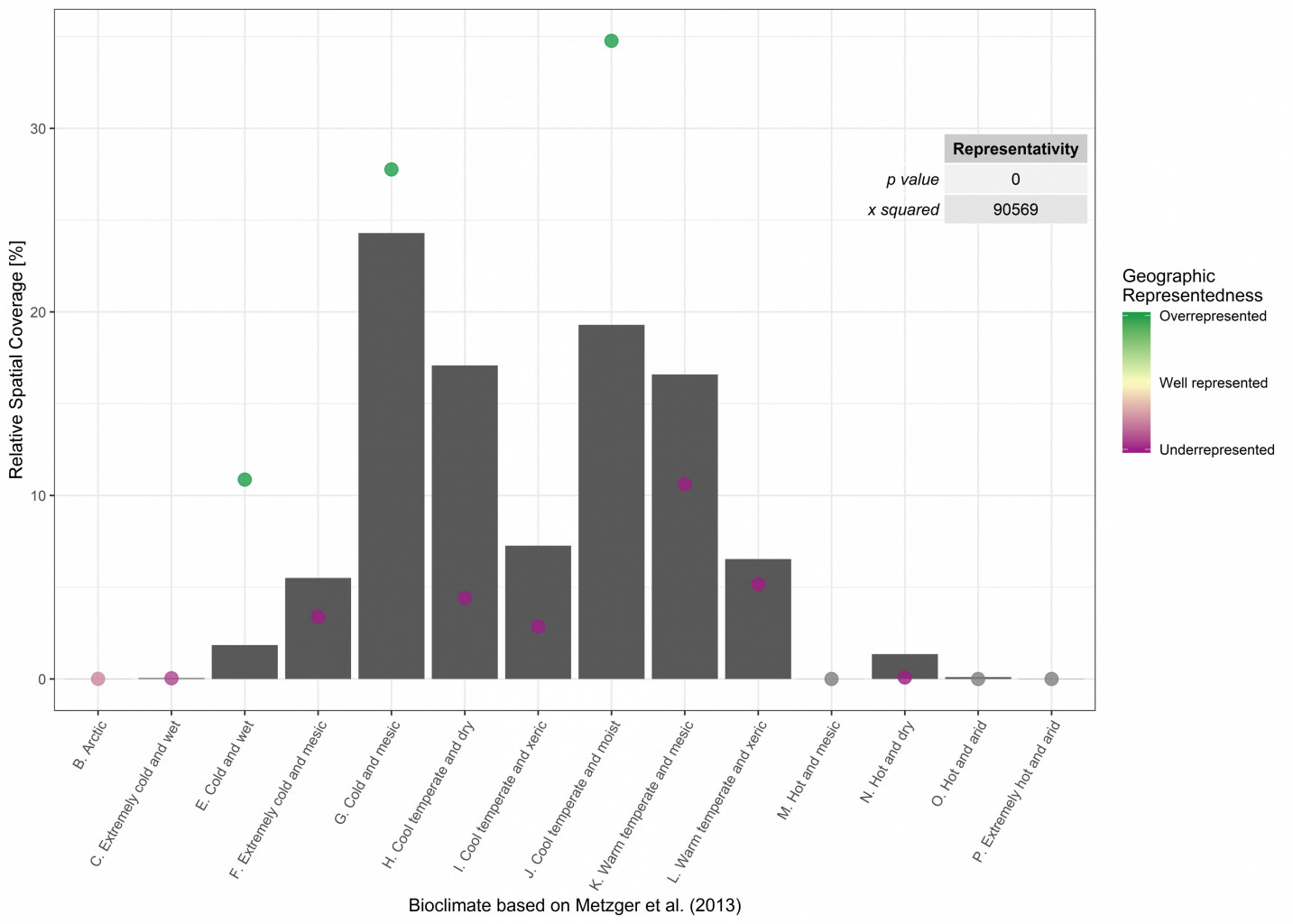
Representativity & Representedness:
Bioclimate

Slide 16
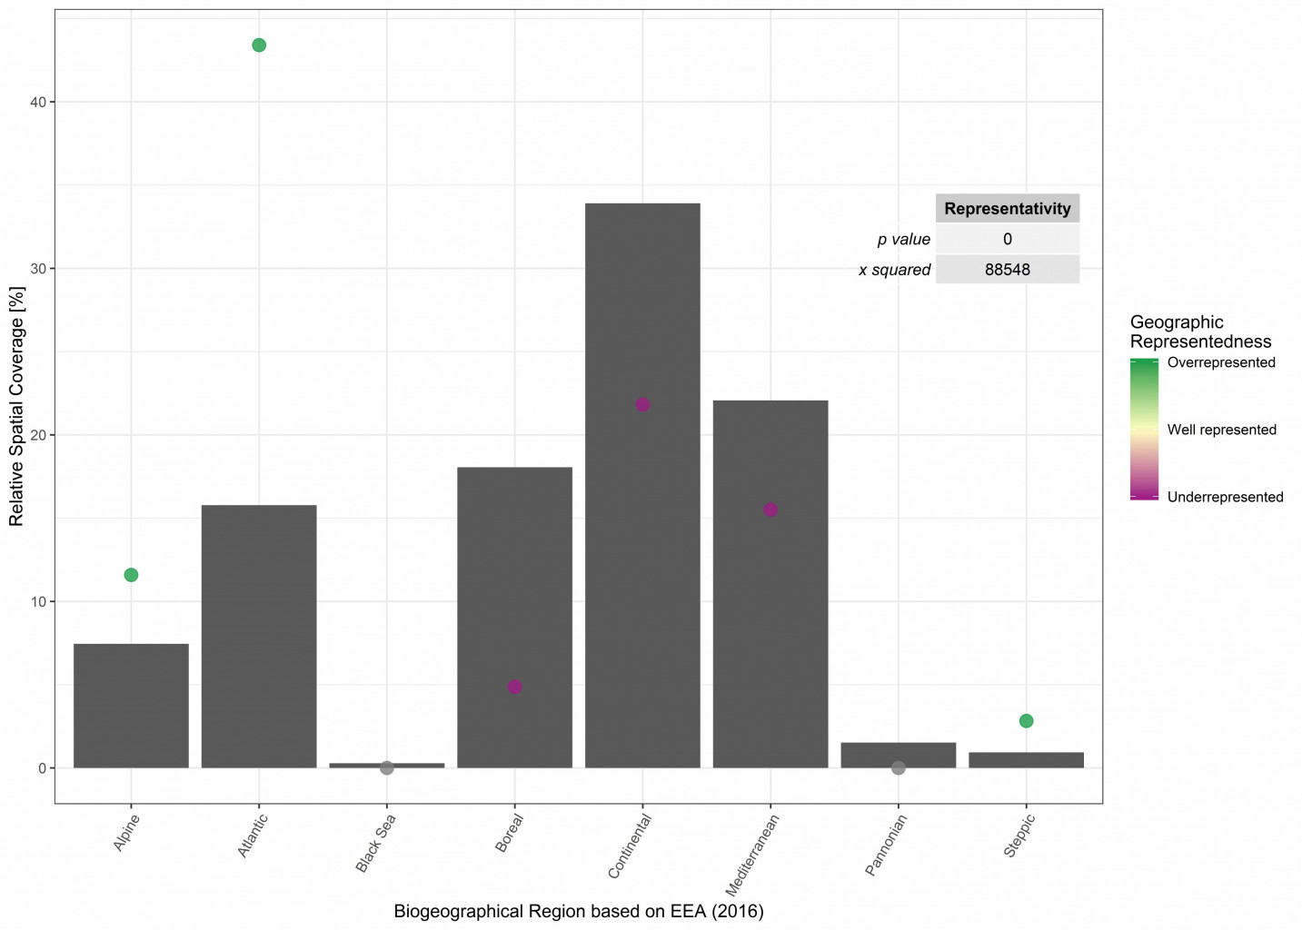
Representativity & Representedness:
Biogeographical
Regions

Slide 17
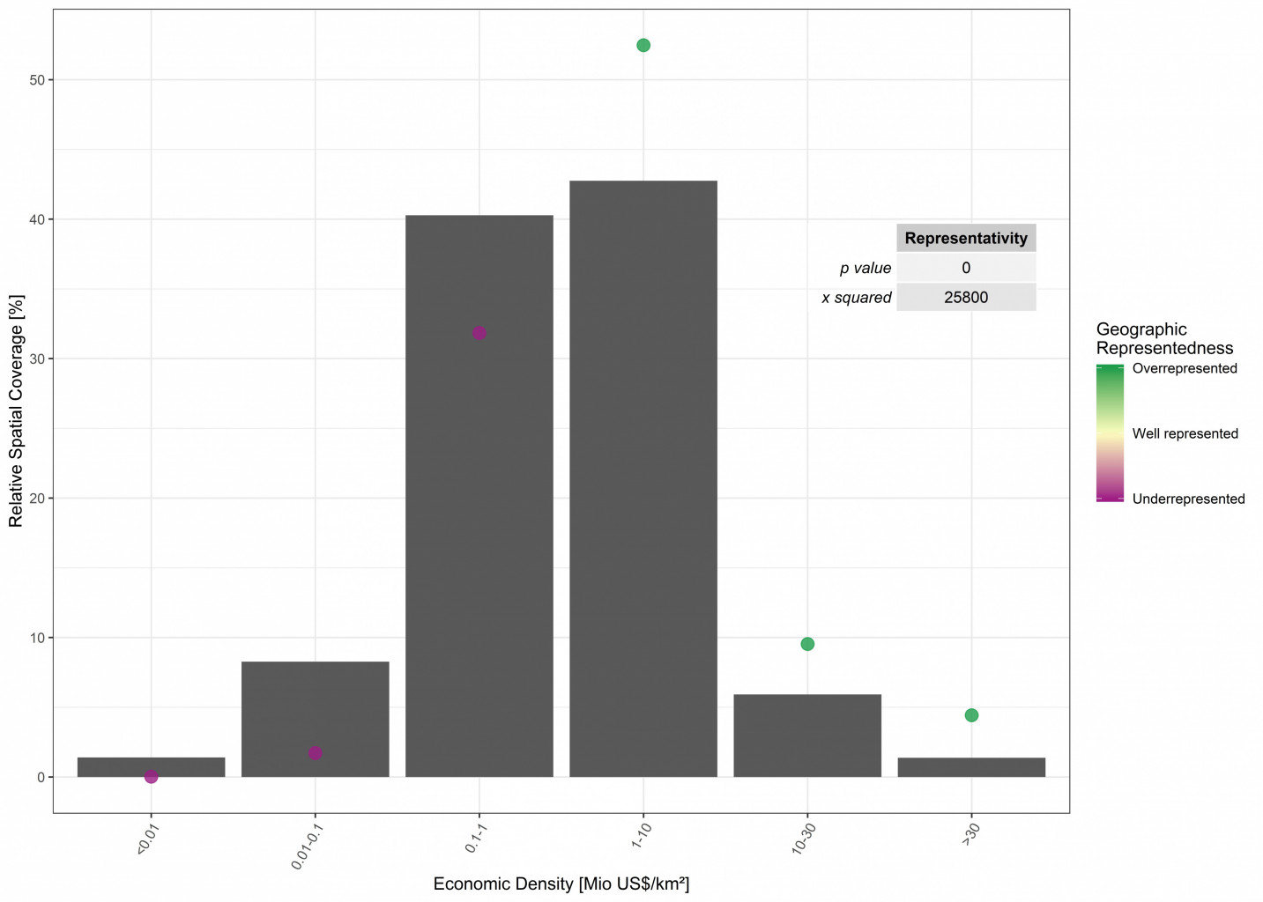
Representativity & Representedness:
Economic
Density

Slide 18
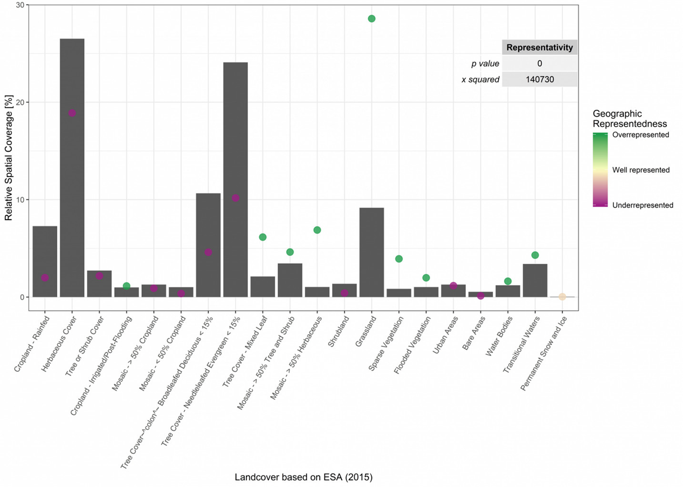
Representativity & Representedness:
Landcover

Slide 19
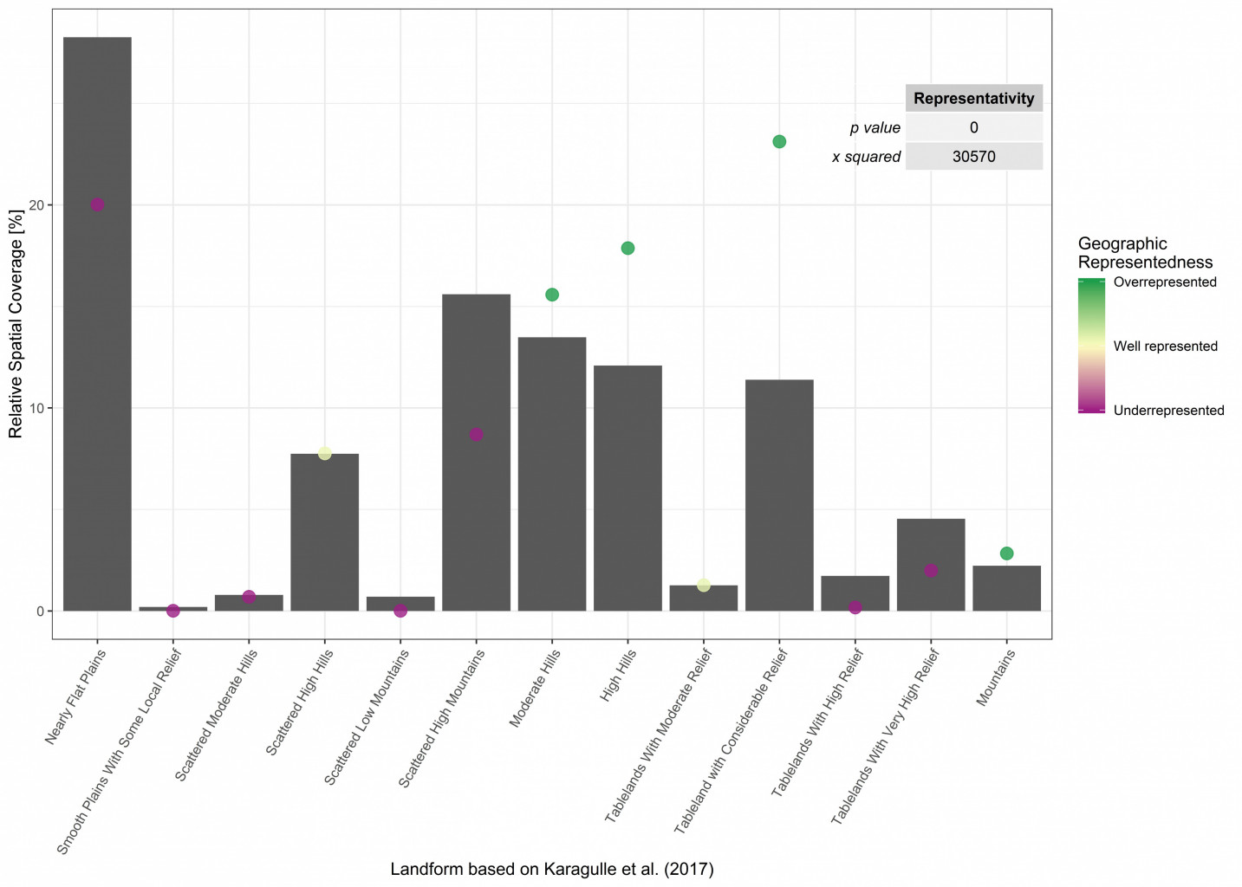
Representativity & Representedness:
Landforms

Slide 20
Global parameters
Reference global parameter (Anthromes)
eLTER sites
with complex boundaries
eLTER sites
with point representation only
eLTER sites
with point representation and size information
Individual processing
buffer()
Resample()
eLTER sites
with polygon buffer
Harmonized global parameters in equal-area Mollweide projection
eLTER dataset
disaggregate()
freq()
extract()
weighting
Global Distribution
Distribution on eLTER sites
Geoprocessing and analyses conducted in…
Representativity
chisq()
Observed cell count on eLTER sites
Expected cell count on eLTER sites
R v. 3.6.0
Geographic Representedness
chisq()
reclassify()
Harmonized global parameters in equal-area Mollweide projection
Priority Regions
make_grid()
Aggregated Representedness
Geographic Representedness Raster
extract()
raster math

