Slide 1


Japan’s
L-SAR missions
Shin-ichi Sobue
Sobue.shinichi@jaxa.jp
ALOS-2 Project manager
Japan Aerospace Exploration Agency (JAXA)
April 29, 2021

Slide 2
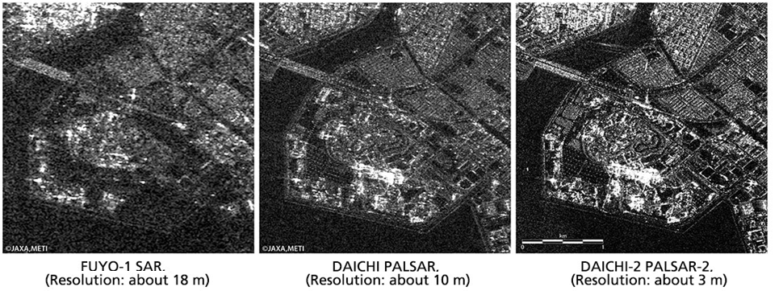
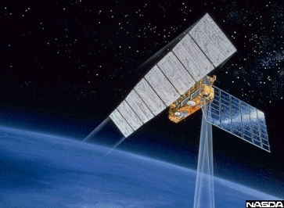
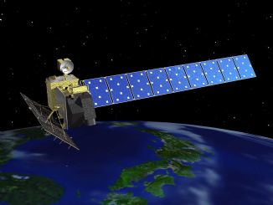
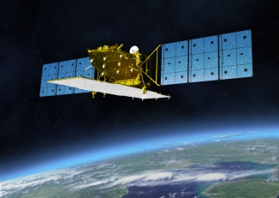
Japanese L-band SAR Satellites – 25-year Legacy
JERS-1
(1992-1998)
ALOS
(2006-2011)
ALOS-2
(2014- )
Improvement of Data Acquisition Abilities

Slide 3
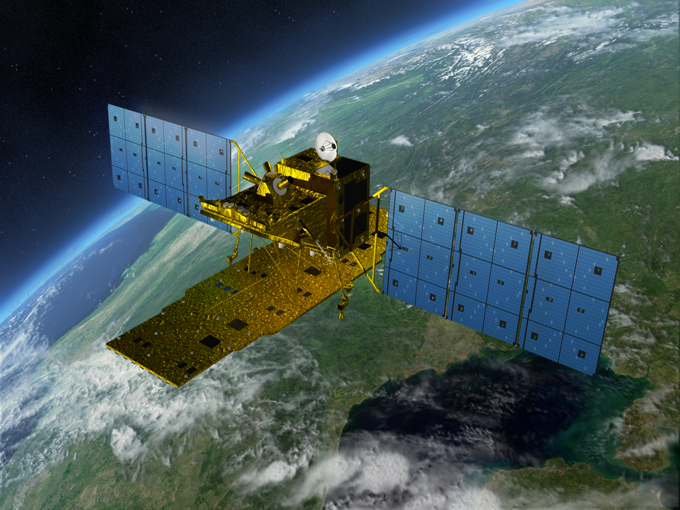

Advanced Land Observing Satellite-2
Application | Disaster, Land, Agriculture, Natural Resources, Sea Ice & Maritime Safety
L-band SAR (PALSAR-2) | Stripmap: 3 to 10m res., 50 to 70 km swath ScanSAR: 100m res., 350km/490km swath Spotlight: 1×3m res., 25km swath
Orbit | Sun-synchronous orbit Altitude: 628km Local sun time : 12:00 +/- 15min Revisit: 14days Orbit control: ≦+/-500m
Life time | 5 years (target: 7 years)
Launch | May 24, 2014; H-IIA launch vehicle
Downlink | X-band: 800Mbps(16QAM) 400/200Mbps(QPSK) Ka-band: 278Mbps (Data Relay)
Experimental Instrument | Compact InfraRed Camera (CIRC) Space-based Automatic Identification System Experiment 2 (SPAISE2)
Notes:
ALOS-2 carries L-band Synthetic Aperture Radar called PALSAR-2.
The local sun time is at noon in order to complement other SAR satellites which are in dawn-dusk orbits. The revisit time is shortened from that of ALOS and the orbit is controlled within 500m tube for interferometry.
The observation data is transmitted either directly to a ground station via X-band at 800Mbps or through inter-satellite communication via Ka-band at 278Mbps.
ALOS-2 will contribute to Disaster monitoring, Land monitoring, Agricultural monitoring, Natural Resource Exploration and Global Forest monitoring as ALOS did.
And potential use such as maritime safety will be expected.

Slide 4
ALOS-2 Observation Modes
Flight Direction
70°
Nadir Track
8°
25 km x 25km
8°
350 km
or 490 km
Non-observable area
Approx. 80km
50 or 70km
Spotlight
Observable area
Approx. 1160km
70°
ScanSAR
Newly added observation mode
for ALOS-2
Strip map
Right & Left Looking
Wide Incidence Angle: 8～70°

Slide 5
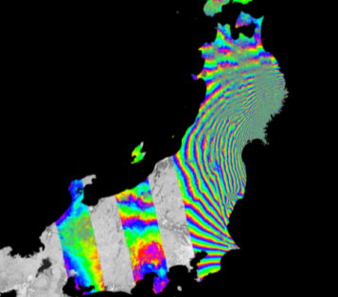
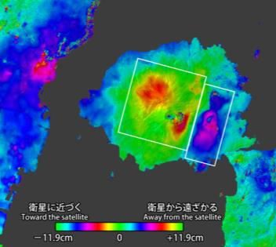
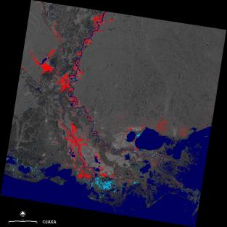
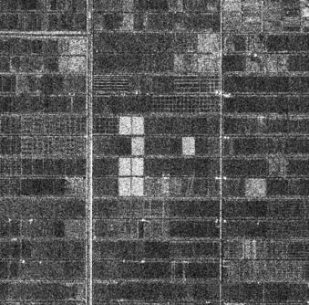
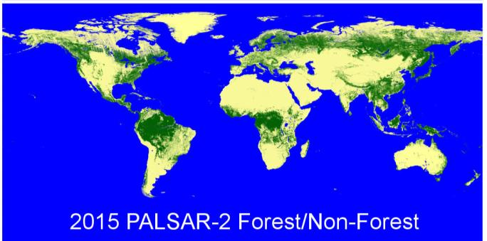
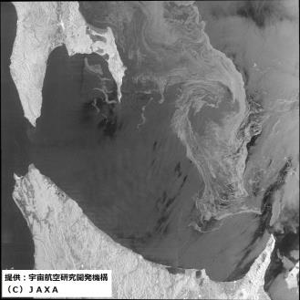
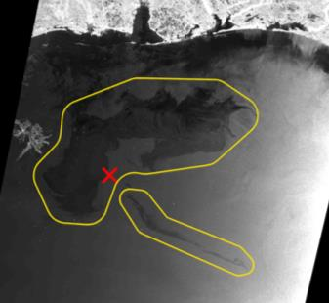
ALOS-2 Mission Objectives
Disaster monitoring
Agriculture & natural resources
Earthquake
Volcano
Flooding
Environment and land management
Ocean
Forest and wetland
Ice
Oil Spill
5

Slide 6


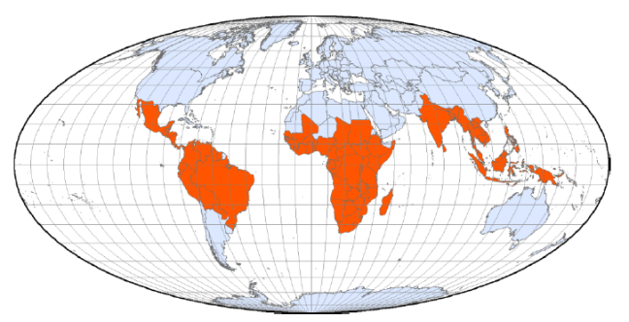
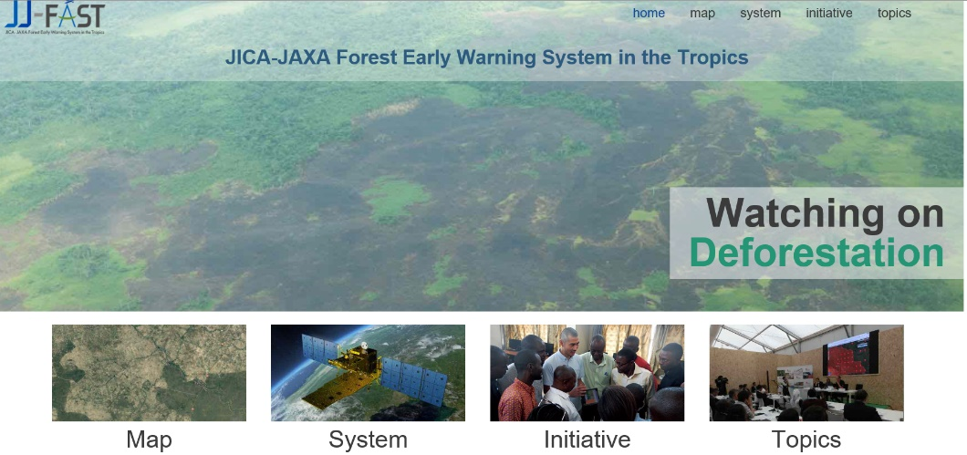
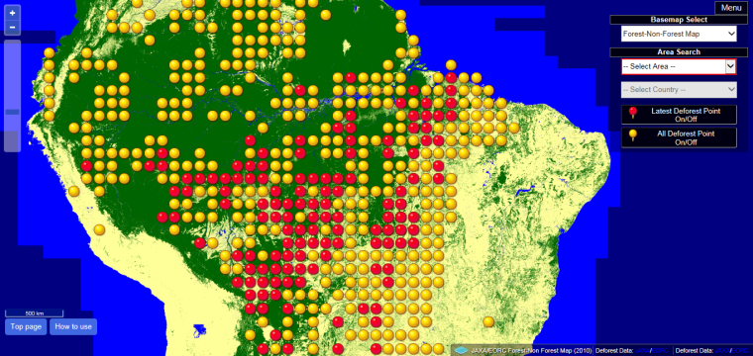
Monitoring Deforestation
JICA-JAXA Forest Early Warning System in the Tropics (JJ-FAST)
JJ-FAST website （http://www.eorc.jaxa.jp/jjfast//jj_index.html）
Data source | ALOS-2/PALSAR-2 (ScanSAR mode)
Target area | 77 countries
Update | Every 1.5 months
Monitoring forests in 77 countries
Red indicates the latest Deforest Point
Yellow indicates all Deforest Point

Slide 7
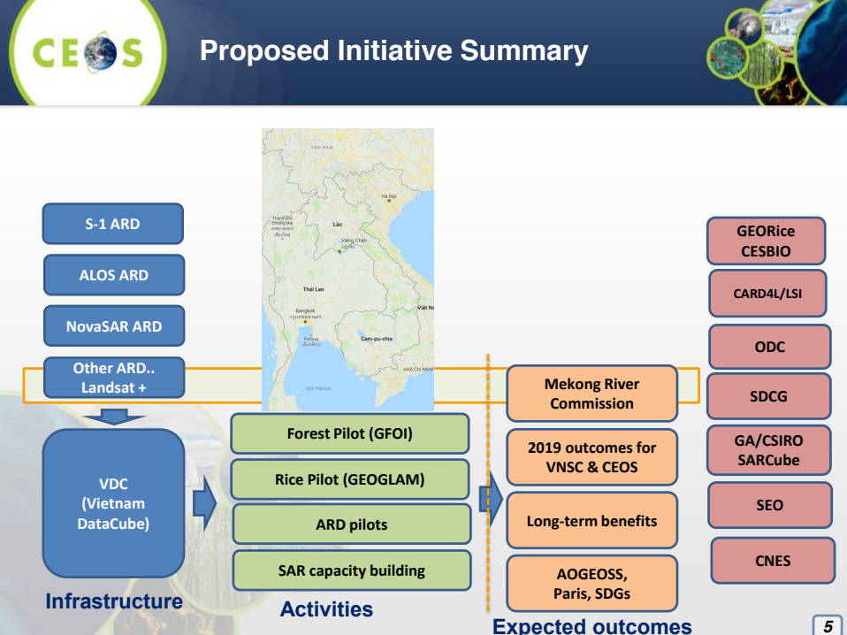
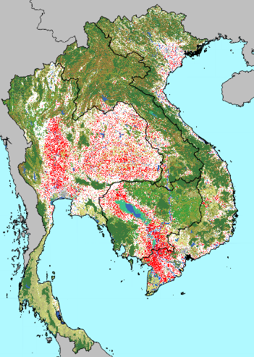



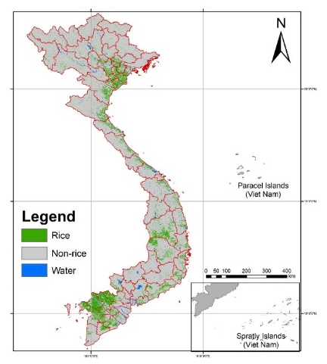

CEOS 2019 VNSC chair initiative
ALOS-2/ INAHOR
GEORICE /S1
ALOS-2/INAHOR
GEORICE
Rice crop maps (crop season product) of the Mekong area (Cambodia, Laos, Thailand, Vietnam) linked with ESA GEORice, JAXA and GEO GEOGLAM Asia Rice team
Rice Phenology / Growth Stage (monthly product) of the Mekong Delta and Red River Delta, Vietnam.
Rice Crop Production / Yield Estimation (crop season product) of provinces in the Mekong Delta and Red River Delta, Vietnam.
Continued development of GEOGLAM National Crop Monitor with NASA Harvest.
Cross comparison among rice crop growth map of Mekong region by VNSC, JAXA and GEORICE by ALOS-2 and S1 in cooperation with respecting countries (space agencies and ministries of agriculture) under APRSAF SAFE and other regional framework
-> Continue to support CEOS 2020 chair activities
VNSC/S1

Slide 8

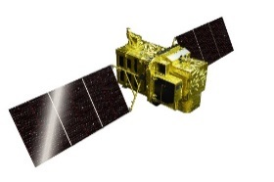
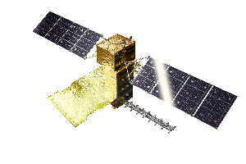
Continuous Observations by ALOS Series
Assurance of safety and security of citizens, i.e. disasters monitoring and management, land deformation monitoring, national developing management, foods and natural resources, environmental issues in global etc.
Enhancement of commercial use of Earth observation data, i.e. National Spatial Data infrastructure (NSDI) and new applications.
JFY 2014 | 2015 | 2016 | 2017 | 2018 | 2019 | 2020 | 2021 | 2022 | 2023 | 2024 | 2025 | 2026 | 2027 | 2028 | 2029 | 2030
ALOS-2 (L-SAR)
Launch
Mission Operation
(5 years)
Post-mission Operation
ALOS-3 (Optical)
Development
Mission Operation (7 years)
ALOS-3 Follow-on
(Under Consideration)
ALOS-4 (L-SAR)
Development
Mission Operation (7 years)
ALOS-4 Follow-on
(Under Consideration)

Slide 9

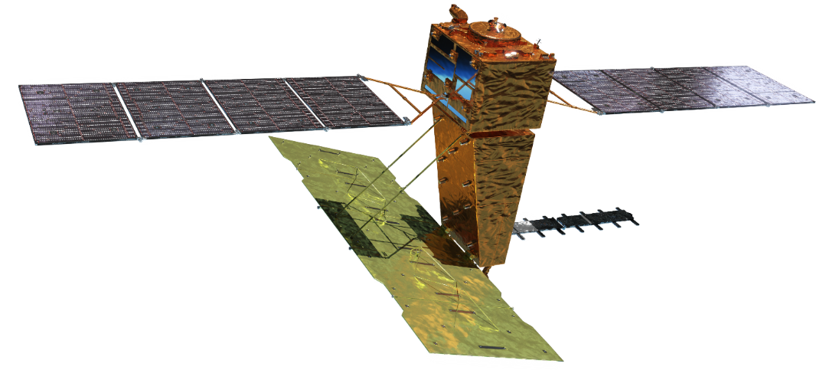
ALOS-4 Overview
Y
Launch | JFY2022~ by H3 launch vehicle
Orbit | Same orbit as ALOS-2 Sun-synchronous sub-recurrent orbit Altitude: 628 km Inclination angle: 97.9 degree Local sun time at descending: 12:00 ± 15 min. Revisit time: 14 day (15-3/14 rev/day)
Lifetime | 7 years
Size | X 10.0 m x Y 20.0 m x Z 6.4 m
Satellite Mass | ~2,990 kg
Downlink | 1.8/3.6 Gbps (Ka-band)
Mission Instruments | PALSAR-3 (Phased Array type L-band Synthetic Aperture Radar-3) SPAISE3 (SPace based AIS Experiment 3)
Prime contractor | Mitsubishi Electric Corporation
Solar array paddle
Z
X
SPAISE3
antenna
PALSAR-3 antenna
Ka-band DT antenna

Slide 10
ALOS-4 Mission Objectives
Precise monitoring of land deformation and subsidence using InSAR
Continuation and enhancement of ALOS-2 mission (all-weather disaster monitoring and forest monitoring, etc.)
Exploring new applications such as large infrastructure monitoring using InSAR time series analysis
Marine monitoring by SAR and Automatic Identification System for ships (AIS)
10

Slide 11
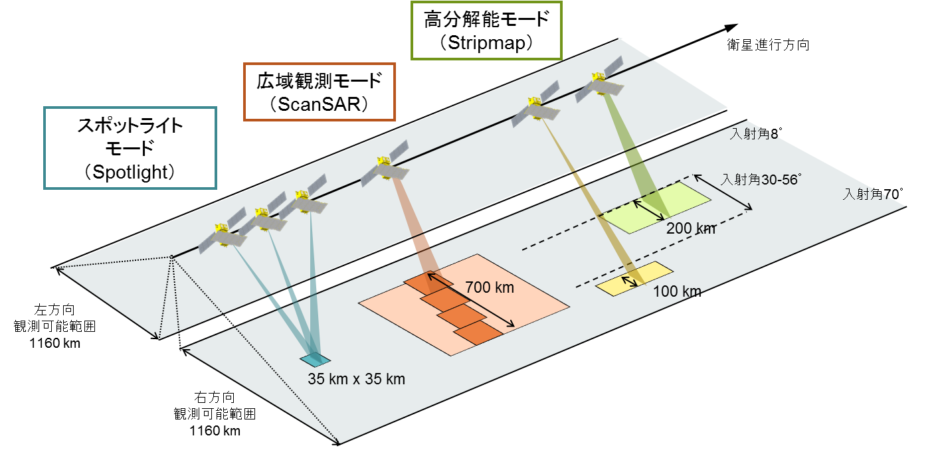
PALSAR-3 Observation mode
Stripmap
ScanSAR
Azimuth direction
Spotlight
Swath width of PALSAR-3/2
8 deg
30 – 56 deg
70 deg
Left observation
Maximum : 1160km
Modes | PALSAR-3 | PALSAR-2
Stripmap (res. 3/6/10 m) | 100-200 km | 30-70 km
ScanSAR (res. 25m*) | 700 km | 350-490 km
Spotlight (res. 1 x 3 m) | 35km×35km | 25km×25km
Right observation
Maximum :1160km
*single look

Slide 12
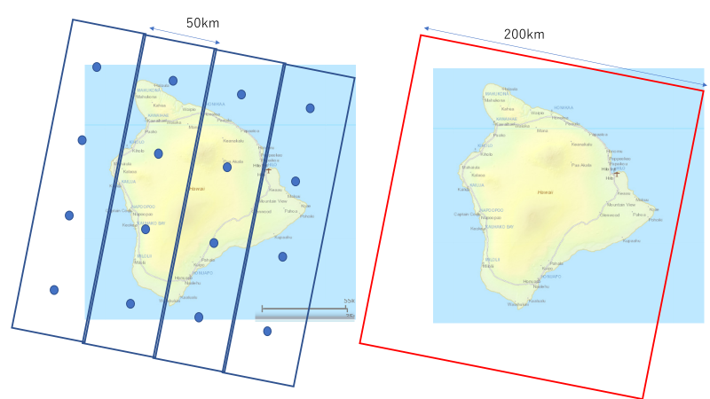
ALOS-4 Mission Objectives
Precise monitoring of land deformation and subsidence using InSAR
More frequent observation
  High resolution + wide swath width
Mutual interference with PALSAR-2
  The same orbit and observation geometry as ALOS-2
Orbit control is performed autonomously and its accuracy is within +/- 500 meters.
Improved orbit determination accuracy
  ~3 m (RMS) for onboard orbit
  ~0.1 m (RMS) for offline orbit
200 km swath
ALOS-4/PALSAR-3
50 km swath
ALOS-2/PALSAR-2
Coverage over Hawaii island

Slide 13
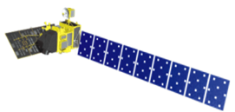

ALOS/ALOS-2 mass processing for O&F
 |  | CY 2020 |  |  |  | CY 2021
 |  | 1Q Jan Mar | 2Q Apr Jun | 3Q Jul Sept | 4Q Oct Dec | 1Q Jan Mar | 2Q Apr Jun | 3Q Jul Sept | 4Q Oct Dec
ALOS | AVNIR-2 (10 m)
 | PALSAR FBS, FBD (10 m)
ALOS-2 | PALSAR-2 ScanSAR (25m)
Data Processing
Global
Data Distribution (Open and Free)
Global (L1.1+
L2.2)
Data Distribution (O&F)
Data Processing
Preparation
Data Processing (L1.1 + L2.1 (L2.2))

