Slide 1
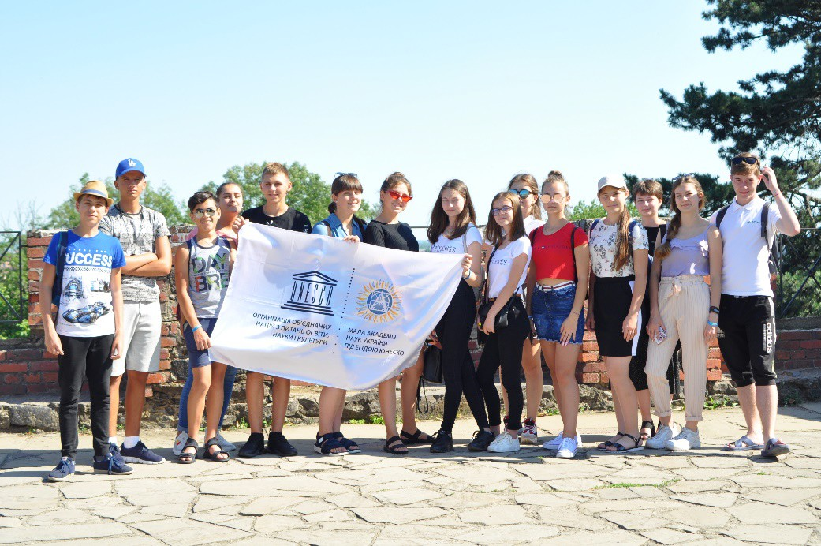
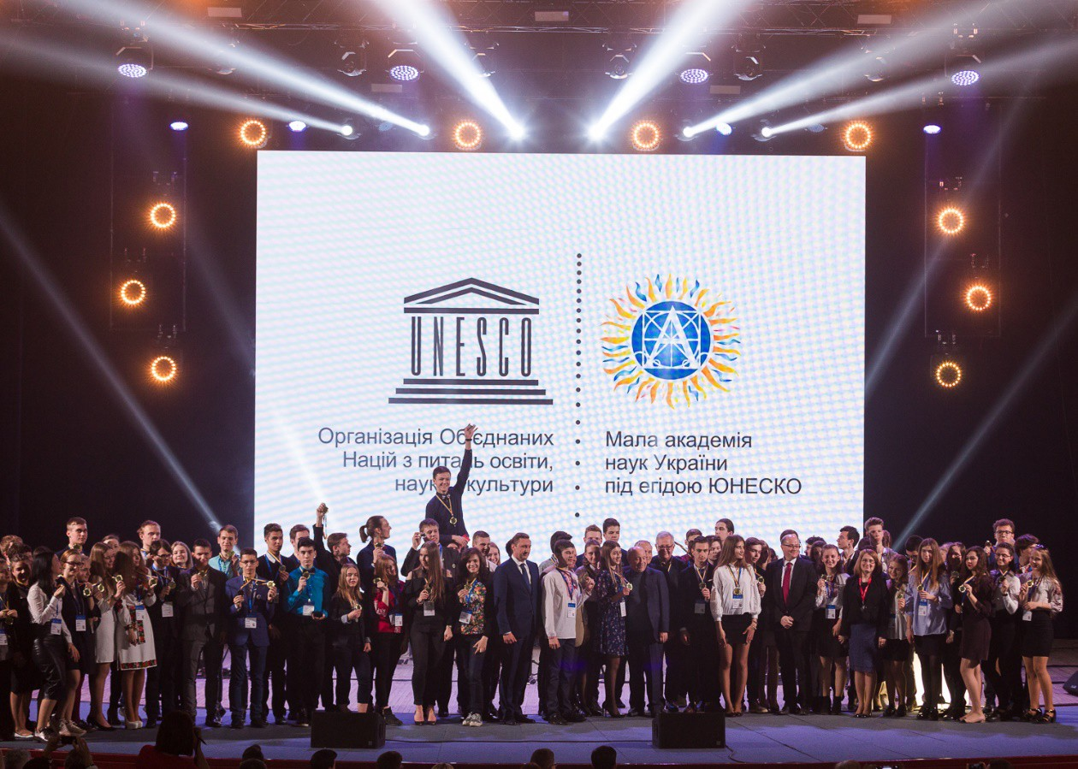
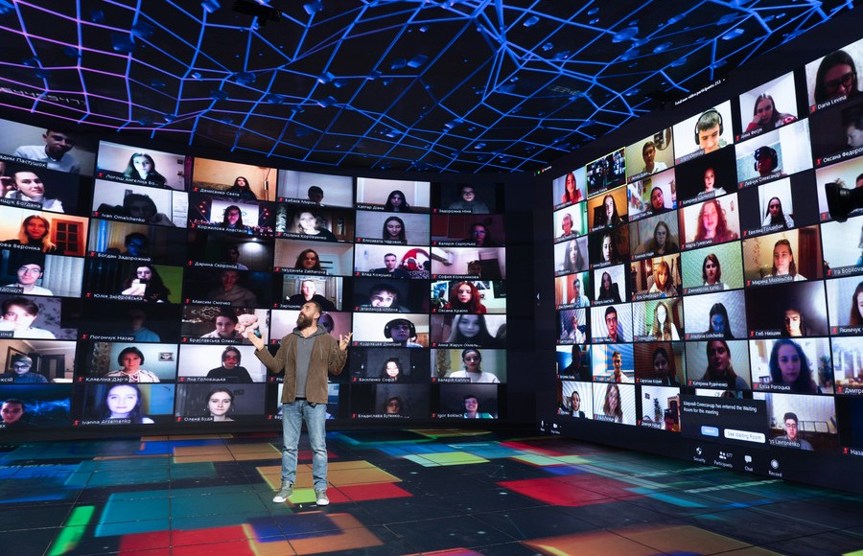
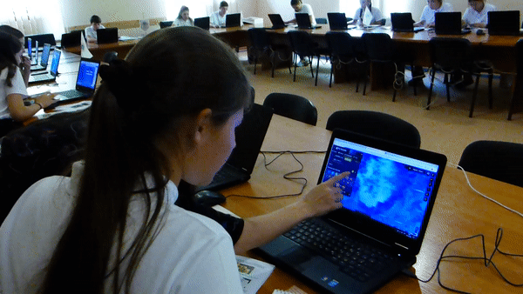
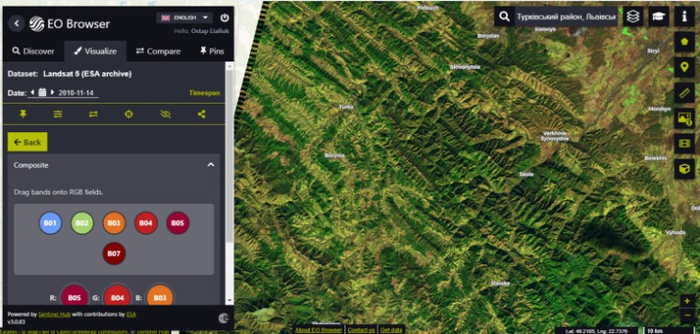
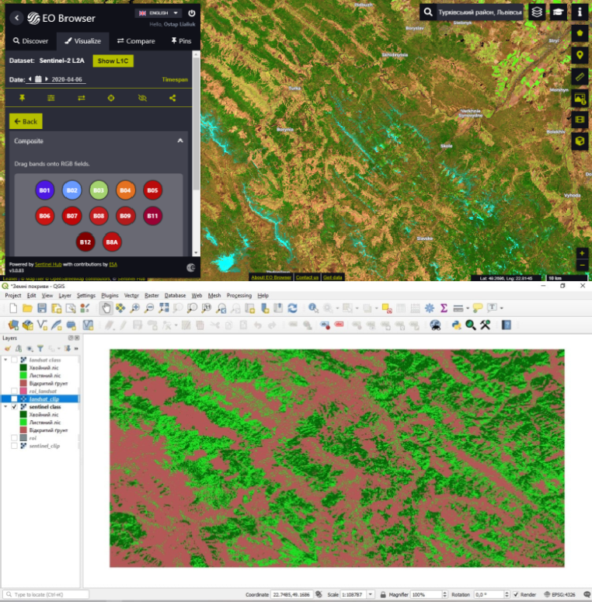
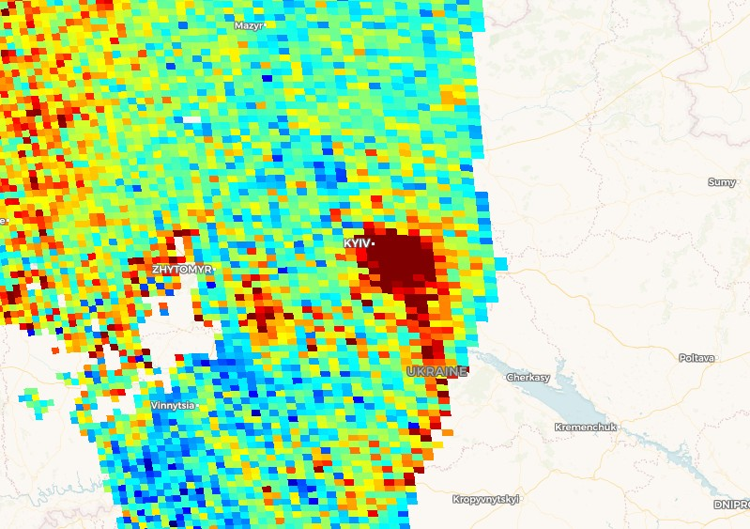
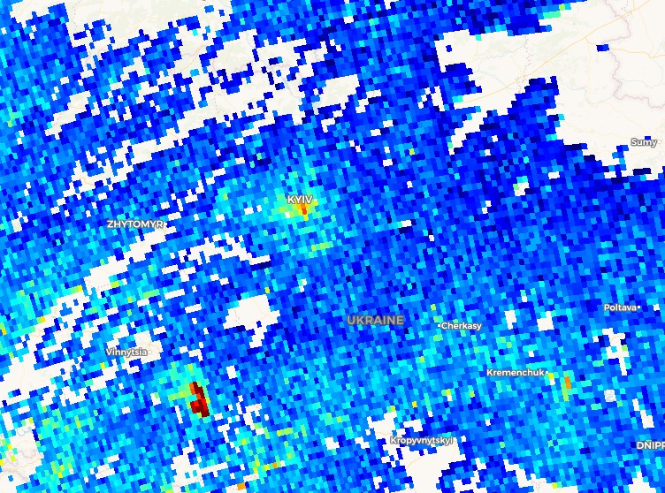
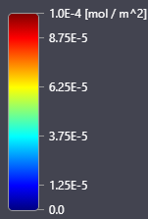
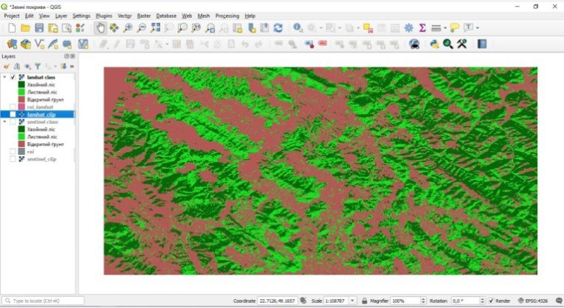
vPICOs:
Mon, 26 Apr
15:48–15:50
EGU21-5380
Using Remote Sensing Technologies to Improve Climate Literacy
of Students at the Junior Academy of Sciences of Ukraine
Svitlana Babiichuk, Stanislav Dovgyi, and Tetyana Kuchma
Junior Academy of Sciences of Ukraine, Kyiv, Ukraine
Junior Academy of Sciences of Ukraine organized the National Research Paper Defense Competition
Educational Process at GIS and RS Laboratory of the Junior Academy of Sciences of Ukraine
International Summer School on Remote Sensing
Winners of the finals of the National Research Paper Defense Competition
Winners of the finals of the National Research Paper Defense Competition held during the COVID-19 pandemic
Ukraine, 2019
Ukraine, 2018
Ukraine, 2020
All-Ukrainian Competition “Ecopohliad” (Ecoview)
2010. 11. 14.
2020. 04. 06.
Landsat - 5
Sentinel -2
Bands:
B05, B04, B03
Bands:
B11, B08, B04
2020. 01. 03.
2020. 06. 12.
NO2 concentration in Kyiv (Ukraine). Data from Sentinel-5P satellite
Analysis of deforestation in Turkiv District, Lviv Oblast
Research project by Kyrylo Degtyarenko, 9th grade student, Kyiv
Research project by Ostap Lyalyuk, 11th grade student, Lviv
GIS_RS@MAN.GOV.UA
/COPERNICUSUA
THANK YOU FOR YOUR ATTENTION!

