Slide 1
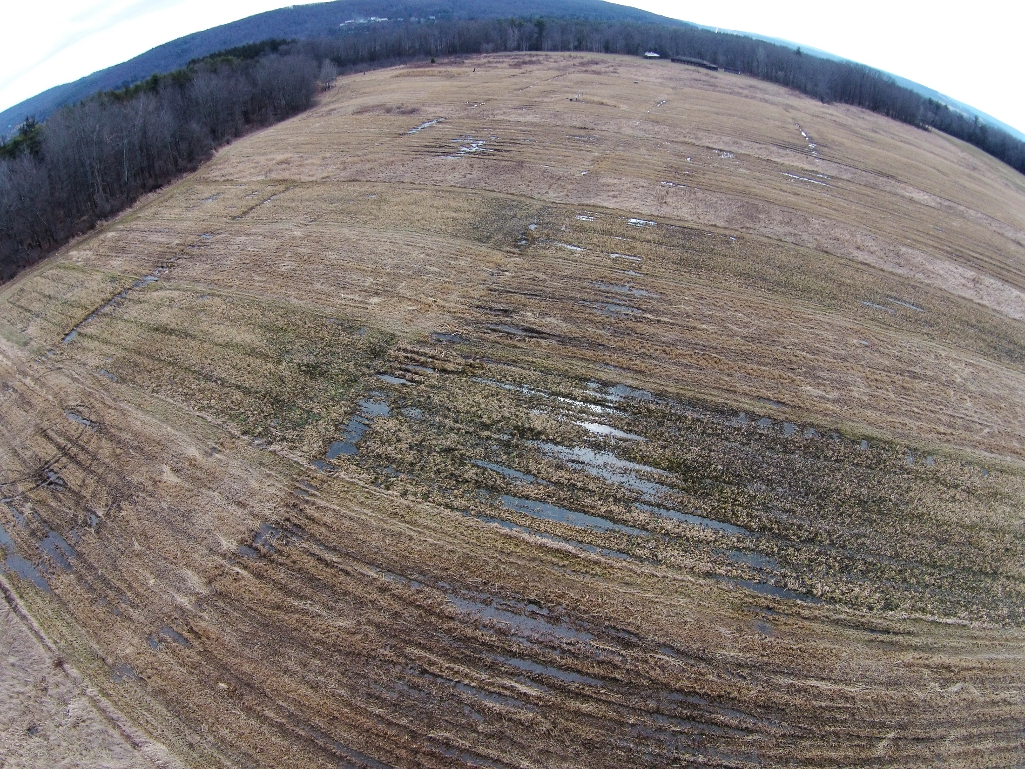
Employing Legacy Road Salt and Soil Electrical Conductivity as Tracers to Unlock Glyphosate Transport Processes in a Variable Source Area
Emma Payne (emp224@cornell.edu)
Steven Pacenka, Brian Richards, Naaran Brindt, Anna Schatz, Tammo Steenhuis

Slide 2
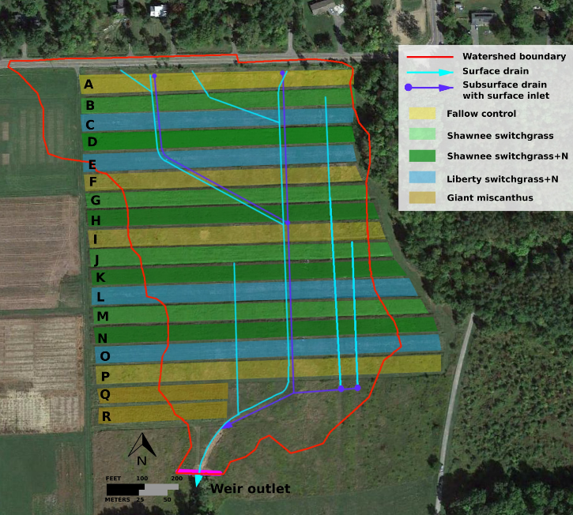
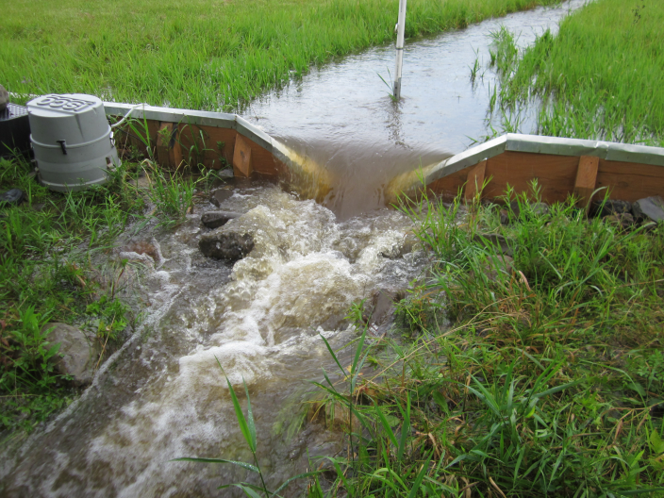
Study Site and Glyphosate Application
Glyphosate is applied annually in the spring
Discharge is measured at an outlet weir. Runoff samples are collected from the weir and analyzed for glyphosate and electrical conductivity
4.9 ha standalone watershed in Ithaca, NY USA, classified as variable source area

Slide 3
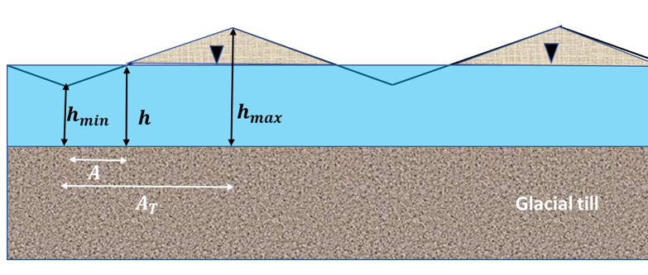
Theory: Glyphosate/EC Ratio
1. Glyphosate travels in surface runoff, EC in subsurface
$$\text{Cc}\text{0− }\text{initial} \text{mass} \text{of} \text{EC}$$
3. In a variable source area, the surface runoff
increases with the saturated area
$R$- rainfall rate
$A_{s}$- saturated area
$$Q_{s}\left(t\right)=R\left(t\right)∗A_{s}$$
4. Extent of saturation (A_{s}) is a function of the water table height
EC concentration: $C_{c}\left(t\right)=\frac{C_{c }^{0}Q_{b}\left(t\right)}{Q_{T}\left(t\right)}$
Glyphosate conc.: $C_{g}\left(t\right)=\frac{C_{g }^{0}Q_{s}\left(t\right)}{Q_{T}\left(t\right)}$
$$\frac{C_{g}\left(t\right)}{C_{c}\left(t\right)}=\frac{C_{g }^{0}Q_{s}\left(t\right)}{C_{c }^{0}Q_{b}}$$
$Q_{b}$- baseflow
$Q_{s}$ - surface runoff
$Q_{T}$- total flow
$C_{c }^{0}$- initial mass of EC
$C_{g }^{0}$- initial mass of glypho.
$$\frac{C_{g}\left(t\right)}{C_{c}\left(t\right)}=α\frac{{h\left(t\right)−h}_{min}}{h_{max}−h_{min}}$$
h- water level height in piezometer
$α$=f(glyphosate mass, rainfall rate, initial EC, baseflow, adsorption partition coefficient, mixing volume)

Slide 4
Results: Glyphosate/EC Ratio
The ratio of glyphosate to EC increases with the water table height during storms

Slide 5
Results: Glyphosate/EC Ratio (cont.)
Linear slope decreases during the campaign as less glyphosate mass is available for transport due to degradation and increasing adsorption to the soil matrix

Slide 6
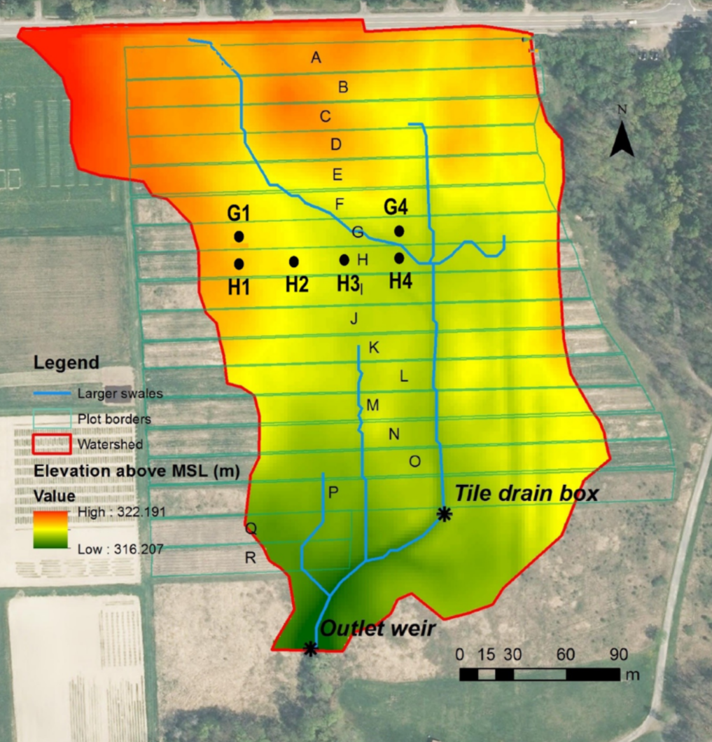
How can we use electrical conductivity as a tracer to improve our understanding of glyphosate transport?
I. Experimental Procedure
II. Results
As flow increased, glypho-sate conc. increased and EC decreased
III. Discussion
Linear relationship can be derived theoretically assuming:
Adsorbed solutes (glyphosate) travel in surface runoff
Dissolved solutes (EC) travel in subsurface
During a storm, surface runoff increases with saturated area
Extent of saturation is a function of water table heighted
Discharge (L/s), EC (uS/m)
Glyphosate was applied annually over a three-year period to a 4.9 ha water-shed in Ithaca, NY. USA.
Water samples were collected at the outlet
Samples were analyzed for glyphosate and electric conductance
.
The ratio of glyphosate to EC increased linearly with discharge
Linear slope decreases due to glyphosate degradation

