Slide 1


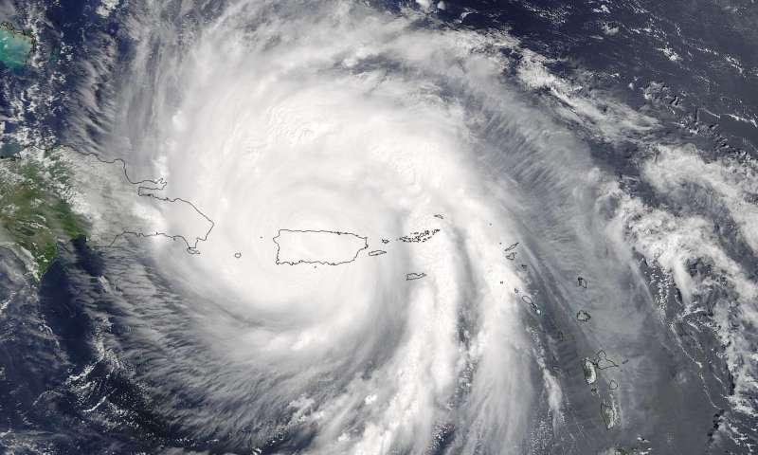



Assessing current and future flood risk estimates associated with hurricane rainfall under the 1.5°C and 2°C Paris Agreement targets in Puerto Rico
Leanne Archer, Dr Jeffrey Neal, Professor Paul Bates, Emily Vosper, Dr Dann Mitchell
NH9.5 Natural hazard event analyses for risk reduction and climate adaptation
Weds 28th April @ 15:37pm (CEST)
Hurricane Maria (2017) - © NASA Goddard Space Flight Center
leanne.archer@bristol.ac.uk
@leanne_archer_

Slide 2
Research Questions
1
What is the current risk of pluvial flooding associated with hurricane rainfall in Puerto Rico?
2
How does this risk change under 1.5°C and 2°C climate change?
3
How do intensity, duration, magnitude and spatial characteristics of hurricane rainfall influence flood estimates?
leanne.archer@bristol.ac.uk
@leanne_archer_

Slide 3
Producing an Event-Based Pluvial Flood Model
HAPPI GCM model ensemble (Mitchell et al., 2017)
Tropical Cyclone Rainfall Model (Vosper et al., 2020)
19,000 events
(present day)
20,000 events
(1.5°C)
20,000 events
(2°C)
LISFLOOD-FP ‘rain on grid’
Current flood risk
Future
flood risk
leanne.archer@bristol.ac.uk
@leanne_archer_
Notes:
Mitchell, D., Achutarao, K., Allen, M., Bethke, I., Beyerle, U., Ciavarella, A., Forster, P.M., Fuglestvedt, J., Gillett, N., Haustein, K., Ingram, W., Iversen, T., Kharin, V., Klingaman, N., Massey, N., Fischer, E., Schleussner, C.-F., Scinocca, J., Seland, Ø., Shiogama, H., Shuckburgh, E., Sparrow, S., Stone, D., Uhe, P., Wallom, D., Wehner, M., Zaaboul, R., 2017. Half a degree additional warming, prognosis and projected impacts (HAPPI): background and experimental design. Geosci. Model Dev 10, 571–583. https://doi.org/10.5194/gmd-10-571-2017
Sampson, C.C., Bates, P.D., Neal, J.C., Horritt, M.S., 2013. An automated routing methodology to enable direct rainfall in high resolution shallow water models. Hydrological Processes 27, 467–476. https://doi.org/10.1002/hyp.9515
Vosper, E.L., Mitchell, M., Emanuel, K., 2020. Extreme Hurricane Rainfall affecting the Caribbean mitigated by the Paris Agreement Goals. Environmental Research Letters 15, 10. https://doi.org/10.1088/1748-9326/ab9794

Slide 4
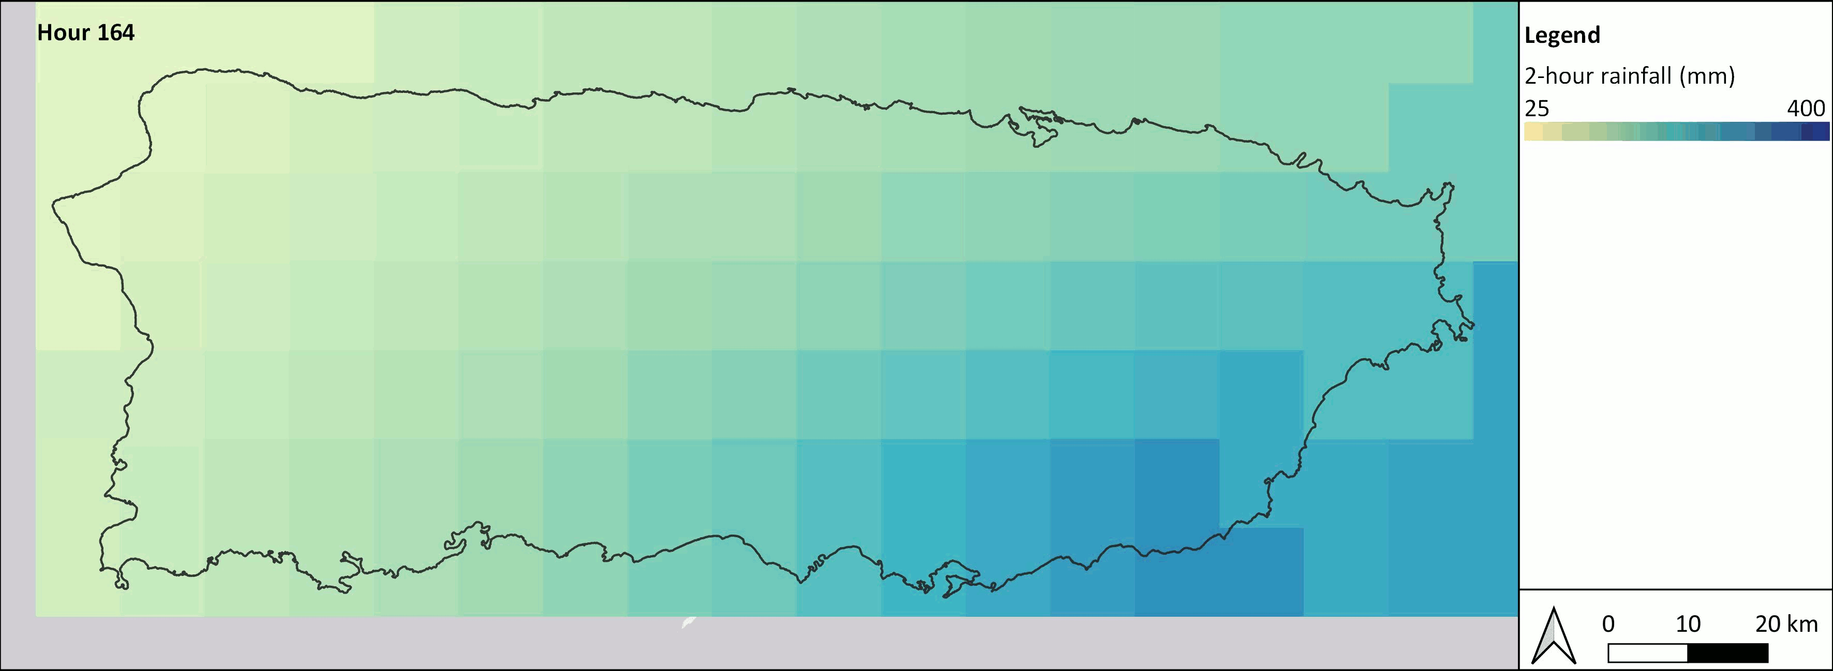
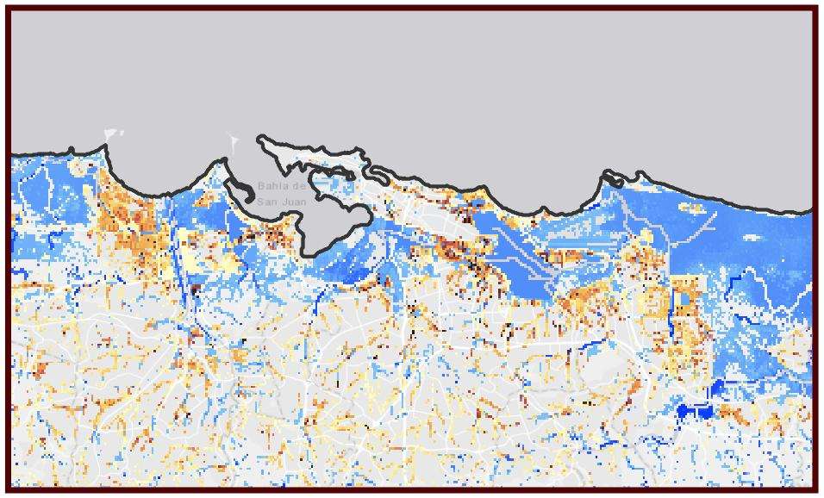
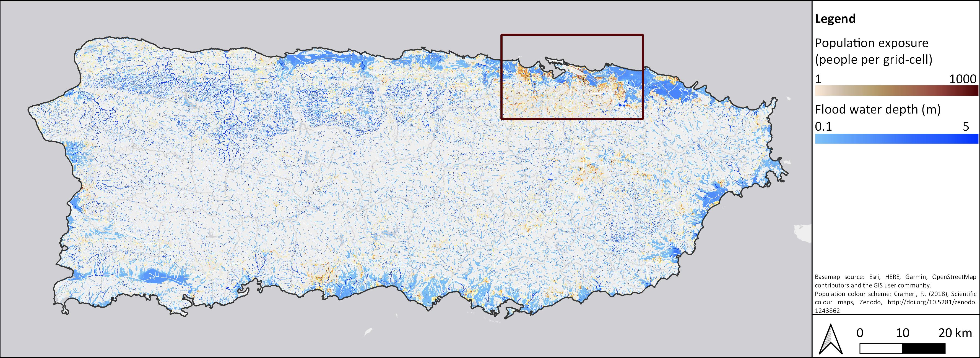
Producing an Event-Based Pluvial Flood Model
Hurricane rainfall event
Flood hazard and exposure
leanne.archer@bristol.ac.uk
@leanne_archer_

Slide 5
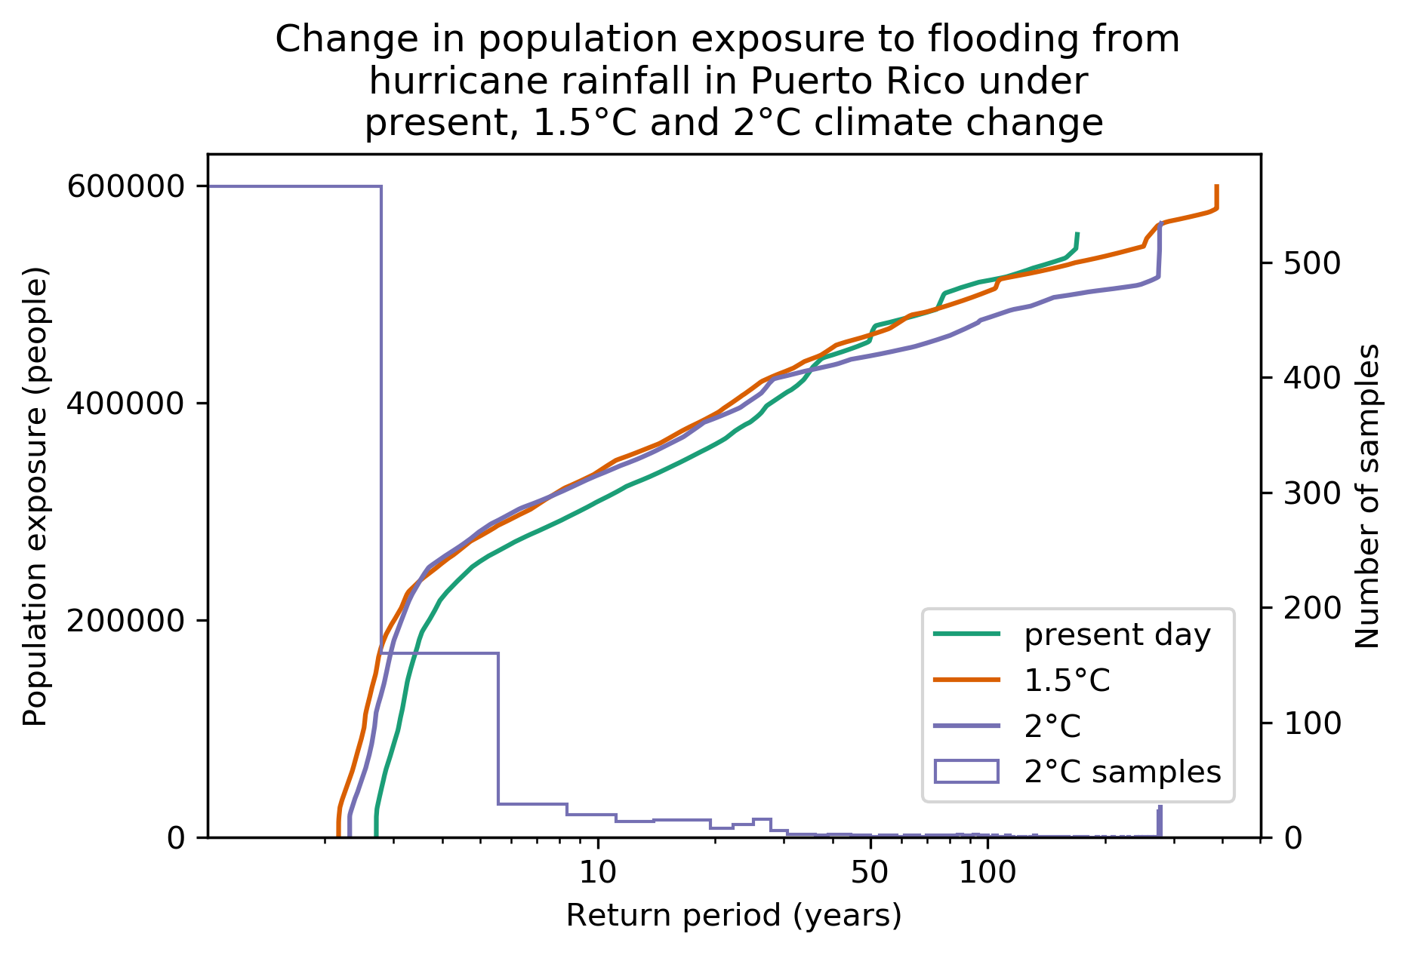
Initial Findings: Changes in Population Exposure
Number of samples too limited to draw conclusions at the larger magnitude events
Increase in population exposure to lower return periods
leanne.archer@bristol.ac.uk
@leanne_archer_

Slide 6
Next Steps
1
Run the event based pluvial model at 20m model resolution
Thanks for stopping by!
Feel free to contact us for more information
leanne.archer@bristol.ac.uk
@leanne_archer_
…or drop by our vPICO:
2
Validate the event based pluvial model against Hurricane Maria
NH9.5 Natural hazard event analyses for risk reduction and climate adaptation
Weds 28th April @ 15:37pm (CEST)
leanne.archer@bristol.ac.uk
@leanne_archer_

