Slide 1



New insights into the ice-covered Southern Ocean circulation from multi altimeter combination
M. Auger^{1,2} , J-B. Sallée¹, P. Prandi²
¹LOCEAN, Sorbonne Université, Paris, France
² Collecte Localisation Satellite (CLS), Toulouse, France
Matthis Auger (LOCEAN, CLS) - matthis.auger@locean-ipsl.upmc.fr - EGU21
Notes:
Ajouter l’isobathe 1200m à toutes les cartes EOFs.

Slide 2
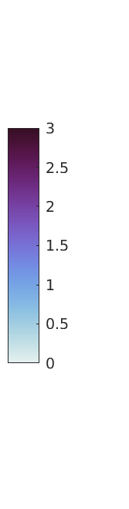
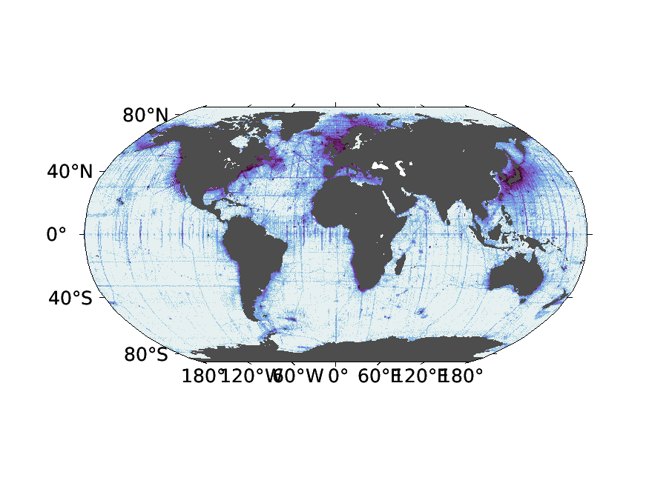
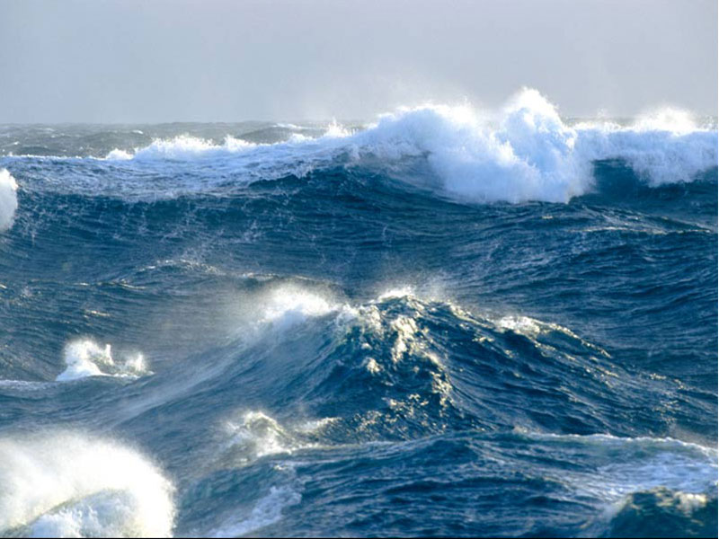
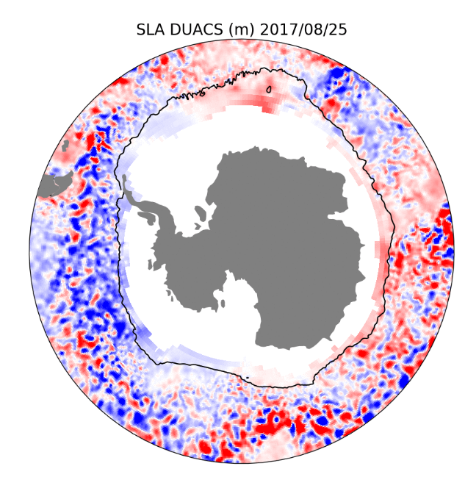
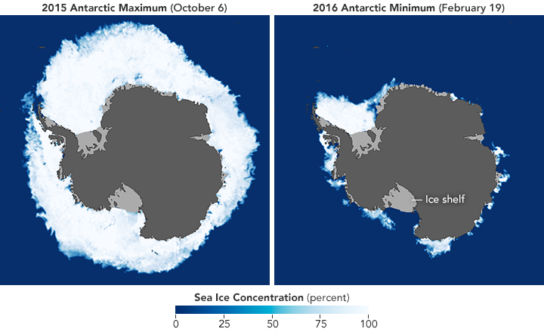
Introduction
The issue of the lack of observations in the Southern Ocean
LOG10 number of ship data in the global ocean
DUACS SLA map (from satellite altimetry)
Matthis Auger (LOCEAN, CLS) - matthis.auger@locean-ipsl.upmc.fr - EGU21

Slide 3
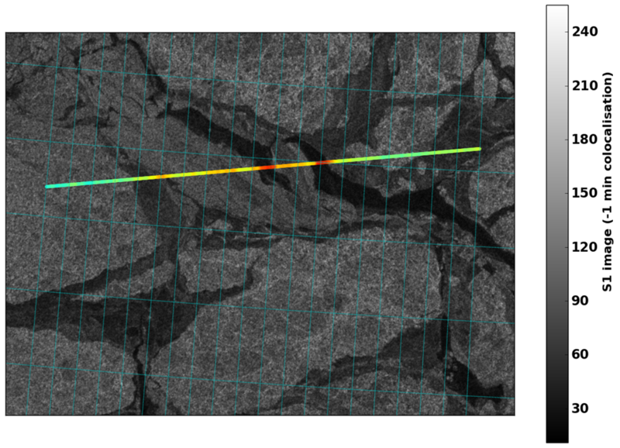
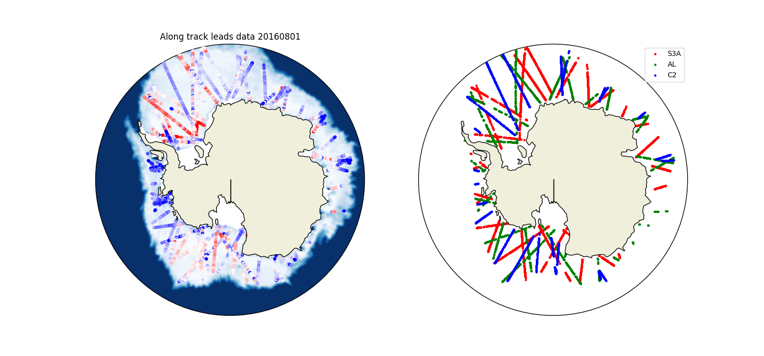
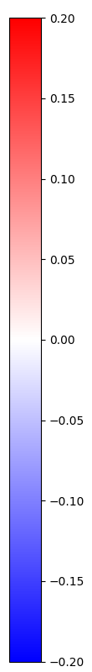
Using radar altimetry in sea ice zones
Sea level Anomalies are obtained using measurements in the leads, distinguished thanks to a dedicated waveform classification algorithm (Poisson et al. (2018), validated with SAR Imagery in Longépé et al. (2019))
Multimission Analysis allows a better temporal and spatial resolution
Matthis Auger (LOCEAN, CLS) - matthis.auger@locean-ipsl.upmc.fr - EGU21
Notes:
Ajouter une slide sur satellite altimetry d’abord ?

Slide 4
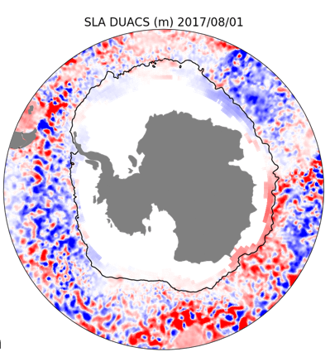
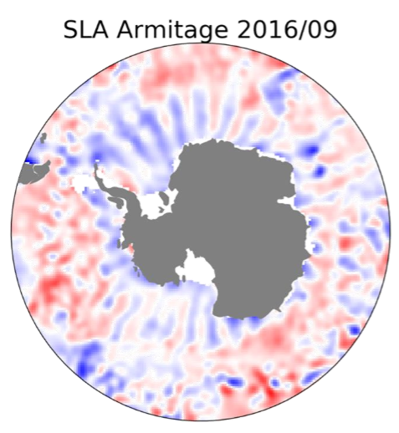
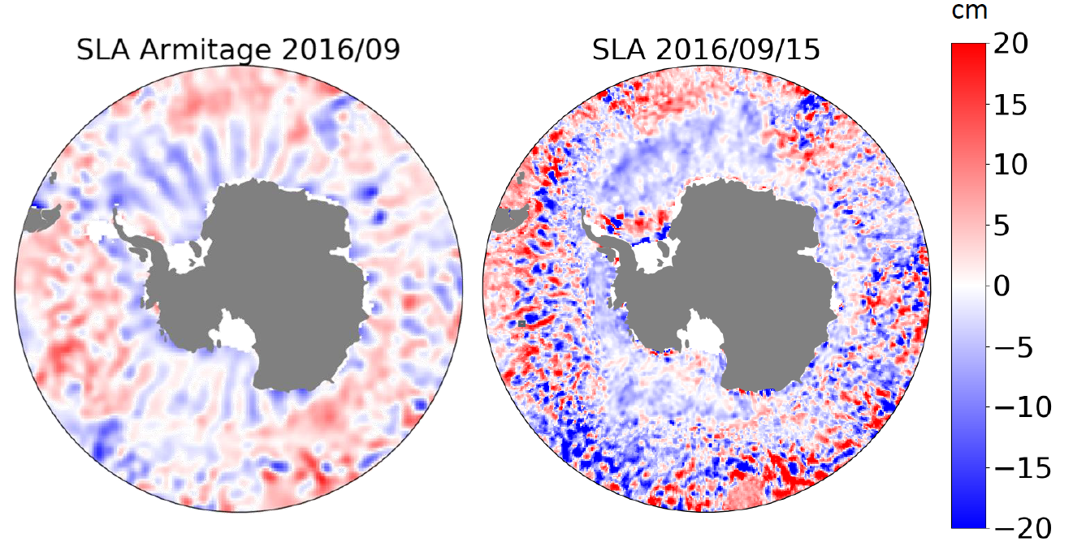
What is already done
T. Armitage (2018) SLA:
Cryosat-2 monthly SLA
50km grid
Data in sea ice zones for the first time
DUACS SLA product:
Daily Multi-mission global SLA product
No data in sea ice zones
3% Sea Ice Concentration
T. Armitage 2016 SLA maps
Matthis Auger (LOCEAN, CLS) - matthis.auger@locean-ipsl.upmc.fr - EGU21

Slide 5
A new daily multi-mission Southern Ocean SLA product
Southern Ocean product:
Daily Multi-mission global SLA product on a 25km grid
Continuity between sea ice zone and open ocean
2013-2019 Product
T. Armitage 2016 SLA maps
Matthis Auger (LOCEAN, CLS) - matthis.auger@locean-ipsl.upmc.fr - EGU21

Slide 6
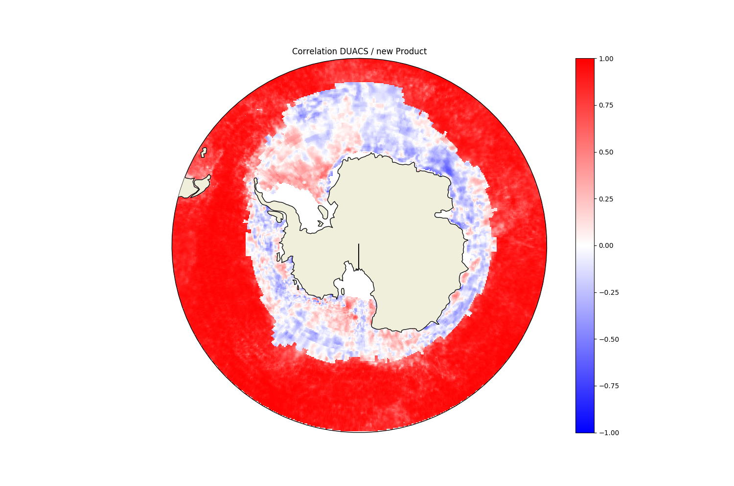
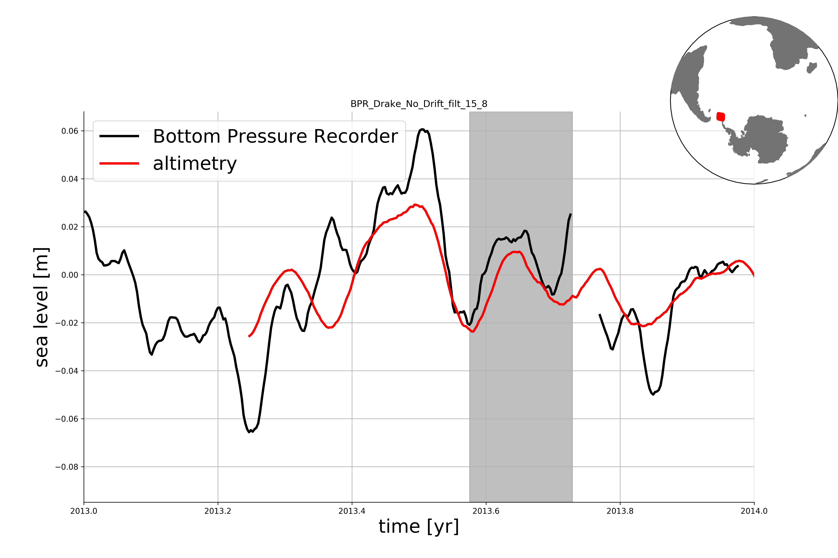
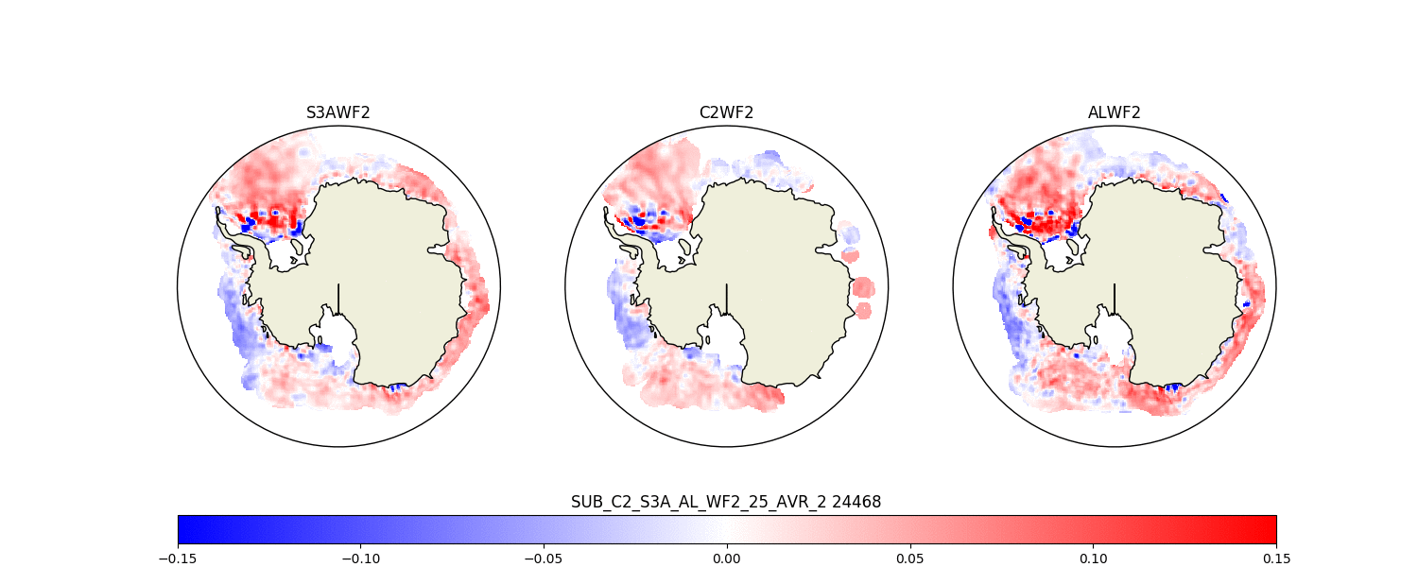
Validation of the SLA product
Concordance between SLA under sea-ice from various altimeters
Correlation with DUACS outside the seasonal ice zone
Comparison with BPR
Matthis Auger (LOCEAN, CLS) - matthis.auger@locean-ipsl.upmc.fr - EGU21

Slide 7
From this product:
Two ongoing projects:
Seasonal Cycle of the subpolar Southern Ocean SLA and Geostrophic Circulation and associated forcings
Eddy identification and tracking in the Subpolar Southern Ocean.
Matthis Auger (LOCEAN, CLS) - matthis.auger@locean-ipsl.upmc.fr - EGU21

Slide 8
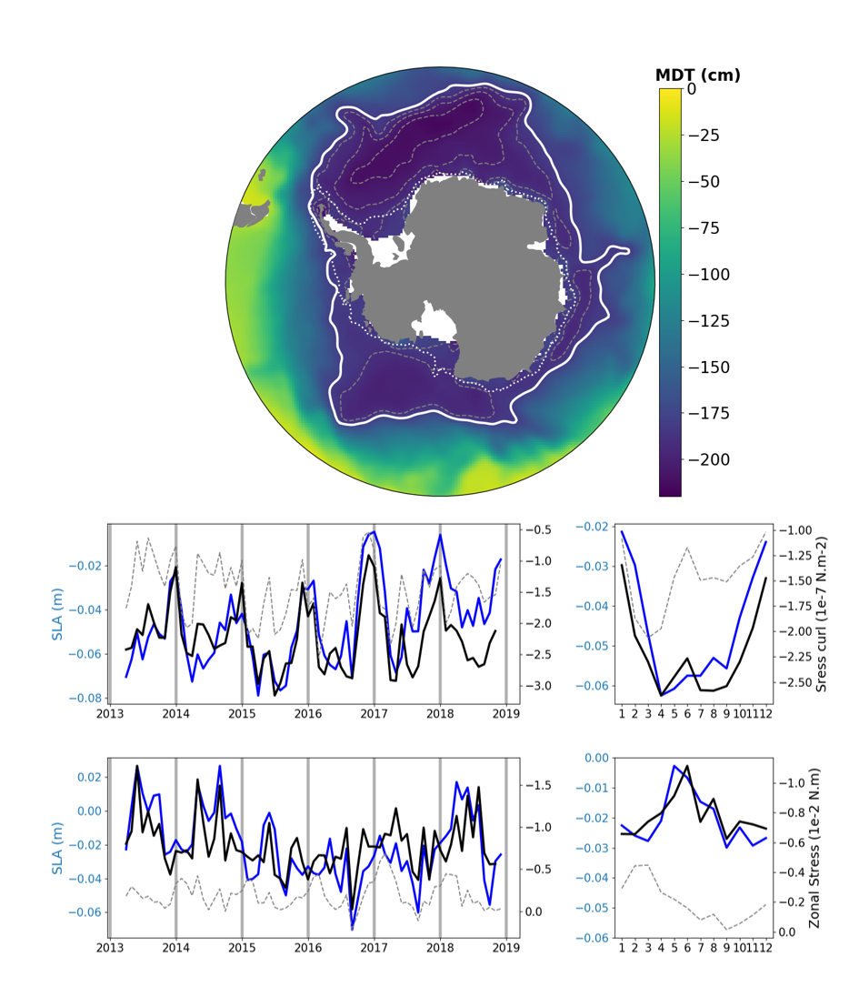
Seasonal Cycle of the subpolar Southern Ocean SLA and Geostrophic Circulation and associated forcings
MDT 180 cm
Offshore
Onshore
Bathymetry 1000m
Armitage (2018) MDT
Matthis Auger (LOCEAN, CLS) - matthis.auger@locean-ipsl.upmc.fr - EGU21

Slide 9
Seasonal Cycle of the subpolar Southern Ocean SLA and Geostrophic Circulation and associated forcings
OFFSHORE
Integrated SLA variations over the onshore and offshore subpolar Southern Ocean
SLA Wind Stress Curl
ONSHORE
SLA Zonal Wind Stress
Matthis Auger (LOCEAN, CLS) - matthis.auger@locean-ipsl.upmc.fr - EGU21

Slide 10
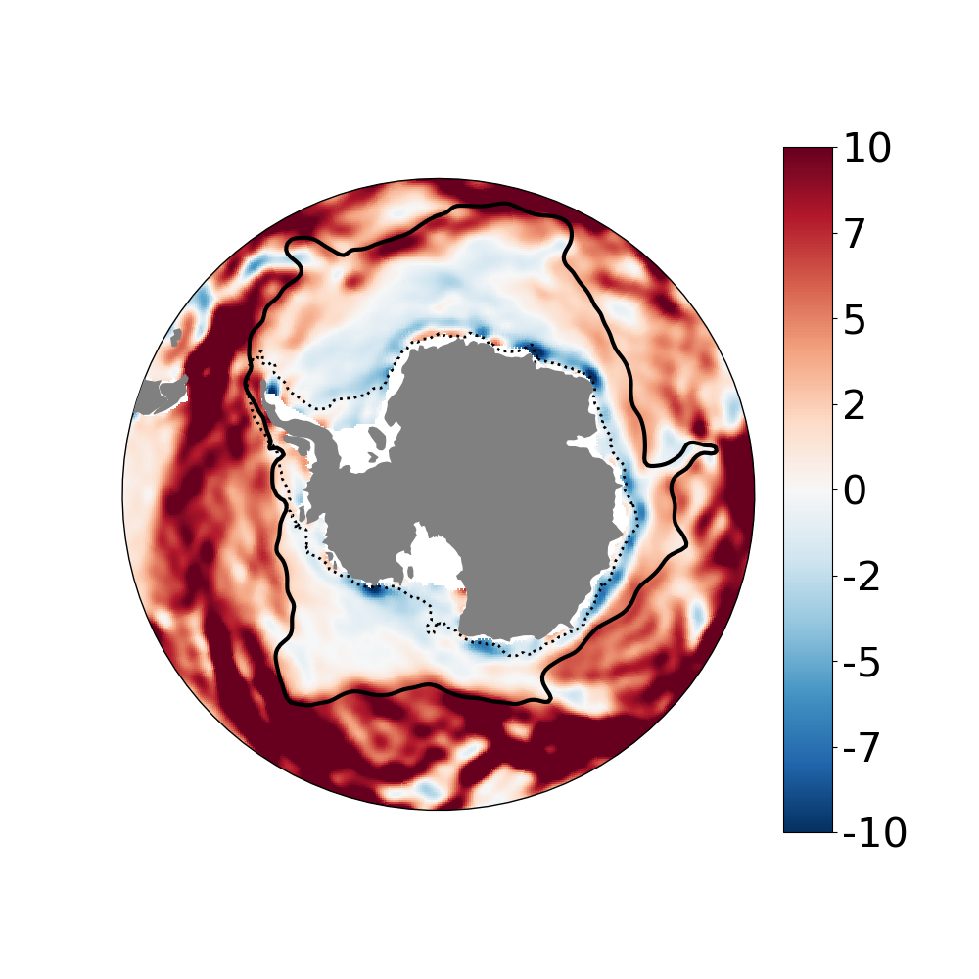
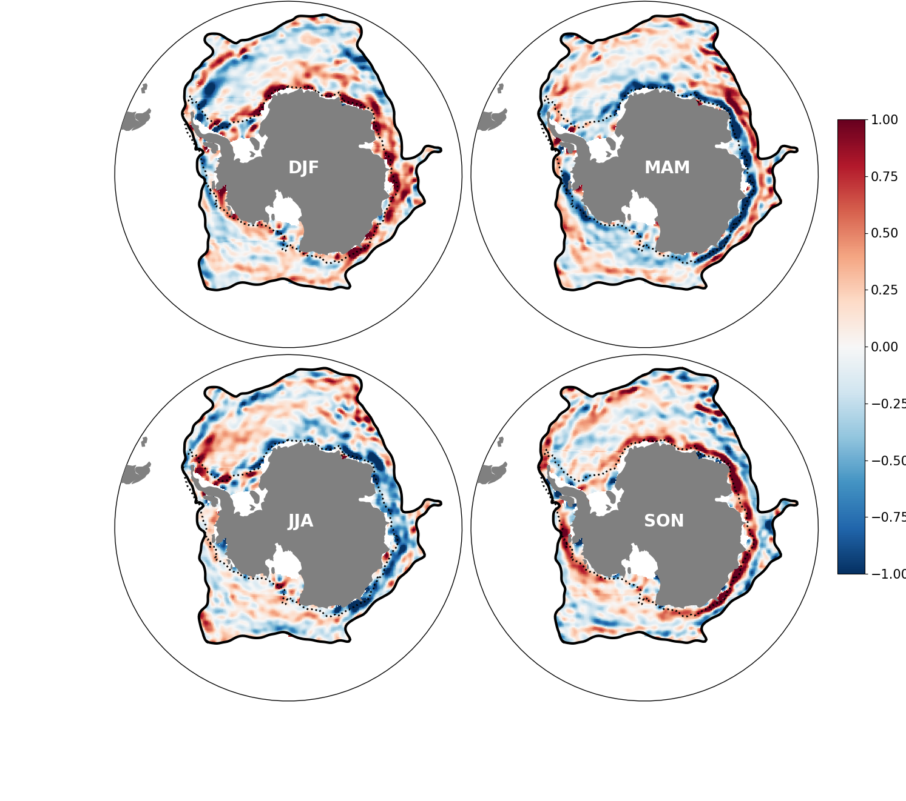
Seasonal Cycle of the subpolar Southern Ocean SLA and Geostrophic Circulation and associated forcings
cm/s
U Seasonal Variation
cm/s
MEAN U
Zonal Mean Circulation of the Southern ocean, from Armitage (2018) MDT
Seasonal cycle of the Circulation of the subpolar Southern ocean
Matthis Auger (LOCEAN, CLS) - matthis.auger@locean-ipsl.upmc.fr - EGU21

Slide 11
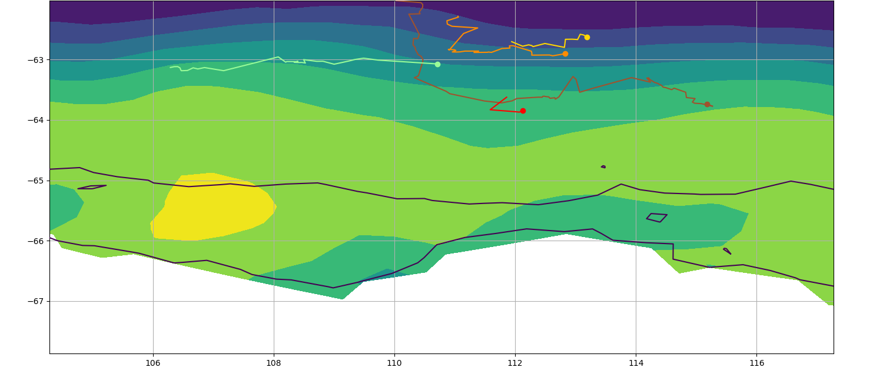
2. Eddy identification and tracking in the Subpolar Southern Ocean.
Snapshot of eddy tracking outputs in the sea-ice zones.
Sea Ice Concentration (%)
100
50
0
Matthis Auger (LOCEAN, CLS) - matthis.auger@locean-ipsl.upmc.fr - EGU21

Slide 12
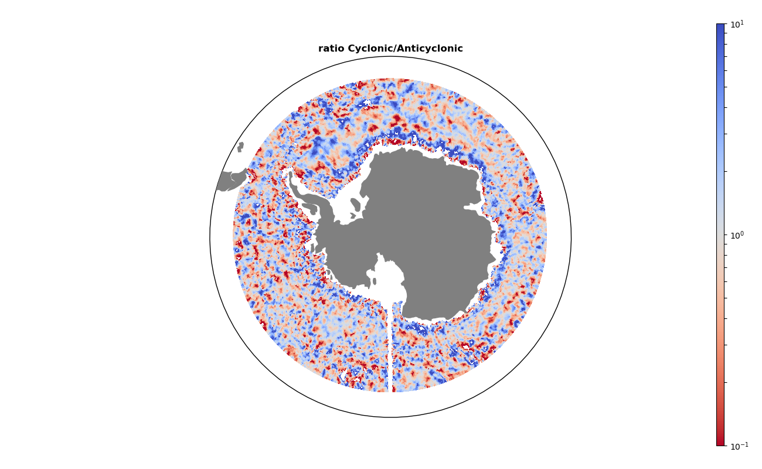
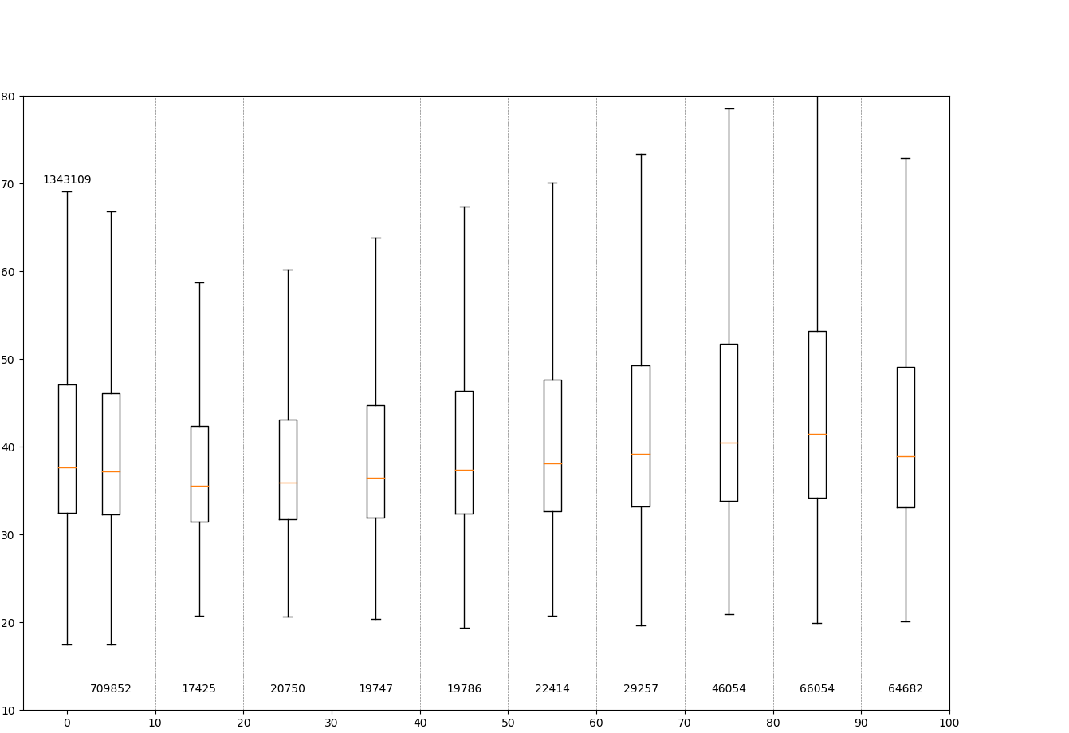
2. Eddy identification and tracking in the Subpolar Southern Ocean.
Some Diagnostics on the Subpolar Southern Ocean eddies
Eddy Radius vs Sea-Ice Concentration
Radius (km)
Number of eddies tracked
SIC (%)
Matthis Auger (LOCEAN, CLS) - matthis.auger@locean-ipsl.upmc.fr - EGU21

Slide 13
Conclusion
A new Southern Ocean Sea Level Anomaly product has been created, using multiple satellite altimeters.
Large Scale variation of the subpolar SLA shows a strong link with the wind stress seasonal cycle.
Eddy tracking and identification shows interesting results, but it is difficult to identify the features that could be influenced by the lower sampling in the sea-ice zones.
Matthis Auger (LOCEAN, CLS) - matthis.auger@locean-ipsl.upmc.fr - EGU21

Slide 14
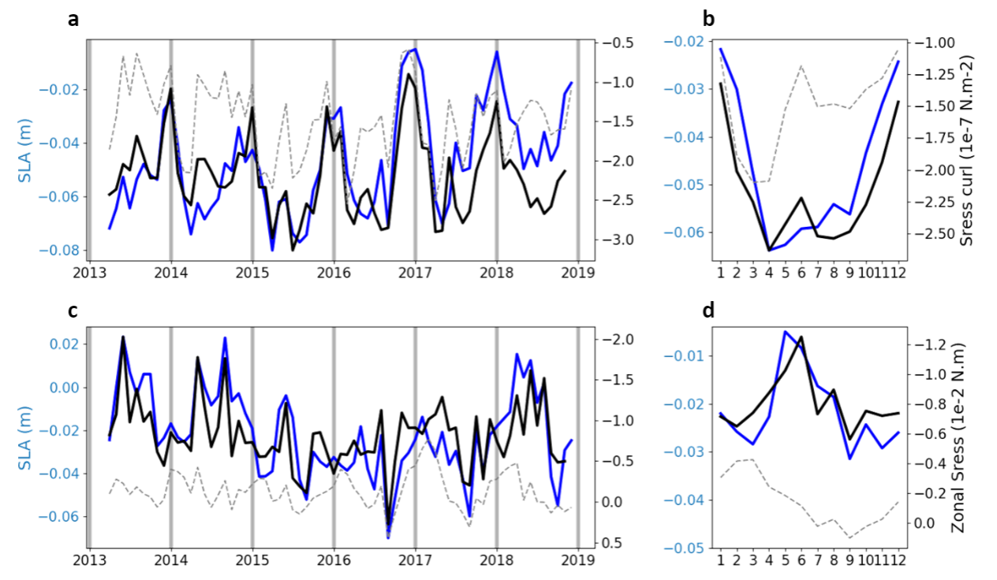
New insights into the ice-covered Southern Ocean circulation from multi-altimeter combination.
Matthis Auger^{1,2}, Jean-Baptiste Sallée¹, Pierre Prandi²
¹LOCEAN, Sorbonne Université, Paris, France
²Collecte Localisation Satellite, Toulouse, France
SLA and geostrophic circulation
New Sea Level Anomaly product over the ice-covered Southern Ocean
From 2013 to 2019
25 km grid
3 altimeters (Cryosat-2, Sentinel-3A, AltiKa)
Subpolar SO
offshore
Subpolar SO
onshore
Eddy tracking

