Slide 1


Hard X-ray impact on the ionospheric D-layer: new results from VLF measurements
C. Briand ⁽¹⁾
S. Inturi ⁽¹⁾
B. Cecconi⁽¹⁾
(1) LESIA, Observatoire de Paris-PSL, CNRS, SU, UP, France

Slide 2
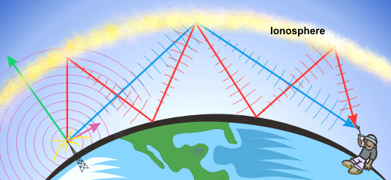
The Basics
VLF emission from ground-based transmitters are bounced back to Earth.
The signal at the receiver is the sum of a ground and a sky wave. The difference of path length change the amplitude and phase of the signal.
The electron density on the ionosphere mostly controls the reflection condition. During solar flares, the reflection height decays

Slide 3
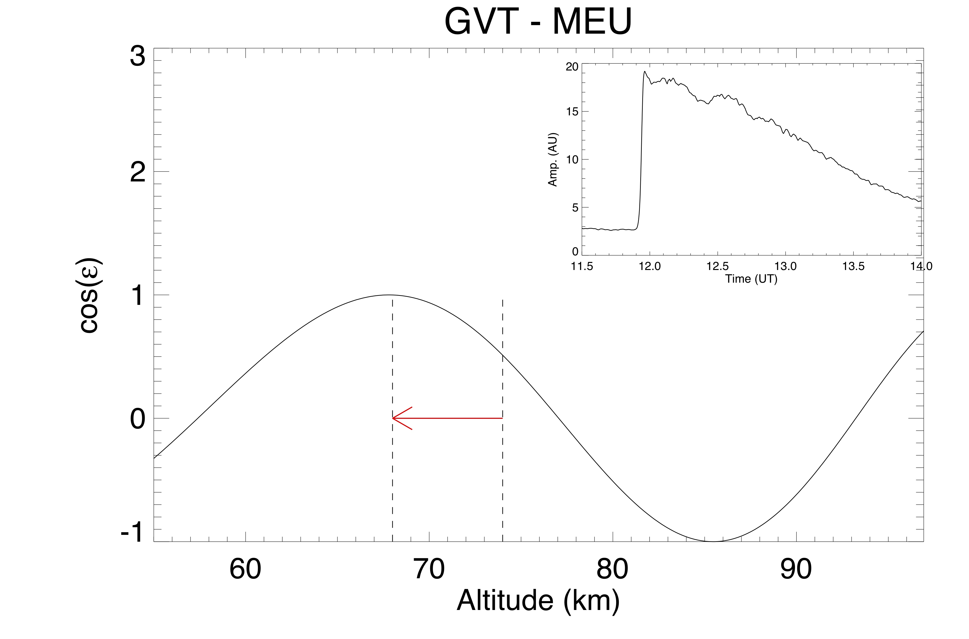
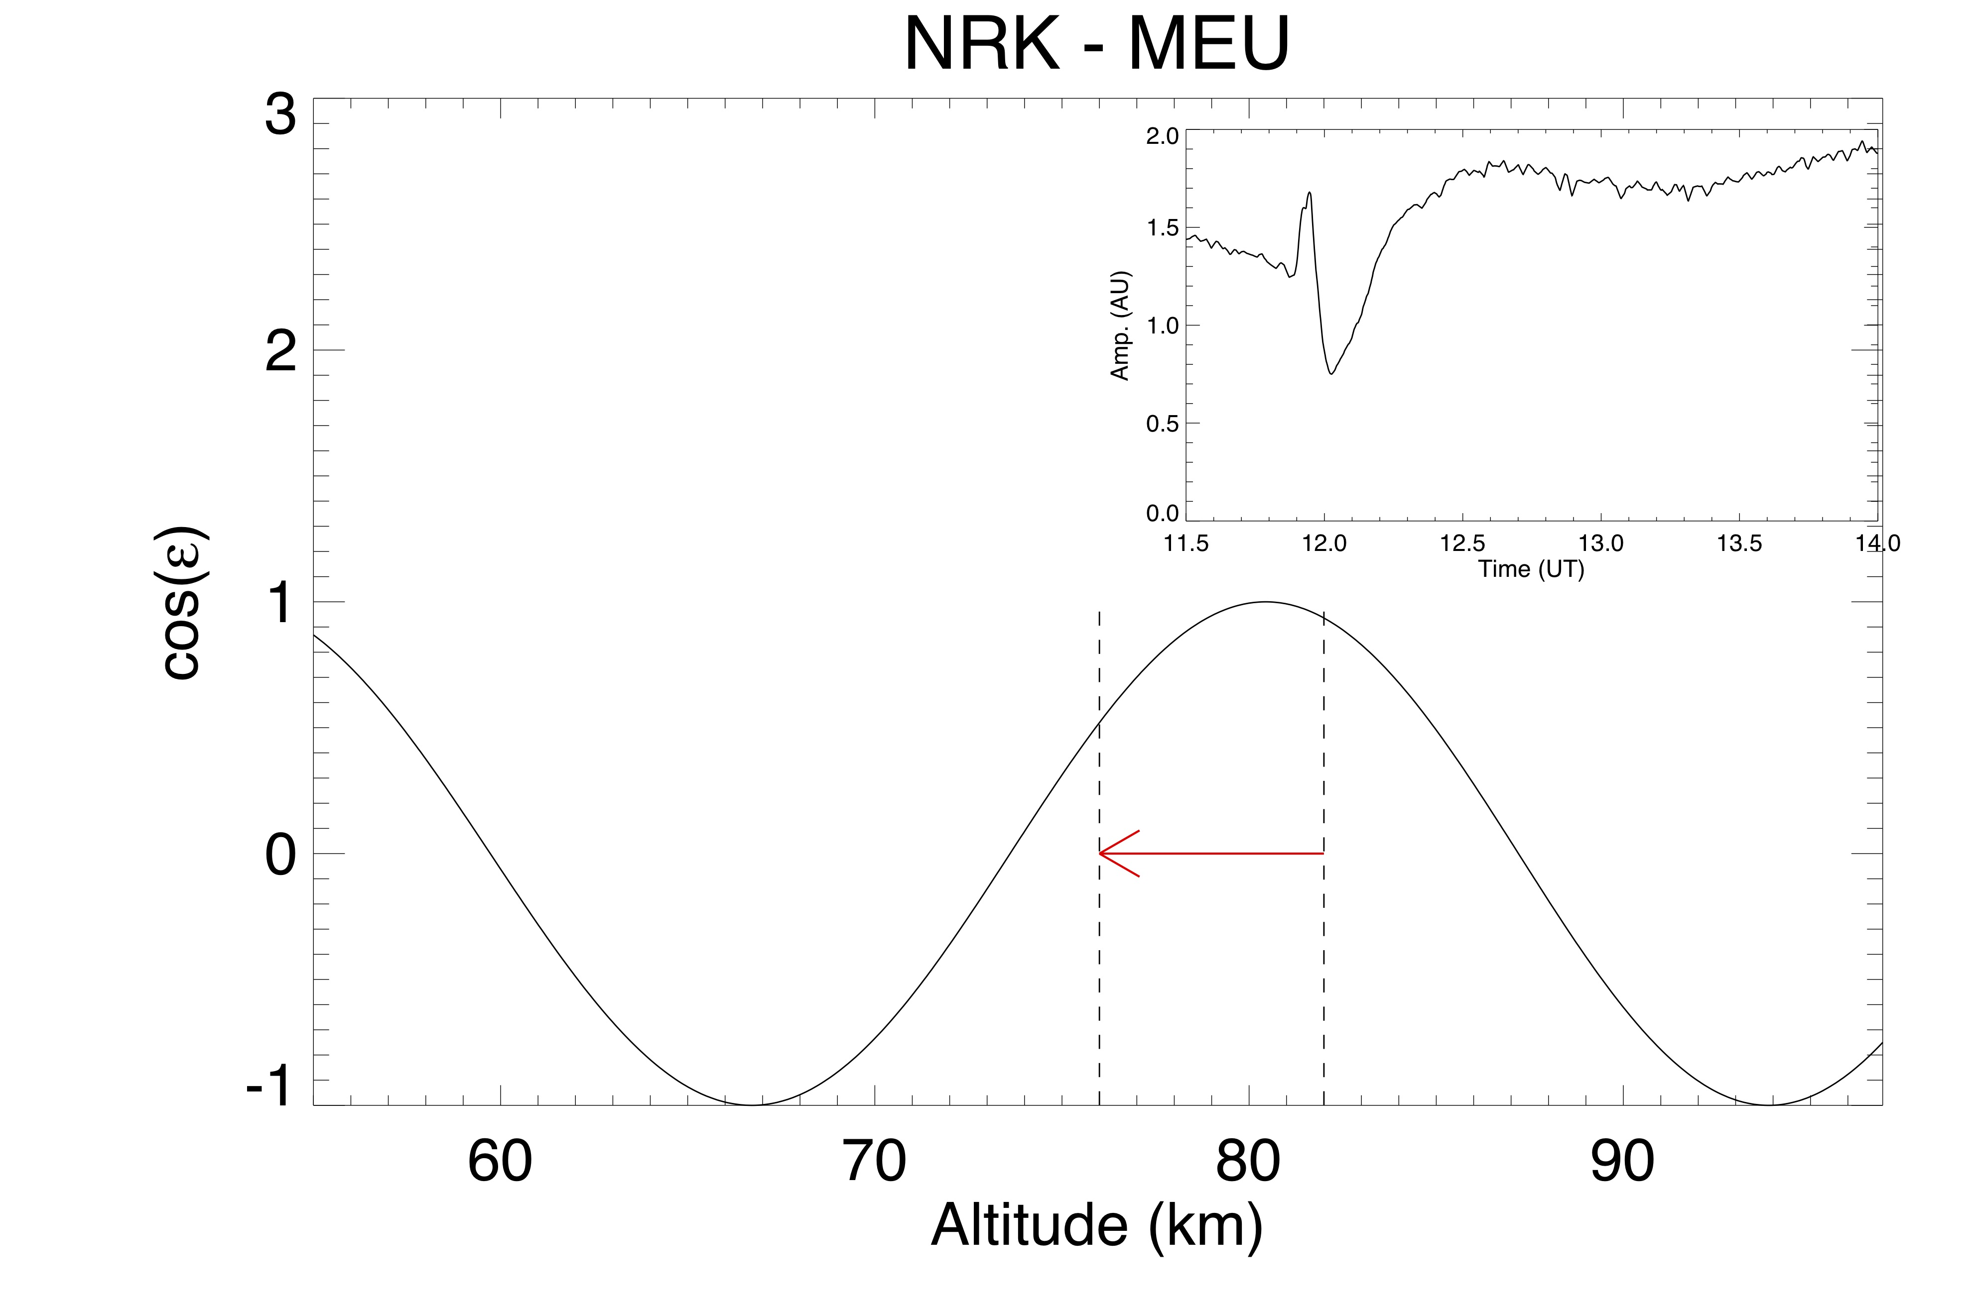
Observed profile
Observed profile
Interference pattern from GVT (UK) and Meudon (F) will always produces and increases of amplitude during flares …
… while an amplitude decrease is observed from NRK (Iceland) in case of very strong flares
Amplitude time-profile strongly depends on the interference figure

Slide 4
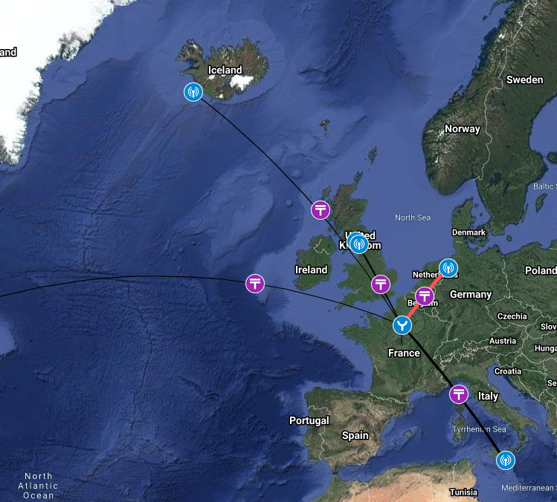
SuperSID (Stanford) antenna installed @Paris-Observatory, Meudon site (south of Paris)
It is tuned over 6 VLF stations since January 2017
It is almost free of EM-contamination
Only amplitude is recorded

Slide 5
VLF records from January 2017
In particular sEPTEMBER 2017 flares

Slide 6
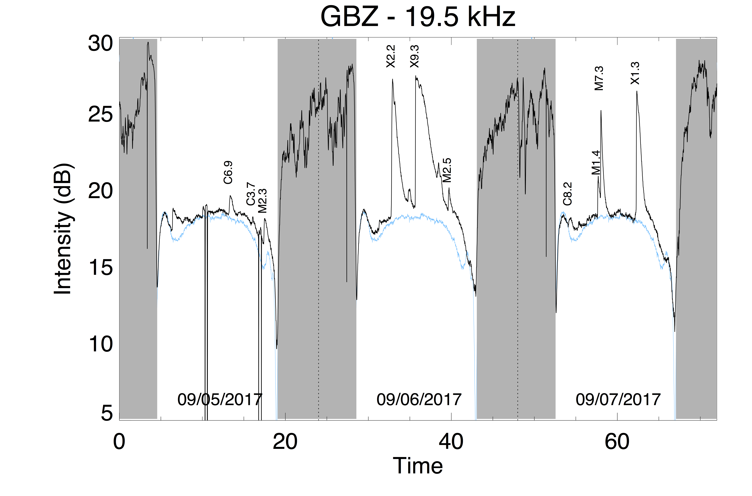
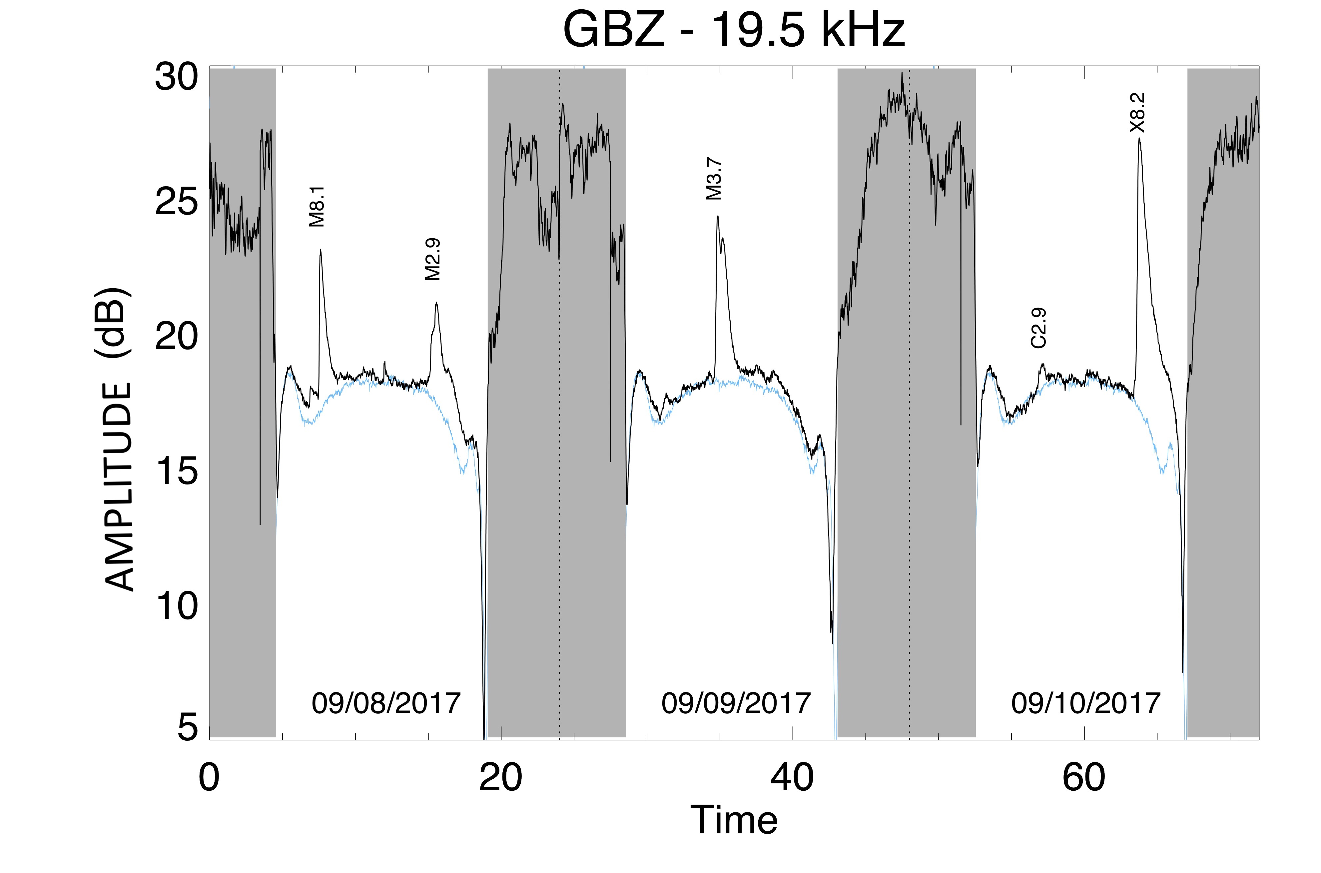
CONTEXT
30 flares in 2017, from C3.2 to X9.3
September 6 to September 10, 2017 : From X1.3 to X9.3 , the biggest since 1à years !
Well detected in VLF
The biggest event occurred at midday, thus with optimal conditions
Nighttime
Quiet day

Slide 7
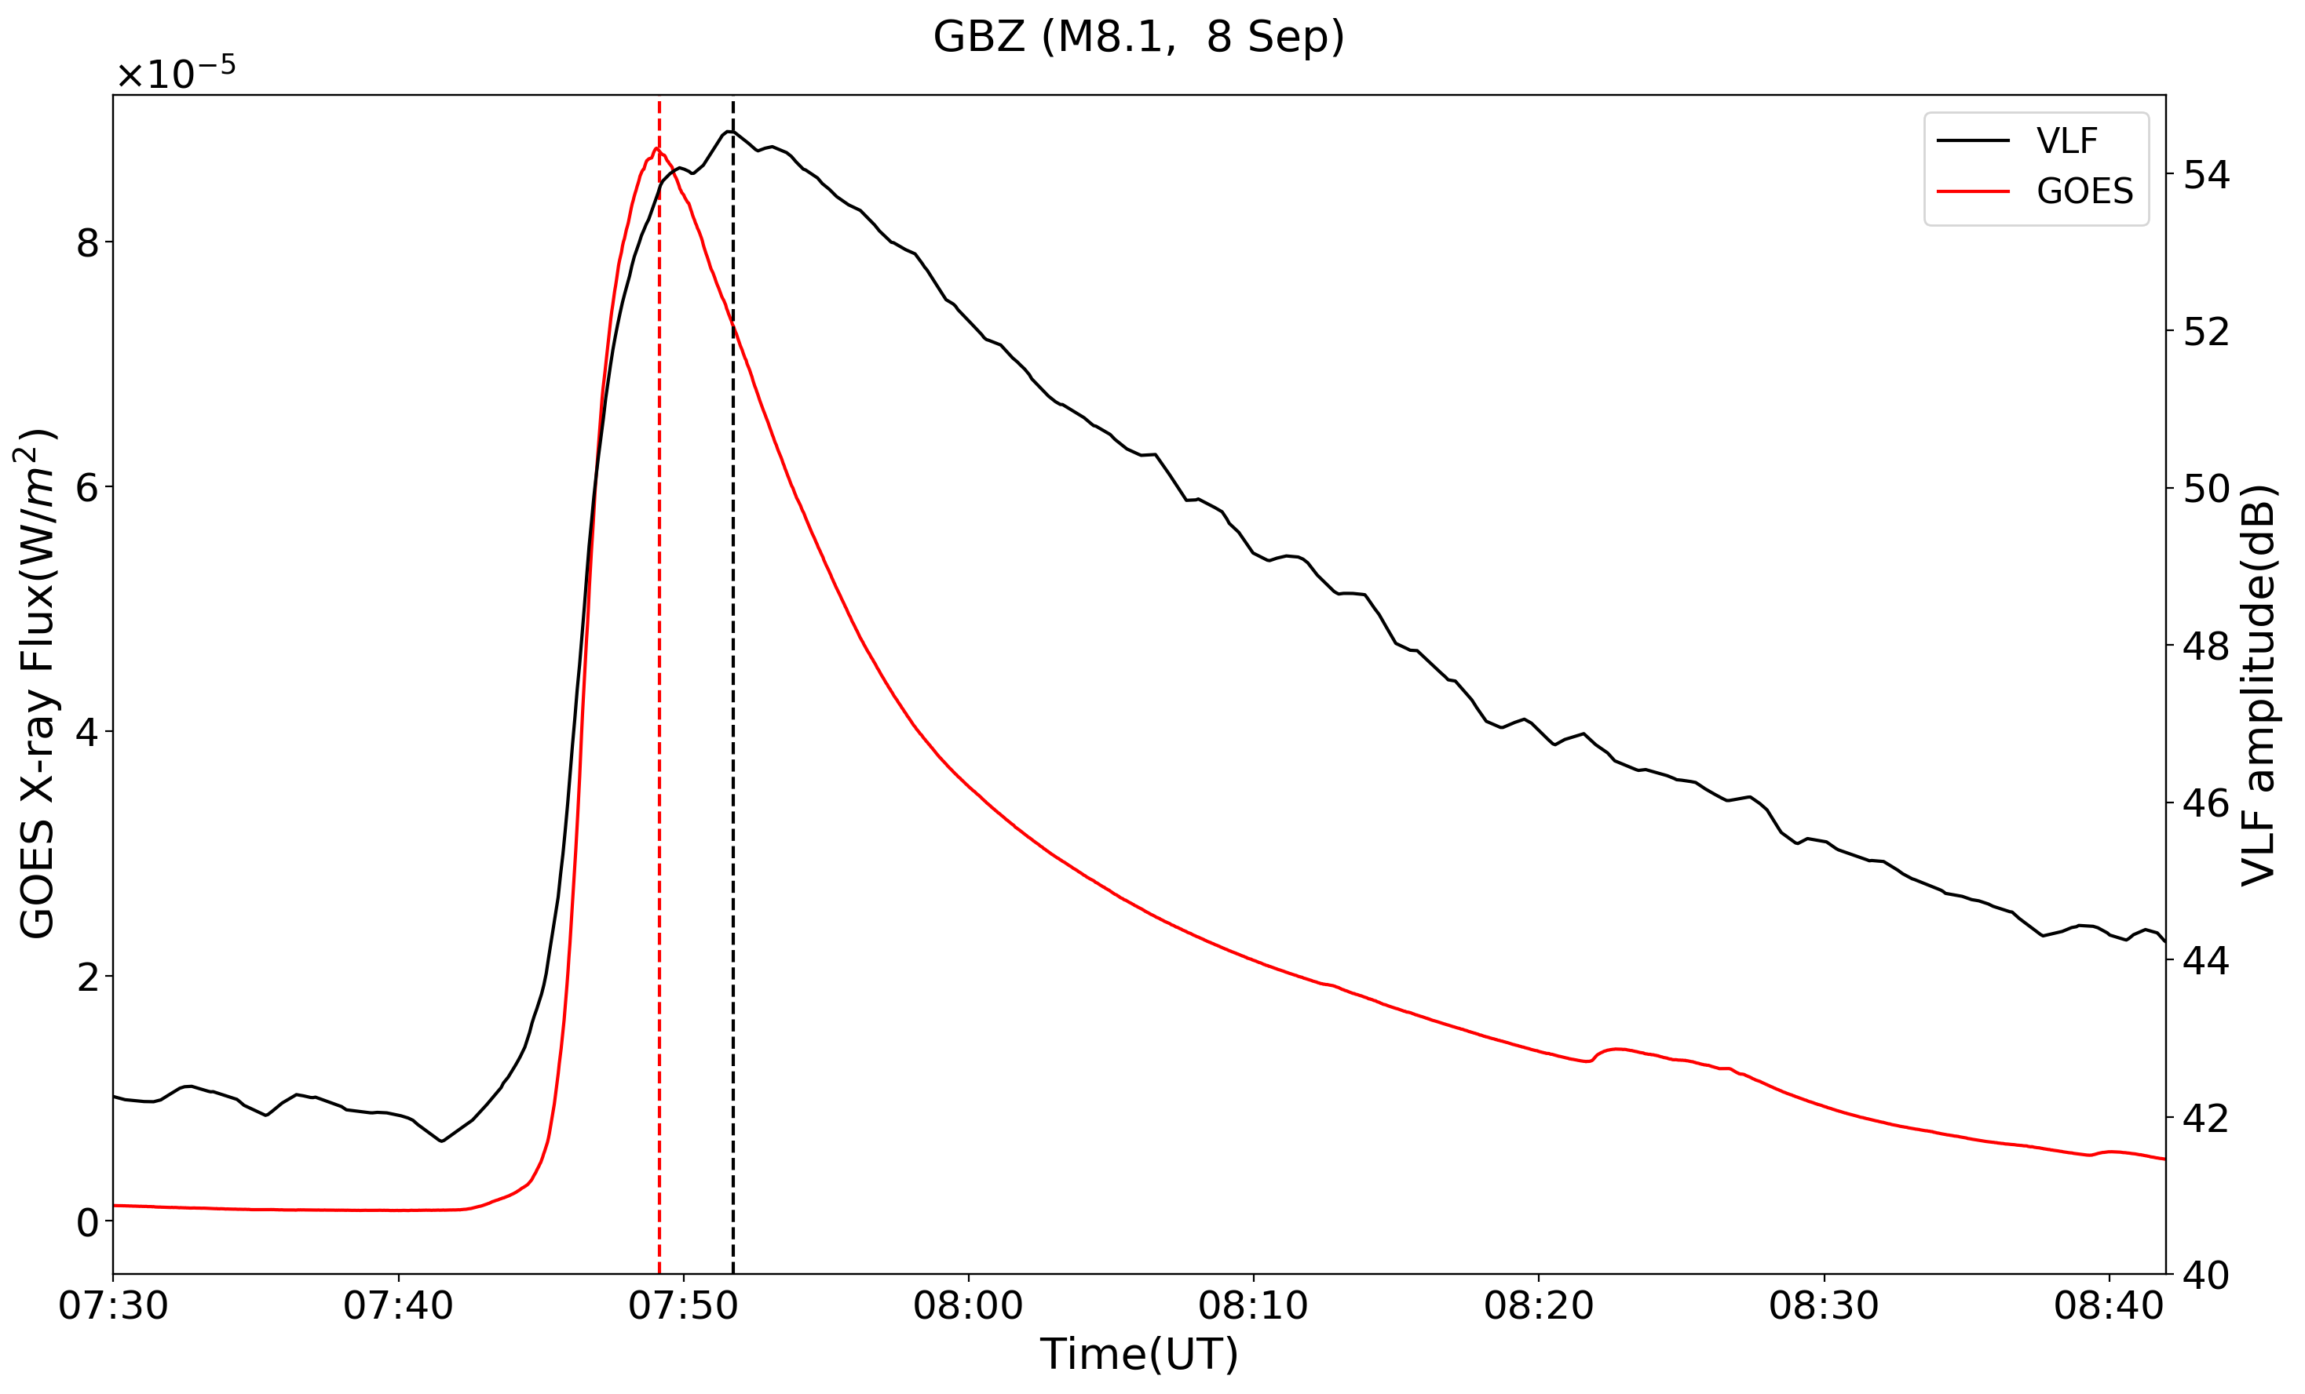
Time delay (Appleton1953; Zigman 2007; Palit 2015)
GVT (M8.1, Sept. 8)
VLF peak time
SXR peak time
Effective Recombination rate
Electron density

Slide 8
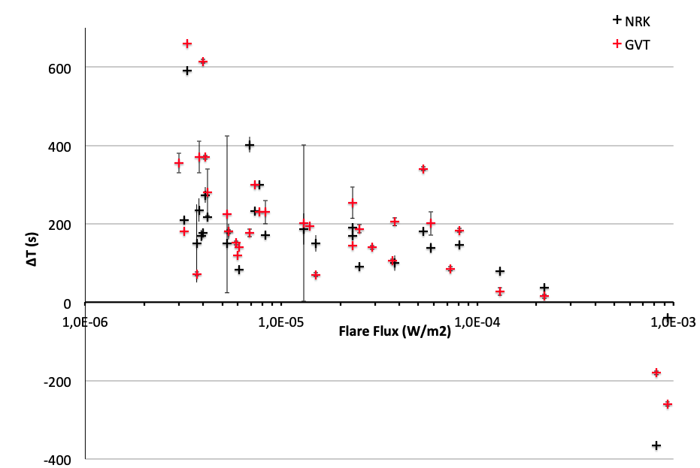
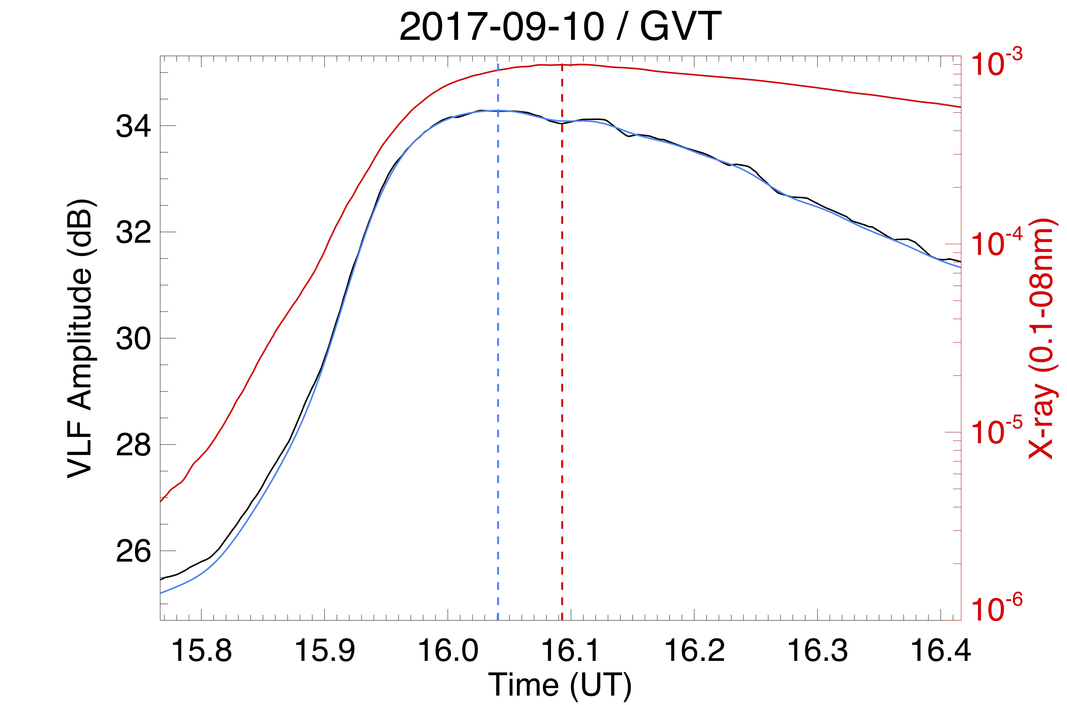
Δt decreases with increasing flare strength.
Results comparable to former authors.
But for very strong flares
Δt <0
(GOES peaks after VLF)

Slide 9
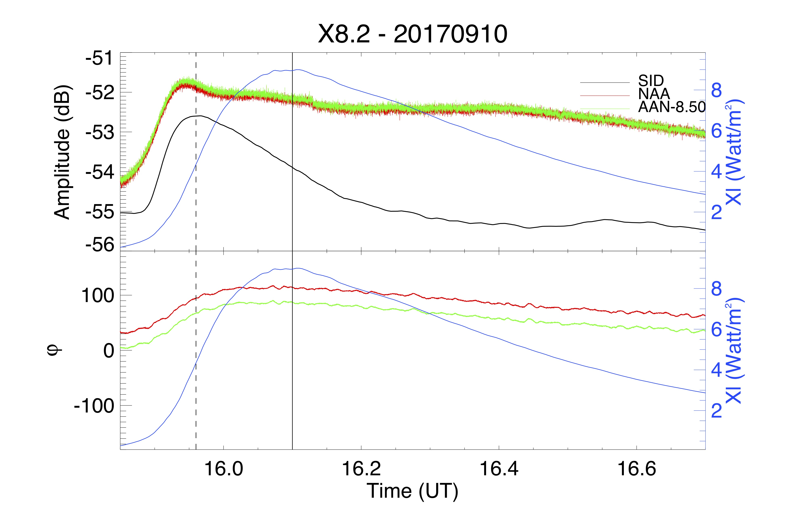
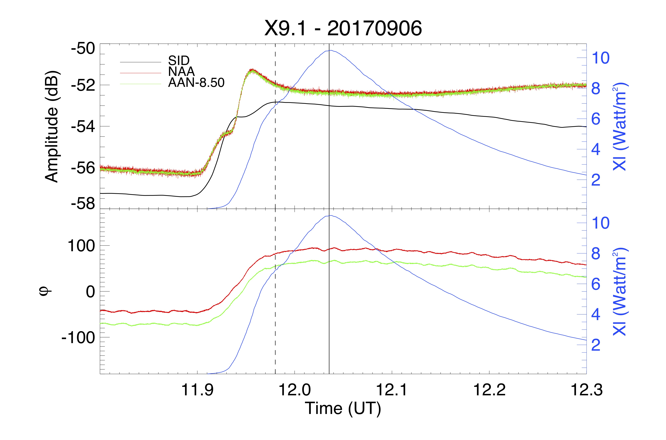
Also observed from Eskdalemuir (Scotland)
AARDDVARK network
ESK: green & red curves
GOES: Blue curve
SID_MEUDON: black curve
GOES Peak
VLF-MEUDON Peak

Slide 10

Hard X-ray:
RHESSI observation
Towards the true forcing source

Slide 11
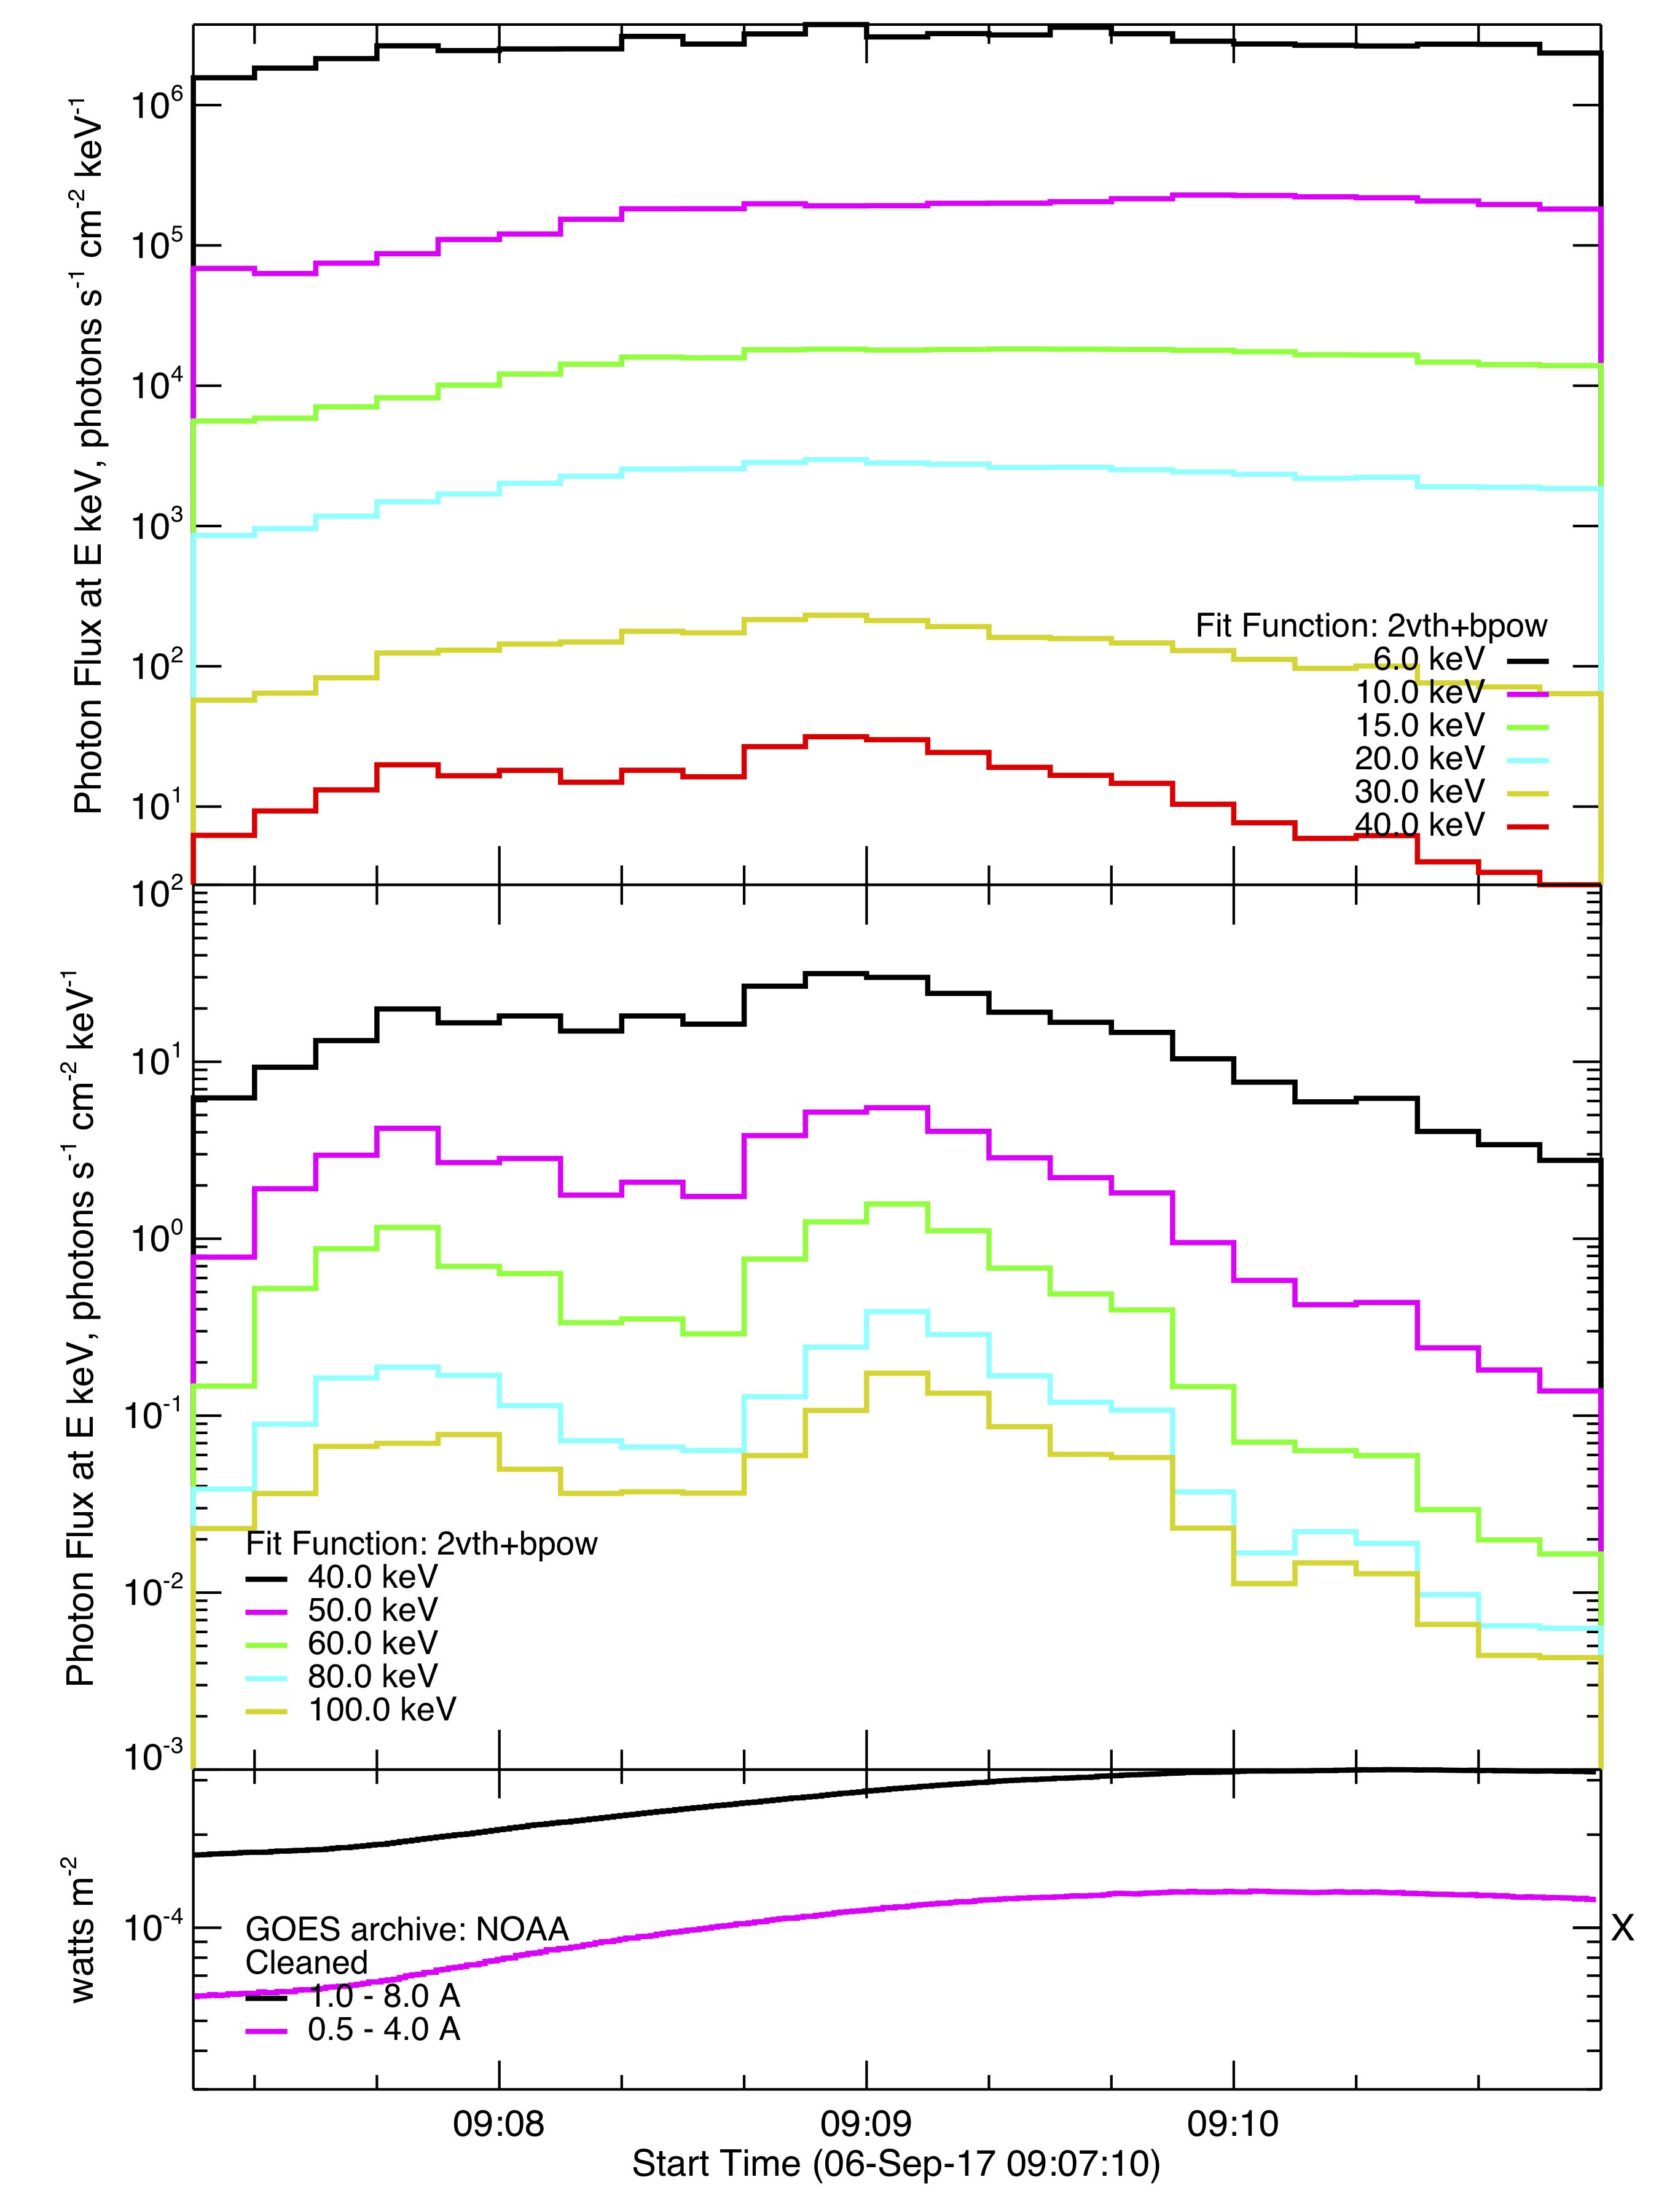
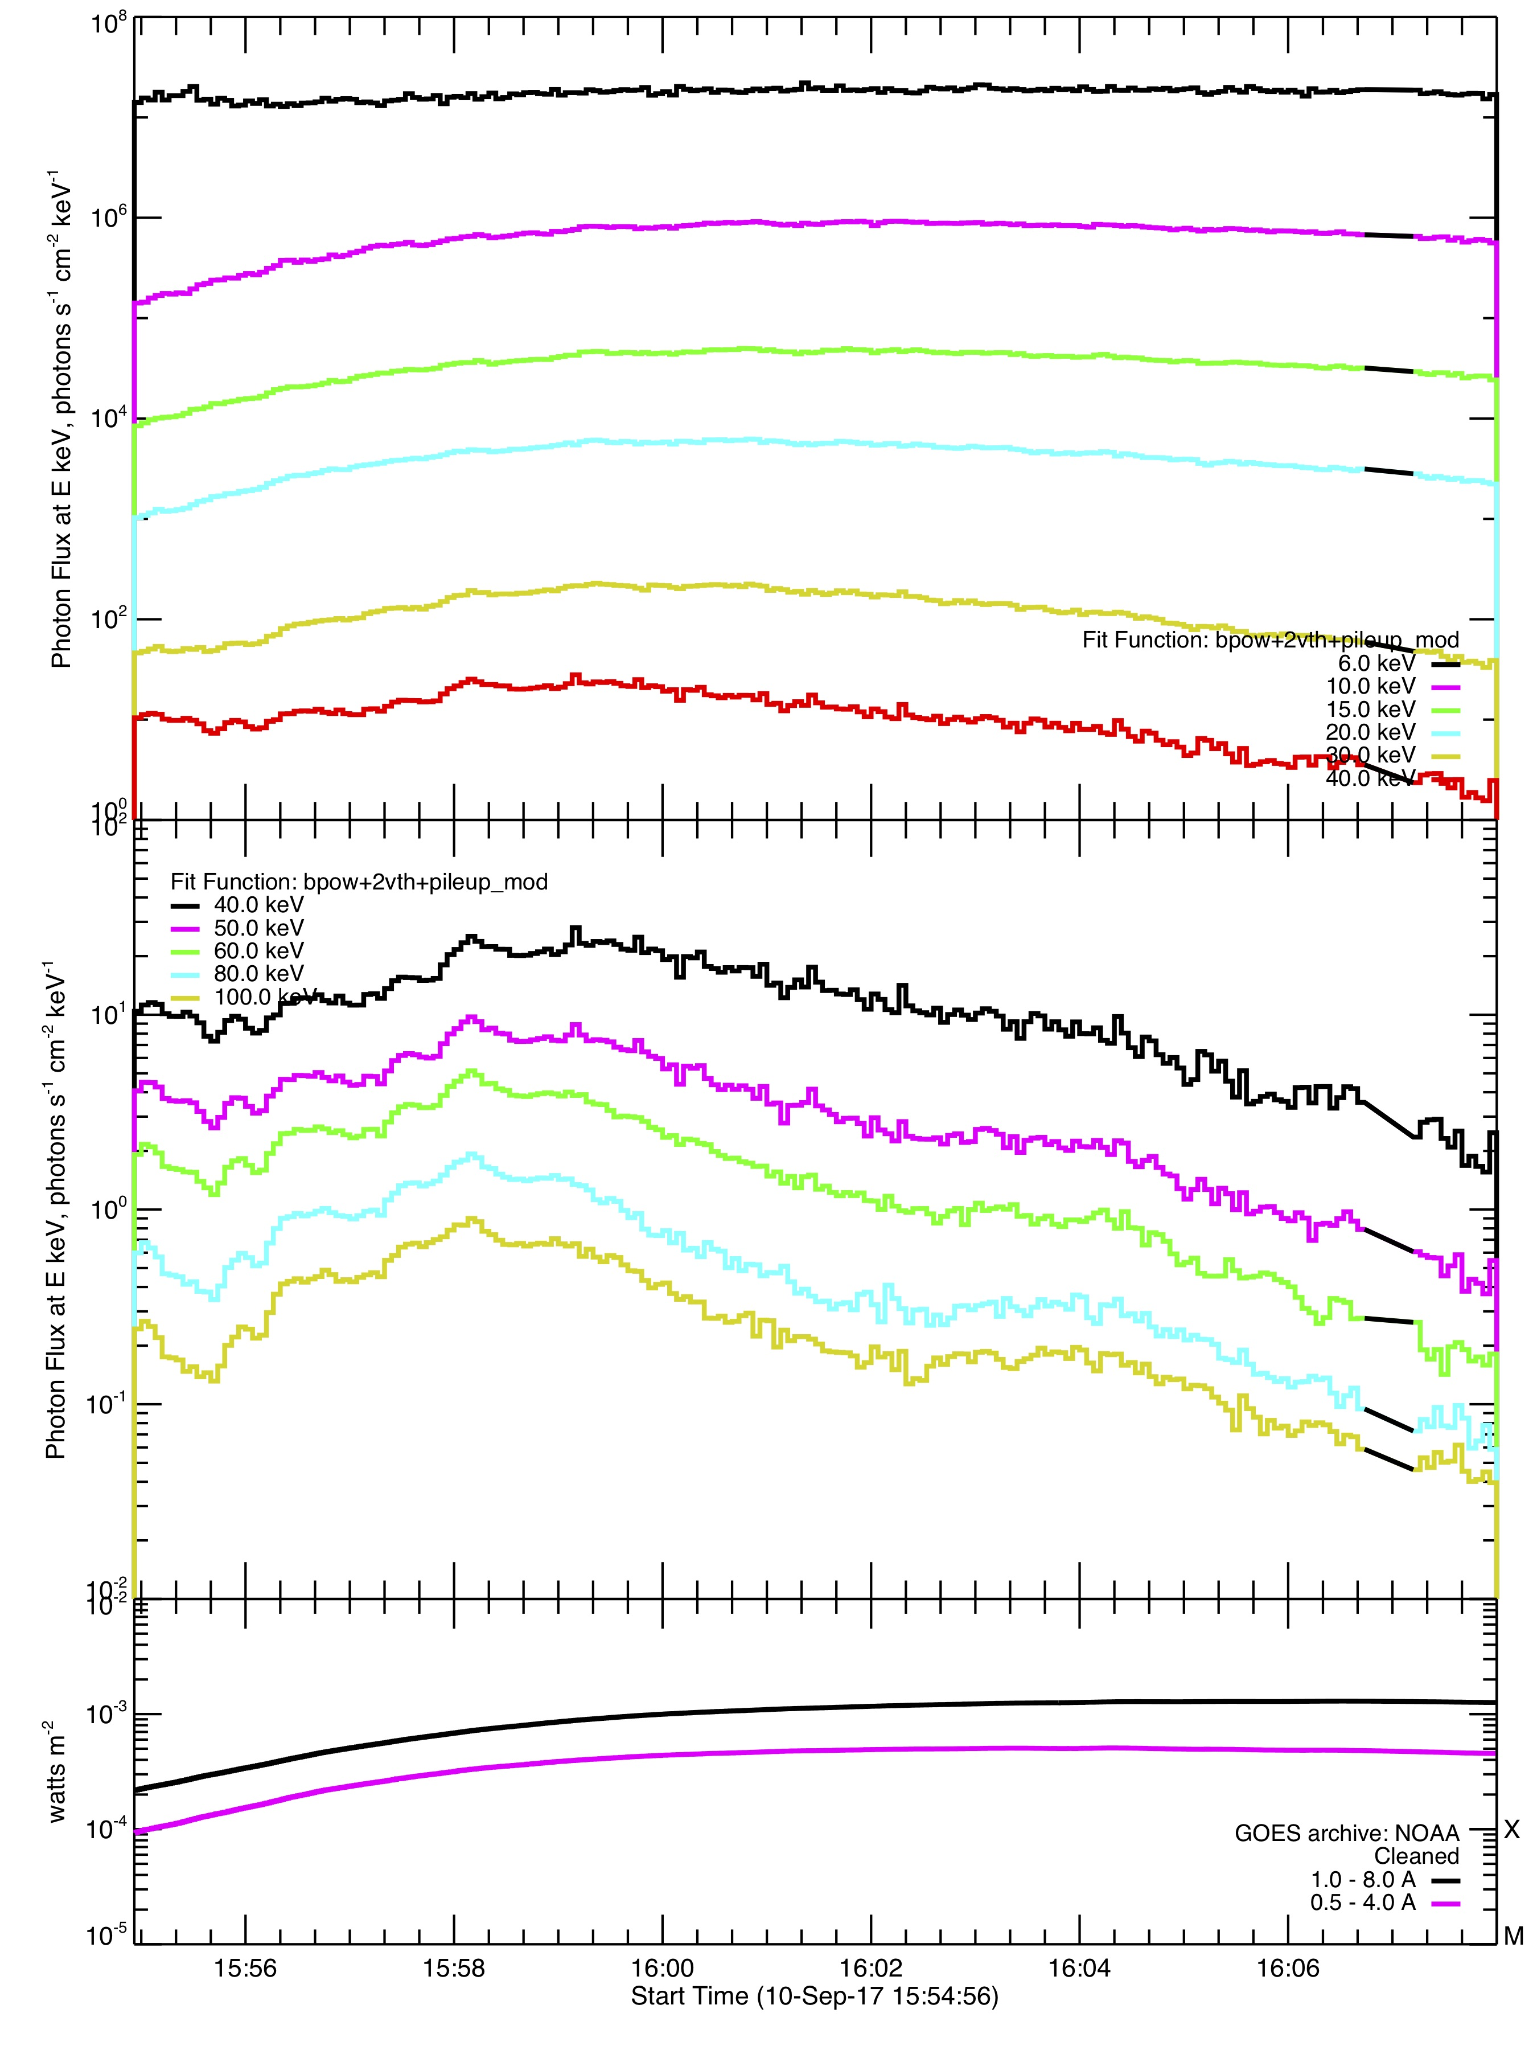
X2.2
X8.2
Temporal behaviour
t_{SXR} ~ t_{HXR} + 1min
t_{SXR} ~ t_{HXR} + 7min
Photons of energy > 40keV arrive several minutes before SXR in strong flares

Slide 12
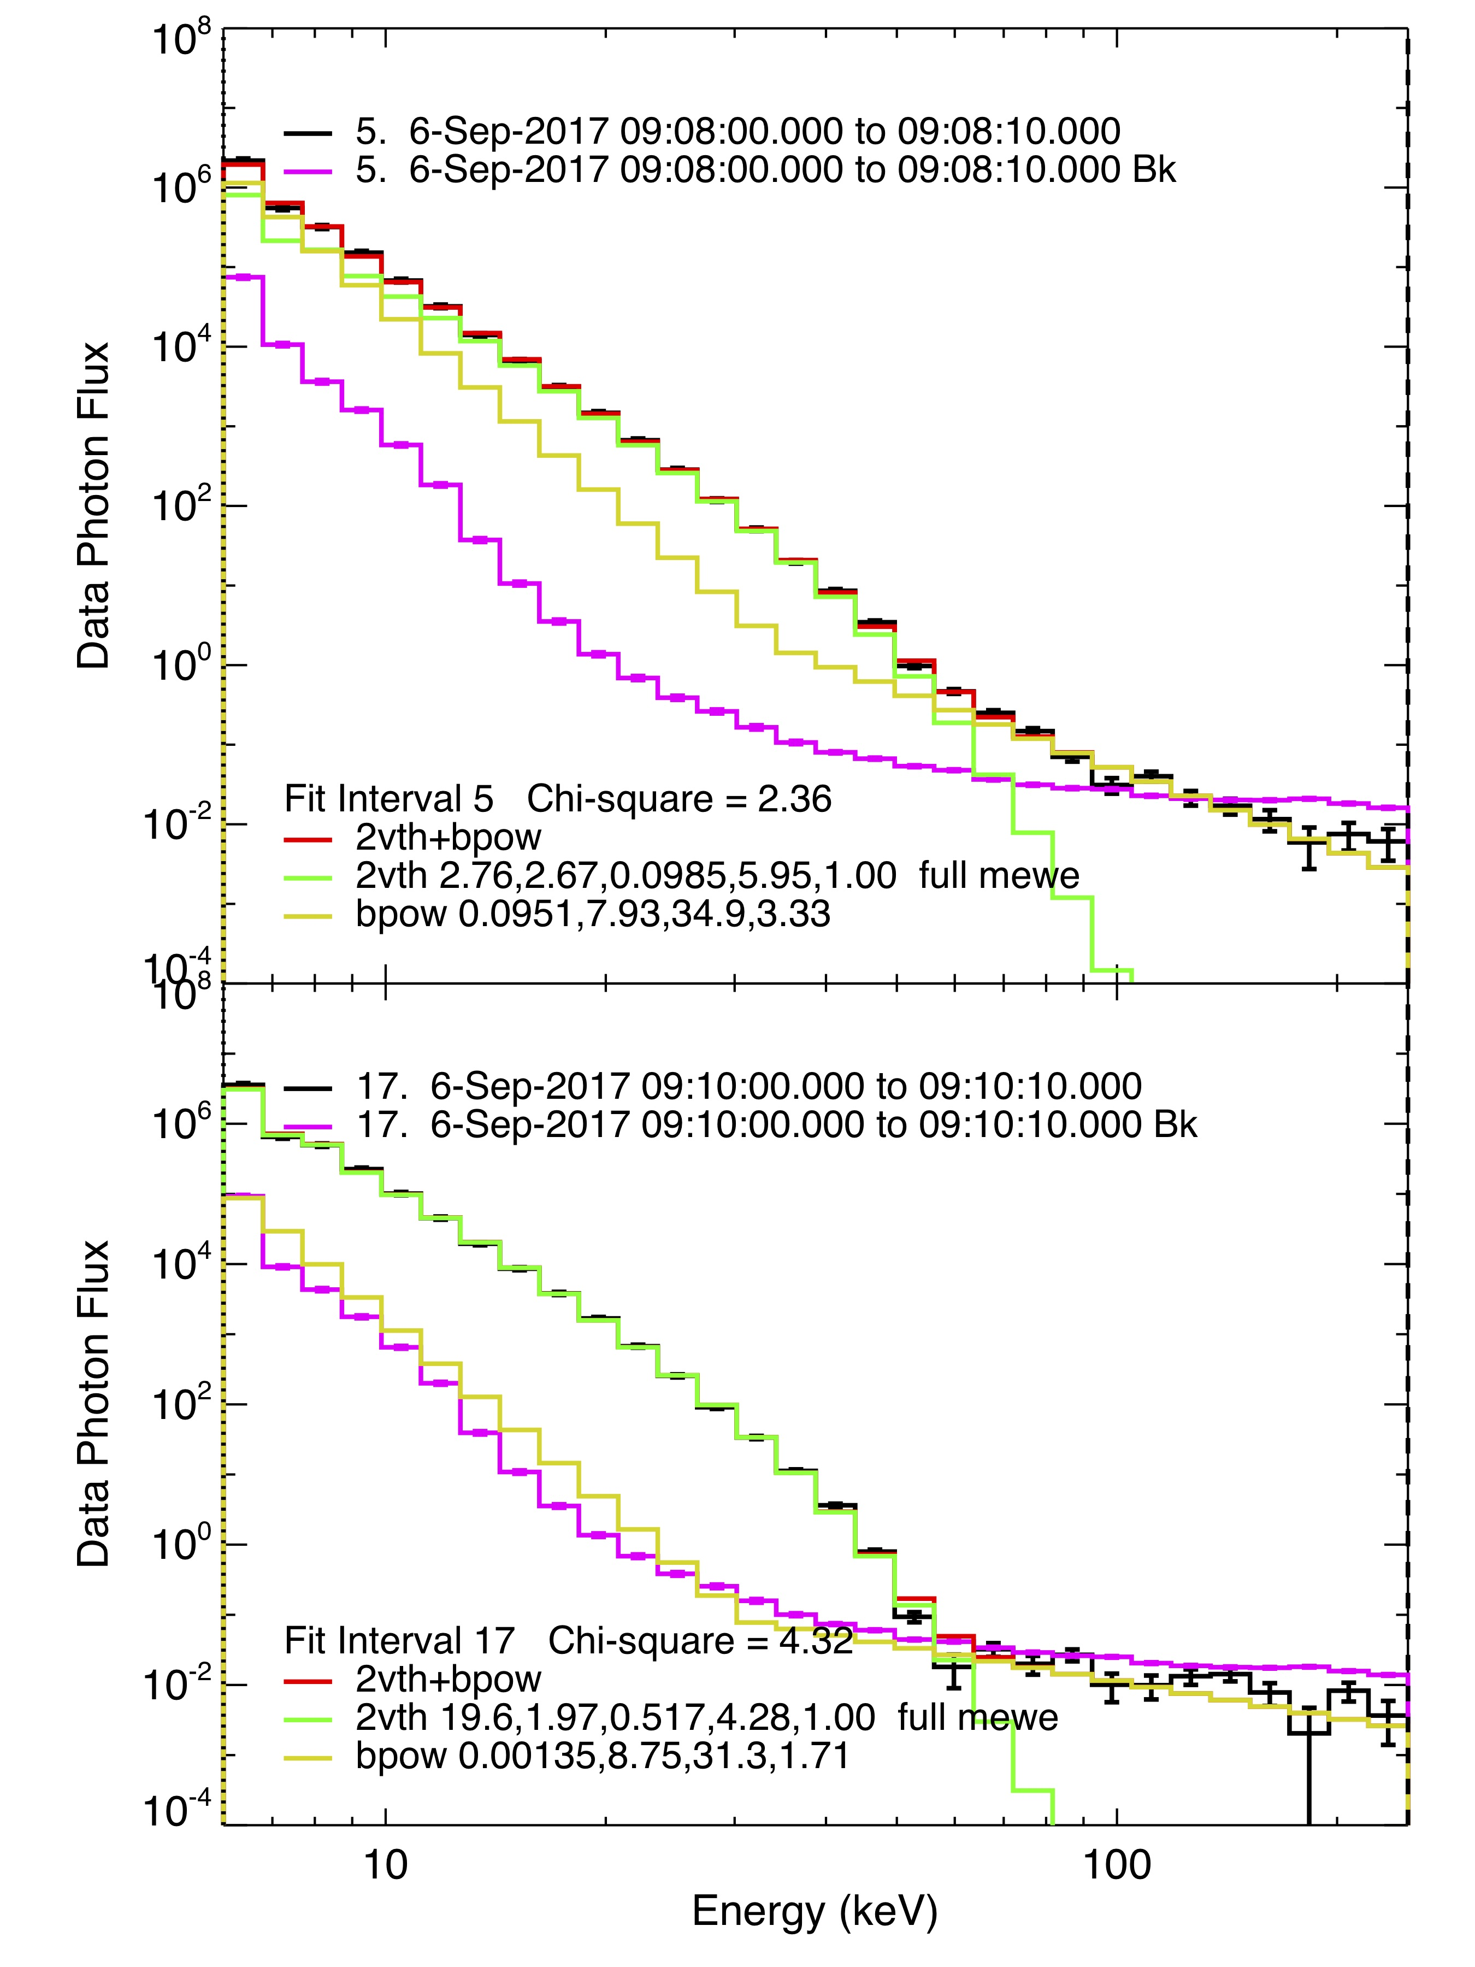
Spectral behaviour
X2.2
a
2 optically thin thermal Bremsstrahlung
+
Broken power law
a
b
Broken power law necessary to account for energy > 30keV
b
Above 50keV, background reached

Slide 13
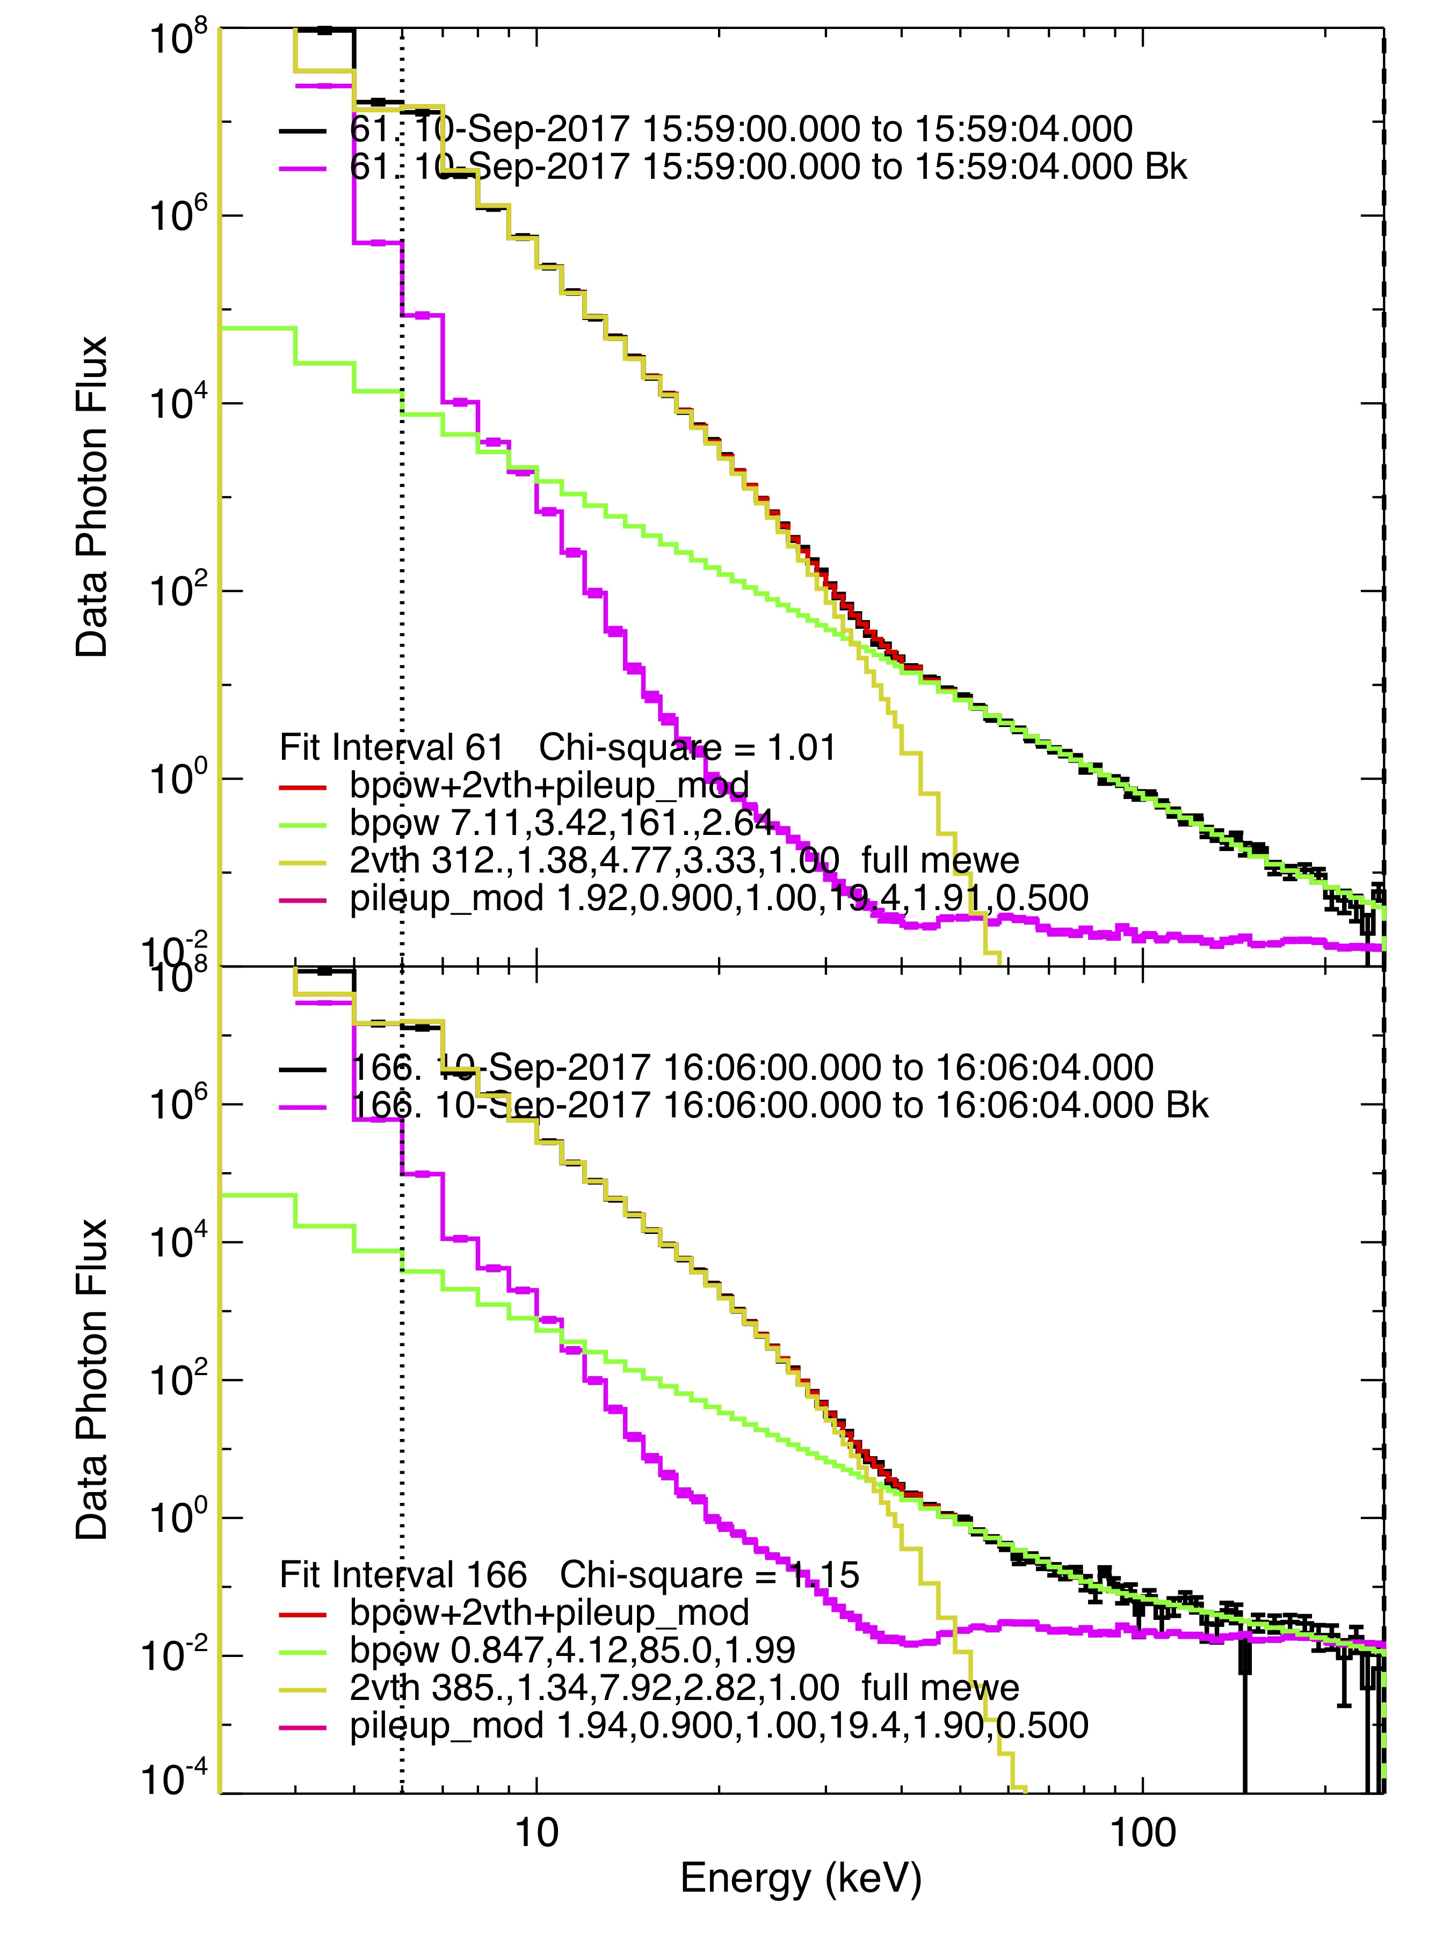
Spectral behaviour
X8.2
a
2 optically thin thermal Bremsstrahlung
+
Broken power law
+
Pile up
a
b
b
Non-thermal component much above background
for energy higher the 35keV

Slide 14
Conclusions

Slide 15
Role of HXR explicited
FUTURE
Δt decrease with increasing flare flux:
  Compatible with an increase of the effective recombinaison rate (due to higher collision with neutrals)
Δt <0 :
  Signature of the role of HXR in ionizing the deepest layers of the D-region
  Specifically the range above 30keV
Antenna upgrade to measure also the phase
European Network for nowcast operations for solar flare detection
Ground-based support for TARANIS-II
Interested in joining us ?

