Slide 1
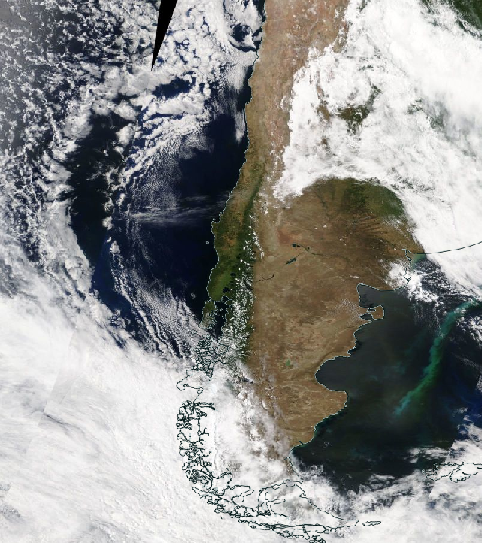
Coastal lows climatology along the Chilean coast using ERA5 reanalysis
Álvaro Gómez, Natalia Carrera, María Jesús Rapanague, Roberto Rondanelli and José Rutllant
Department of Geophysics, University of Chile
Notes:
Hello to everyone. We are a work team composed by Alvaro Gómez, Natalia Carrera and María Jesús Rapanague. We are master’s students in Meteorology and Climatology at the University of Chile. The investigation we are developing together is entitled “Coastal lows climatology along the Chilean coast using ERA5 reanalysis”.

Slide 2
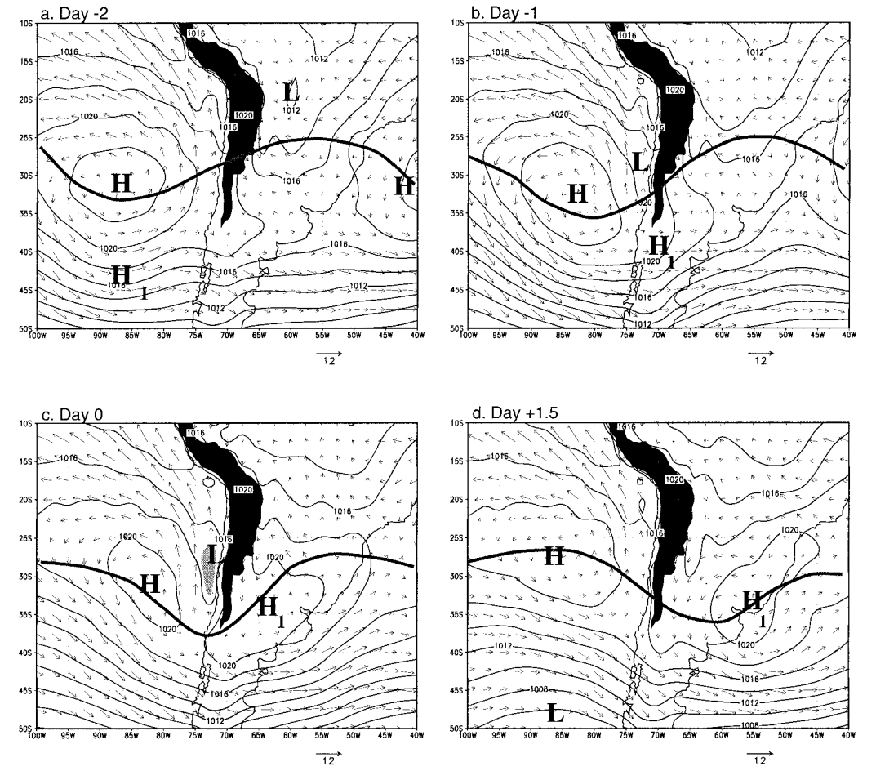
¿What is a coastal low?
CLs are superficial low pressure zones of subsynoptic scale, produced by the passage of a surface migratory anticyclone (H1) in extratropical latitudes, which reverts the climatological pressure gradient (Garreaud, 2002).
Despite their frequency, almost one per week at the Chilean coast, there are no previous climatological studies.
Garreaud, R., Rutllant, J., y Fuenzalida, H. (2002). Coastal lows along the subtropical west coast of south america: Mean structure and evolution
Composite of winter events (Garreaud et al. 2002):
Sea level pressure (lines)
500 hPa geopotential (bold line)
Surface winds (vectors)
H: South Pacific anticyclone
H1: migratory anticyclone
L: coastal low (low pressure system)
Notes:
First of all, what are coastal lows? They are subsynoptic-scale low-pressure systems that occur on the coast and are not associated with the passage of cold fronts. They occur due to the passage of a surface migratory anticyclone and an upper-level ridge in extratropical latitudes, denoted by the H1 and bold line in the figure a), respectively. As this anticyclone approaches the Andes mountain range, surface pressure drops next to the coast for around 2 days, as can be seen in the figure (c ). Similar phenomena occur in South Africa. Given Chile's location, these events develop year-round, almost once a week, in the central zone of our country, around 27-37°S. However, to date doesn’t exist a climatological characterization of this phenomenon.

Slide 3
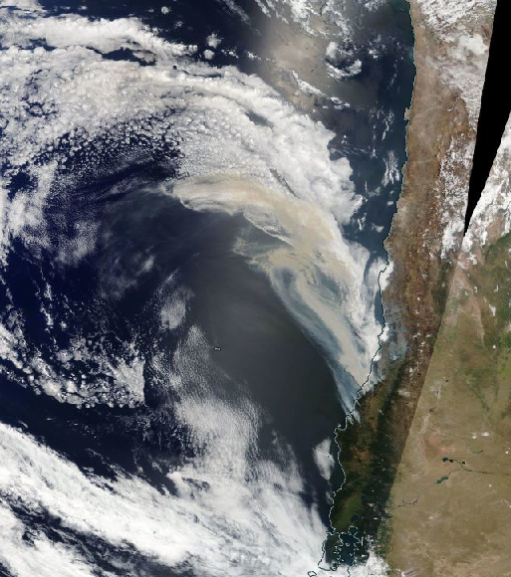
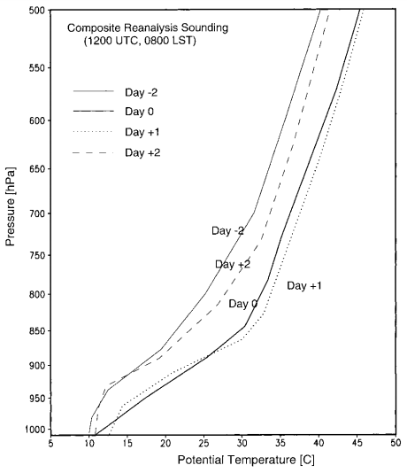
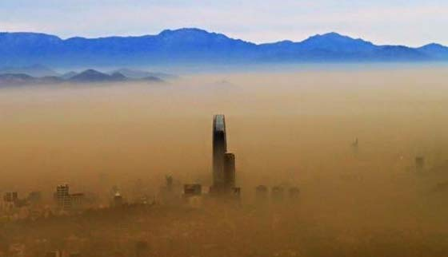
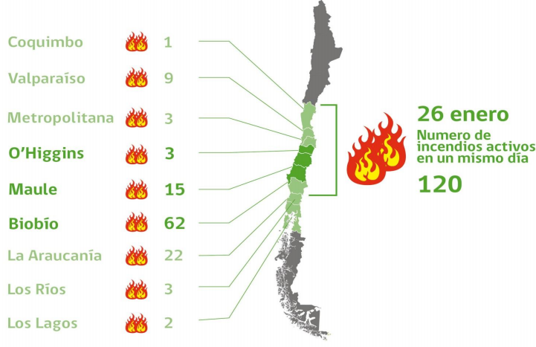
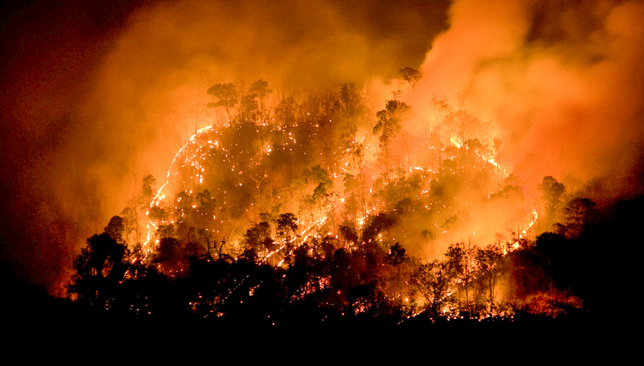
Coastal lows features
Garreaud et al. (2002)
Notes:
Coastal lows have very different features on its trailing and leading edge. On the first one, moist, cool and overcast conditions prevail, as on the leading edge, sunny, warm, dry and shallow mixed-layer conditions dominate. In our work we focus on the effects that occur under the leading edge conditions, on the south-central zone of Chile. The circulation reinforces the southerly winds near the coastal surface and leads to the generation of easterly winds through the numerous valleys born from the Andes mountain range. Subsidence also occurs, which depresses the boundary layer and deepens the inversion layer, as shown in the figure on the left. This is associated with warm and clear days (fig. Top right), air pollution episodes in winter (middle fig.), and heat waves in the summer. The latter could favor the spread of forest fires. For example, in the 2017 fire season, which was the most devastating in Chile, January 26th was the day with more simultaneous fires. On that day an intense coastal low was observed (figs. Bottom middle and 2 on the right).

Slide 4
Objectives
General objective
Characterize the climatology of coastal lows in Chile.
Specific objectives
Create an algorithm that automatically identifies coastal lows.
Analyse interseasonal variability.
Estimate the propagation speed.
Notes:
So, the main objective of our research is to characterize the coastal lows climatology in Chile, while the specific objectives are to create an algorithm that automatically identifies coastal low’s events; analyze their interseasonal variability; and estimate the propagation speed, in order to compare it with Kelvin waves theory in the future.

Slide 5
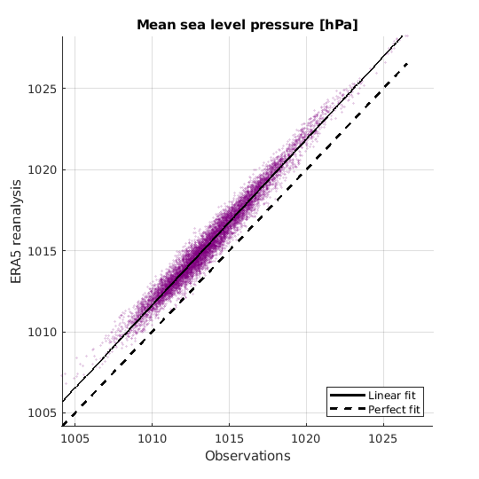
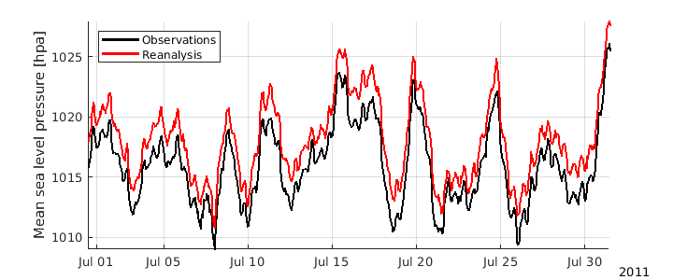
Data
Period: 1979-2018
Used variables:
Mean sea level pressure
10 meter wind
500 hPa geopotential
Sources:
ERA5 reanalysis (dx = 0.25°, dt = 1 hr)
Observations in Lengua de Vaca (dt = 30 min)
¡R² = 0.98!
Notes:
The data used corresponds mainly to ERA5 reanalysis, comprising the period between 1979 and 2018. These have a spatial resolution of 0.25 degrees and a temporal resolution of 1 hour. The variables used were sea level pressure, winds at 10 meters above the surface and geopotential height at 500 hPa. In addition, sea level pressure data from Lengua de Vaca meteorological station, located on the coast at 30.25 ° S, were used to validate the ERA5 reanalysis. Only winter of 2011 was employed for this purpose, obtaining a correlation of 0.98. In both figures is observed the almost perfect joint variation of observations and the reanalysis, as well as a slight overestimation by the reanalysis of approximately 2 hPa.

Slide 6
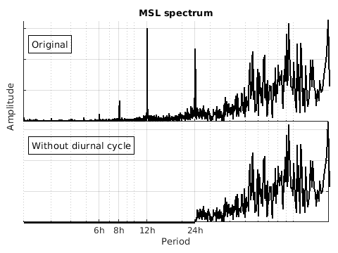
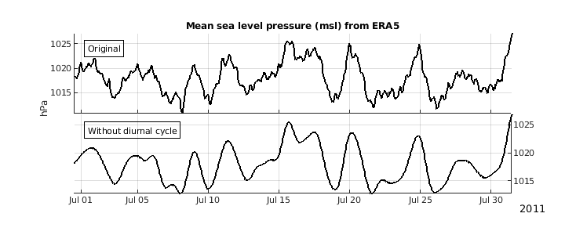
Coastal lows identification method
Removal of diurnal cycle.
Criteria of acceptance:
Pressure drop > 3 hPa in less than 36 hours.
Southerly winds > 3 m / s during the 24 hours prior to the minimum pressure.
Notes:
The identification method used is based on the criteria proposed by Garreaud et al. in 2002, and therefore is based on the grid point corresponding to meteorological station Lengua de Vaca. A new feature of our method is that it works with all seasons of the year. In the first place, the diurnal cycle of both pressure and winds was removed, so we could eliminate oscillations of periods less than 24 hours, since the phenomenon under study is of subsynoptic scale. The figures presented show the nature of the filter on the right and the result obtained from it on the left. Then the fulfillment of certain criteria is sought: first, we searched, within a moving 5-day time window, for 3 hPa decrease in surface pressure in less than 36 hours. Then, for these pressure drops to be considered events, we searched for those with southerly winds over 3 m/s, for a minimum of 18 hours during the 24 hours prior to the minimum pressure found, this due to the southerly coastal jet that is generated while the coastal low is forming in the Chilean coast.

Slide 7
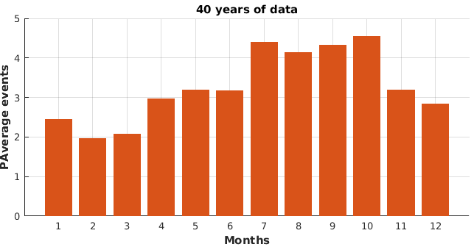
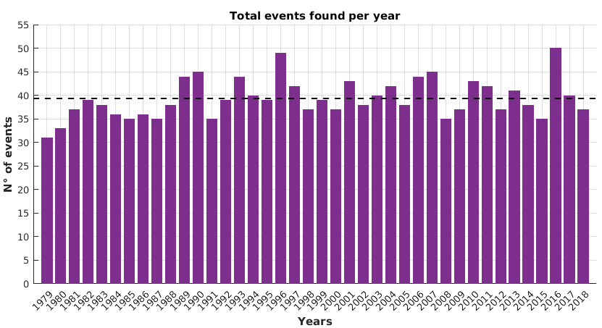
Results
Seasonal average of events:
Summer: 7
Autumn: 8
Winter: 12
Spring: 12
Notes:
The results obtained for the whole period are as follows. In the lower left figure there is a histogram of the number of events identified per year, whose average is 39 events per year, indicated by the segmented line. An interesting interannual variability is observed, with a maximum of 50 events found in 2017 and a minimum of 31 events identified in 1979. The upper right figure shows the total of events found by season and year. The segmented line corresponds to the seasonal average. It was found that on average more events take place in winter and spring, which corresponds to 12. In summer and autumn there are 7 and 8 events on average, respectively. The lower right figure shows the average number of events found per month. It is observed that between July and October usually more than 4 events take place. The period between January and March corresponds to that with the least development.

Slide 8
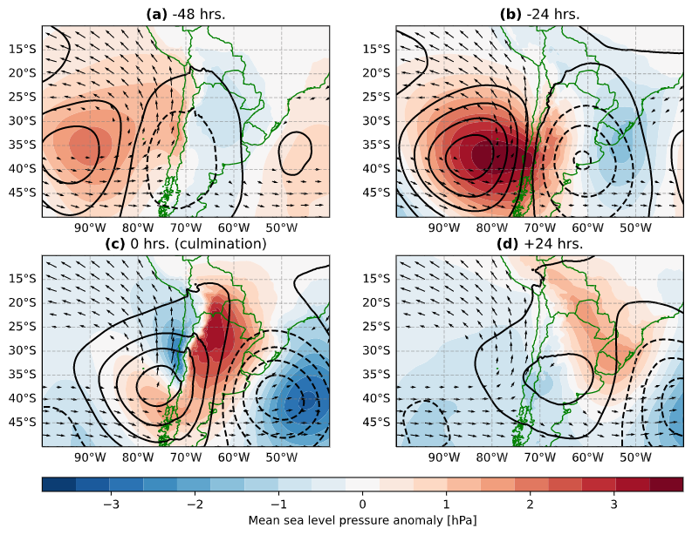
Coastal lows evolution
Composite of all events.
Sea level pressure anomalies (colors)
500 hPa geopotential anomalies (contours)
Surface winds greater than 3 m/s (vectors)
Observations:
Culmination (lowest pressure):
It is reached when most of the anticyclone has crossed the Andes cordillera.
Matches the positioning of the ridge axis along the coast.
Low pressure extends between 25 °S and 36 °S approximately.
Intense anticyclonic circulation (southerly winds exceed 5 m/s).
Notes:
The following figures present composites generated with all the identified events throughout the entire data period. Colours correspond to mean sea level pressure anomalies, contours to geopotential height anomalies at 500 hPa and vectors to surface wind’s over 3 m/s. The culmination point or day zero, to which we will refer repeatedly from now on, is defined as the moment when the minimum sea level pressure on Lengua de Vaca station is reached. Panel a) shows two days prior to culmination point. A surface migratory anticyclone is off the coast, to the west of South America. Over the anticyclone, a ridge is observed shifted to the west, giving account of baroclinicity. A day before it is observed that the surface anticyclone reaches the central zone of Chile, and baroclinicity increases. During culmination, the migratory anticyclone is already drifting over Argentina. However, the Andes mountain range deforms it, generating a configuration similar to a kidney. This configuration triggers a series of mechanisms that generate a drop in local pressure to the north of the anticyclone. This coastal low spreads to the south, as the anticyclone moves east. 24 hours later it is observed how the high pressure system dissipates after crossing the Andes Mountains, also dying the coastal low.

Slide 9
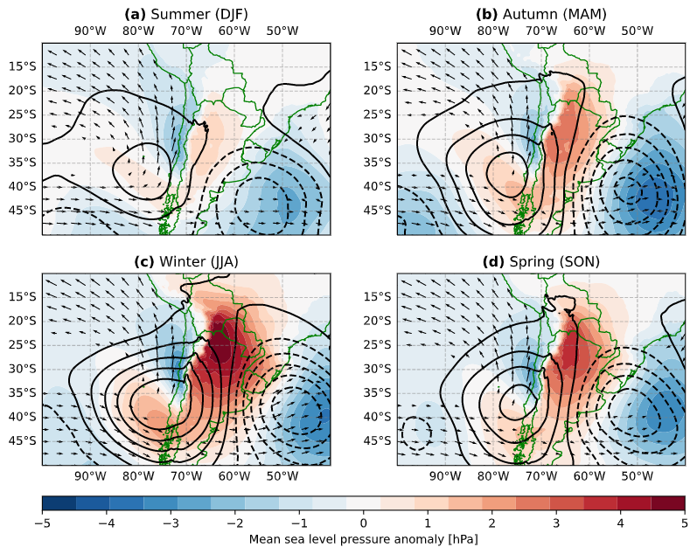
Seasonal variability
Composite of the culmination time per season.
Sea level pressure anomalies (colors)
500 hPa geopotential anomalies (contours)
Surface winds greater than 3 m/s (vectors)
In winter:
Greater meridional pressure gradient
Deeper ridge
Summer is opposed to winter, whereas that autumn and spring are transitioning seasons.
Notes:
But, which are the main seasonal differences? The following figures show the composites of the culmination time, differentiating the events by season. The maps and their variables are analogous to those seen on the previous slide. It can be clearly seen that the high pressure system is more intense in winter, and weaker in summer. This leads to more intense meridional pressure gradients in the coastal zone in winter than in summer. On the other hand, autumn and spring look quite similar, acting as transitory seasons towards winter and summer.

Slide 10
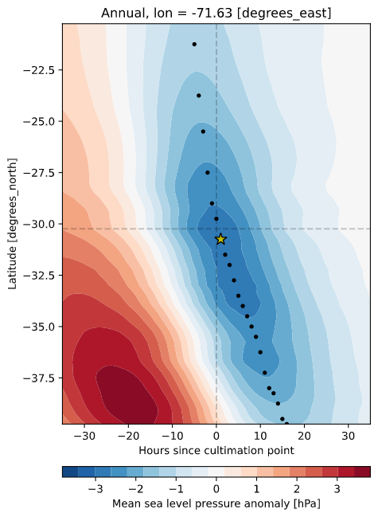
Hovmollers
About the figure:
Surface pressure anomaly composite of all events.
Latitudinal Hovmollers, along 71.63°W (LdV).
Vertical segmented line indicates the culmination time.
Horizontal segmented line indicates the 30.24°S latitud (LdV).
Black points indicate the latitudinal minimum pressure.
The star shows the deepest pressure minimum (low center).
Observations:
A change in the slope from 30°S is observed (propagation velocity).
The center of the low is found arround 33°S throughout the year, except for winter.
Notes:
Another topic of interest is the propagation speed. To study this, we calculated composites of the surface pressure anomaly, both annual and seasonal. We built hovmollers with these composites, which allowed us to see the temporal evolution along the latitudinal profile for the fixed longitude of 71.63 ° W, that corresponds to the location of Lengua de Vaca station. In this figure we can see the annual hovmoller, the black points account for the pressure minimum per latitude. The star shows the deepest minimum found.
In general, the displacement of the center of minimum pressure towards the south is observed. However, this displacement presents a sudden change around 30°S. From this latitude, the minimum pressure moves towards the South at a lower speed.

Slide 11
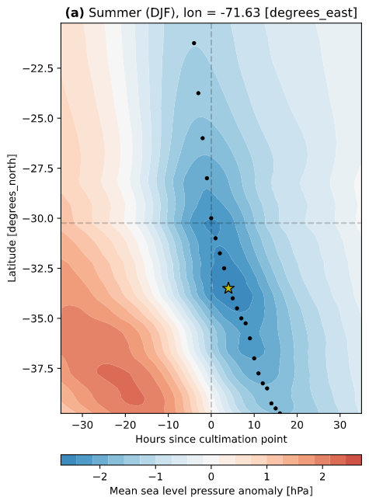
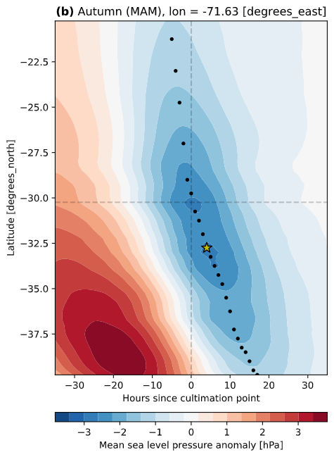
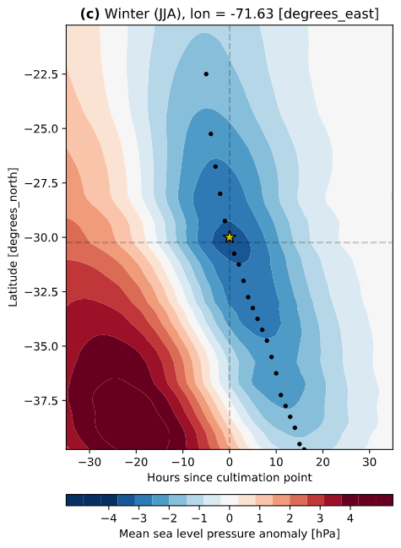
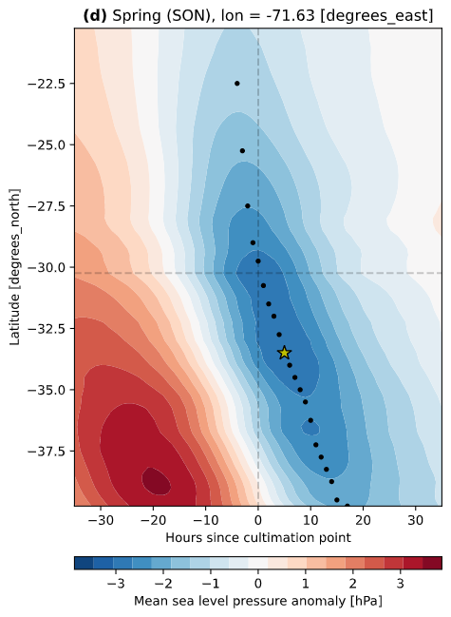
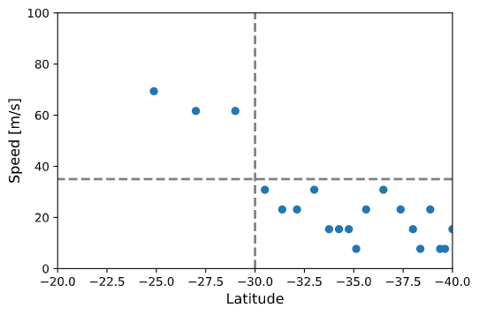
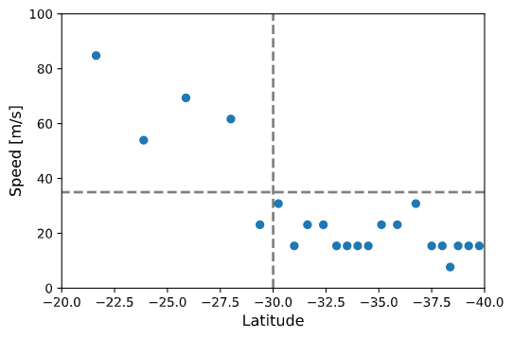
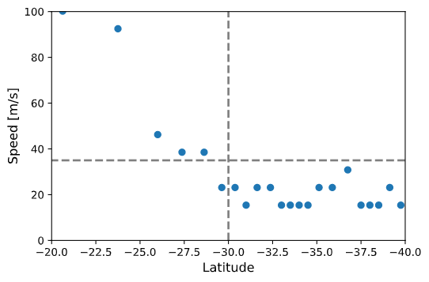
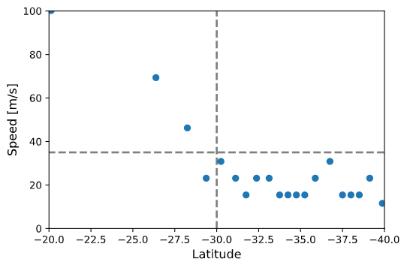
67 m/s 19 m/s 52 m/s 18 m/s 46 m/s 19 m/s 56 m/s 19 m/s
Notes:
And again what are the seasonal differences? Beyond those inherent to the high pressure system, identified by the intensity of the color of the large red spots, all stations show a similar behavior. The propagation change continues to be around 30°S in all seasons. The only noticeable difference in these figures is that in winter, the deepest pressure minimum occurs at 30°S, while in summer, autumn and spring, this minimum moves south, between 34-35°S. The lower panels show the propagation speed estimated with the latitudinal pressure minimums for each station. On average, we found speeds around 56 m/s below 30°S (which is too high!) and around 18 m/s above this latitude.

Slide 12
Closing remarks
ERA5 reanalysis is validated for the Chilean coast.
A satisfying automatic identification method of CLs was developed.
An average of 39 events per year was found.
Coastal low events are more frequent and intense in winter and spring.
The coastal lows center are found in average around 30°S, moving to ~34°S in summer, autumn and spring.
2 phases of the coastal lows propagation speed were identified.
Notes:
And now, these are the main conclusions we have so far: it was possible to validate the ERA5 reanalysis for south-central Chile. We developed a satisfactory method of automatic identification of coastal lows in Chile. We found that 39 events take place on average per year, with considerable interannual variability. On a seasonal scale they are more frequent and intense in winter and spring. In general they are centered around 30°S in winter, but move up to 33°S in the rest of the seasons. And 2 different phases of the propagation speed of coastal lows were identified.

Slide 13
Next steps
Analyze the evolution of other variables, like temperature and cloud cover.
Improve the calculation of the propagation speed, and compare it with Kelvin waves theory.
Relate interannual variability to weather patterns, like ENSO and MJO.
Compare the occurrence of coastal lows with summer heat waves and wildfires.
Notes:
Finally, the next steps in our research will be to analyze the evolution of other variables, such as temperature and cloud cover. Improve the calculation of propagation speed and compare the results with the Kelvin wave theory. We also want to relate the interannual variability of event’s occurrence with large-scale patterns, such as ENSO and MJO. Finally, we would like to compare the occurrence of coastal lows with that of heat waves and large wildfires.
So… that was our presentation, thank you very much.

