Slide 1


Geodynamic inversion with uncertain initial geometries
Arne Spang, Tobias Baumann, Boris Kaus
Johannes Gutenberg-University, Mainz arspang@uni-mainz.de
EGU General Assembly 2021
Arne Spang, Tobias Baumann, Boris Kaus
Johannes Gutenberg-University, Mainz
arspang@uni-mainz.de
Notes:
Hello Everybody, my name is Arne and I am representing the university of Mainz in Germany and I want to talk to you about Geodynamic inversion with uncertain initial geometries.

Slide 2
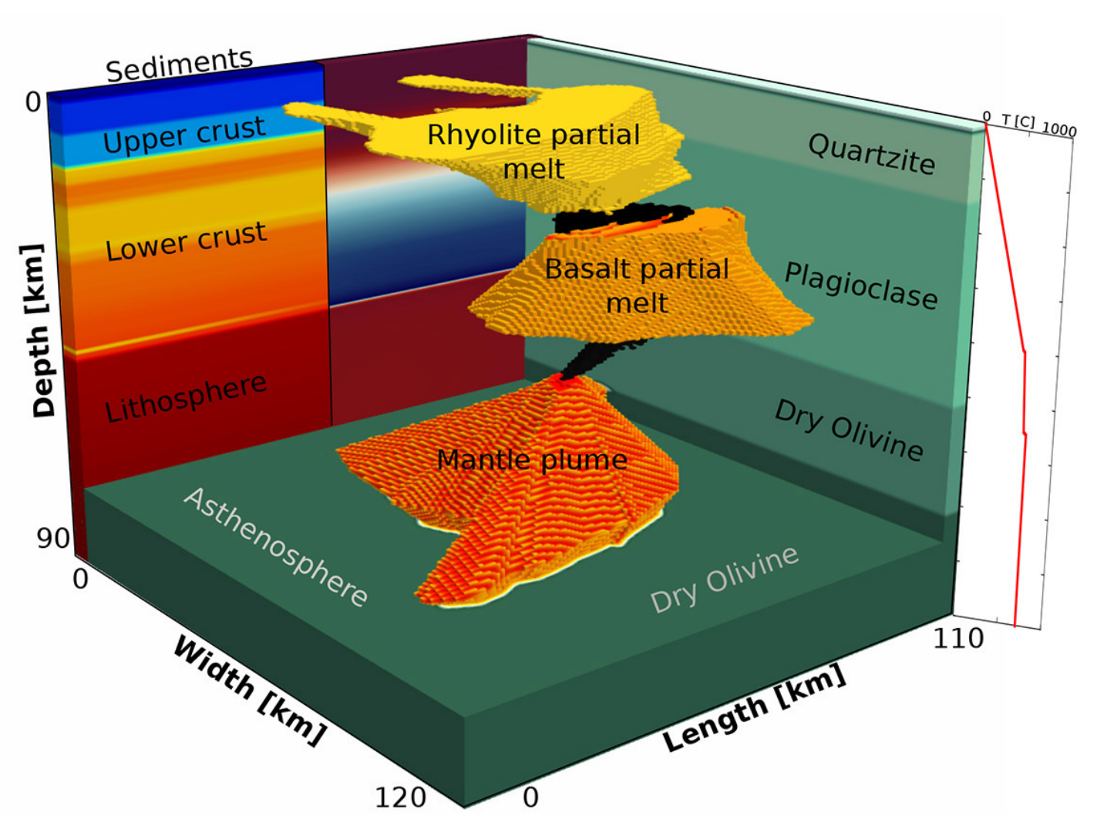
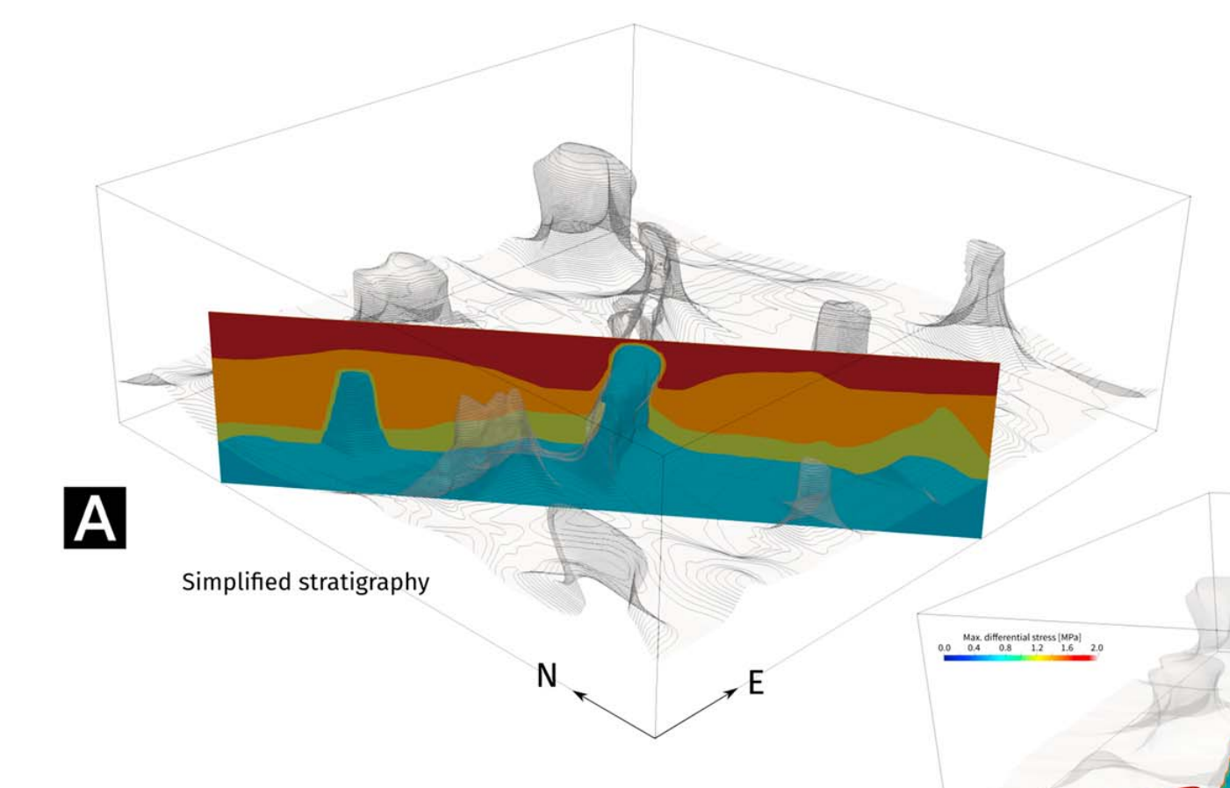
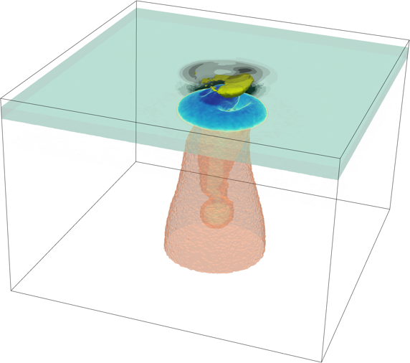
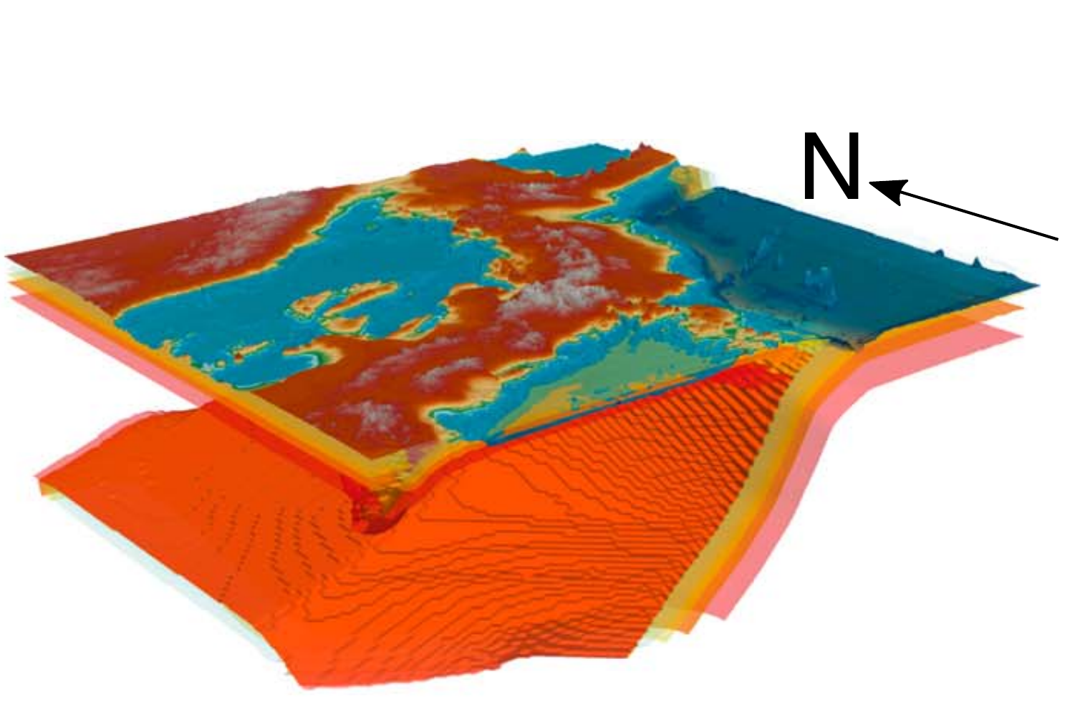
Motivation
Modern codes, methods and hardware allow us to run models with varying material parameters
But initial geometry usually stays constant
(though there are uncertainties!)
Why?
  → Generation is time consuming
  Parameterization is difficult
We are developing a new tool to automatically generate
variable initial geometries
Reuber et al., 2018
Baumann et al., 2018
Piccolo et al., 2020
Bauville & Baumann, 2019
Arne Spang, Tobias Baumann, Boris Kaus
Johannes Gutenberg-University, Mainz
arspang@uni-mainz.de
Notes:
Over the years, we have developed advanced numerical methods and at the same time, our computers have become much faster. So nowadays we can run inversions for a lot of material parameters in our models. But something that is usually constant is the initial geometry. And that is despite the fact, that we know that the geometry is just as uncertain as our material parameters.

Slide 3
Motivation
We are developing a new tool to automatically generate
variable initial geometries
Expectations for new tool:
  Work fast
  Work automatically
  Use few parameters
  Parameters are intuitive to use
Arne Spang, Tobias Baumann, Boris Kaus
Johannes Gutenberg-University, Mainz
arspang@uni-mainz.de

Slide 4
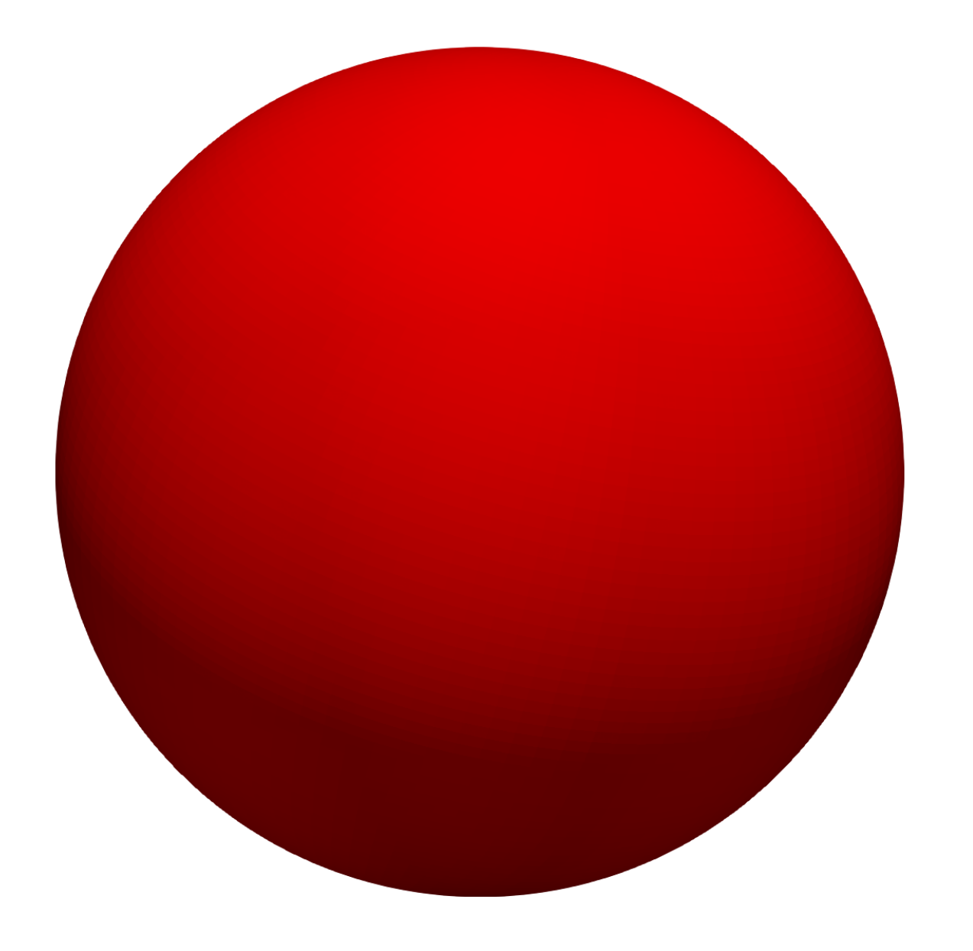
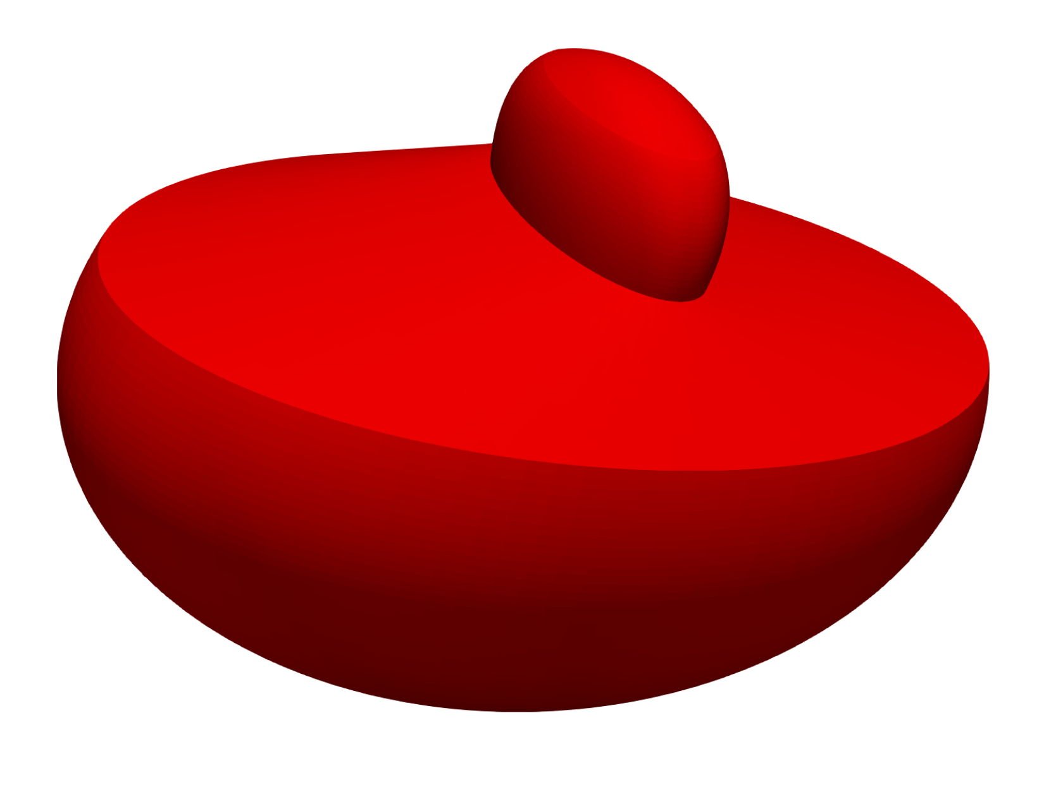
Motivation Problem
We are developing a new tool to automatically generate
variable initial geometries
Expectations for new tool:
  Work fast
  Work automatically
  Use few parameters
  Parameters are intuitive to use
How to parameterize complex 3D bodies?
radius r
?
Arne Spang, Tobias Baumann, Boris Kaus
Johannes Gutenberg-University, Mainz
arspang@uni-mainz.de

Slide 5
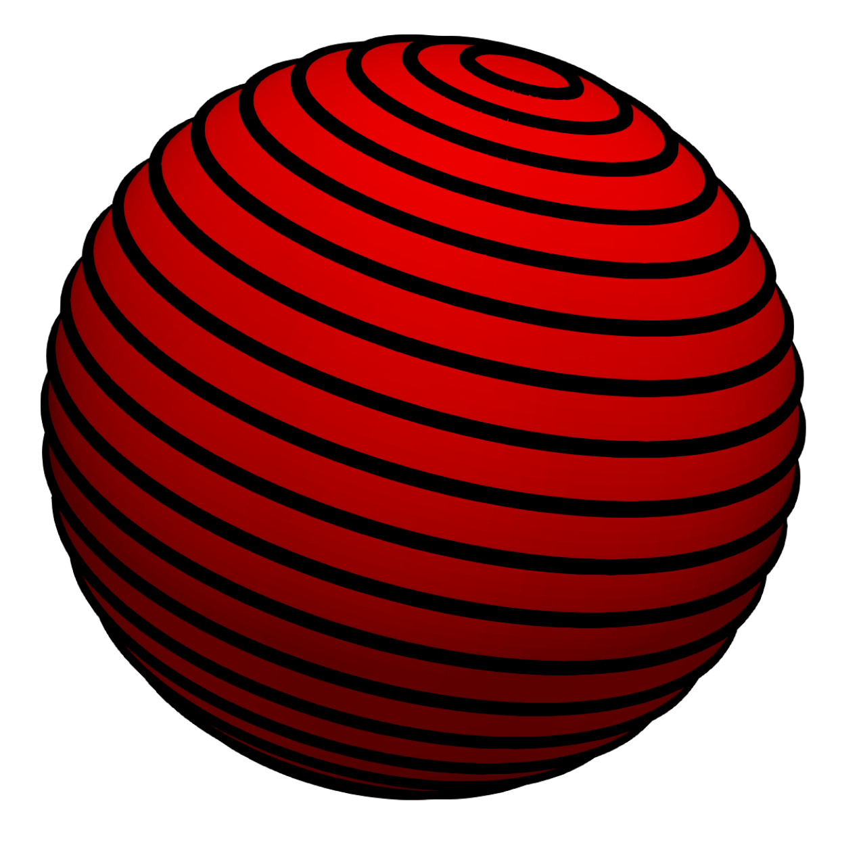
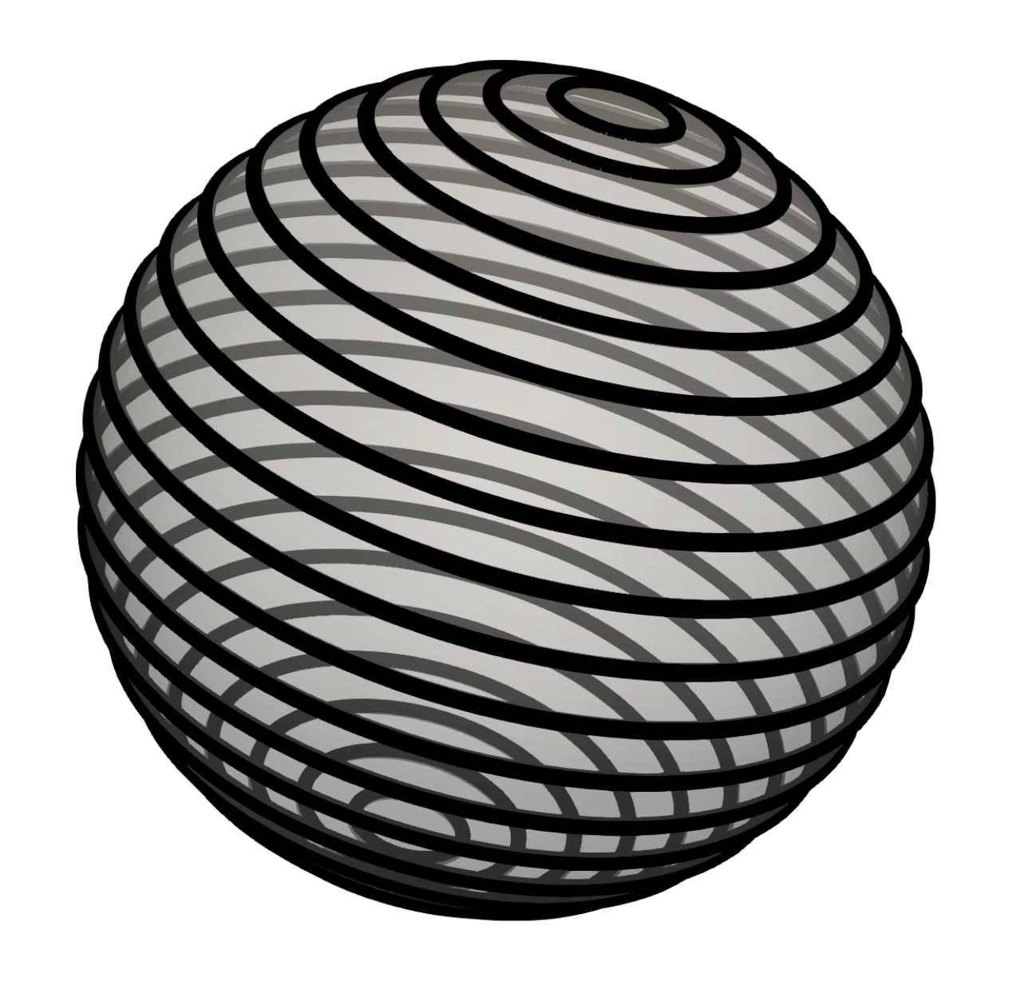
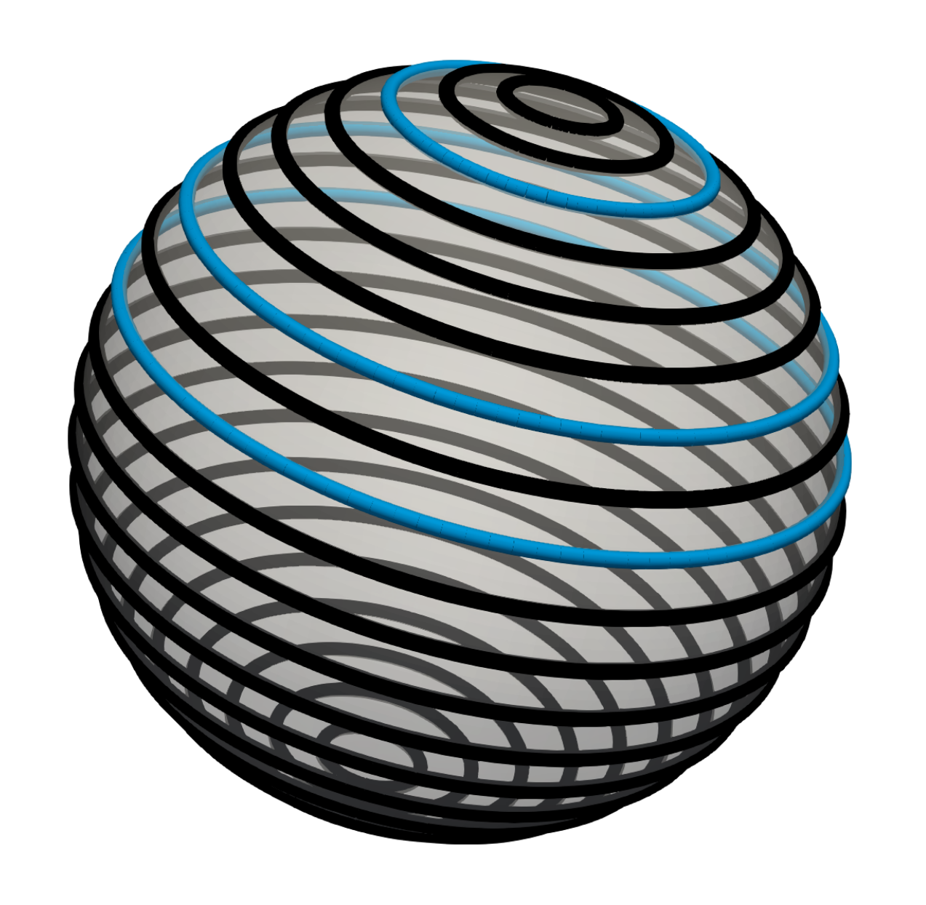
Solution
Cut body into slices
Select some slices to be control polygons (14, 16, 20)
Arne Spang, Tobias Baumann, Boris Kaus
Johannes Gutenberg-University, Mainz
arspang@uni-mainz.de

Slide 6
Solution
Cut body into slices
Select some slices to be control polygons (14, 16, 20)
Define stretch factors (Sx, Sy) for each
control polygon
Polygon | Sx | Sy
20 | 0.5 | 0.9
16 | 0.3 | 0.6
14 | 1.5 | 1.0
Arne Spang, Tobias Baumann, Boris Kaus
Johannes Gutenberg-University, Mainz
arspang@uni-mainz.de

Slide 7
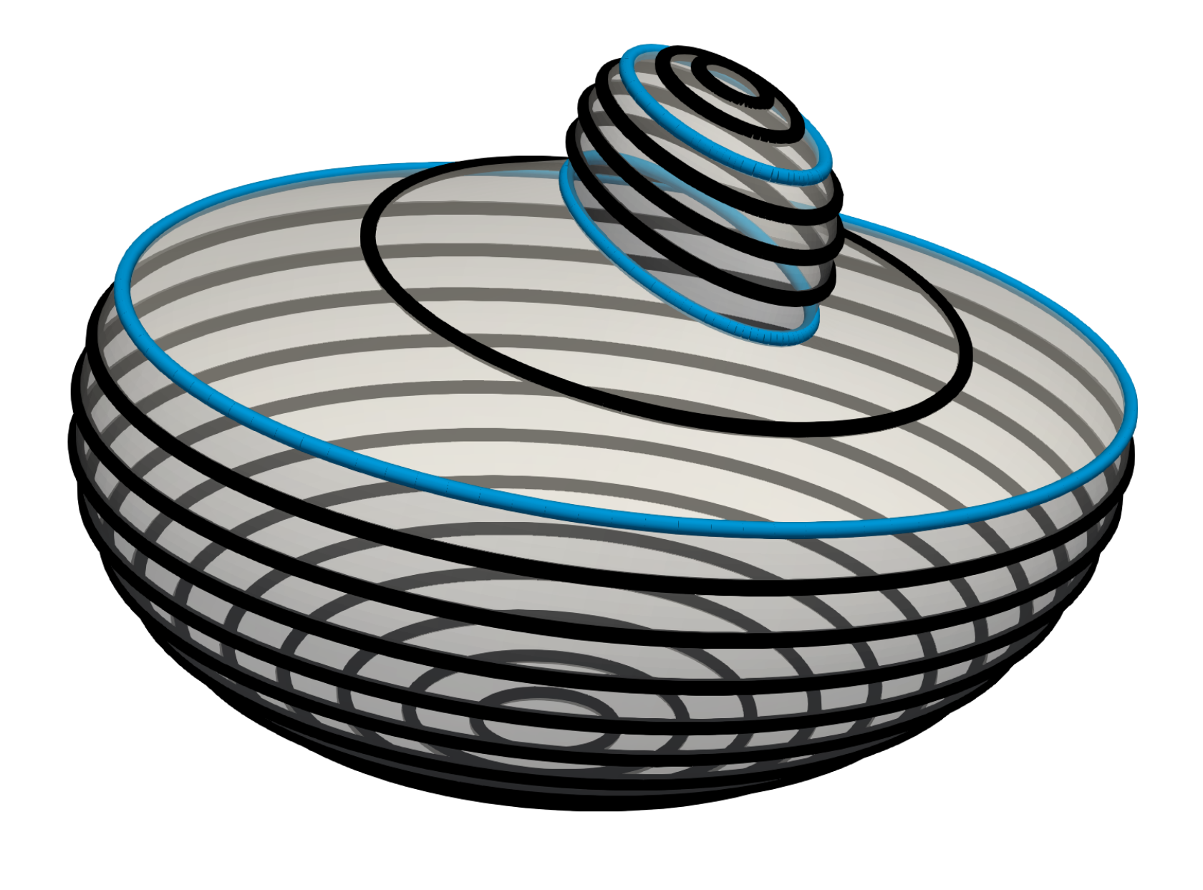
Solution
Stretch polygons
Arne Spang, Tobias Baumann, Boris Kaus
Johannes Gutenberg-University, Mainz
arspang@uni-mainz.de

Slide 8
Simple Geometry
Polygon | Sx | Sy
20 | 0.5 | 0.9
16 | 0.3 | 0.6
14 | 1.5 | 1.0
radius r
? → 6 numbers
Arne Spang, Tobias Baumann, Boris Kaus
Johannes Gutenberg-University, Mainz
arspang@uni-mainz.de

Slide 9
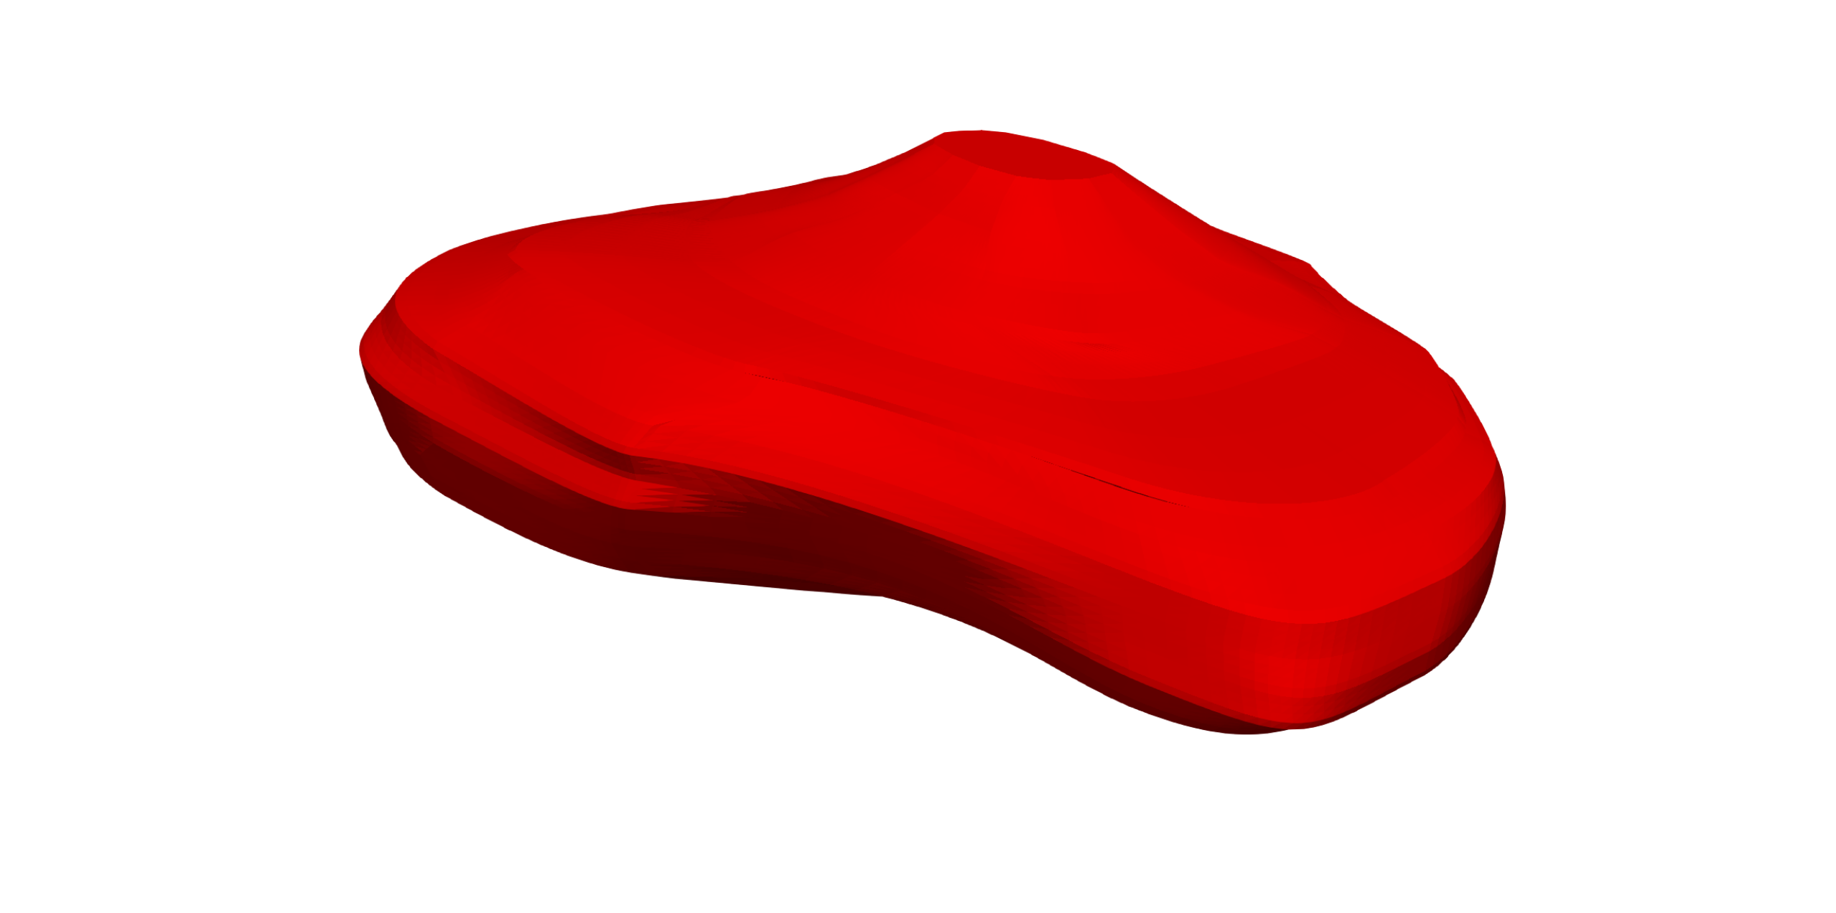
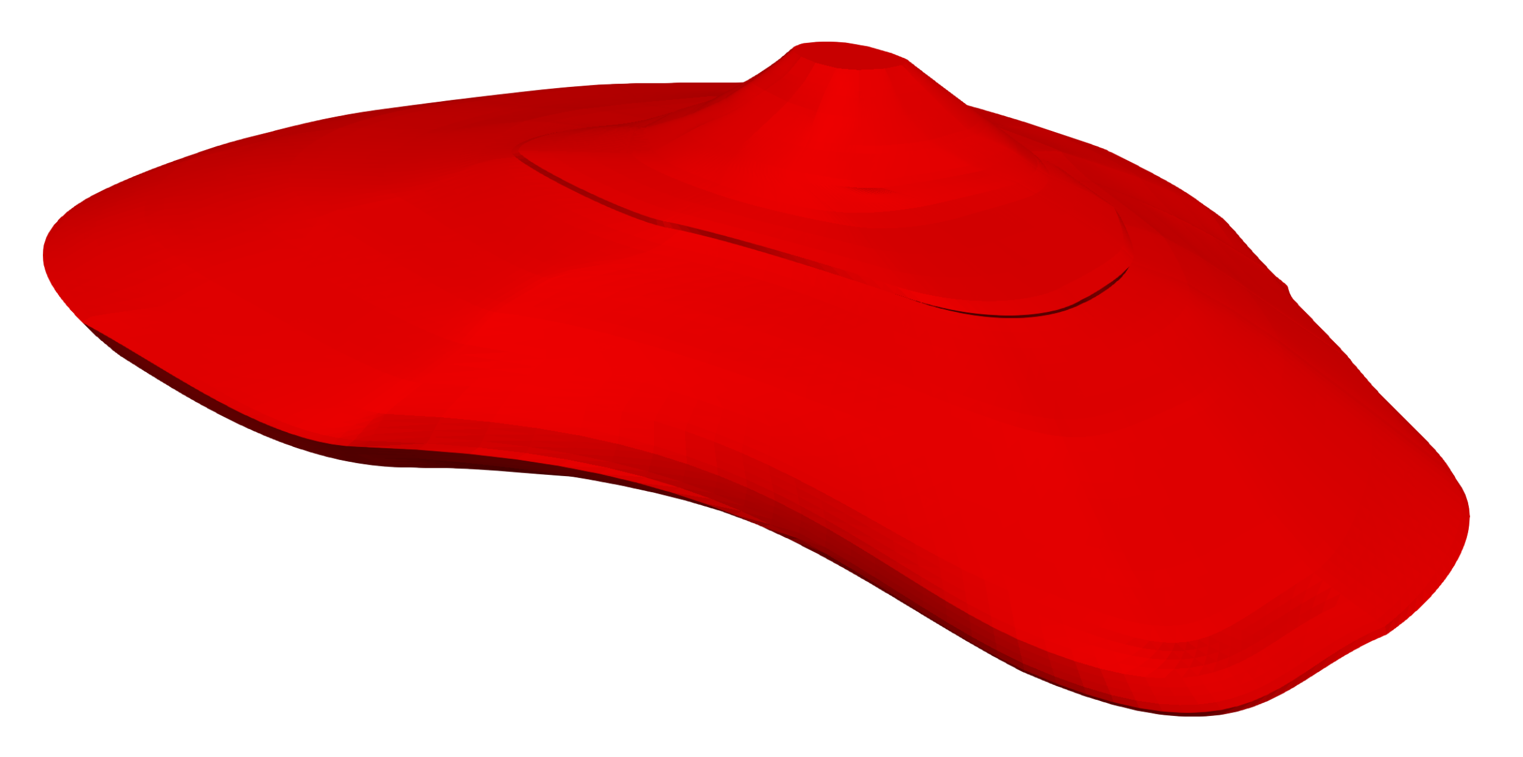
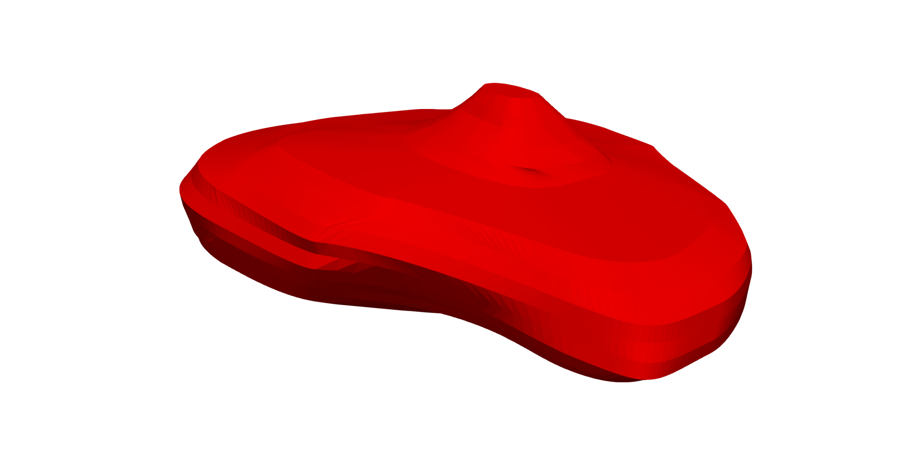
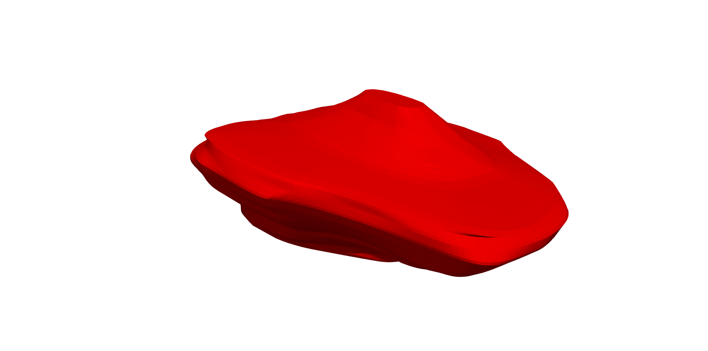
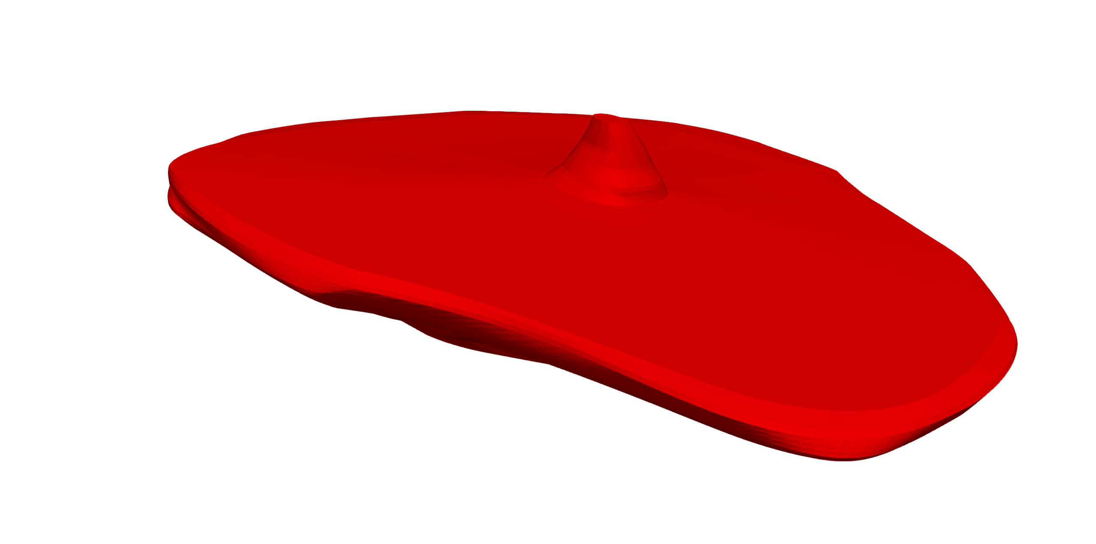
Solution
Magma
body
3 Control polygons
Arne Spang, Tobias Baumann, Boris Kaus
Johannes Gutenberg-University, Mainz
arspang@uni-mainz.de

Slide 10
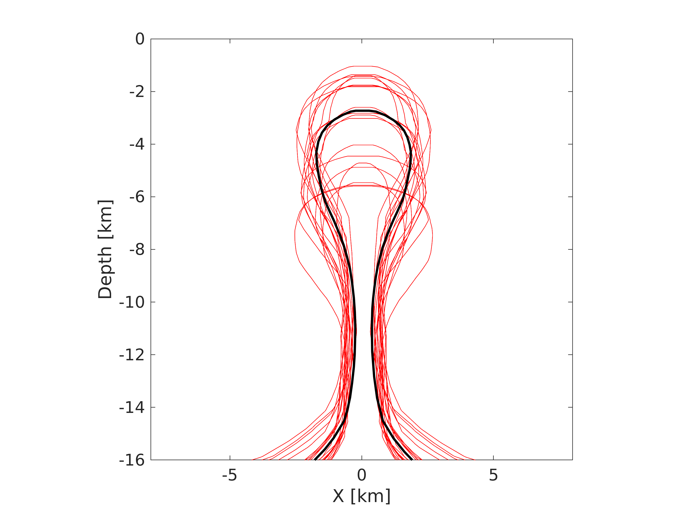
Salt Diapir
4 control polygons
(2D → only need Sx and no Sy)
+ 1 parameter Sz for vertical stretch
Black outline shows reference model
Red outlines show 20 automatically generated variations
Arne Spang, Tobias Baumann, Boris Kaus
Johannes Gutenberg-University, Mainz
arspang@uni-mainz.de

Slide 11
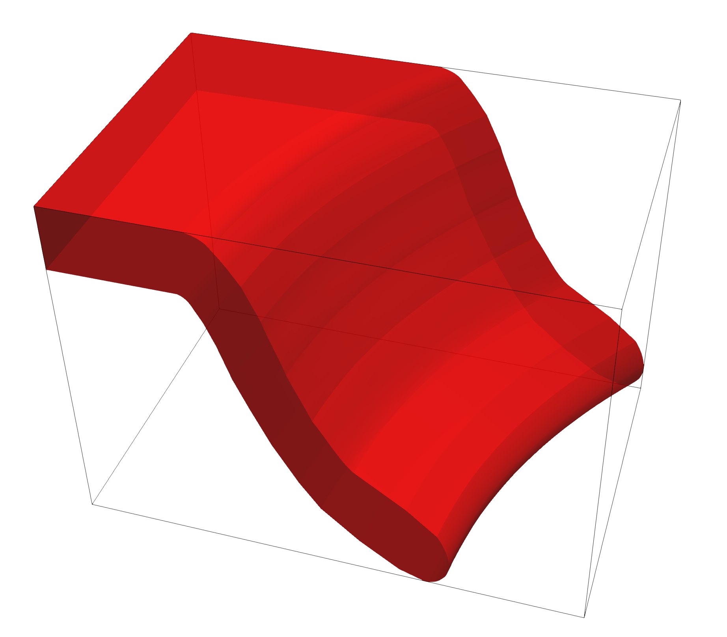
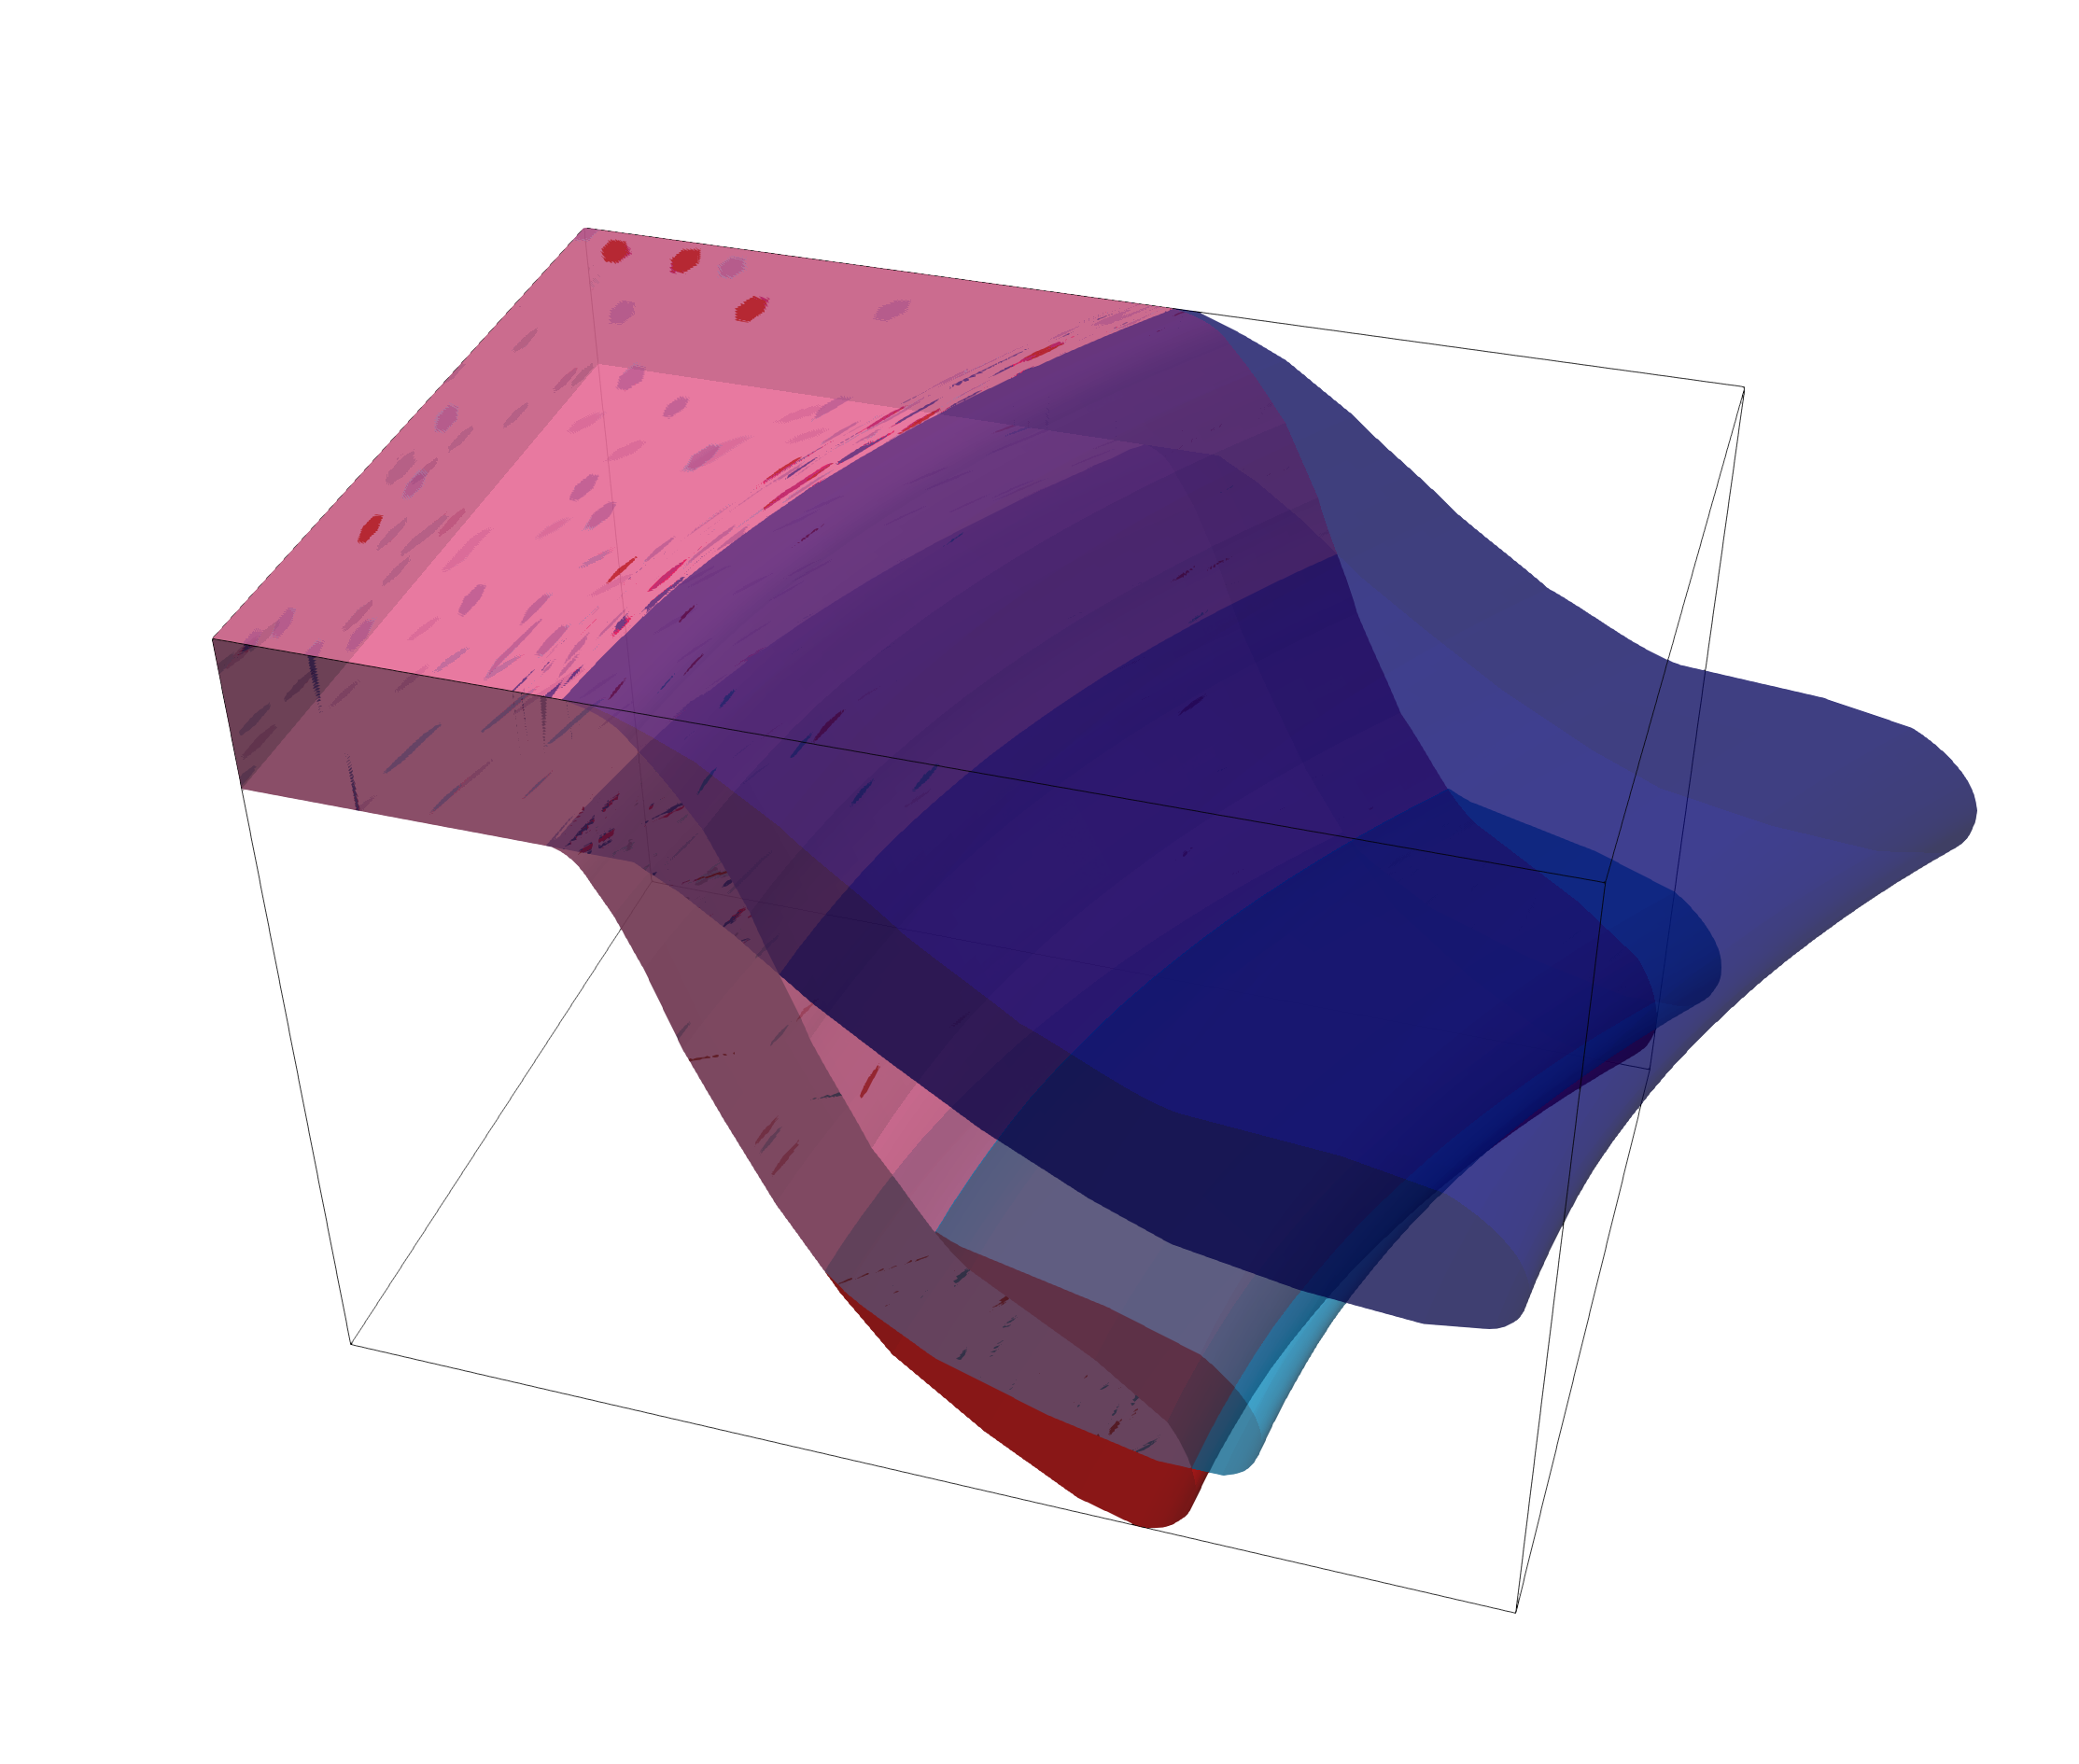
Subducting Slab
Variation of the method to work for subducting slabs
Works on arbitrary slab geometries
(straight, oblique, curved)
Reference model in red
2 variations in light and dark blue
Each only uses 2 parameters
Arne Spang, Tobias Baumann, Boris Kaus
Johannes Gutenberg-University, Mainz
arspang@uni-mainz.de

Slide 12
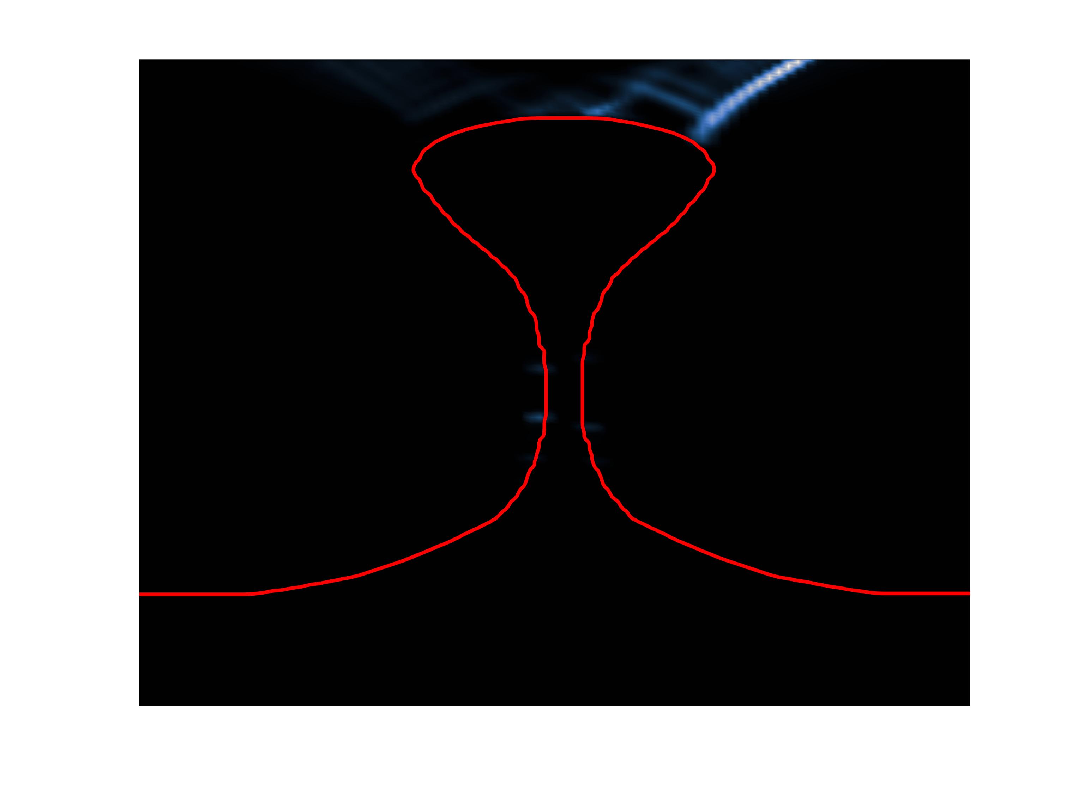
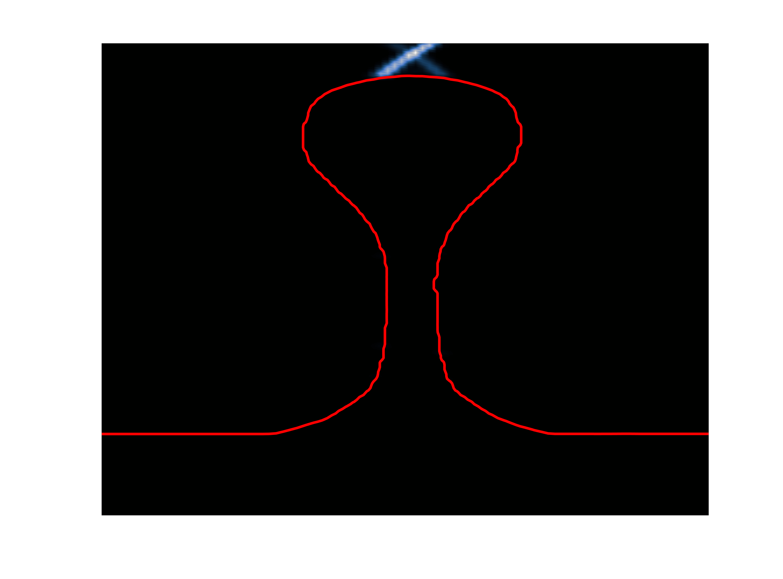
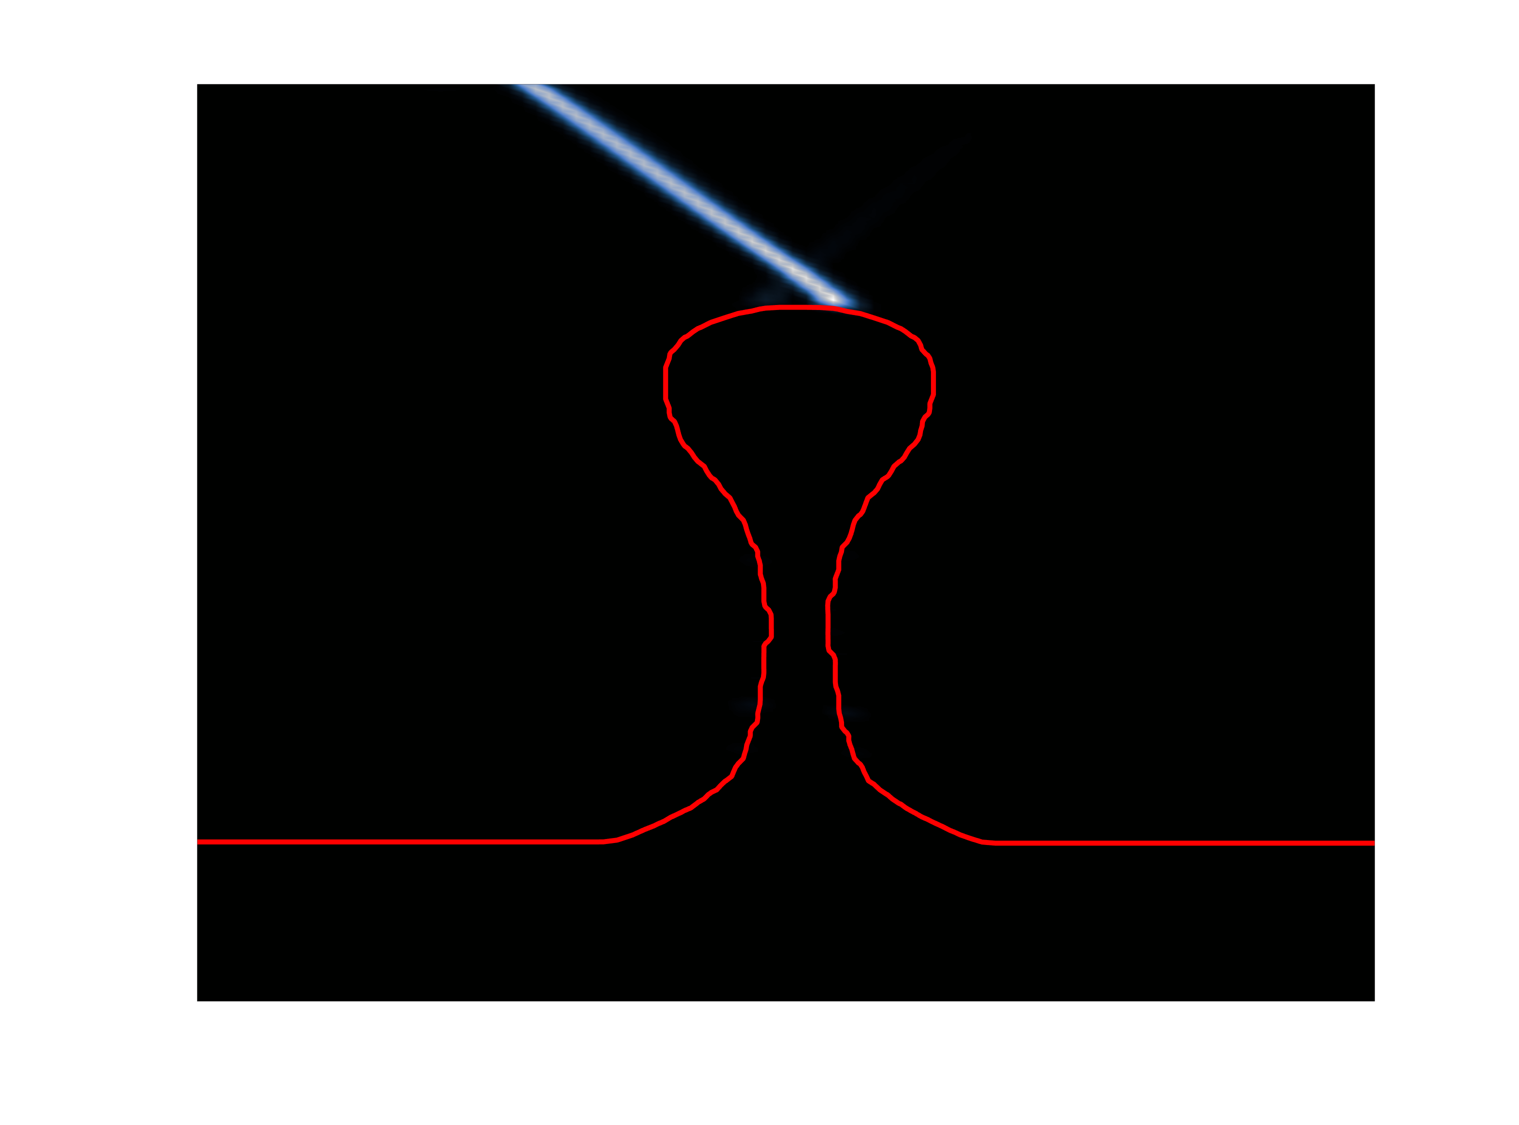
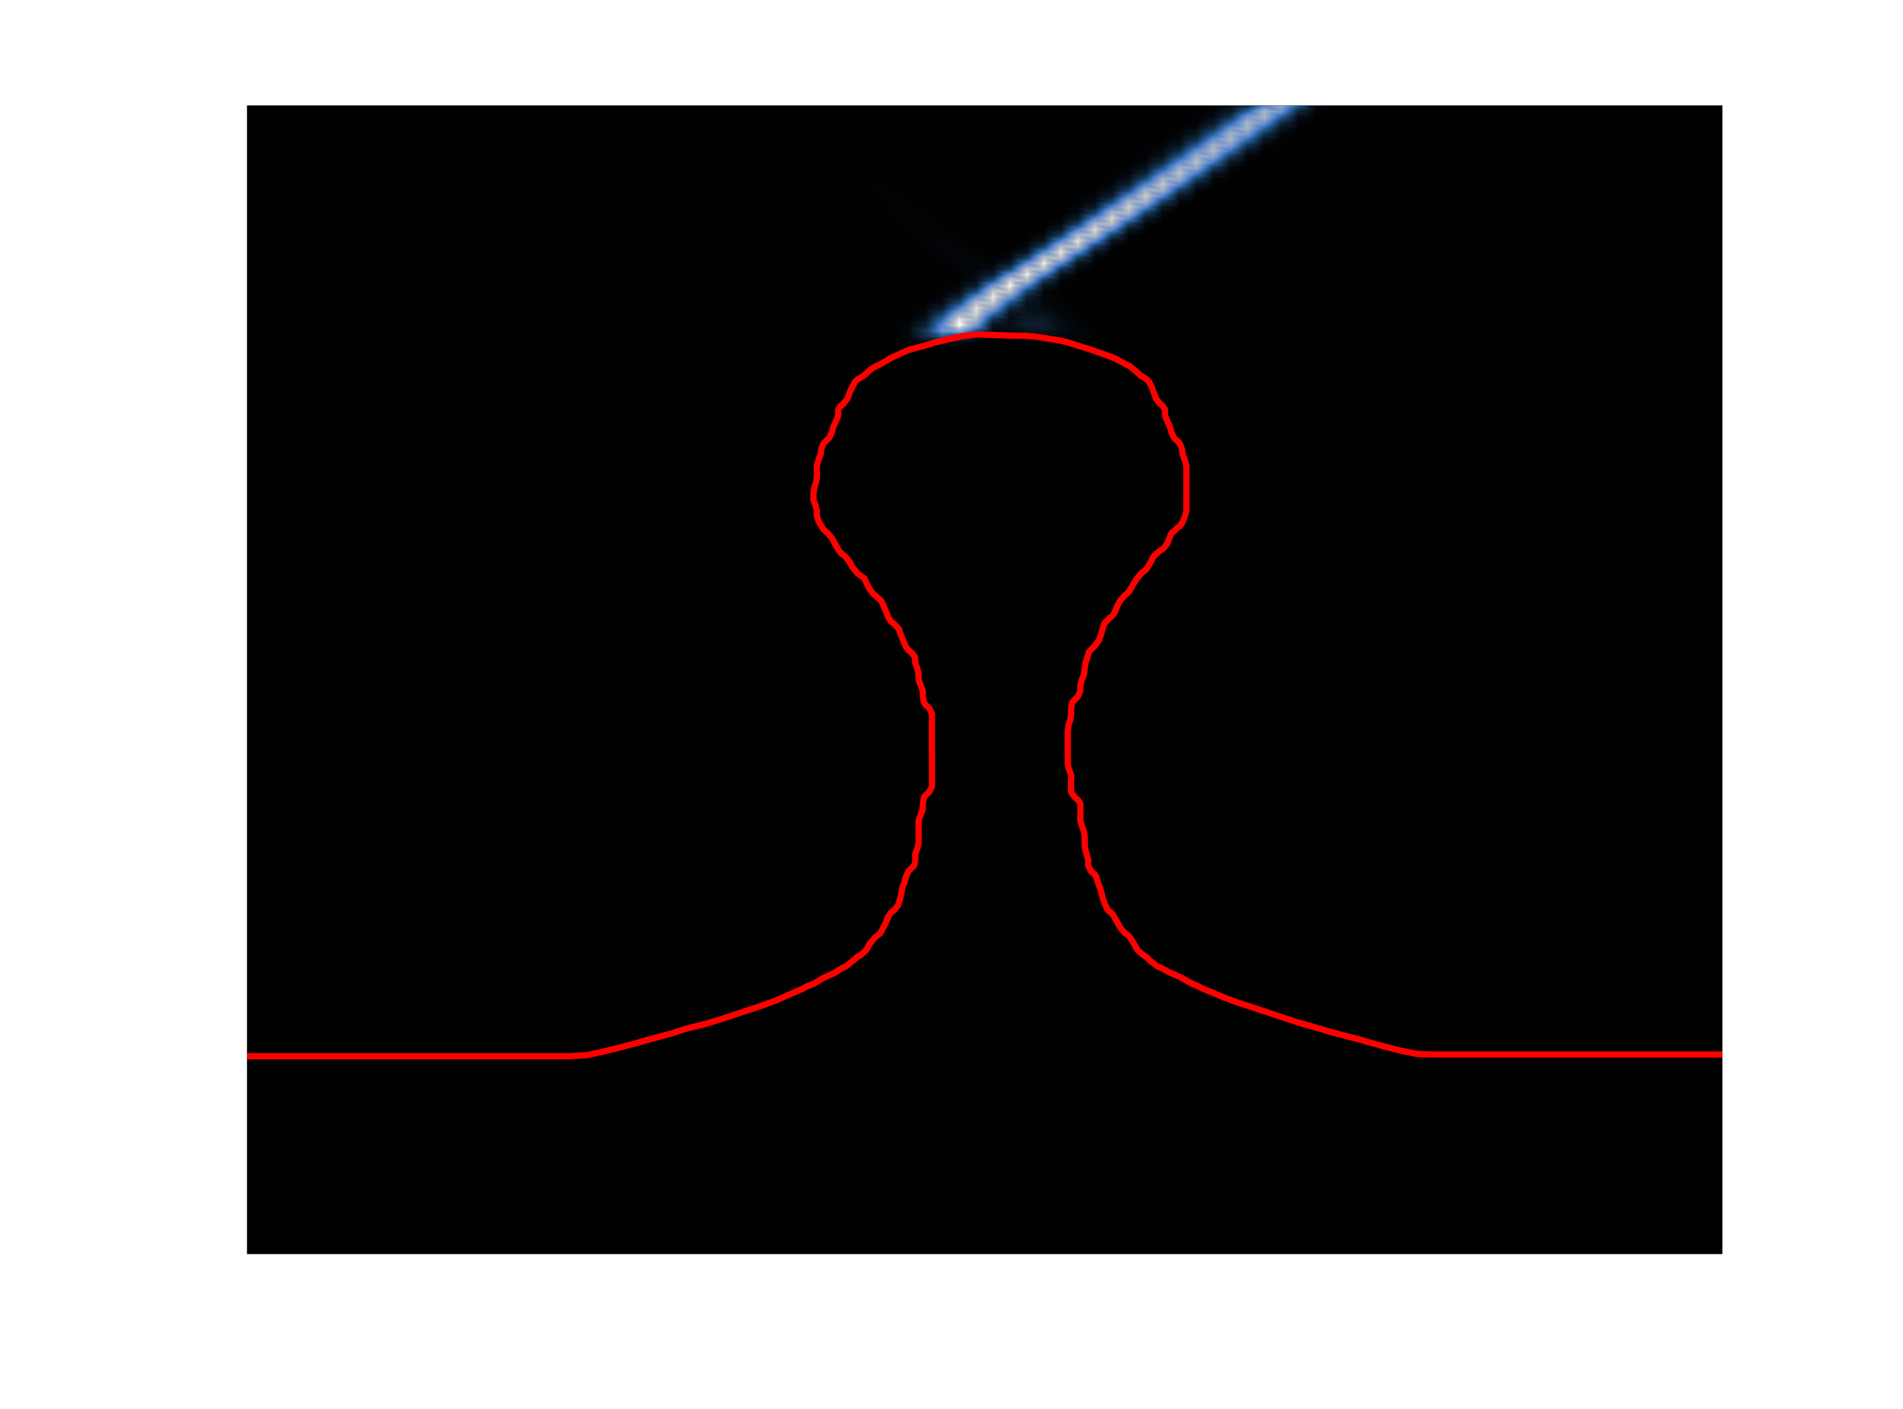
Influence of initial geometry
4 of the previously shown 20 salt diapirs (slide 10) in an extending regime
Fault patterns are significantly different
From clean faults in opposite directions to systems of parallel and crossing faults
Arne Spang, Tobias Baumann, Boris Kaus
Johannes Gutenberg-University, Mainz
arspang@uni-mainz.de

Slide 13
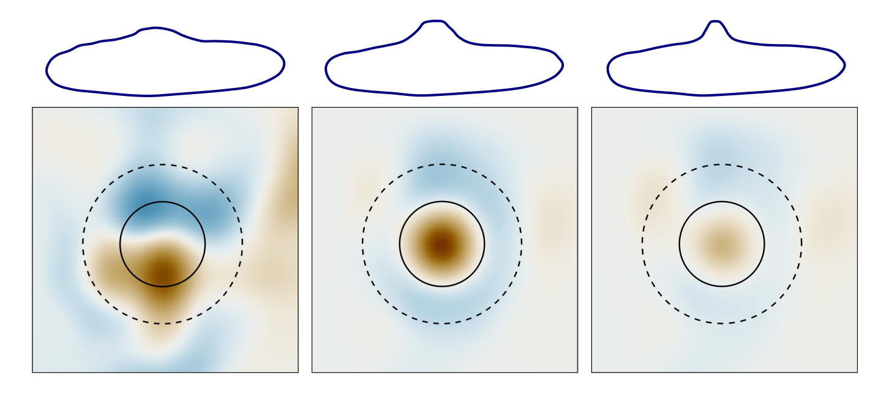
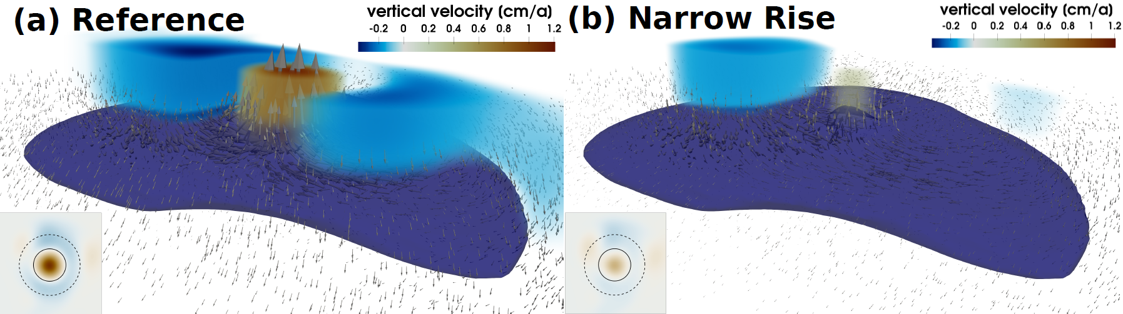
Influence of initial geometry
Slight variations to the upper part of a magma body drastically change:
  Flow field inside the magma body
  The associated surface velocities
EW-Slice
Spang et al., 2021 (in review at JGR Solid Earth)
Surface Velocity
Arne Spang, Tobias Baumann, Boris Kaus
Johannes Gutenberg-University, Mainz
arspang@uni-mainz.de

Slide 14
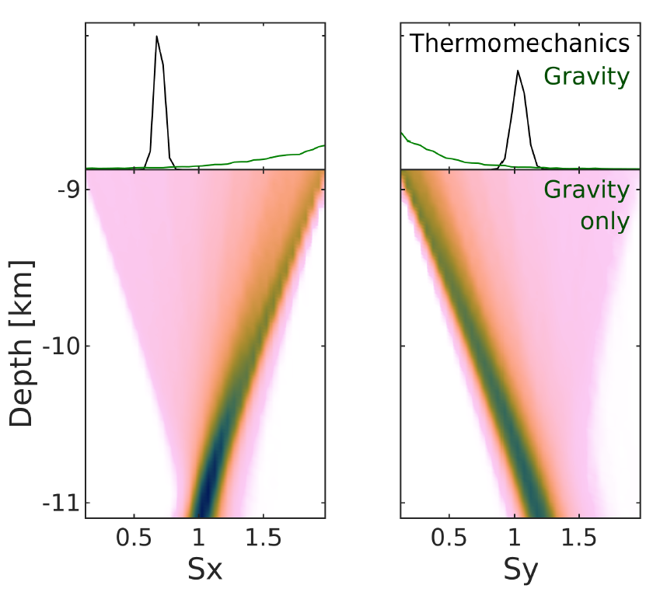
Influence of initial geometry
Slight variations to the upper part
of a magma body drastically change:
  Flow field inside the magma body
  The associated surface velocities
→ We can invert for geometry!
Spang et al., 2021 (in review at JGR Solid Earth)
Arne Spang, Tobias Baumann, Boris Kaus
Johannes Gutenberg-University, Mainz
arspang@uni-mainz.de

Slide 15
Summary
Initial geometry has a big impact on model results
(and is often associated with large uncertainties)
New tool to parameterize and manipulate complex 3D bodies
Allows us to account for uncertain geometry
Allows to invert for geometry
Tool will be integrated in open-source software geomIO
(Bauville & Baumann, 2019)
Arne Spang, Tobias Baumann, Boris Kaus
Johannes Gutenberg-University, Mainz
arspang@uni-mainz.de

Slide 16
Questions?
arspang@uni-mainz.de
Arne Spang, Tobias Baumann, Boris Kaus
Johannes Gutenberg-University, Mainz
arspang@uni-mainz.de

