Slide 1
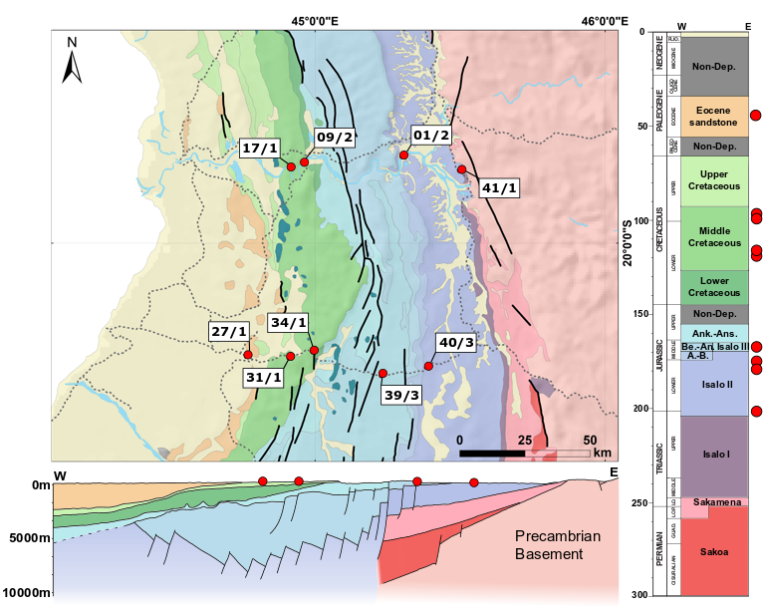
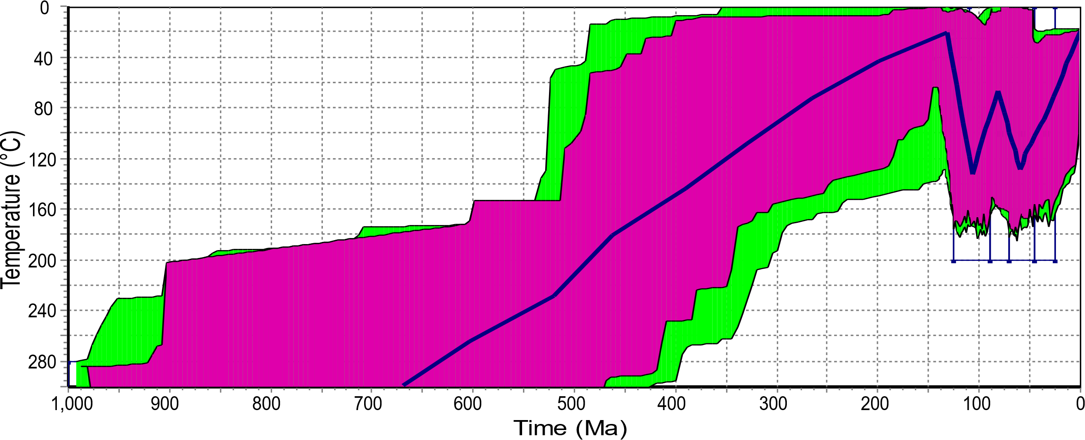
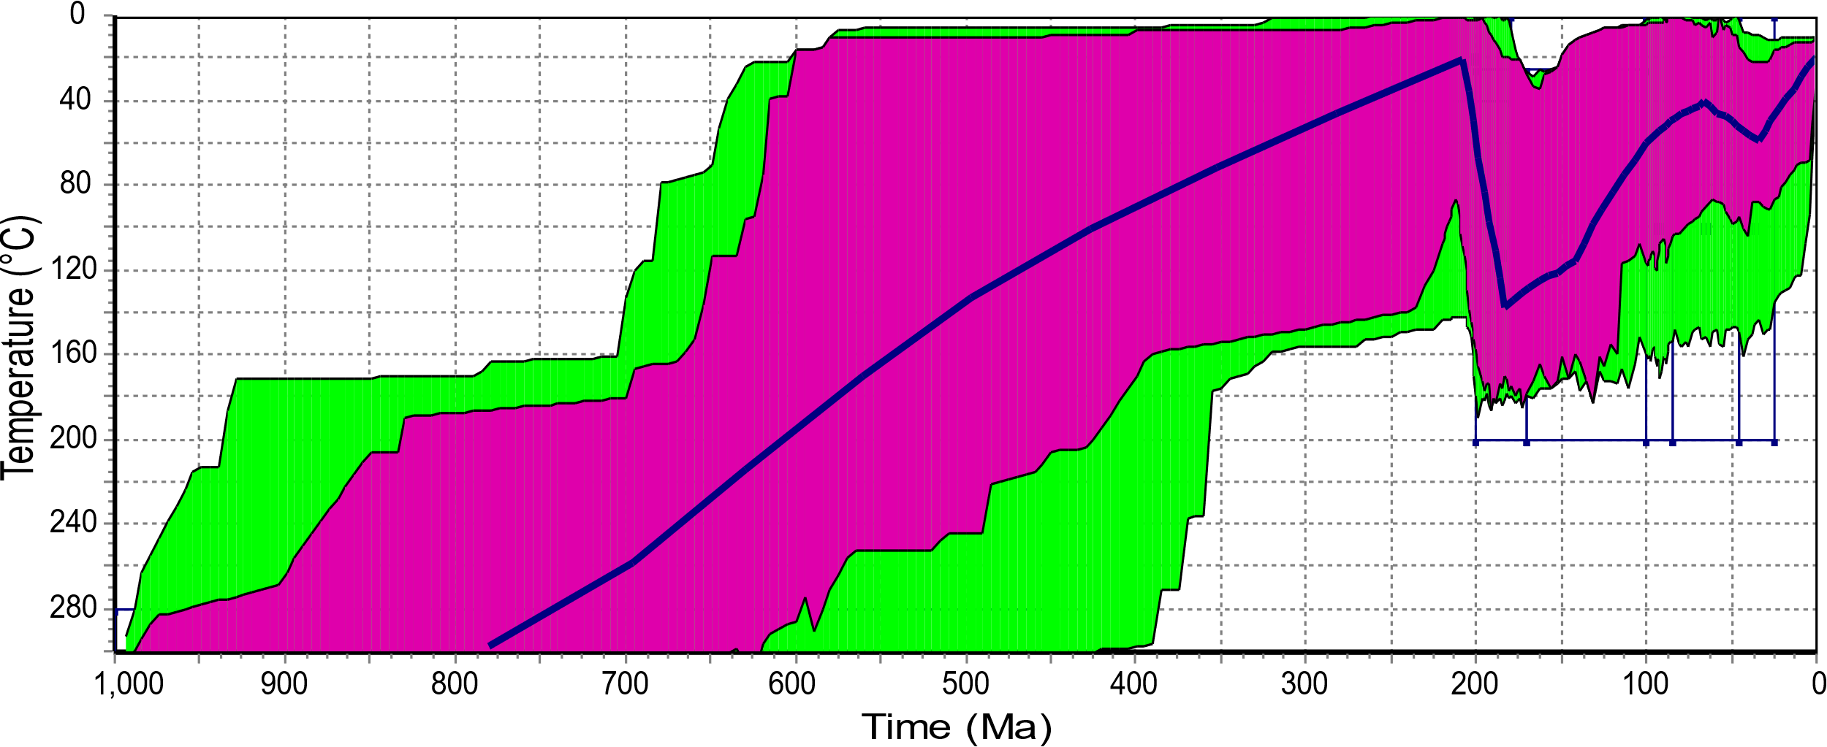
Detrital zircon U-Pb and (U-Th)/He geochronology
of the central Morondava Basin, Madagascar
W.M. Schetselaar¹, D.A. Schneider¹, G. Tari², H. Raharisolofo³, S. Rahajarivelo³, F. Ramboasalama⁴
1. University of Ottawa, Canada 2. OMV, Austria 3. OMNIS Hydrocarbon Division, Madagascar 4. Consultant, Madagascar
Cretaceous
Jurassic

Slide 2
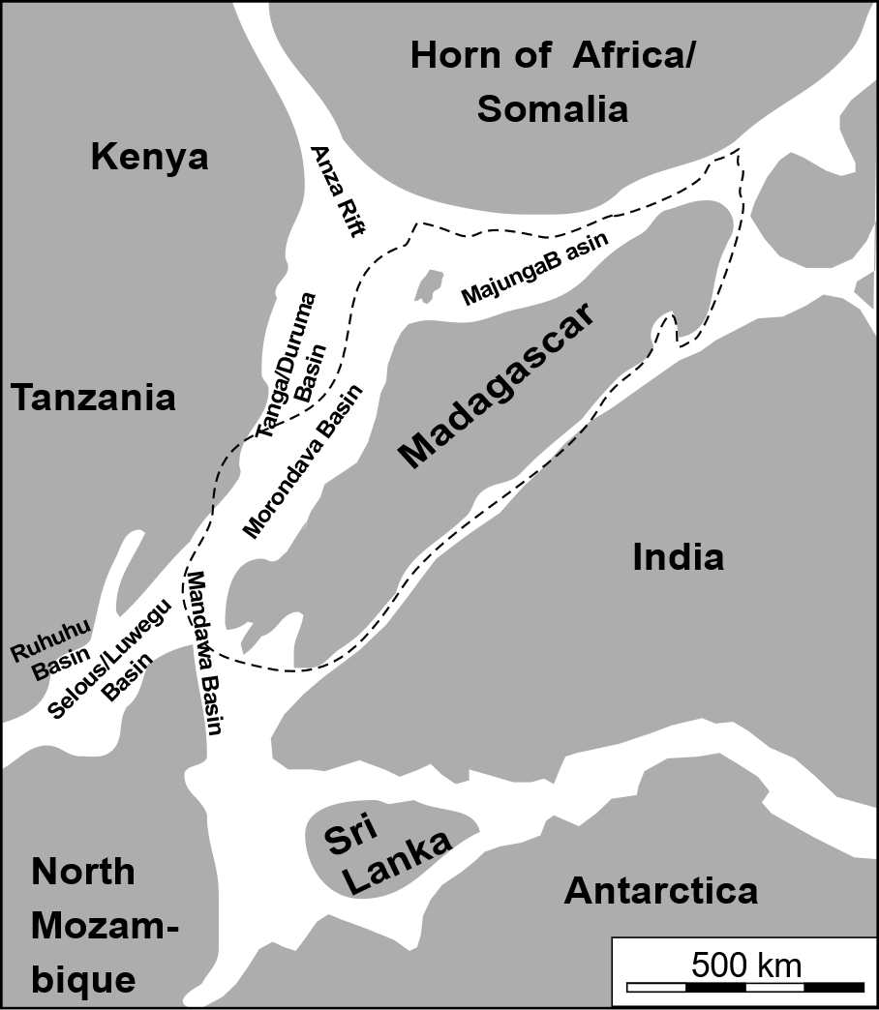
Overview
500 m.y.a
Understanding the deposition and tectonics of the Morondava Basin, Madagascar in context of post-Gondwana rifting
Depositional patterns by U-Pb detrital zircon geochronology
Heating and cooling of the basin by zircon (U-Th)/He thermochronology
Heating and cooling during rifting of Madagascar from Africa, and later India/Antarctica
Uplift of the basin shoulder independent of passive margin
Geiger et al. 2004

Slide 3
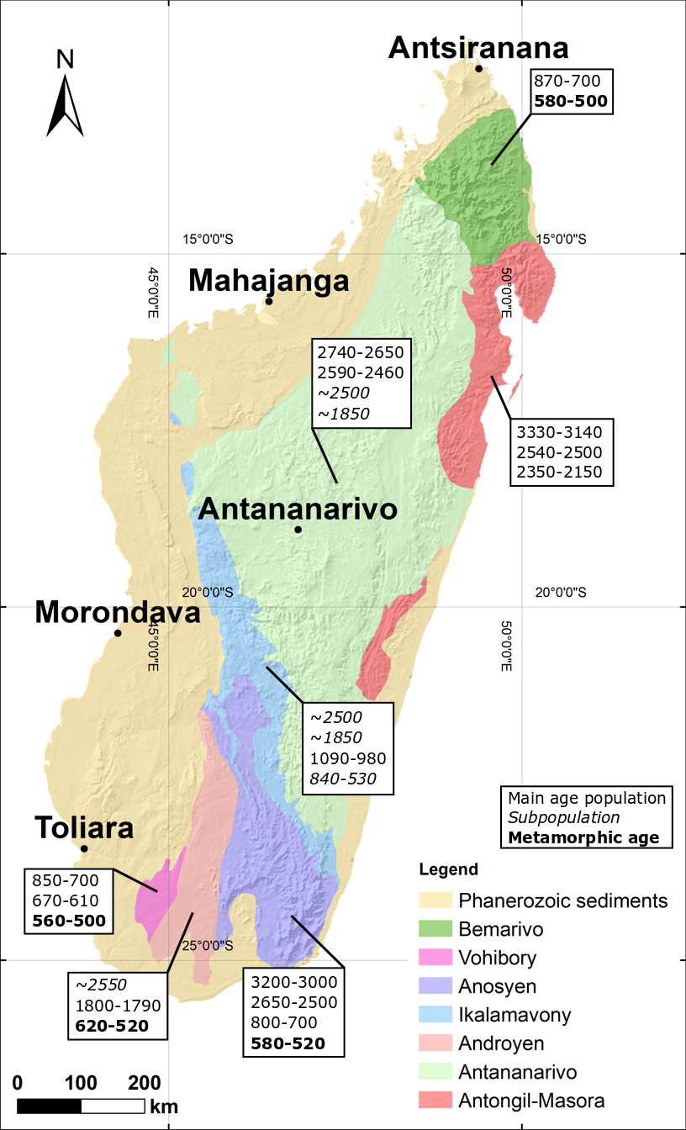
Madagascar terranes
After Roig et al. 2012
Central highlands made up of Precambrian basement terranes
Surrounded by Phanerozoic sedimentary basins formed during Permo-Triassic rifting
Southwestern basement terranes record 500 Ma metamorphism in zircon during Gondwana amalgamation
Central Antananarivo basement terrane records relatively little metamorphism in zircon

Slide 4
Morondava basin
Coarse-grained sedimentary rocks sampled along two transects
9 samples for detrital zircon U-Pb geochronology
Identical 9 samples for zircon (U-Th)/He thermochronology
Jurassic samples on flat-lying basement shoulder
Cretaceous samples lie on top of fault blocks tilted during middle-Jurassic rifting

Slide 5
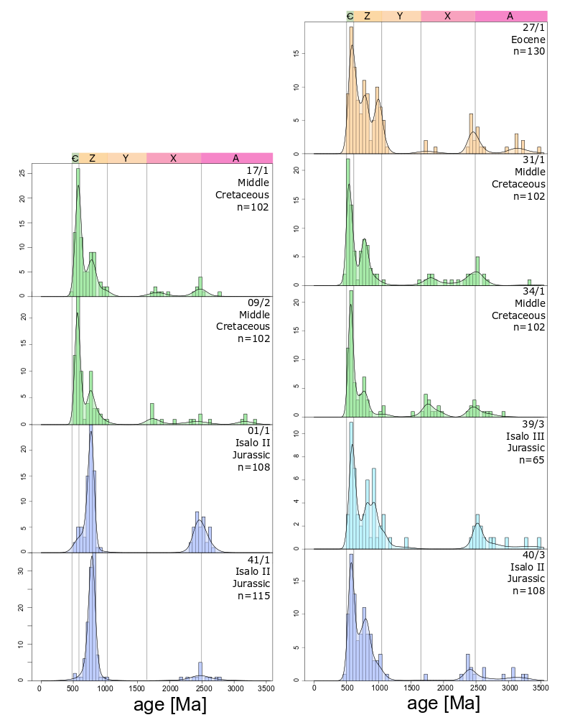
U-Pb detrital zircon
South transect
North transect
140 zircon grains per sample analyzed by LA ICP-MS methods
Major DZ age modes at 500, 800, and 2500 Ma with minor modes at 1600 and 3000+ Ma
800 and 2500 Ma age zircon sourced from central Madagascar terranes
500 Ma metamorphism during Gondwana amalgamation
Reflected by southwest basement terranes
3000+ Ma in recycled metasedimentary terranes

Slide 6
(U-Th)/He thermochronology
Cooling date corresponds to ~180°C, and is a function of grain size and effective U, which is a proxy for radiation damage
8-9 zircon per sample were analyzed
Wide range of effective U values from 34 to 2000 ppm
(U-Th)/He ages range from 500 to 60 Ma, indicating partial resetting

Slide 7
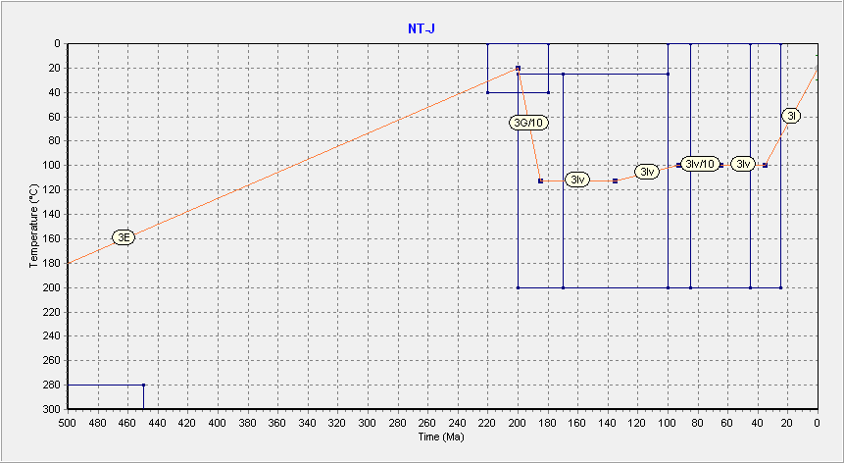
Model constraints
Eocene cooling
Uplift
Inverse model
Rifting
Jurassic deposition
Passive Margin
Rifting
Basin sag
Basement uplift
Uplift
Jurassic burial
African rifting
Failed Rifting

Slide 8
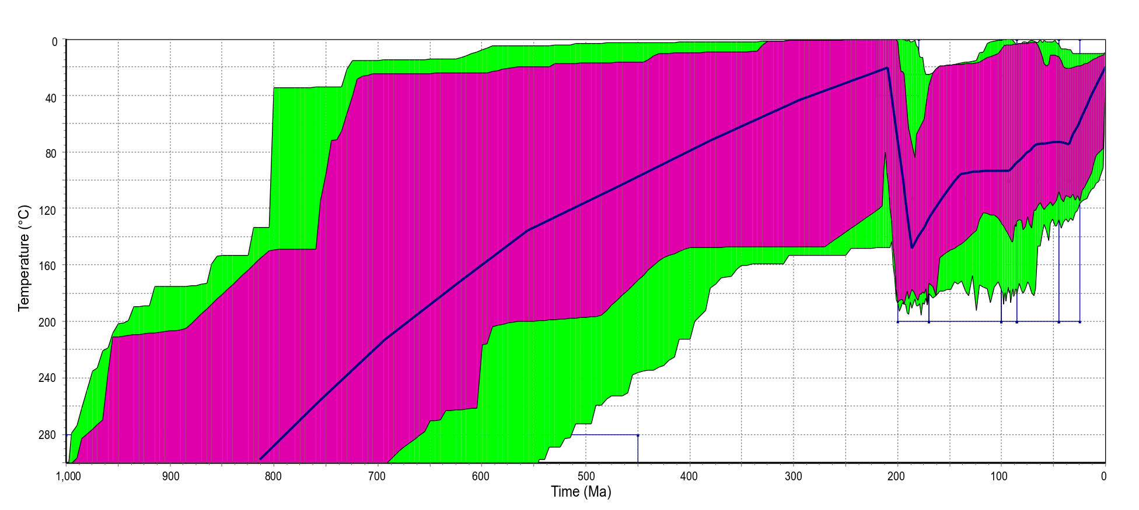
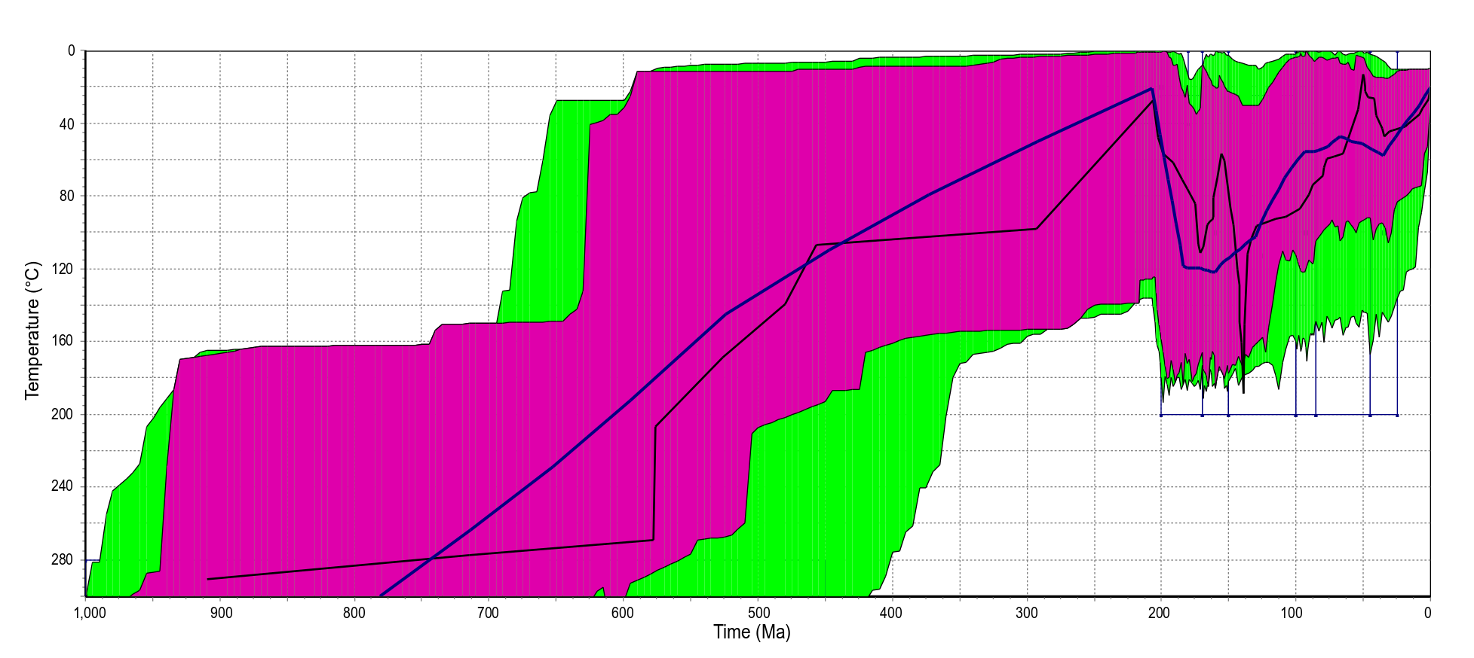
Jurassic thermal model
North Transect
Inverse model uses 4 zircon for model; forward model used to assess viable path for all zircon
Heating to 140°C during early-middle Jurassic – Rifting from Africa
Middle Cretaceous cooling – Separation from India
Final cooling in Eocene
Pre-Deposition cooling between 600 and 400 Ma
Good agreement between North and South transect
South Transect

Slide 9
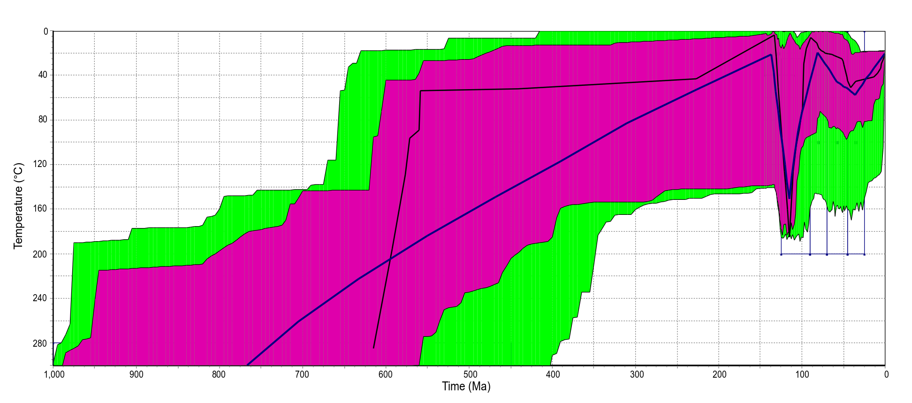
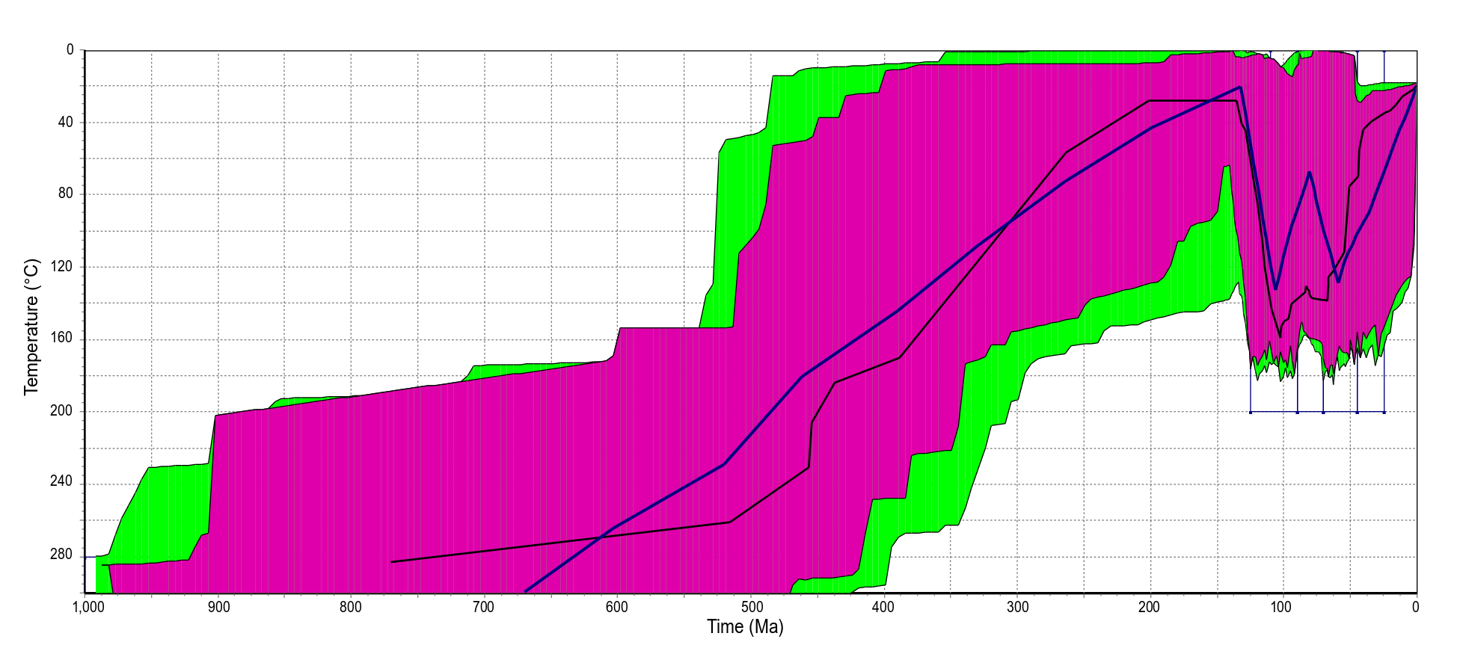
Cretaceous thermal model
North Transect
Inverse model uses 4 zircon for model; forward model used to assess viable path for all zircon
Heating to 160°C during middle Cretaceous – Passive margin formation
Middle Cretaceous cooling – Separation from India
Final cooling in Eocene
South transect shows reheating in Late Cretaceous
North transect similar to Jurassic samples
South Transect

Slide 10
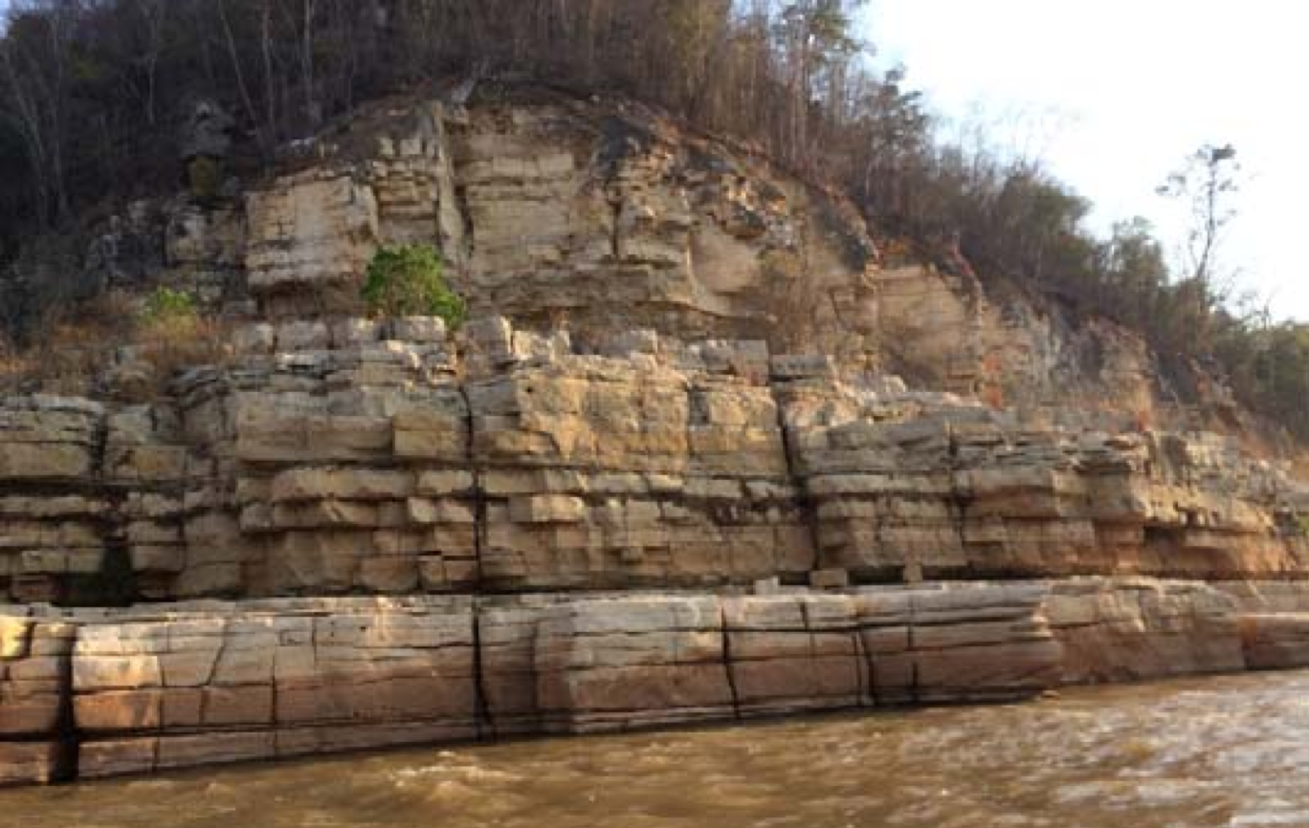
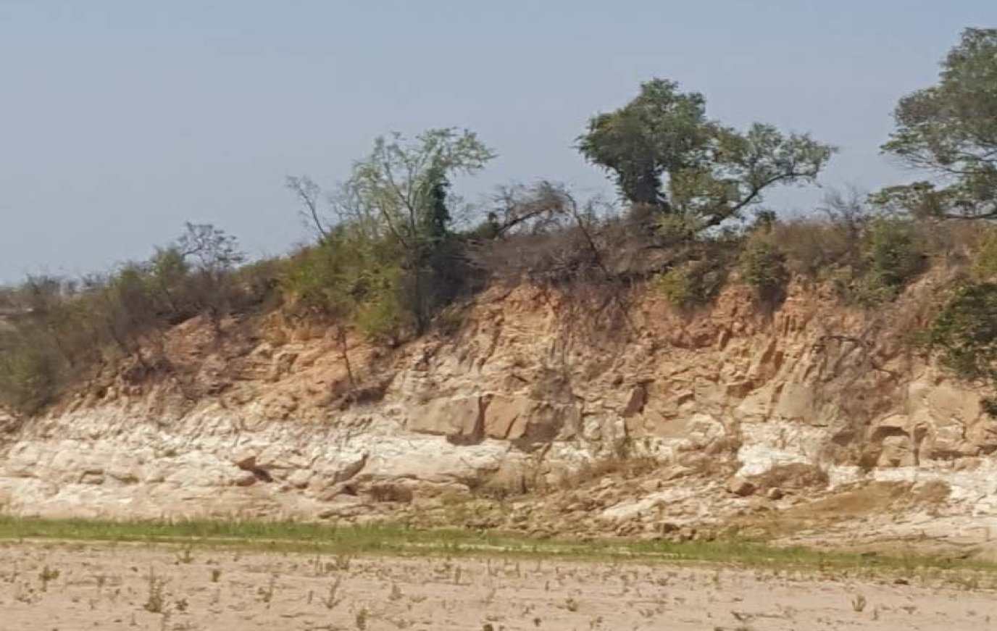
Summary
Sedimentation patterns
Northeast basin sourced by Central Madagascar Terranes
Southwest basin sourced by Southern Terranes
Metamorphic 500 Ma and 3000 Ma recycled sedimentations
Thermal models of Morondava basin
Basin shoulder uplifted during Turonian rifting with minimal heating in late Cretaceous
Middle-Jurassic rifting resulting in shoulder uplift?
Passive margin overlying tilted fault blocks uplifted during Turonian rifting, continued deposition in late Cretaceous
Middle-Jurassic rifting; creation of accommodation space

