Slide 1
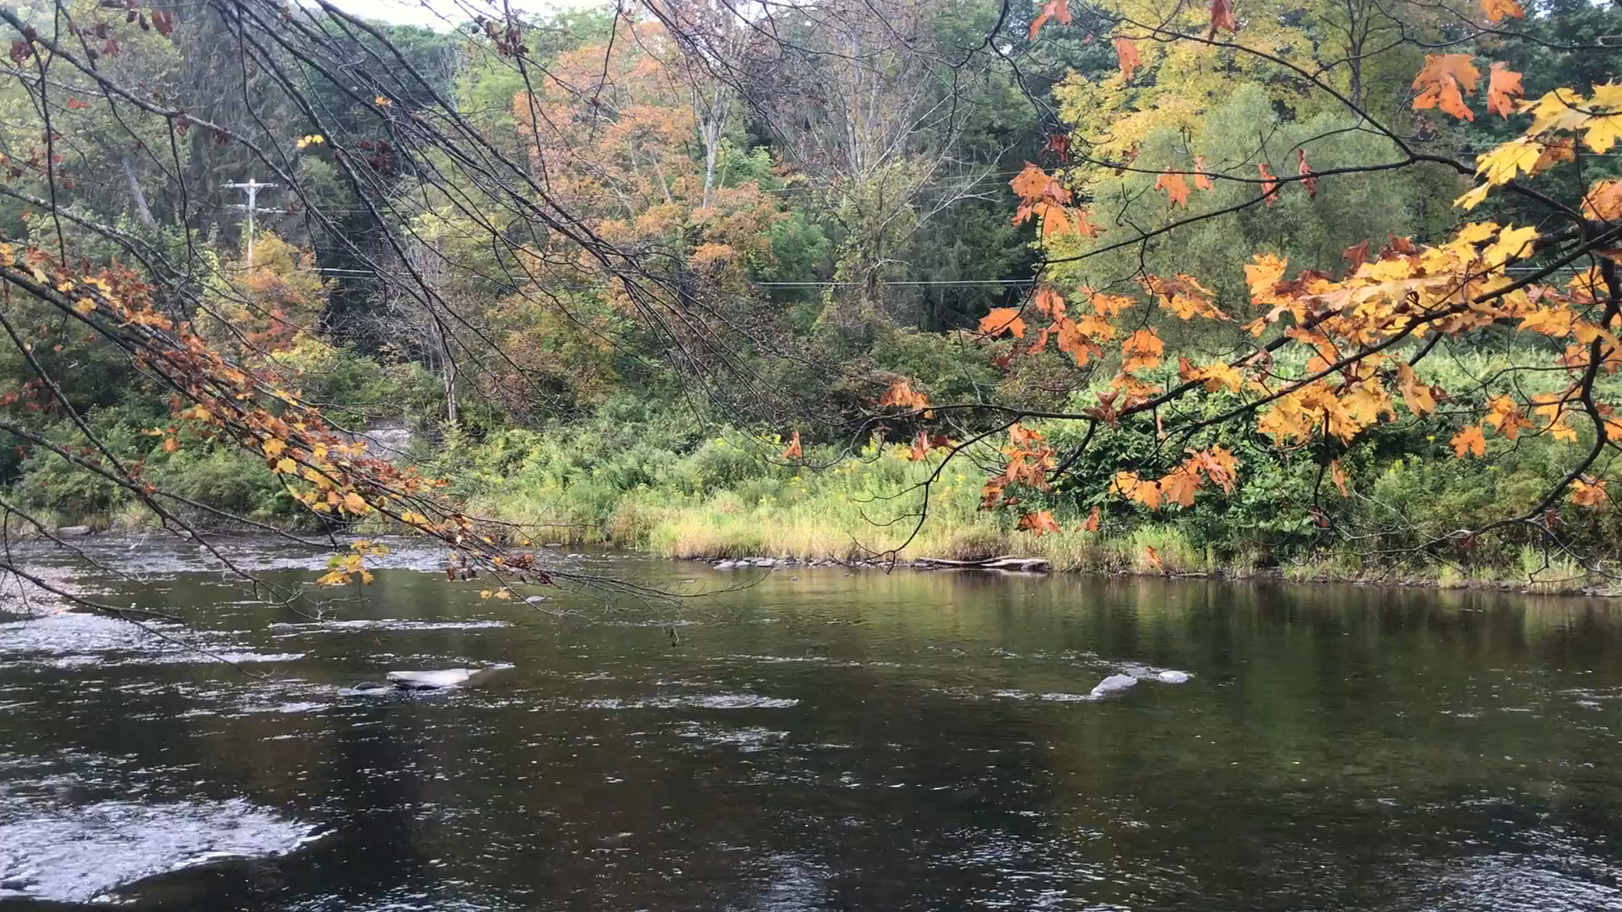



Effects of the Turbulent Schmidt Number on the Mass Exchange of a Vegetated Lateral Cavity
Luiz Oliveira¹
Taís Natsumi¹
Filipe Queiroz¹
Johannes Janzen¹
Carlo Gualtieri²
2021

Slide 2
Lateral Cavity
Region connected to the main flux with close to zero net flux.
Main Characteristics
Slow motion;
Presence of vortexes;
Transient storage;
Enhance the biodiversity.

Slide 3
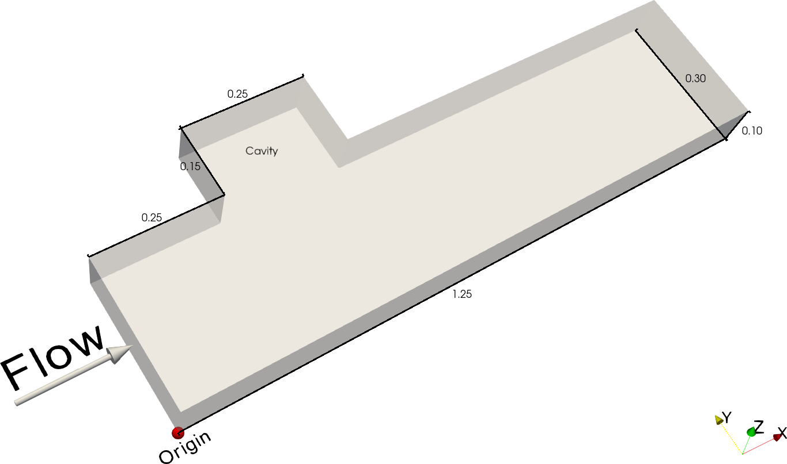
Geometry
Notes:
U = 0.101 m/s
Re = 9000
W/L = 0.6

Slide 4
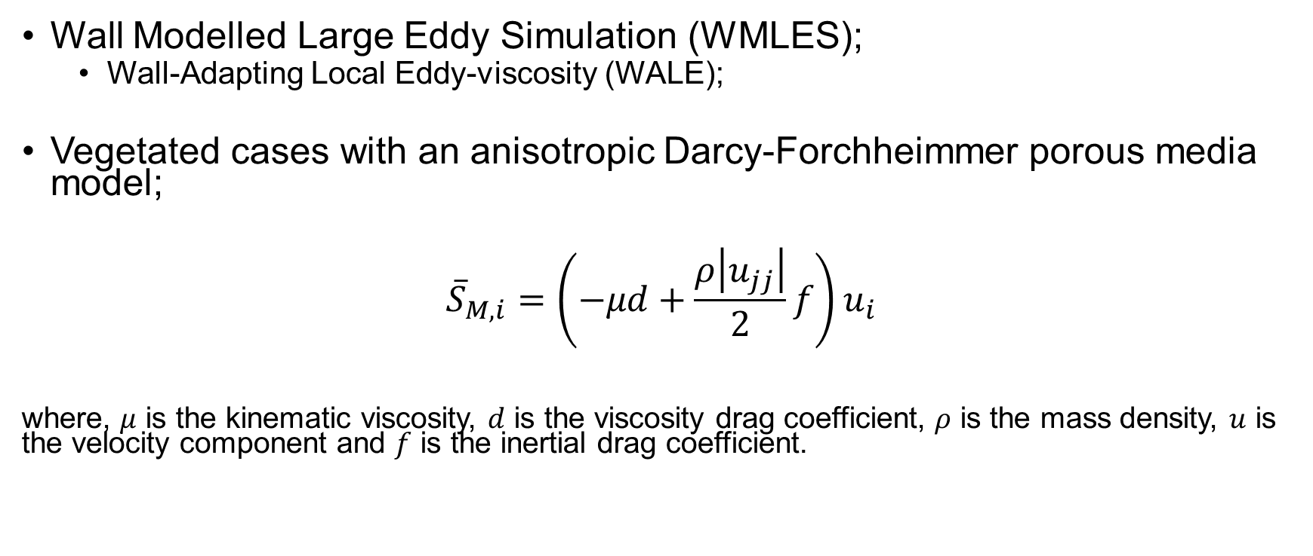
Model
Wall Modelled Large Eddy Simulation (WMLES);
  Wall-Adapting Local Eddy-viscosity (WALE);
Vegetated cases with an anisotropic Darcy-Forchheimmer porous media model;
$${\overline{S}}_{M,i}=\left(−μd+\frac{ρ\left|u_{jj}\right|}{2}f\right)u_{i}$$
where, $μ$ is the kinematic viscosity, $d$ is the viscosity drag coefficient, $ρ$ is the mass density, $u$ is the velocity component and $f$ is the inertial drag coefficient.

Slide 5
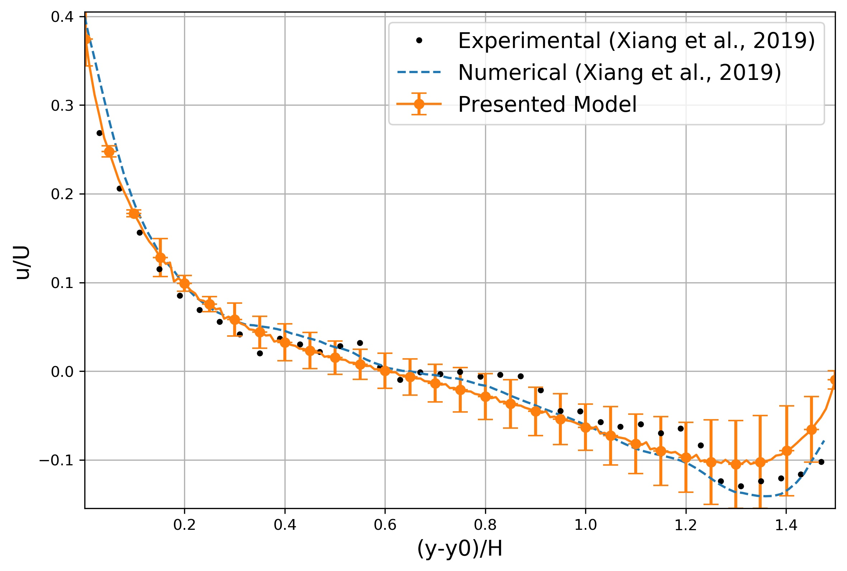
Validation

Slide 6
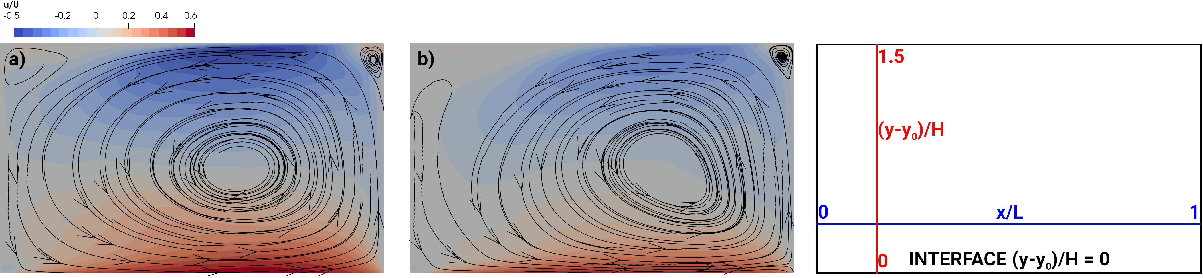
a) Non-vegetated and b) Vegetated (a = 0.132 %)

Slide 7
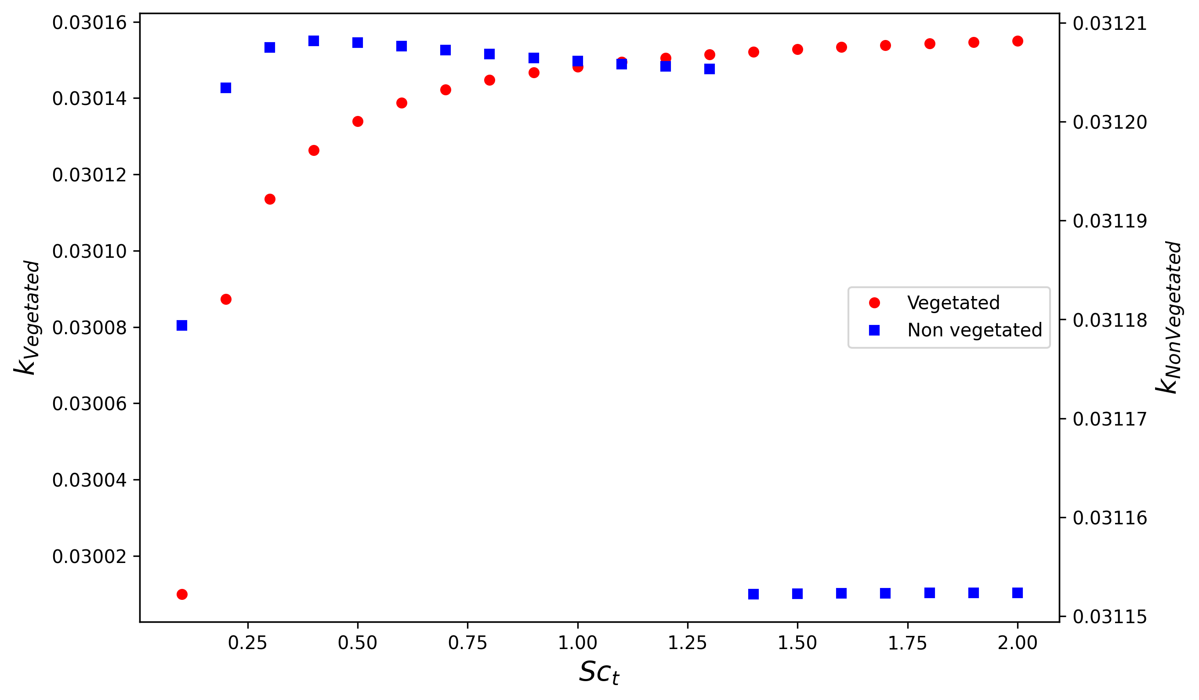

Mass Exchange Rate (k)
$$k=\frac{1}{T_{D}}$$
where, Td (s) is the mean retention time.
Notes:
0.1 s of the mean retention time variation (vegetated)
0.2 s of the mean retention time variation (non-vegetated)

Slide 8
Conclusion
There is no significant variance in the mass exchange values in both scenarios.
The vegetated case remained with a higher mass exchange rate (k) for all turbulent Schmidt numbers.

Slide 9

Funding
This study was financed in part by the Coordenação de Aperfeiçoamento de Pessoal de Nível Superior - Brazil (CAPES) -Finance Code 001.
This study was partly conducted in Lobo Carneiro cluster located in NACAD/Coppe - Rio de Janeiro, Brazil

Slide 10


