Slide 2
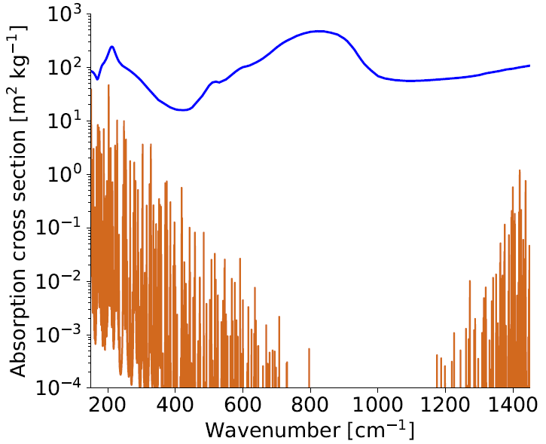
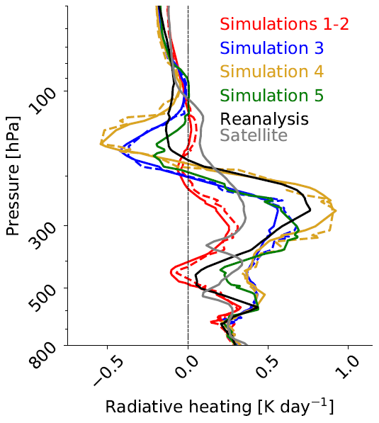
Ice cloud absorbs more radiation than clear sky.
max top cooling
max bottom warming
S. Sullivan and A. Voigt et al. (2021) [under review]
Radiative heating [K day⁻¹]
Notes:
K_wv shown for surface temperature of 300 K, atmospheric temperature of 220 K, and RH of 75%
Warren and Brandt JGR 2008
Absorption coefficient is an effective cross-sectional area per mass and we multiply this by the density of absorbers to obtain optical depth.

Slide 3
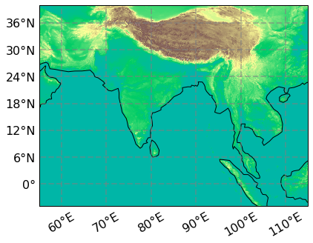
We start by switching microphysics schemes and vertical resolution.
M | One-moment or two-moment
V
A
R
Default or higher vertical resolution
Aerosol dependence or not
Consistent size (effective Radius) of ice crystals between microphysics and radiation or not

Slide 4
Part I: Limited-area storm-resolving simulations
Ice microphysics switches have a strong control on cloud-radiative heating in ICON.

Slide 5
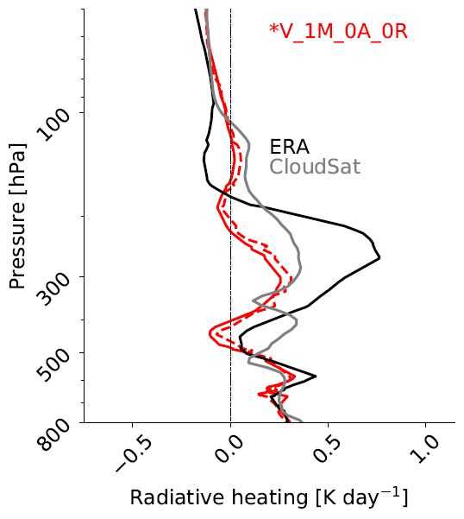
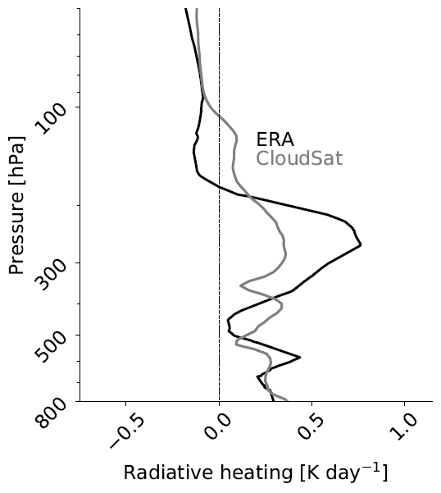
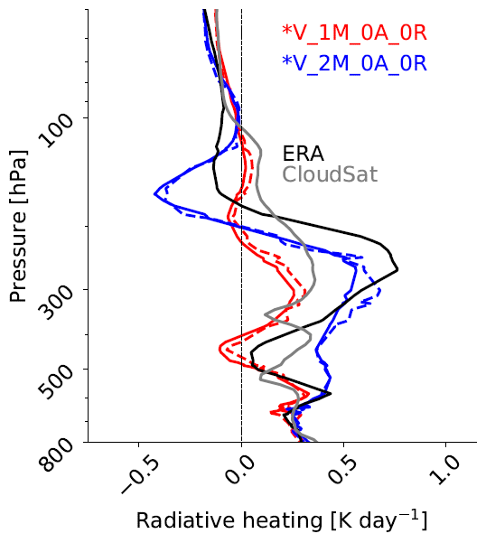
M – microphysics V – vert res R – ice crystal size A - aerosol
Reanalysis and satellite profiles do not agree.
Vertical resolution has little impact.
In-cloud heating is almost 2 times larger from 1M → 2M.
Cloud-top cooling is almost 10 times larger.

Slide 6
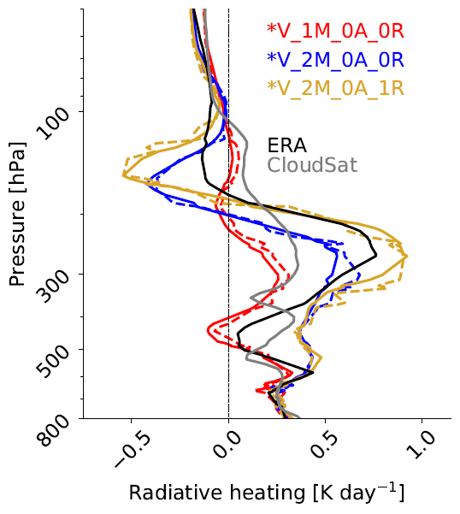
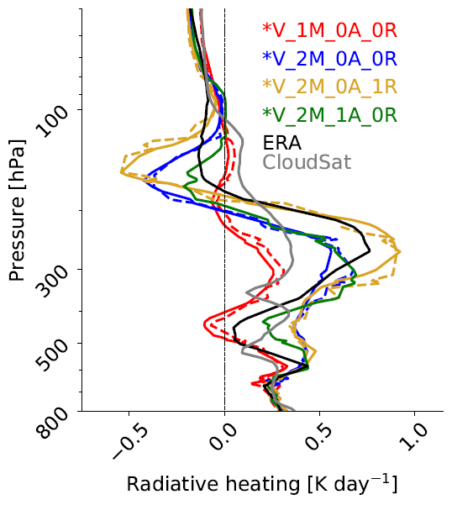
M – microphysics V – vert res R – ice crystal size A - aerosol
Heating-cooling dipole increases by a factor of 2 with consistent ice crystal size.
Heating-cooling dipole decreases above 200 hPa and below 400 hPa with aerosol dependence.

Slide 7
We can kind of generate whatever we want with ice microphysics switches...
Reanalysis and satellite profiles do not agree.
Vertical resolution has little impact.
Cloud-top cooling is almost 10 times larger.
Heating-cooling dipole increases by a factor of 2 with consistent ice crystal size.
Heating-cooling dipole decreases above 200 hPa and below 400 hPa with aerosol dependence.
… but we can also understand why.

Slide 8
… but we can also understand why.

Slide 9
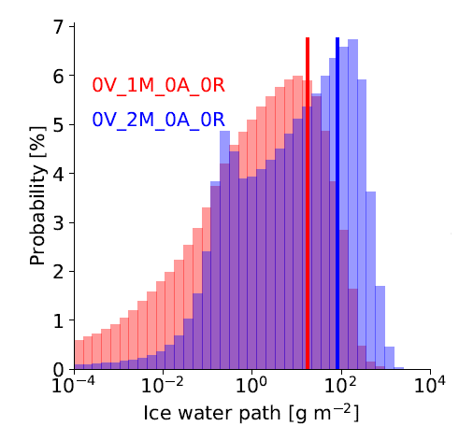
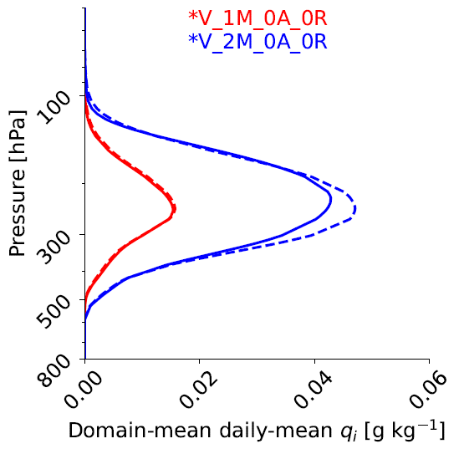
In-cloud heating is almost 2 times larger from 1M → 2M.
Convective outflow
Thin cirrus
Unimodal versus bimodal IWP distribution
2M generates >4 times more ice and over a greater depth.
Notes:
The simulation with increased vertical resolution puts the peak qi at a larger value and lower in the atmosphere.

Slide 10
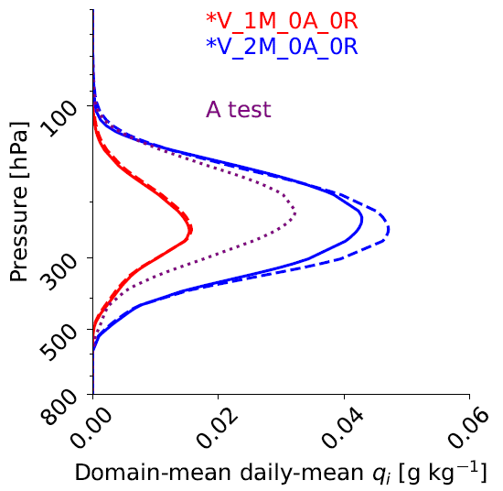
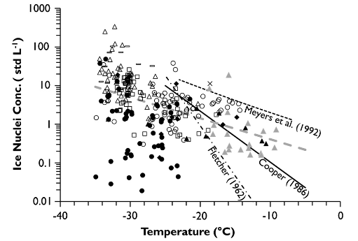
Why does 2M generate >4 times more ice? low
T_{min}= 237 K
A = 2.969 x 10⁴ m⁻³
T_{min}= 237 K
A = 1.0 x 10² m⁻³
Parameters from Hande et al. 2015 ACP & Doms et al. 2005
Fig from DeMott et al. 2010 PNAS

Slide 11
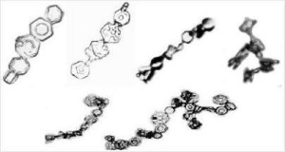
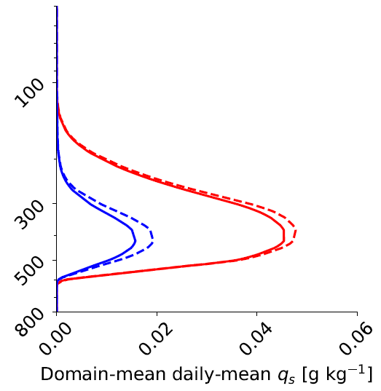
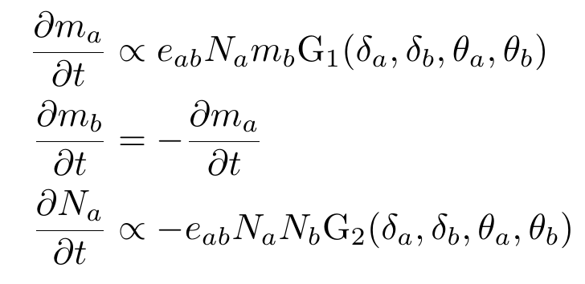
Why does 2M generate >4 times more ice? middle
ice-to-snow conversion processes:
C =10³ s⁻¹
i + i = s (aggregation, ice autoconversion)
s + c = i (riming)
i + s = s (aggregation)
i + i = s (aggregation)
s + c = i (riming)
i + s = s (aggregation)

Slide 12
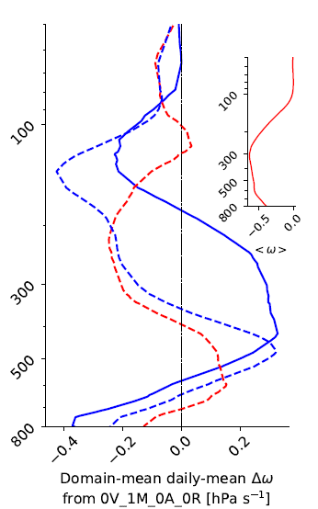
Why does 2M generate >4 times more ice? high
2 times larger UT mean updrafts

Slide 13
Part II: Online trajectories and a microphysical box model
Lagrangian analysis allows us to turn off microphysical-dynamical feedbacks.

Slide 14
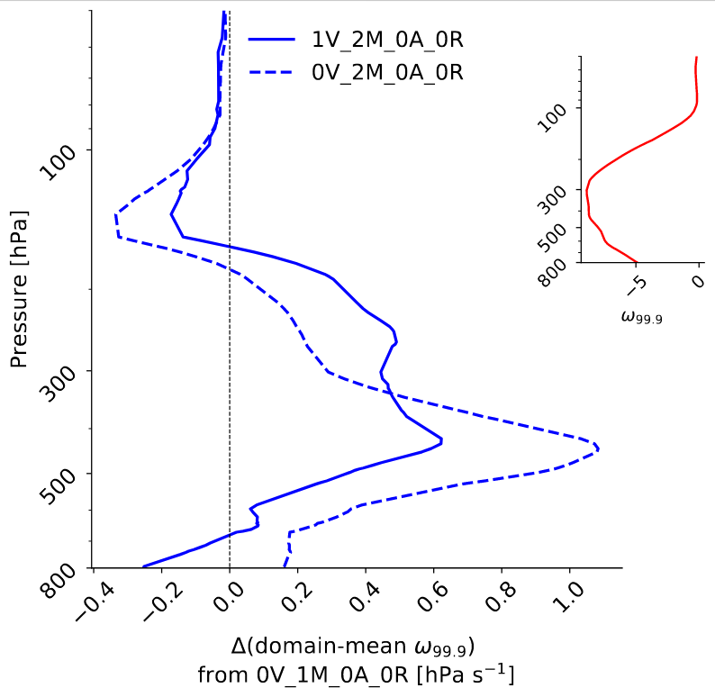
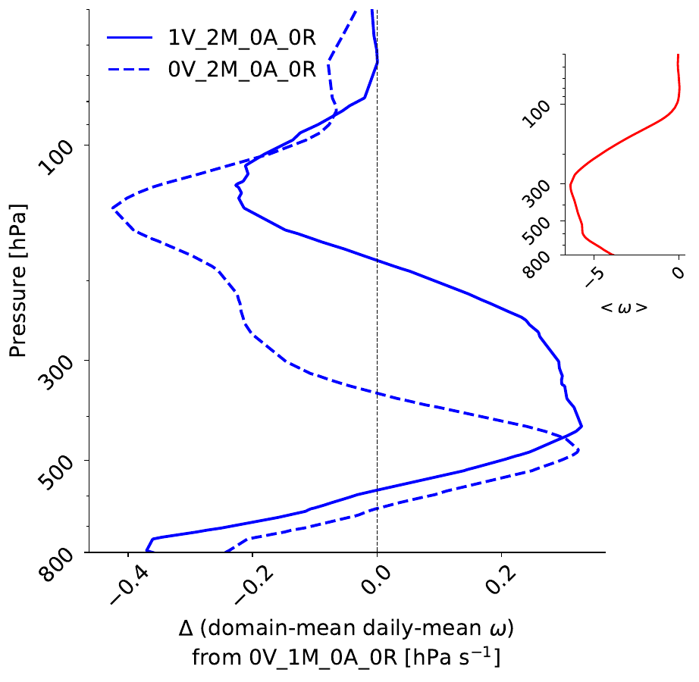
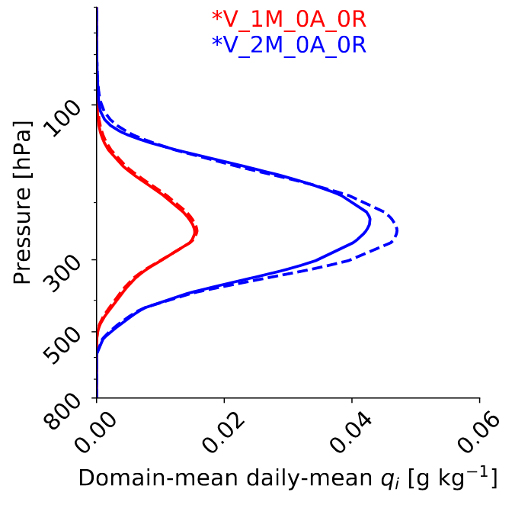
Part of this variation could be due to microphysical-dynamic feedbacks.

Slide 15
A
negative direct feedback
and
positive indirect feedback
exist.
$$N_{i}=f\left(T,p\right)=A exp[−B{\left(T−T_{min}\right)}^{c}]$$
Ice crystals generate diabatic heating
Ice crystals generate diabatic heating
Ascent generates ice crystals
Ascent generates ice crystals
$$\frac{dT}{dt}=\frac{1}{ρc_{p}}ω+\dot{Q}+\dot{R}$$
$$∇^{2}ω ∝\frac{R∇^{2}\dot{Q}}{c_{p}σp}$$
+
Diabatic heating generates ascent
-
What if we fix the dynamics?

Slide 16
A
negative direct feedback
and
positive indirect feedback
exists.
direct generation of diabatic heating by ice
$$N_{i}=f\left(T,p\right)=A exp[−B{\left(T−T_{min}\right)}^{c}]$$
$$\dot{Q}∝∫κ_{i}q_{i}\frac{dp^{′}}{g}$$
Ice crystals generate diabatic heating
Ascent generates ice crystals
$$\frac{dT}{dt}=\frac{1}{ρc_{p}}ω+\dot{Q}+\dot{R}$$
$$∇^{2}ω=\frac{R∇^{2}\dot{Q}}{c_{p}σp}$$
+
Diabatic heating generates ascent
-
What if we fix the dynamics?

Slide 17
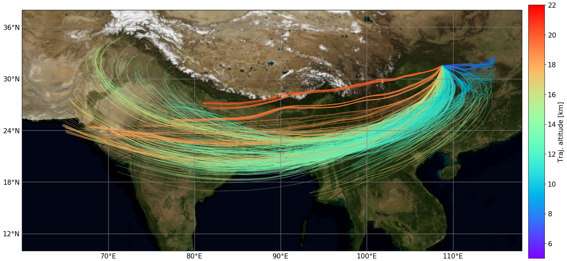
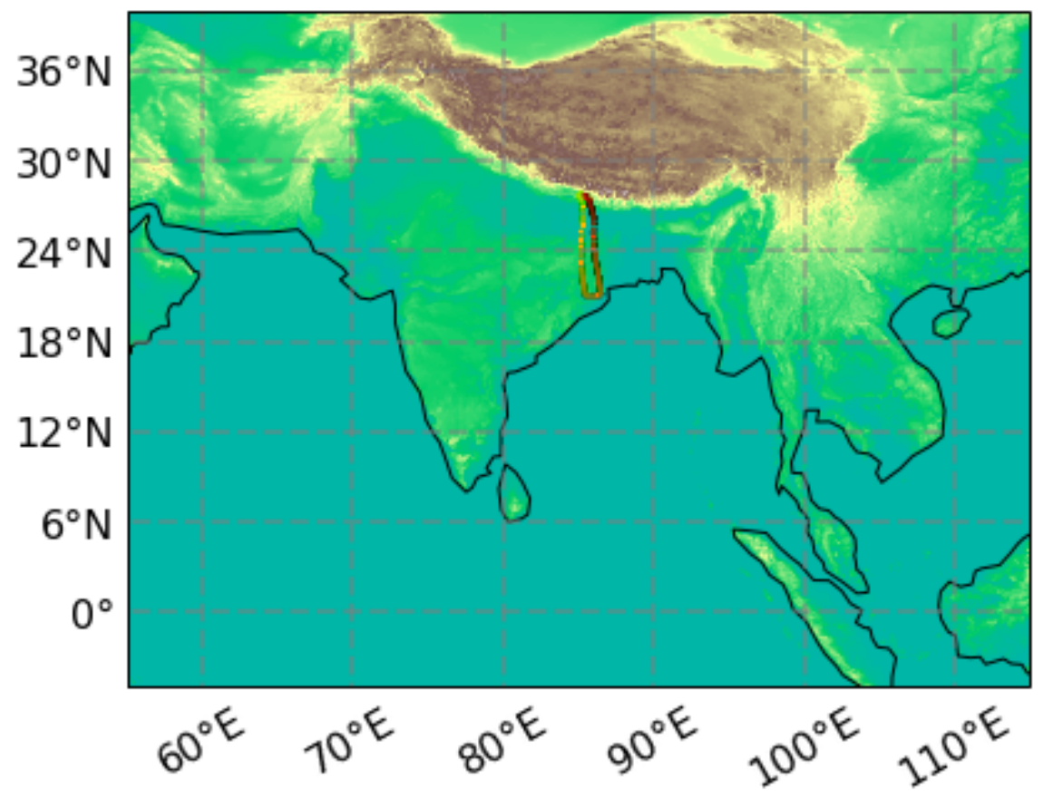
Dynamics is fixed along Lagrangian trajectories.
z
22 km
8 km

Slide 18
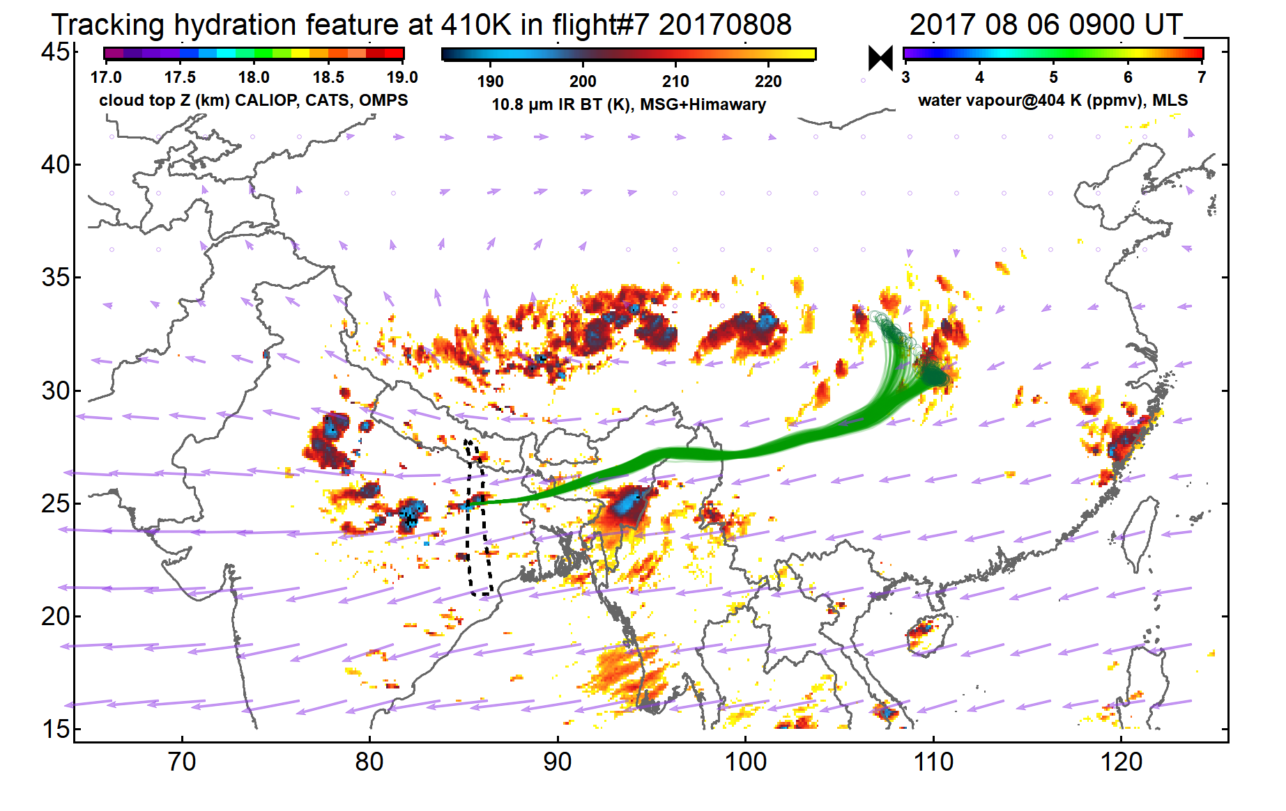
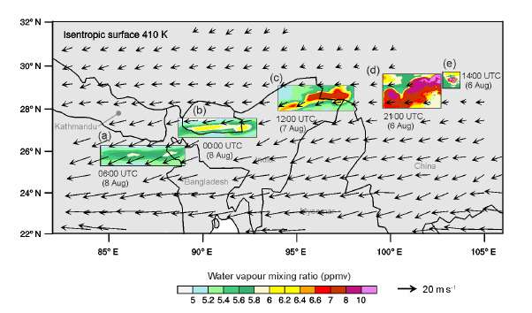
Dynamics is fixed along Lagrangian trajectories.
Upper-level moisture during Flight 7 was tracked to convective overshooting in the Sichuan basin.
K. O. Lee, T. Dauhut, J. P. Chaboureau, S. Khaykin, M. Krämer, and C. Rolf (2019). Atmos. Chem. Phys.
S. Khaykin et al. (2021). in preparation for Atmos. Chem. Phys.
Notes:
During Flight 7, they measured a „moist layer“ and an „ice layer“. These were attributed to convective overshooting in the Sichuan basin 1.5 days earlier.
The paper from Khaykin et al. Is entitled „Persistence of moist plumes from overshooting convection in the Asian monsoon anticyclone“

Slide 19
What do these dynamics look like?
High-frequency dynamics (gravity waves) are dramatically underestimated.

Slide 20
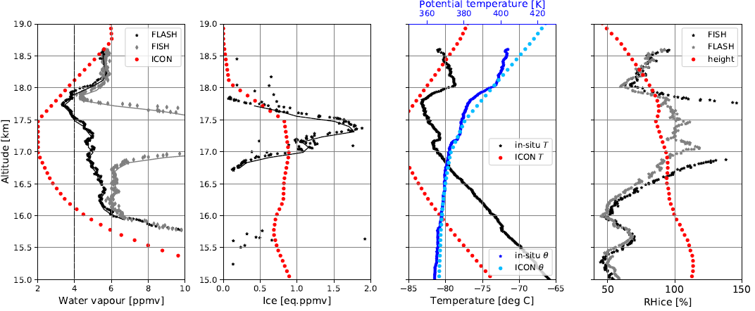
Model-in-situ data comparisons are not straightforward.
Working on an algorithm for “synthetic simulation trajectories...”

Slide 21
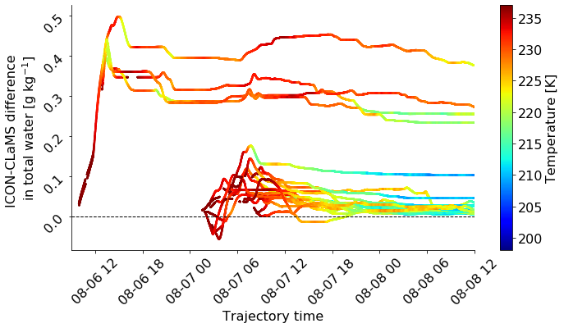
Some first comparisons of ICON-CLaMS differences as a function of temperature and moisture….

Slide 22
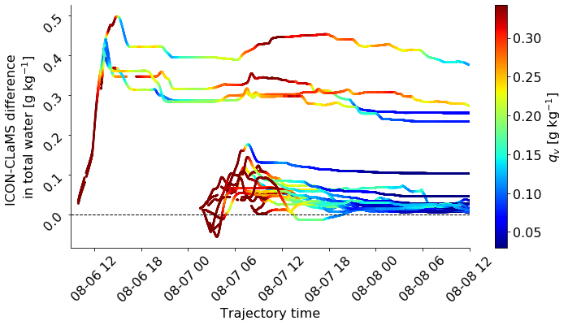
Some first comparisons of ICON-CLaMS differences as a function of temperature and moisture….

Slide 23
Summary
By switching ice microphysics schemes in a storm-resolving simulation we can change upper tropospheric cloud radiative heating by a factor of 4. We can give a three-fold mechanistic explanations for this change:
Lower atm: 10² difference in heterogeneous nucleation prefactor
Mid atm: Far more radiatively inactive snow in 1M
Upper atm: 2 times stronger ascent rates in 2M
Ongoing work uses trajectories to understand what these values look like when we constrain microphysical-dynamic feedbacks.

