Slide 1
AGI’s Framework on Addressing Equity in the Geoscience Societies and the Challenge of Defining Success
Christopher M. Keane, Susan Sullivan and Leila Gonzales
American Geosciences Institute
26 April 2021

Slide 2
Professional societies have a responsibility
Calls for action: No Time for Silence; Call for a Robust Anti-racism Plan
Framework for Addressing Racial and Ethnic Equity in Geosciences Professional Societies
  AGI, AGU, GSA, IAGD, SSSA, NAGT, Paleo Society, SEG
Surveyed AGI 50+ Member Societies and Associated Societies
  Qualitative, top of mind

Slide 3
No Time for Silence: Professional society actions
Develop robust and meaningful DEI strategic plans.
Fully implement strategic plans with all necessary resources.
Track progress against traceable metrics
Diversify leadership and staff with scientists drawn from underrepresented groups.
Diversify the selection process for invited speakers and invited papers.
Examine why award recipients are not diverse and make an effort to encourage nominations for awards – especially the early career awards

Slide 4
What has your society already done?

Slide 5
What is your society planning?

Slide 6
Framework for Addressing Racial and Ethnic Equity in Geosciences Professional Societies
Form a cross-society committee to support top to bottom review and improvement.
Cultivate an environment and practices that are safe and inclusive.
Champion and advocate for the complete inclusion of students of color
Promote increased respect for indigenous knowledge and rights in geoscience
Collaborate on and create support initiatives such as affinity groups and mentoring programs across all career stages.
Communicate and improve the demographic composition of annual award recipients and invited speakers.

Slide 7
Measuring Diversity in Geoscience

Slide 8
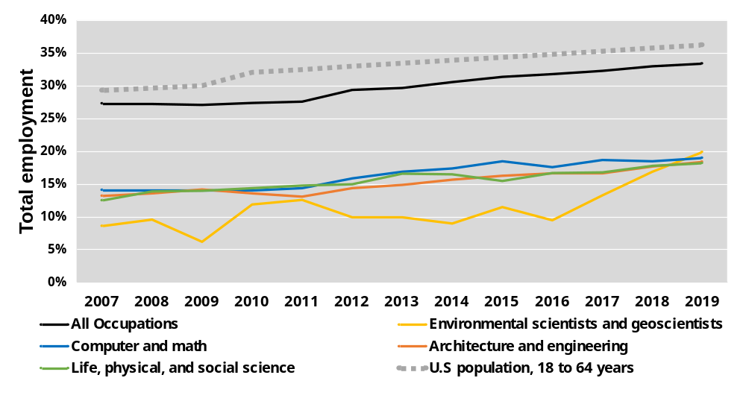
Workforce Participation by Occupation
All Underrepresented Populations, US Geoscience Workforce

Slide 9
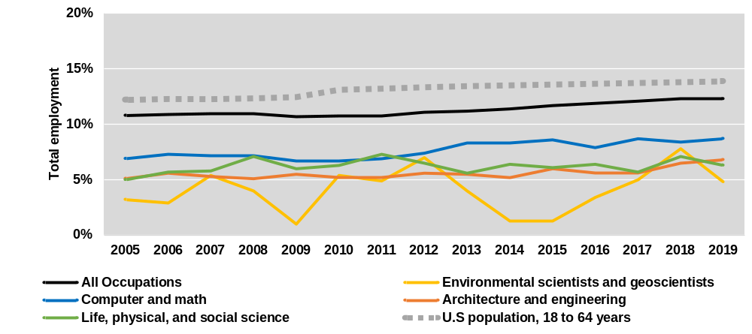
Workforce Participation by Occupation
Black and African-American

Slide 10
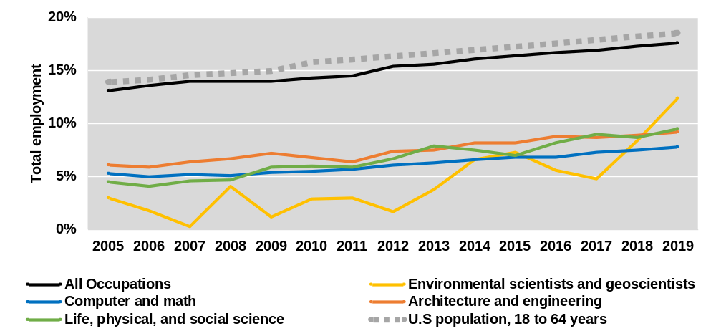
Workforce Participation by Occupation
Hispanic and Latino

Slide 11
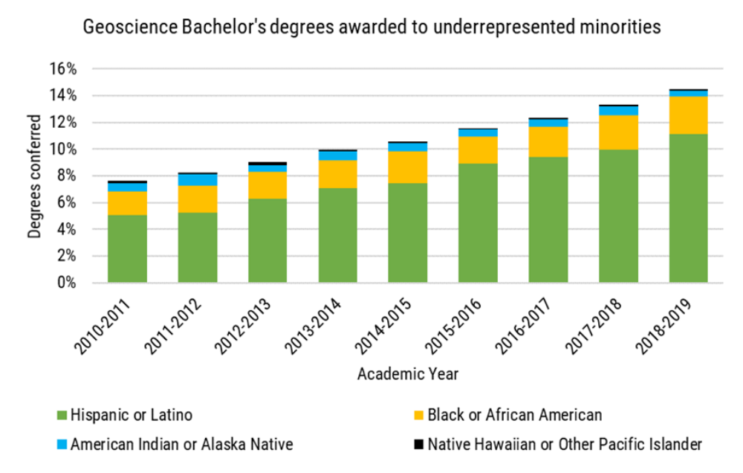
US Undergraduate Geoscience Degrees
All Underrepresented Populations

Slide 12
First Generation Students
The Geoscience Challenge
Only 8% of geoscience students are first generation
What Do First Gens Do
24% of students are first generation
51% of first gen are URM vs. 30% of other students
Only 23% of first gen have earned at least a BS after 7 years
Opportunity?

Slide 13
Can We Measure Our Goals?
Diversity metrics in the US are misleading
  Convolution of race and ethnicity
  Only affirmative IF one is a minority
  Are we using this as a socio-economic proxy or something else?
Doubtful the US can move to affirmative identity (UK & Ireland)
Are our goals actually measurable?
Can we create an accurate & precise evaluative metric on progress in diversity?

Slide 14
Contact
Susan Sullivan
Susan.Sullivan@Colorado.edu
https://calendly.com/susan-sullivan/information-interview
Christopher Keane
keane@americangeosciences.org

