Slide 1
EGU21-5799
Improve Drone Survey Hazard Mapping Technology to Decipher Landslide Activity and Geomorphological Evolution
Kuo-Jen Chang¹, Ho-Hsuan Chang², Yu-Chung Hsieh³, & Mei-Jen Huang¹
Dept. Civil Eng., National Taipei University of Technology, Taiwan, R.O.C.
Dept. Information Eng., Guangzhou City Construction College, Guangzhou, P.R.C.
Central Geological Survey, Ministry of Economic Affairs, Taiwan, R.O.C.

Slide 2
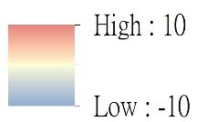
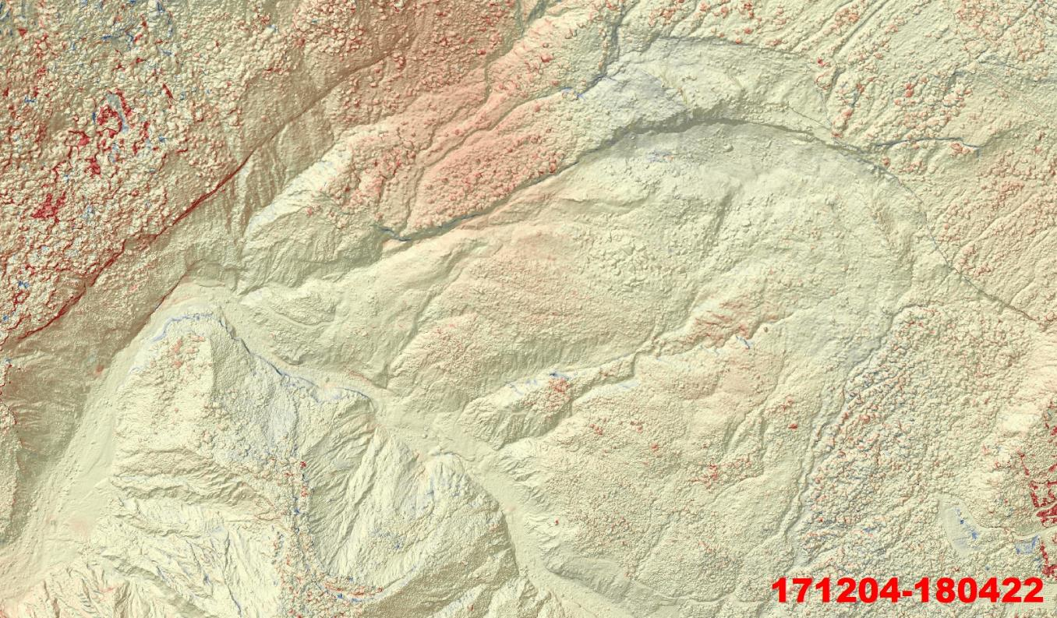
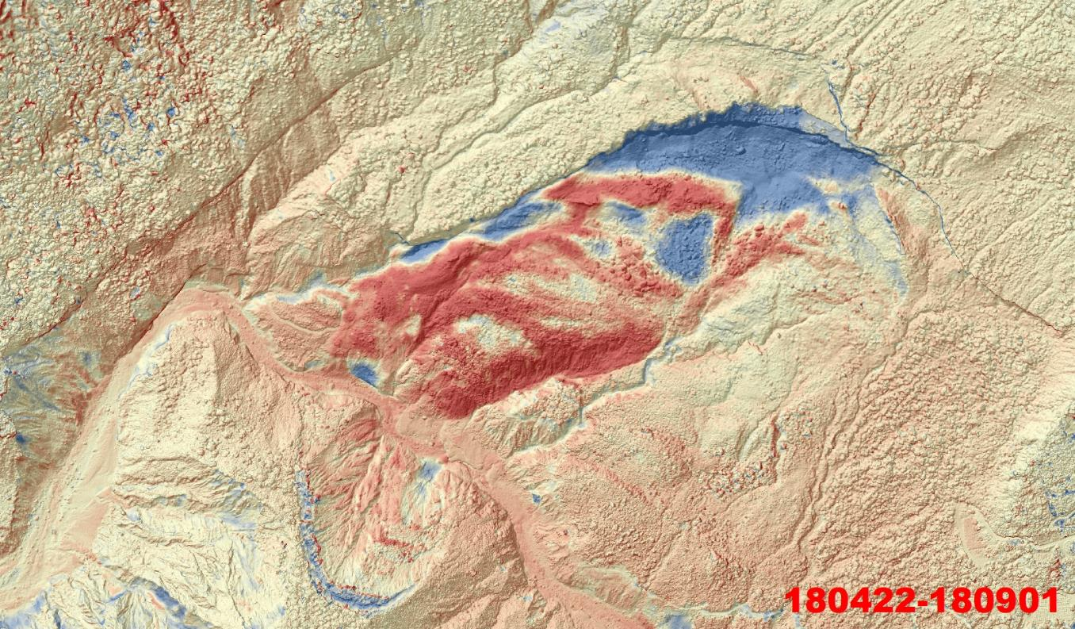
DoD from Ordinary Algorism

Slide 3
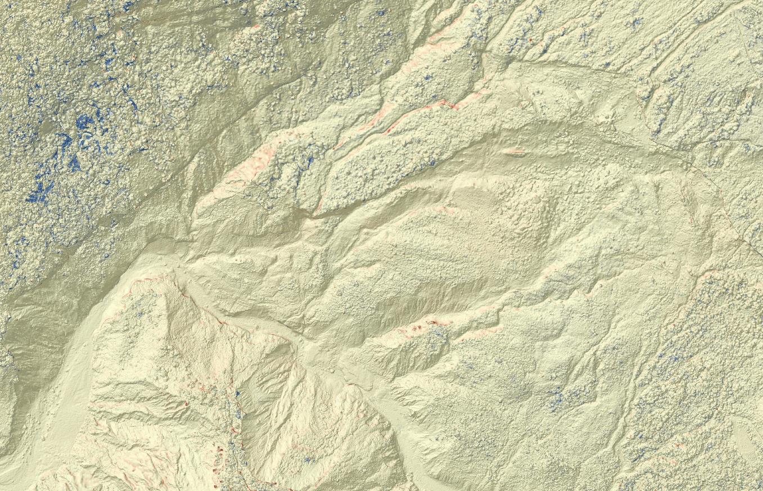
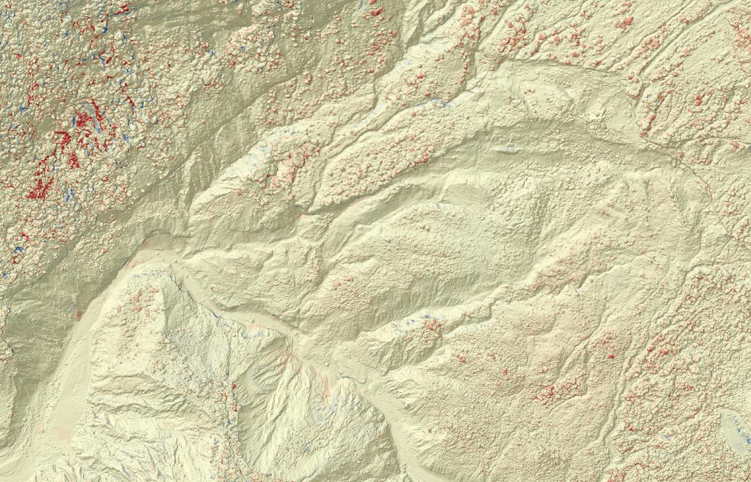
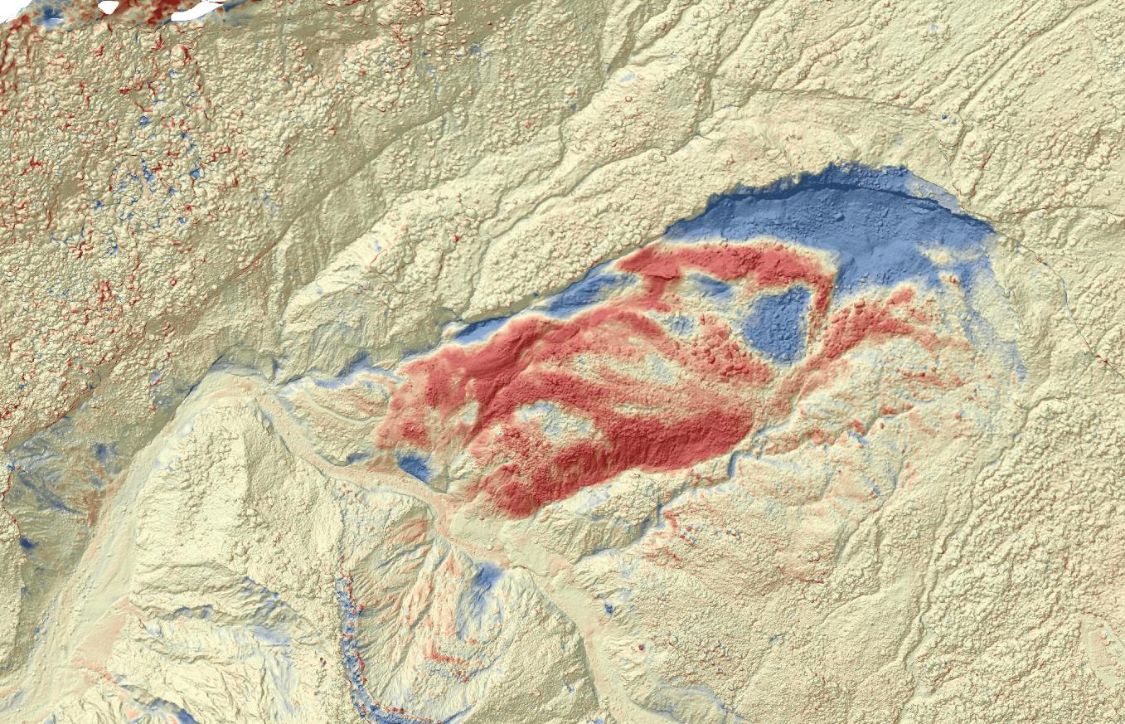
DoD from New Algorism
171111-171204
171204-180422
180422-180901

Slide 4
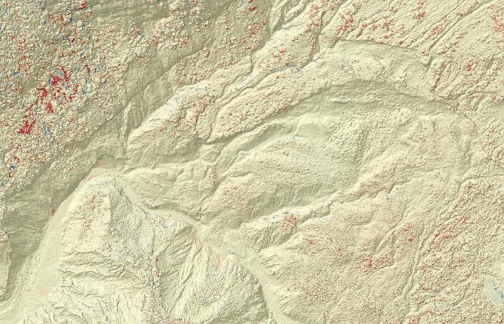
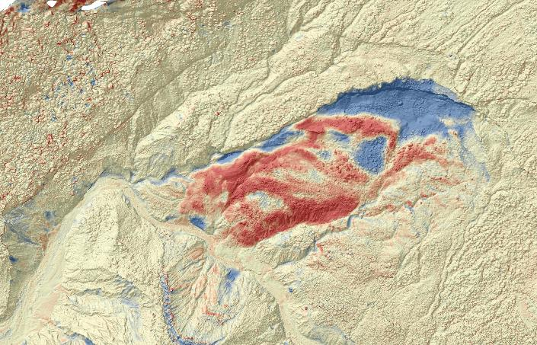
Data Comparison
Ordinary
New
171204-180422
180422-180901

Slide 5
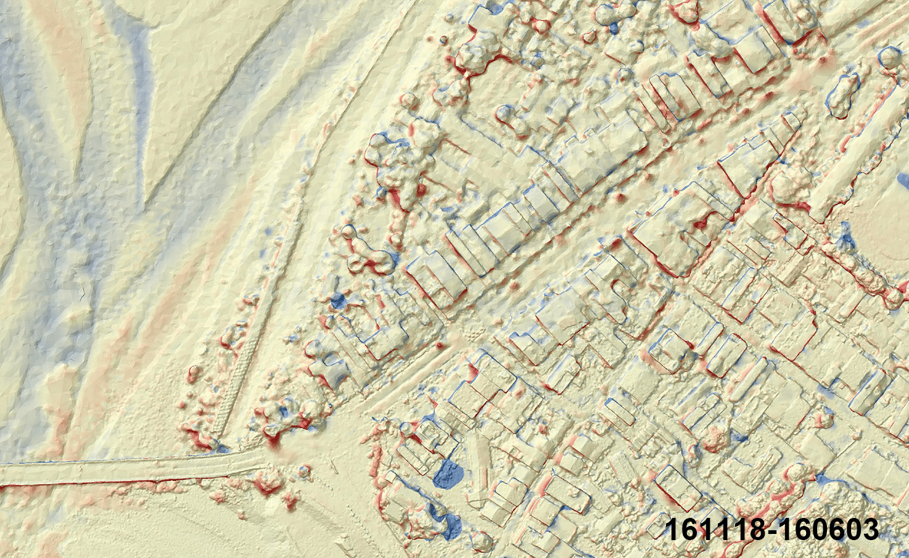
BaoLai DoD from New Algorism

Slide 6
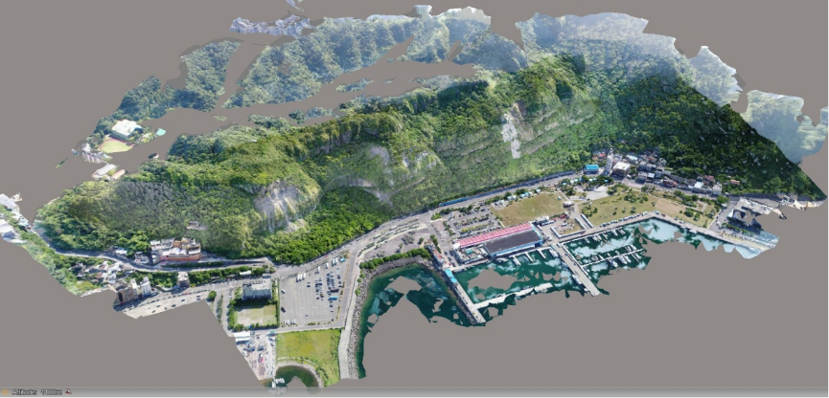
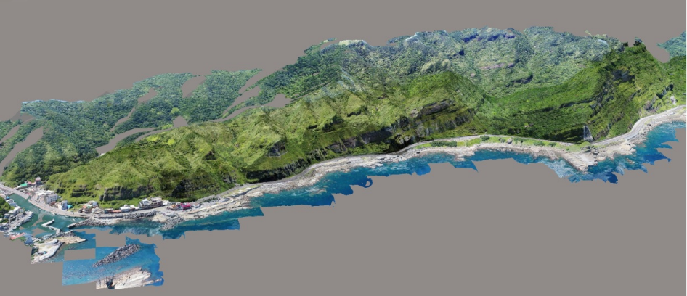
七
3D models: 2019 vs. 2020
Data acquisition:
2019/07/27
2020/03/09
Area：80 Hectares
GSD : <3.3 cm
2019/07/27
Data acquisition:
2019/07/27
2020/03/09
Area：140 Hectares
GSD : <3.1 cm
2020/03/09

Slide 7
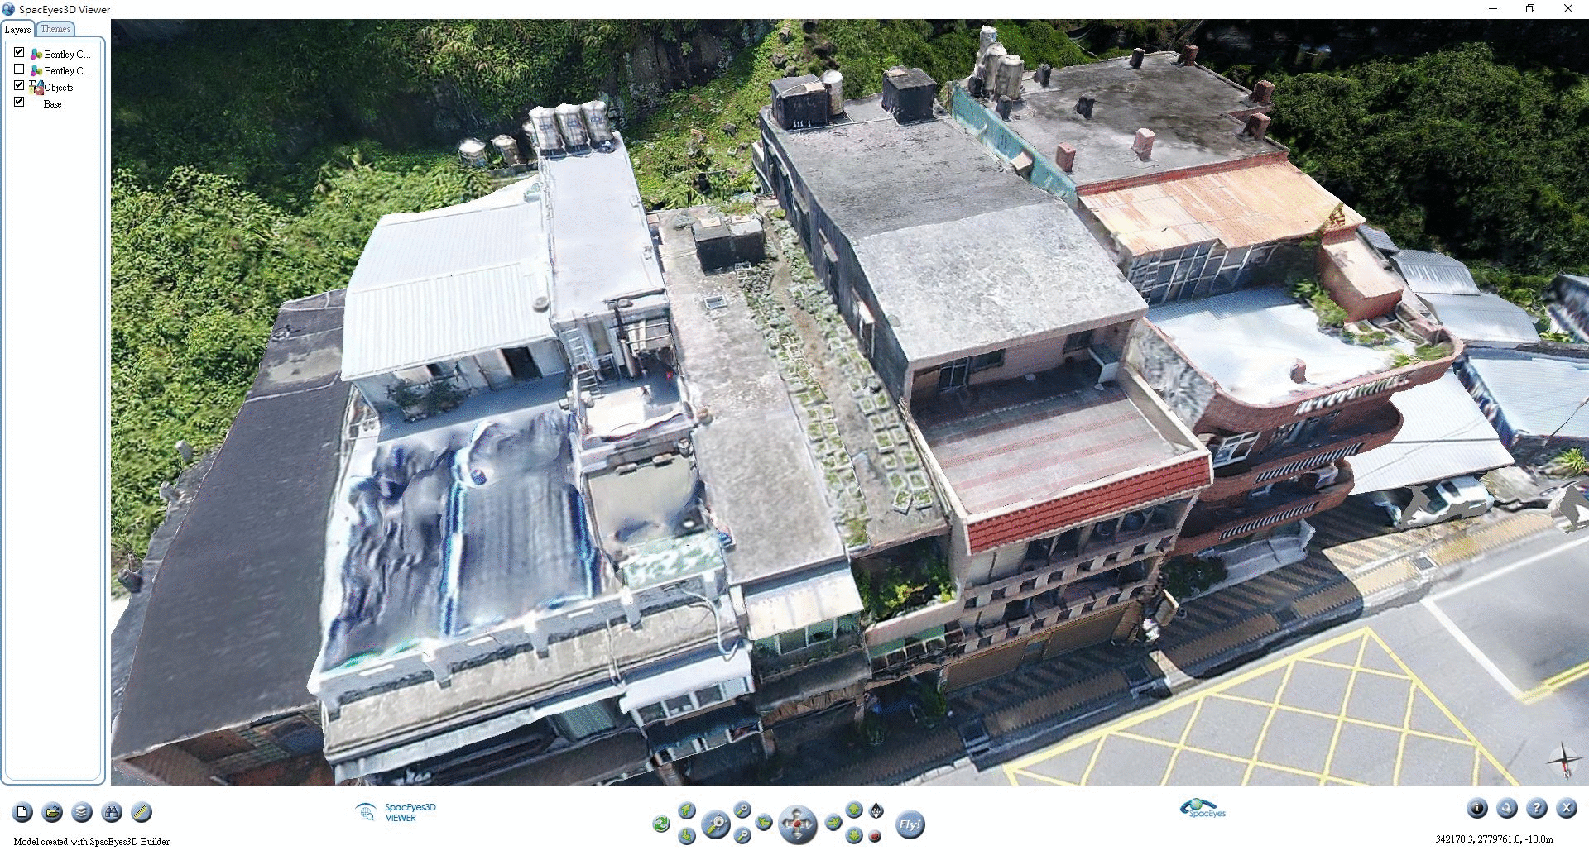
Change Detection 2

Slide 8
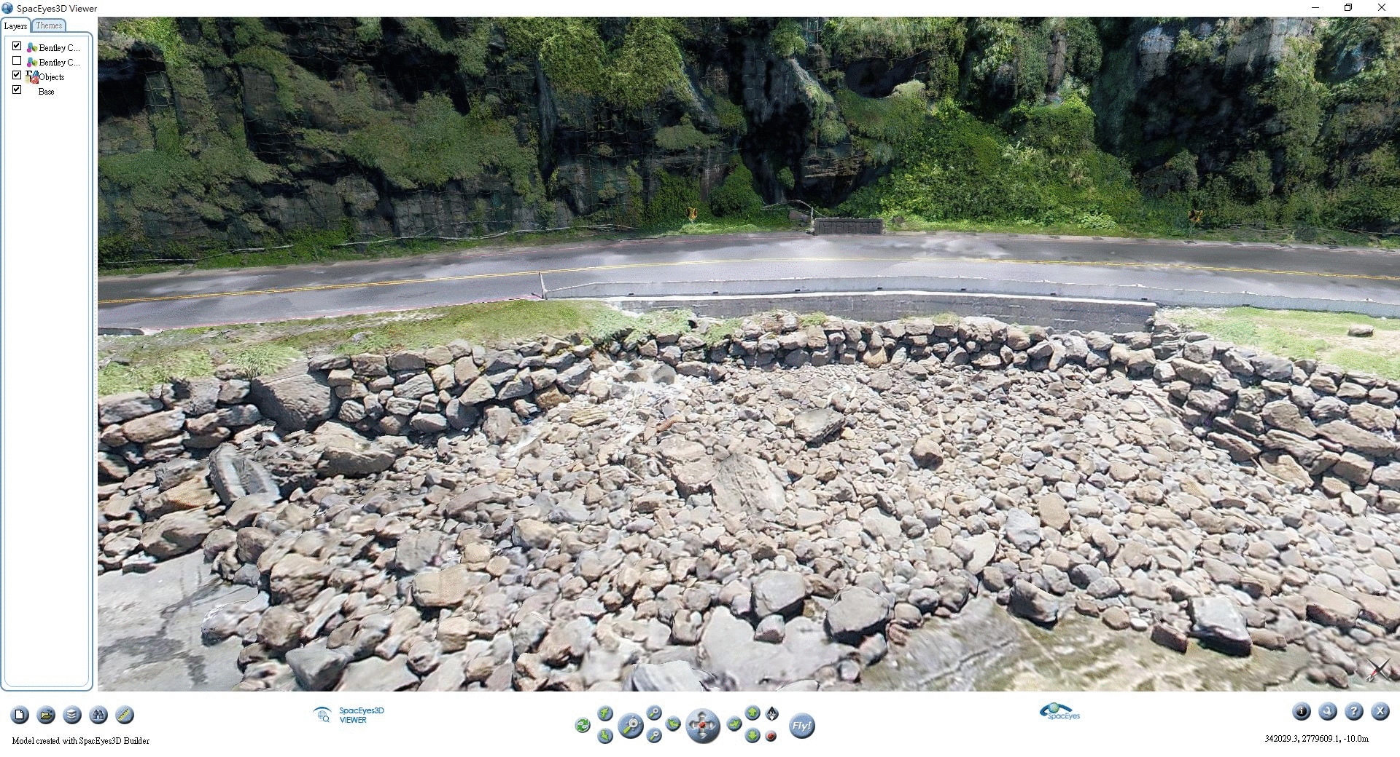
Change Detection 3

Slide 9
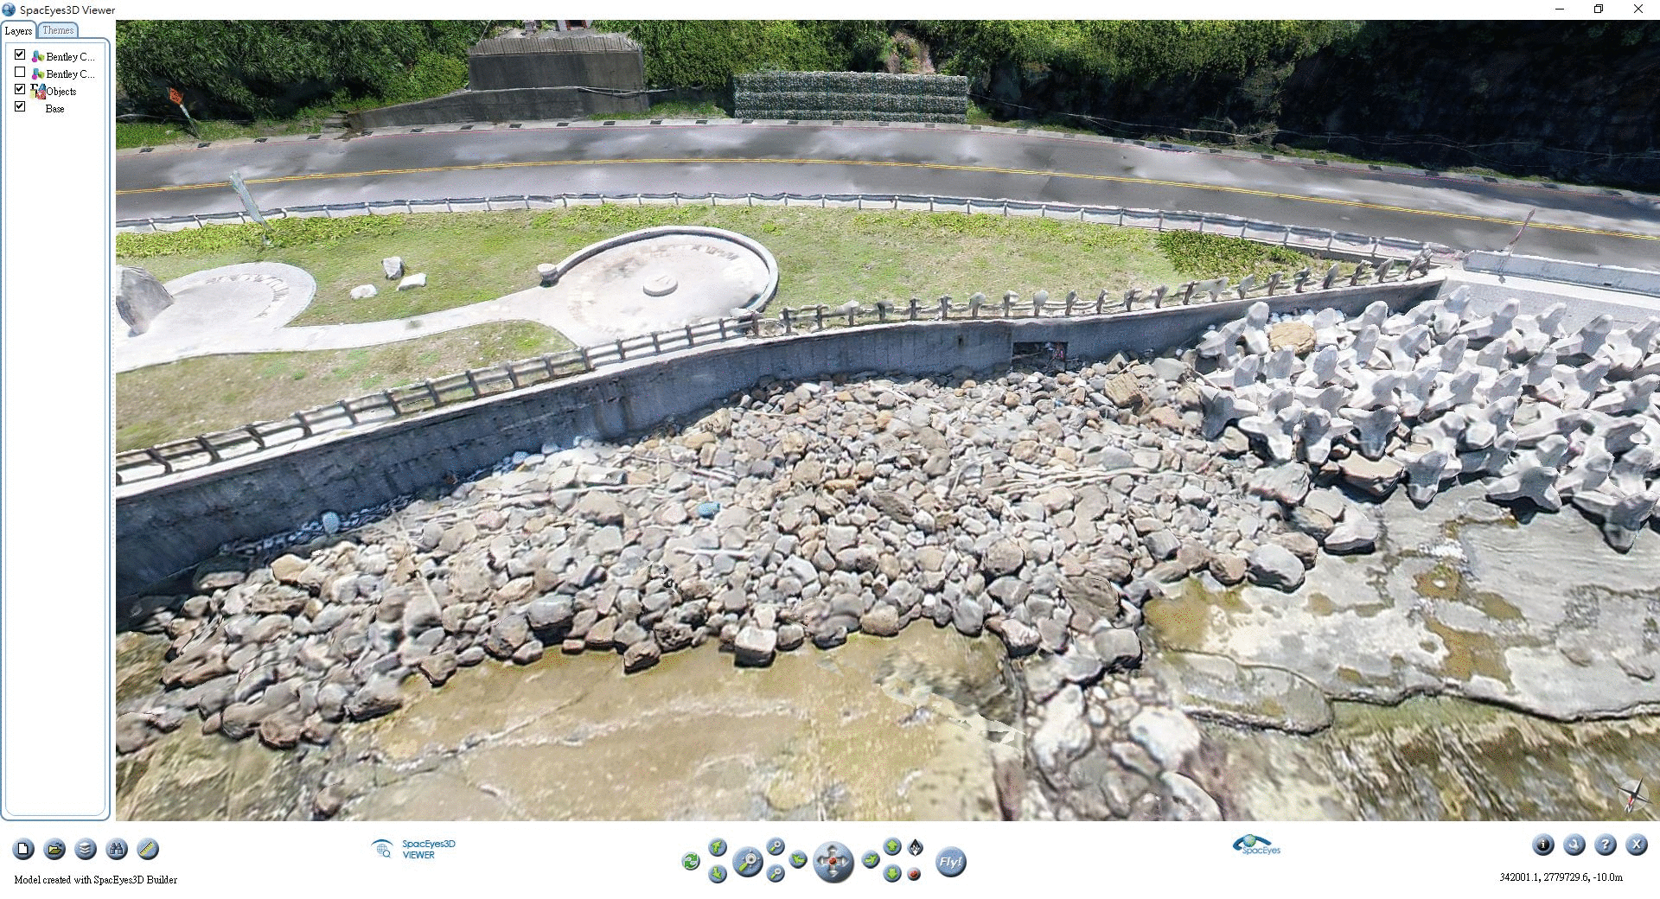
Change Detection 4

Slide 10
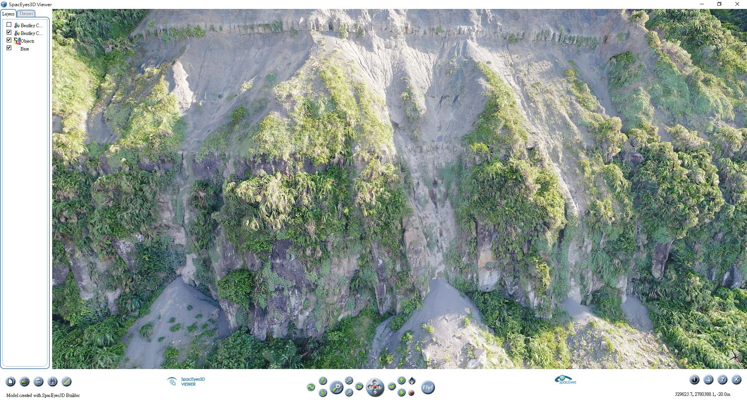
Topographic Change Detection

Slide 11
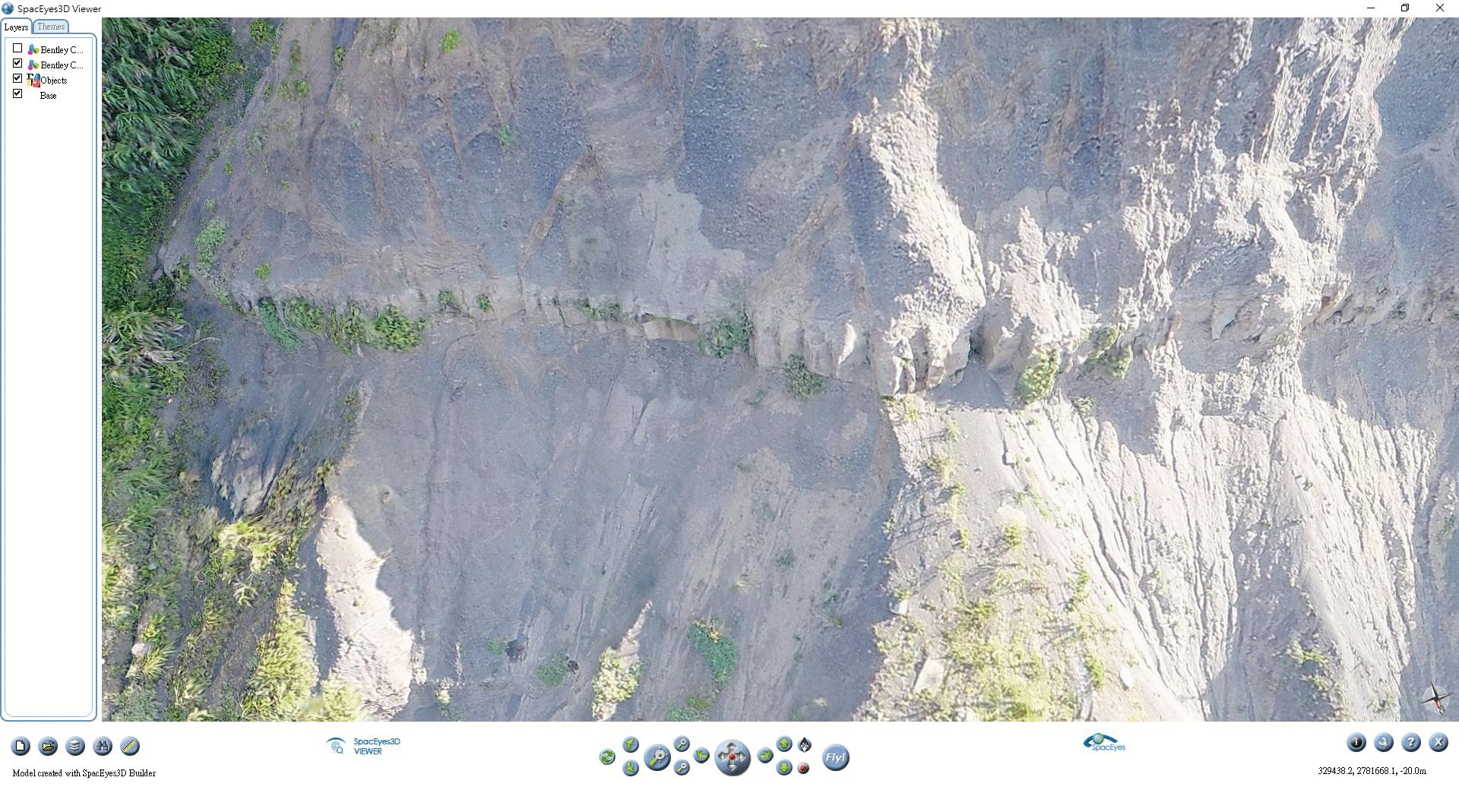
Rock Fall Detection

