Slide 1
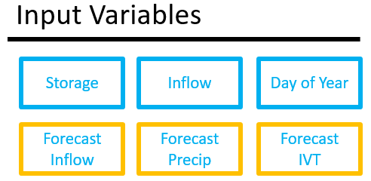
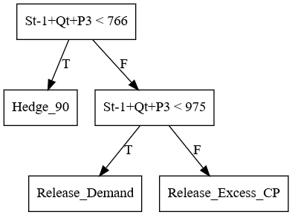
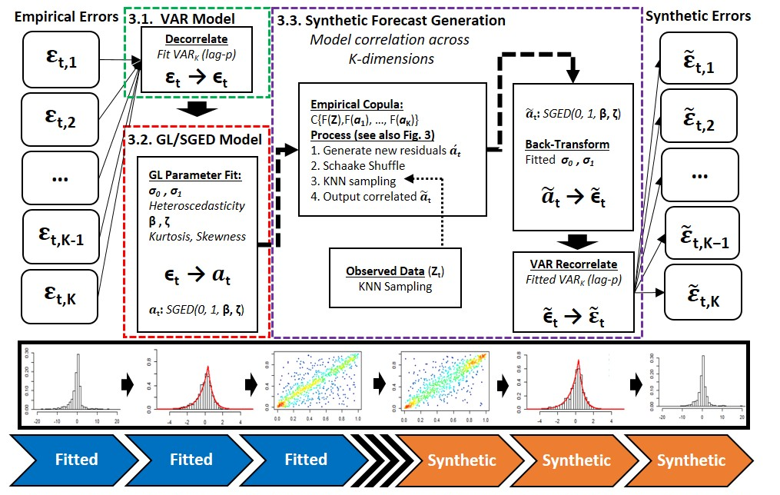
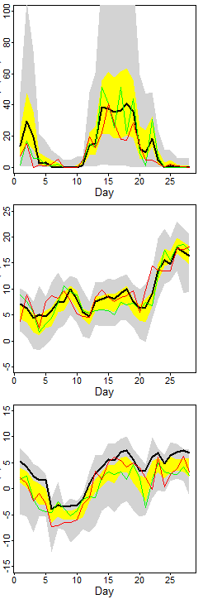


Forecast Informed Policy Design
Design
Zach Brodeur, Scott Steinschneider – Cornell University
CALIBRATE
Selection
VALIDATE / TEST
Better
Policy!
Synthetic Generation
Zach Brodeur, zpb4@cornell.edu

