Slide 1
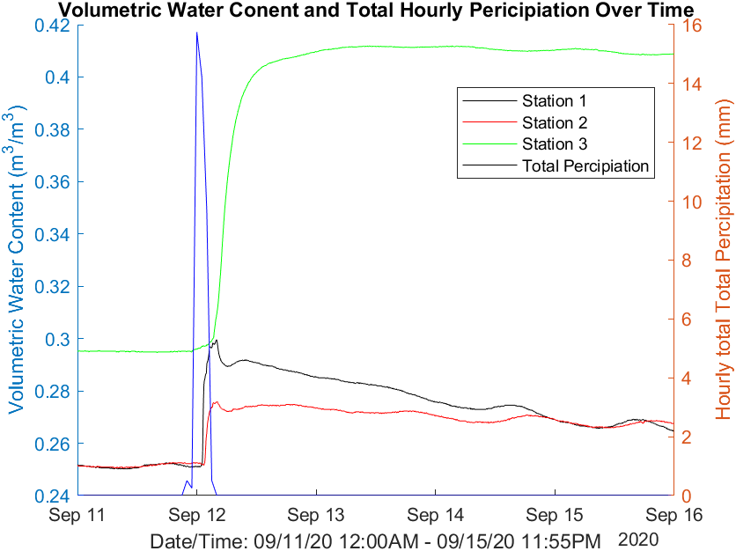
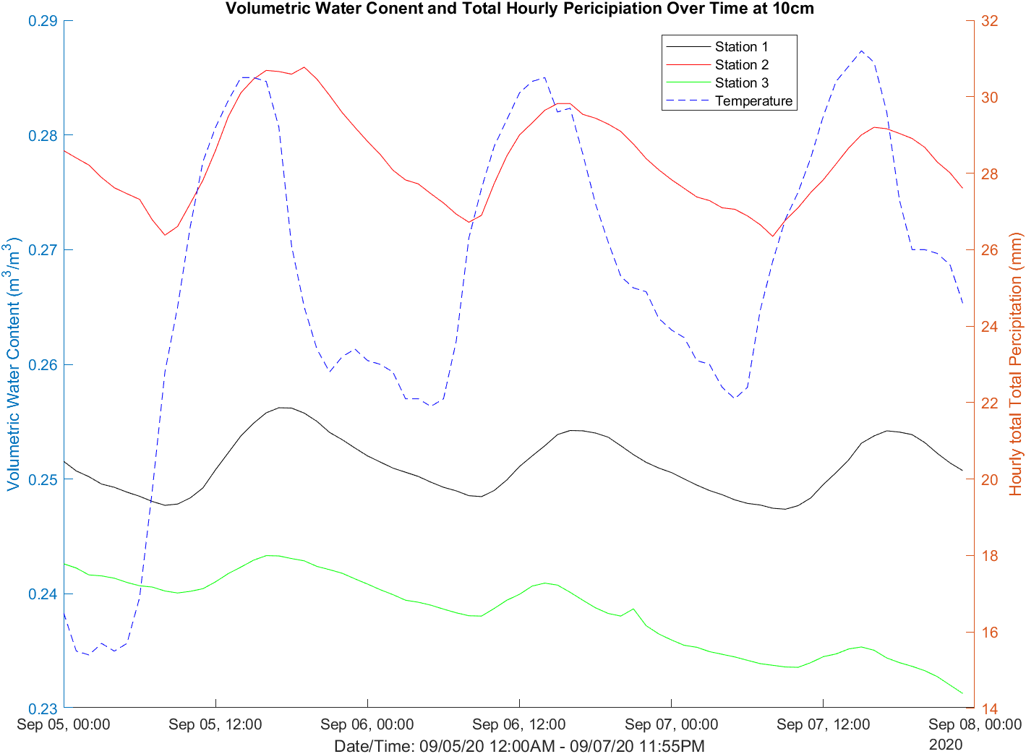
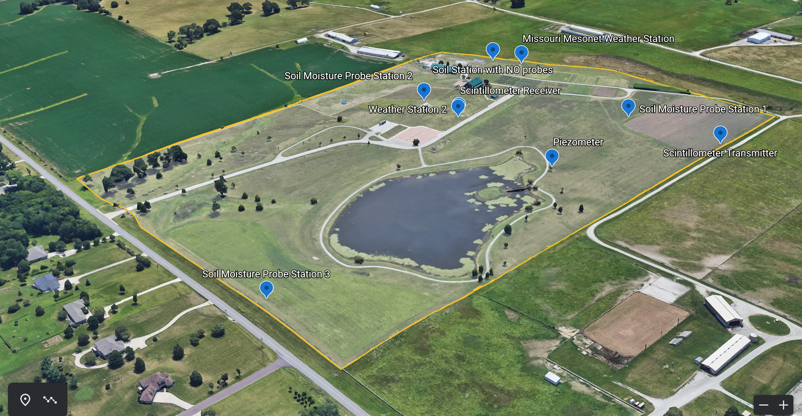
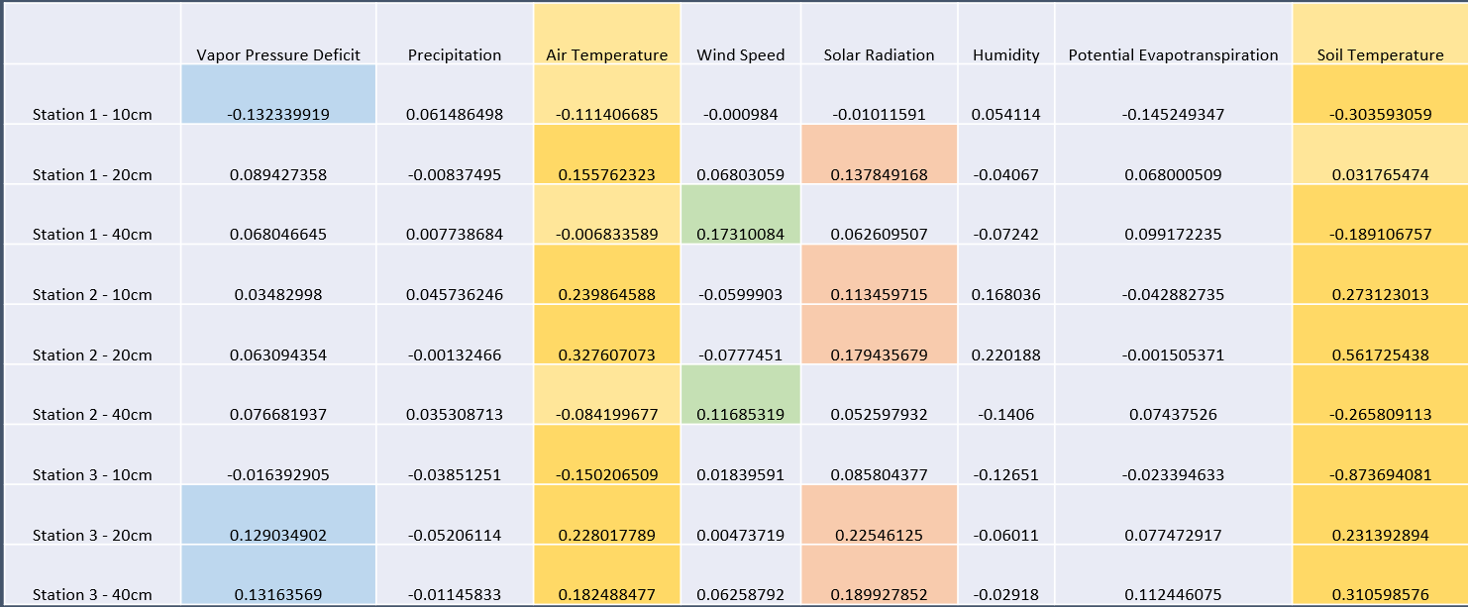
Elucidating soil moisture dynamics in agricultural landscapes under varying weather patterns
ELUCIDATION SOIL MOISTURE DYNAMICS IN AGRICULTURE LANDSCAPES UNDER VARYING WEATHER PATTERNS
PURPOSE
The goal of this experiment is to develop a means of predicting volumetric water content based on climate parameters. This research was done on a small scale at a Jefferson Farm and Garden in Columbia, Missouri. This is a small-scale version of the experiment we hope to be able to replicate in another location along the Mississippi River Basin to very the results in this initial experiment. By looking at various vegetative landscapes (cropped land, turf grass, and an unkept weeded area) our goal is to draw conclusions on the effects of industrial agriculture on soil storage. These results could potentially educate us on how to make agriculture more sustainable.
METHODS AND MATERIALS
RESULTS AND CONCULSION
These results were obtained from working with ECHO2 utility soil moisture probes to measure the soil storage measured by the volumetric water content (VWC) of the soil. These probes also measured the soil temperature. The weather data used in these experiment's was obtained from a weather station on the site of the research plot. Hourly historical data can be obtained from Jefferson Farm and Garden website. VWC is sampled at five-minute increments 24-hours a day consistently since September 3rd, 2020 at three different plots. This data was used to develop first long average plots overlaying eight different climate parameters measured hourly to averaged hourly VWC. Then developed scatter plots of VWC against each weather parameter to numerically discuss the correlation between soil storage and weather. We looked at these correlations at three different depths between 1000-1600 hours. The table of this data can be seen below.
From these results it can be observed that there is an evident correlation between both air and soil temperature and volumetric water content. Other climate variables do not appear to have as strong correlation. This may be due to lack of calibration with sensors and is an issue I would like to investigate further as I expand my data to include more extreme weather and a wider variety of landscapes.
The graph on the left depict the impact of a rain event and its effect on VWC at 10cm for each land use type over the course of five days. It can be observed that the rain event causes the greatest increase in the unkept station and hold consistent, whereas the VWC drops off in the other two stations. The graph to the right depicts VWC against soil temperature on a relatively hot three-day period with little cloud coverage. This shows the volatility of the VWC at 10cm for the turfed and cropped stations as compared to the unkept station. This indicated that overuse of land effects the quality of soil and its ability to store water. This information could be beneficial in helping us to better understand how our agricultural practice can be better informed and changed to maintain the health of the soil.
AUTHORS;
Veronica Fritz, University of Missouri – Biological Engineering and Mathematics Undergraduate Student
Thakshajini Thaasan, University of Missouri – Biological Engineering Graduate Student
Andrew Williams, University of Missouri – Water Resource Management Graduate Student
Prasad Calyam, University of Missouri – Associate Professor
Ranjith Udawatta, University of Missouri – Research Professor of Soil, Environmental and Atmospheric Sciences
Sidath Mendis, University of Missouri – Soil Science Graduate Student
Noel Aloysius, University of Missouri - Assistant Professor of Biological Engineering and Natural
Don’t clutter the top of your poster with logos. Put them at the bottom.
Unit | Program
Unit | Program
Unit | Program

