Slide 1


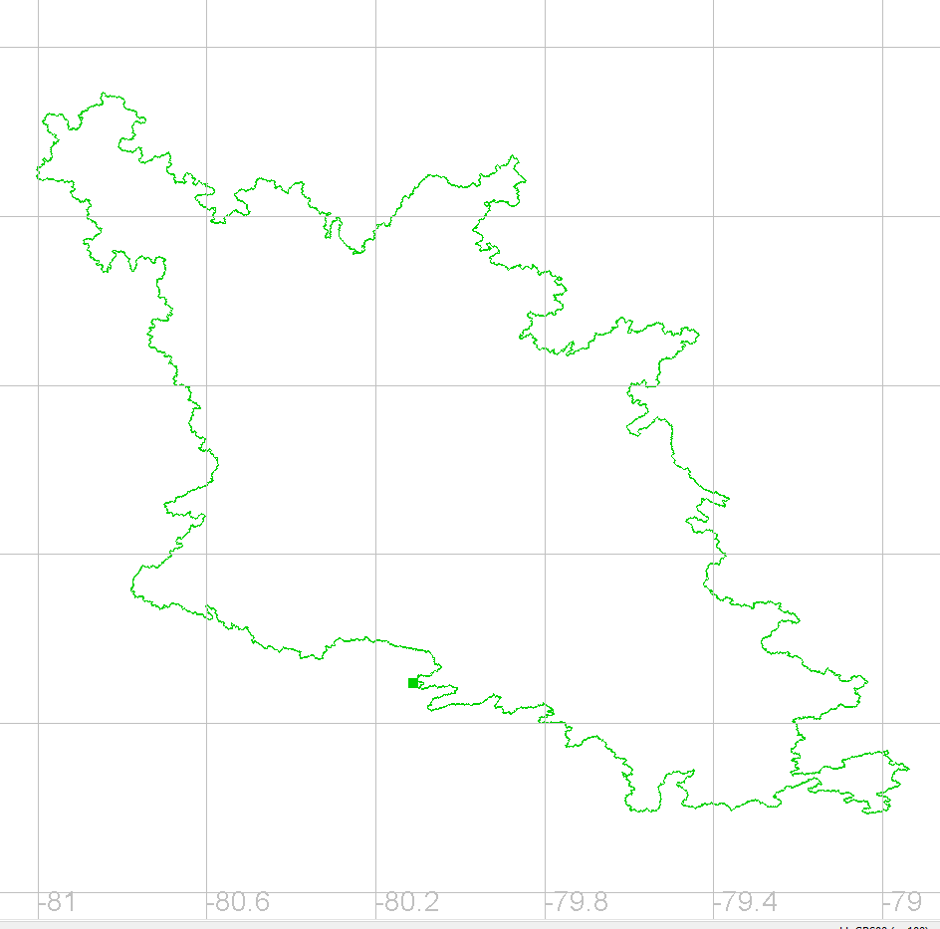
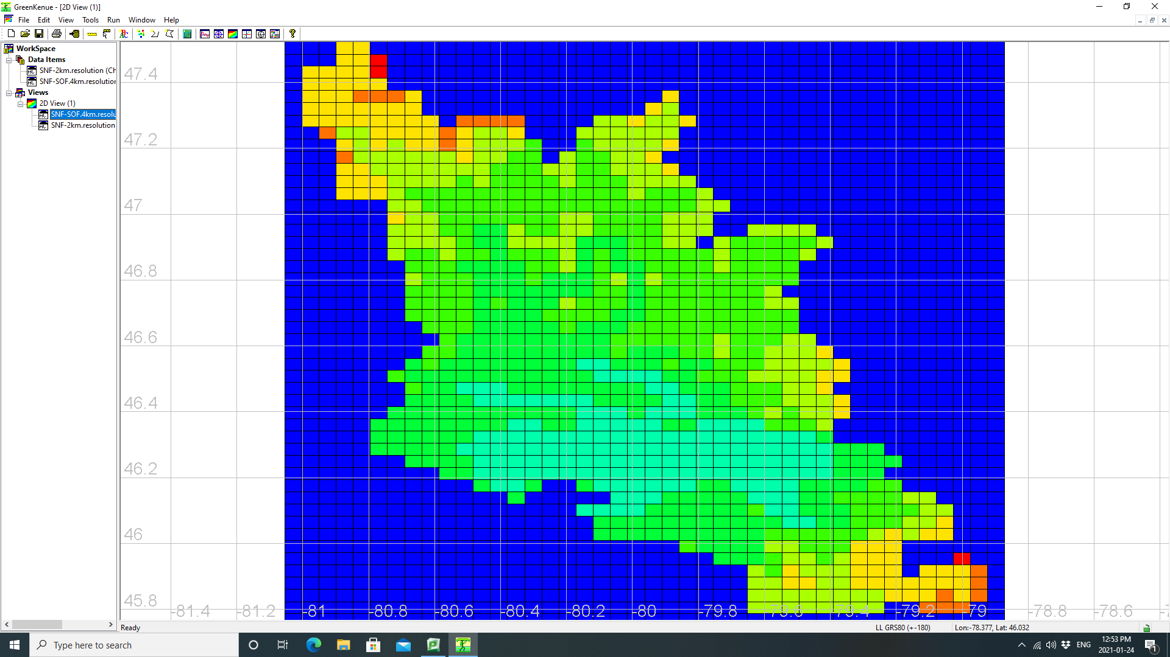
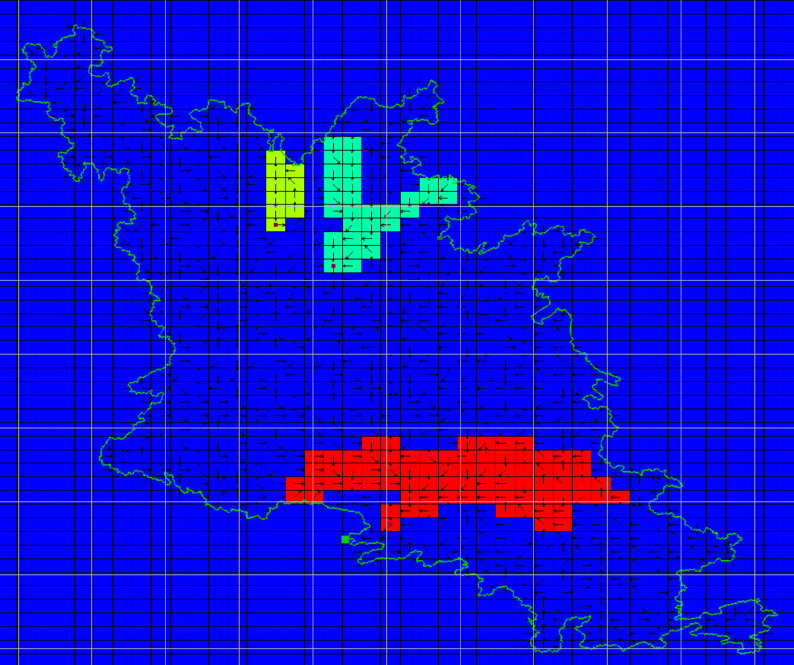
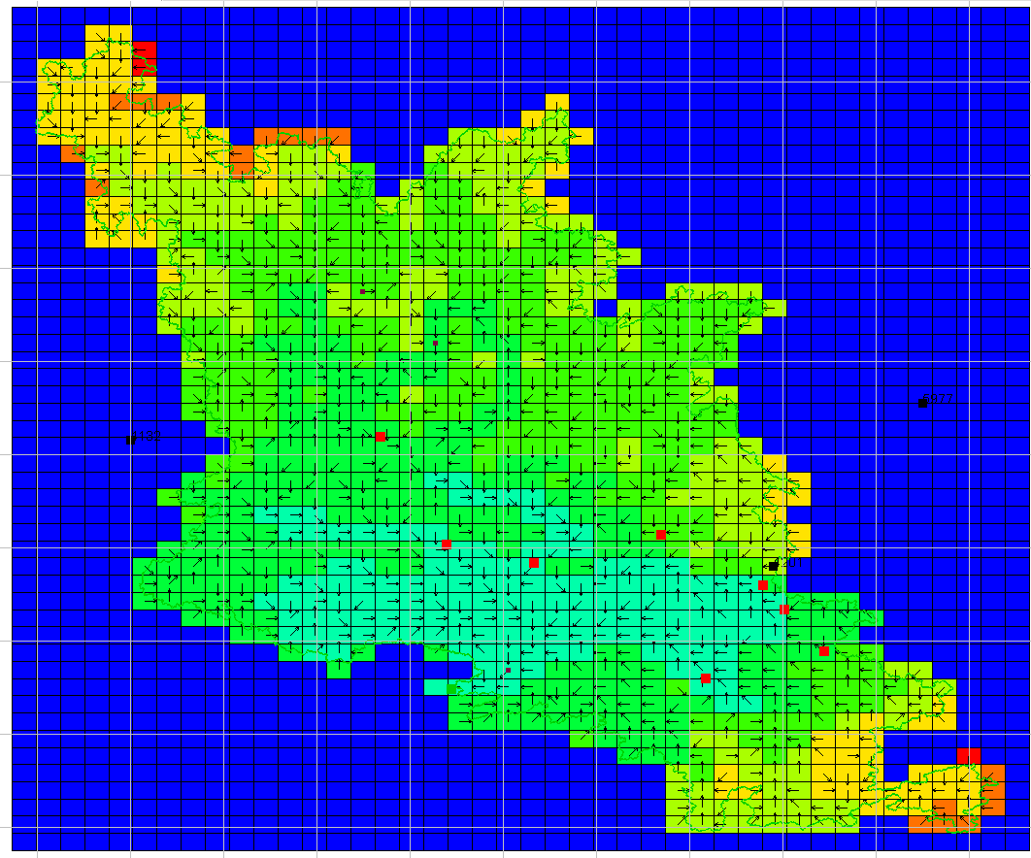
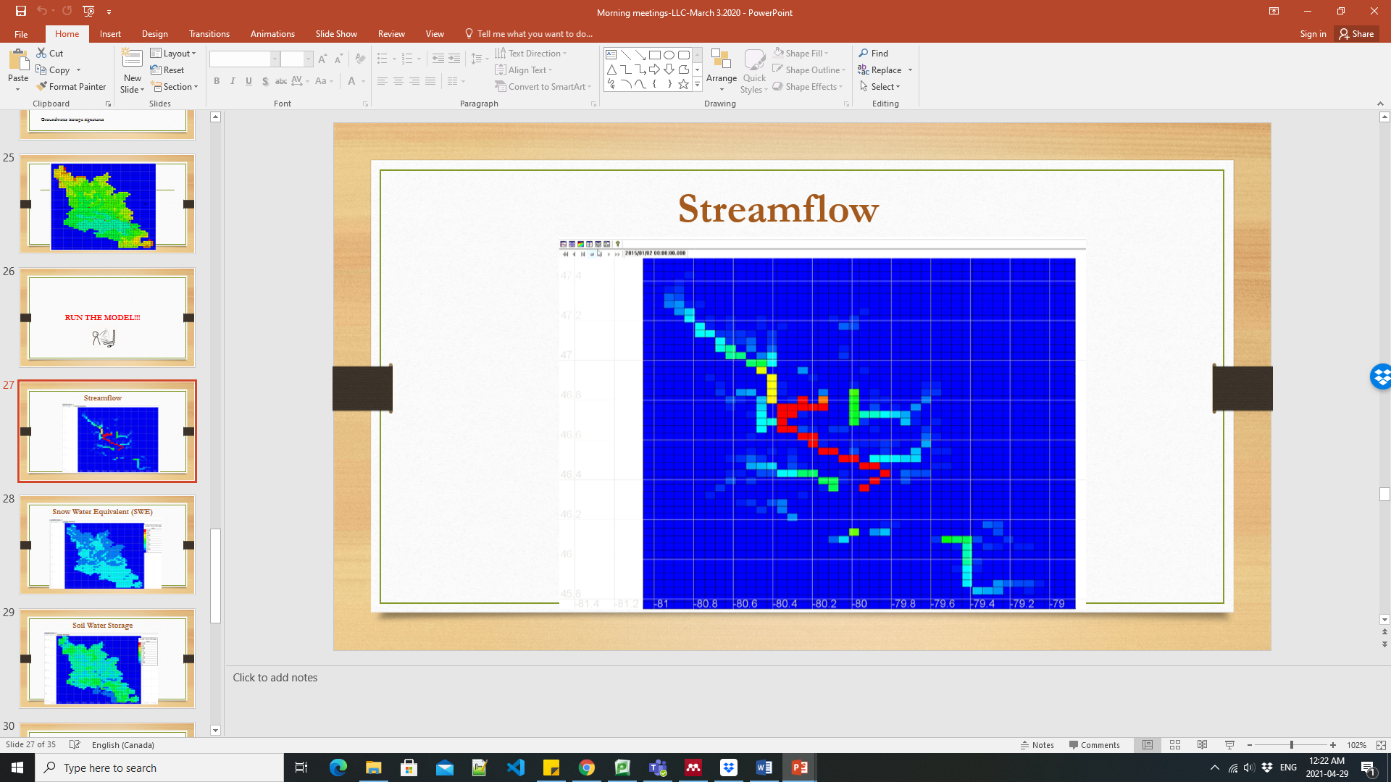
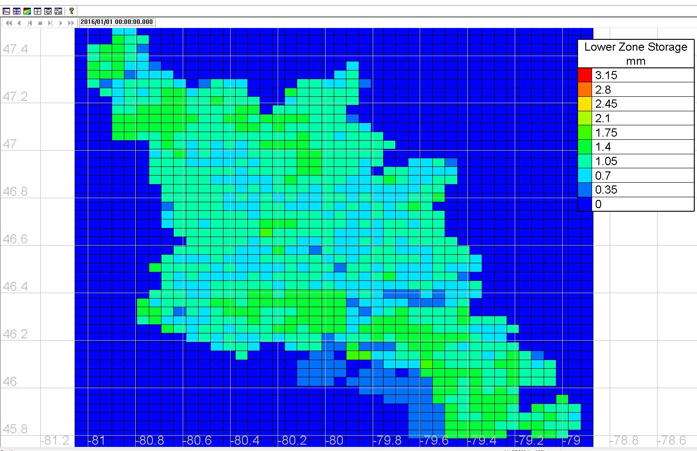
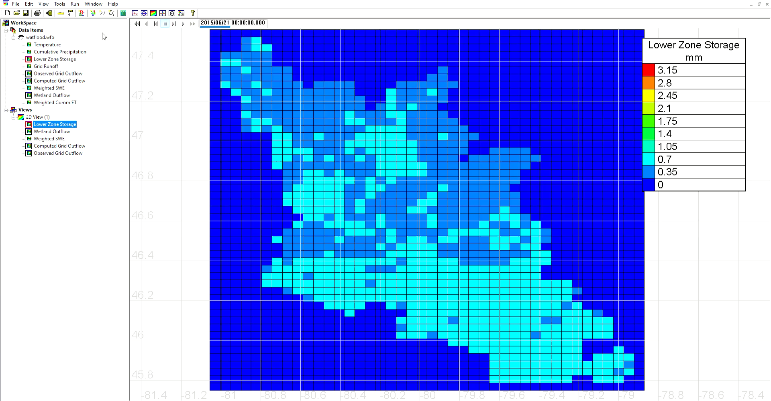
Investigation of Lake and Wetlands Influence on Streamflow in Mesoscale Precambrian Shield Watersheds
Using IsoWATFLOOD, A Tracer-Aided Hydrologic Model
A. Tafvizi¹, A. James², T. Stadnyk³, H. Yao⁴, and Ch. Ramcharan¹
¹Laurentian University, ON CA, ² Nipissing University, ON CA, ³ University of Calgary, AB CA,⁴ Ontario Ministry of Environment, Conservation and Parks, ON CA
1. Introduction
2. Materials and Methods
Stable isotopes of δ¹⁸O and δ²H are useful tools for capturing high temporal-resolution data in a cost effective way to enhance the understanding of hydrologic processes at the watershed scale (Birkel et al., 2010; Untereiner et al., 2015) and can now be integrated in tracer-aided modeling to assess the potential controls on hydrologic response (Stadnyk et al., 2013).
Objectives:
Classify catchments by landcape, geology, hydrology and stable isotope characteristics.
Determine if lakes and wetlands have different impact on hydrologic function across 16 Precambrian Shield catchments.
Development of application of isoWATFLOOD tracer-aided hydrological model.
Study Area: Sturgeon River - Lake Nipissing - French River watershed (SNF) and Muskoka- Black River watersheds (located in Precambrian Shield in central and northeastern Ontario, Canada (Fig 1).
Stable Water Isotopes Surveys (δ²H and δ¹⁸O) : River water samples were collected weekly, biweekly or monthly from 16 catchments in SNF and 10 catchments in Muskoka and Black river watershed between 2013-2019 (Fig 2). Groundwater and precipitation also sampled.
Streamflow, weather, physiography, geology: Daily discharge records from 14 river stations. Three weather stations within/around SNF (daily/hourly P , T , RH(%)). Landscape characteristics: Ontario Flow Assessment Tool (OMNRF, 2020). Geology: % glacialacustrine, glaciofluvial outwash deposits, and bedrock (OGS, 1997)
DEM, and Landuse: 50 m DEM (www.open.Canada.ca.). Landcover (Fig 3): LandSatTM imagery and re-classified into six dominant land classes.
PCA and HCPC : HCPC and PCA -based catchment classification for three scenarios for 14 catchments with Q (p<0.05) (Fig 4). FactoMineR and Factoextra R packages for PCA and HCPC analysis in R
isoWATFLOOD: All maps generated using GreenKenue (GK) (https://nrc.canada.ca) software (REF) (Fig 5). The temperature, precipitation, humidity, soil moisture, and snow is distributed across SNF watershed, using preprocessor toolbox which are available: http://www.civil.uwaterloo.ca/watflood/ Hourly time steps for streamflow simulations.
3.1 Results and Discussion - Catchment classification
Landscape, SWIs, geology and Hydrometric Function variables (Comprehensive scenario): Cluster I (left hand side) groups catchments with higher wetland area (%) and less damped SWIs. Right hand side, there are catchments with higher lake area and more damped SWIs signature (Muskoka/Black and 3 SNF catchments.
Fig 1. SNF and Muskoka-Black River watersheds
3.2 Results and Discussion- isoWATFLOOD model setup
DEM+ Hydrography = watershed delineation (GK)
watershed delineation + Landcover map= WATFLOOD map (GRUs =4km*4km)
Lake delineation
Discharge and SWIs observation locations
Fig 3. SNF watershed landcover map
A
B
C
D
Run
Discharge
E
Soil Water Storage
F
F
SWE
G
Fig 4. Catchment classification comprehensive scenario
Fig 2. Discharge and δ¹⁸O time series for SNF catchments
Fig 5. SNF model setup:
a)Watershed delineation b) Group Response Units (GRUs) c)lakes delineation d) Observation locations (discharge and SWI) e) Discharge simulation f) Soil water storage simulation g) SWE simulations
4. Conclusion
PCA and HCPC results indicated % lakes versus wetlands are important controls on differences in hydrologic response across the 16 Precambrian Shield catchments.
Shallower depth of wetlands can result in lower impact of evaporative enrichment. Size of wetlands change seasonally while lakes size are more constant. So, large coverage of lakes (e.g. Muskoka) increase evaporative enrichment.
Implications for modeling: important differences between different landcover classes should be considered in generating GRUs, in isoWATFLOOD. so six different landcover types. Are considered in SNF model set up. Lakes and wetlands are separated as 2 different landcover types.
isoWATFLOOD is able to simulate both discharge and SWIs signatures of streamflow, and soil.
References
Birkel et al.. (2010). Assessing the value of high-resolution isotope tracer data in the stepwise development of a lumped conceptual rainfall-runoff model. Hydrological Processes, 24(16), 2335–2348. https://doi.org/10.1002/hyp.7763; Untereiner et al.(2015). Stadnyk et al.. (2013). DOI: 10.1002/hyp.9695. Spatiotemporal variability of water quality and stable water isotopes in intensively managed prairie watersheds. Hydrological Processes, 29(18), 4125–4143. https://doi.org/10.1002/hyp.10579;; OGS. Ontario Geological Survey. (1997). Quaternary geology, seamless coverage of the province of Ontario: Ontario Geological Survey, Data Set 14.; Kouwen N. 1988. WATFLOOD: A micro-computer based flood forecasting system based on real-time weather data. Canadian Water Resources Journal 13:62–77.

