Slide 1



Hydrogeological, topographical and drain factors controlling water table depth variation and potential nitrate reduction in subsurface drained clayey till area
Hydro Geophysics Group,
Department of Geoscience,
Aarhus University
Hafsa Mahmood
Rasmus Rumph Frederiksen

Slide 2
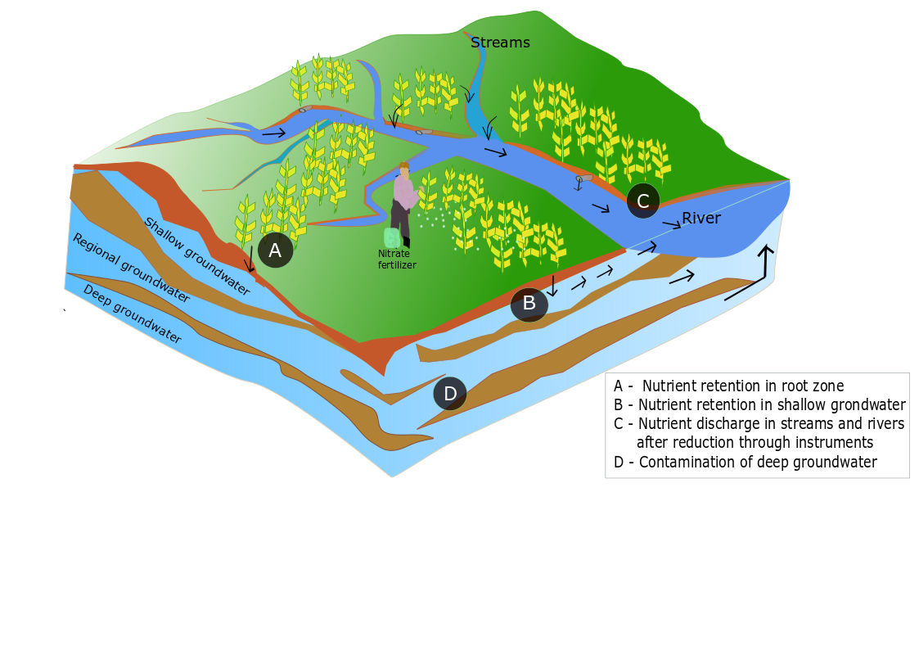
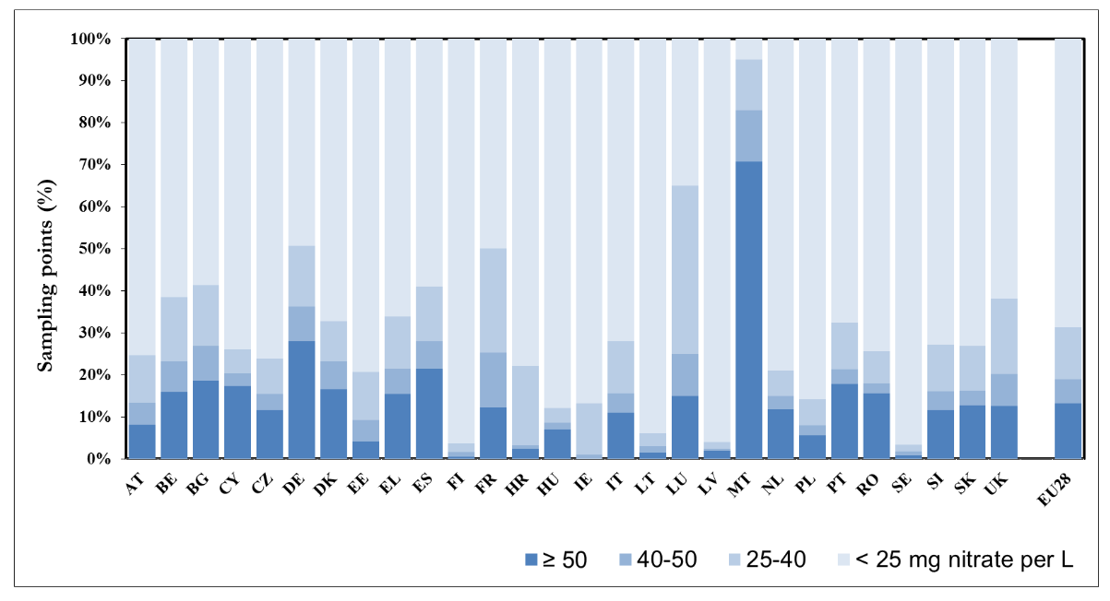
Motivation
High amount of nitrate in groundwater and surface water in European countries
Nitrate reduction in freshwater and groundwater essential part of EU Nitrate directive
Therefore, need for a deeper understanding of the controlling processes in order to implement efficient and fair regulation
Approximately 17% of groundwater sampling points in Denmark contained >=50mg NO₃ conc. /L
Frequency diagram of annual average nitrate concentrations in groundwater (EU, 2018)

Slide 3
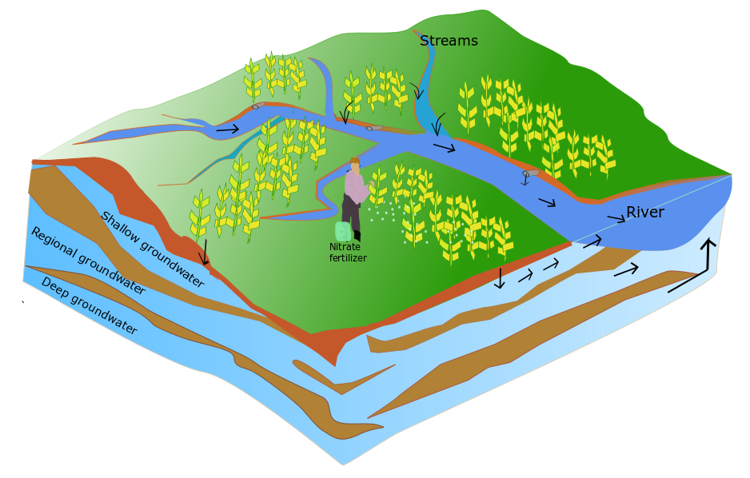
Background
Leaching of nutrients from agricultural fields
N-retention varies between agricultural area (unsaturated zone, saturated zone, riparian zone)
In subsurface drained areas, drain flow fraction affects the N-retention in the unsaturated zone
Riparian zone
Unsaturated zone
Saturated zone

Slide 4

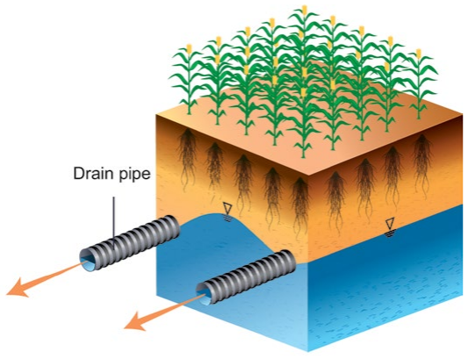
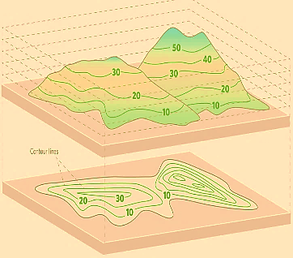
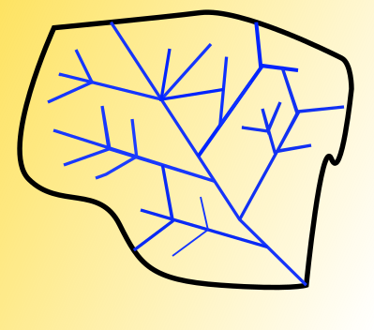
Focus
Geology
Recharge
Topography
Subsurface drain
2m
Drainage
Tile-drain network
Shallow groundwater system (0-2 m below ground level)
Drain flow fraction is a function of geology, topography and tile drain network

Slide 5
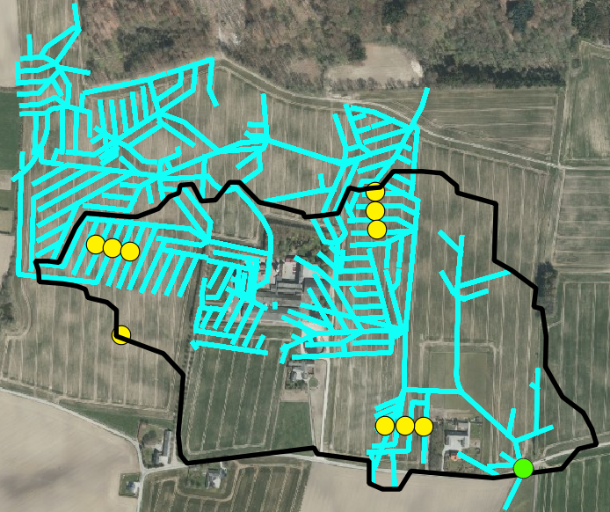
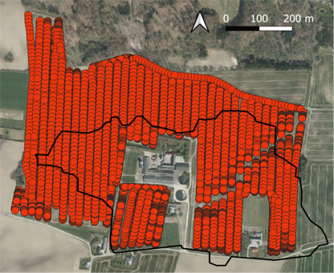
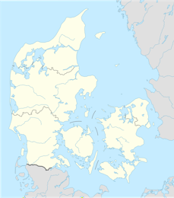

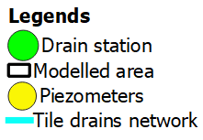
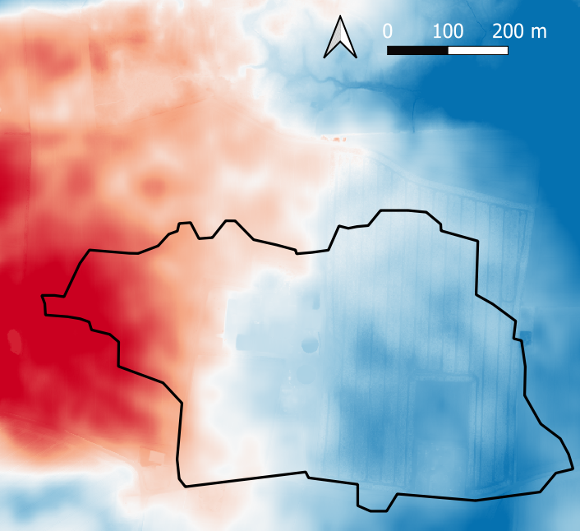
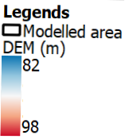
Study site
Geophysical data collected by GCM and TTEM
Drain network, Piezometer, Drain station
Digital elevation model

Slide 6
Sensitivity analysis based on numerical modelling
Development of base model
Calibration based on drain flow
Test parameters of interest
Model
Data
Prediction
Drain flow at outlet
Water table depth - piezometer
Drain flow fraction

Slide 7
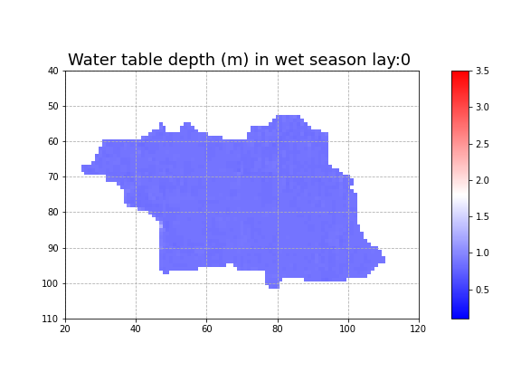
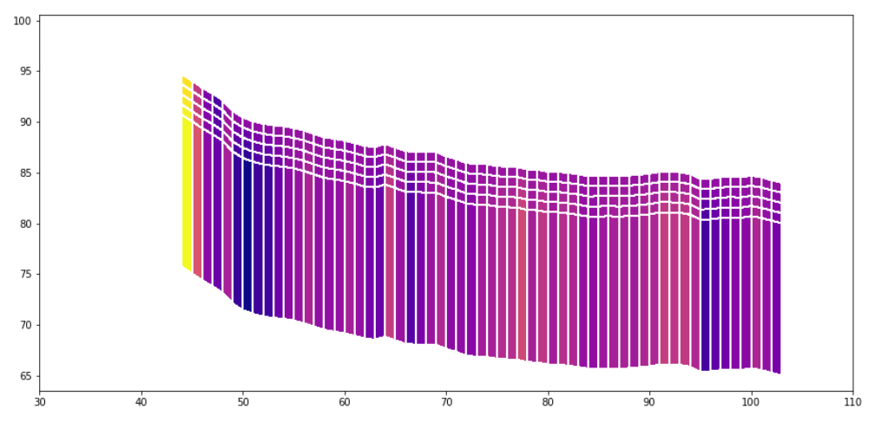
Model Setup
Groundwater model - MODFLOW 6
Simulation period 01-Jan-2013 to 31-Dec-2014
10 x 10 m Resolution (120 *140)
6 model layers
  1 m thickness for layer 1-5
  15 m thickness for layer 6
No-flow boundaries
Subsurface drainage where needed

Slide 8
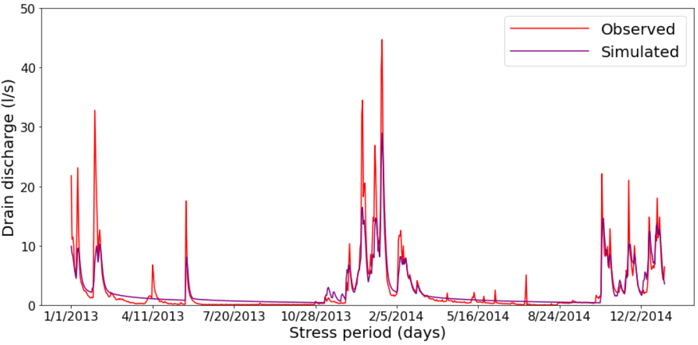
Drain flow calibration
Coefficient of Determination = 0.82
Nash-sutcliffe coefficient = 0.79
Pbias = -2.7

Slide 9
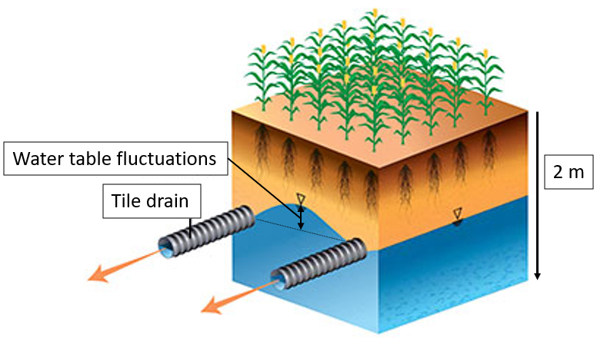
Focus
Geology
Topography
Tile-drain network
Shallow water table fluctuations (0-2 m below ground level)
Drain flow fraction is a function of geology, topography and tile drain network

Slide 10
Focus
1.
Geology
Recharge
Topography
Subsurface drain
2m
Drainage
Tile-drain network
Shallow groundwater system (0-2 m below ground level)
Drain flow fraction is a function of geology, topography and tile drain network

Slide 11
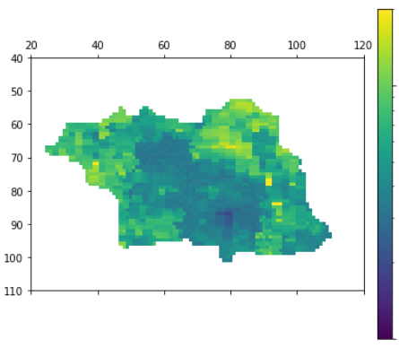
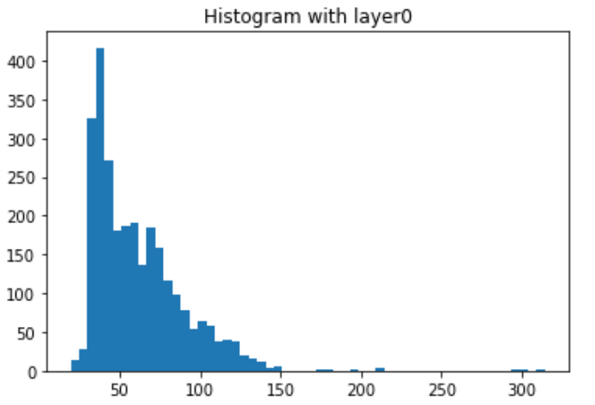
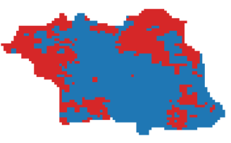
Using Geophysics to obtain Geology
Resistivity distribution and K-field generation
Resistivity Model (ohm-m)
Frequency Distribution
100
Low K
High K
Frequency
High and low K units (threshold 65ohm-m )
10
Resistivity (ohm-m)
B
A
Low K
High K
C

Slide 12
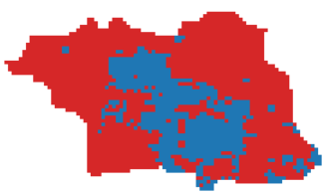
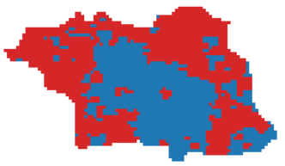
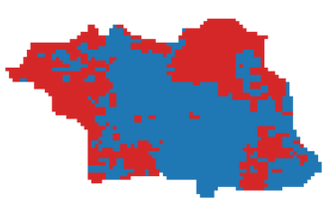
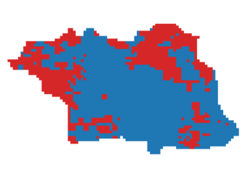
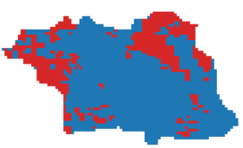
Geology scenario: Varying Distribution of low and high K
Low K
40 ohm m threshold
50 ohm m threshold
60 ohm m threshold
High K
65 ohm m threshold
70 ohm m threshold
75 ohm m threshold

Slide 13
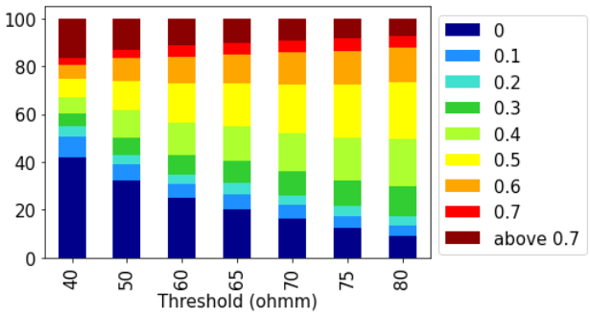
Drain flow fraction at basin scale
Lower threshold has highest proportion of lowest and highest drain fraction whereas increasing threshold increase proportion of intermediate drain fraction

Slide 14
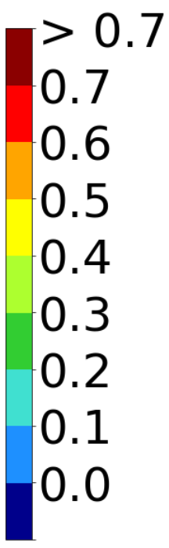
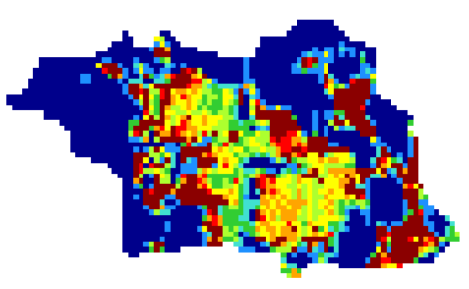
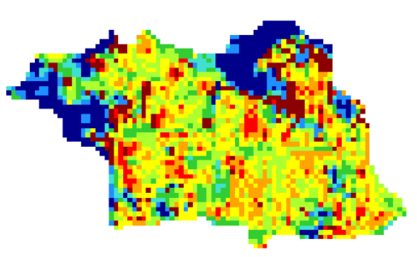
Spatial distribution of basin drain flow fraction
40 ohm m threshold
Low K
High K
75 ohm m threshold
Variation in magnitude of drain fraction is higher in lower threshold compared to higher threshold

Slide 15
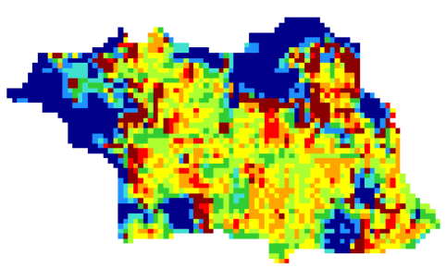
Spatial distribution of basin drain flow fraction
40 ohm m threshold
Low K
High K
High drain fraction in transition areas where water move from high K zone to low K zone
65 ohm m threshold
75 ohm m threshold

Slide 16

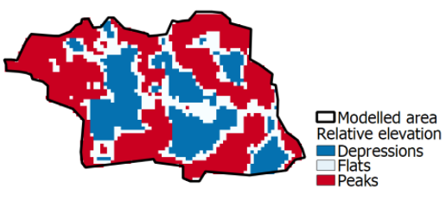
Spatial distribution of basin drain flow fraction
40 ohm m threshold
75 ohm m threshold
High K unit follows regional topographical trend

Slide 17
Focus
Geology
Recharge
Topography
Subsurface drain
2.
2m
Drainage
Tile-drain network
Shallow groundwater system (0-2 m below ground level)
Drain flow fraction is a function of geology, topography and tile drain network

Slide 18
Topographical Smoothing
Purpose: To understand the effect of local peaks and depressions on drain flow fraction
Smoothing –removing the local peaks and depressions
Method: Python gaussian filter (Move extreme values towards mean)

Slide 19
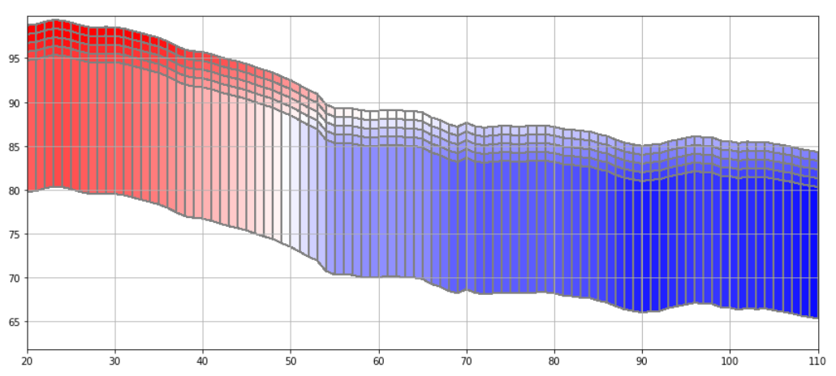
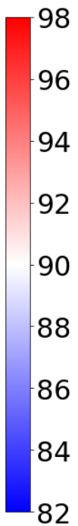
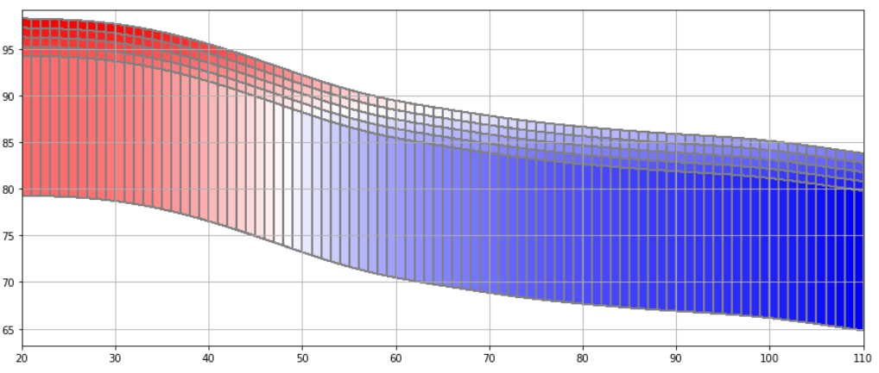
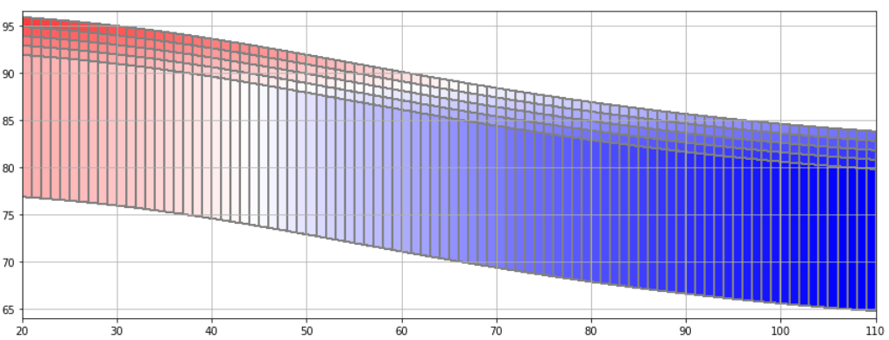
Topographical Smoothing
Smoothing factor 0
Smoothing factor 6
Smoothing factor 18

Slide 20
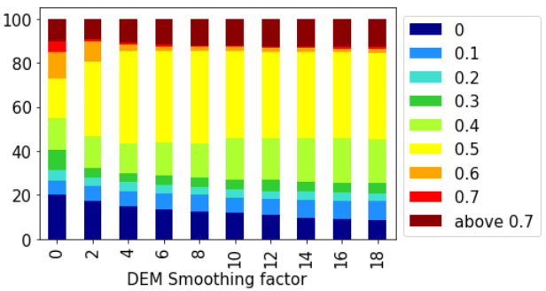
Drain flow fraction at basin scale
DEM smoothing reduces the lowest drain fraction proportion and significantly increase the average drain fraction cluster (0.5)
After a certain level of smoothing factor 8, there are quite small difference in drain fraction clusters

Slide 21
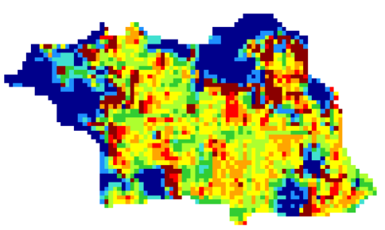
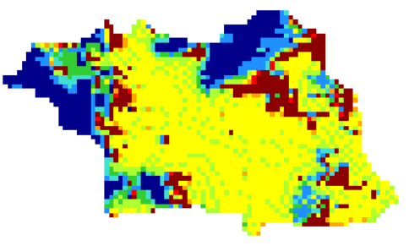
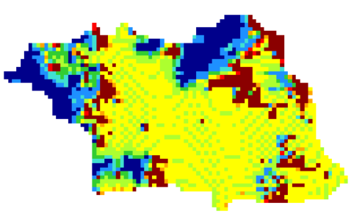
Spatial distribution of basin drain flow fraction
No smoothing
Smoothing factor 6
Smoothing factor 10
High K and low K unit
Variability in the low K unit is decreased and drain fraction has become more intermediate

Slide 22
Spatial distribution of basin drain flow fraction
No smoothing
Smoothing factor 2
Smoothing factor 10
High K and low K unit
Smoothing the DEM, increased the pooling of high drain fraction in region where water is flowing from high K to low K

Slide 23
Summary
We have collected data related to drain discharge and piezometer water table
For spatial distribution of high and low K scenario:
In high K dominant regions, extreme drain fraction values are observed compared to low K dominant regions.
For the topographical smoothing scenario:
Topographical smoothing, increase the pooling of high drain fraction in region where water is flowing from high K to low K
Topographical smoothing decrease the drain fraction local differences with in the high and low K units

Slide 24
Next steps
Categorizing basin into different cluster based on geology, topography and drain network to observe how they correlate with each other or vice versa
Increasing DEM differences of peaks and depression
New recharge timeseries from national model
Calibrating using piezometers data

Slide 25
References
European Union. 2018, ‘Report from the commission to the council and the European Parliament on the implementation of Council Directive 91/676/EEC concerning the protection of waters against pollution caused by nitrates from agricultural sources based on Member State reports for the period 2012–2015’, Brussels
Ghane, E. 2018, ‘Agricultural Drainage’, Michigan State University, USA
https://www.flaticon.com/

Slide 26
Any Questions?

