Slide 1
Evolution of the crystallisation conditions in the Wellington Lake Pegmatite in the Pikes Peak Granite, Colorado (USA)
Fonseca Teixeira, l. m. allaz, j. Bachmann, o.

Slide 2
Goal: to understand the magmatic-hydrothermal nature of pegmatites
Pegmatites are usually considered to be derived from granitic bodies - magmatic source
Some of their most remarkable features suggest crystallization from low viscosity, H2O-rich fluid (e.g., large crystal size, monomineralic core)
Pegmatites represent the transition from a magmatic to a hydrothermal system, but this transition is yet to be fully understood
Which zones represent the transition from magmatic to hydrothermal conditions?
How do temperatures evolve through the crystallisation of pegmatites?

Slide 3
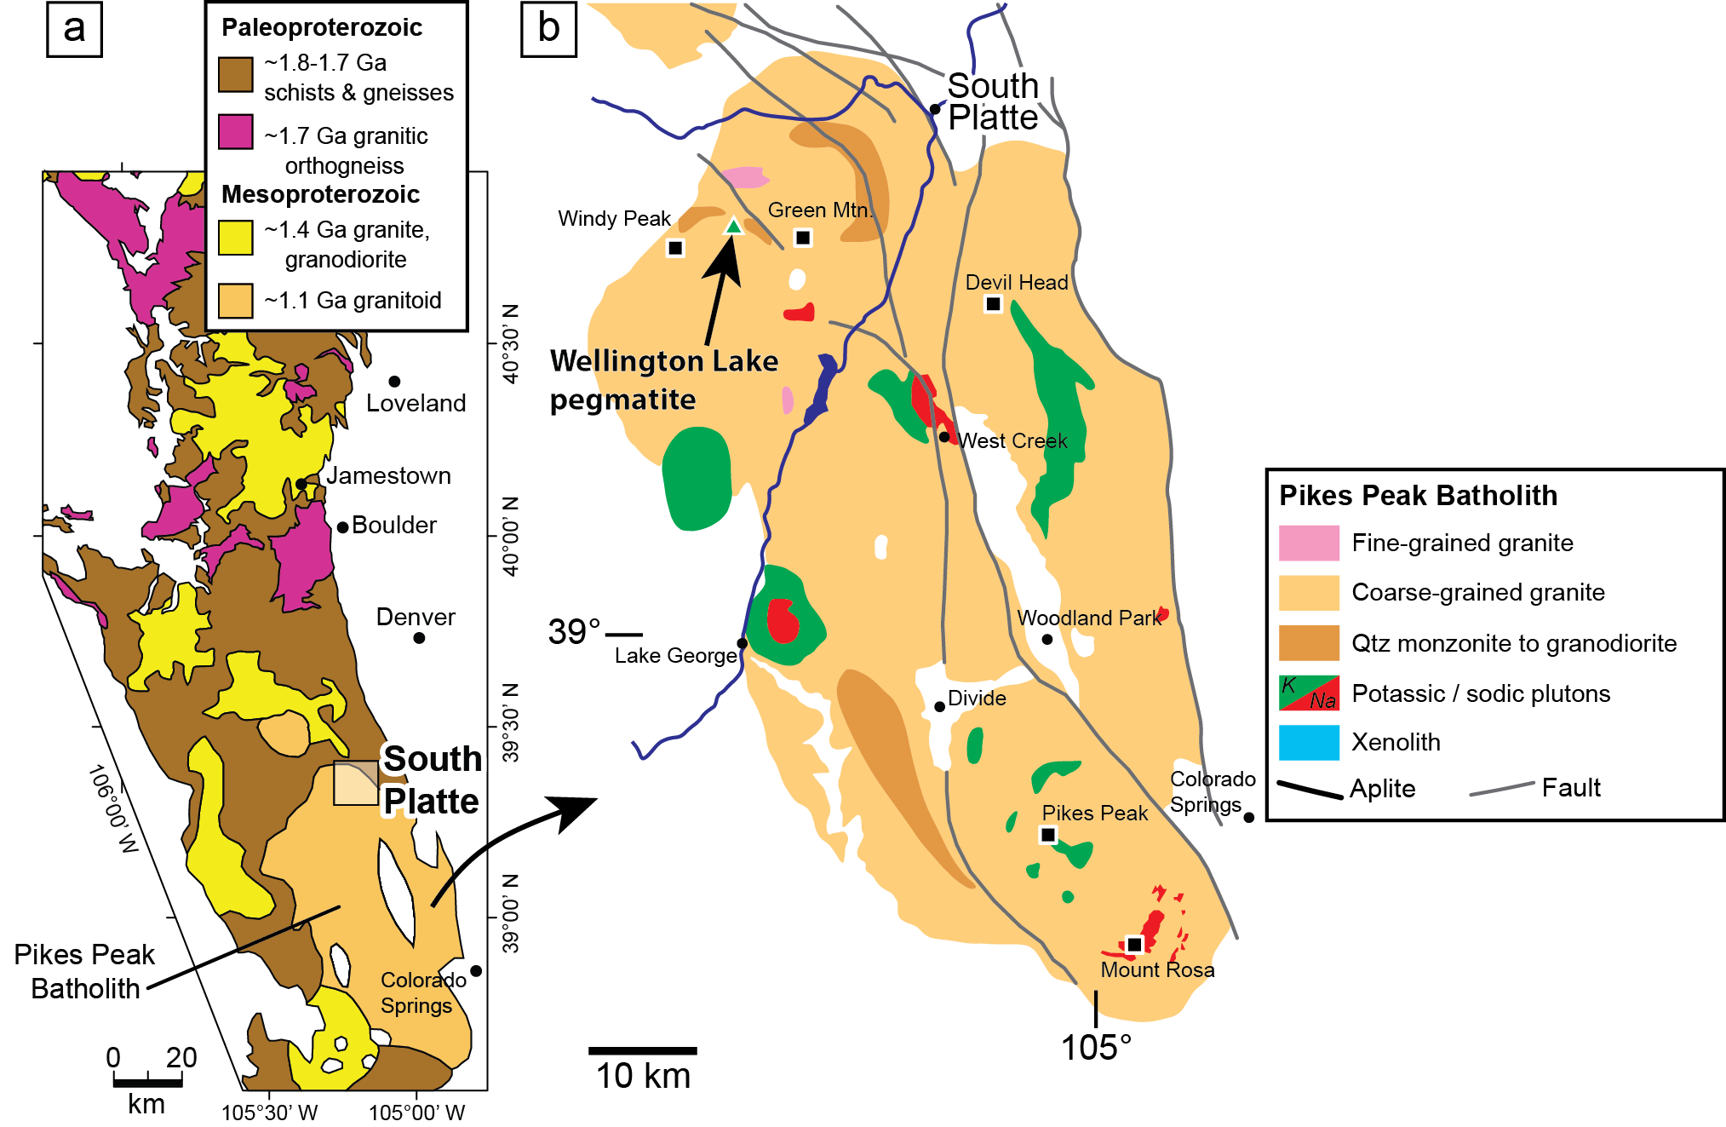
Case study
Wellington Lake Pegmatite in the Pikes Peak Batholith, Colorado (USA)
Wellington Lake is a NYF-pegmatite with a REE-dominated mineralisation containing fluocerite, bastnäsite, thorite, columbite, zircon and cassiterite.
Pike Peak Batholith is an anorogenic A-type granite
(modified after Simmons et al., 1987 and Allaz, 2019)

Slide 4
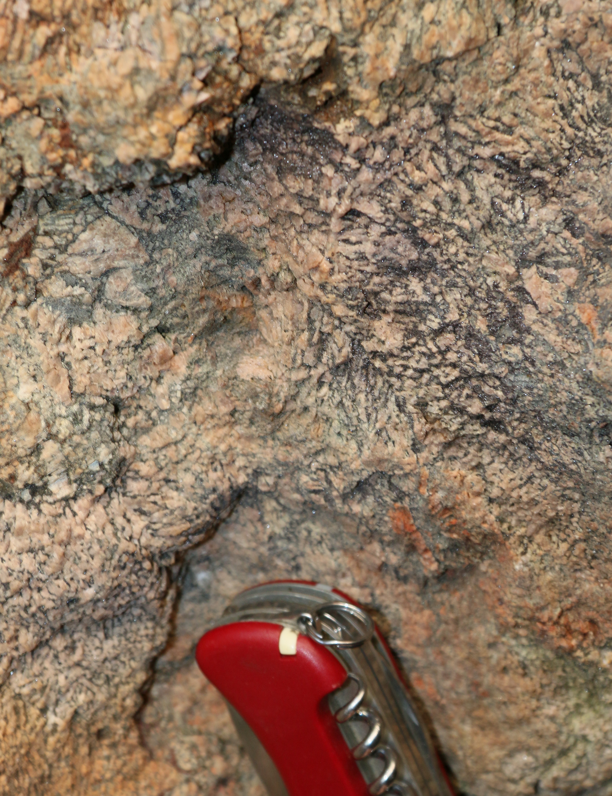
Samples
Pikes Peak main granite (pegmatite host rock)
Wellington Lake pegmatite
Wall zone: graphic granite
Intermediate zone: albite + quartz
Core zone: pure blocky quartz
Graphic granite wall zone
Core and Intermediate zones

Slide 5
Methods
LA-ICP-MS for quartz trace element analysis
Microthermometry of fluid inclusions
EPMA
WDS quantitative analysis
EDS-WDS compositional maps
Quantitative maps of plagioclase compositions
SEM
EDS compositional maps
Catholuminescence images

Slide 6
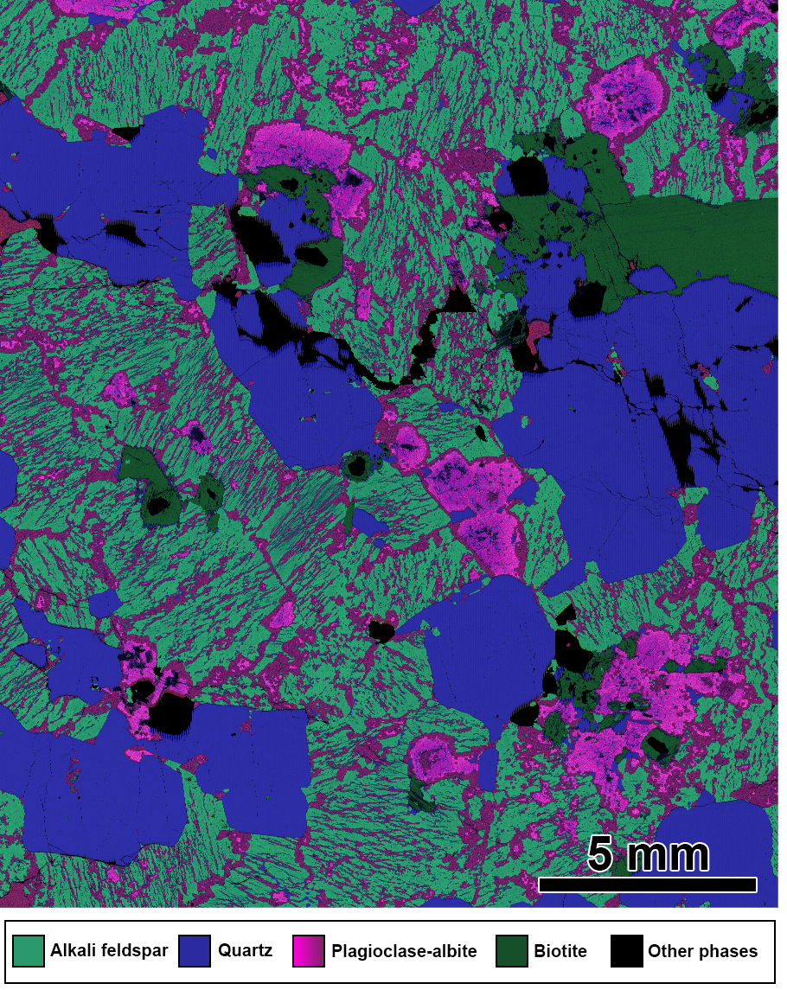
Granite
Syenogranite
Main phases: perthitic alkali feldspar (55%), quartz (30%), plagioclase (10%)
Other phases: biotite, fluorite, iron oxides, zircon and apatite

Slide 7
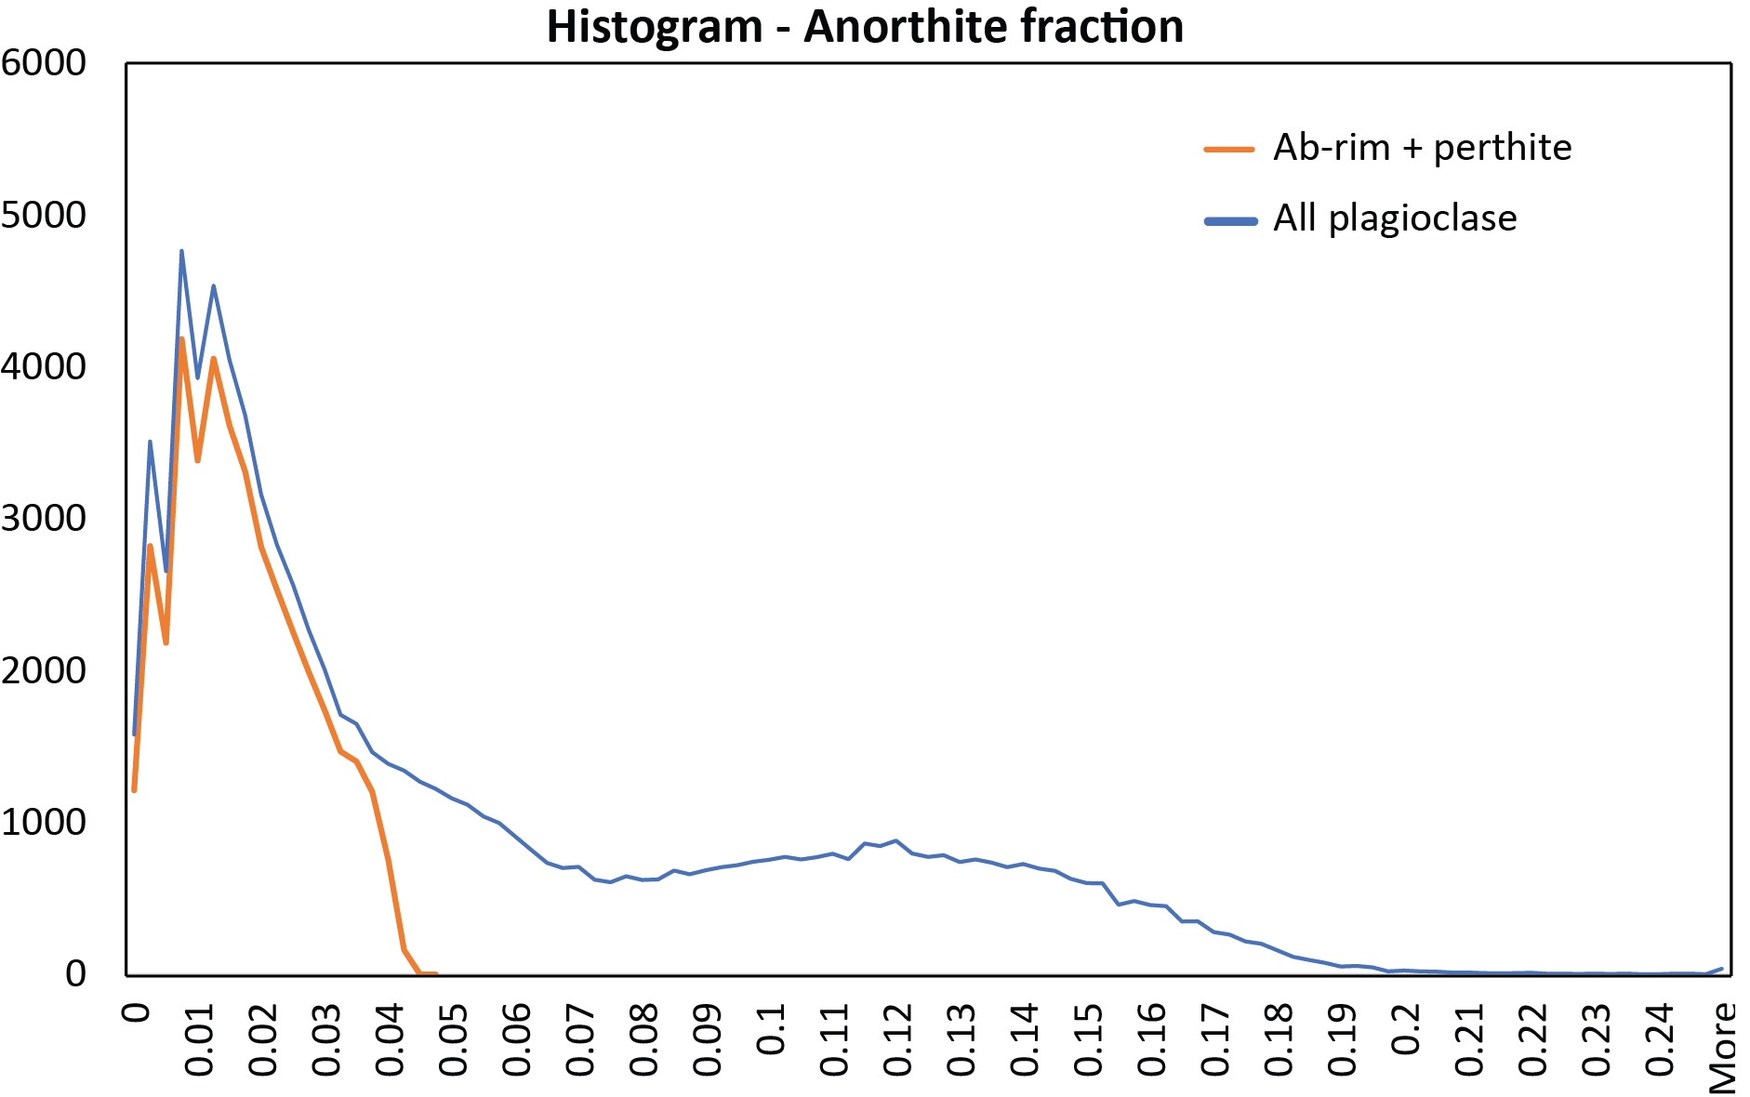
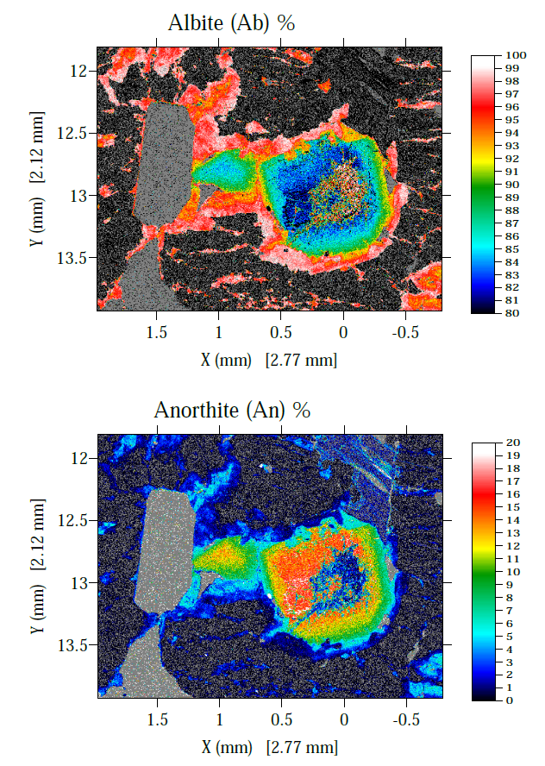
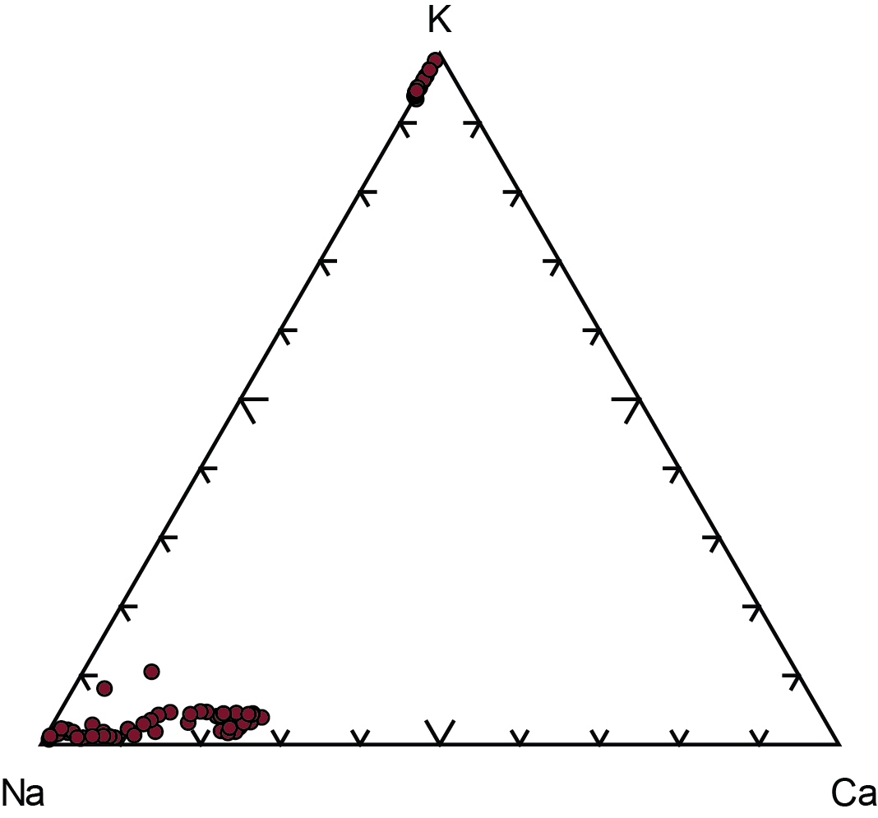
Granite
Plagioclase range from An08-18%, with rims of pure albite (<3%)

Slide 8
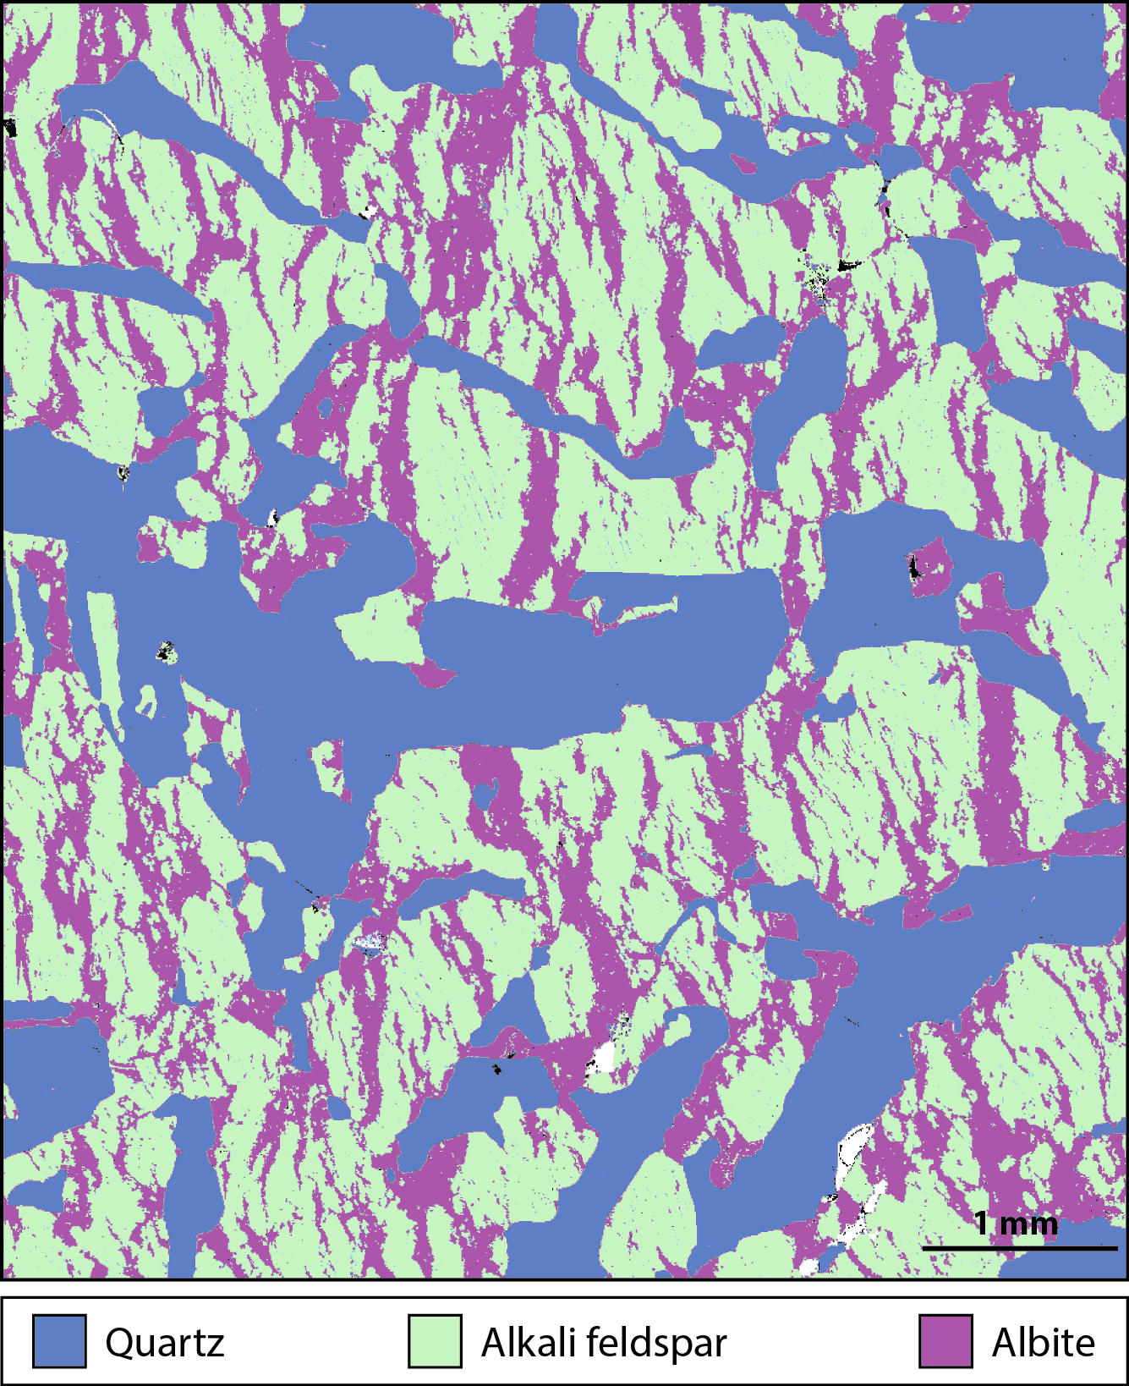
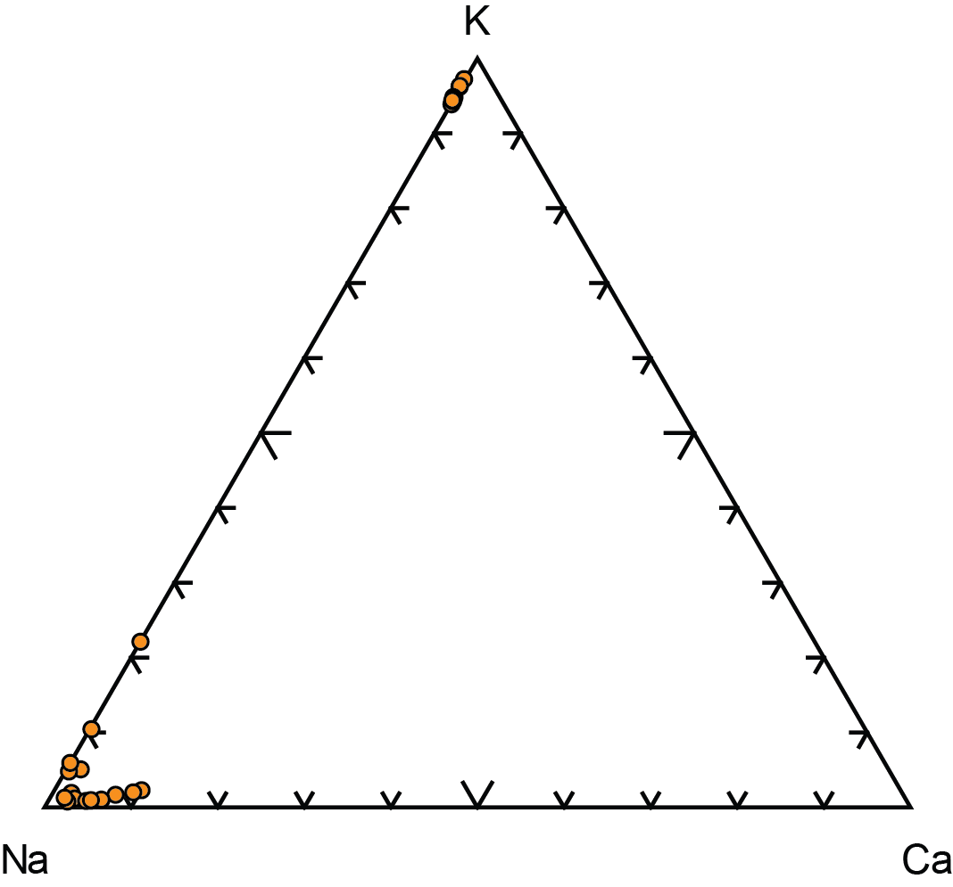
Wall zone
Fine-grained biotite graphic granite
Quartz, perthitic alkali feldspar, biotite
Rutile as an accessory phase
Qz30-Ab25-Or45

Slide 9
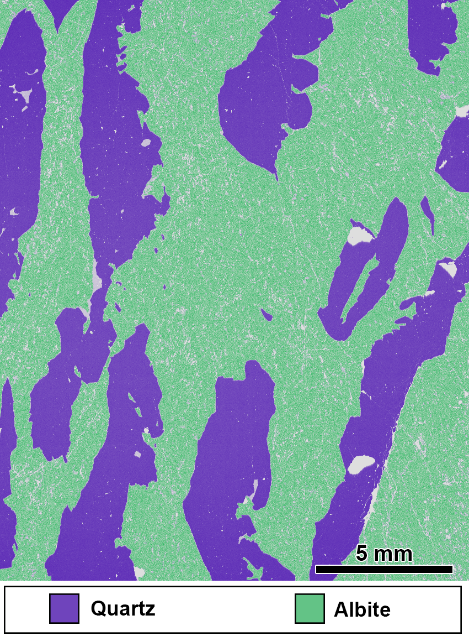
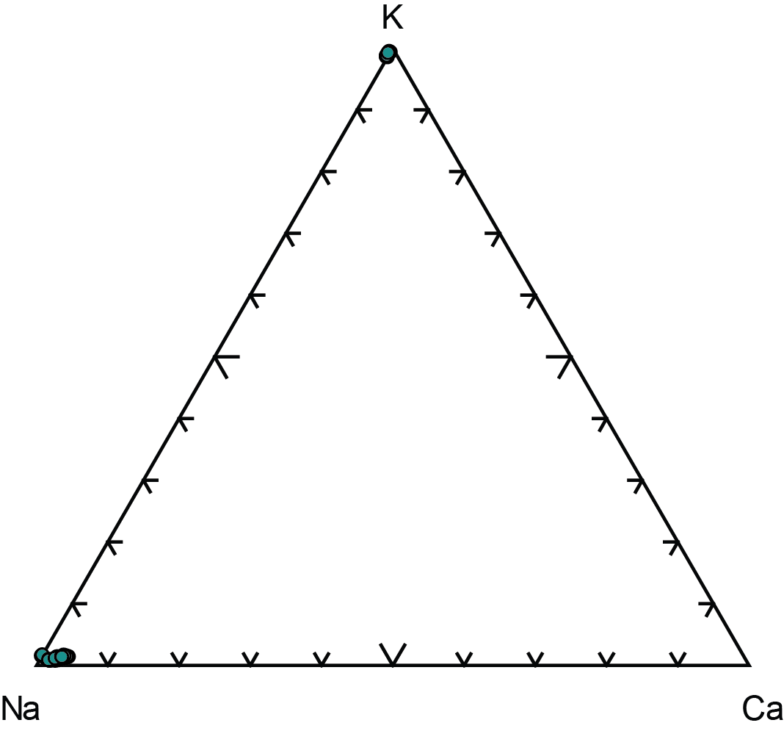
Intermediate zone
Coarser grain size
Mineralogy: quartz (43%) and albite (57%)
Rare alkali feldspar

Slide 10
Al, Ge and Ti in Quartz
Wall zone: narrower range, partly overlapping with the evolved side of the host granite quartz
Intermediate and core zones: very distinctive compositions, with low Ti and high Al and Ge content.
The compositional gap seen in the quartz compositions within the pegmatite suggests a pronounced change in the chemistry of the precipitating medium/fluid.

Slide 11
Al, Ge and Ti in Quartz
Quartz crystals from the host granite show a wide range Ti, Ge and Al content (e.g., Ti from 130 to 20 ppm), overlapping with clearly magmatic examples (e.g. quartz in volcanic and plutonic fragments found in the Kos Plateau Tuff, a quaternary ignimbrite from the Aegean arc)
Kos Plateau Tuff data from Fiedrich et al., 2020

Slide 12
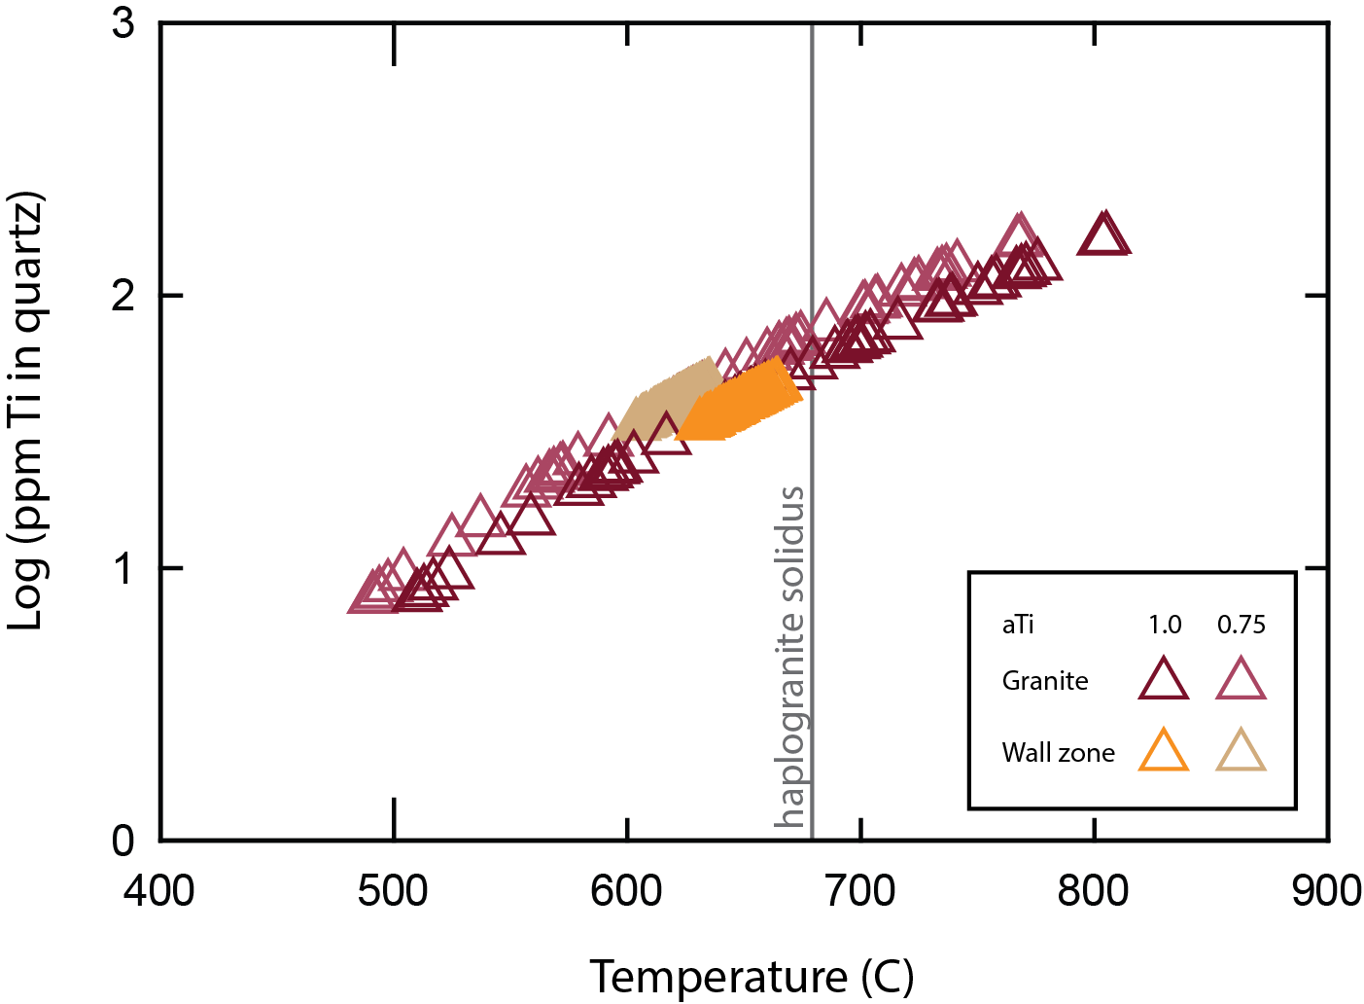
Quartz crystallization temperatures
Temperatures calculated with TitaniQ (Wark and Watson, 2006; with aTi ~1 and aTi ~ 0.75)
Rutile (aTi = 1.0) is present in the wall zone
Subsolidus crystallisation conditions, below H2O-saturated haplogranite curve (Ebadi and Johannes, 1991)
Pegmatite started to crystallise towards the end of the host rock crystallisation
Granite: ~800-500°C
Wall zone: ~660-630°C

Slide 13
quartz crystallization stages in the granite
Near-magmatic
Dark CL, no growth zones observed
40-60 ppm Ti in the core
~690-620°C
Crystallisation starts already near solidus conditions
<15 ppm Ti in the rim
<560°C
Magmatic (Figure in slide 14)
Catholuminescence shows growth zones
100-150 ppm of Ti in the core
~700-800°C
40 ppm in the rim
Transition to near-magmatic conditions
~630-660°C
Crystallisation ends at subsolidus conditions
Later-stage fluid percolation
Black fractures in CL images
Present in both magmatic and near-magmatic quartz crystals
Very low Ti (< 20 ppm)
Correspondence to areas with secondary fluid inclusions

Slide 14
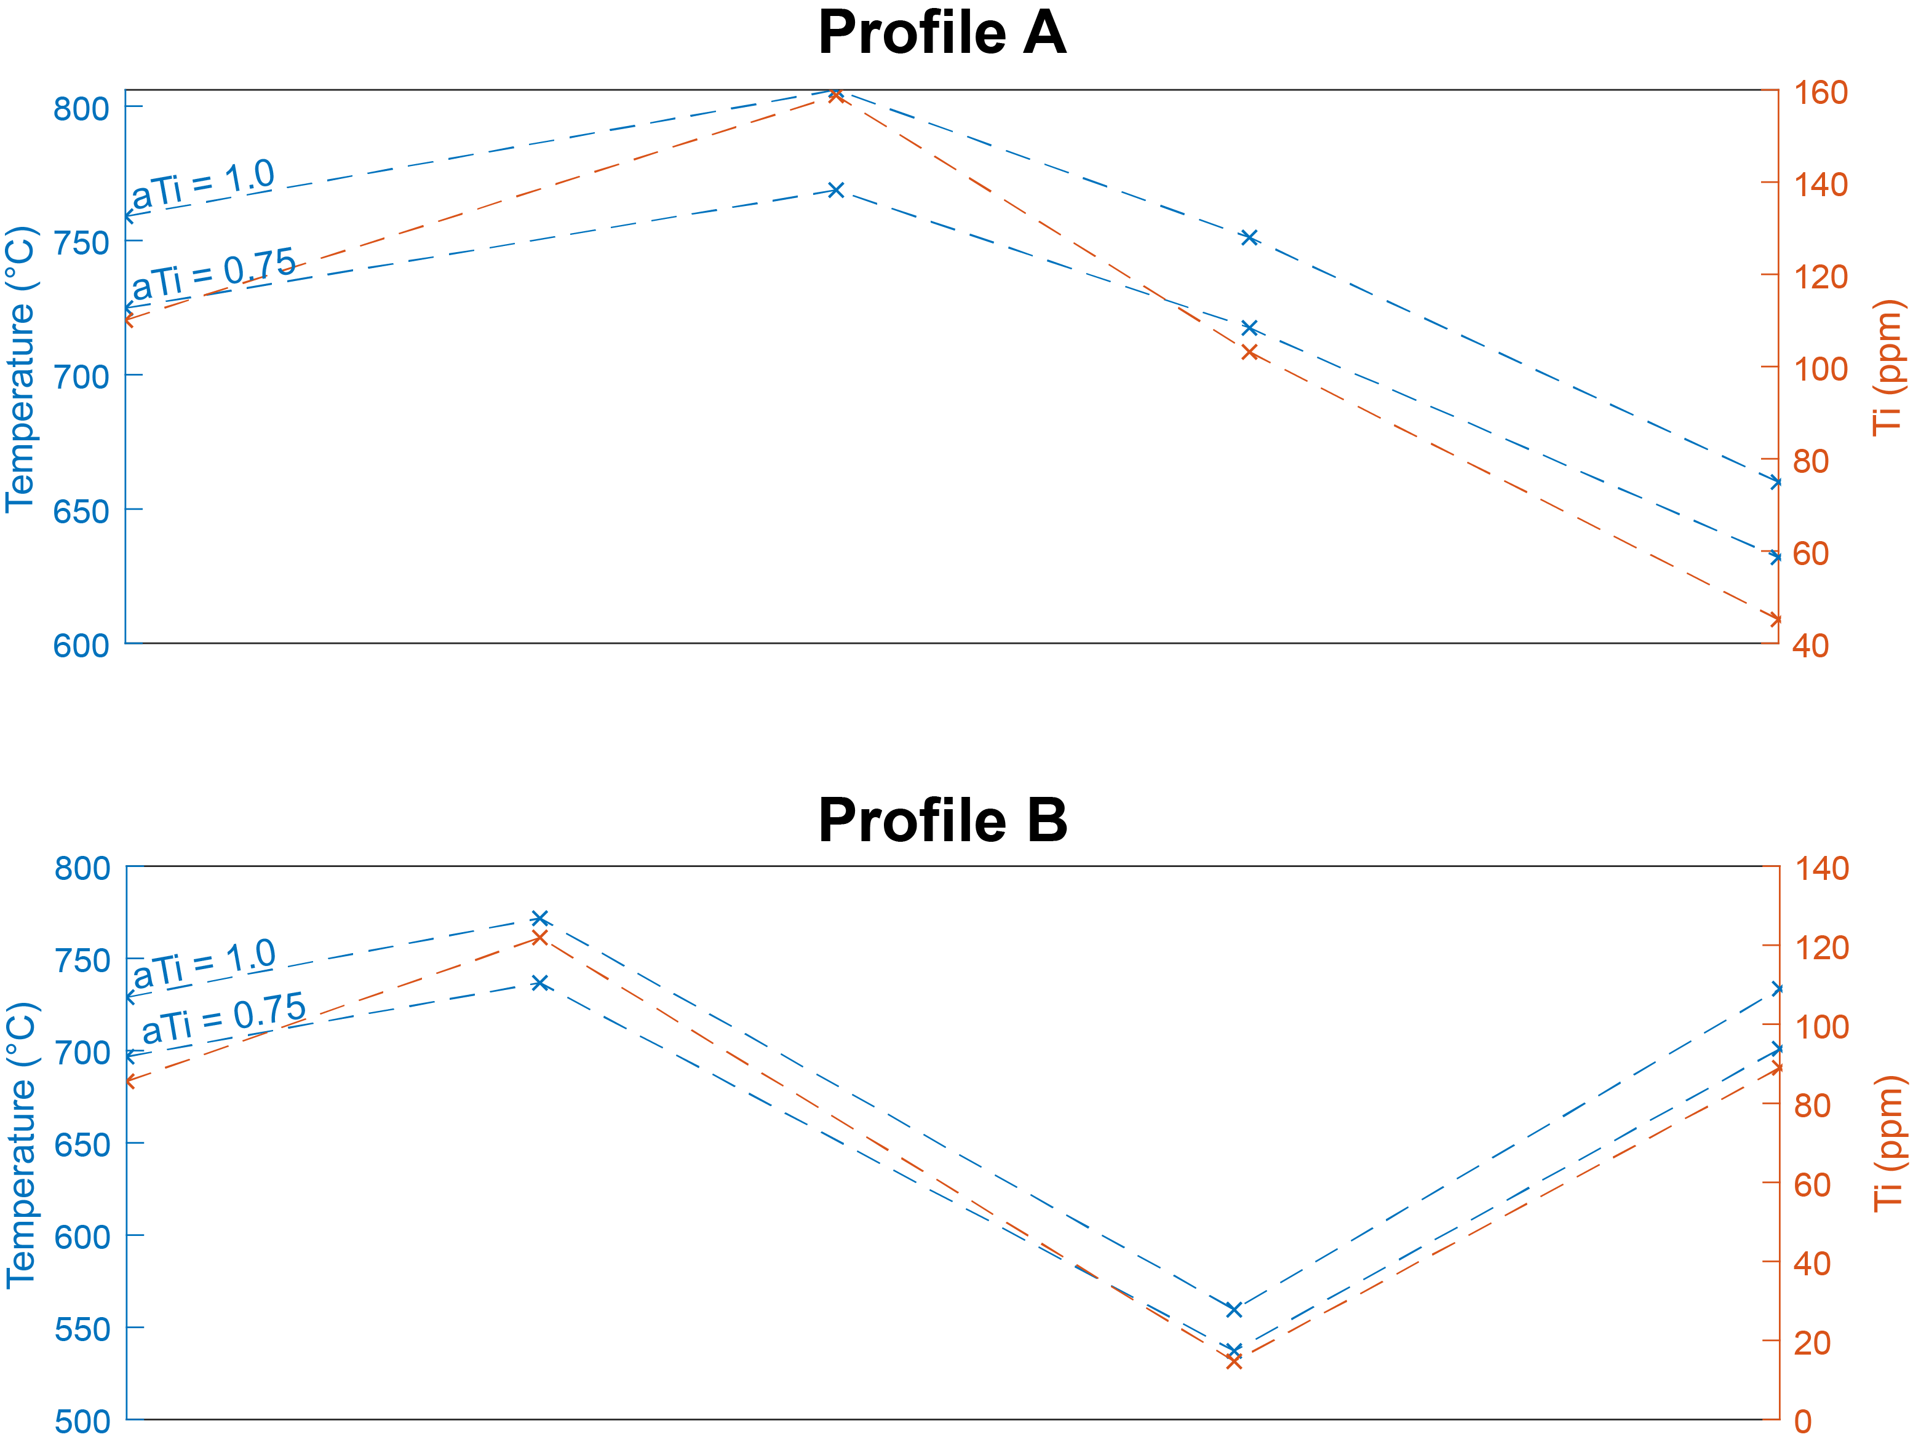
Magmatic quartz
Profile crosses later-fluid percolation zone

Slide 15
Fluid inclusions in quartz
Crystallisation conditions calculated from homogenisation temperatures for typical pegmatite pressures
Fluid inclusions assemblages in quartz
Core and intermediate zone:
FIA I: primary, Fv = 0.1, salinity = ca.10%
FIA II: secondary, Fv = 0.1-0.2, salinity = ca.10%
FIA III: CO₂ inclusions
FIA IV: vapor inclusions, Fv = 0.8-0.9
Granite and wall zone: small (<10 um) and scarce secondary inclusions (challenging to analyze)
 | Intermediate zone | Core
300 MPa | ~450°C | ~380°C
200 MPa | ~380°C | ~325°C

Slide 16
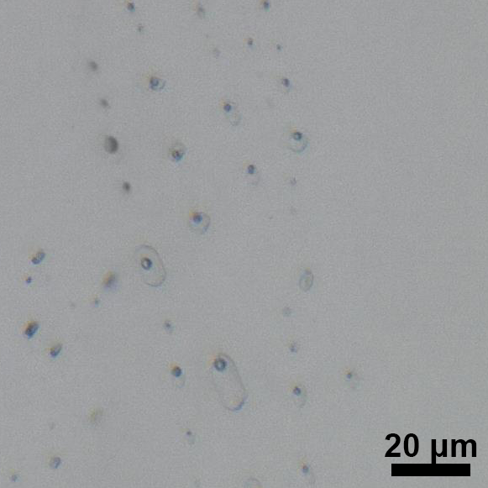
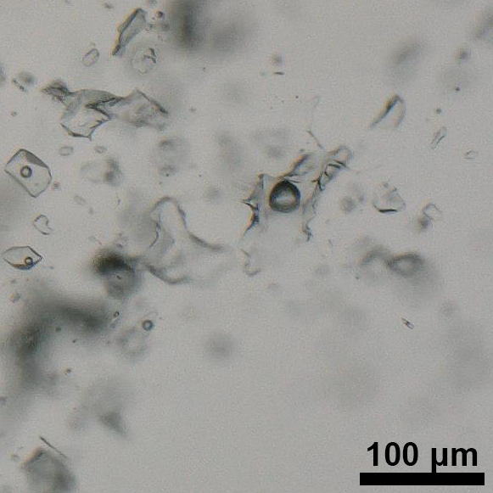
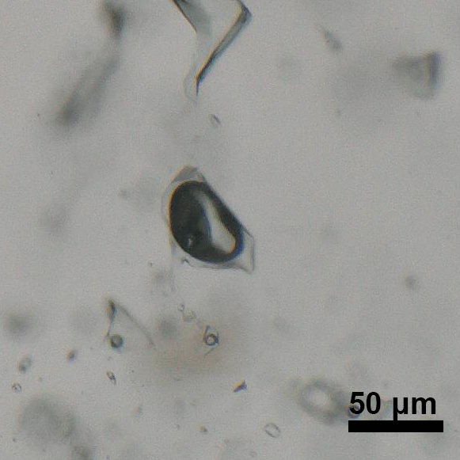
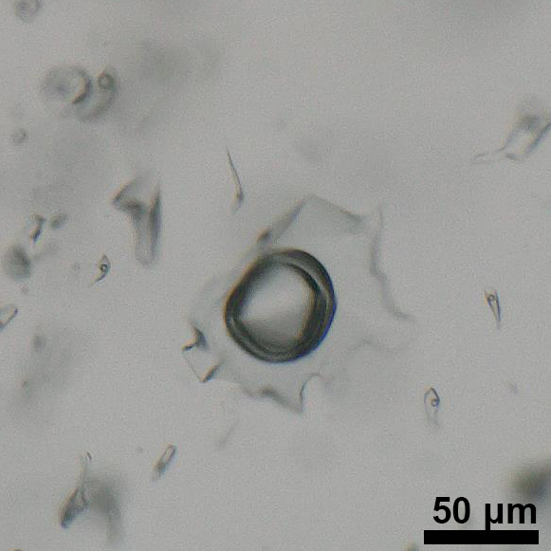
Fluid inclusions
FIA 1
FIA II
At room temperature
FIA III
FIA IV

Slide 17
Summary
Granite and wall zone
Intermediate and core zones
Dominantly high Ti, low Ge, but significant range in trace element contents in the granite
Quartz composition overlaps with other magmatic examples
Temperatures (from Ti in quartz)
Granite: ~800-500°C
Wall zone: ~660-630°C
Scarce and small secondary only inclusions
High Ge, low Ti
Abundant and large primary and secondary inclusions
Temperatures (from fluid inclusions)
Intermediate zone
380°C (200 Mpa) – 450°C (300 Mpa)
Core
325°C (200 Mpa) – 380°C (300 Mpa)
Magmatic to near-magmatic conditions
Hydrothermal conditions

Slide 18
summary
The Wellington Lake Pegmatite / Pikes Peak Granite system show an evolution from a syenogranitic with low An content, to Albite/K-spar/quartz pegmatite wall and intermediate zones and ending in a monomineralic quartz pegmatitic core
Quartz from the granite crystallised over a wide range of temperatures (~800-500°C) that represent the transition from magmatic to near-magmatic conditions
Pegmatite crystallisation started at temperatures near the end of the granite crystallisation, below the the water-saturated haplogranite solidus
Wall zone at near-magmatic conditions (~660-630°C)
Intermediate to core zones are clearly fluid-like, with many fluid inclusions, and temperatures below 450 °C

Slide 19
References & acknowledgments
Acknowledgments: We thank Prof. Markus Raschke for his contribution towards this work
Ebadi, A., and Johannes, W., 1991, Beginning of melting and composition of first melt in the system Qz-Ab-Or-H2O-CO2: Contributions To Mineralogy and Petrology, v. 106, p. 286–295, doi:10.1007/BF00324558.
Fiedrich, A., Heinrich, C., and Bachmann, O., 2020, Evolution from magmatic to hydrothermal activity beneath the Cerro Escorial volcano (NW Argentina) as sampled by erupted quartz and brines: Lithos, v. 374-375, doi:10.1016/j.lithos.2020.105706.
Simmons, W., Lee, M.T., and Brewster, R.H., 1987, Geochemistry and evolution of the South Platte granite-pegmatite system, Jefferson County, Colorado: Geochimica et Cosmochimica Acta, v. 51, no. 3, p. 455 – 471, doi:10.1016/0016-7037(87)90061-5.
Wark, D., and Watson, E., 2006, TitaniQ: A titanium-in-quartz geothermometer: Beiträage zur Mineralogie und Petrographie, v. 152, p. 743–754, doi:10.1007/s00410-006-0132-1.

