Slide 1
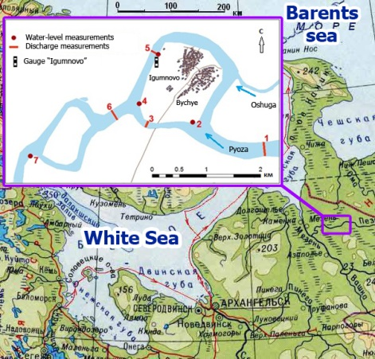
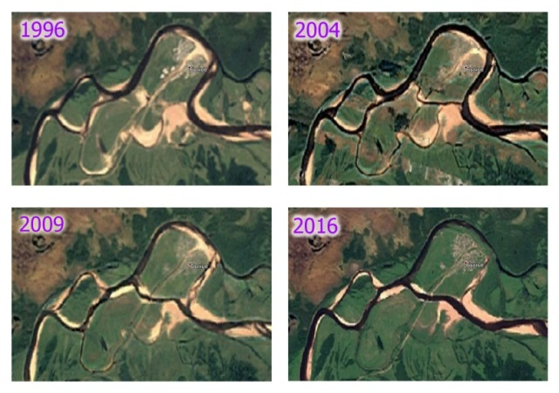
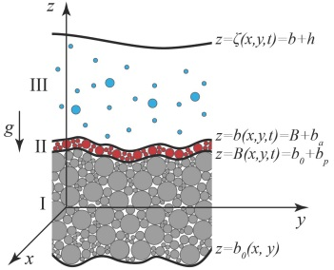
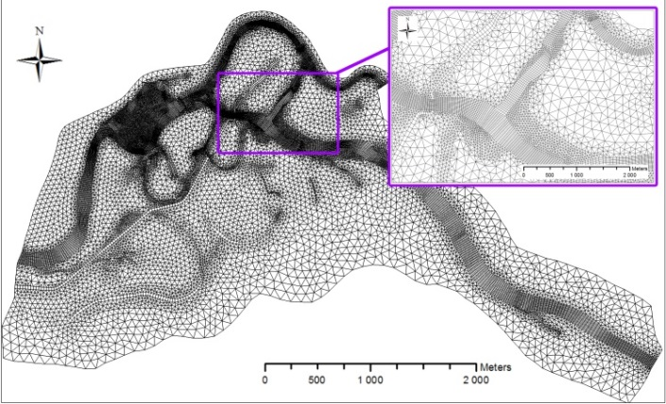
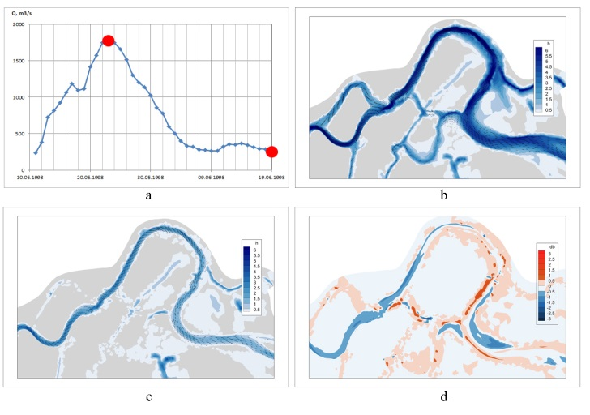
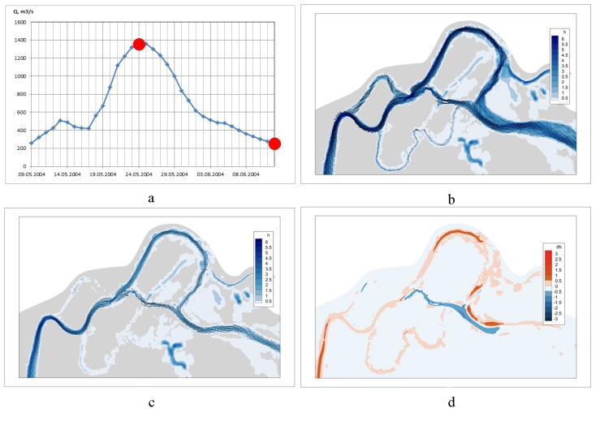
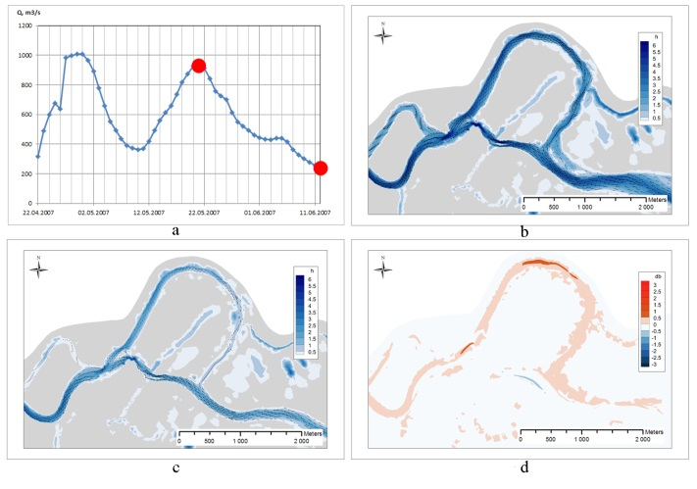
Simulation of the meander cut-off by 2D hydrodynamic model for erodible bed
Fedorova T.¹ (tatiana.fyodorova@gmail.com),
Alabyan A.^{1,2}, Belikov V.¹
¹Water Problems Institute of RAS, Moscow, Russia
²Lomonosov Moscow State University, Moscow, Russia
STREAM_2D CUDA
a new method for the numerical solution of 2D Saint-Venant equations [1] and the deformation equation for 3-layers of non-uniform soil [2]
Computational domain of the Pyoza river section of 13 km long consists of 37 329 cells
The simulation started at the year 1997 when where was no any rill across the meander neck, and finished at 2008.
The time step of calculation was taken to be one day [3]
1. Aleksyuk A.I., Belikov V.V. (2017): Simulation of shallow water flows with shoaling areas and bottom discontinuities. Computational Mathematics and Mathematical Physics, Volume 57, issue 2, pp. 318–339. https://doi.org/10.1134/S0965542517020026
2. Aleksyuk А. I., Belikov V. V., Borisova N. M., Fedorova T. A. (2018): Numerical modeling of non-uniform sediment transport in river channels. Water Resources, Volume 45, Special Issue S1, pp. 11–17. http://dx.doi.org/10.1134/S0097807818050275
3. Fedorova T.A., Alabyan A.M., Belikov V.V. (2021): Modelling of the bend cutoff on the meandering river. GeoRisk World, Vol. XV, No. 1, pp. 28–42, https;//doi.org/10.25296/1997-8669-2021-15-1-28-42.
1998
2004
2007
Modeling results for representative years: a - hydrograph, red dots correspond to the situation of the peak flood and low water, for which the fields of depths and currents are given (b and c); d - deformation layer for a year (blue - erosion, red - accumulation)

